Slide 1
An Architecture and Implement Model for Model-View-Presenter Pattern
Yang Zhang, Yanjing Luo
Slides made by Ke Xu

Slide 2
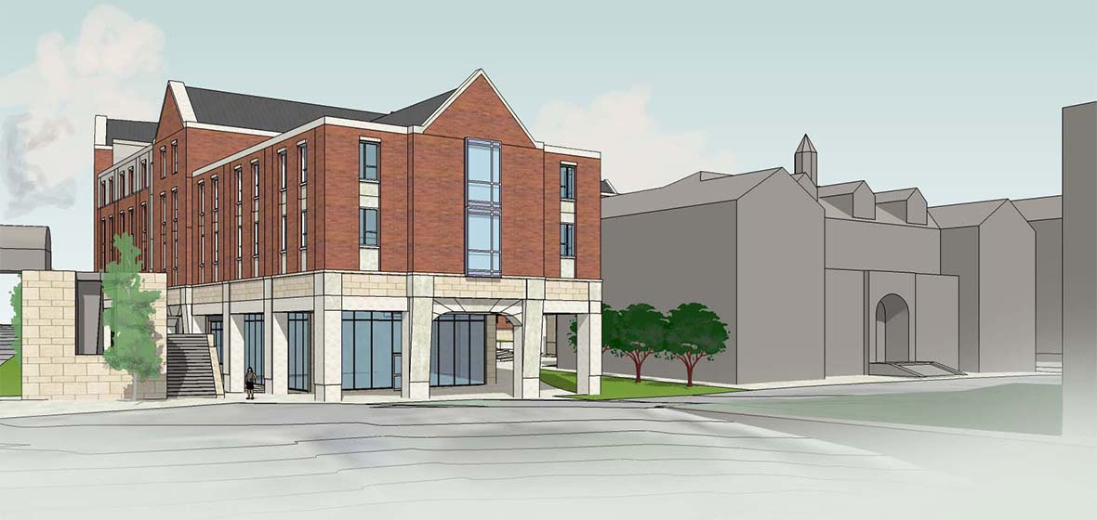
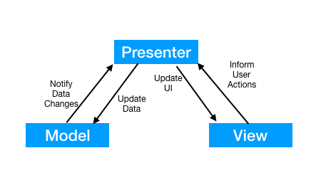
What is architecture?
Generally, both the process and the product of planning, designing, and constructing buildings or any other structures.
Software architecture refers to the fundamental structures of a software system and the discipline of creating such structures and systems.

Slide 3
What is MVP architecture?
developed in 1990s, first implemented in C++ and Java
Model-View-Presenter
Model: preserve data, state and business logic
View: user interface, receive user’s action, display result to user
Presenter: bridge, pass input from View to Model, get result from Model and update View

Slide 4
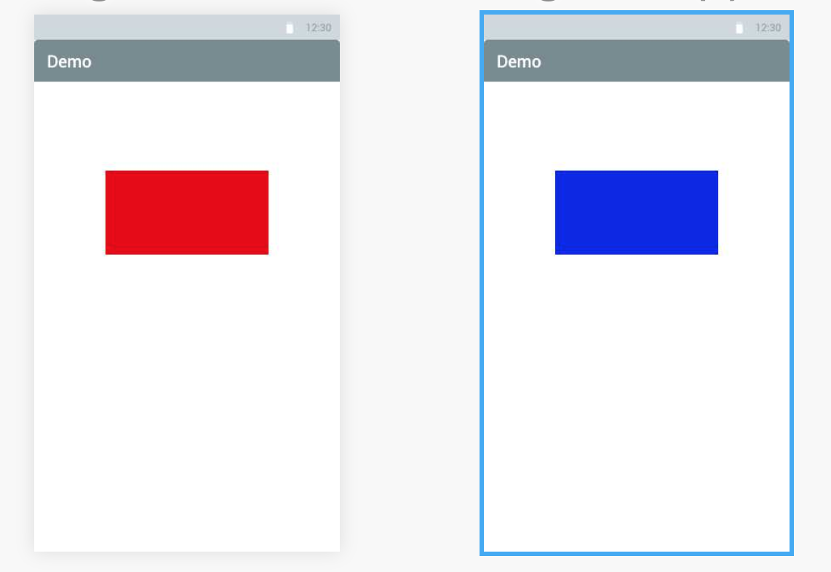
Why do we need to use MVP pattern?
An app that taps screen to switch color of the rectangle between red and blue.
If not using MVP, pseudo code:
void onClick() {
if color == “RED”
color = “BLUE”
else
color = “RED”
}

Slide 5
Why do we need to use MVP pattern? cont.
class View {
...
private Presenter mPresenter;
private Color curColor;
void onClick() {
mPresenter.onClick();
}
void displayColor(newColor) {
curColor = newColor;
}
...
}
class Presenter {
...
private View view;
private Model model;
void onClick() { this.model.changeColor();
}
void displayColor(Color newColor) {
this.view.displayColor(newColor);
}
...
}
class Model {
...
private Color mColor;
private Presenter mPresenter;
void changeColor() {
if mColor == “RED”
mColor = “BLUE”
else
mColor = “RED”
mPresenter.displayColor(mColor);
}
...
}
Tells model to modify color value
Tapped, request to change color
Update value, tells present to display new color
Tells view to display the color that model told
Display new color

Slide 6
Why do we need to use MVP pattern? cont.
Low coupling between Model and View. No need to modify if Model or View changes as long as Presenter is stable.
Can ignore the UI technology behind View.
Easy to test. Can test View and Model independently.
...

Slide 7
How to implement MVP?
Building UI prototype
just a frame of UI, doesn’t have any logic
Creating the View Abstract Model
identify input, output, and actions from UI prototype
in the demo case, input is a tap, output is a color, action is tap
Defining interfaces of View and Presenter
functions in View and Presenter
in the demo case, onClick() and displayColor(newColor)
Implementing View and Presenter
Defining services interfaces and implement services
complete the Model

Slide 8
Conclusion
Understand MVP and each component
Understand advantages of MVP
It depends on the use case.
Know the 5 steps to implement MVP.

Slide 9
References
https://en.wikipedia.org/wiki/Architecture
https://en.wikipedia.org/wiki/Software_architecture
https://www.unr.edu/nevada-today/news/2016/construction-update
https://www.journaldev.com/14886/android-mvp

Slide 10
Questions & Reference Answers
What does Model/View/Presenter do in MVP architecture?
Model: preserve data, state and business logic / View: user interface, receive user’s action, display result to user / Presenter: bridge, pass input from View to Model, get result from Model and update View
Please indicate one advantage of using MVP architecture.
Low coupling between Model and View. No need to modify if Model or View changes as long as Presenter is stable.
Can ignore the UI technology behind View.
Easy to test. Can test View and Model independently.

