Slide 1
When prototyping meets storytelling:
practices and malpractices in innovating software firms
Paper Authors: Raffaele F. Ciriello, Alexander Richter, Gerhard Schwabe
Presented by: Lucas Calabrese
Notes:
Insert title and citation

Slide 2
StoryTelling
“the communication of ideas, beliefs, and experiences via stories [30], [31]”
Multiple interpretations, vivid, appealing, amusing, relatable
Paper aims to fill a gap to show how prototyping and storytelling are related

Slide 3
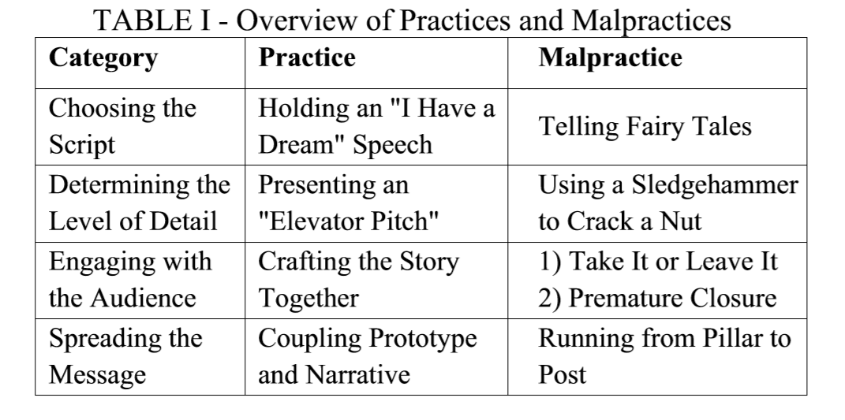
Introduction
[3] Pages 166
Notes:
We will be going over several practices and malpractices with prototyping
The categories are story telling-like

Slide 4
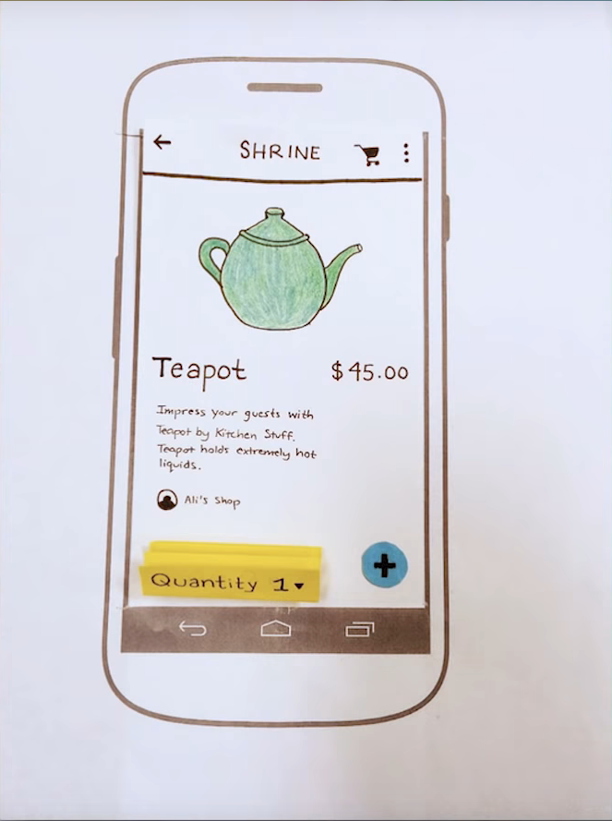
What is a prototype?
(Review)
[1] page 164
https://www.youtube.com/watch?v=JMjozqJS44M [4]
Notes:
Vary in fidelity,
Help to find requirements
Validation
Experimentation
Sell ideas
Allows for proper communicaiton
We can do all this before we put effort into implementation, therefore save on resources, and have proper direction.
I think it’s interesting that somethign like this made from paper can play such an integral role

Slide 5
Information Gathering
They explain in more detail in paper,
Over 2 years with two Swiss software companies, BITS and CustomSoft
Interviews, participant observation, prototypes, documentary material
[3] Pages 165-166
Notes:
Banking and IT Solutions (BITS):

Slide 6
Choosing the Script
Do: Holding an “I have a Dream Speech”:
Use the Prototype to show the positive future the product can bring
Finish with a statement urging for the completion of the final product
Don’t Do: Tell Fairy Tales
Make sure that the story is realistic, if the case presented is not realistic, it serves no purpose.
[3] Pages 166-167

Slide 7
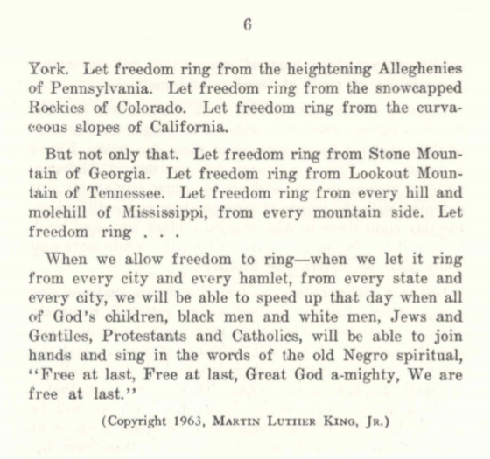
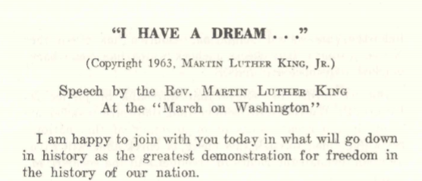
Finish with a statement urging for the completion of the final product
https://www.archives.gov/files
https://www.archives.gov/files/press/exhibits/dream-speech.pdf [2]
Notes:
The boxed section show an example of urging people to make something happen.
In this case a future where people are truly equal and free

Slide 8
Determining the Level of Detail
Do: Present an Elevator Pitch:
Be as concise as possible, keep the main ideas
No need to make story more complicated for the listeners.
Don’t Do: Use a Sledgehammer to Crack a Nut
Do not focus on unimportant details
No need to put excess effort where it does not need to be put.
Pages 167-168
[3] Pages 167-168

Slide 9
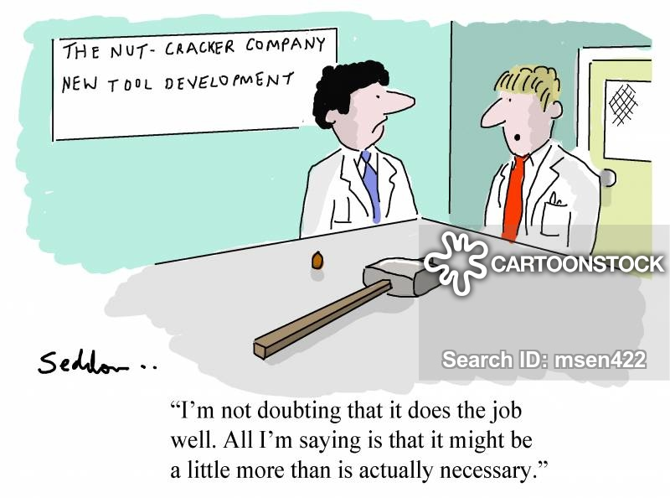
https://www.cartoonstock.com/cartoonview.asp?catref=msen422&type=download [4]
Notes:
Here is just a cartoon I found online,
It’s here just to further illustrate the point the authors are making
There is no need to add excess

Slide 10
Engaging with the Audience
Do: Craft the Story Together:
Work with stakeholders to find requirements
Bring in attention, keep attention, gather feedback
Don’t Do: Take it or Leave it
Do not assume that you alone know what is best
It is too risky. It is better to gather input to insure that the consumer is happy with the product
Pages 167-168
[3] Pages 168-169

Slide 11
Engaging with the Audience
Don’t Do: Premature Closure
“... storytellers, frequently overestimate their understanding of the listeners' real needs” (169)
Rather than just having stakeholders agree with your prototype without meaning it, make them “‘... fed up and say ‘this is what I really want’’”(169)
Pages 167-168
[3] Pages 169
Notes:
Keep attention through updates
Might be hyperbole, but sometimes you might have to be persistent to make sure that things run smoothly

Slide 12
Spreading the Message
Do: Coupling Prototype and Narrative:
Show a prototype of what the final product could be and explain with a story.
Makes it easier to explain hard to understand problems and it can make customers more invested
Direct audience -> indirect audience, thus the idea is spread
[3] Page 169
Notes:
Know who it will be spread too.

Slide 13
Spreading the Message
Don’t Do: Running from Pillar to Post
Don’t attempt to please everyone if it’s not possible
Be aware of who has control of decisions, and help provide those who make decisions make a convincing case.
[3] Page 170

Slide 14
Personal Opinion
Although only two companies were used, 2 years of information was taken, and I feel that it is worth listening to the provided advice.
Learning how to properly communicate with different types of people and handle situations with different types of people is important
It is better to play it safe and not risk wasting resources
Notes:
I agree with checking with others to make sure the prototype is what stakeholders want, to validate and test, to experiment.

Slide 15
Conclusion
[3] Page 166
Notes:
Elevator Pitch: reduce details, SledgeHammer to crack a Nut: too much detail
Craft story together: work with stakeholder to gather requirements, take it or leave it: assume you know what is best, Preamature closure, you assume that client says you are providing what they want, when you are not
Coupling prototype and naratinve: Using the porotype with a story Running from Pillar to Post: trying to please everyone,

Slide 16
Citations
[1] Google (2019). Rapid Prototyping 1 of 3: Sketching & Paper Prototyping. [video] Available at: https://www.youtube.com/watch?v=JMjozqJS44M [Accessed 26 Sep. 2019].
[2] King, Martin Luther. “PDF.” National Archives and Records Administration. https://www.archives.gov/files/press/exhibits/dream-speech.pdf
[3] Raffaele F. Ciriello, Alexander Richter, and Gerhard Schwabe. 2017. When prototyping meets storytelling: practices and malpractices in innovating software firms. In Proceedings of the 39th International Conference on Software Engineering: Software Engineering in Practice Track (ICSE-SEIP '17). IEEE Press, Piscataway, NJ, USA, 163-172. DOI:
[4] Seddon, Mike. “‘I'm Not Doubting That It Does the Job Well. All I'm Saying Is That It Might Be a Little More than Is Actually Necessary." - CartoonStock -.” CartoonStock, 2 Mar. 2018, www.cartoonstock.com/cartoonview.asp?catref=msen422&amp;type=download.

Slide 17
The End + Questions
What are two things that you should do when making a prototype? Explain. (according to the paper)
What are two things you should not do when making a prototype? Explain.(according to the paper)
What is the value of a prototype?
Paper Link: https://ieeexplore.ieee.org/document/7965440

