Slide 1
Empirical Study of Agile Software Development Methodologies: A Comparative Analysis
Authors- Gurpreet Singh Matharu, Harmeet Singh, Anju Mishra, Priyanka Upadhyay
Presented by
MOUNICA

Slide 2
Contents
Introduction
Transition to Agile Development
Agile Software Development Methodologies
- Scrum
- Extreme Programming
- Kanban
Comparison among Agile Software Development Methodologies
Limitations
Conclusions

Slide 3
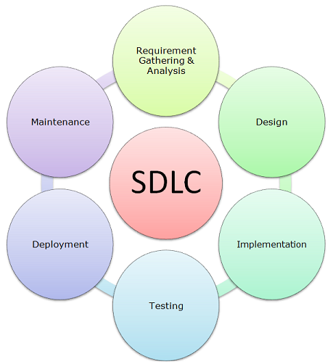
Introduction
In the modern software industry delivery of high quality software is very important for a developer
So, Software development approach plays an important role to decide the
quality of a software.
This led to the deployment of many software development life cycles
Later on the software practitioners shifted from traditional software development models to Agile based development with the increasing complexity and requirements of the software.

Slide 4
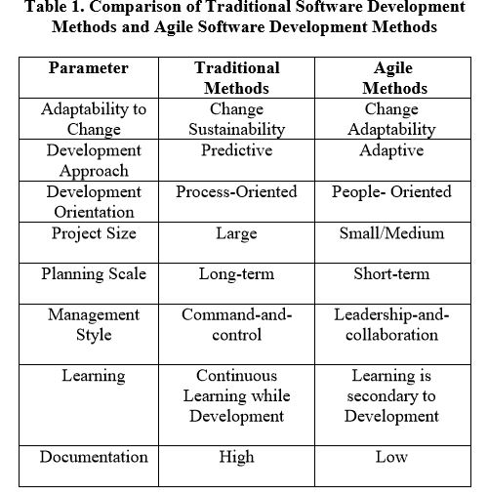
Transition to Agile Development
To meet the increasing software complexity and user requirements modern practitioners eliminated old-fashioned and informal software approaches and started using Agile methods.
Heavyweight methodologies, also known as traditional software development approaches are characterized by comprehensive planning, process-orientation, predictive approach and heavy documentation.
The lightweight methodologies, popularly known as agile methodologies, have made huge inroads into the software industry in the past few years. These methodologies promise frequent delivery of software increments in small iteration cycles and are team-oriented and adaptive approach.
Video- https://www.youtube.com/watch?v=tZb5G4GXNLI

Slide 5
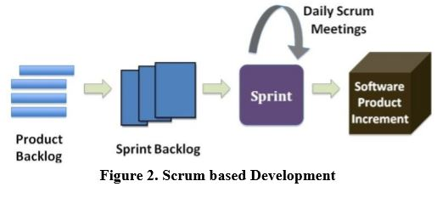
Agile Software Development Methodologies
In Agile approach to software development, work is carried out in small phases, based on collaboration, adaptive planning, early delivery, continuous improvement, regular customer feedback, frequent redesign resulting into development of software increments being delivered in successive iterations in response to the everchanging customer requirements.
The Agile software development embodies several methodologies including Scrum, Extreme Programming, Kanban.
-Scrum: Scrum is a methodology that manages the
software development in various short iterations
known as sprints. Each sprint includes all the phases of a
software development lifecycle model such as designing,
implementation, testing, customer review, etc.

Slide 6
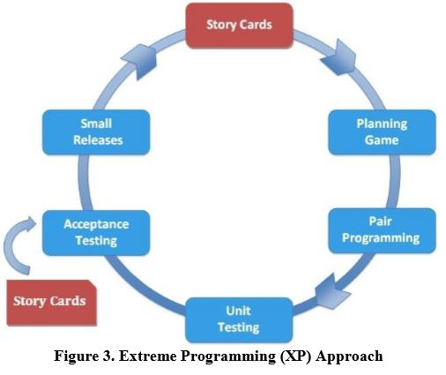
Agile Software Development Methodologies(contd..)
- Extreme Programming (XP): Extreme Programming
facilitates planned and
iterative software development by small teams of developers
to achieve higher software quality and enhanced productivity,
in response to rapidly evolving requirements. Extreme
Programming is characterized by intense levels of interaction
with customers during the software development process.

Slide 7
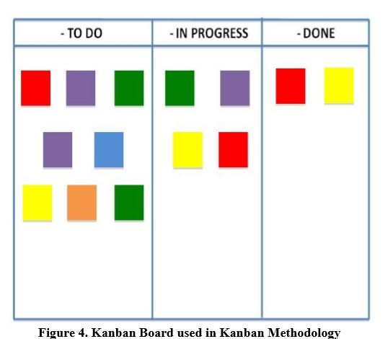
Agile Software Development Methodologies(contd..)
- Kanban: Kanban provides a means to visualize and limit the work-in
progress during software development process. Kanban method lays emphasis
on scheduling of work so as to facilitate the delivery of software product just-in-
time for implementation. The characteristics of Kanban methodology are
Kanban Board , Maximizes Productivity , Continuous delivery, Waste
Minimization, Limits Work in Progress (WIP) .

Slide 8
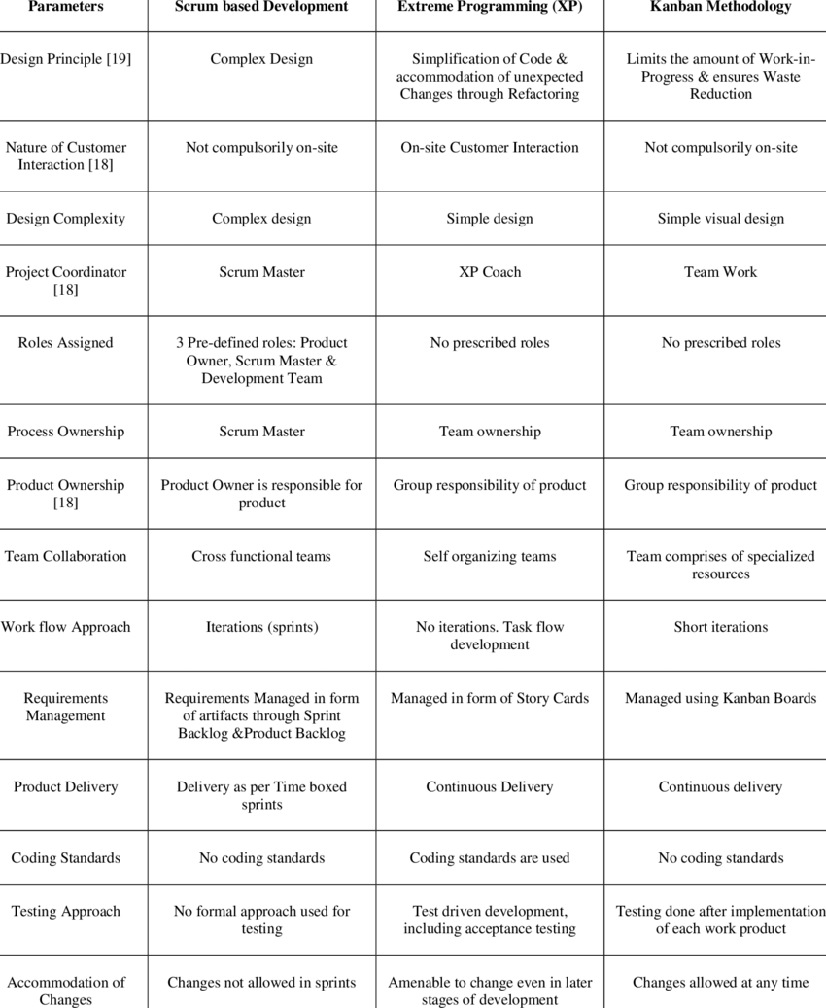
Comparison among Agile Software Development Methodologies
Several Agile methods follow the same set of principles as formulated by Agile manifesto, but they differ on various parameters of Agile principles. These differences are as follows:

Slide 9
Comparison among Agile Software Development Methodologies(contd…)
The authors have conducted a mix of telephonic and email conversations with the representatives of 15 software development companies. As a result of the survey, 10 companies were found to be following Scrum based development, while 3 of them expressed their faith in Extreme Programming approach and the remaining 2 companies have adopted Kanban approach to software development.
As per another survey conducted by the French Scrum User Group in 2009, also says that maximum percentage of companies advocated the use of Scrum than Extreme Programming and Kanban.

Slide 10
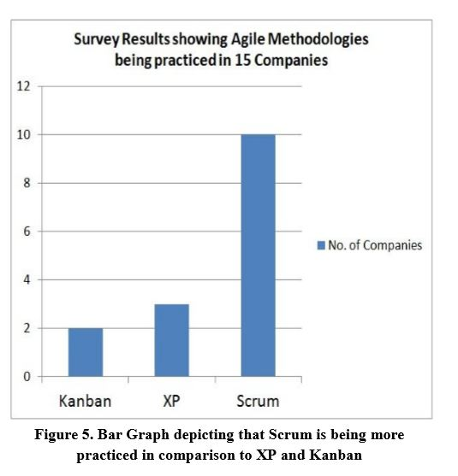
Comparison among Agile Software Development Methodologies(contd…)

Slide 11
Limitations
In the paper the comparison of the Agile software development methodologies were supported by a survey but it did not mention any reasons why the companies have chosen Scrum, Extreme Programming and Kanban.
It could have been even more clear if some reasons stated by the representatives were included in the paper.

Slide 12
Conclusion
With the authors empirical study and survey there is clear trend towards the higher adoption of Scrum based development in comparison to other Agile variants such as Extreme Programming and Kanban.
The comparative analysis of three Agile methodologies, namely Scrum, Extreme Programming and Kanban conclude that although the Agile family consists of several software development approaches which share the same set of Agile principles, but they do differ on various parameters.
Among all Agile methods, Scrum has the highest adoption whereas Extreme Programming is certainly picking up pace with software practitioners starting to exploit it to their advantage, and Kanban approach to software development is increasingly being explored for addition to existing Agile software development process.

Slide 13
Questions
What could be the reasons for transition from traditional methods to agile methods other that increasing complexity of software and user requirements?
Explain the Agile Software Development methodologies (Scrum, XP, Kanban) with an example.
Differences between Traditional methods and Agile methods.

Slide 14
Thank You!

