Slide 1
Software Modularization
Using the Modified Firefly Algorithm
by Ali Safari Mamaghani
Meysam Hajizadeh
Presented by Luyueh Chuang

Slide 2
Overview
Introduction/Goal
Modularization Quality measurement (MQ)
Firefly Algorithm (FA)
Results/Conclusions
3 Questions

Slide 3
Introduction and Goal
Cluster 1
Logout
Maintenance of software
Module Dependency Graph
nodes : files & classes
edges : function calls & Inheritance
Modularization - https://www.youtube.com/watch?v=20JP8w6_nVA
clusters
modules
NP-Problem
Genetic Algorithm
Learning Automation
Firefly Algorithm
Login
Add
item
Delete
item
Update
item
Cluster 2

Slide 4
Modularization Quality (MQ) measurement
MQ measurement:
A fitness function of the software clustering problem.
Coupling:
relations between the modules from two seperate clusters.
Cohesion:
connections between the modules of the same cluster.

Slide 5
Firefly Algorithm
Visualization: https://www.youtube.com/watch?v=LPKg_luHxpc&t=2m13s
All fireflies have the same gender, so the pairs are attracted to each other regardless of their genders.
A firefly’s attractiveness is directly proportional to its brightness which reduces when its distance from another firefly rises, and also if the attractiveness of both fireflies are the same, the movement’s direction will be random.
The brightness of a particular firefly is evaluated based on the value of fitness function.

Slide 6
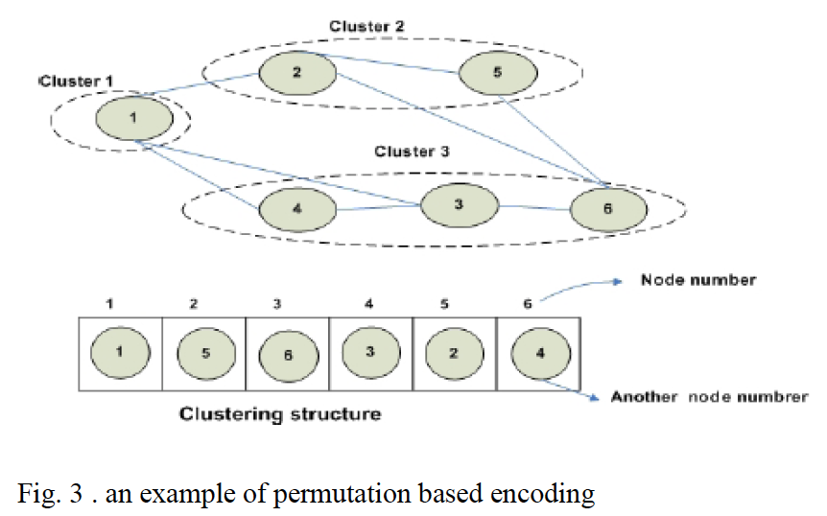
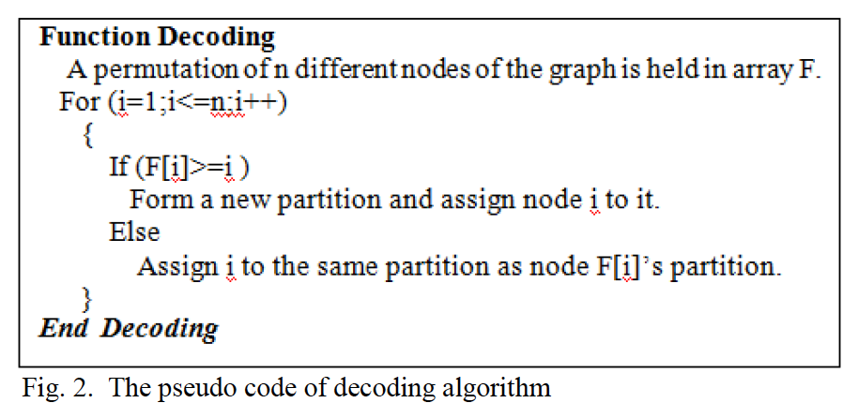
Firefly Algorithm - Adaption
Representation of the particles(fireflies):
Each particle is a permutation of the MDG nodes in which ith cell presents ith
node of the graph

Slide 7
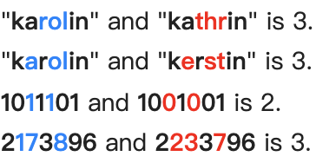
Firefly Algorithm - Adaption
Distance: Hamming distance
Movement: Ri is generated as Ri= Random(1,dij)
di,j is the distance between two fireflies

Slide 8
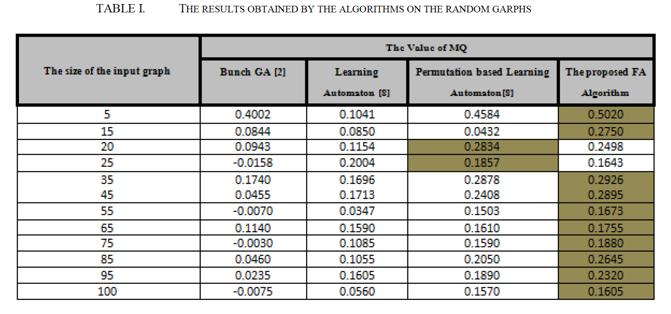
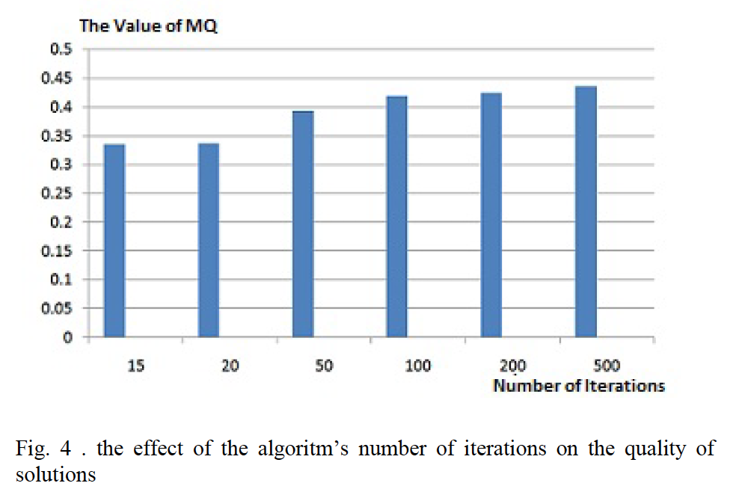
Results and Conclusions

Slide 9
3 Questions
Please simply describe coupling and cohesion in software modularization.
Please compute the hamming distance in binary of number 113 and 89.
Please simply describe “cluster” in software modularization

Slide 11
Modularization Quality (MQ) measurement(cont.)
Coh => Higher, better [ 0,1 ]
Coup => Higher, worse [ 0,1 ]
MQ => Higher, better [ -1,1 ]

