Slide 1
CS 302 Data Structures
C++ Interlude 2
Pointers, Polymorphism, and Memory Allocation

Slide 2
Review
What is a template?
How do we declare one?
How do we use one?

Slide 3
Memory Allocation
int a;
Where is a?
int * a_ptr;
Allocate memory and have a_ptr point to it.
Where is that memory?

Slide 4
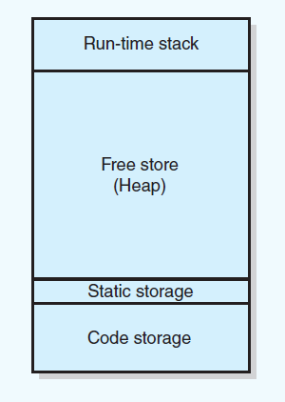
Figure C2-2 Sample program memory layout

Slide 5
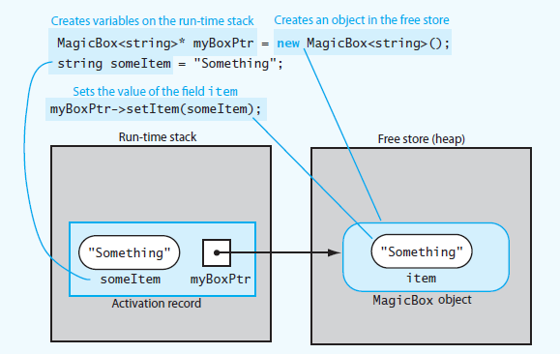
Figure C2-3 Run-time stack and free store.

Slide 6
Memory Allocation
What is a memory leak?
How do you create one?
How do you de-allocate memory?
What is a dangling pointer?
Please declare an array of integers.
Please declare a dynamically allocated array of integers.

Slide 7
End of C++ Interlude 2

