Slide 1
CS 302 Data Structures
Recursion: The Mirrors

Slide 2
Recursive Solutions
What is recursion?
There are two types of recursive functions:
Direct and Indirect
Explain…
There are two basic parts of recursive functions.
What are they?
They are:
Base Case/Stopping Condition
Recursive Call.

Slide 3
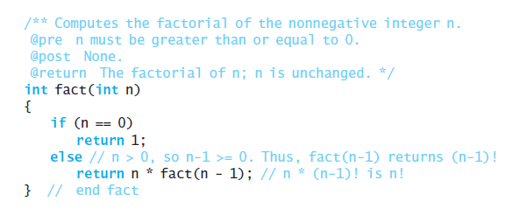
Example: Factorial of n

Slide 4
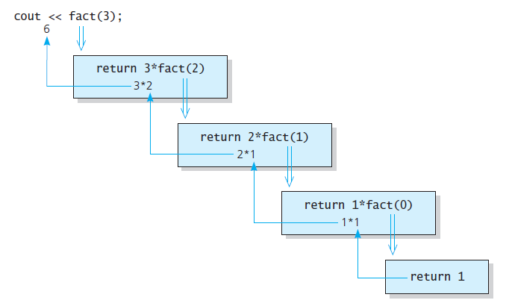
fact(3);

Slide 5
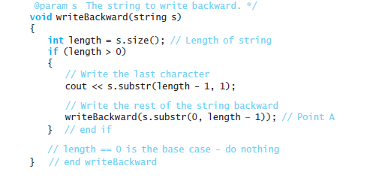
void writeBackwards(string s);

Slide 6
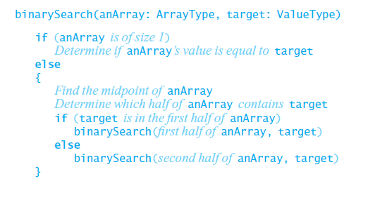
binarySearch(anArray: ArrayType, target:ValueType);

Slide 7
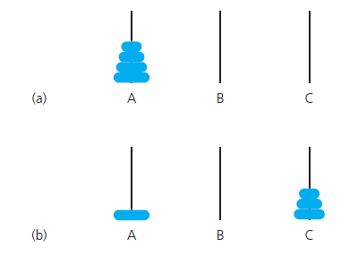
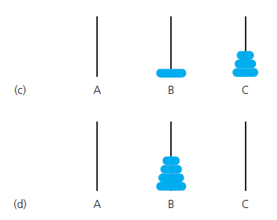
Towers of Hanoi

Slide 8
int fibonacci(int n);
The sequence
1, 2, 3, 5, 8,
What does the code look like?

Slide 9
Recursion and Eficiency
Recursion is a powerful problem solving technique, but..
Two factors contribute to the inefficiency of recursive solutions:
The overhead associated with function calls
The inherent inefficiency of some recursive algorithms.
Principle:
Don not use recursion if an efficient iterative solution exits

Slide 10
End of Chapter 2

