Slide 1
CS 302 Data Structures
Recursion as a Problem-Solving Technique

Slide 2
Recursive Solutions
What is recursion?
There are two types of recursive functions:
Direct and Indirect
Explain…
There are two basic parts of recursive functions.
What are they?
They are:
Base Case/Stopping Condition
Recursive Call.

Slide 3
Recursive Applications
Defining Languages
Algebraic Expressions
Backtracking

Slide 4
Defining Languages
A language is
A set of strings of symbols
From a finite alphabet.
C++Programs = {string s : s is a syntactically correct C++ program}
Algebraic Expressions = {string s : s is an algebraic expression}

Slide 5
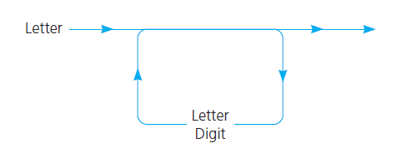
The Basics of Grammars
Special symbols
x | y means x or y
xy (and sometimes x • y ) means x followed by y
< word > means any instance of word, where word is a symbol that must be defined elsewhere in the grammar.
C++Identifiers = {string s : s is a legal C++ identifier}

Slide 6
Palindromes
Palindromes = {string s : s reads the same left to right as right to left}
Grammar for the language of palindromes:

Slide 7
Palindromes
A recognition algorithm for palindromes

Slide 8
Application 2: Backtracking
Consider searching for an airline route
Input text files that specify all of the flight information for HPAir Company
Names of cities HPAir serves
Pairs of city names, each pair representing origin and destination of one of HPAir’s flights
Pairs of city names, each pair representing a request to fly from some origin to some destination

Slide 9
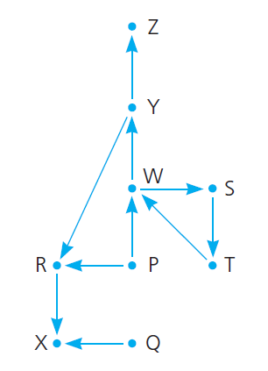
Backtracking
Flight Graph

Slide 10
Backtracking
A recursive strategy

Slide 11
Backtracking
Possible outcomes of applying the previous strategy
Eventually reach destination city and can conclude that it is possible to fly from origin to destination.
Reach a city C from which there are no departing flights.
Go around in circles

Slide 12
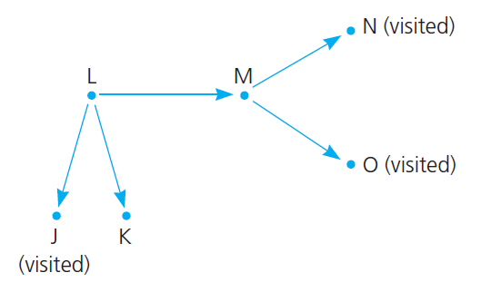
Backtracking

Slide 13
The Eight Queens Problem
Place one queen at a time.

Slide 14
End of Chapter 5

