Slide 1
CS 302 Data Structures
Algorithm Efficiency

Slide 2
This chapter will show you how to analyze the efficiency of algorithms.
The basic mathematical techniques for analyzing algorithms are central to more advanced topics in Computer Science.
As examples we will see analysis of some algorithms that you have studied before
In addition, this chapter examines the important topic of sorting data.

Slide 3
Measuring an algorithms efficiency is quite important because your choice of algorithm for a given application often has a great impact.
Suppose two algorithms perform the same task, such as searching.
What does it mean to compare the algorithms and conclude that one is better?

Slide 4
The analysis of algorithms is the area of Computer Science that provides the tools for contrasting the efficiency of different methods of solution.
How do you compare them?
Implement them both in C++ and run them?
There are a few difficulties with this
How are the algorithms coded?
What computer should you use?
What data should the programs use?
To overcome these (and other) difficulties, we will use some mathematical techniques to the algorithms independently of coding, computers, and data.

Slide 5
Execution Time of Algorithm
Traversal of linked nodes – example:
So the total time is A(n+1) + C(n+1) + W(n)
Which is proportional to n
Therefore a list of 100 takes longer than a list of 10

Slide 6
The Towers of Hanoi
In the Chapter on Recursion we proved recursively that the solution to the towers of Hanoi problem with n disks requires 2^{n}-1 moves
If each move requires the same time, m,
the solution requires (2^{n}-1)*m time units.
As you can see, this time requirement increases rapidly as the number of disks increases

Slide 7
Nested Loops
Consider an algorithm that contains nested loops of the following form:
for (i=1 to n)
for (j=1 to i)
for (k=1 to 5)
taks T
If task T requires t time units,
the innermost loop (on k) requires 5*t time units,
the loop on j requres 5*t*i time units, and
the outermost loop on i requires

Slide 8
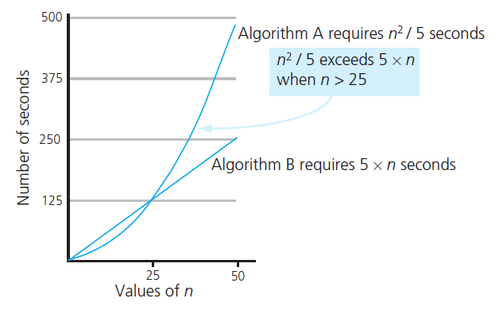
Algorithm Growth Rate
The most important thing to learn is how quickly the algorithm’s time requirement grows as a function of the problem size.
Algorithm A requires time proportional to n²
Algorithm B requires time proportional to n
This is called the growth rate

Slide 9
Analysis and Big O Notation
Definition:
Algorithm A is order f ( n )
Denoted O( f ( n ))
If constants k and n₀ exist
Such that A requires no more than k × f ( n ) time units to solve a problem of size n ≥ n₀ .

Slide 10
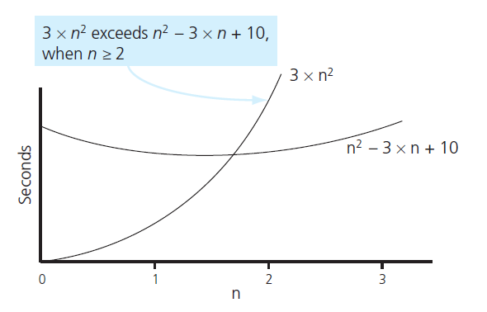
Analysis and Big O Notation
FIGURE 10-2 The graphs of 3 × n² and n² - 3 × n + 10

Slide 11
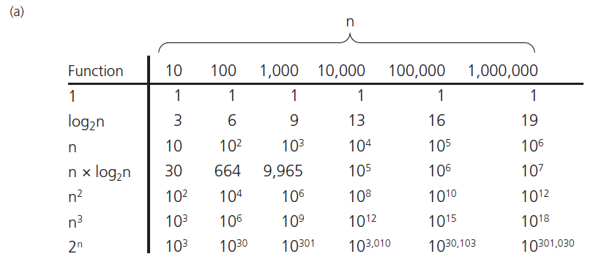
Analysis and Big O Notation
FIGURE 10-3 A comparison of growth-rate functions: (a) in tabular form

Slide 12
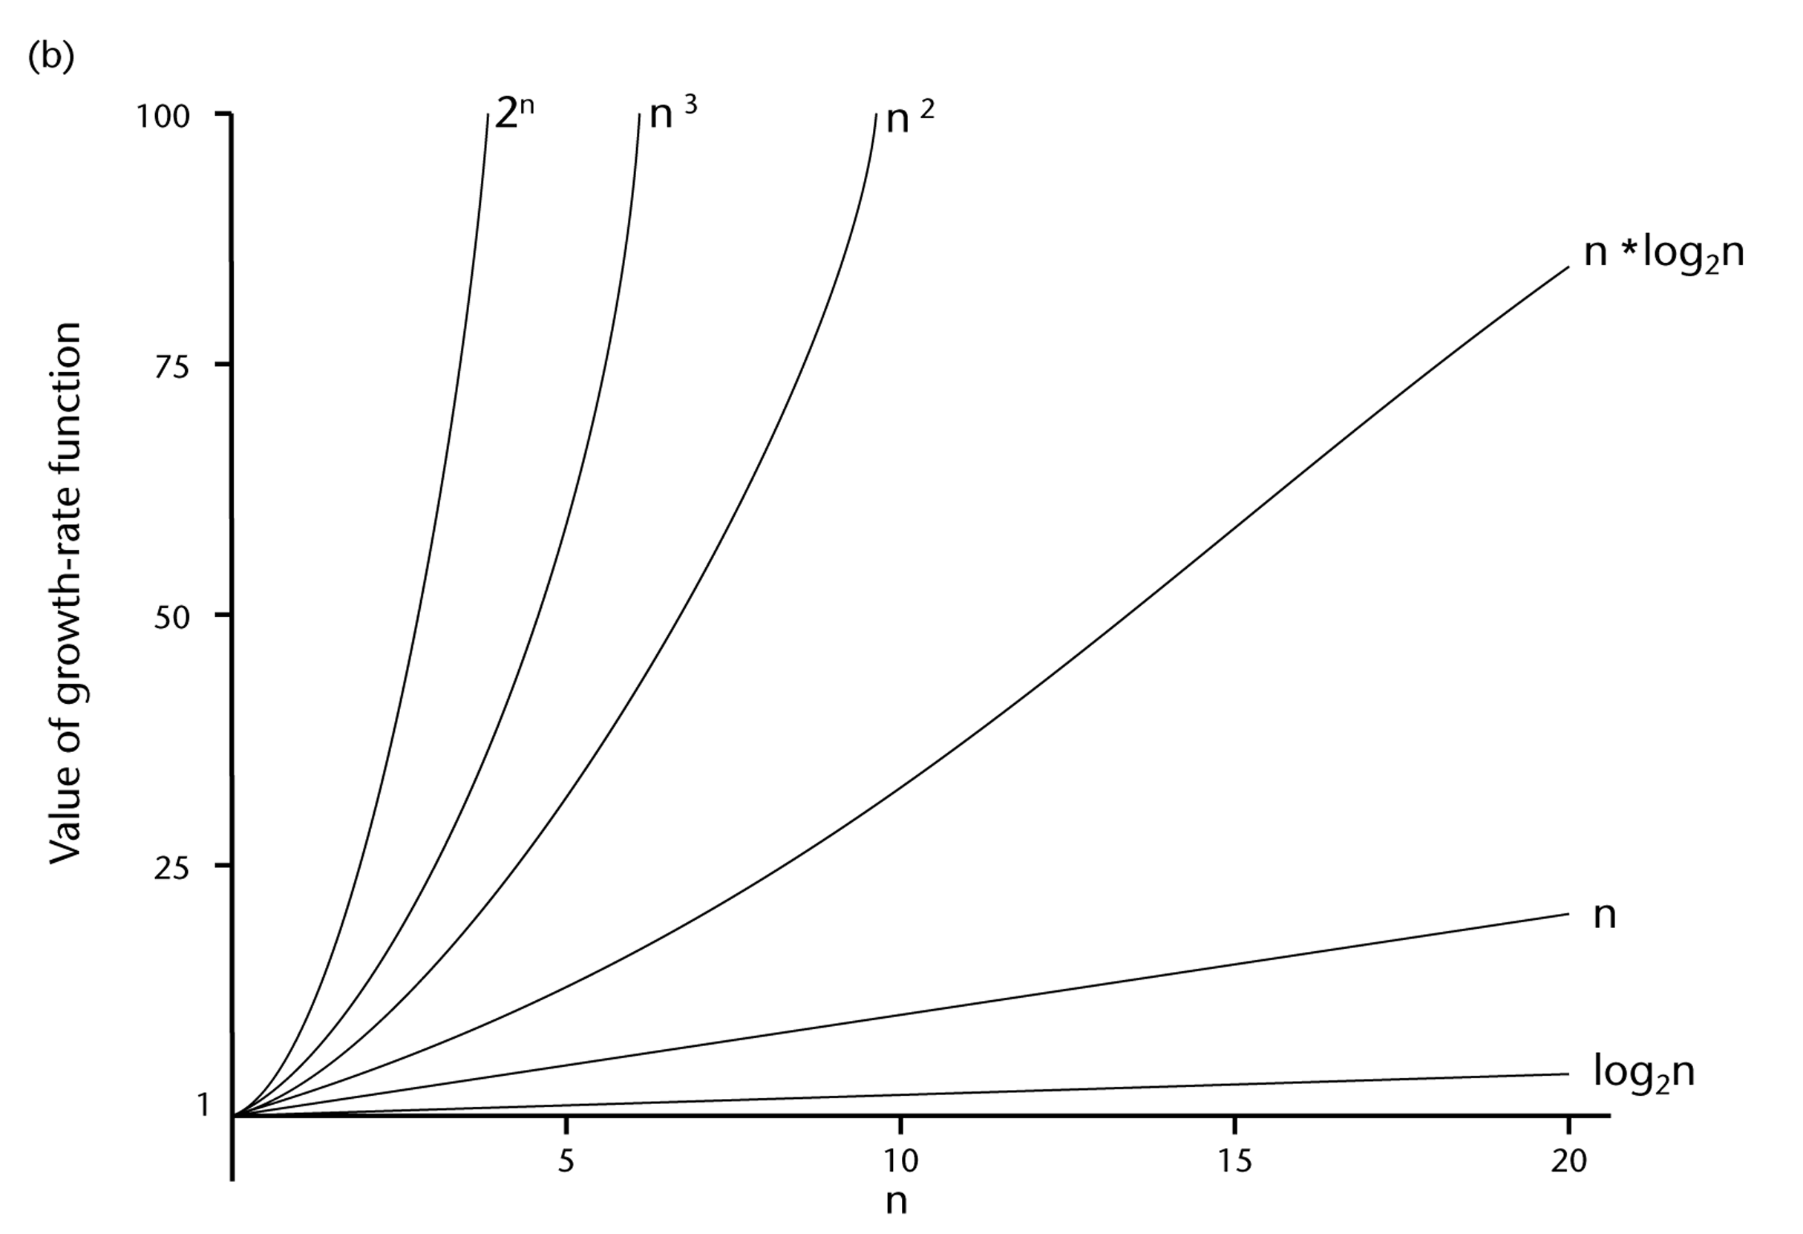
Analysis and Big O Notation

Slide 13
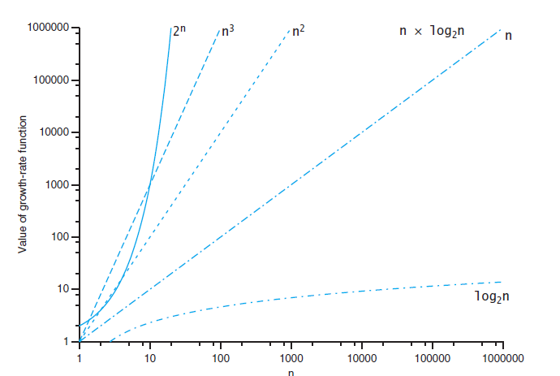
Analysis and Big O Notation
FIGURE 10-3 A comparison of growth-rate functions: (a) in graphical form

Slide 14
Analysis and Big O Notation
Order of growth of some common functions

Slide 15
Properties of Growth-Rate Functions
You can ignore low order terms in an algorithm’s growth rate function:
O(n³+4n²+3n) is O(n³)
You can ignore a multiplicative constant in the high-order term of an algorithm’s growth rate function
O(5n³) is O(n³)
You can combine growth rate functions
O(f(n)) + O(g(n)) = O(f(n)+g(n))
O(n²) + O(n) = O(n²+n) = O(n²)

Slide 16
Worst-case and average-case analysis
A particular algorithm might require different times to solve different problems of the same size.
Worst-case analysis concludes that the algorithms is O(f(n)) if, in the worst case, A requires no more time than k*f(n)
Average-case analysis attempts to determine the average amount of time that an algorithm requires to solve problems of size n
This is more difficult than worst-case analysis.

Slide 17
The efficiency of Searching Algorithms
Lets look at two algorithms sequential search and binary search
Sequential Search
Start at the beginning and look until you find it or run out of data.
Best case:
Worst case:
Average case:

Slide 18
The efficiency of Searching Algorithms
Binary Search
Assumes a sorted array.
The algorithm determines which half to look at and ignores the other half.
If n = 2^{k}, there are k divisions
Therefore k = log₂n
Thus the algorithm is O(log₂n) in the worst case
So, is a binary search better than a sequential search?
If n = 1,000,000
log₂ 1,000,000 = 19
Therefore at most 20 compares as opposed to at most 1,000,000 compares.

Slide 19
Efficiency of Searching Algorithms
Sequential search
Worst case O(n)
Average case O(n)
Best case O(1)
Binary search of sorted array
Worst case O(log₂n)
Remember required overhead for keeping array sorted

Slide 20
Keeping Your Perspective
Array-based getEntry is O(1)
Link-based getEntry is O(n)
Consider how frequently particular ADT operations occur in given application
Some seldom-used but critical operations must be efficient

Slide 21
Keeping Your Perspective
If problem size always small, ignore an algorithm’s efficiency
Weigh trade-offs between algorithm’s time and memory requirements
Compare algorithms for both style and efficiency

Slide 22
End of Chapter 10

