Slide 1
CS 302 Data Structures
Sorting Algorithms and their Efficiency

Slide 2
Contents
Basic Sorting Algorithms
Faster Sorting Algorithms
A Comparison of Sorting Algorithms

Slide 3
Basic Sorting Algorithms
Sorting is:
A process
It organizes a collection of data
Organized into ascending/descending order
Internal: data fits in memory
External: data must reside on secondary storage
Sort key: data item which determines order

Slide 4
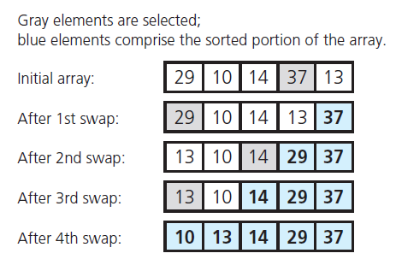
The Selection Sort

Slide 5
The Selection Sort
View implementation of the selection sort, Listing 11-1
Analysis
This is an O (n² ) algorithm
If sorting a very large array, selection sort algorithm probably too inefficient to use

Slide 6
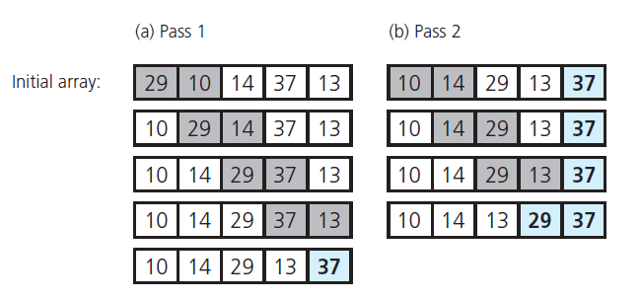
The Bubble Sort

Slide 7
The Bubble Sort
View an implementation of the bubble sort, Listing 11-2
Analysis
Best case, O(n) algorithm
Worst case, O(n²) algorithm
Again, a poor choice for large amounts of data

Slide 8
The Insertion Sort
Take each item from unsorted region, insert into its correct order in sorted region
FIGURE 11-3 An insertion sort partitions
the array into two regions

Slide 9
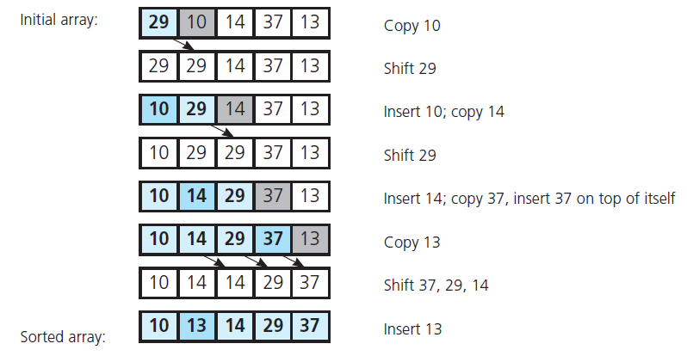
The Insertion Sort
FIGURE 11-4 An insertion sort of an array of five integers

Slide 10
The Insertion Sort
View implantation of insertion sort, Listing 11-3
Analysis
An algorithm of order O(n²)
Best case O(n)
Appropriate for 25 or less data items

Slide 11
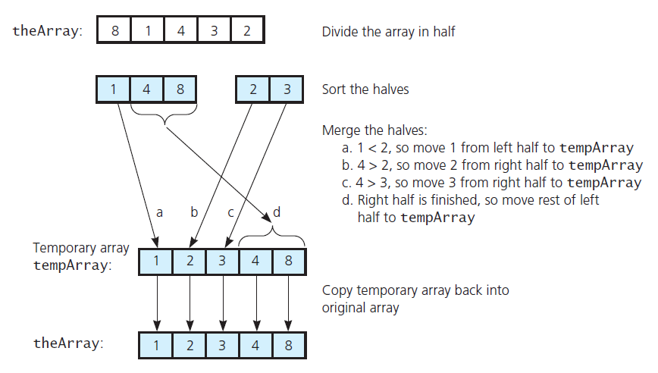
The Merge Sort
FIGURE 11-5 A merge sort with an auxiliary temporary array

Slide 12
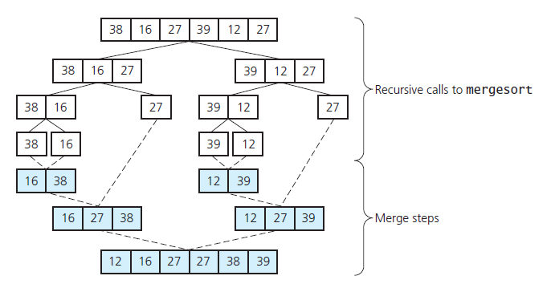
The Merge Sort
FIGURE 11-6 A merge sort of an array of six integers

Slide 13
The Merge Sort
View implementation of the merge sort, Listing 11-4
Analysis
Merge sort is of order O(n × log n)
This is significantly faster than O(n²)

Slide 14
The Merge Sort
FIGURE 11-7 A worst-case instance of the merge step in a merge sort

Slide 15
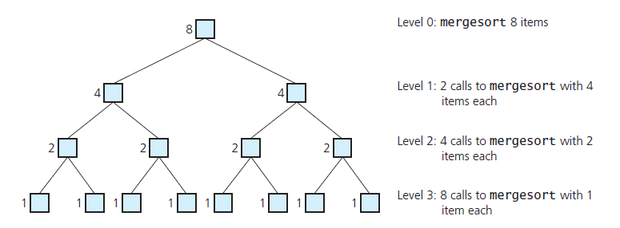
The Merge Sort
FIGURE 11-8 Levels of recursive calls to mergeSort , given an array of eight items

Slide 16
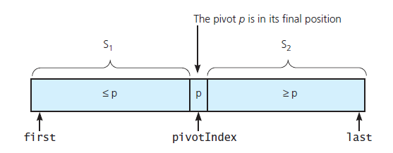
The Quick Sort
FIGURE 11-9 A partition about a pivot

Slide 17
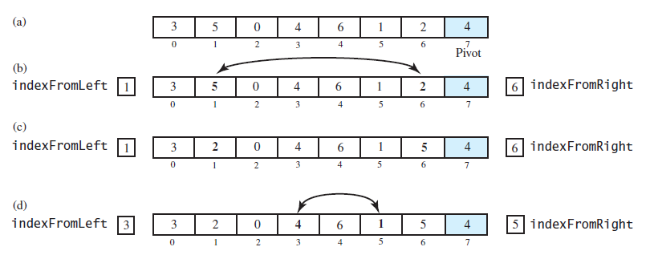
The Quick Sort
FIGURE 11-10 Partitioning of array during quick sort

Slide 18
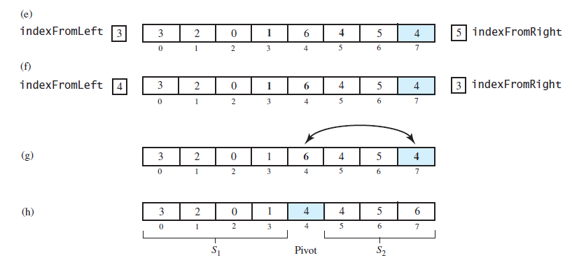
The Quick Sort
FIGURE 11-10 Partitioning of array during quick sort

Slide 19
The Quick Sort
FIGURE 11-11 Median-of-three pivot selection: (a) The original array; (b) the array with its
first, middle, and last entries sorted

Slide 20
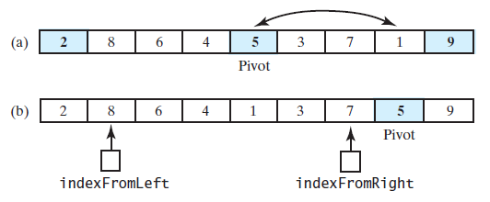
The Quick Sort
FIGURE 11-12 (a) The array with its first, middle, and last entries sorted; (b) the array after positioning the pivot and just before partitioning

Slide 21
The Quick Sort
Note function that performs a quick sort, Listing 11-5
Analysis
Worst case O(n²)
Average case O(n × log n)
Does not require extra memory like merge sort

Slide 22
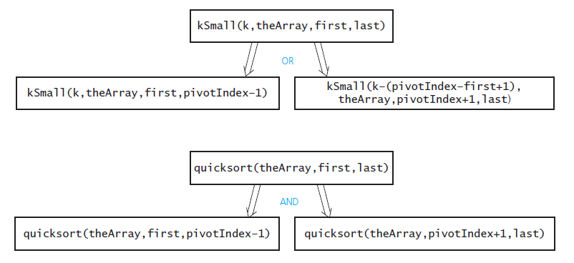
The Quick Sort
FIGURE 11-13 kSmall versus quickSort

Slide 23
The Radix Sort
Uses the idea of forming groups, then combining them to sort a collection of data.
Consider collection of three letter groups
ABC, XYZ, BWZ, AAC, RLT, JBX, RDT, KLT, AEO, TLJ
Group strings by rightmost letter
(ABC, AAC) (TLJ) (AEO) (RLT, RDT, KLT) (JBX) (XYZ, BWZ)
Combine groups
ABC, AAC, TLJ, AEO, RLT, RDT, KLT, JBX, XYZ, BWZ

Slide 24
The Radix Sort
Group strings by middle letter
(AAC) (A B C, J B X) (R D T) (A E O) (T L J, R L T, K L T) (B W Z) (X Y Z)
Combine groups
AAC, ABC, JBX, RDT, AEO, TLJ, RLT, KLT, BWZ, XYZ
Group by first letter, combine again
( A AC, A BC, A EO) ( B WZ) ( J BX) ( K LT) ( R DT, R LT) ( T LJ) ( X YZ)
Sorted strings
AAC, ABC, AEO, BWZ, JBX, KLT, RDT, RLT, TLJ, XYZ

Slide 25
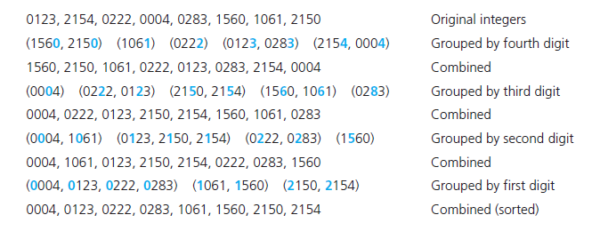
The Radix Sort
FIGURE 11-14 A radix sort of eight integers

Slide 26
The Radix Sort
Analysis
Has order O(n)
Large n requires significant amount of memory, especially if arrays are used
Memory can be saved by using chain of linked nodes
Radix sort more appropriate for chain than for array

Slide 27
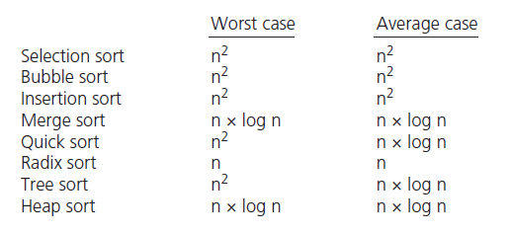
Comparison of Sorting Algorithms
FIGURE 11-15 Approximate growth rates of time required for eight sorting algorithms

Slide 28
End of Chapter 11

