Slide 1
CS 480/680
Computer Graphics
GLSL Overview

Slide 2
Vertex Shader Applications
Moving Vertices
  Morphing
  Wave Motion
  Fractals
Lighting
  More realistic models
  Cartoon Shaders

Slide 3
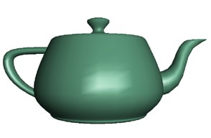
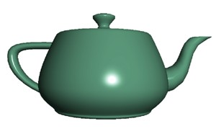
Shader Applications:
Per Vertex Lighting Per Fragment Lighting

Slide 4
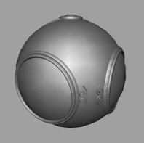

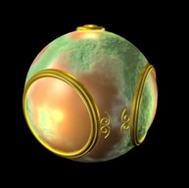
Fragment Shader Applications:
Texture mapping
  Smooth shading Environment Mapping Bump Mapping

Slide 5
GLSL
OpenGL Shading Language
Vertex and Fragment shaders written in GLSL
Part of OpeGL 2.0 and up
As of OpenGL 3.1, application must use shaders.
Example code of a vertex shader:
  const vec4 red = vec4(1.0, 0.0, 0.0, 1.0);
  out vec3 color_out;
  void main(void){
    gl_Position = vPosition;
    color_out = red;
  }

Slide 6
Vertex & Fragment shader pipeline

Slide 7
Data Types
C types: int, float, bool, double, uint
Arrays/Vectors:
  float vec2, vec3, vec4
  Also int (ivec) and boolean (bvec)
Matrices of floats or doubles:
  Square matrices: 2x2, 3x3, or 4x4 : mat2, mat3, mat4
  Stored by columns
  Standard referencing m[row][col]
  non-square matrices: size {2,3,4}x{2,3,4}: mat3x4, dmat4x2
Texture samplers
  sampler1D, sampler2D, sampler3D for 1, 2, 3D power-of-two textures
  sampler2DRect for rectangle textures
  samplerCube for cubemap textures

Slide 8
Data Types
Variable declaration and initialization very similar to C-style
  float a = 1.0;
  vec3 point = vec3(1.0,1.0,4.0);
  mat2 mat = mat2(1.0,0.0,0.0,1.0);
  (matrices are assigned in column major order)
C++ style constructors
  vec3 a = vec3(1.0, 2.0, 3.0)
  vec2 b = vec2(a)

Slide 9
Pointers
There are no pointers in GLSL
We can use C structs which can be copied back from functions.
Because matrices and vectors are basic types they can be passed into and be output from GLSL functions
  mat3 func(mat3 a)

Slide 10
Qualifiers
GLSL has many of the same qualifiers (const) as C/C++
Need others due to the nature of the execution model
Variables can change
  Once per primitive
  Once per vertex
  Once per fragment
  Any time in the program

Slide 11
Passing Values
call by value‐return. Two possibilities
  in: variables copied in
  out: returned values are copied back
  inout (deprecated)
Example: vertex shader using out
  const vec4 red = vec4(1.0, 0.0, 0.0, 1.0);
  out vec3 color_out;
  void main(void){
    gl_Position = vPosition;
    color_out = red;
  }

Slide 12
Vertex Attribute Variables
Vertex Attribute variables can change at most once per vertex
  Flows down the pipeline with each vertex
  Position, color, normal, texture coordinates
There are a few built in variables such as gl_Position but most have been deprecated
User defined (in application program)
  Use in qualifier to get to shader (read only)
  in float temperature
  in vec3 velocity
  layout (location = 0) in vec3 vp;

Slide 13
Uniform parameters
Variables that are set by the application but are constant for the entire primitive
  Transformation matrices, parameters of light sources, textures
Can be changed in the application and sent to the shader
Cannot be changed in the shader.
  uniform mat4 projectionMatrix;

Slide 14
Uniform parameters
To set parameters, use glGetUniformLocation, glUniform* in application
  After shader is active, before rendering
Example
  In shader declare
    uniform float a;
  In application, set a using
    GLuint p;
    //… initialize program p
    int i=glGetUniformLocation(p,”a”);
    glUniform1f(i, 1.f);

Slide 15
Some Built-In Variables
vertex shader in:
  int gl_VertexID (for indexed rendering)
vertex shader out:
  vec4 gl_Position (clip space position), - Required
  float gl_PointSize (pixel width/height for point rendering)
  Note other out variables will be interpolated during rasterization (texture coordiantes, …)
fragment shader in:
  vec4 gl_FragCoord (location in window space)
  Note: for user defined variables you Need to have same variable name as output (declared as out) of vertex shader
fragment shader out:
  float gl_FragDepth (fragment depth)

Slide 16
Operators and Functions
Standard C functions
  Trigonometric: cos, sin, tan, etc
  Arithmetic: log, min, max, abs, etc
  Normalize, reflect, length
Overloading of vector and matrix types
  mat4 a;
  vec4 b, c, d;
  c = b*a; // a column vector stored as a 1d array
  d = a*b; // a row vector stored as a 1d array

Slide 17
Swizzling and Selection
Can refer to array elements by element using [] or selection (.) operator with
  x, y, z, w
  r, g, b, a
  s, t, p, q
  vec4 a;
  a[2], a.b, a.z, a.p are the same
Swizzling operator lets us manipulate components
  a.yz = vec2(1.0, 2.0);

Slide 18
Open GL Quick Reference Card
https://www.khronos.org/files/opengl45-quick-reference-card.pdf
GLSL starts on page 9

