Slide 1
From Vertices to Fragments
Chapter 7

Slide 2
Part I Objectives
Introduce basic implementation strategies
Clipping
Scan conversion

Slide 3
Overview
At end of the geometric pipeline, vertices have been assembled into primitives
Must clip out primitives that are outside the view frustum
Algorithms based on representing primitives by lists of vertices
Must find which pixels can be affected by each primitive
Fragment generation
Rasterization or scan conversion

Slide 4
Required Tasks
Clipping
Rasterization or scan conversion
Transformations
Some tasks deferred until fragment processing
Hidden surface removal
Antialiasing

Slide 5
Rasterization Meta Algorithms
Consider two approaches to rendering a scene with opaque objects
For every pixel, determine which object that projects on the pixel is closest to the viewer and compute the shade of this pixel
Ray tracing paradigm
For every object, determine which pixels it covers and shade these pixels
Pipeline approach
Must keep track of depths

Slide 6
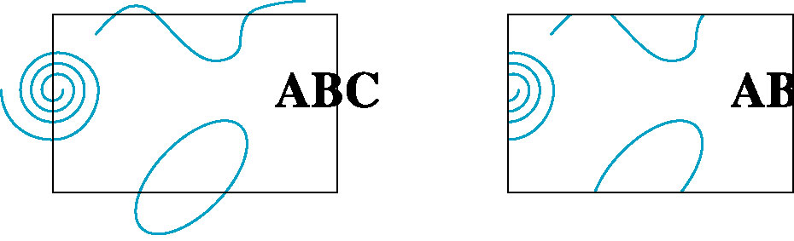
Clipping
2D against clipping window
3D against clipping volume
Easy for line segments polygons
Hard for curves and text
Convert to lines and polygons first

Slide 7
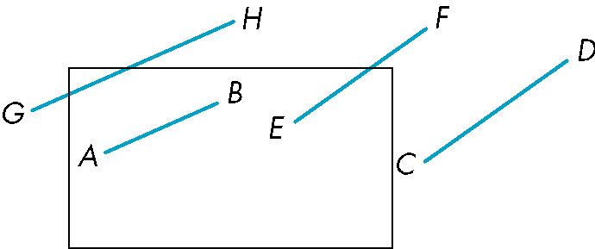
Clipping 2D Line Segments
Brute force approach: compute intersections with all sides of clipping window
Inefficient: one division per intersection

Slide 8
Cohen-Sutherland Algorithm
Idea: eliminate as many cases as possible without computing intersections
Start with four lines that determine the sides of the clipping window
y = y_{max}
x = x_{min}
x = x_{max}
y = y_{min}

Slide 9
The Cases
Case 1: both endpoints of line segment inside all four lines
Draw (accept) line segment as is
Case 2: both endpoints outside all lines and on same side of a line
Discard (reject) the line segment
y = y_{max}
x = x_{min}
x = x_{max}
y = y_{min}

Slide 10
The Cases
Case 3: One endpoint inside, one outside
Must do at least one intersection
Case 4: Both outside
May have part inside
Must do at least one intersection
y = y_{max}
x = x_{min}
x = x_{max}

Slide 11
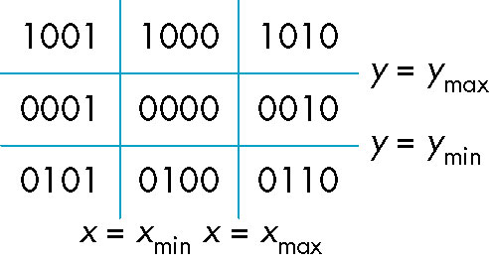
Defining Outcodes
For each endpoint, define an outcode
Outcodes divide space into 9 regions
Computation of outcode requires at most 4 subtractions
b₀b₁b₂b₃
b₀ = 1 if y > y_{max}, 0 otherwise
b₁ = 1 if y < y_{min}, 0 otherwise
b₂ = 1 if x > x_{max}, 0 otherwise
b₃ = 1 if x < x_{min}, 0 otherwise

Slide 12
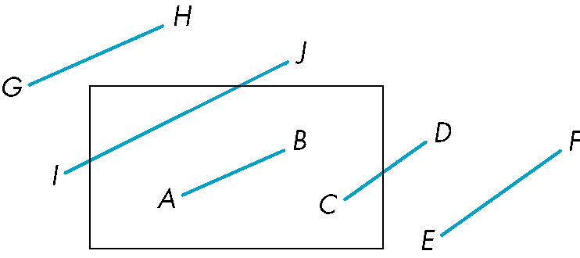
Using Outcodes
Consider the 5 cases below
AB: outcode(A) = outcode(B) = 0
Accept line segment

Slide 13
Using Outcodes
CD: outcode (C) = 0, outcode(D) ≠ 0
Compute intersection
Location of 1 in outcode(D) determines which edge to intersect with
Note if there were a segment from A to a point in a region with 2 ones in outcode, we might have to do two intersections

Slide 14
Using Outcodes
EF: outcode(E) logically ANDed with outcode(F) (bitwise) ≠ 0
Both outcodes have a 1 bit in the same place
Line segment is outside of corresponding side of clipping window
reject

Slide 15
Using Outcodes
GH and IJ: same outcodes, neither zero but logical AND yields zero
Shorten line segment by intersecting with one of sides of window
Compute outcode of intersection (new endpoint of shortened line segment)
Reexecute algorithm

Slide 16
Efficiency
In many applications, the clipping window is small relative to the size of the entire data base
Most line segments are outside one or more side of the window and can be eliminated based on their outcodes
Inefficiency when code has to be re-executed for line segments that must be shortened in more than one step

Slide 17
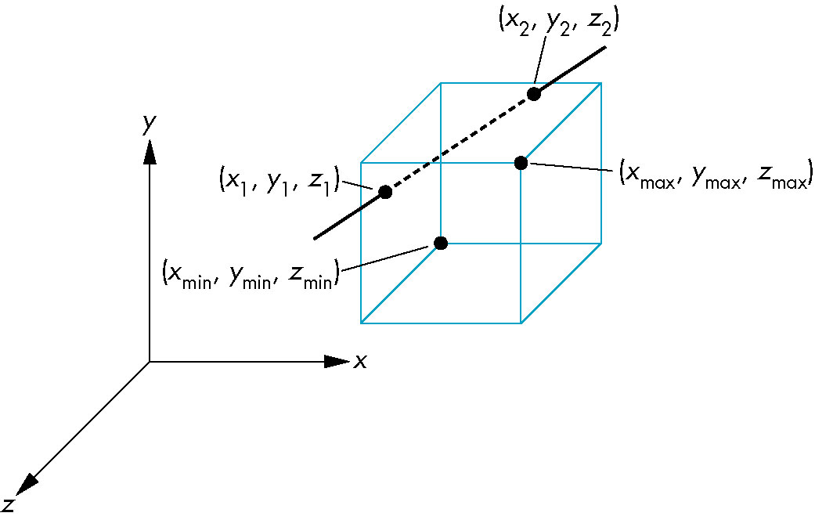
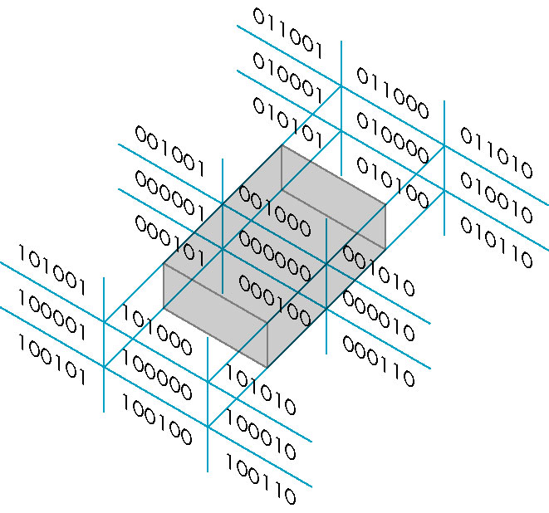
Cohen Sutherland in 3D
Use 6-bit outcodes
When needed, clip line segment against planes

Slide 18
Liang-Barsky Clipping
Consider the parametric form of a line segment
We can distinguish between the cases by looking at the ordering of the values of α where the line determined by the line segment crosses the lines that determine the window
p(α) = (1-α)p₁+ αp₂ 1 ≥ α ≥ 0
p₂
p₁

Slide 19
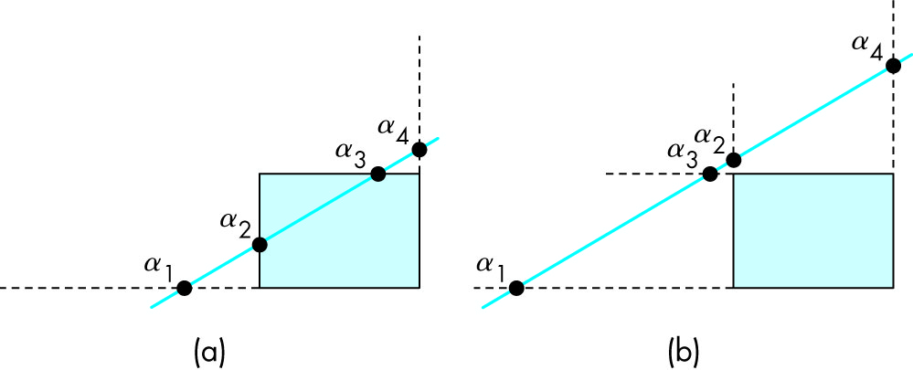
Liang-Barsky Clipping
In (a): α₄ > α₃ > α₂ > α₁
Intersect right, top, left, bottom: shorten
In (b): α₄ > α₂ > α₃ > α₁
Intersect right, left, top, bottom: reject

Slide 20
Advantages
Can accept/reject as easily as with Cohen-Sutherland
Using values of α, we do not have to use algorithm recursively as with C-S
Extends to 3D

Slide 21
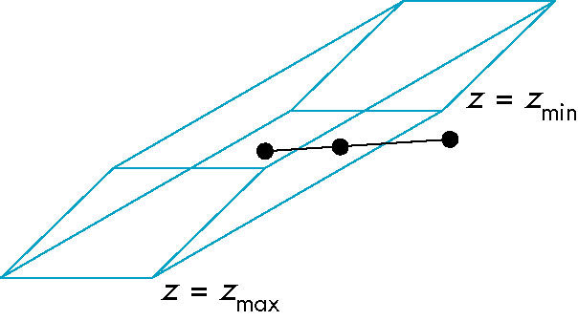
Clipping and Normalization
General clipping in 3D requires intersection of line segments against arbitrary plane
Example: oblique view

Slide 22
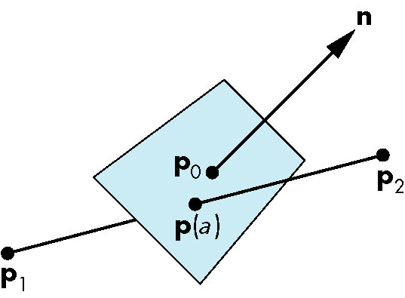
Plane-Line Intersections

Slide 23
Normalized Form
Normalization is part of viewing (pre clipping) but after normalization, we clip against sides of right parallelepiped
Typical intersection calculation now requires only a floating point subtraction, e.g. is x > x_{max} ?
top view
before normalization
after normalization

Slide 25
Part II Objectives
Introduce clipping algorithms for polygons
Survey hidden-surface algorithms

Slide 26
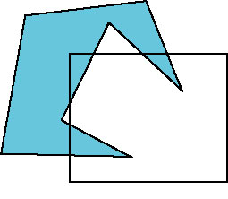
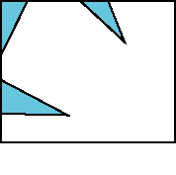
Polygon Clipping
Not as simple as line segment clipping
Clipping a line segment yields at most one line segment
Clipping a polygon can yield multiple polygons
However, clipping a convex polygon can yield at most one other polygon

Slide 27
Tessellation and Convexity
One strategy is to replace nonconvex (concave) polygons with a set of triangular polygons (a tessellation)
Also makes fill easier
Tessellation code in GLU library

Slide 28
Clipping as a Black Box
Can consider line segment clipping as a process that takes in two vertices and produces either no vertices or the vertices of a clipped line segment

Slide 29
Pipeline Clipping of Line Segments
Clipping against each side of window is independent of other sides
Can use four independent clippers in a pipeline

Slide 30
Pipeline Clipping of Polygons
Three dimensions: add front and back clippers
Strategy used in SGI Geometry Engine
Small increase in latency

Slide 31
Bounding Boxes
Rather than doing clipping on a complex polygon, we can use an axis-aligned bounding box or extent
Smallest rectangle aligned with axes that encloses the polygon
Simple to compute: max and min of x and y

Slide 32
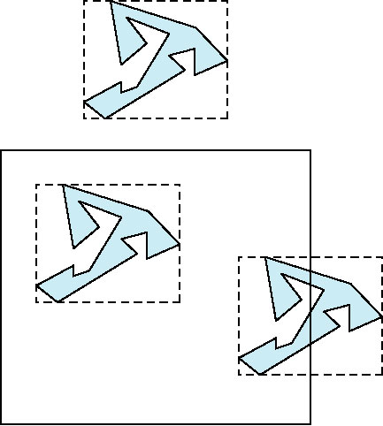
Bounding boxes
Can usually determine accept/reject based only on bounding box
reject
accept
requires detailed
clipping

Slide 33
Clipping and Visibility
Clipping has much in common with hidden-surface removal
In both cases, we are trying to remove objects that are not visible to the camera
Often we can use visibility or occlusion testing early in the process to eliminate as many polygons as possible before going through the entire pipeline

Slide 34
Hidden Surface Removal
Object-space approach: use pair-wise testing between polygons (objects)
Worst case complexity O(n²) for n polygons
partially obscuring
can draw independently

Slide 35
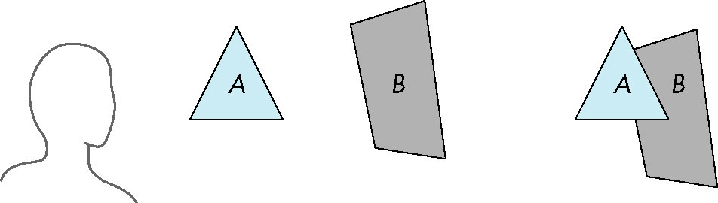
Painter’s Algorithm
Render polygons a back to front order so that polygons behind others are simply painted over
B behind A as seen by viewer
Fill B then A

Slide 36
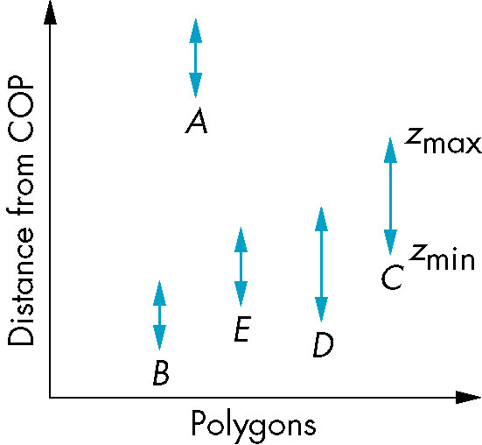
Depth Sort
Requires ordering of polygons first
O(n log n) calculation for ordering
Not every polygon is either in front or behind all other polygons
Order polygons and deal with
easy cases first, harder later
Polygons sorted by
distance from COP

Slide 37
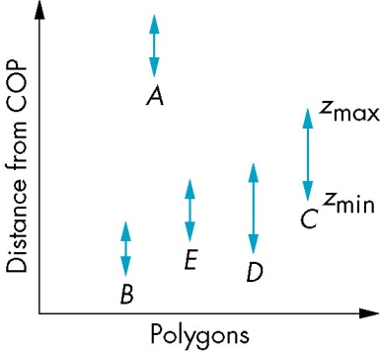
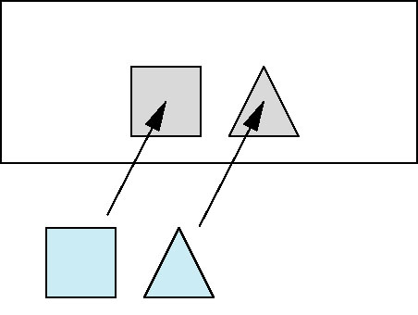
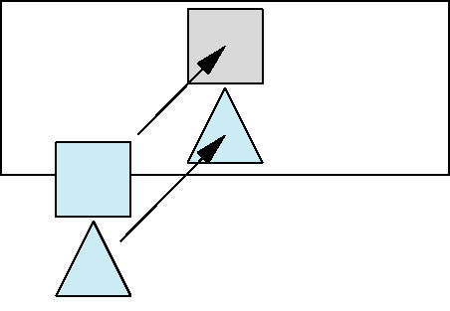
Easy Cases
A lies behind all other polygons
Can render
Polygons overlap in z but not in either x or y
Can render independently

Slide 38
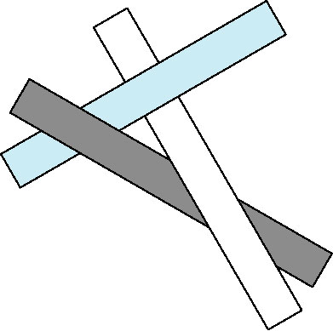
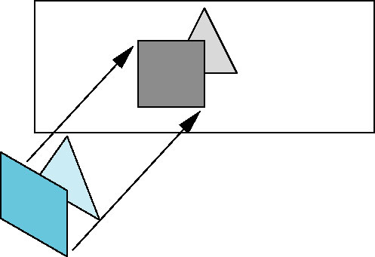
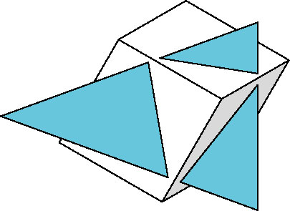
Hard Cases
cyclic overlap
Overlap in all directions
but one is fully on
one side of the other
penetration

Slide 39
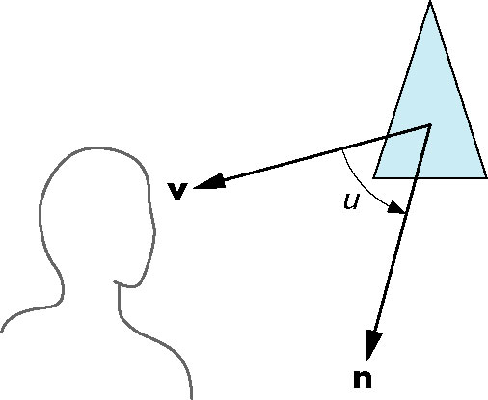
Back-Face Removal (Culling)
face is visible iff 90 ≥ θ ≥ -90
equivalently cos θ ≥ 0
or v • n ≥ 0
plane of face has form ax + by +cz +d =0
but after normalization n = ( 0 0 1 0)^{T}
need only test the sign of c
In OpenGL we can simply enable culling but may not work correctly if we have nonconvex objects

Slide 40
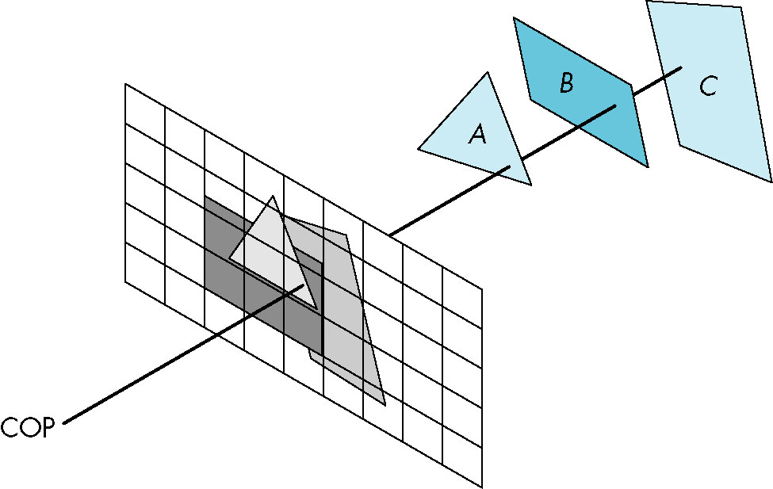
Image Space Approach
Look at each projector (nm for an n x m frame buffer) and find closest of k polygons
Complexity O(nmk)
Ray tracing
z-buffer

Slide 41
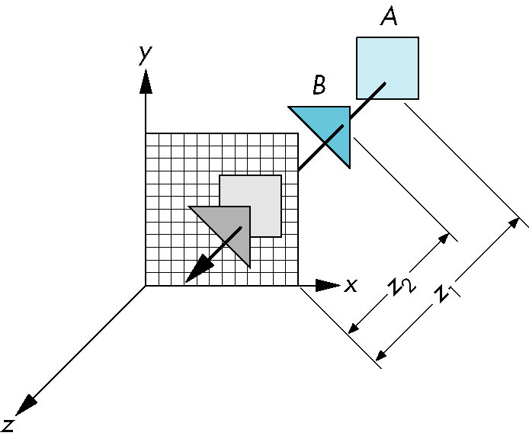
z-Buffer Algorithm
Use a buffer called the z or depth buffer to store the depth of the closest object at each pixel found so far
As we render each polygon, compare the depth of each pixel to depth in z buffer
If less, place shade of pixel in color buffer and update z buffer

Slide 42
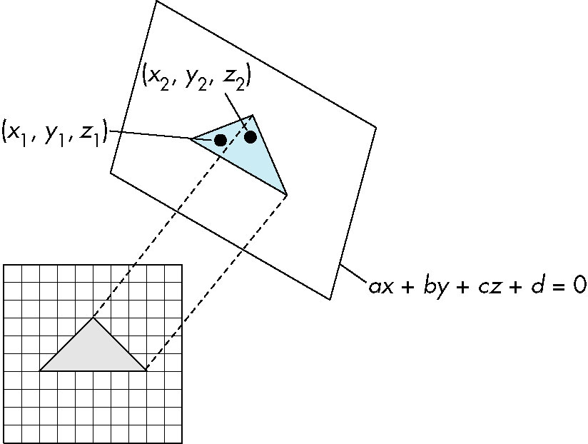
Efficiency
If we work scan line by scan line as we move across a scan line, the depth changes satisfy aΔx+bΔy+cΔz=0
Along scan line
Δy = 0
Δz = - Δx
In screen space Δx = 1

Slide 43
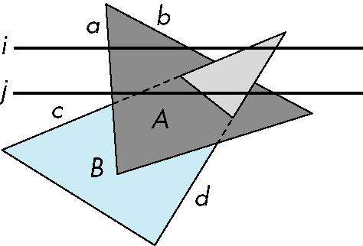
Scan-Line Algorithm
Can combine shading and hsr through scan line algorithm
scan line i: no need for depth
information, can only be in no
or one polygon
scan line j: need depth
information only when in
more than one polygon

Slide 44
Implementation
Need a data structure to store
Flag for each polygon (inside/outside)
Incremental structure for scan lines that stores which edges are encountered
Parameters for planes

Slide 45
Visibility Testing
In many real-time applications, such as games, we want to eliminate as many objects as possible within the application
Reduce burden on pipeline
Reduce traffic on bus
Partition space with Binary Spatial Partition (BSP) Tree

Slide 46
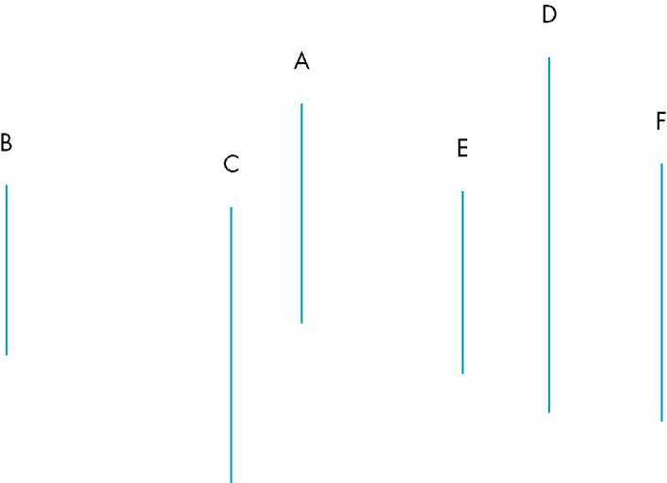
Simple Example
consider 6 parallel polygons
top view
The plane of A separates B and C from D, E and F

Slide 47
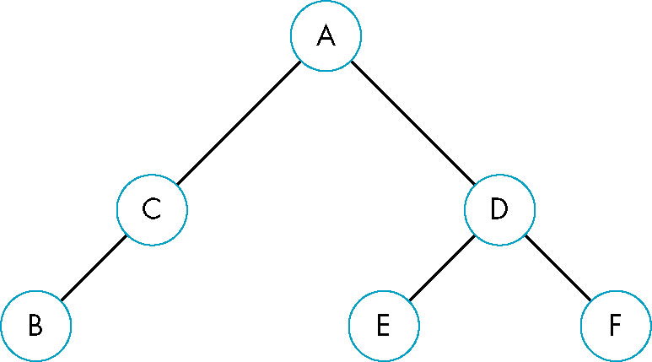
BSP Tree
Can continue recursively
Plane of C separates B from A
Plane of D separates E and F
Can put this information in a BSP tree
Use for visibility and occlusion testing

Slide 49
Part III Objectives
Survey Line Drawing Algorithms
DDA
Bresenham

Slide 50
Rasterization
Rasterization (scan conversion)
Determine which pixels that are inside primitive specified by a set of vertices
Produces a set of fragments
Fragments have a location (pixel location) and other attributes such color and texture coordinates that are determined by interpolating values at vertices
Pixel colors determined later using color, texture, and other vertex properties

Slide 51
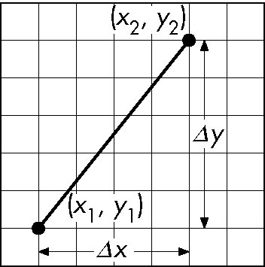
Scan Conversion of Line Segments
Start with line segment in window coordinates with integer values for endpoints
Assume implementation has a write_pixel function
y = mx + h

Slide 52
DDA Algorithm
Digital Differential Analyzer
DDA was a mechanical device for numerical solution of differential equations
Line y=mx+ h satisfies differential equation
dy/dx = m = Δy/Δx = y₂-y₁/x₂-x₁
Along scan line Δx = 1
For(x=x1; x<=x2,ix++) {
y+=m;
write_pixel(x, round(y), line_color)
}

Slide 53
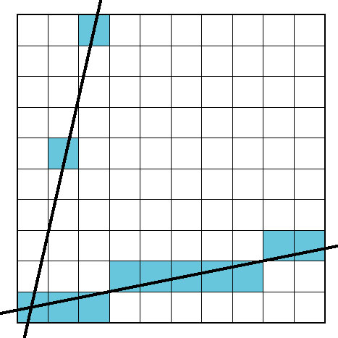
Problem
DDA = for each x plot pixel at closest y
Problems for steep lines

Slide 54
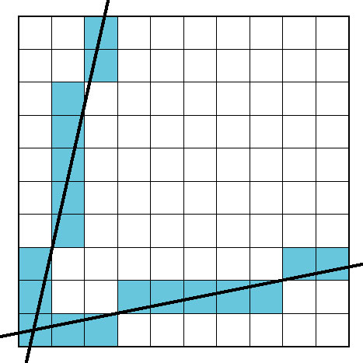
Using Symmetry
Use for 1 ≥ m ≥ 0
For m > 1, swap role of x and y
For each y, plot closest x

Slide 55
Bresenham’s Algorithm
DDA requires one floating point addition per step
We can eliminate all fp through Bresenham’s algorithm
Consider only 1 ≥ m ≥ 0
Other cases by symmetry
Assume pixel centers are at half integers
If we start at a pixel that has been written, there are only two candidates for the next pixel to be written into the frame buffer

Slide 56
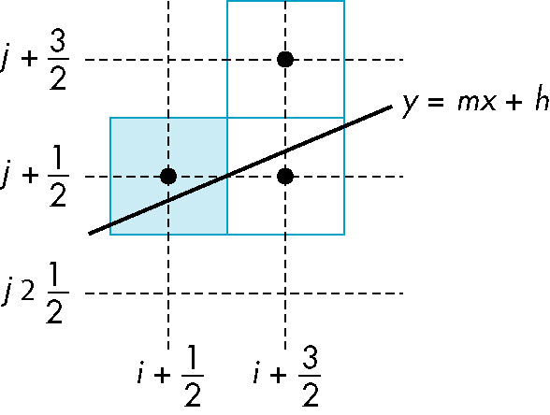
Candidate Pixels
1 ≥ m ≥ 0
candidates
last pixel
Note that line could have
passed through any
part of this pixel

Slide 57
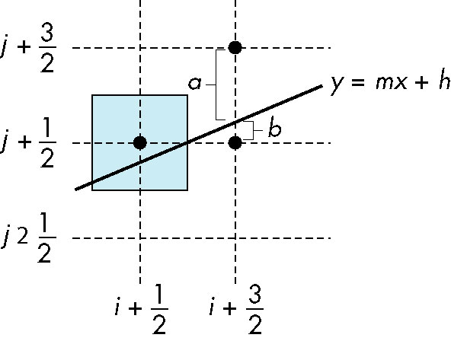
Decision Variable
d = Δx(b-a)
d is an integer
d > 0 use upper pixel
d < 0 use lower pixel

Slide 58
Incremental Form
More efficient if we look at d_{k}, the value of the decision variable at x = k
For each x, we need do only an integer addition and a test
Single instruction on graphics chips
d_{k+1}= d_{k} –2Δy, if d_{k} <0
d_{k+1}= d_{k} –2(Δy- Δx), otherwise

Slide 59
Polygon Scan Conversion
Scan Conversion = Fill
How to tell inside from outside
Convex easy
Nonsimple difficult
Odd even test
Count edge crossings
Winding number
odd-even fill

Slide 60
Winding Number
Count clockwise encirclements of point
Alternate definition of inside: inside if winding number ≠ 0
winding number = 1
winding number = 2

Slide 61
Filling in the Frame Buffer
Fill at end of pipeline
Convex Polygons only
Nonconvex polygons assumed to have been tessellated
Shades (colors) have been computed for vertices (Gouraud shading)
Combine with z-buffer algorithm
March across scan lines interpolating shades
Incremental work small

Slide 62
Using Interpolation
C₁ C₂ C₃ specified by glColor or by vertex shading
C₄ determined by interpolating between C₁ and C₂
C₅ determined by interpolating between C₂ and C₃
interpolate between C₄ and C₅ along span
C₁
C₄
C₂
scan line
C₅
span
C₃

Slide 63
Flood Fill
Fill can be done recursively if we know a seed point located inside (WHITE)
Scan convert edges into buffer in edge/inside color (BLACK)
flood_fill(int x, int y) {
if(read_pixel(x,y)= = WHITE) {
write_pixel(x,y,BLACK);
flood_fill(x-1, y);
flood_fill(x+1, y);
flood_fill(x, y+1);
flood_fill(x, y-1);
} }

Slide 64
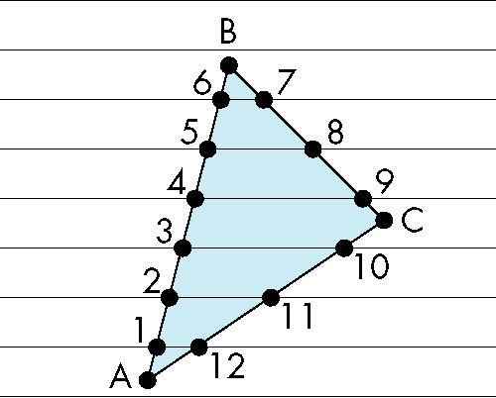
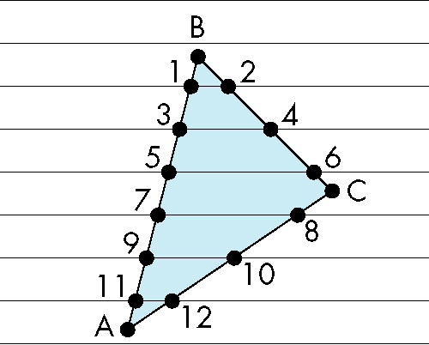
Scan Line Fill
Can also fill by maintaining a data structure of all intersections of polygons with scan lines
Sort by scan line
Fill each span
vertex order generated
by vertex list
desired order

Slide 65
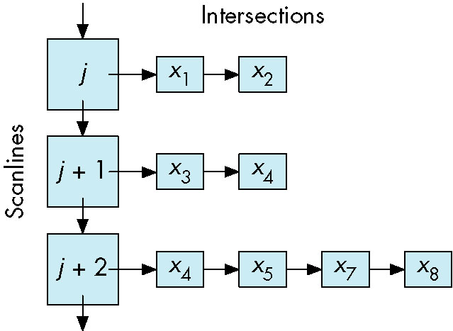
Data Structure

Slide 66
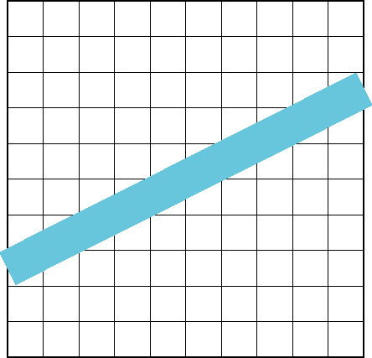
Aliasing
Ideal rasterized line should be 1 pixel wide
Choosing best y for each x (or visa versa) produces aliased raster lines

Slide 67
Antialiasing by Area Averaging
Color multiple pixels for each x depending on coverage by ideal line
original
antialiased
magnified

Slide 68
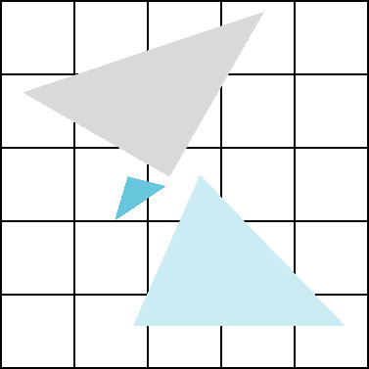
Polygon Aliasing
Aliasing problems can be serious for polygons
Jaggedness of edges
Small polygons neglected
Need compositing so color
of one polygon does not
totally determine color of
pixel
All three polygons should contribute to color

