Slide 1
CS 480/680
Computer Graphics
What is Computer Graphics
Dr. Frederick C Harris, Jr.

Slide 2
Objectives
In this lecture, we explore what computer graphics is about and survey some application areas
We start with a historical introduction

Slide 3
Computer Graphics
So, What is Computer Graphics?
Computer graphics deals with all aspects of creating images with a computer
Hardware
Software
Applications

Slide 4
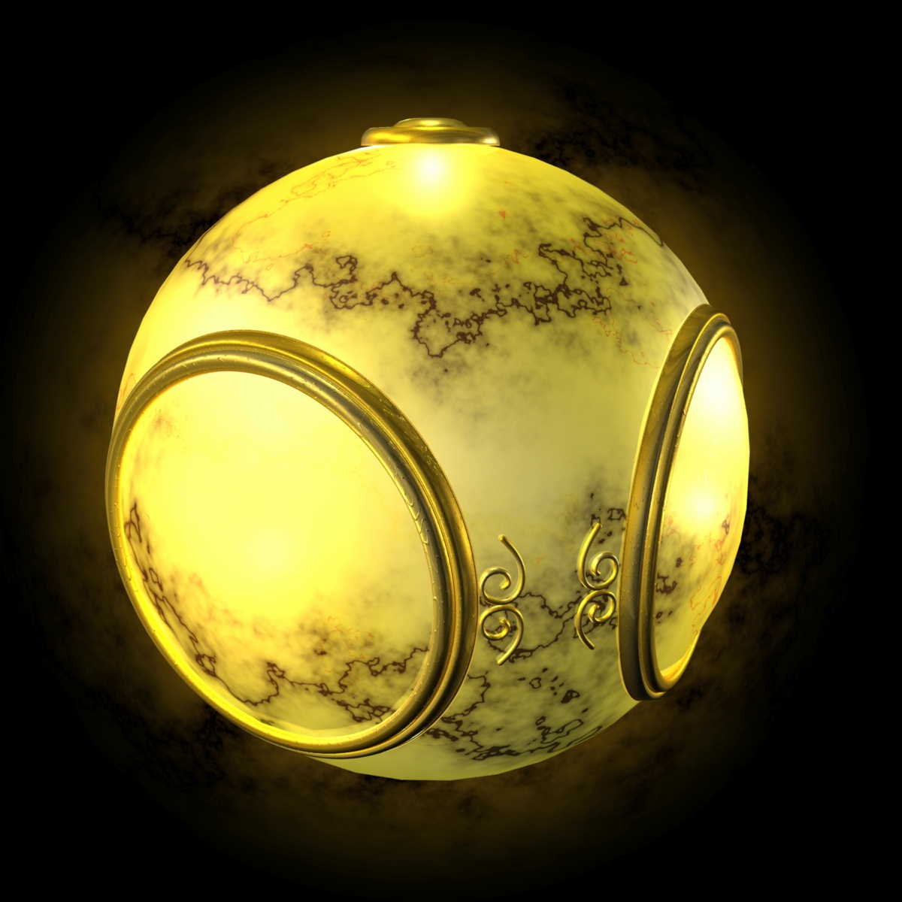
Example
Where did this image come from?
What hardware/software did we need to produce it?

Slide 5
Preliminary Answer
Application:
The object is an artist’s rendition of the sun for an animation to be shown in a domed environment (planetarium)
Software:
Maya for modeling and rendering but Maya is built on top of OpenGL
Hardware:
PC with graphics card for modeling and rendering

Slide 6
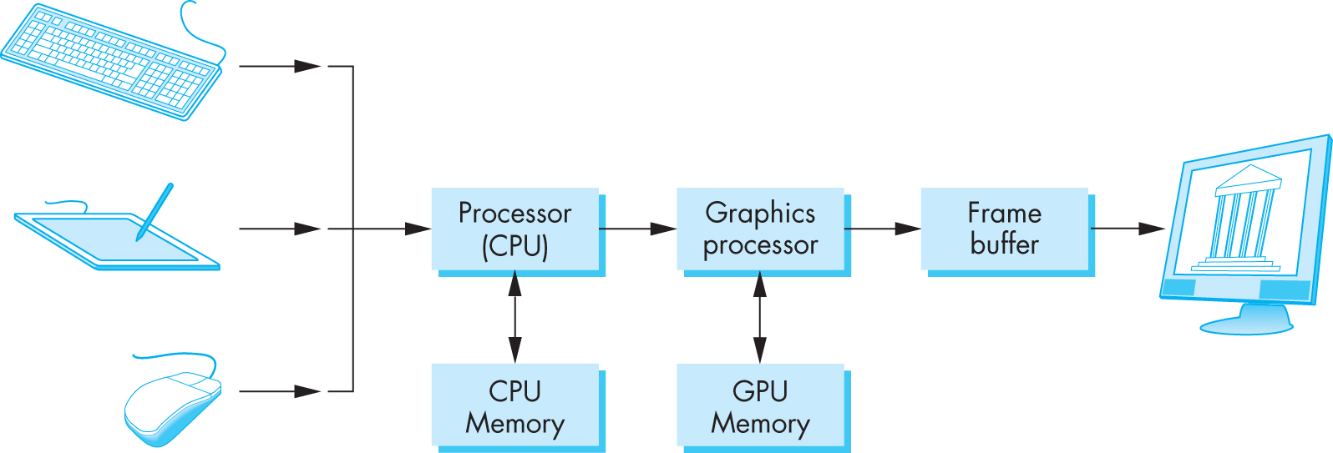
Basic Graphics System
Image formed in frame buffer
Input devices
Output device

Slide 7
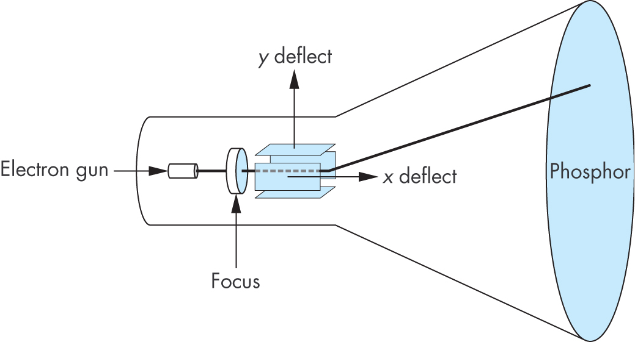
CRT
Can be used either as a line-drawing device (calligraphic) or to display contents of frame buffer (raster mode)

Slide 8
Computer Graphics: 1950-1960
Computer graphics goes back to the earliest days of computing
Strip charts
Pen plotters
Simple displays using A/D converters to go from computer to calligraphic CRT
Cost of refresh for CRT too high
Computers slow, expensive, unreliable

Slide 9
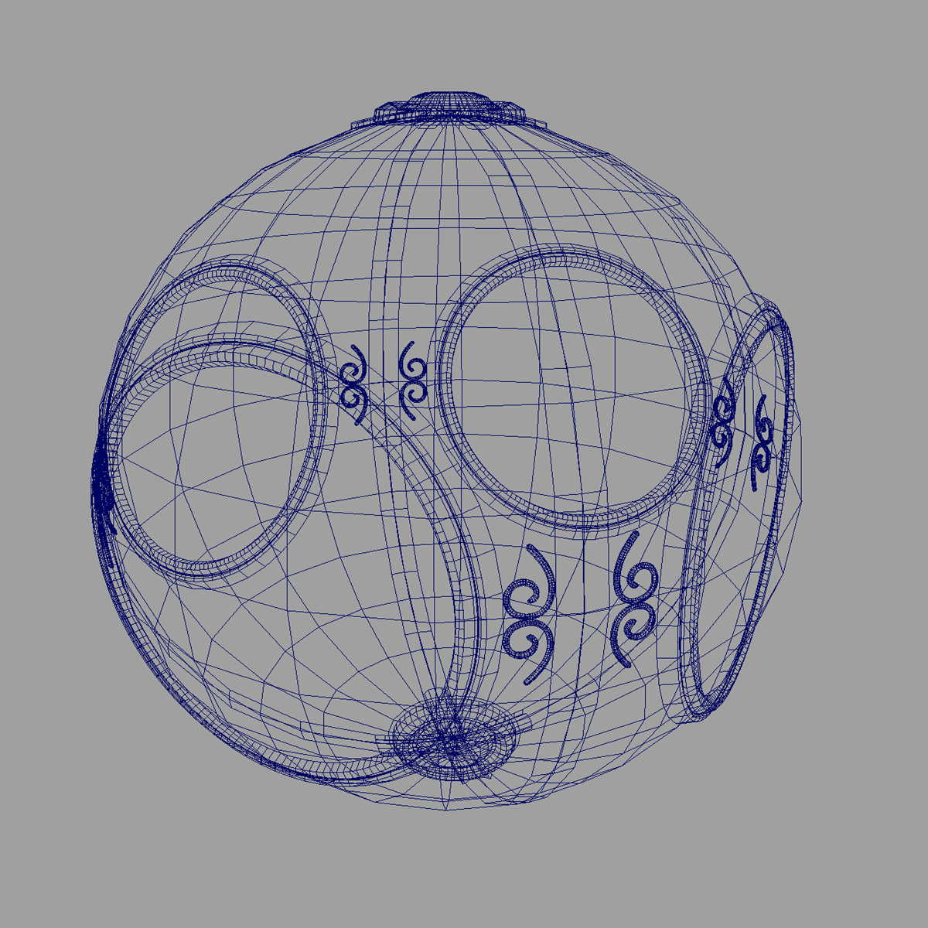
Computer Graphics: 1960-1970
Wireframe graphics
Draw only lines
Sketchpad
Display Processors
Storage tube

Slide 10
Sketchpad
Ivan Sutherland’s PhD thesis at MIT
Recognized the potential of man-machine interaction
Loop
Display something
User moves light pen
Computer generates new display
Sutherland also created many of the now common algorithms for computer graphics

Slide 11
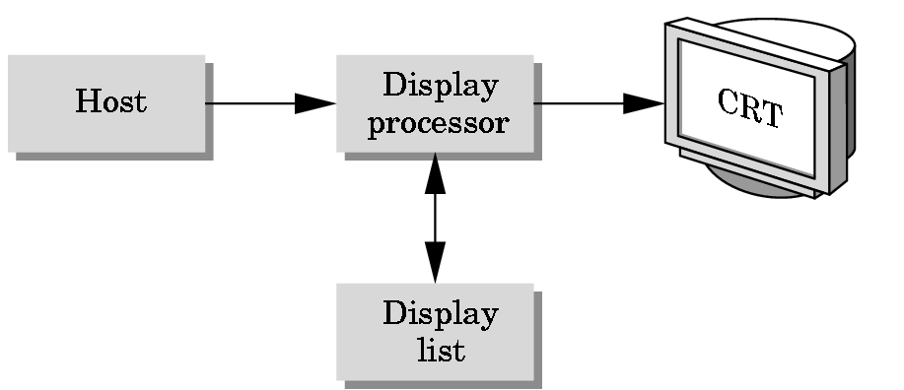
Display Processor
Rather than have the host computer try to refresh display use a special purpose computer called a display processor (DPU)
Graphics stored in display list (display file) on display processor
Host compiles display list and sends to DPU

Slide 12
Direct View Storage Tube
Created by Tektronix
Did not require constant refresh
Standard interface to computers
Allowed for standard software
Plot3D in Fortran
Relatively inexpensive
Opened door to use of computer graphics for CAD community

Slide 13
Computer Graphics: 1970-1980
Raster Graphics
Beginning of graphics standards
IFIPS
GKS: European effort
Becomes ISO 2D standard
Core: North American effort
3D but fails to become ISO standard
Workstations and PCs

Slide 14
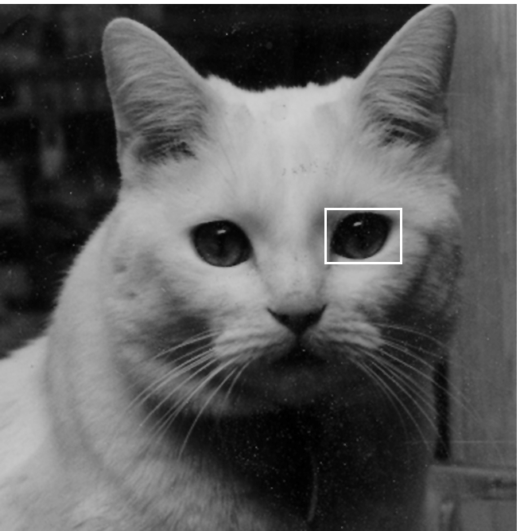
Raster Graphics
Image produced as an array (the raster) of picture elements (pixels) in the frame buffer

Slide 15
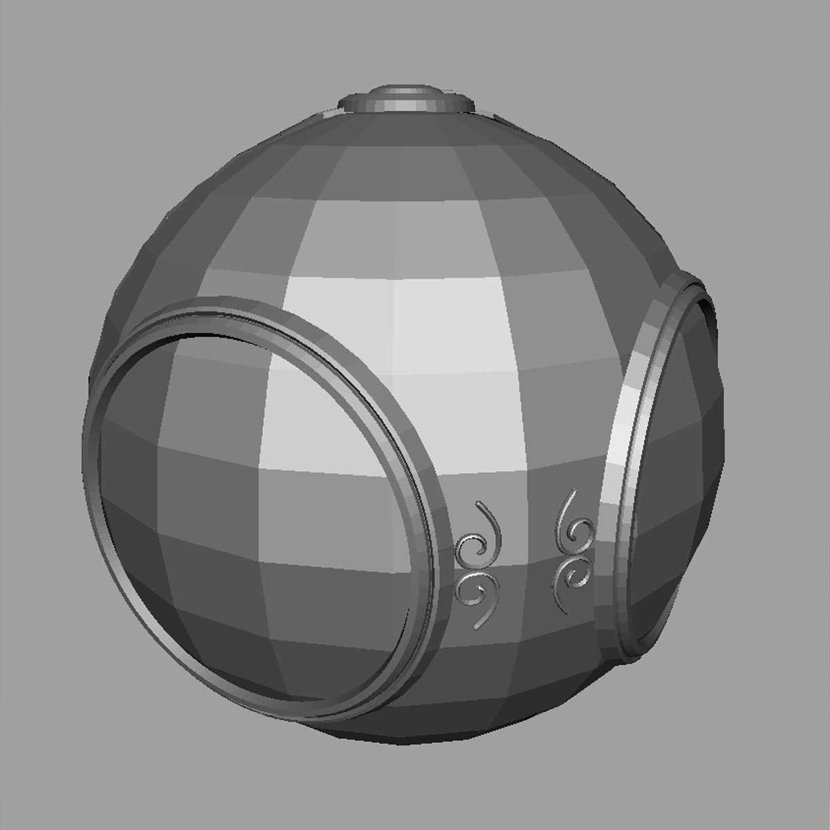
Raster Graphics
Allows us to go from lines and wire frame images to filled polygons

Slide 16
PCs and Workstations
Although we no longer make the distinction between workstations and PCs, historically they evolved from different roots
Early workstations characterized by
Networked connection: client-server model
High-level of interactivity
Early PCs included frame buffer as part of user memory
Easy to change contents and create images

Slide 17
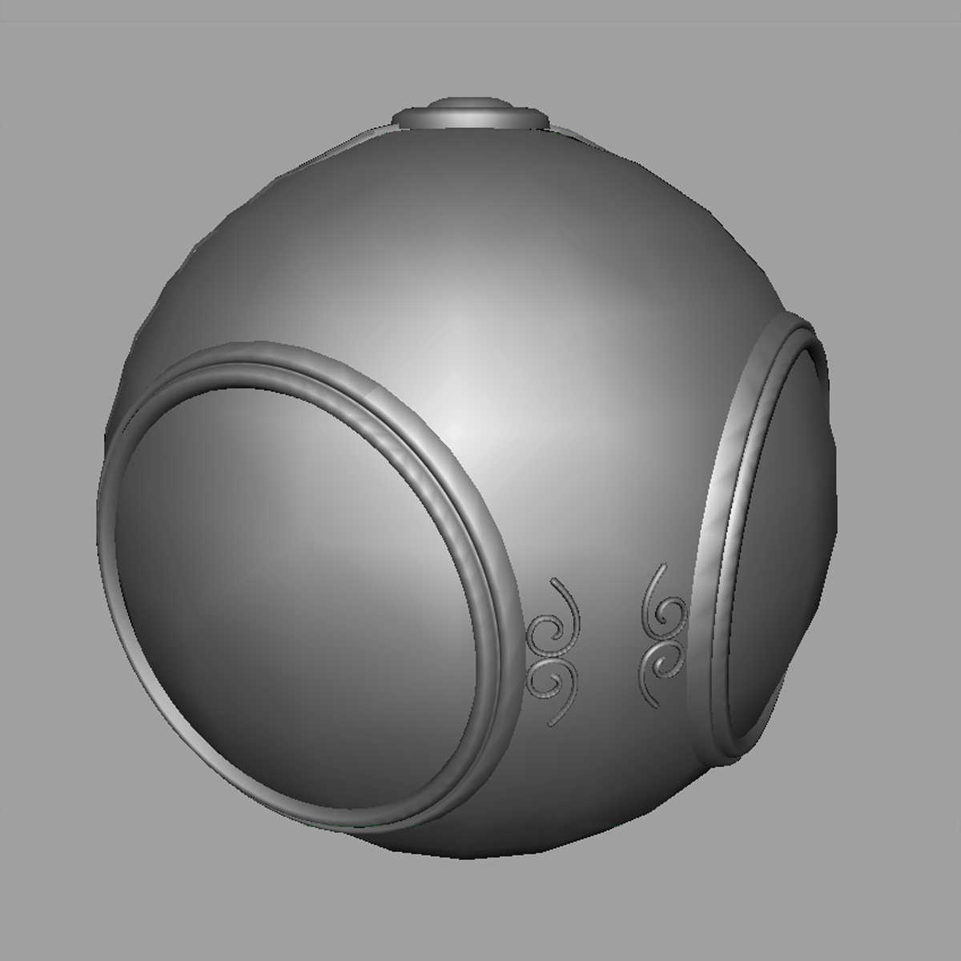
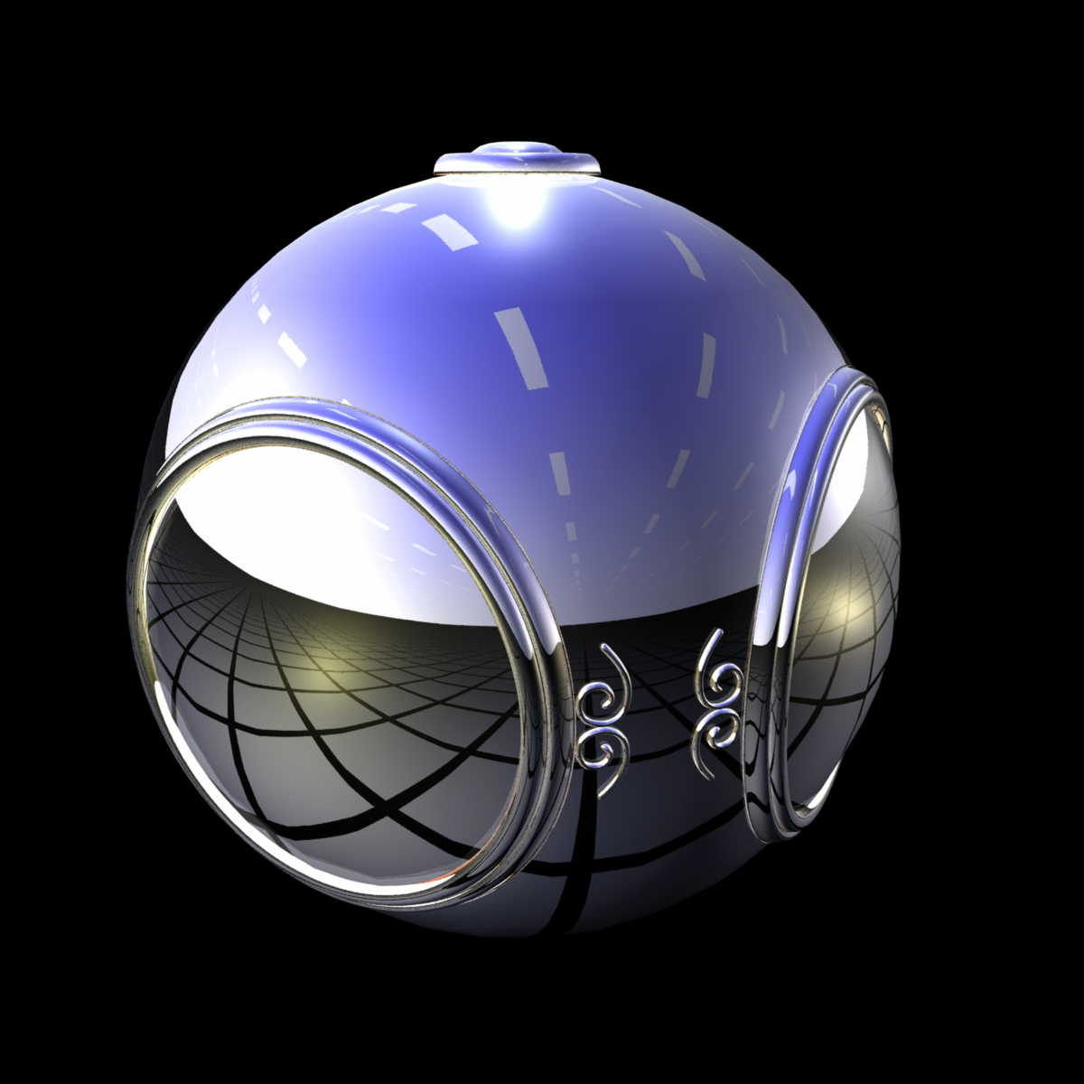
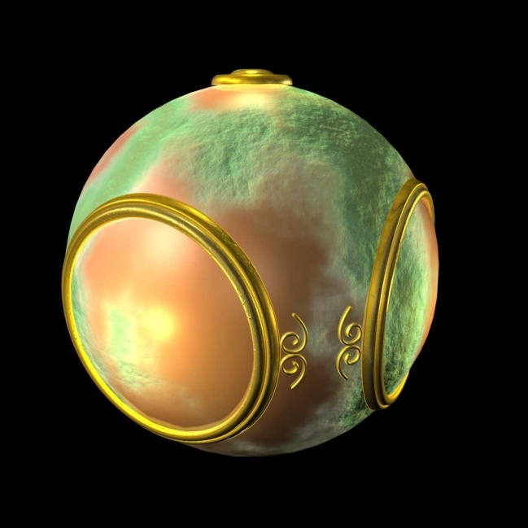
Computer Graphics: 1980-1990
Realism comes to computer graphics
smooth shading
environment
mapping
bump mapping

Slide 18
Computer Graphics: 1980-1990
Special purpose hardware
Silicon Graphics geometry engine
VLSI implementation of graphics pipeline
Industry-based standards
PHIGS
RenderMan
Networked graphics: X Window System
Human-Computer Interface (HCI)

Slide 19
Computer Graphics: 1990-2000
OpenGL API
Completely computer-generated feature-length movies (Toy Story) are successful
New hardware capabilities
Texture mapping
Blending
Accumulation, stencil buffers

Slide 20
Computer Graphics: 2000-
Photorealism
Graphics cards for PCs dominate market
Nvidia, ATI
Game boxes and game players determine direction of market
Computer graphics routine in movie industry: Maya, Lightwave
Programmable pipelines

Slide 21
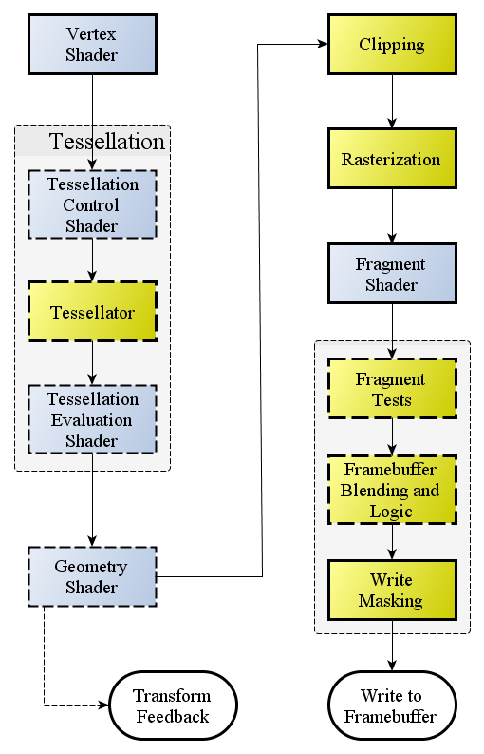
The Rendering Pipeline
The OpenGL rendering pipeline works in the following order:
Get vertices, in a specific ordered sequence.
Vertex processing via Vertex Shader. Each vertex in the stream is processed in turn into an output vertex.
Optional primitive tessellation stages.
Primitive assembly and optional Geometry Shader primitive processing. The output is a sequence of primitives.
Primitive clipping, and culling.
Scan conversion and primitive parameter interpolation.
The data for each fragment is processed with a Fragment Shader. Each fragment generates a number of outputs.
Per-sample blending, depth, and stencil operations.

Slide 23
Review…
What is Computer Graphics
Why is Ivan Sutherland famous?
What else did we cover?

Slide 24
Objectives
Fundamental imaging notions
Physical basis for image formation
Light
Color
Perception
Synthetic camera model
Other models

Slide 25
Image Formation
In computer graphics, we form images which are generally two dimensional using a process analogous to how images are formed by physical imaging systems
Cameras
Microscopes
Telescopes
Human visual system

Slide 26
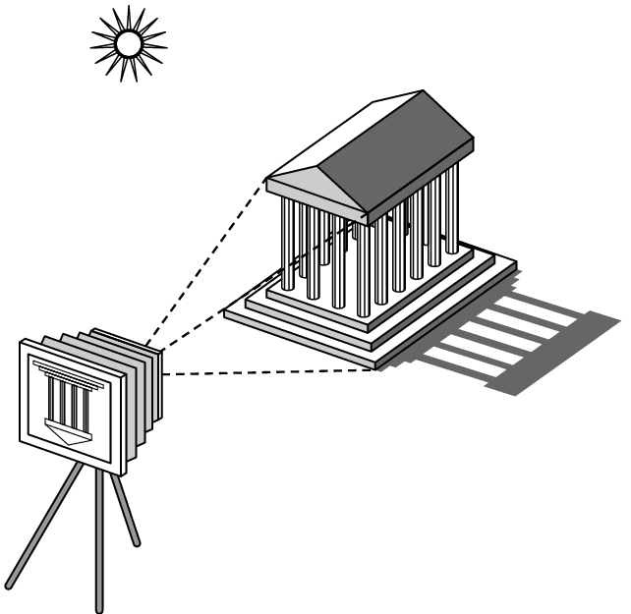
Elements of Image Formation
Objects
Viewer
Light source(s)
Attributes that govern how light interacts with the materials in the scene
Note the independence of the objects, the viewer, and the light source(s)

Slide 27
Light
Light is the part of the electromagnetic spectrum that causes a reaction in our visual systems
Generally these are wavelengths in the range of about 350-750 nm (nanometers)
Long wavelengths appear as reds and short wavelengths as blues

Slide 28
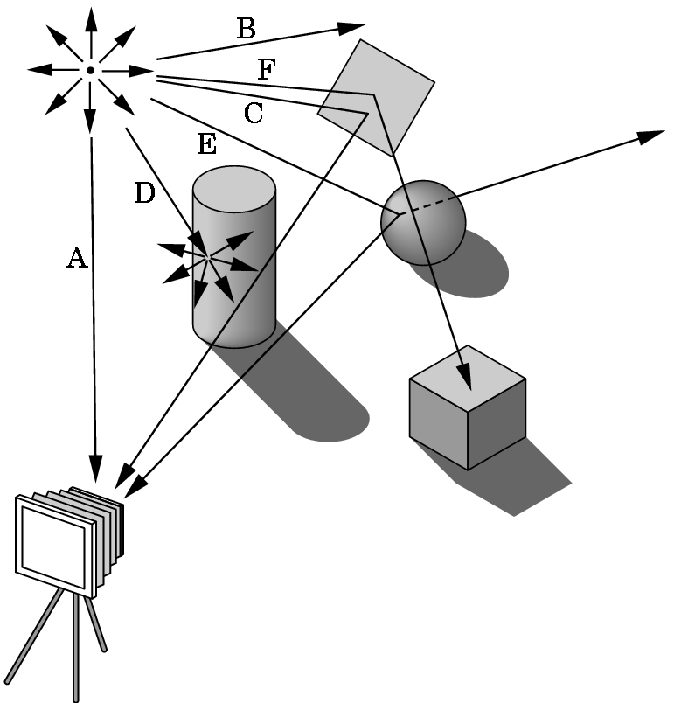
Ray Tracing and Geometric Optics
One way to form an image is to
follow rays of light from a
point source finding which
rays enter the lens of the
camera. However, each
ray of light may have
multiple interactions with objects
before being absorbed or going to infinity.

Slide 29
Luminance and Color Images
Luminance Image
Monochromatic
Values are gray levels
Analogous to working with black and white film or television
Color Image
Has perceptional attributes of hue, saturation, and lightness
Do we have to match every frequency in visible spectrum? No!

Slide 30
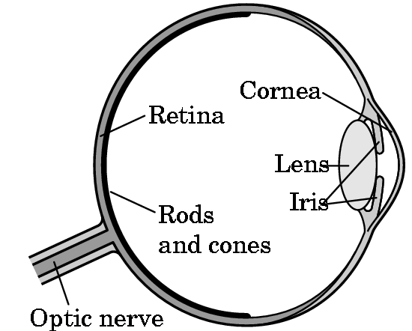
Three-Color Theory
Human visual system has two types of sensors
Rods: monochromatic, night vision
Cones
Color sensitive
Three types of cones
Only three values
(the tristimulus values) are sent to the brain
Need only match these three values
Need only three primary colors

Slide 31
Additive Color
Additive color
Form a color by adding amounts of three primaries
CRTs, projection systems, positive film
Primaries are Red (R), Green (G), Blue (B)

Slide 32
Subtractive Color
Subtractive color
Form a color by filtering white light with Cyan (C), Magenta (M), and Yellow (Y) filters
Light-material interactions
Printing
Negative film

Slide 33
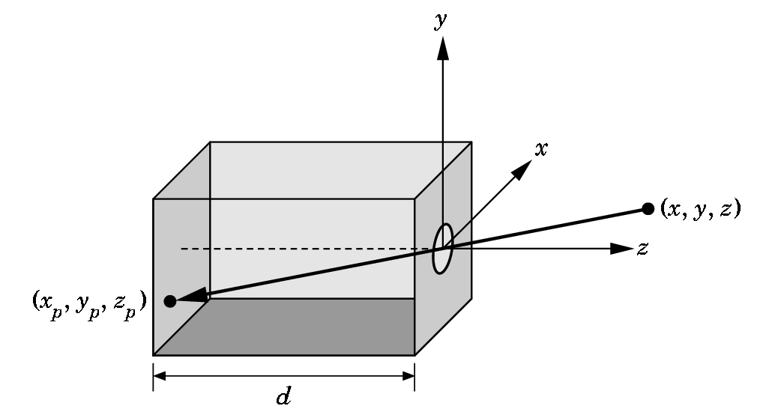
Pinhole Camera
Use trigonometry to find projection of point at (x,y,z)
x_{p}= -x/z/d
y_{p}= -y/z/d
z_{p}= d
These are equations of simple perspective

Slide 34
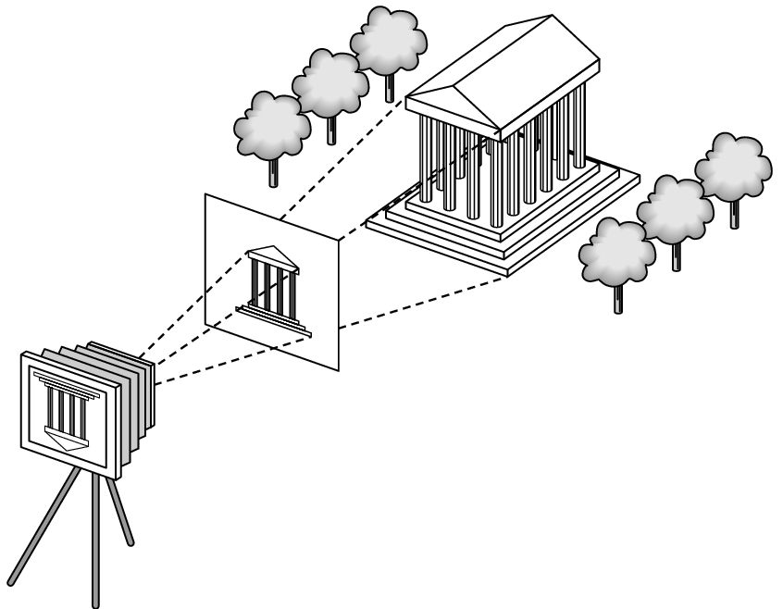
Synthetic Camera Model
projector
p
image plane
projection of p
center of projection

Slide 35
Advantages
Separation of objects, viewer, light sources
Two-dimensional graphics is a special case of three-dimensional graphics
Leads to simple software API
Specify objects, lights, camera, attributes
Let implementation determine image
Leads to fast hardware implementation

Slide 36
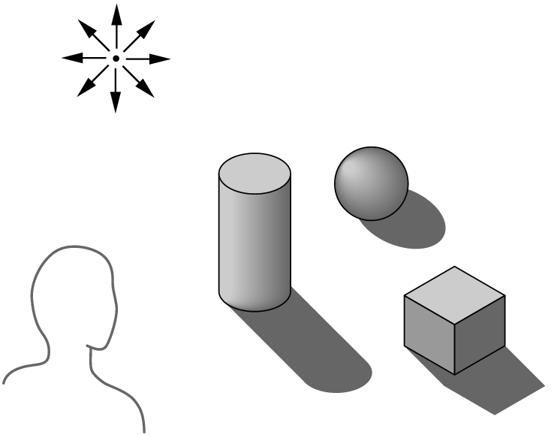
Global vs Local Lighting
Cannot compute color or shade of each object independently
Some objects are blocked from light
Light can reflect from object to object
Some objects might be translucent

Slide 37
Why not ray tracing?
Ray tracing seems more physically based so why don’t we use it to design a graphics system?
Possible and is actually simple for simple objects such as polygons and quadrics with simple point sources
In principle, can produce global lighting effects such as shadows and multiple reflections but ray tracing is slow and not well-suited for interactive applications
Ray tracing with GPUs is close to real time

Slide 39
API Contents
Functions that specify what we need to form an image
Objects
Viewer
Light Source(s)
Materials
Other information
Input from devices such as mouse and keyboard
Capabilities of system

Slide 40
Object Specification
Most APIs support a limited set of primitives including
Points (0D object)
Line segments (1D objects)
Polygons (2D objects)
Some curves and surfaces
Quadrics
Parametric polynomials
All are defined through locations in space or vertices

Slide 41
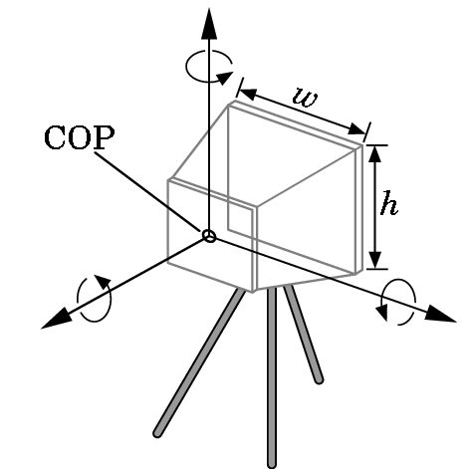
Camera Specification
Six degrees of freedom
Position of center of lens
Orientation
Lens
Film size
Orientation of film plane

Slide 42
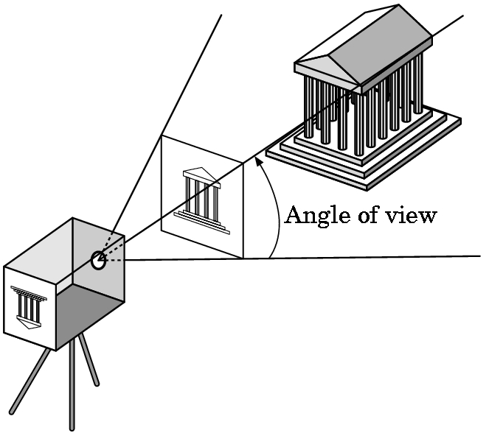
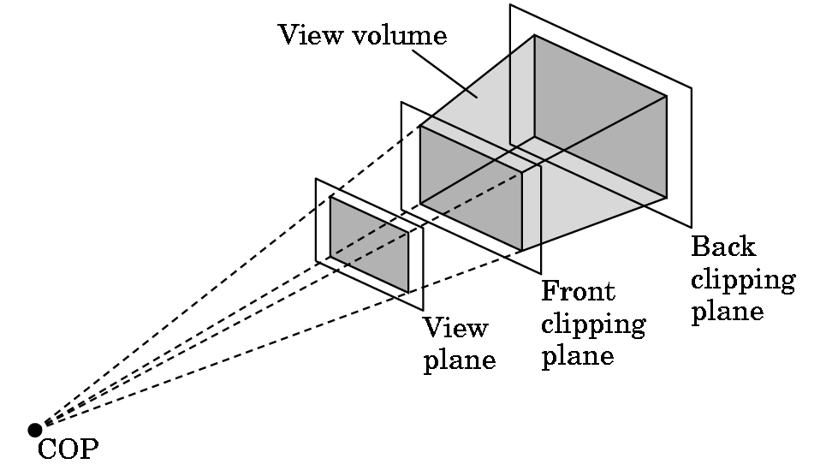
Clipping
Just as a real camera cannot “see” the whole world, the virtual camera can only see part of the world or object space
Objects that are not within this volume are said to be clipped out of the scene

Slide 43
Lights and Materials
Types of lights
Point sources vs distributed sources
Spot lights
Near and far sources
Color properties
Material properties
Absorption: color properties
Scattering
Diffuse
Specular

