Slide 1
CS 480/680
Computer Graphics
Image Formation
Dr. Frederick C Harris, Jr.

Slide 2
From last time…
What is Computer Graphics
Why is Ivan Sutherland famous?
What else did we cover?

Slide 3
Objectives
Fundamental imaging notions
Physical basis for image formation
Light
Color
Perception
Synthetic camera model
Other models

Slide 4
Image Formation
In computer graphics, we form images which are generally two dimensional using a process analogous to how images are formed by physical imaging systems
Cameras
Microscopes
Telescopes
Human visual system

Slide 5
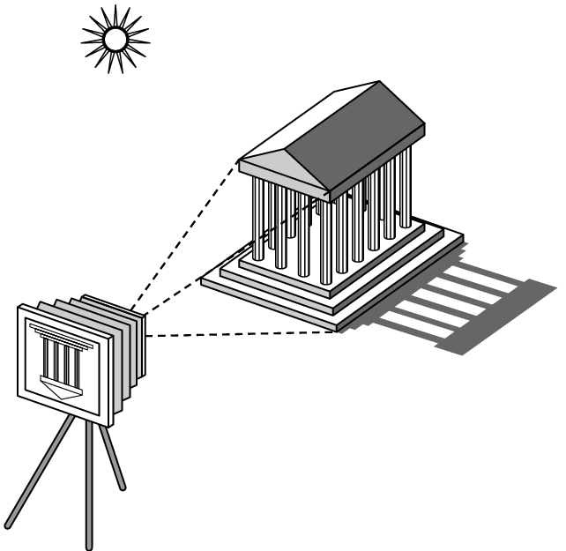
Elements of Image Formation
Objects
Viewer
Light source(s)
Attributes that govern how light interacts with the materials in the scene
Note the independence of the objects, the viewer, and the light source(s)

Slide 6
Light
Light is the part of the electromagnetic spectrum that causes a reaction in our visual systems
Generally these are wavelengths in the range of about 350-750 nm (nanometers)
Long wavelengths appear as reds and short wavelengths as blues

Slide 7
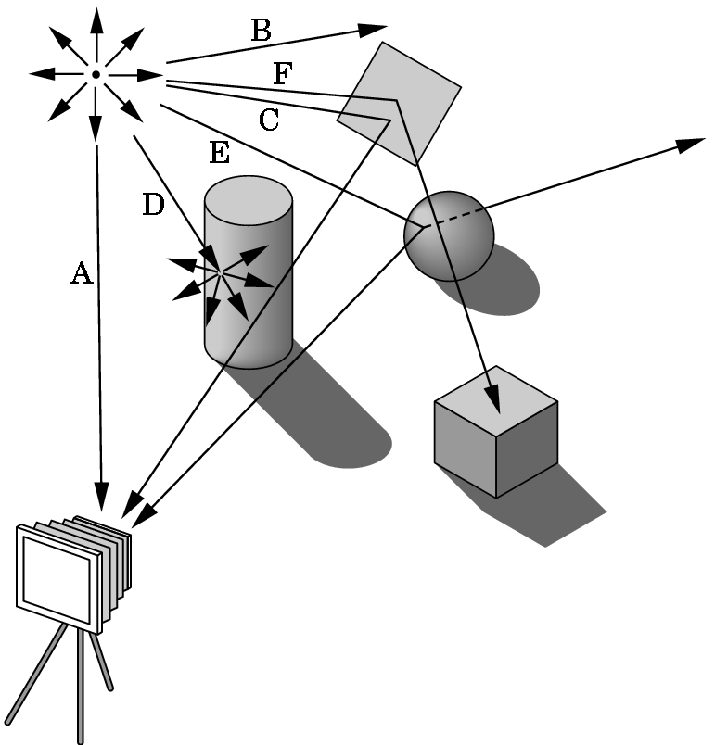
Ray Tracing and Geometric Optics
One way to form an image is to
follow rays of light from a
point source finding which
rays enter the lens of the
camera. However, each
ray of light may have
multiple interactions with objects
before being absorbed or going to infinity.

Slide 8
Luminance and Color Images
Luminance Image
Monochromatic
Values are gray levels
Analogous to working with black and white film or television
Color Image
Has perceptional attributes of hue, saturation, and lightness
Do we have to match every frequency in visible spectrum? No!

Slide 9
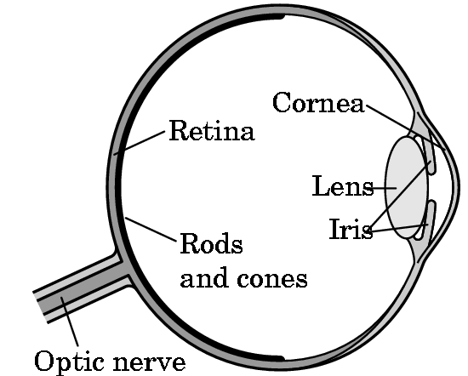
Three-Color Theory
Human visual system has two types of sensors
Rods: monochromatic, night vision
Cones
Color sensitive
Three types of cones
Only three values
(the tristimulus values) are sent to the brain
Need only match these three values
Need only three primary colors

Slide 10
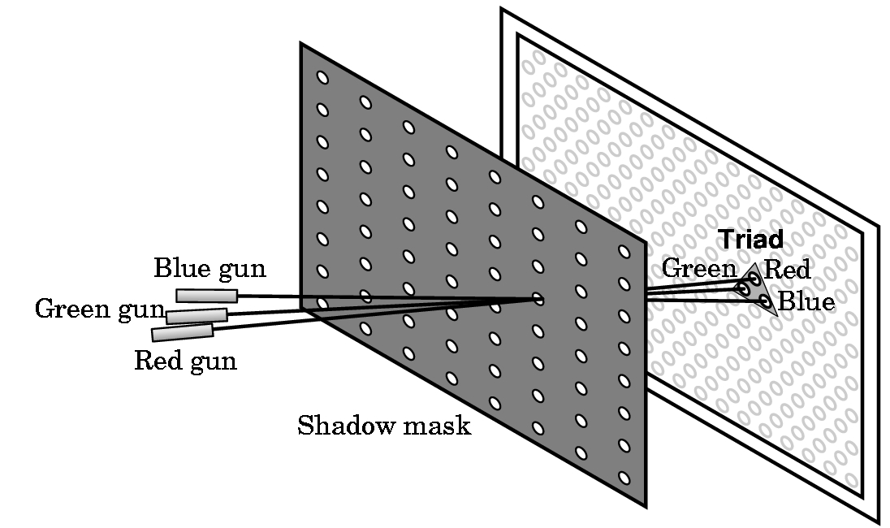
Shadow Mask CRT

Slide 11
Additive Color
Additive color
Form a color by adding amounts of three primaries
CRTs, projection systems, positive film
Primaries are Red (R), Green (G), Blue (B)

Slide 12
Subtractive Color
Subtractive color
Form a color by filtering white light with Cyan (C), Magenta (M), and Yellow (Y) filters
Light-material interactions
Printing
Negative film

Slide 13
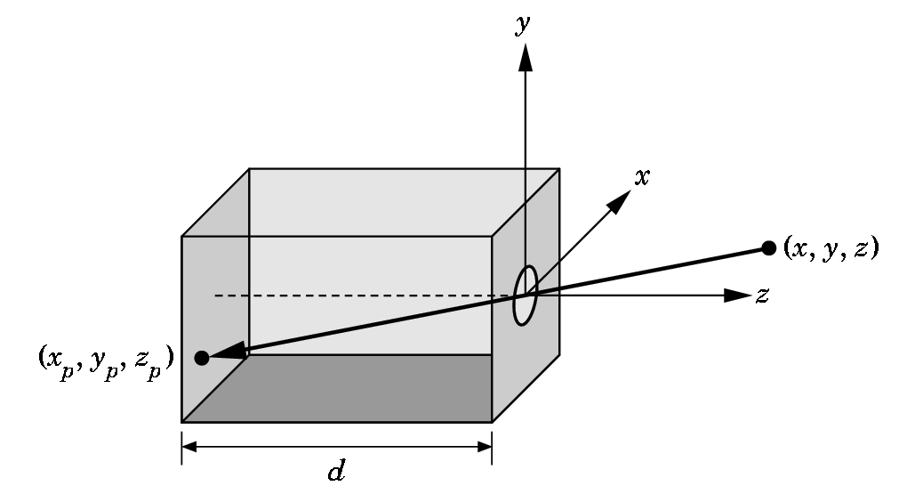
Pinhole Camera
Use trigonometry to find projection of point at (x,y,z)
x_{p}= -x/z/d
y_{p}= -y/z/d
z_{p}= d
These are equations of simple perspective

Slide 14
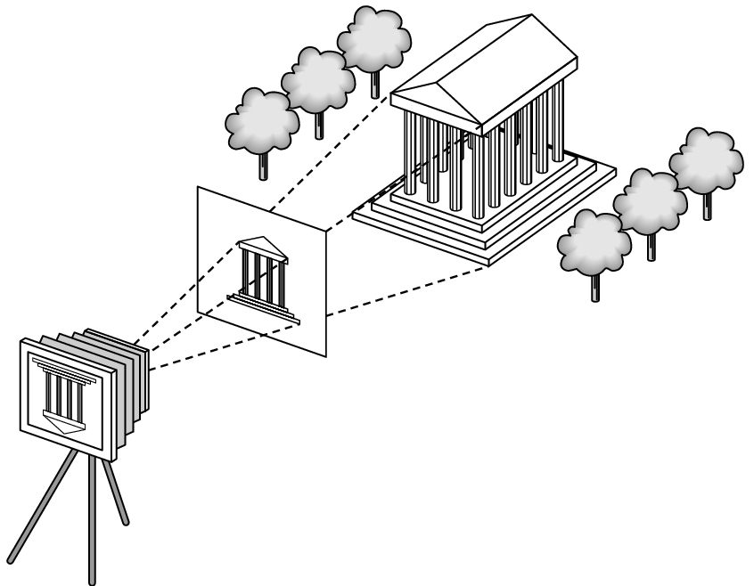
Synthetic Camera Model
projector
p
image plane
projection of p
center of projection

Slide 15
Advantages
Separation of objects, viewer, light sources
Two-dimensional graphics is a special case of three-dimensional graphics
Leads to simple software API
Specify objects, lights, camera, attributes
Let implementation determine image
Leads to fast hardware implementation

Slide 16
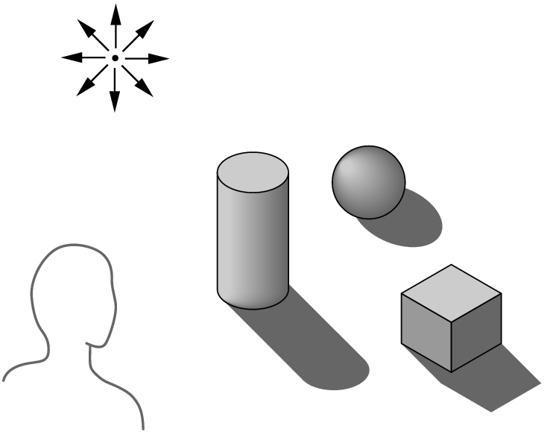
Global vs Local Lighting
Cannot compute color or shade of each object independently
Some objects are blocked from light
Light can reflect from object to object
Some objects might be translucent

Slide 17
Why not ray tracing?
Ray tracing seems more physically based so why don’t we use it to design a graphics system?
Possible and is actually simple for simple objects such as polygons and quadrics with simple point sources
In principle, can produce global lighting effects such as shadows and multiple reflections but ray tracing is slow and not well-suited for interactive applications
Ray tracing with GPUs is close to real time

Slide 19
Models and Architecture: Objectives
Learn the basic design of a graphics system
Introduce pipeline architecture
Examine software components for an interactive graphics system

Slide 20
Image Formation Revisited
Can we mimic the synthetic camera model to design graphics hardware software?
Application Programmer Interface (API)
Need only specify
Objects
Materials
Viewer
Lights
But how is the API implemented?

Slide 21
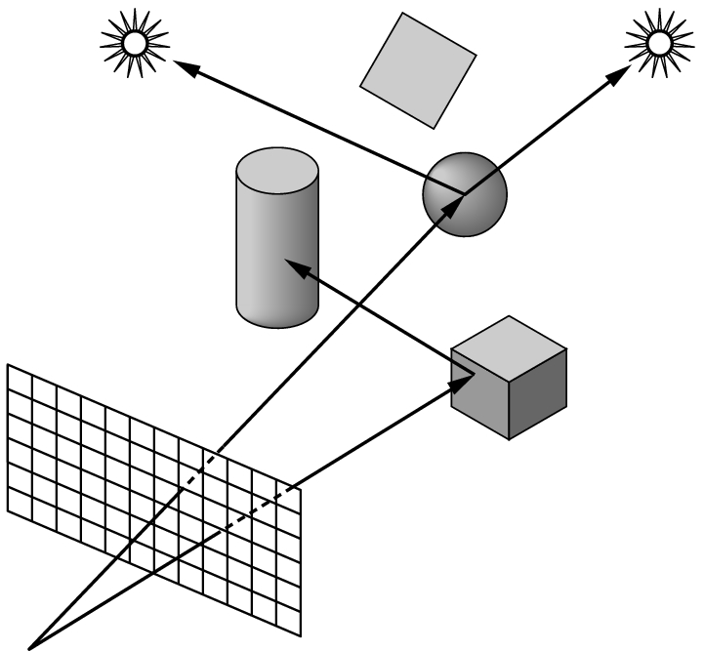
Physical Approaches
Ray tracing: follow rays of light from center of projection until they either are absorbed by objects or go off to infinity
Can handle global effects
Multiple reflections
Translucent objects
Slow
Must have whole data base
available at all times
Radiosity: Energy based approach
Very slow

Slide 22
Practical Approach
Process objects one at a time in the order they are generated by the application
Can consider only local lighting
Pipeline architecture
All steps can be implemented in hardware on the graphics card
application
program
display

Slide 23
Vertex Processing
Much of the work in the pipeline is in converting object representations from one coordinate system to another
Object coordinates
Camera (eye) coordinates
Screen coordinates
Every change of coordinates is equivalent to a matrix transformation
Vertex processor also computes vertex colors

Slide 24
Projection
Projection is the process that combines the 3D viewer with the 3D objects to produce the 2D image
Perspective projections: all projectors meet at the center of projection
Parallel projection: projectors are parallel, center of projection is replaced by a direction of projection

Slide 25
Primitive Assembly
Vertices must be collected into geometric objects before clipping and rasterization can take place
Line segments
Polygons
Curves and surfaces

Slide 26
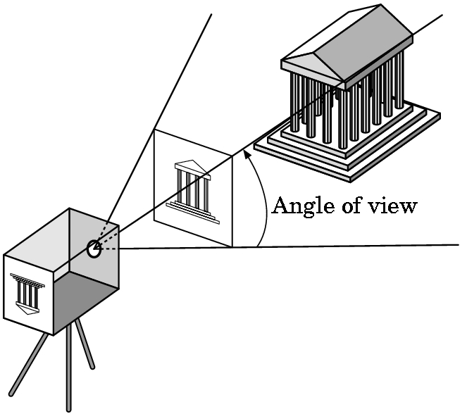
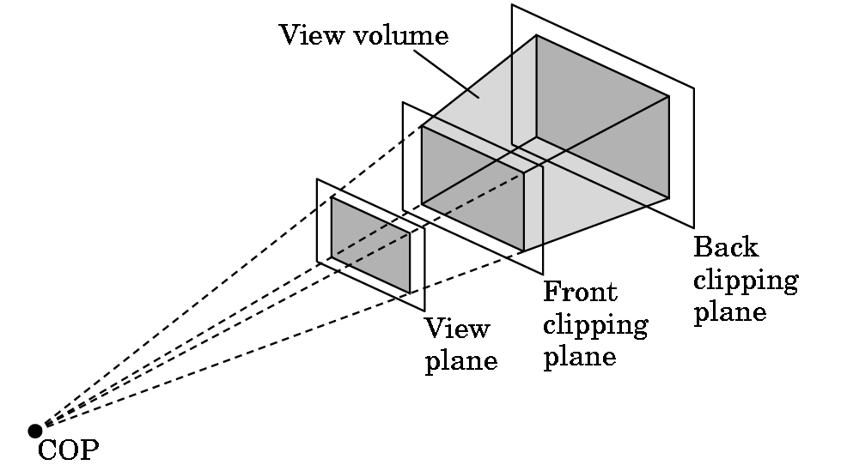
Clipping
Just as a real camera cannot “see” the whole world, the virtual camera can only see part of the world or object space
Objects that are not within this volume are said to be clipped out of the scene

Slide 27
Rasterization
If an object is not clipped out, the appropriate pixels in the frame buffer must be assigned colors
Rasterizer produces a set of fragments for each object
Fragments are “potential pixels”
Have a location in frame bufffer
Color and depth attributes
Vertex attributes are interpolated over objects by the rasterizer

Slide 28
Fragment Processing
Fragments are processed to determine the color of the corresponding pixel in the frame buffer
Colors can be determined by texture mapping or interpolation of vertex colors
Fragments may be blocked by other fragments closer to the camera
Hidden-surface removal

Slide 29
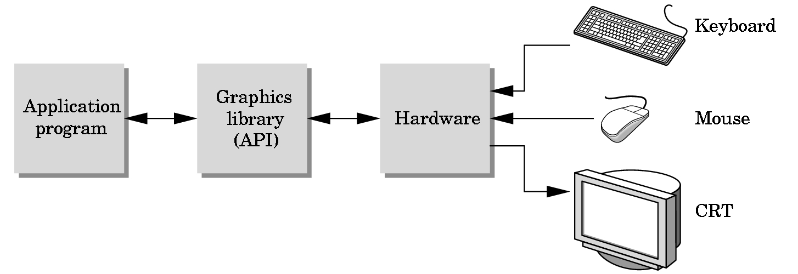
The Programmer’s Interface
Programmer sees the graphics system through a software interface: the Application Programmer Interface (API)

Slide 30
API Contents
Functions that specify what we need to form an image
Objects
Viewer
Light Source(s)
Materials
Other information
Input from devices such as mouse and keyboard
Capabilities of system

Slide 31
Object Specification
Most APIs support a limited set of primitives including
Points (0D object)
Line segments (1D objects)
Polygons (2D objects)
Some curves and surfaces
Quadrics
Parametric polynomials
All are defined through locations in space or vertices

Slide 32
Example (old style)
type of object
location of vertex
glBegin(GL_POLYGON)
glVertex3f(0.0, 0.0, 0.0);
glVertex3f(0.0, 1.0, 0.0);
glVertex3f(0.0, 0.0, 1.0);
glEnd( );
end of object definition

Slide 33
Example (GPU based)
Put geometric data in an array
Send array to GPU
Tell GPU to render as triangle
vec3 points[3];
points[0] = vec3(0.0, 0.0, 0.0);
points[1] = vec3(0.0, 1.0, 0.0);
points[2] = vec3(0.0, 0.0, 1.0);

Slide 34
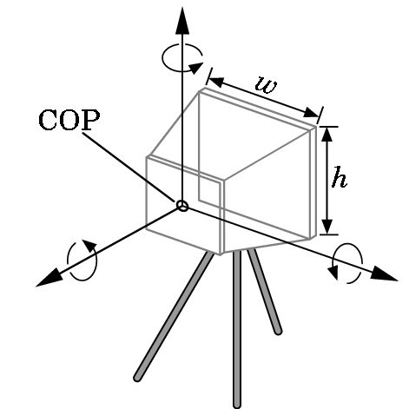
Camera Specification
Six degrees of freedom
Position of center of lens
Orientation
Lens
Film size
Orientation of film plane

Slide 35
Lights and Materials
Types of lights
Point sources vs distributed sources
Spot lights
Near and far sources
Color properties
Material properties
Absorption: color properties
Scattering
Diffuse
Specular

Slide 36
Homework
Chapter 1 Review Questions
Due via email by Friday 11:59pm
1 T/F,
1 MC,
1 SA/Fill in the blank,
1 Essay/Code
Question, Answer, Where you found the answer.

