Slide 1
CS 480/680
Computer Graphics
Transformations
Dr. Frederick C Harris, Jr.

Slide 2
Objectives
Introduce standard transformations
Rotation
Translation
Scaling
Shear
Derive homogeneous coordinate transformation matrices
Learn to build arbitrary transformation matrices from simple transformations

Slide 3
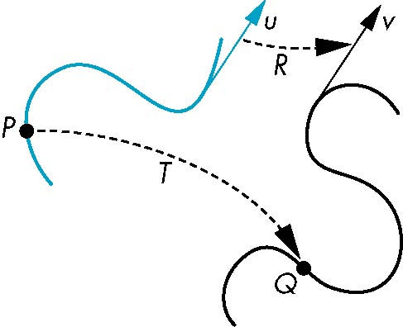
General Transformations
A transformation maps points to other points and/or vectors to other vectors
v=T(u)
Q=T(P)

Slide 4
Affine Transformations
Line preserving
Characteristic of many physically important transformations
Rigid body transformations: rotation, translation
Scaling, shear
Importance in graphics is that we need only transform endpoints of line segments and let implementation draw line segment between the transformed endpoints

Slide 5
Pipeline Implementation
T
(from application program)
frame
buffer
u
transformation
T(u)
rasterizer
v
T(v)
T(v)
T(v)
v
T(u)
u
T(u)
vertices
vertices
pixels

Slide 6
Notation
We will be working with both coordinate-free representations of transformations and representations within a particular frame
P,Q, R: points in an affine space
u, v, w: vectors in an affine space
α, β, γ: scalars
p, q, r: representations of points
-array of 4 scalars in homogeneous coordinates
u, v, w: representations of points
-array of 4 scalars in homogeneous coordinates

Slide 7
Translation
Move (translate, displace) a point to a new location
Displacement determined by a vector d
Three degrees of freedom
P’=P+d
P’
d
P

Slide 8
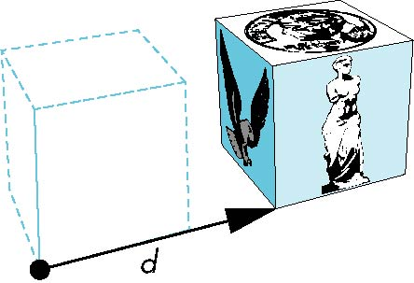
How many ways?
Although we can move a point to a new location in infinite ways, when we move many points there is usually only one way
object
translation: every point displaced
by same vector

Slide 9
Translation Using Representations
Using the homogeneous coordinate representation in some frame
p=[ x y z 1]^{T}
p’=[x’ y’ z’ 1]^{T}
d=[dx dy dz 0]^{T}
Hence p’ = p + d or
x’=x+d_{x}
y’=y+d_{y}
z’=z+d_{z}
note that this expression is in
four dimensions and expresses
point = vector + point

Slide 10
Translation Matrix
We can also express translation using a
4 x 4 matrix T in homogeneous coordinates
p’=Tp where
T = T(d_{x}, d_{y}, d_{z}) =
This form is better for implementation because all affine transformations can be expressed this way and multiple transformations can be concatenated together

Slide 11
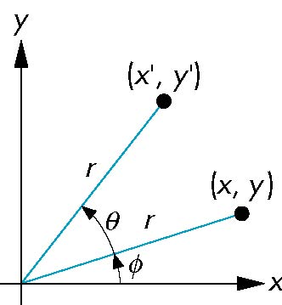
Rotation (2D)
Consider rotation about the origin by θ degrees
radius stays the same, angle increases by θ
x = r cos (φ + θ)
y = r sin (φ + θ)
x’=x cos θ –y sin θ
y’ = x sin θ + y cos θ
x = r cos φ
y = r sin φ

Slide 12
Rotation about the z axis
Rotation about z axis in three dimensions leaves all points with the same z
Equivalent to rotation in two dimensions in planes of constant z
or in homogeneous coordinates
p’=R_{z}(θ)p
x’=x cos θ –y sin θ
y’ = x sin θ + y cos θ
z’ =z

Slide 13
Rotation Matrix
R = R_{z}(θ) =

Slide 14
Rotation about x and y axes
Same argument as for rotation about z axis
For rotation about x axis, x is unchanged
For rotation about y axis, y is unchanged
R = R_{x}(θ) =
R = R_{y}(θ) =

Slide 15
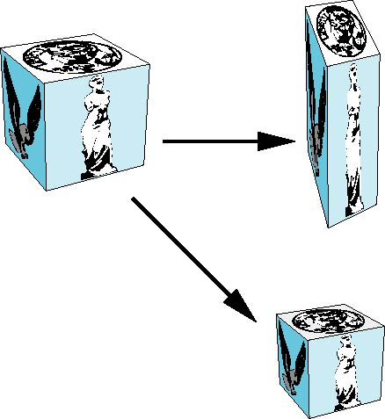
Scaling
Expand or contract along each axis (fixed point of origin)
S = S(s_{x}, s_{y}, s_{z}) =
x’=s_{x}x
y’=s_{y}x
z’=s_{z}x
p’=Sp

Slide 16
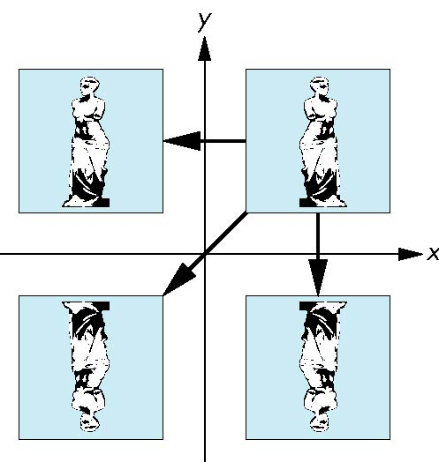
Reflection
corresponds to negative scale factors
s_{x} = -1 s_{y} = 1
original
s_{x} = -1 s_{y} = -1
s_{x} = 1 s_{y} = -1

Slide 17
Inverses
Although we could compute inverse matrices by general formulas, we can use simple geometric observations
Translation: T⁻¹(d_{x}, d_{y}, d_{z}) = T(-d_{x}, -d_{y}, -d_{z})
Rotation: R ⁻¹(θ) = R(-θ)
Holds for any rotation matrix
Note that since cos(-θ) = cos(θ) and sin(-θ)=-sin(θ)
R ⁻¹(θ) = R ^{T}(θ)
Scaling: S⁻¹(s_{x}, s_{y}, s_{z}) = S(1/s_{x}, 1/s_{y}, 1/s_{z})

Slide 18
Concatenation
We can form arbitrary affine transformation matrices by multiplying together rotation, translation, and scaling matrices
Because the same transformation is applied to many vertices, the cost of forming a matrix M=ABCD is not significant compared to the cost of computing Mp for many vertices p
The difficult part is how to form a desired transformation from the specifications in the application

Slide 19
Order of Transformations
Note that matrix on the right is the first applied
Mathematically, the following are equivalent
p’ = ABCp = A(B(Cp))
Note many references use column matrices to represent points. In terms of column matrices
p^{’T} = p^{T}C^{T}B^{T}A^{T}

Slide 20
General Rotation About the Origin
A rotation by θ about an arbitrary axis
can be decomposed into the concatenation
of rotations about the x, y, and z axes
R(θ) = R_{z}(θ_{z}) R_{y}(θ_{y}) R_{x}(θ_{x})
y
v
θ_{x} θ_{y} θ_{z} are called the Euler angles
θ
Note that rotations do not commute
We can use rotations in another order but
with different angles
x
z

Slide 21
Rotation About a Fixed Point other than the Origin
Move fixed point to origin
Rotate
Move fixed point back
M = T(p_{f}) R(θ) T(-p_{f})

Slide 22
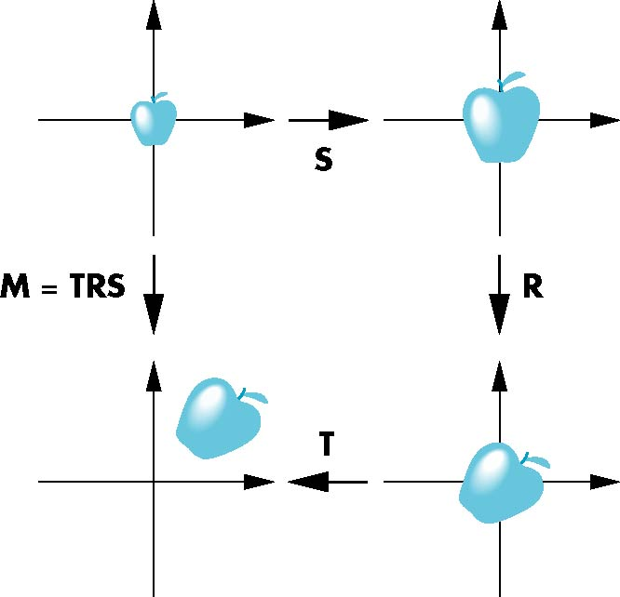
Instancing
In modeling, we often start with a simple object centered at the origin, oriented with the axis, and at a standard size
We apply an instance transformation to its vertices to
Scale
Orient
Locate

Slide 23
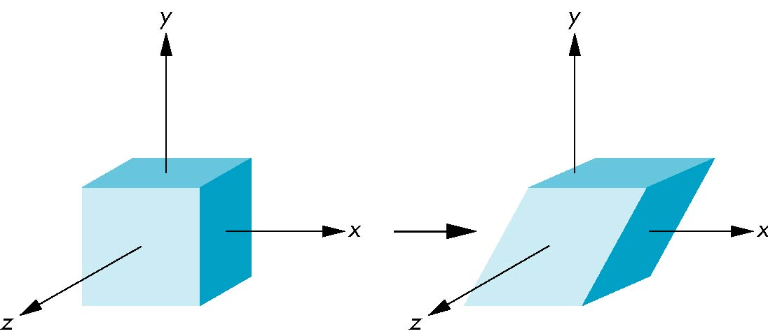
Shear
Helpful to add one more basic transformation
Equivalent to pulling faces in opposite directions

Slide 24
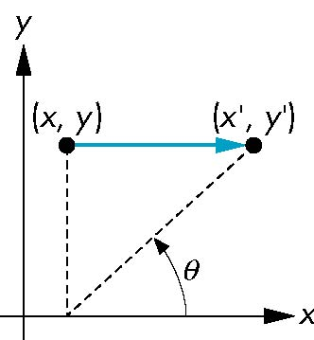
Shear Matrix
Consider simple shear along x axis
x’ = x + y cot θ
y’ = y
z’ = z
H(θ) =

