Slide 1
CS 480/680
Fall 2012
Computer Graphics
Representation
Dr. Frederick C Harris, Jr.

Slide 2
Objectives
Introduce concepts such as dimension and basis
Introduce coordinate systems for representing vectors spaces and frames for representing affine spaces
Discuss change of frames and bases
Introduce homogeneous coordinates

Slide 3
Linear Independence
A set of vectors v₁, v₂, …, v_{n} is linearly independent if
α₁v₁+α₂v₂+.. α_{n}v_{n}=0 iff α₁=α₂=…=0
If a set of vectors is linearly independent, we cannot represent one in terms of the others
If a set of vectors is linearly dependent, as least one can be written in terms of the others

Slide 4
Dimension
In a vector space, the maximum number of linearly independent vectors is fixed and is called the dimension of the space
In an n-dimensional space, any set of n linearly independent vectors form a basis for the space
Given a basis v₁, v₂,…., v_{n}, any vector v can be written as
v=α₁v₁+ α₂v₂ +….+α_{n}v_{n}
where the {α_{i}} are unique

Slide 5
Representation
Until now we have been able to work with geometric entities without using any frame of reference, such as a coordinate system
Need a frame of reference to relate points and objects to our physical world.
For example, where is a point?
Can’t answer without a reference system
World coordinates
Camera coordinates

Slide 6
Coordinate Systems
Consider a basis v₁, v₂,…., v_{n}
A vector is written v=α₁v₁+ α₂v₂ +….+α_{n}v_{n}
The list of scalars {α₁, α₂, …. α_{n}}is the representation of v with respect to the given basis
We can write the representation as a row or column array of scalars
a=[α₁ α₂ …. α_{n}]^{T}=

Slide 7
Example
v=2v₁+3v₂-4v₃
a=[2, 3, –4]^{T}
Note that this representation is with respect to a particular basis
For example, in OpenGL we start by representing vectors using the object basis but later the system needs a representation in terms of the camera or eye basis

Slide 8
Coordinate Systems
Which is correct?
Both are because vectors have no fixed location
v
v

Slide 9
Frames
A coordinate system is insufficient to represent points
If we work in an affine space we can add a single point, the origin, to the basis vectors to form a frame
v₂
P₀
v₁
v₃

Slide 10
Representation in a Frame
Frame determined by (P₀, v₁, v₂, v₃)
Within this frame, every vector can be written as
v=α₁v₁+ α₂v₂ +….+α_{n}v_{n}
Every point can be written as
P = P₀ + β₁v₁+ β₂v₂ +….+β_{n}v_{n}

Slide 11
Confusing Points and Vectors
Consider the point and the vector
P = P₀ + β₁v₁+ β₂v₂ +….+β_{n}v_{n}
v=α₁v₁+ α₂v₂ +….+α_{n}v_{n}
They appear to have the similar representations
p=[β₁ β₂ β₃] v=[α₁ α₂ α₃]
which confuses the point with the vector
A vector has no position
v
p
v
Vector can be placed anywhere
point: fixed

Slide 12
A Single Representation
If we define 0•P = 0 and 1•P =P then we can write
v=α₁v₁+ α₂v₂ +α₃v₃ = [α₁ α₂ α₃ 0 ] [v₁ v₂ v₃ P₀] ^{T}
P = P₀ + β₁v₁+ β₂v₂ +β₃v₃= [β₁ β₂ β₃ 1 ] [v₁ v₂ v₃ P₀] ^{T}
Thus we obtain the four-dimensional homogeneous coordinate representation
v = [α₁ α₂ α₃ 0 ] ^{T}
p = [β₁ β₂ β₃ 1 ] ^{T}

Slide 13
Homogeneous Coordinates
The homogeneous coordinates form for a three dimensional point [x y z] is given as
p =[x’ y’ z’ w] ^{T} =[wx wy wz w] ^{T}
We return to a three dimensional point (for w≠0) by
x←x’/w
y←y’/w
z←z’/w
If w=0, the representation is that of a vector
Note that homogeneous coordinates replaces points in three dimensions by lines through the origin in four dimensions
For w=1, the representation of a point is [x y z 1]

Slide 14
Homogeneous Coordinates and Computer Graphics
Homogeneous coordinates are key to all computer graphics systems
All standard transformations (rotation, translation, scaling) can be implemented with matrix multiplications using 4 x 4 matrices
Hardware pipeline works with 4 dimensional representations
For orthographic viewing, we can maintain w=0 for vectors and w=1 for points
For perspective we need a perspective division

Slide 15
Change of Coordinate Systems
Consider two representations of a the same vector with respect to two different bases. The representations are
a=[α₁ α₂ α₃ ]
b=[β₁ β₂ β₃]
where
v=α₁v₁+ α₂v₂ +α₃v₃ = [α₁ α₂ α₃] [v₁ v₂ v₃] ^{T}
=β₁u₁+ β₂u₂ +β₃u₃ = [β₁ β₂ β₃] [u₁ u₂ u₃] ^{T}

Slide 16
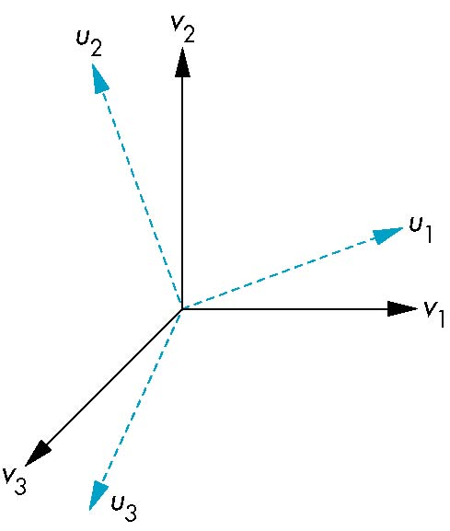
Representing second basis in terms of first
Each of the basis vectors, u1,u2, u3, are vectors that can be represented in terms of the first basis
v
u₁ = γ₁₁v₁+γ₁₂v₂+γ₁₃v₃
u₂ = γ₂₁v₁+γ₂₂v₂+γ₂₃v₃
u₃ = γ₃₁v₁+γ₃₂v₂+γ₃₃v₃

Slide 17
Matrix Form
The coefficients define a 3 x 3 matrix
and the bases can be related by
see text for numerical examples
M =
a=M^{T}b

Slide 18
Change of Frames
We can apply a similar process in homogeneous coordinates to the representations of both points and vectors
Any point or vector can be represented in either frame
We can represent Q₀, u₁, u₂, u₃ in terms of P₀, v₁, v₂, v₃
u₂
u₁
v₂
Consider two frames:
(P₀, v₁, v₂, v₃)
(Q₀, u₁, u₂, u₃)
Q₀
P₀
v₁
u₃
v₃

Slide 19
Representing One Frame in Terms of the Other
Extending what we did with change of bases
u₁ = γ₁₁v₁+γ₁₂v₂+γ₁₃v₃
u₂ = γ₂₁v₁+γ₂₂v₂+γ₂₃v₃
u₃ = γ₃₁v₁+γ₃₂v₂+γ₃₃v₃
Q₀ = γ₄₁v₁+γ₄₂v₂+γ₄₃v₃ +γ₄₄P₀
defining a 4 x 4 matrix
M =

Slide 20
Working with Representations
Within the two frames any point or vector has a representation of the same form
a=[α₁ α₂ α₃ α₄ ] in the first frame
b=[β₁ β₂ β₃ β₄ ] in the second frame
where α₄ = β₄ = 1 for points and α₄ = β₄ = 0 for vectors and
The matrix M is 4 x 4 and specifies an affine transformation in homogeneous coordinates
a=M^{T}b

Slide 21
Affine Transformations
Every linear transformation is equivalent to a change in frames
Every affine transformation preserves lines
However, an affine transformation has only 12 degrees of freedom because 4 of the elements in the matrix are fixed and are a subset of all possible 4 x 4 linear transformations

Slide 22
The World and Camera Frames
When we work with representations, we work with n-tuples or arrays of scalars
Changes in frame are then defined by 4 x 4 matrices
In OpenGL, the base frame that we start with is the world frame
Eventually we represent entities in the camera frame by changing the world representation using the model-view matrix
Initially these frames are the same (M=I)

Slide 23
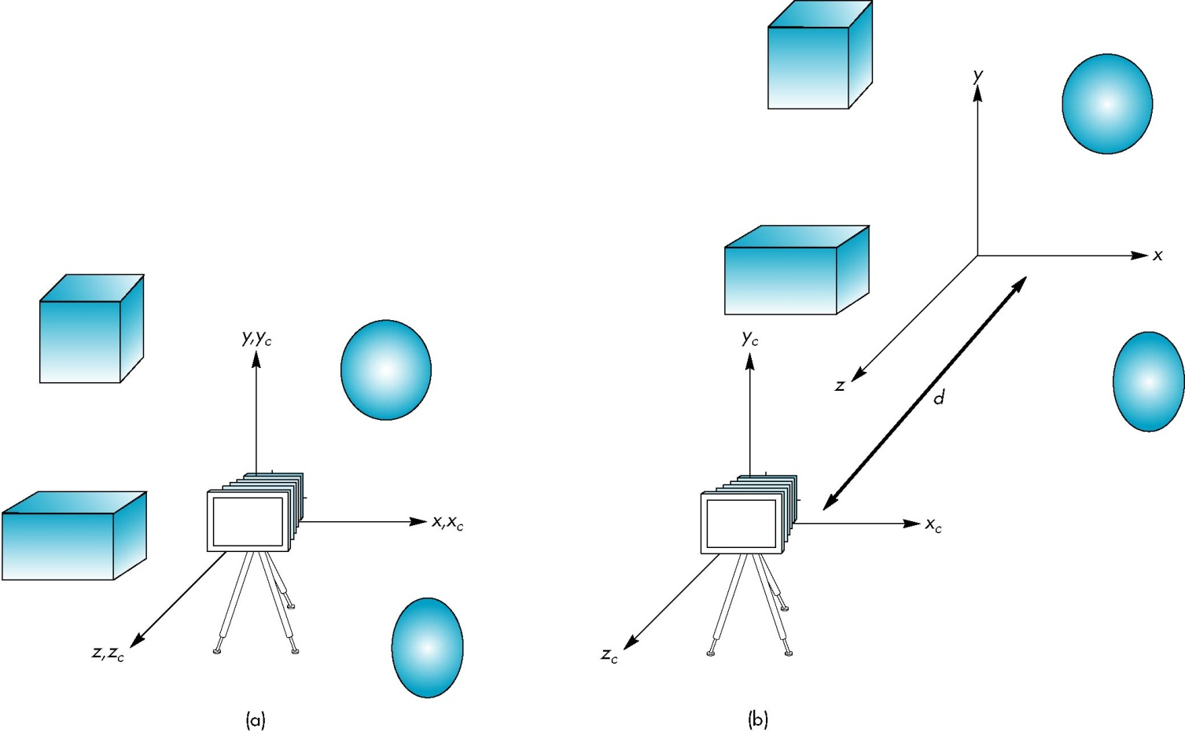
Moving the Camera
If objects are on both sides of z=0, we must move camera frame
M =

Slide 24
Now on to Transformations

Slide 25
Introduce standard transformations
Rotation
Translation
Scaling
Shear
Derive homogeneous coordinate transformation matrices
Learn to build arbitrary transformation matrices from simple transformations

Slide 26
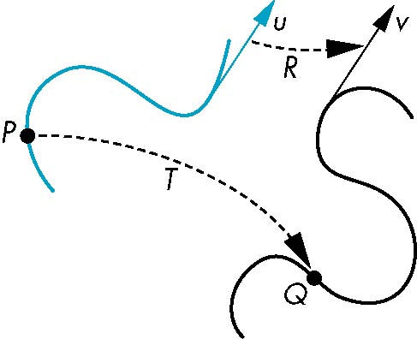
General Transformations
A transformation maps points to other points and/or vectors to other vectors
v=T(u)
Q=T(P)

Slide 27
Affine Transformations
Line preserving
Characteristic of many physically important transformations
Rigid body transformations: rotation, translation
Scaling, shear
Importance in graphics is that we need only transform endpoints of line segments and let implementation draw line segment between the transformed endpoints

Slide 28
Pipeline Implementation
T
(from application program)
frame
buffer
u
transformation
T(u)
rasterizer
v
T(v)
T(v)
T(v)
v
T(u)
u
T(u)
vertices
vertices
pixels

Slide 29
Notation
We will be working with both coordinate-free representations of transformations and representations within a particular frame
P,Q, R: points in an affine space
u, v, w: vectors in an affine space
α, β, γ: scalars
p, q, r: representations of points
-array of 4 scalars in homogeneous coordinates
u, v, w: representations of points
-array of 4 scalars in homogeneous coordinates

Slide 30
Translation
Move (translate, displace) a point to a new location
Displacement determined by a vector d
Three degrees of freedom
P’=P+d
P’
d
P

Slide 31
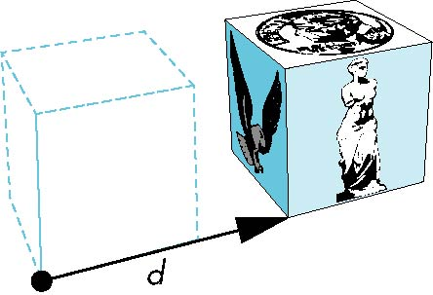
How many ways?
Although we can move a point to a new location in infinite ways, when we move many points there is usually only one way
object
translation: every point displaced
by same vector

Slide 32
Translation Using Representations
Using the homogeneous coordinate representation in some frame
p=[ x y z 1]^{T}
p’=[x’ y’ z’ 1]^{T}
d=[dx dy dz 0]^{T}
Hence p’ = p + d or
x’=x+d_{x}
y’=y+d_{y}
z’=z+d_{z}
note that this expression is in
four dimensions and expresses
point = vector + point

Slide 33
Translation Matrix
We can also express translation using a
4 x 4 matrix T in homogeneous coordinates
p’=Tp where
T = T(d_{x}, d_{y}, d_{z}) =
This form is better for implementation because all affine transformations can be expressed this way and multiple transformations can be concatenated together

Slide 34
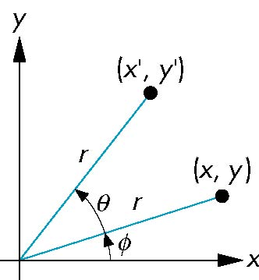
Rotation (2D)
Consider rotation about the origin by θ degrees
radius stays the same, angle increases by θ
x = r cos (φ + θ)
y = r sin (φ + θ)
x’=x cos θ –y sin θ
y’ = x sin θ + y cos θ
x = r cos φ
y = r sin φ

Slide 35
Rotation about the z axis
Rotation about z axis in three dimensions leaves all points with the same z
Equivalent to rotation in two dimensions in planes of constant z
or in homogeneous coordinates
p’=R_{z}(θ)p
x’=x cos θ –y sin θ
y’ = x sin θ + y cos θ
z’ =z

Slide 36
Rotation Matrix
R = R_{z}(θ) =

Slide 37
Rotation about x and y axes
Same argument as for rotation about z axis
For rotation about x axis, x is unchanged
For rotation about y axis, y is unchanged
R = R_{x}(θ) =
R = R_{y}(θ) =

Slide 38
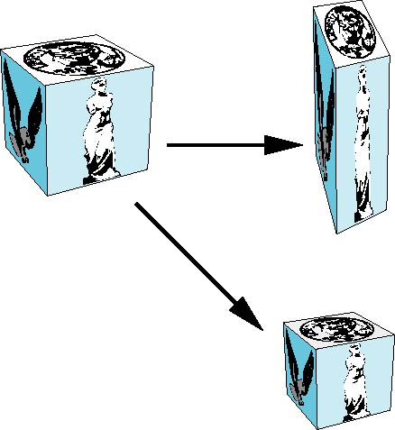
Scaling
Expand or contract along each axis (fixed point of origin)
S = S(s_{x}, s_{y}, s_{z}) =
x’=s_{x}x
y’=s_{y}x
z’=s_{z}x
p’=Sp

Slide 39
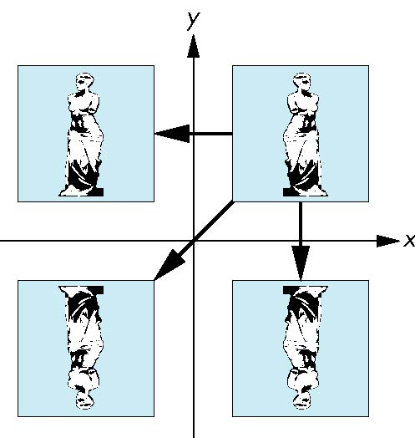
Reflection
corresponds to negative scale factors
s_{x} = -1 s_{y} = 1
original
s_{x} = -1 s_{y} = -1
s_{x} = 1 s_{y} = -1

Slide 40
Inverses
Although we could compute inverse matrices by general formulas, we can use simple geometric observations
Translation: T⁻¹(d_{x}, d_{y}, d_{z}) = T(-d_{x}, -d_{y}, -d_{z})
Rotation: R ⁻¹(θ) = R(-θ)
Holds for any rotation matrix
Note that since cos(-θ) = cos(θ) and sin(-θ)=-sin(θ)
R ⁻¹(θ) = R ^{T}(θ)
Scaling: S⁻¹(s_{x}, s_{y}, s_{z}) = S(1/s_{x}, 1/s_{y}, 1/s_{z})

Slide 41
Concatenation
We can form arbitrary affine transformation matrices by multiplying together rotation, translation, and scaling matrices
Because the same transformation is applied to many vertices, the cost of forming a matrix M=ABCD is not significant compared to the cost of computing Mp for many vertices p
The difficult part is how to form a desired transformation from the specifications in the application

Slide 42
Order of Transformations
Note that matrix on the right is the first applied
Mathematically, the following are equivalent
p’ = ABCp = A(B(Cp))
Note many references use column matrices to represent points. In terms of column matrices
p^{’T} = p^{T}C^{T}B^{T}A^{T}

Slide 43
General Rotation About the Origin
A rotation by θ about an arbitrary axis
can be decomposed into the concatenation
of rotations about the x, y, and z axes
R(θ) = R_{z}(θ_{z}) R_{y}(θ_{y}) R_{x}(θ_{x})
y
v
θ_{x} θ_{y} θ_{z} are called the Euler angles
θ
Note that rotations do not commute
We can use rotations in another order but
with different angles
x
z

Slide 44
Rotation About a Fixed Point other than the Origin
Move fixed point to origin
Rotate
Move fixed point back
M = T(p_{f}) R(θ) T(-p_{f})

Slide 45
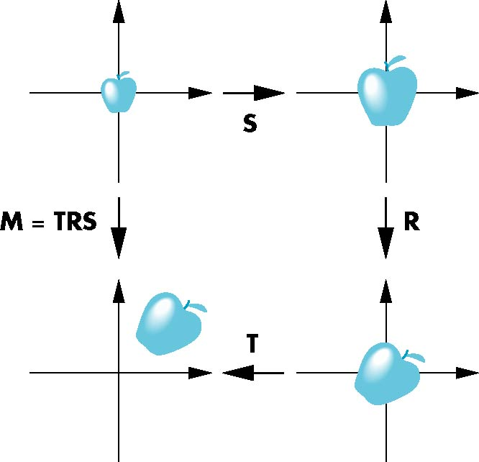
Instancing
In modeling, we often start with a simple object centered at the origin, oriented with the axis, and at a standard size
We apply an instance transformation to its vertices to
Scale
Orient
Locate

Slide 46
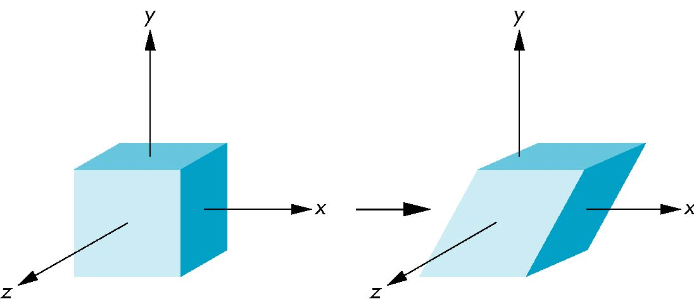
Shear
Helpful to add one more basic transformation
Equivalent to pulling faces in opposite directions

Slide 47
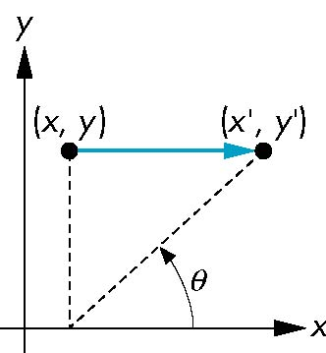
Shear Matrix
Consider simple shear along x axis
x’ = x + y cot θ
y’ = y
z’ = z
H(θ) =

