Slide 1
CS 480/680
Computer Graphics
Buffers
Dr. Frederick C Harris, Jr.

Slide 2
Objectives
Introduce additional OpenGL buffers
Learn to read from buffers
Learn to use blending

Slide 3
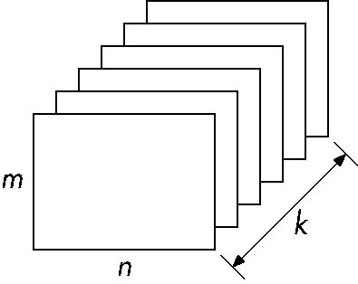
Buffer
Define a buffer by its spatial resolution (n x m) and its depth (or precision) k, the number of bits/pixel
pixel

Slide 4
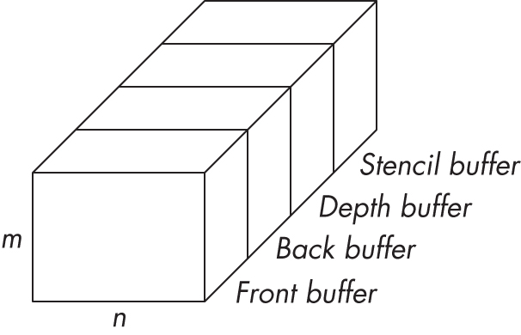
OpenGL Frame Buffer

Slide 5
OpenGL Buffers
Color buffers can be displayed
Front
Back
Auxiliary
Stereo
Depth
Stencil
Holds masks
Most RGBA buffers 8 bits per component
Latest are floating point (IEEE)

Slide 6
Writing in Buffers
Conceptually, we can consider all of memory as a large two-dimensional array of pixels
We read and write rectangular block of pixels
Bit block transfer (bitblt) operations
The frame buffer is part of this memory
memory
source
frame buffer
(destination)
writing into frame buffer

Slide 7
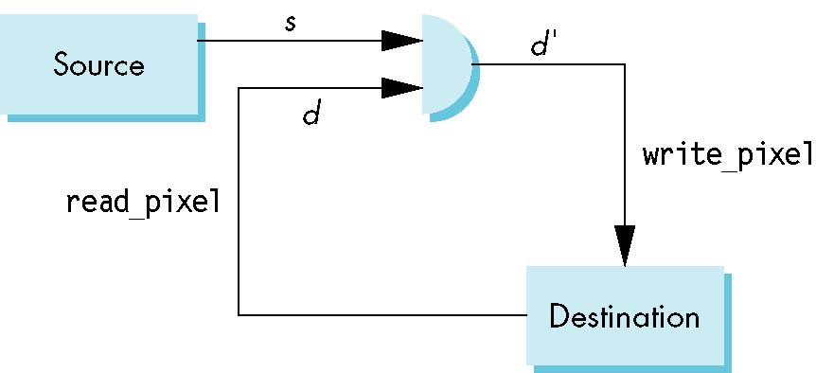
Writing Model
Read destination pixel before writing source

Slide 8
Bit Writing Modes
Source and destination bits are combined bitwise
16 possible functions (one per column in table)
replace
XOR
OR

Slide 9
XOR mode
Recall from Chapter 3 that we can use XOR by enabling logic operations and selecting the XOR write mode
XOR is especially useful for swapping blocks of memory such as menus that are stored off screen
If S represents screen and M represents a menu
the sequence
S ← S ⊕ M
M ← S ⊕ M
S ← S ⊕ M
swaps the S and M

Slide 10
The Pixel Pipeline
OpenGL has a separate pipeline for pixels
Writing pixels involves
Moving pixels from processor memory to the frame buffer
Format conversions
Mapping, Lookups, Tests
Reading pixels
Format conversion

Slide 11
Buffer Selection
OpenGL can read from any of the buffers (front, back, depth)
Default to the back buffer
Change with glReadBuffer
Note that format of the pixels in the frame buffer is different from that of processor memory and these two types of memory reside in different places
Need packing and unpacking
Reading can be slow
Drawing through texture functions

Slide 12
OpenGL Pixel Functions
glReadPixels(x,y,width,height,format,type,myimage)
start pixel in frame buffer
size
type of pixels
type of image
pointer to processor
memory
GLubyte myimage[512][512][3];
glReadPixels(0,0, 512, 512, GL_RGB,
GL_UNSIGNED_BYTE, myimage);

Slide 13
Deprecated Functionality
glDrawPixels
glCopyPixels
glBitMap
Replace by use of texture functionality, glBltFrameBuffer, frame buffer objects

