Slide 1
CS 480/680
Fall 2011
Computer Graphics
Texture Mapping
Dr. Frederick C Harris, Jr.

Slide 2
Objectives
Introduce Mapping Methods
Texture Mapping
Environment Mapping
Bump Mapping
Consider basic strategies
Forward vs backward mapping
Point sampling vs area averaging
2

Slide 3
The Limits of Geometric Modeling
Although graphics cards can render over 10 million polygons per second, that number is insufficient for many phenomena
Clouds
Grass
Terrain
Skin
3

Slide 4
Modeling an Orange
Consider the problem of modeling an orange (the fruit)
Start with an orange-colored sphere
Too simple
Replace sphere with a more complex shape
Does not capture surface characteristics (small dimples)
Takes too many polygons to model all the dimples
4

Slide 5
Modeling an Orange (2)
Take a picture of a real orange, scan it, and “paste” onto simple geometric model
This process is known as texture mapping
Still might not be sufficient because resulting surface will be smooth
Need to change local shape
Bump mapping
5

Slide 6
Three Types of Mapping
Texture Mapping
Uses images to fill inside of polygons
Environment (reflection mapping)
Uses a picture of the environment for texture maps
Allows simulation of highly specular surfaces
Bump mapping
Emulates altering normal vectors during the rendering process
6

Slide 7
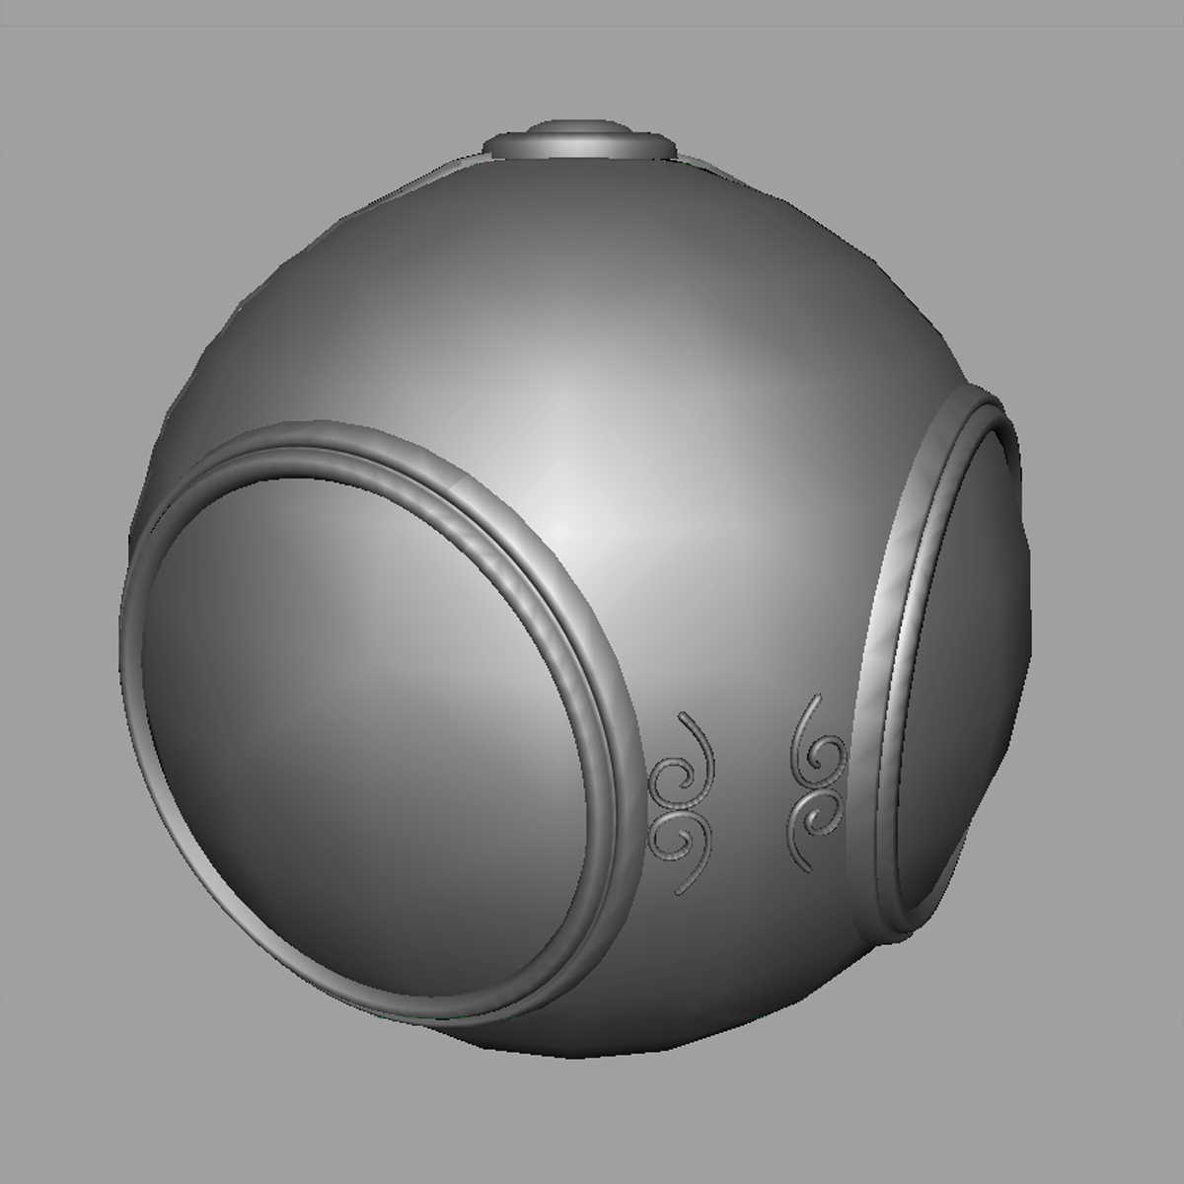
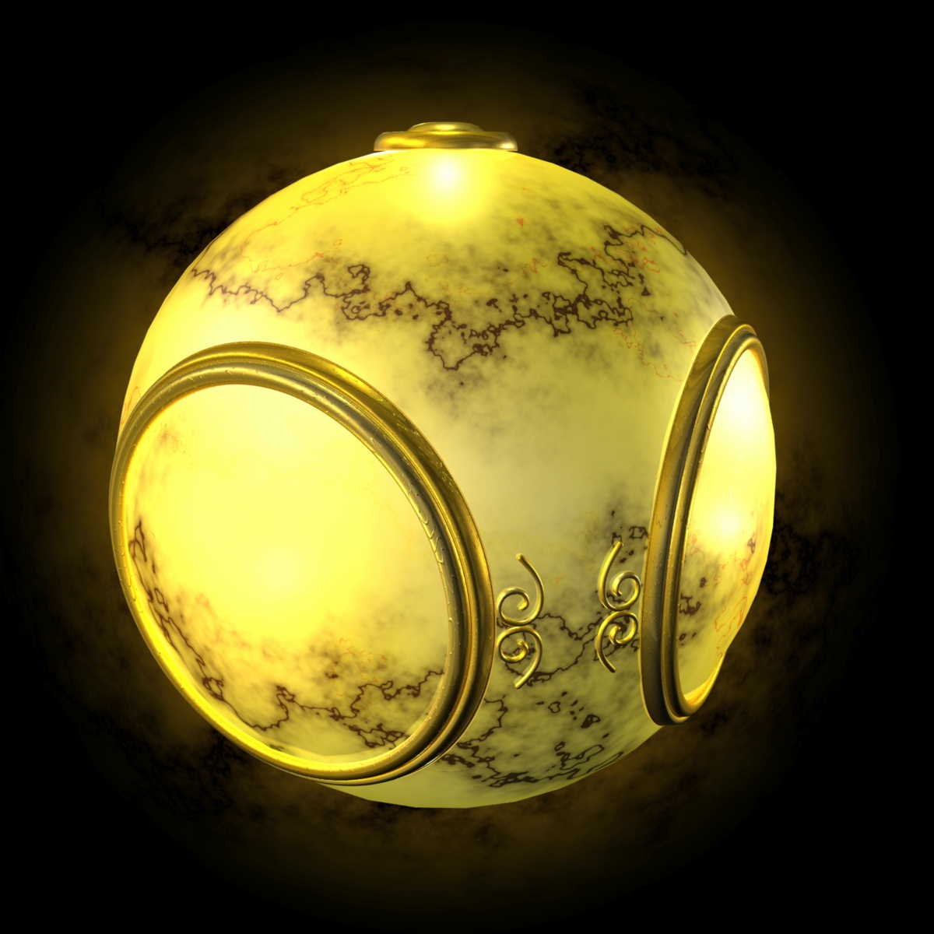
Texture Mapping
geometric model
texture mapped
7

Slide 8
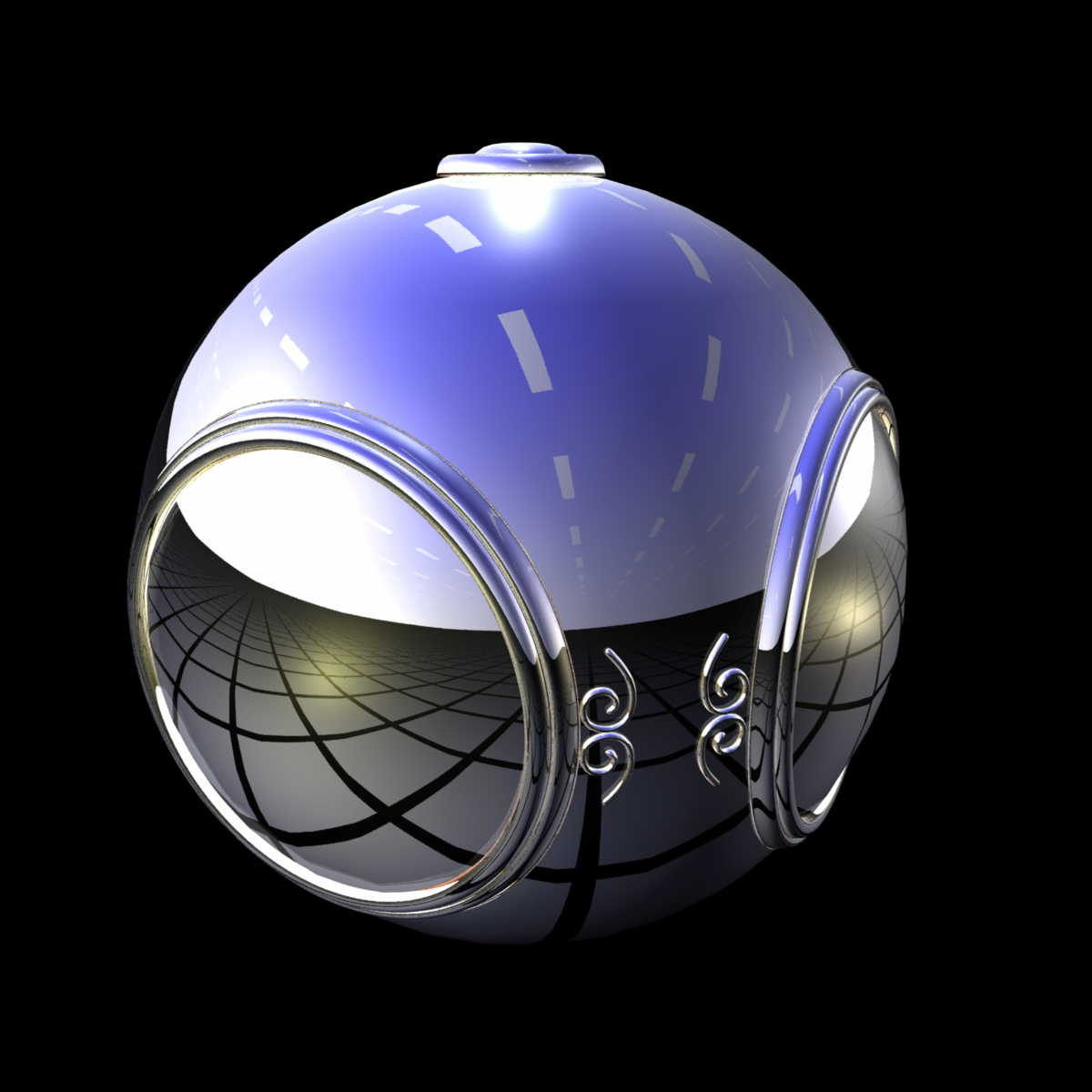
Environment Mapping
8

Slide 9
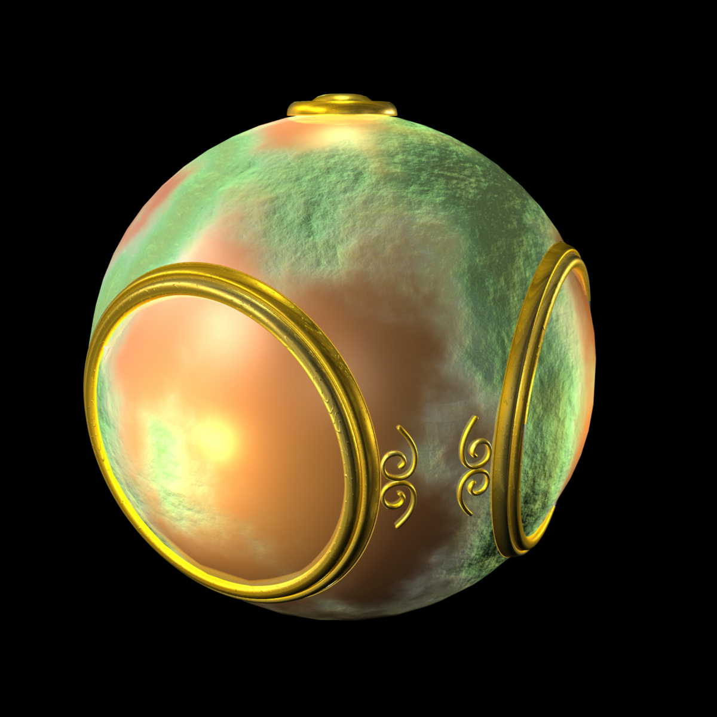
Bump Mapping
9

Slide 10
Where does mapping take place?
Mapping techniques are implemented at the end of the rendering pipeline
Very efficient because few polygons make it past the clipper
10

Slide 11
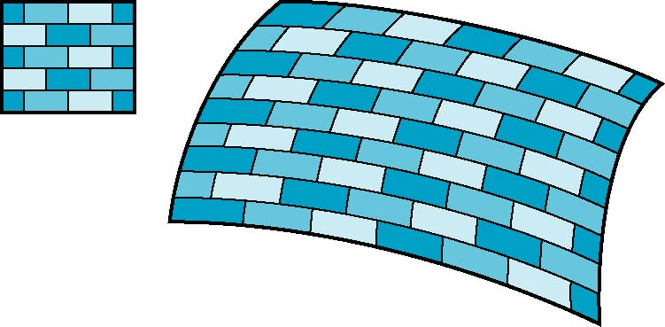
Is it simple?
Although the idea is simple---map an image to a surface---there are 3 or 4 coordinate systems involved
2D image
3D surface
11

Slide 12
Coordinate Systems
Parametric coordinates
May be used to model curves and surfaces
Texture coordinates
Used to identify points in the image to be mapped
Object or World Coordinates
Conceptually, where the mapping takes place
Window Coordinates
Where the final image is really produced
12

Slide 13
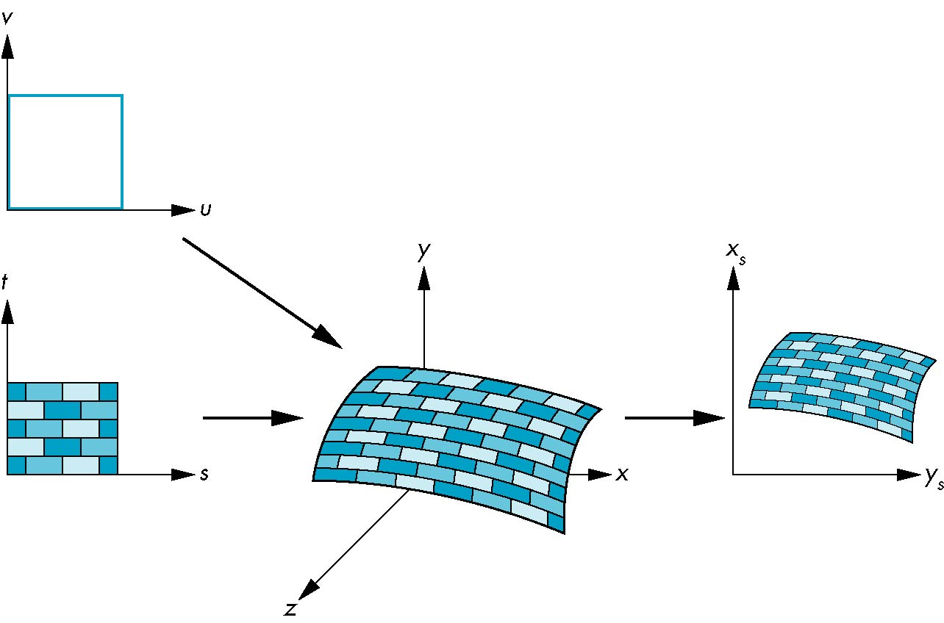
Texture Mapping
parametric coordinates
texture coordinates
window coordinates
world coordinates
13

Slide 14
Mapping Functions
Basic problem is how to find the maps
Consider mapping from texture coordinates to a point a surface
Appear to need three functions
x = x(s,t)
y = y(s,t)
z = z(s,t)
But we really want
to go the other way
(x,y,z)
t
s
14

Slide 15
Backward Mapping
We really want to go backwards
Given a pixel, we want to know to which point on an object it corresponds
Given a point on an object, we want to know to which point in the texture it corresponds
Need a map of the form
s = s(x,y,z)
t = t(x,y,z)
Such functions are difficult to find in general
15

Slide 16
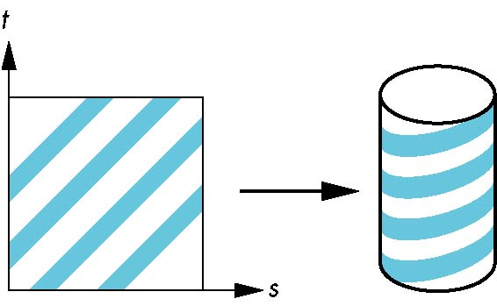
Two-part mapping
One solution to the mapping problem is to first map the texture to a simple intermediate surface
Example: map to cylinder
16

Slide 17
Cylindrical Mapping
parametric cylinder
x = r cos 2π u
y = r sin 2πu
z = v/h
maps rectangle in u,v space to cylinder of radius r and height h in world coordinates
s = u
t = v
maps from texture space
17

Slide 18
Spherical Map
We can use a parametric sphere
x = r cos 2πu
y = r sin 2πu cos 2πv
z = r sin 2πu sin 2πv
in a similar manner to the cylinder
but have to decide where to put the distortion
Spheres are used in environmental maps
18

Slide 19
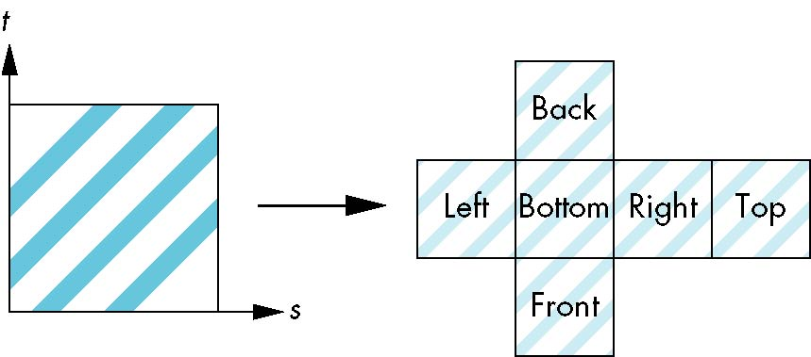
Box Mapping
Easy to use with simple orthographic projection
Also used in environment maps
19

Slide 20
Second Mapping
Map from intermediate object to actual object
Normals from intermediate to actual
Normals from actual to intermediate
Vectors from center of intermediate
actual
intermediate
20

Slide 21
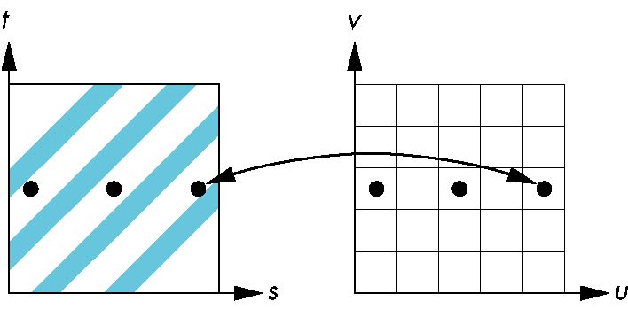
Aliasing
Point sampling of the texture can lead to aliasing errors
point samples in u,v
(or x,y,z) space
miss blue stripes
point samples in texture space
21

Slide 22
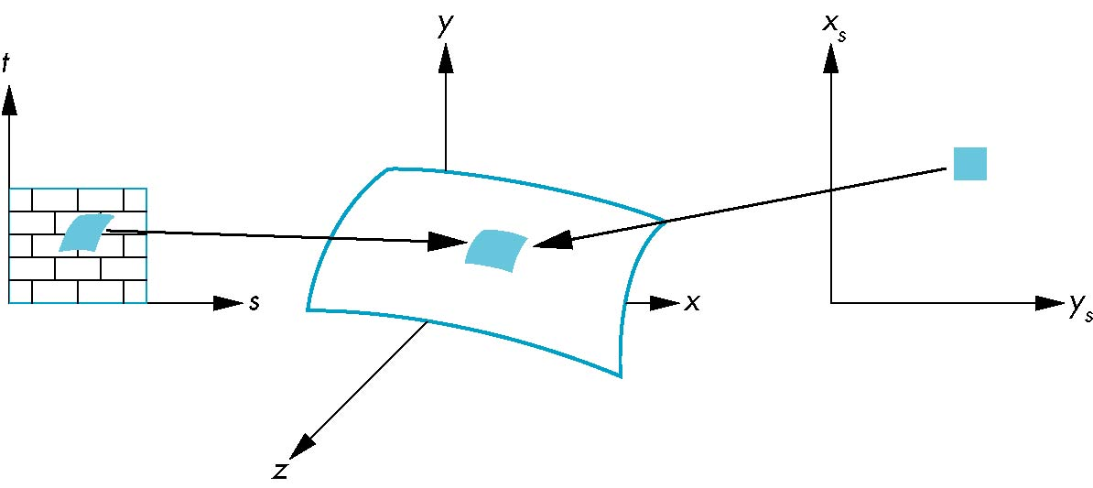
Area Averaging
A better but slower option is to use area averaging
pixel
preimage
Note that preimage of pixel is curved
22

