Slide 1
CS 480/680
Fall 2011
Computer Graphics
OpenGL Texture Mapping
Dr. Frederick C Harris, Jr.

Slide 2
Objectives
Introduce the OpenGL texture functions and options

Slide 3
Basic Stragegy
Three steps to applying a texture
specify the texture
read or generate image
assign to texture
enable texturing
assign texture coordinates to vertices
Proper mapping function is left to application
specify texture parameters
wrapping, filtering
Notes:
3

Slide 4
Texture Mapping
y
z
x
geometry
display
t
image
s
Notes:
4

Slide 5
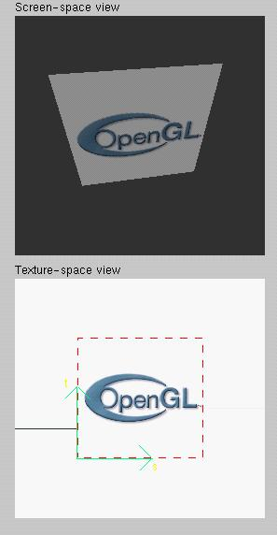
Texture Example
The texture (below) is a 256 x 256 image that has been mapped to a rectangular polygon which is viewed in perspective
Notes:
5

Slide 6
Texture Mapping and the OpenGL Pipeline
Images and geometry flow through separate pipelines that join during fragment processing
“complex” textures do not affect geometric complexity
vertices
geometry pipeline
fragmentprocessor
image
pixel pipeline
Notes:
6

Slide 7
Specifying a Texture Image
Define a texture image from an array of texels (texture elements) in CPU memory
Glubyte my_texels[512][512];
Define as any other pixel map
Scanned image
Generate by application code
Enable texture mapping
glEnable(GL_TEXTURE_2D)
OpenGL supports 1-4 dimensional texture maps
Notes:
7

Slide 8
Define Image as a Texture
glTexImage2D( target, level, components, w, h, border, format, type, texels );
target: type of texture, e.g. GL_TEXTURE_2D
level: used for mipmapping (discussed later)
components: elements per texel
w, h: width and height of texels in pixels
border: used for smoothing (discussed later)
format and type: describe texels
texels: pointer to texel array
glTexImage2D(GL_TEXTURE_2D, 0, 3, 512, 512, 0, GL_RGB, GL_UNSIGNED_BYTE, my_texels);

Slide 9
Mapping a Texture
Based on parametric texture coordinates
glTexCoord*() specified at each vertex
Texture Space
Object Space
t
1, 1
(s, t) = (0.2, 0.8)
0, 1
A
a
c
(0.4, 0.2)
b
B
C
0, 0
1, 0
s
(0.8, 0.4)
Notes:
9

Slide 10
Typical Code
offset = 0;
GLuint vPosition =
glGetAttribLocation( program, "vPosition" );
glEnableVertexAttribArray( vPosition );
glVertexAttribPointer( vPosition, 4, GL_FLOAT, GL_FALSE, 0,BUFFER_OFFSET(offset) );
offset += sizeof(points);
GLuint vTexCoord =
glGetAttribLocation( program, "vTexCoord" );
glEnableVertexAttribArray( vTexCoord );
glVertexAttribPointer( vTexCoord, 2,GL_FLOAT,
GL_FALSE, 0, BUFFER_OFFSET(offset) );

Slide 11
Interpolation
OpenGL uses interpolation to find proper texels from specified texture coordinates
Can be distortions
texture stretched
over trapezoid
showing effects of
bilinear interpolation
good selection
of tex coordinates
poor selection
of tex coordinates

Slide 12
Texture Parameters
OpenGL has a variety of parameters that determine how texture is applied
Wrapping parameters determine what happens if s and t are outside the (0,1) range
Filter modes allow us to use area averaging instead of point samples
Mipmapping allows us to use textures at multiple resolutions
Environment parameters determine how texture mapping interacts with shading

Slide 13
Wrapping Mode
Clamping: if s,t > 1 use 1, if s,t <0 use 0
Wrapping: use s,t modulo 1
glTexParameteri( GL_TEXTURE_2D, GL_TEXTURE_WRAP_S, GL_CLAMP )
glTexParameteri( GL_TEXTURE_2D, GL_TEXTURE_WRAP_T, GL_REPEAT )
t
s
GL_REPEAT
wrapping
GL_CLAMP
wrapping
texture
Notes:
13

Slide 14
Magnification and Minification
More than one texel can cover a pixel (minification) or more than one pixel can cover a texel (magnification)
Can use point sampling (nearest texel) or linear filtering ( 2 x 2 filter) to obtain texture values
Texture
Polygon
Texture
Polygon
Magnification
Minification
Notes:
14

Slide 15
Filter Modes
Modes determined by
glTexParameteri( target, type, mode )
glTexParameteri(GL_TEXTURE_2D, GL_TEXURE_MAG_FILTER, GL_NEAREST);
glTexParameteri(GL_TEXTURE_2D, GL_TEXURE_MIN_FILTER, GL_LINEAR);
Note that linear filtering requires a border of an extra texel for filtering at edges (border = 1)

Slide 16
Mipmapped Textures
Mipmapping allows for prefiltered texture maps of decreasing resolutions
Lessens interpolation errors for smaller textured objects
Declare mipmap level during texture definition
glTexImage2D( GL_TEXTURE_*D, level, … )
Notes:
16

Slide 17
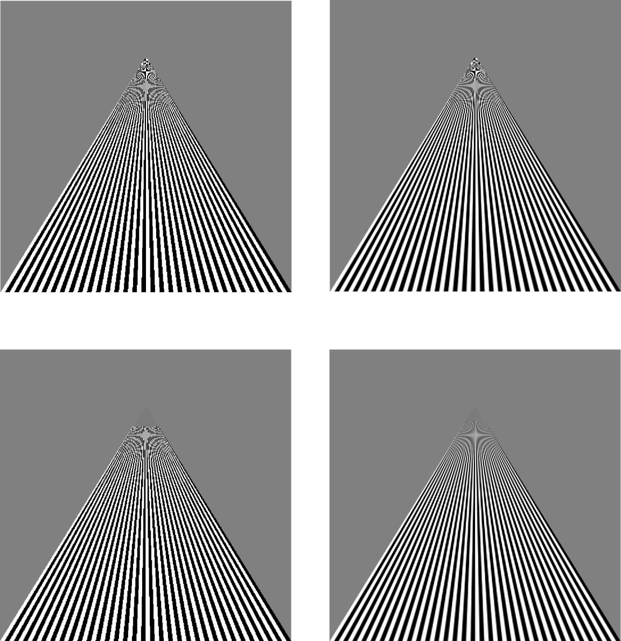
Example
point
sampling
linear
filtering
mipmapped
point
sampling
mipmapped
linear
filtering

Slide 18
Texture Functions
Controls how texture is applied
glTexEnv{fi}[v]( GL_TEXTURE_ENV, prop, param )
GL_TEXTURE_ENV_MODE modes
GL_MODULATE: modulates with computed shade
GL_BLEND: blends with an environmental color
GL_REPLACE: use only texture color
GL(GL_TEXTURE_ENV, GL_TEXTURE_ENV_MODE, GL_MODULATE);
Set blend color with GL_TEXTURE_ENV_COLOR
Notes:
18

Slide 19
Perspective Correction Hint
Texture coordinate and color interpolation
either linearly in screen space
or using depth/perspective values (slower)
Noticeable for polygons “on edge”
glHint( GL_PERSPECTIVE_CORRECTION_HINT, hint )
where hint is one of
GL_DONT_CARE
GL_NICEST
GL_FASTEST
Notes:
19

Slide 20
Generating Texture Coordinates
OpenGL can generate texture coordinates automatically
glTexGen{ifd}[v]()
specify a plane
generate texture coordinates based upon distance from the plane
generation modes
GL_OBJECT_LINEAR
GL_EYE_LINEAR
GL_SPHERE_MAP (used for environmental maps)
Notes:
20

Slide 21
Texture Objects
Texture is part of the OpenGL state
If we have different textures for different objects, OpenGL will be moving large amounts data from processor memory to texture memory
Recent versions of OpenGL have texture objects
one image per texture object
Texture memory can hold multiple texture objects
Notes:
21

Slide 22
Applying Textures II
specify textures in texture objects
set texture filter
set texture function
set texture wrap mode
set optional perspective correction hint
bind texture object
enable texturing
supply texture coordinates for vertex
coordinates can also be generated
Notes:
22

Slide 23
Other Texture Features
Environment Maps
Start with image of environment through a wide angle lens
Can be either a real scanned image or an image created in OpenGL
Use this texture to generate a spherical map
Use automatic texture coordinate generation
Multitexturing
Apply a sequence of textures through cascaded texture units

