Slide 1
CS 480/680
Fall 2011
Computer Graphics
Shader Applications
Dr. Frederick C Harris, Jr.

Slide 2
Objectives
Shader Applications
Texture Mapping Applications
Reflection Maps
Bump Maps

Slide 3
Vertex Shader Applications
Moving vertices
Morphing
Wave motion
Fractals
Lighting
More realistic models
Cartoon shaders

Slide 4
Wave Motion Vertex Shader
uniform float time;
uniform float xs, zs, // frequencies
uniform float h; // height scale
uniform mat4 ModelView, Projection;
in vec4 vPosition;
void main() {
vec4 t =vPosition;
t.y = vPosition.y
+ h*sin(time + xs*vPosition.x)
+ h*sin(time + zs*vPosition.z);
gl_Position = Projection*ModelView*t;
}

Slide 5
Particle System
uniform vec3 init_vel;
uniform float g, m, t;
uniform mat4 Projection, ModelView;
in vPosition;
void main(){
vec3 object_pos;
object_pos.x = vPosition.x + vel.x*t;
object_pos.y = vPosition.y + vel.y*t
+ g/(2.0*m)*t*t;
object_pos.z = vPosition.z + vel.z*t;
gl_Position = Projection*
ModelView*vec4(object_pos,1);
}

Slide 6
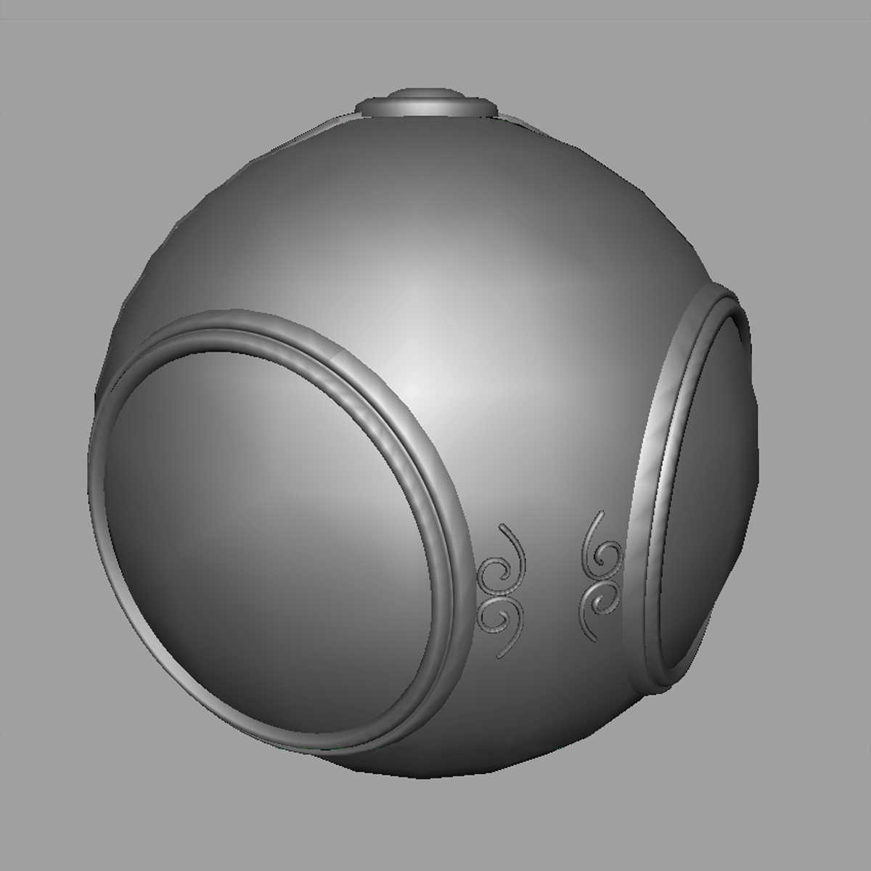
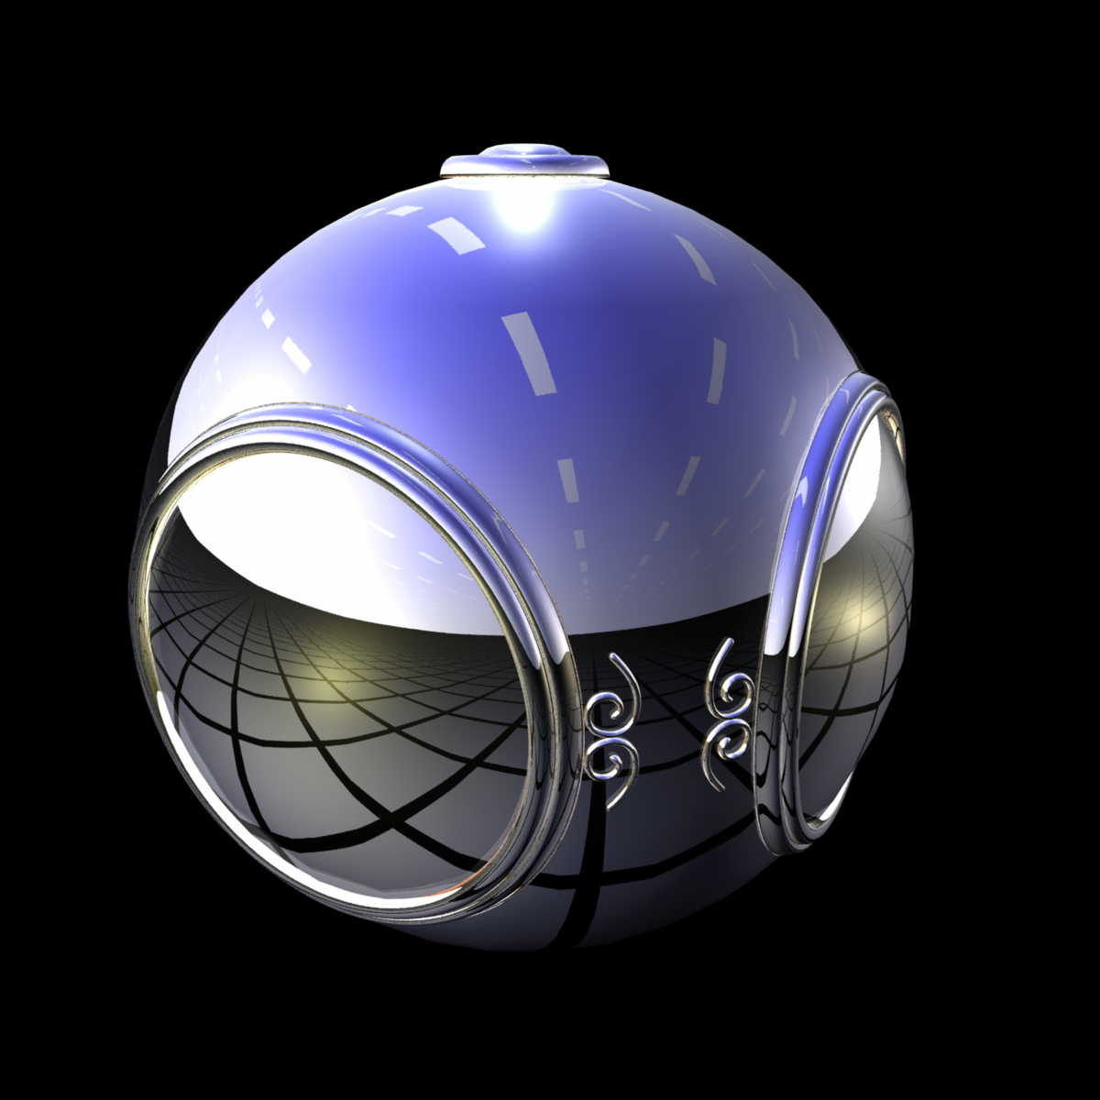
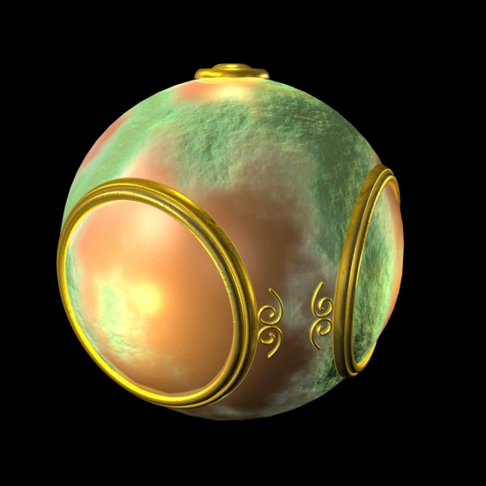
Fragment Shader Applications
Texture mapping
smooth shading
environment
mapping
bump mapping

Slide 7
Cube Maps
We can form a cube map texture by defining six 2D texture maps that correspond to the sides of a box
Supported by OpenGL
Also supported in GLSL through cubemap sampler
vec4 texColor = textureCube(mycube, texcoord);
Texture coordinates must be 3D

Slide 8
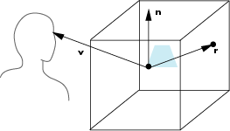
Environment Map
Use reflection vector to locate texture in cube map

Slide 9
Environment Maps with Shaders
Environment map usually computed in world coordinates which can differ from object coordinates because of modeling matrix
May have to keep track of modeling matrix and pass it shader as a uniform variable
Can also use reflection map or refraction map (for example to simulate water)

Slide 10
Reflection Map Vertex Shader
uniform mat4 Projection, ModelView, NormalMatrix;
in vec4 vPosition;
in vec4 normal;
out vec3 R;
void main(void)
{
gl_Position = Projection*ModelView*vPosition;
vec3 N = normalize(NormalMatrix*normal);
vec4 eyePos = ModelView*gvPosition;
R = reflect(-eyePos.xyz, N);
}

Slide 11
Refelction Map Fragment Shader
in vec3 R;
uniform samplerCube texMap;
void main(void)
{
gl_FragColor = textureCube(texMap, R);
}

Slide 12
Bump Mapping
Perturb normal for each fragment
Store perturbation as textures

Slide 13
Normalization Maps
Cube maps can be viewed as lookup tables 1-4 dimensional variables
Vector from origin is pointer into table
Example: store normalized value of vector in the map
Same for all points on that vector
Use “normalization map” instead of normalization function
Lookup replaces sqrt, mults and adds

Slide 14
Introduction
Let’s consider an example for which a fragment program might make sense
Mapping methods
Texture mapping
Environmental (reflection) mapping
Variant of texture mapping
Bump mapping
Solves flatness problem of texture mapping

Slide 15
Modeling an Orange
Consider modeling an orange
Texture map a photo of an orange onto a surface
Captures dimples
Will not be correct if we move viewer or light
We have shades of dimples rather than their correct orientation
Ideally we need to perturb normal across surface of object and compute a new color at each interior point

Slide 16
Bump Mapping (Blinn)
Consider a smooth surface
n
p

Slide 17
Rougher Version
n’
p’
p

Slide 18
Equations
p(u,v) = [x(u,v), y(u,v), z(u,v)]^{T}
p_{u}=[ ∂x/ ∂u, ∂y/ ∂u, ∂z/ ∂u]^{T}
p_{v}=[ ∂x/ ∂v, ∂y/ ∂v, ∂z/ ∂v]^{T}
n = (p_{u} × p_{v} ) / | p_{u} × p_{v} |

Slide 19
Tangent Plane
p_{v}
n
p_{u}

Slide 20
Displacement Function
p’ = p + d(u,v) n
d(u,v) is the bump or displacement function
|d(u,v)| << 1

Slide 21
Perturbed Normal
n’ = p’_{u} × p’_{v}
p’_{u} = p_{u} + (∂d/∂u)n + d(u,v)n_{u}
p’_{v} = p_{v} + (∂d/∂v)n + d(u,v)n_{v}
If d is small, we can neglect last term

Slide 22
Approximating the Normal
n’ = p’_{u} × p’_{v}
≈ n + (∂d/∂u)n × p_{v} + (∂d/∂v)n × p_{u}
The vectors n × p_{v} and n × p_{u} lie in the tangent plane
Hence the normal is displaced in the tangent plane
Must precompute the arrays ∂d/ ∂u and ∂d/ ∂v
Finally, we perturb the normal during shading

Slide 23
Image Processing
Suppose that we start with a function d(u,v)
We can sample it to form an array D=[d_{ij}]
Then ∂d/ ∂u ≈ d_{ij} – d_{i-1,j}
and ∂d/ ∂v ≈ d_{ij} – d_{i,j-1}
Embossing: multipass approach using floating point buffer

Slide 24
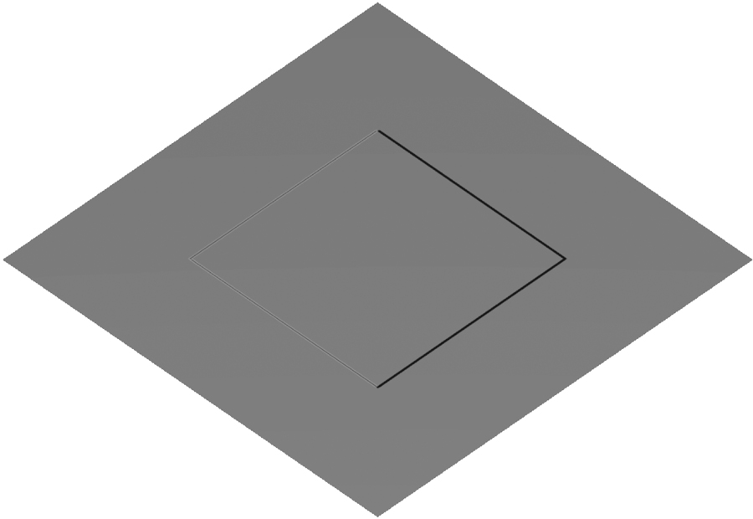
Example
Single Polygon and a Rotating Light Source

Slide 25
How to do this?
The problem is that we want to apply the perturbation at all points on the surface
Cannot solve by vertex lighting (unless polygons are very small)
Really want to apply to every fragment
Can’t do that in fixed function pipeline
But can do with a fragment program!!

