Slide 1
CS 480/680
Fall 2011
Computer Graphics
Compositing and Blending
Dr. Frederick C Harris, Jr.

Slide 2
Objectives
Learn to use the A component in RGBA color for
Blending for translucent surfaces
Compositing images
Antialiasing

Slide 3
Opacity and Transparency
Opaque surfaces permit no light to pass through
Transparent surfaces permit all light to pass
Translucent surfaces pass some light
translucency = 1 – opacity (α)
opaque surface α =1

Slide 4
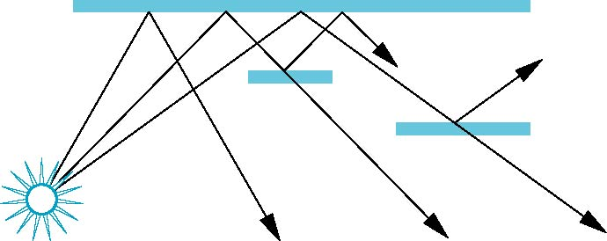
Physical Models
Dealing with translucency in a physically correct manner is difficult due to
the complexity of the internal interactions of light and matter
Using a pipeline renderer

Slide 5
Writing Model
Use A component of RGBA (or RGBα) color to store opacity
During rendering we can expand our writing model to use RGBA values
blend
source blending factor
source
component
destination
component
destination blending
factor
Color Buffer

Slide 6
Blending Equation
We can define source and destination blending factors for each RGBA component
s = [s_{r}, s_{g}, s_{b}, s_{α}]
d = [d_{r}, d_{g}, d_{b}, d_{α}]
Suppose that the source and destination colors are
b = [b_{r}, b_{g}, b_{b}, b_{α}]
c = [c_{r}, c_{g}, c_{b}, c_{α}]
Blend as
c’ = [b_{r} s_{r}+ c_{r} d_{r}, b_{g} s_{g}+ c_{g} d_{g} , b_{b} s_{b}+ c_{b} d_{b} , b_{α} s_{α}+ c_{α} d_{α} ]

Slide 7
OpenGL Blending and Compositing
Must enable blending and pick source and destination factors
glEnable(GL_BLEND)
glBlendFunc(source_factor,
destination_factor)
Only certain factors supported
GL_ZERO, GL_ONE
GL_SRC_ALPHA, GL_ONE_MINUS_SRC_ALPHA
GL_DST_ALPHA, GL_ONE_MINUS_DST_ALPHA
See Redbook for complete list

Slide 8
Example
Suppose that we start with the opaque background color (R₀,G₀,B₀,1)
This color becomes the initial destination color
We now want to blend in a translucent polygon with color (R₁,G₁,B₁,α₁)
Select GL_SRC_ALPHA and GL_ONE_MINUS_SRC_ALPHA as the source and destination blending factors
R’₁ = α₁ R₁ +(1- α₁) R_{0,} ……
Note this formula is correct if polygon is either opaque or transparent

Slide 9
Clamping and Accuracy
All the components (RGBA) are clamped and stay in the range (0,1)
However, in a typical system, RGBA values are only stored to 8 bits
Can easily loose accuracy if we add many components together
Example: add together n images
Divide all color components by n to avoid clamping
Blend with source factor = 1, destination factor = 1
But division by n loses bits

Slide 10
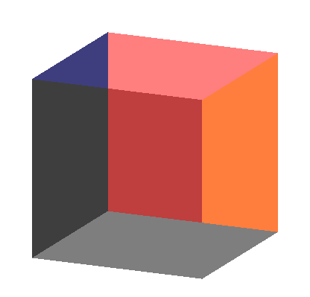
Order Dependency
Is this image correct?
Probably not
Polygons are rendered
in the order they pass
down the pipeline
Blending functions
are order dependent

Slide 11
Opaque and Translucent Polygons
Suppose that we have a group of polygons some of which are opaque and some translucent
How do we use hidden-surface removal?
Opaque polygons block all polygons behind them and affect the depth buffer
Translucent polygons should not affect depth buffer
Render with glDepthMask(GL_FALSE) which makes depth buffer read-only
Sort polygons first to remove order dependency

Slide 12
Fog
We can composite with a fixed color and have the blending factors depend on depth
Simulates a fog effect
Blend source color C_{s} and fog color C_{f} by
C_{s}’=f C_{s} + (1-f) C_{f}
f is the fog factor
Exponential
Gaussian
Linear (depth cueing)

Slide 13
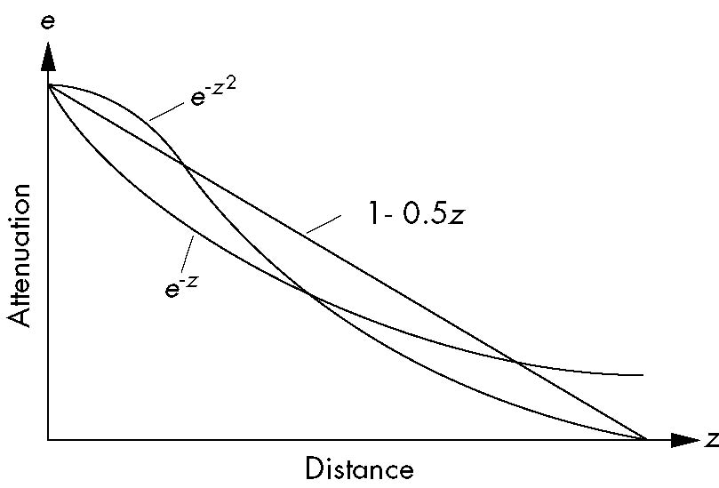
Fog Functions

Slide 14
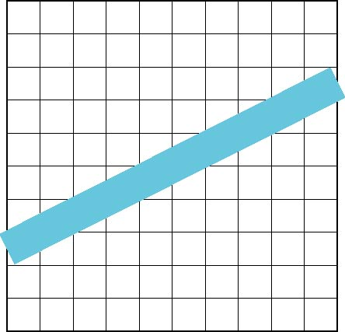
Line Aliasing
Ideal raster line is one pixel wide
All line segments, other than vertical and horizontal segments, partially cover pixels
Simple algorithms color
only whole pixels
Lead to the “jaggies”
or aliasing
Similar issue for polygons

Slide 15
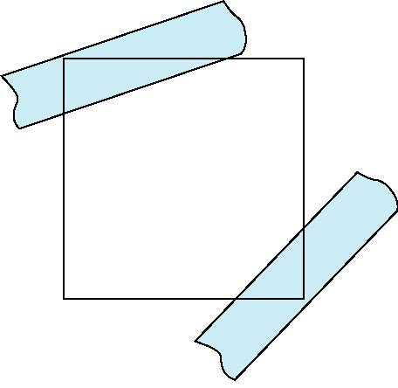
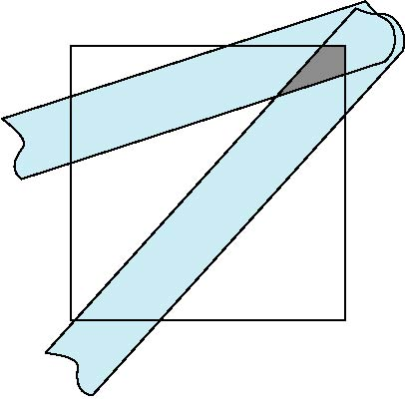
Antialiasing
Can try to color a pixel by adding a fraction of its color to the frame buffer
Fraction depends on percentage of pixel covered by fragment
Fraction depends on whether there is overlap
no overlap
overlap

Slide 16
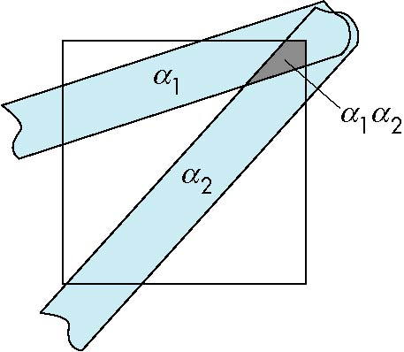
Area Averaging
Use average area α₁+α₂-α₁α₂ as blending factor

Slide 17
OpenGL Antialiasing
Can enable separately for points, lines, or polygons
glEnable(GL_POINT_SMOOTH);
glEnable(GL_LINE_SMOOTH);
glEnable(GL_POLYGON_SMOOTH);
glEnable(GL_BLEND);
glBlendFunc(GL_SRC_ALPHA, GL_ONE_MINUS_SRC_ALPHA);

Slide 18
Accumulation Techniques
Compositing and blending are limited by resolution of the frame buffer
Typically 8 bits per color component
The accumulation buffer was a high resolution buffer (16 or more bits per component) that avoided this problem
Could write into it or read from it with a scale factor
Slower than direct compositing into the frame buffer
Now deprecated but can do techniques with floating point frame buffers

Slide 19
Applications
Compositing
Image Filtering (convolution)
Whole scene antialiasing
Depth of Field
Motion effects

