Slide 1
CS 480/680
Fall 2011
Computer Graphics
Programming with Open GL
Part 1: Background
Dr. Frederick C Harris, Jr.

Slide 2
Objectives
Development of the OpenGL API
OpenGL Architecture
OpenGL as a state machine
OpenGL as a data flow machine
Functions
Types
Formats
Simple program

Slide 3
Early History of APIs
IFIPS (1973) formed two committees to come up with a standard graphics API
Graphical Kernel System (GKS)
2D but contained good workstation model
Core
Both 2D and 3D
GKS adopted as IS0 and later ANSI standard (1980s)
GKS not easily extended to 3D (GKS-3D)
Far behind hardware development

Slide 4
PHIGS and X
Programmers Hierarchical Graphics System (PHIGS)
Arose from CAD community
Database model with retained graphics (structures)
X Window System
DEC/MIT effort
Client-server architecture with graphics
PEX combined the two
Not easy to use (all the defects of each)

Slide 5
SGI and GL
Silicon Graphics (SGI) revolutionized the graphics workstation by implementing the pipeline in hardware (1982)
To access the system, application programmers used a library called GL
With GL, it was relatively simple to program three dimensional interactive applications

Slide 6
OpenGL
The success of GL lead to OpenGL (1992), a platform-independent API that was
Easy to use
Close enough to the hardware to get excellent performance
Focus on rendering
Omitted windowing and input to avoid window system dependencies

Slide 7
OpenGL Evolution
Originally controlled by an Architectural Review Board (ARB)
Members included SGI, Microsoft, Nvidia, HP, 3DLabs, IBM,…….
Now Kronos Group
Was relatively stable (through version 2.5)
Backward compatible
Evolution reflected new hardware capabilities
3D texture mapping and texture objects
Vertex and fragment programs
Allows platform specific features through extensions

Slide 8
Modern OpenGL
Performance is achieved by using GPU rather than CPU
Control GPU through programs called shaders
Application’s job is to send data to GPU
GPU does all rendering

Slide 9
OpenGL 3.1
Totally shader-based
No default shaders
Each application must provide both a vertex and a fragment shader
No immediate mode
Few state variables
Most 2.5 functions deprecated
Backward compatibility not required

Slide 10
Other Versions
OpenGL ES
Embedded systems
Version 1.0 simplified OpenGL 2.1
Version 2.0 simplified OpenGL 3.1
Shader based
WebGL
Javascript implementation of ES 2.0
Supported on newer browsers
OpenGL 4.1 and 4.2
Add geometry shaders and tessellator

Slide 11
What About Direct X?
Windows only
Advantages
Better control of resources
Access to high level functionality
Disadvantages
New versions not backward compatible
Windows only
Recent advances in shaders are leading to convergence with OpenGL

Slide 12
OpenGL Libraries
OpenGL core library
OpenGL32 on Windows
GL on most unix/linux systems (libGL.a)
OpenGL Utility Library (GLU)
Provides functionality in OpenGL core but avoids having to rewrite code
Will only work with legacy code
Links with window system
GLX for X window systems
WGL for Windows
AGL for Macintosh

Slide 13
GLUT
OpenGL Utility Toolkit (GLUT)
Provides functionality common to all window systems
Open a window
Get input from mouse and keyboard
Menus
Event-driven
Code is portable but GLUT lacks the functionality of a good toolkit for a specific platform
No slide bars

Slide 14
freeglut
GLUT was created long ago and has been unchanged
Amazing that it works with OpenGL 3.1
Some functionality can’t work since it requires deprecated functions
freeglut updates GLUT
Added capabilities
Context checking

Slide 15
GLEW
OpenGL Extension Wrangler Library
Makes it easy to access OpenGL extensions available on a particular system
Avoids having to have specific entry points in Windows code
Application needs only to include glew.h and run a glewInit()

Slide 16
Software Organization

Slide 17
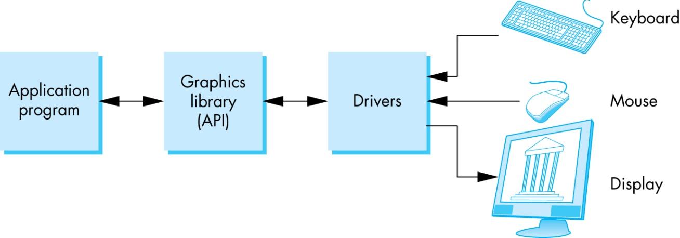
OpenGL Architecture

Slide 18
OpenGL Functions
Primitives
Points
Line Segments
Triangles
Attributes
Transformations
Viewing
Modeling
Control (GLUT)
Input (GLUT)
Query

Slide 19
OpenGL State
OpenGL is a state machine
OpenGL functions are of two types
Primitive generating
Can cause output if primitive is visible
How vertices are processed and appearance of primitive are controlled by the state
State changing
Transformation functions
Attribute functions
Under 3.1 most state variables are defined by the application and sent to the shaders

Slide 20
Lack of Object Orientation
OpenGL is not object oriented so that there are multiple functions for a given logical function
glUniform3f
glUniform2i
glUniform3dv
Underlying storage mode is the same
Easy to create overloaded functions in C++ but issue is efficiency

Slide 21
OpenGL function format
function name
dimensions
glUniform3f(x,y,z)
belongs to GL library
x,y,z are floats
glUniform3fv(p)
p is a pointer to an array

Slide 22
OpenGL #defines
Most constants are defined in the include files gl.h, glu.h and glut.h
Note #include <GL/glut.h> should automatically include the others
Examples
glEnable(GL_DEPTH_TEST)
glClear(GL_COLOR_BUFFER_BIT)
include files also define OpenGL data types: GLfloat, GLdouble,….

Slide 23
OpenGL and GLSL
Shader based OpenGL is based less on a state machine model than a data flow model
Most state variables, attributes and related pre 3.1 OpenGL functions have been deprecated
Action happens in shaders
Job of the application is to get data to GPU

Slide 24
GLSL
OpenGL Shading Language
C-like with
Matrix and vector types (2, 3, 4 dimensional)
Overloaded operators
C++ like constructors
Similar to Nvidia’s Cg and Microsoft HLSL
Code sent to shaders as source code
New OpenGL functions to compile, link and get information to shaders

Slide 25
A Simple Program (?)
Generate a square on a solid background

Slide 26
It used to be easy
#include <GL/glut.h>
void mydisplay(){
glClear(GL_COLOR_BUFFER_BIT);
glBegin(GL_QUAD;
glVertex2f(-0.5, -0.5);
glVertex2f(-0,5, 0,5);
glVertex2f(0.5, 0.5);
glVertex2f(0.5, -0.5);
glEnd()
}
int main(int argc, char** argv){
glutCreateWindow("simple");
glutDisplayFunc(mydisplay);
glutMainLoop();
}

Slide 27
What happened
Most OpenGL functions deprecated
Makes heavy use of state variable default values that no longer exist
Viewing
Colors
Window parameters
Next version will make the defaults more explicit
However, processing loop is the same

Slide 28
simple.c
#include <GL/glut.h>
void mydisplay(){
glClear(GL_COLOR_BUFFER_BIT);
// need to fill in this part
// and add in shaders
}
int main(int argc, char** argv){
glutCreateWindow("simple");
glutDisplayFunc(mydisplay);
glutMainLoop();
}

Slide 29
Event Loop
Note that the program specifies a display callback function named mydisplay
Every glut program must have a display callback
The display callback is executed whenever OpenGL decides the display must be refreshed, for example when the window is opened
The main function ends with the program entering an event loop

Slide 30
Notes on compilation
Unix/linux
Include files usually in …/include/GL
Compile with –lglut –lgl loader flags
May have to add –L flag for X libraries
Mesa implementation included with most linux distributions
Check web for latest versions of Mesa and glut

Slide 31
Compilation on Windows
Visual C++
Get glut.h, glut32.lib and glut32.dll from web
Install in same places as corresponding OpenGL files
Create an empty application
Add glut32.lib to project settings (under link tab)
Same for freeglut and GLEW

Slide 32
Compilation on Windows
Cygwin (linux under Windows)
Can use gcc and similar makefile to linux
Use –lopengl32–lglut32 flags

