Slide 1
CS 480/680
Fall 2011
Computer Graphics
Programming with Open GL
Part 2: Complete Programs
Dr. Frederick C Harris, Jr.

Slide 2
Objectives
Build a complete first program
Introduce shaders
Introduce a standard program structure
Simple viewing
Two-dimensional viewing as a special case of three-dimensional viewing
Initialization steps and program structure

Slide 3
Program Structure
Most OpenGL programs have a similar structure that consists of the following functions
main():
specifies the callback functions
opens one or more windows with the required properties
enters event loop (last executable statement)
init(): sets the state variables
Viewing
Attributes
initShader():read, compile and link shaders
callbacks
Display function
Input and window functions

Slide 4
simple.c revisited
main() function similar to last lecture
Mostly GLUT functions
init() will allow more flexibility for colors
initShader() will hides details of setting up shaders for now
Key issue is that we must form a data array to send to GPU and then render it

Slide 5
main.c
#include <GL/glew.h>
#include <GL/glut.h>
int main(int argc, char** argv)
{
glutInit(&argc,argv);
glutInitDisplayMode(GLUT_SINGLE|GLUT_RGB);
glutInitWindowSize(500,500);
glutInitWindowPosition(0,0);
glutCreateWindow("simple");
glutDisplayFunc(mydisplay);
glewInit();
init();
glutMainLoop();
}
includes gl.h
specify window properties
display callback
set OpenGL state and initialize shaders
enter event loop

Slide 6
GLUT functions
glutInit allows application to get command line arguments and initializes system
gluInitDisplayMode requests properties for the window (the rendering context)
RGB color
Single buffering
Properties logically ORed together
glutWindowSize in pixels
glutWindowPosition from top-left corner of display
glutCreateWindow create window with title “simple”
glutDisplayFunc display callback
glutMainLoop enter infinite event loop

Slide 7
Immediate Mode Graphics
Geometry specified by vertices
Locations in space (2 or 3 dimensional)
Points, lines, circles, polygons, curves, surfaces
Immediate mode
Each time a vertex is specified in application, its location is sent to the GPU
Old style uses glVertex
Creates bottleneck between CPU and GPU
Removed from OpenGL 3.1

Slide 8
Retained Mode Graphics
Put all vertex and attribute data in array
Send array to GPU to be rendered immediately
Almost OK but problem is we would have to send array over each time we need another render of it
Better to send array over and store on GPU for multiple renderings

Slide 9
Display Callback
Once we get data to GLU, we can initiate the rendering with a simple callback
Arrays are buffer objects that contain vertex arrays
void mydisplay()
{
glClear(GL_COLOR_BUFFER_BIT);
glDrawArrays(GL_TRIANGLES, 0, 3);
glFlush();
}

Slide 10
Vertex Arrays
Vertices can have many attributes
Position
Color
Texture Coordinates
Application data
A vertex array holds these data
Using types in vec.h
point2 vertices[3] = {point2(0.0, 0.0),
point2(0.0, 1.0), point2(1.0, 1.0)};

Slide 11
Vertex Array Object
Bundles all vertex data (positions, colors, ..,)
Get name for buffer then bind
At this point we have a current vertex array but no contents
Use of glBindVertexArray lets us switch between VBOs
Glunit abuffer;
glGenVertexArrays(1, &abuffer);
glBindVertexArray(abuffer);

Slide 12
Buffer Object
Buffers objects allow us to transfer large amounts of data to the GPU
Need to create, bind and identify data
Data in current vertex array is sent to GPU
Gluint buffer;
glGenBuffers(1, &buffer);
glBindBuffer(GL_ARRAY_BUFFER, buffer);
glBufferData(GL_ARRAY_BUFFER,
sizeof(points), points);

Slide 13
Initialization
Vertex array objects and buffer objects can be set up in init()
Also set clear color and other OpeGL parameters
Also set up shaders as part of initialization
Read
Compile
Link
First let’s consider a few other issues

Slide 14
Coordinate Systems
The units in points are determined by the application and are called object, world, model or problem coordinates
Viewing specifications usually are also in object coordinates
Eventually pixels will be produced in window coordinates
OpenGL also uses some internal representations that usually are not visible to the application but are important in the shaders

Slide 15
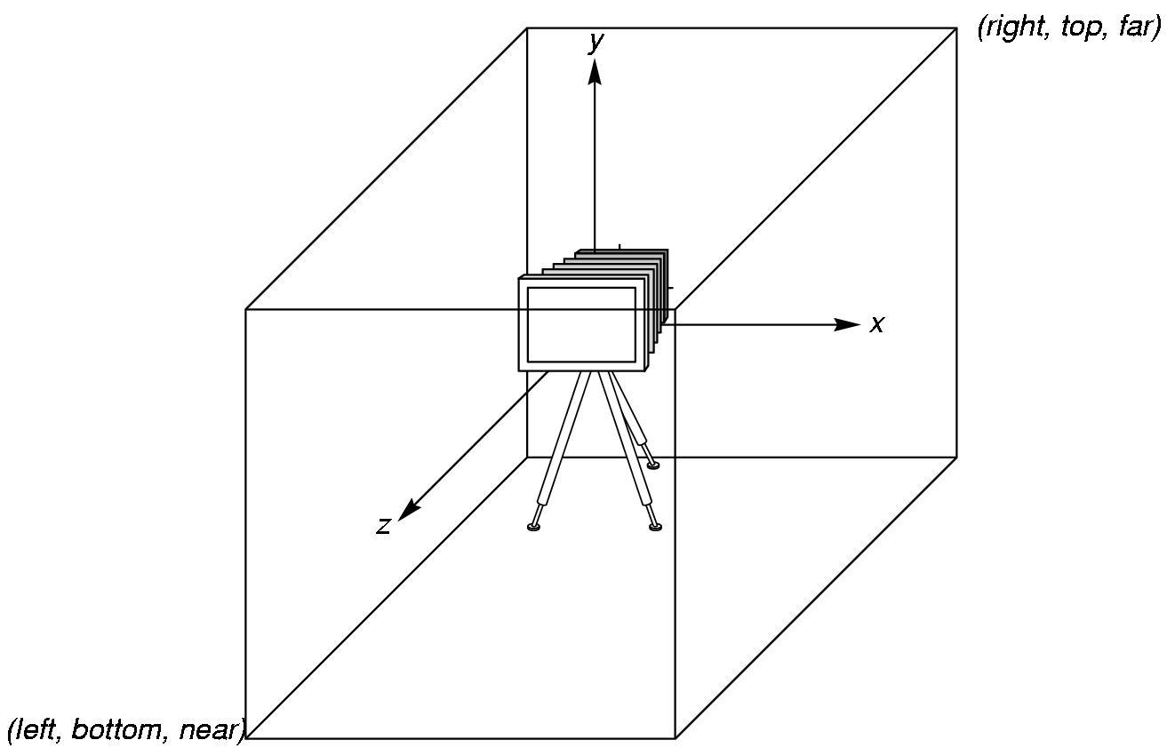
OpenGL Camera
OpenGL places a camera at the origin in object space pointing in the negative z direction
The default viewing volume
is a box centered at the
origin with sides of
length 2

Slide 16
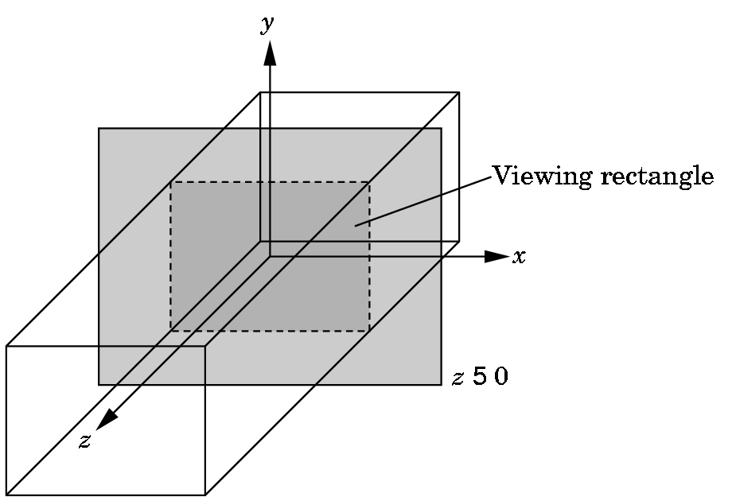
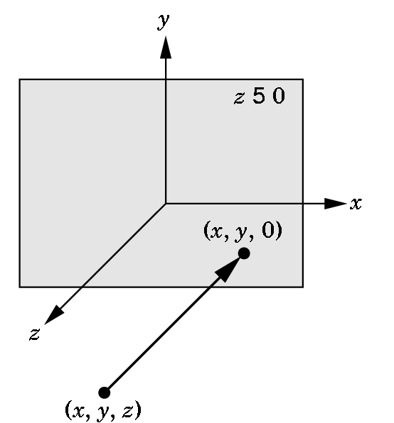
Orthographic Viewing
In the default orthographic view, points are
projected forward along the z axis onto the
plane z=0
z=0
z=0

Slide 17
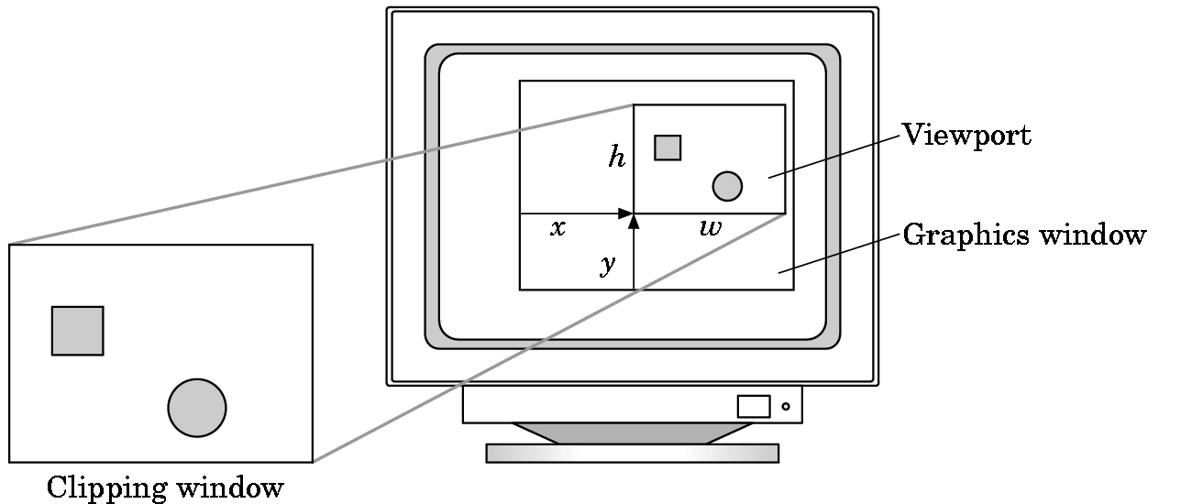
Viewports
Do not have use the entire window for the image: glViewport(x,y,w,h)
Values in pixels (window coordinates)

Slide 18
Transformations and Viewing
In OpenGL, projection is carried out by a projection matrix (transformation)
Transformation functions are also used for changes in coordinate systems
Pre 3.0 OpenGL had a set of transformation functions which have been deprecated
Three choices
Application code
GLSL functions
vec.h and mat.h

