Slide 1
CS 480/680
Fall 2011
Computer Graphics
Programming with Open GL
Part 3: Programming with Shaders
Dr. Frederick C Harris, Jr.

Slide 2
Objectives
Simple Shaders
Vertex shader
Fragment shaders
Programming shaders with GLSL
Finish first program

Slide 3
Vertex Shader Applications
Moving vertices
Morphing
Wave motion
Fractals
Lighting
More realistic models
Cartoon shaders

Slide 4
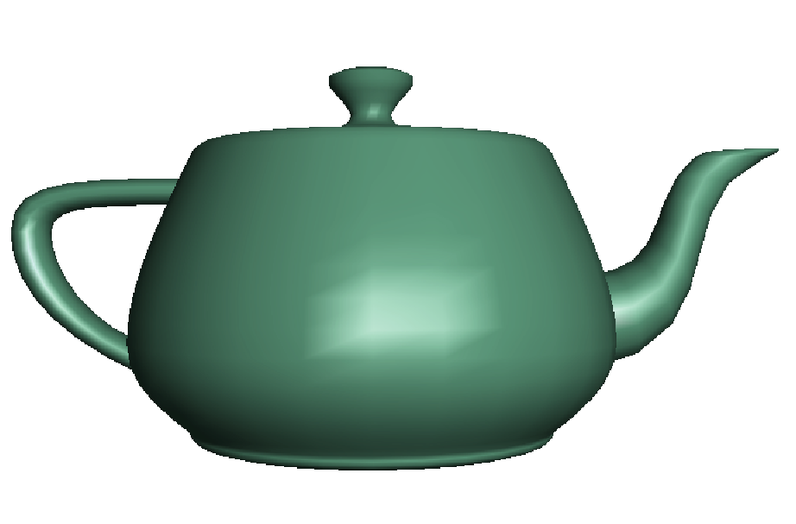
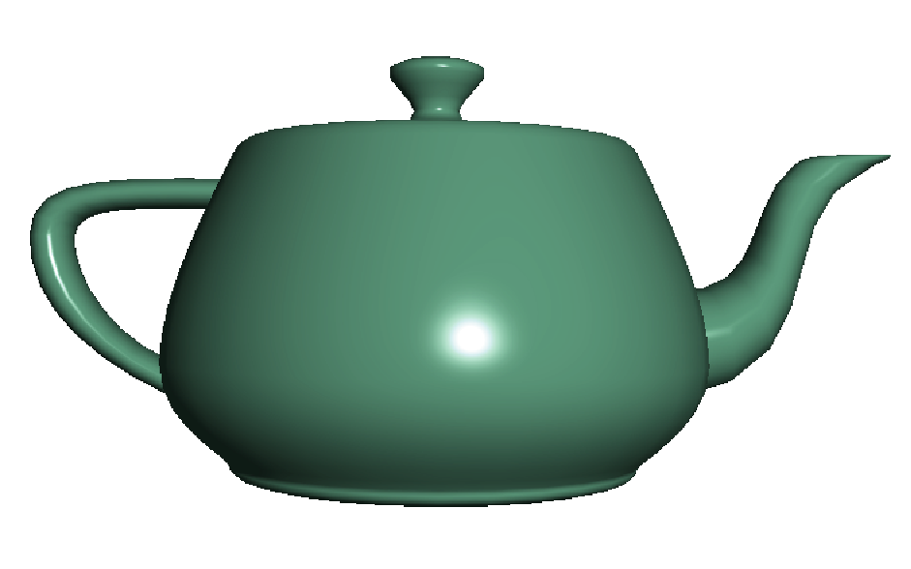
Fragment Shader Applications
Per fragment lighting calculations
per vertex lighting
per fragment lighting

Slide 5
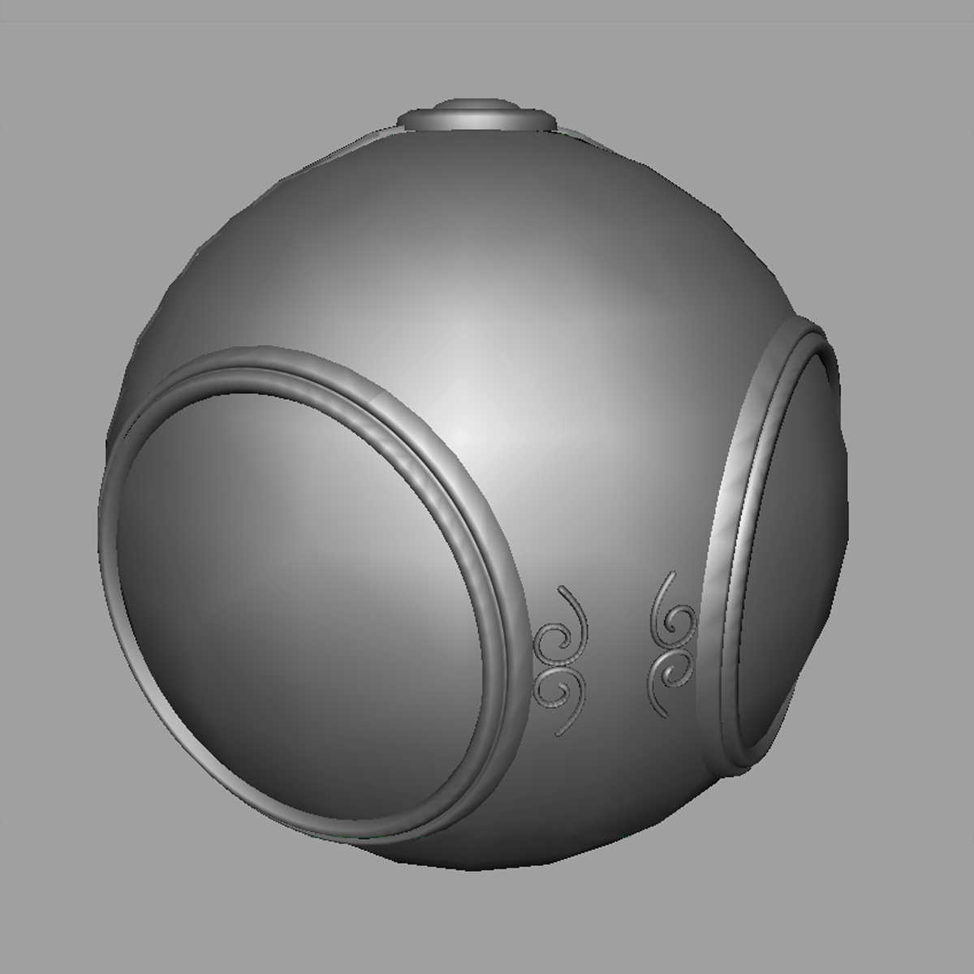
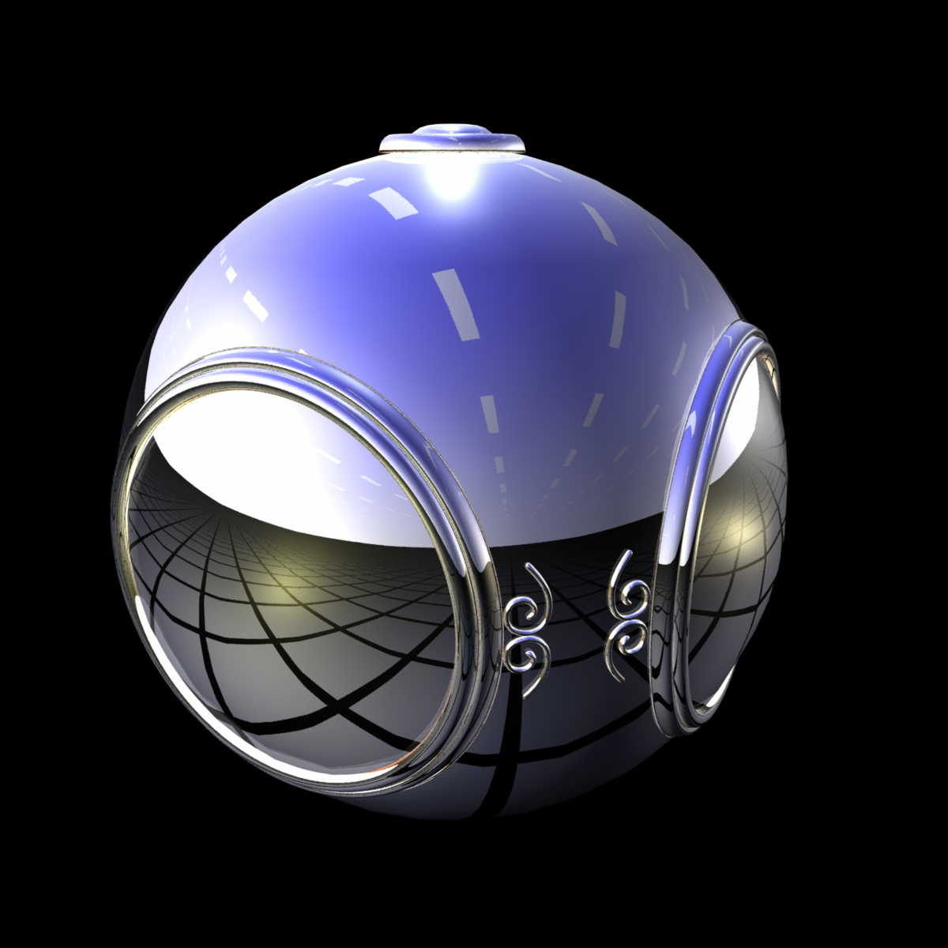
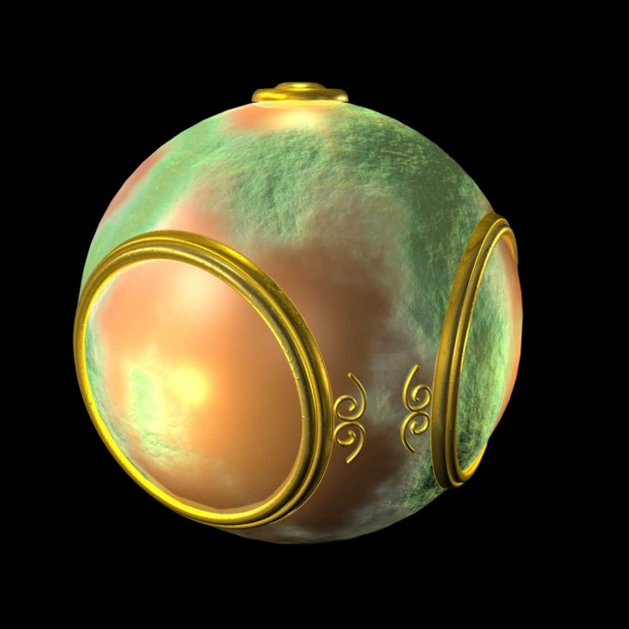
Fragment Shader Applications
Texture mapping
smooth shading
environment mapping
bump mapping

Slide 6
Writing Shaders
First programmable shaders were programmed in an assembly-like manner
OpenGL extensions added for vertex and fragment shaders
Cg (C for graphics) C-like language for programming shaders
Works with both OpenGL and DirectX
Interface to OpenGL complex
OpenGL Shading Language (GLSL)

Slide 7
GLSL
OpenGL Shading Language
Part of OpenGL 2.0 and up
High level C-like language
New data types
Matrices
Vectors
Samplers
As of OpenGL 3.1, application must provide shaders

Slide 8
Simple Vertex Shader
in vec4 vPosition;
void main(void)
{
gl_Position = vPosition;
}
input from application
must link to variable in application
built in variable

Slide 9
Execution Model
Vertex data
Shader Program
GPU
Application
Program
Vertex
Shader
Primitive
Assembly
glDrawArrays
Vertex

Slide 10
Simple Fragment Program
void main(void)
{
gl_FragColor = vec4(1.0, 0.0, 0.0, 1.0);
}

Slide 11
Execution Model
Application
Shader Program
Rasterizer
Fragment
Shader
Frame Buffer
Fragment
Fragment
Color

Slide 12
Data Types
C types: int, float, bool
Vectors:
float vec2, vec3, vec4
Also int (ivec) and boolean (bvec)
Matrices: mat2, mat3, mat4
Stored by columns
Standard referencing m[row][column]
C++ style constructors
vec3 a =vec3(1.0, 2.0, 3.0)
vec2 b = vec2(a)

Slide 13
Pointers
There are no pointers in GLSL
We can use C structs which can be copied back from functions
Because matrices and vectors are basic types they can be passed into and output from GLSL functions, e.g.
mat3 func(mat3 a)

Slide 14
Qualifiers
GLSL has many of the same qualifiers such as const as C/C++
Need others due to the nature of the execution model
Variables can change
Once per primitive
Once per vertex
Once per fragment
At any time in the application
Vertex attributes are interpolated by the rasterizer into fragment attributes

Slide 15
Attribute Qualifier
Attribute-qualified variables can change at most once per vertex
There are a few built in variables such as gl_Position but most have been deprecated
User defined (in application program)
Use in qualifier to get to shader
in float temperature
in vec3 velocity

Slide 16
Uniform Qualified
Variables that are constant for an entire primitive
Can be changed in application and sent to shaders
Cannot be changed in shader
Used to pass information to shader such as the bounding box of a primitive

Slide 17
Varying Qualified
Variables that are passed from vertex shader to fragment shader
Automatically interpolated by the rasterizer
Old style used the varying qualifier
varying vec4 color;
Now use out in vertex shader and in in the fragment shader
out vec4 color;

Slide 18
Example: Vertex Shader
const vec4 red = vec4(1.0, 0.0, 0.0, 1.0);
out vec3 color_out;
void main(void)
{
gl_Position = vPosition;
color_out = red;
}

Slide 19
Required Fragment Shader
in vec3 color_out;
void main(void)
{
gl_FragColor = color_out;
}
// in latest version use form
// out vec4 fragcolor;
// fragcolor = color_out;

Slide 20
Passing values
call by value-return
Variables are copied in
Returned values are copied back
Three possibilities
in
out
inout (deprecated)

Slide 21
Operators and Functions
Standard C functions
Trigonometric
Arithmetic
Normalize, reflect, length
Overloading of vector and matrix types
mat4 a;
vec4 b, c, d;
c = b*a; // a column vector stored as a 1d array
d = a*b; // a row vector stored as a 1d array

Slide 22
Swizzling and Selection
Can refer to array elements by element using [] or selection (.) operator with
x, y, z, w
r, g, b, a
s, t, p, q
a[2], a.b, a.z, a.p are the same
Swizzling operator lets us manipulate components
vec4 a;
a.yz = vec2(1.0, 2.0);

