Slide 1
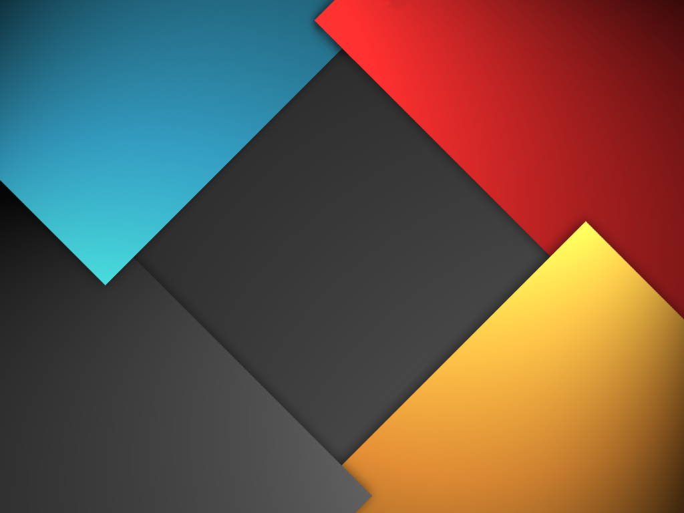
CS 480/680
Fall 2011
Computer Graphics
Programming with Open GL
Part 4: Color and Attributes
Dr. Frederick C Harris, Jr.

Slide 2
Objectives
Expanding primitive set
Adding color
Vertex attributes
Uniform variables

Slide 3
OpenGL Primitives
GL_POINTS
GL_LINES
GL_LINE_STRIP
GL_LINE_LOOP
GL_TRIANGLES
GL_TRIANGLE_STRIP
GL_TRIANGLE_FAN

Slide 4
Polygon Issues
OpenGL will only display triangles
Simple: edges cannot cross
Convex: All points on line segment between two points in a polygon are also in the polygon
Flat: all vertices are in the same plane
Application program must tessellate a polygon into triangles (triangulation)
OpenGL 4.1 contains a tessellator
nonconvex polygon
nonsimple polygon

Slide 5
Polygon Testing
Conceptually simple to test for simplicity and convexity
Time consuming
Earlier versions assuming both and left testing to the application
Present version only renders triangles
Need algorithm to triangulate an arbitrary polygon

Slide 6
Good and Bad Triangles
Long thin triangles render badly
Equilateral triangles render well
Maximize minimum angle
Delaunay triangulation for unstructured points

Slide 7
Triangularization
Convex polygon
Start with abc, remove b, then acd, ….
d
c
b
a

Slide 8
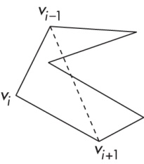
Non-convex (concave)

Slide 9
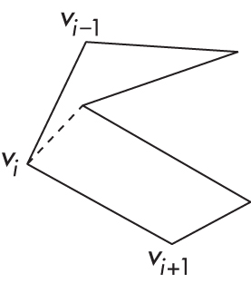
Recursive Division
Find leftmost vertex and split

Slide 10
Attributes
Attributes determine the appearance of objects
Color (points, lines, polygons)
Size and width (points, lines)
Stipple pattern (lines, polygons)
Polygon mode
Display as filled: solid color or stipple pattern
Display edges
Display vertices
Only a few (glPointSize) are supported by OpenGL functions

Slide 11
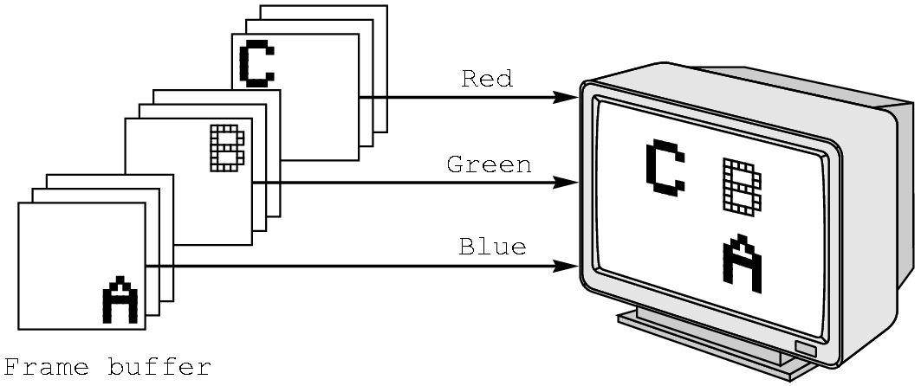
RGB color
Each color component is stored separately in the frame buffer
Usually 8 bits per component in buffer
Color values can range from 0.0 (none) to 1.0 (all) using floats or over the range from 0 to 255 using unsigned bytels

Slide 12
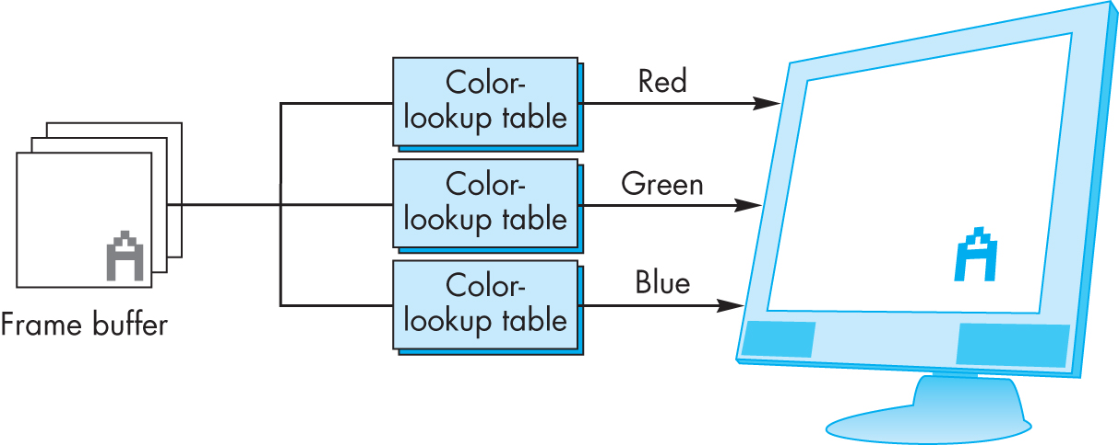
Indexed Color
Colors are indices into tables of RGB values
Requires less memory
indices usually 8 bits
not as important now
Memory inexpensive
Need more colors for shading

Slide 13
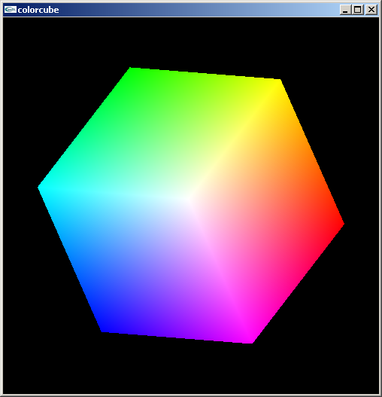
Smooth Color
Default is smooth shading
OpenGL interpolates vertex colors across visible polygons
Alternative is flat shading
Color of first vertex
determines fill color
Handle in shader

Slide 14
Setting Colors
Colors are ultimately set in the fragment shader but can be determined in either shader or in the application
Application color: pass to vertex shader as a uniform variable (next lecture) or as a vertex attribute
Vertex shader color: pass to fragment shader as varying variable (next lecture)
Fragment color: can alter via shader code

