Slide 1
CS 480/680
Fall 2011
Computer Graphics
Programming with Open GL
Part 5: Putting it all together
Dr. Frederick C Harris, Jr.

Slide 2
Objectives
Coupling shaders to applications
Reading
Compiling
Linking
Vertex Attributes
Setting up uniform variables
Example applications

Slide 3
Linking Shaders with Application
Read shaders
Compile shaders
Create a program object
Link everything together
Link variables in application with variables in shaders
Vertex attributes
Uniform variables

Slide 4
Program Object
Container for shaders
Can contain multiple shaders
Other GLSL functions
GLuint myProgObj;
myProgObj = glCreateProgram();
/* define shader objects here */
glUseProgram(myProgObj);
glLinkProgram(myProgObj);

Slide 5
Reading a Shader
Shaders are added to the program object and compiled
Usual method of passing a shader is as a null-terminated string using the function glShaderSource
If the shader is in a file, we can write a reader to convert the file to a string

Slide 6
Shader Reader
#include <stdio.h>
static char*
readShaderSource(const char* shaderFile)
{
FILE* fp = fopen(shaderFile, "r");
if ( fp == NULL ) { return NULL; }
fseek(fp, 0L, SEEK_END);
long size = ftell(fp);
fseek(fp, 0L, SEEK_SET);
char* buf = new char[size + 1];
fread(buf, 1, size, fp);
buf[size] = '\0';
fclose(fp);
return buf;
}

Slide 7
Adding a Vertex Shader
GLuint vShader;
GLunit myVertexObj;
GLchar vShaderfile[] = “my_vertex_shader”;
GLchar* vSource =
readShaderSource(vShaderFile);
glShaderSource(myVertexObj,
1, &vertexShaderFile, NULL);
myVertexObj =
glCreateShader(GL_VERTEX_SHADER);
glCompileShader(myVertexObj);
glAttachObject(myProgObj, myVertexObj);

Slide 8
Vertex Attributes
Vertex attributes are named in the shaders
Linker forms a table
Application can get index from table and tie it to an application variable
Similar process for uniform variables

Slide 9
Vertex Attribute Example
#define BUFFER_OFFSET( offset )
((GLvoid*) (offset))
GLuint loc =
glGetAttribLocation( program, "vPosition" );
glEnableVertexAttribArray( loc );
glVertexAttribPointer( loc, 2, GL_FLOAT,
GL_FALSE, 0, BUFFER_OFFSET(0) );

Slide 10
Uniform Variable Example
GLint angleParam;
angleParam = glGetUniformLocation(myProgObj,
"angle");
/* angle defined in shader */
/* my_angle set in application */
GLfloat my_angle;
my_angle = 5.0 /* or some other value */
glUniform1f(angleParam, my_angle);

Slide 11
Double Buffering
Updating the value of a uniform variable opens the door to animating an application
Execute glUniform in display callback
Force a redraw through glutPostRedisplay()
Need to prevent a partially redrawn frame buffer from being displayed
Draw into back buffer
Display front buffer
Swap buffers after updating finished

Slide 12
Adding Double Buffering
Request a double buffer
glutInitDisplayMode(GLUT_DOUBLE)
Swap buffers
void mydisplay()
{
glClear(……);
glDrawArrays();
glutSwapBuffers();
}

Slide 13
Idle Callback
Idle callback specifies function to be executed when no other actions pending
glutIdleFunc(myIdle);
void myIdle()
{
// recompute display
glutPostRedisplay();
}

Slide 14
Attribute and Varying Qualifiers
Starting with GLSL 1.5 attribute and varying qualifiers have been replaced by in and out qualifiers
No changes needed in application
Vertex shader example:
#version 1.4
attribute vec3 vPosition;
varying vec3 color;
#version 1.5
in vec3 vPosition;
out vec3 color;

Slide 15
Adding Color
If we set a color in the application, we can send it to the shaders as a vertex attribute or as a uniform variable depending on how often it changes
Let’s associate a color with each vertex
Set up an array of same size as positions
Send to GPU as a vertex buffer object

Slide 16
Setting Colors
typedef vec3 color3;
color3 base_colors[4] = {color3(1.0, 0.0. 0.0), ….
color3 colors[NumVertices];
vec3 points[NumVertices];
//in loop setting positions
colors[i] = basecolors[color_index]
position[i] = …….

Slide 17
Setting Up Buffer Object
//need larger buffer
glBufferData(GL_ARRAY_BUFFER, sizeof(points) +
sizeof(colors), NULL, GL_STATIC_DRAW);
//load data separately
glBufferSubData(GL_ARRAY_BUFFER, 0,
sizeof(points), points);
glBufferSubData(GL_ARRAY_BUFFER, sizeof(points),
sizeof(colors), colors);

Slide 18
Second Vertex Array
// vPosition and vColor identifiers in vertex shader
loc = glGetAttribLocation(program, “vPosition”);
glEnableVertexAttribArray(loc);
glVertexAttribPointer(loc, 3, GL_FLOAT, GL_FALSE, 0,
BUFFER_OFFSET(0));
loc2 = glGetAttribLocation(program, “vColor”);
glEnableVertexAttribArray(loc2);
glVertexAttribPointer(loc2, 3, GL_FLOAT, GL_FALSE, 0,
BUFFER_OFFSET(sizeofpoints));

Slide 19
Vertex Shader Applications
Moving vertices
Morphing
Wave motion
Fractals
Lighting
More realistic models
Cartoon shaders

Slide 20
Wave Motion Vertex Shader
in vec4 vPosition;
uniform float xs, zs, // frequencies
uniform float h; // height scale
void main()
{
vec4 t = vPosition;
t.y = vPosition.y
+ h*sin(time + xs*vPosition.x)
+ h*sin(time + zs*vPosition.z);
gl_Position = t;
}

Slide 21
Particle System
in vec3 vPosition;
Uniform mat4 ModelViewProjectionMatrix;
uniform vec3 init_vel;
uniform float g, m, t;
void main()
{
vec3 object_pos;
object_pos.x = vPosition.x + vel.x*t;
object_pos.y = vPosition.y + vel.y*t
+ g/(2.0*m)*t*t;
object_pos.z = vPosition.z + vel.z*t;
gl_Position =
ModelViewProjectionMatrix*vec4(object_pos,1);
}

Slide 22
Pass Through Fragment Shader
/* pass-through fragment shader */
in vec4 color;
void main(void)
{
gl_FragColor = color;
}

Slide 23
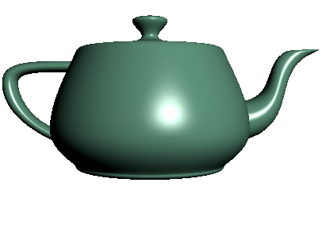
Vertex vs Fragment Lighting
per vertex lighting
per fragment lighting

Slide 24
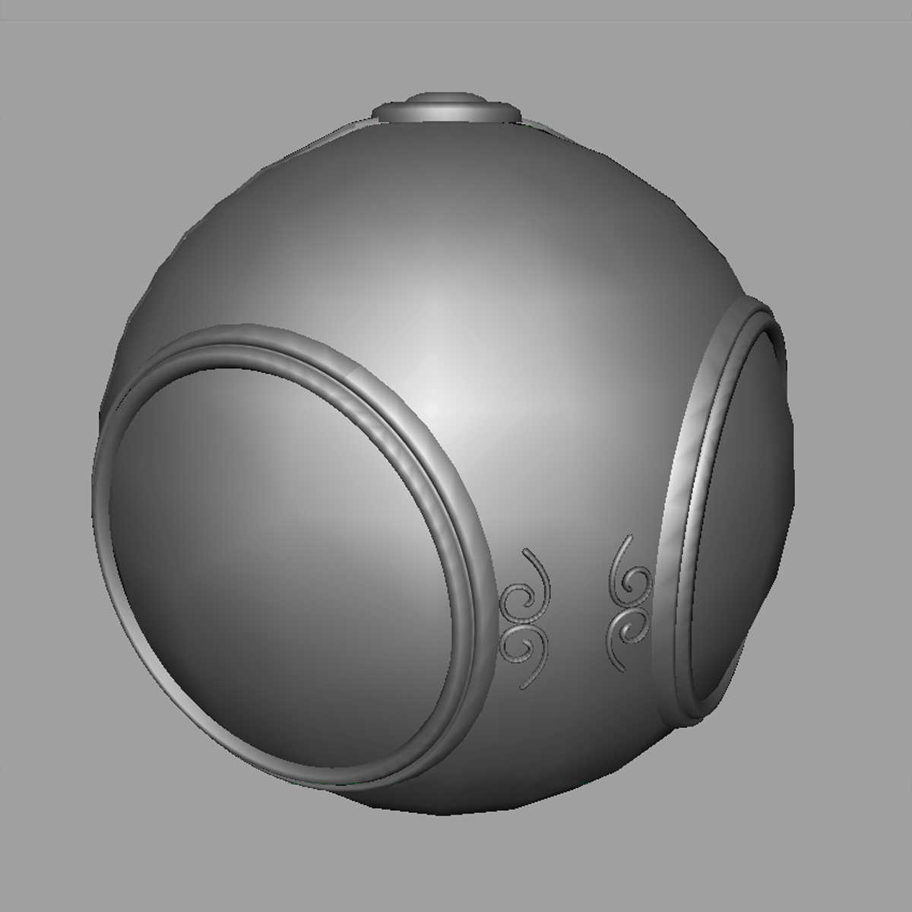
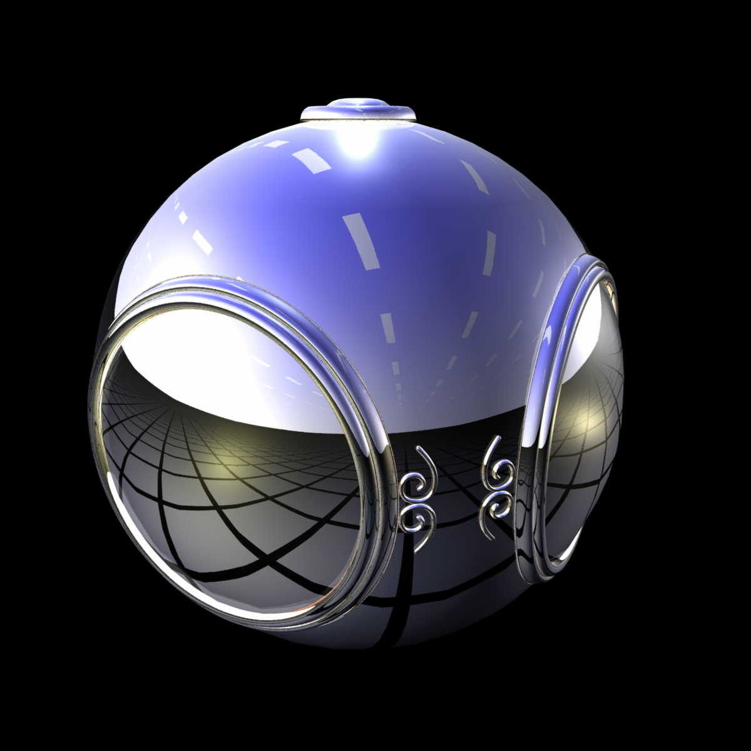
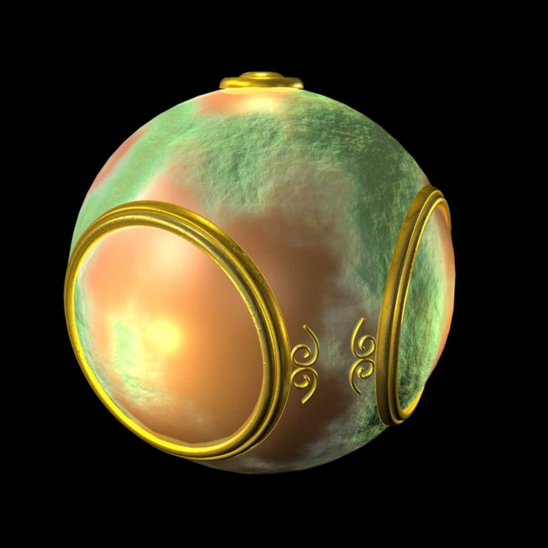
Fragment Shader Applications
Texture mapping
smooth shading
environment mapping
bump mapping

