Slide 1
CS 480/680
Fall 2011
Computer Graphics
Programming with Open GL
Part 6: Three Dimensions
Dr. Frederick C Harris, Jr.

Slide 2
Objectives
Develop a more sophisticated three-dimensional example
Sierpinski gasket: a fractal
Introduce hidden-surface removal

Slide 3
Three-dimensional Applications
In OpenGL, two-dimensional applications are a special case of three-dimensional graphics
Going to 3D
Not much changes
Use vec3, glUniform3f
Have to worry about the order in which primitives are rendered or use hidden-surface removal

Slide 4
Sierpinski Gasket (2D)
Start with a triangle
Connect bisectors of sides and remove central triangle
Repeat

Slide 5
Example
Five subdivisions

Slide 6
The gasket as a fractal
Consider the filled area (black) and the perimeter (the length of all the lines around the filled triangles)
As we continue subdividing
the area goes to zero
but the perimeter goes to infinity
This is not an ordinary geometric object
It is neither two- nor three-dimensional
It is a fractal (fractional dimension) object

Slide 7
Gasket Program
#include <GL/glut.h>
/* initial triangle */
GLfloat v[3][2]={{-1.0, -0.58},
{1.0, -0.58}, {0.0, 1.15}};
int n; /* number of recursive steps */

Slide 8
Draw one triangle
void triangle( point2 a, point2 b, point2 c)
/* display one triangle */
{
static int i =0;
points[i] = a;
points[i] = b;
points[i] = c;
i += 3;
}

Slide 9
Triangle Subdivision
void divide_triangle(point2 a, point2 b, point2 c, int m)
{
/* triangle subdivision using vertex numbers */
point2 ab, ac, bc;
if(m>0)
{
ab = (a + b )/2;
ac = (a + c)/2;
bc = (b + c)/2;
divide_triangle(a, ab, ac, m-1);
divide_triangle(c, ac, bc, m-1);
divide_triangle(b, bc, ac, m-1);
}
else(triangle(a,b,c));
/* draw triangle at end of recursion */
}

Slide 10
display and init Functions
void display()
{
glClear(GL_COLOR_BUFFER_BIT);
glDrawArrays(GL_TRIANGLES, 0, NumVertices);
glFlush();
}
void myinit()
{
vec2 v[3] = {point2(……
.
.
divide_traingles(v[0], v[1], v[2], n);
.
.
}

Slide 11
main Function
int main(int argc, char **argv)
{
n=4;
glutInit(&argc, argv);
glutInitDisplayMode(GLUT_SINGLE|GLUT_RGB);
glutInitWindowSize(500, 500);
glutCreateWindow(“2D Gasket");
glutDisplayFunc(display);
myinit();
glutMainLoop();
}

Slide 12
Moving to 3D
We can easily make the program three-dimensional by using
point3 v[3]
and we start with a tetrahedron

Slide 13
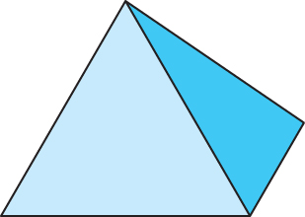
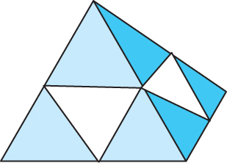
3D Gasket
We can subdivide each of the four faces
Appears as if we remove a solid tetrahedron from the center leaving four smaller tetrahedra
Code almost identical to 2D example

Slide 14
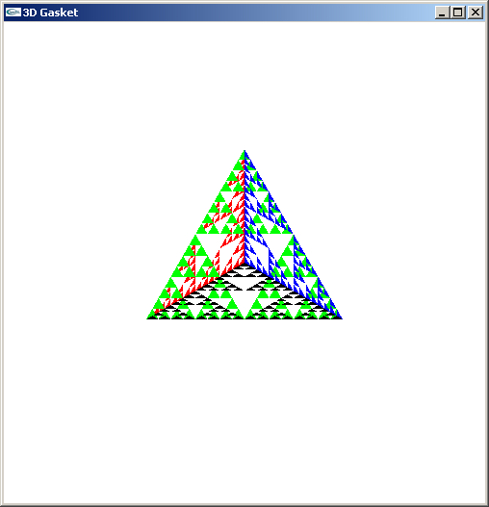
Almost Correct
Because the triangles are drawn in the order they are specified in the program, the front triangles are not always rendered in front of triangles behind them (see red/green edge)
get this
want this

Slide 15
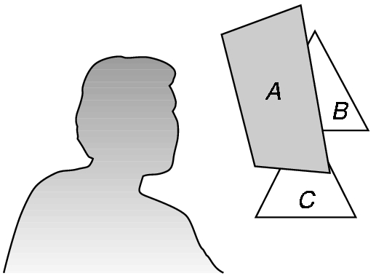
Hidden-Surface Removal
We want to see only those surfaces in front of other surfaces
OpenGL uses a hidden-surface method called the z-buffer algorithm that saves depth information as objects are rendered so that only the front objects appear in the image

Slide 16
Using the z-buffer algorithm
The algorithm uses an extra buffer, the z-buffer, to store depth information as geometry travels down the pipeline
It must be
Requested in main.c
glutInitDisplayMode
(GLUT_SINGLE | GLUT_RGB | GLUT_DEPTH)
Enabled in init.c
glEnable(GL_DEPTH_TEST)
Cleared in the display callback
glClear(GL_COLOR_BUFFER_BIT |
GL_DEPTH_BUFFER_BIT)

Slide 17
Surface vs Volume Subdvision
In our example, we divided the surface of each face
We could also divide the volume using the same midpoints
The midpoints define four smaller tetrahedrons, one for each vertex
Keeping only these tetrahedrons removes a volume in the middle
See text for code

Slide 18
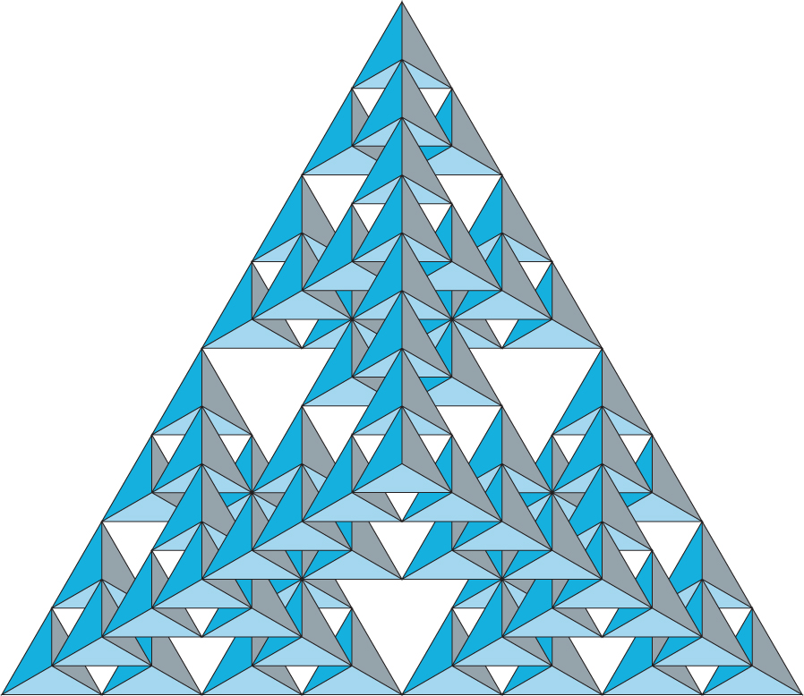
Volume Subdivision

