Slide 1
CS 480/680
Computer Graphics
Compositing and Blending
Dr. Frederick C Harris, Jr.

Slide 2
Objectives
Develop a basic recursive ray tracer
Computer intersections for quadrics and polygons

Slide 3
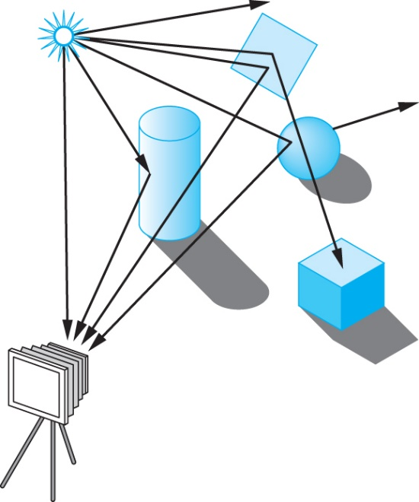
Ray Tracing
Follow rays of light from a point source
Can account for reflection and transmission

Slide 4
Computation
Should be able to handle all physical interactions
Ray tracing paradigm is not computational
Most rays do not affect what we see
Scattering produces many (infinite) additional rays
Alternative: ray casting

Slide 5
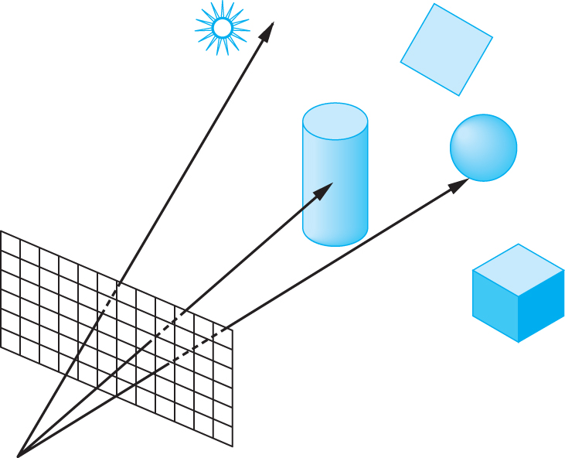
Ray Casting
Only rays that reach the eye matter
Reverse direction and cast rays
Need at least one ray per pixel

Slide 6
Ray Casting Quadrics
Ray casting has become the standard way to visualize quadrics which are implicit surfaces in CSG systems
Constructive Solid Geometry
Primitives are solids
Build objects with set operations
Union, intersection, set difference

Slide 7
Ray Casting a Sphere
Ray is parametric
Sphere is quadric
Resulting equation is a scalar quadratic equation which gives entry and exit points of ray (or no solution if ray misses)

Slide 8
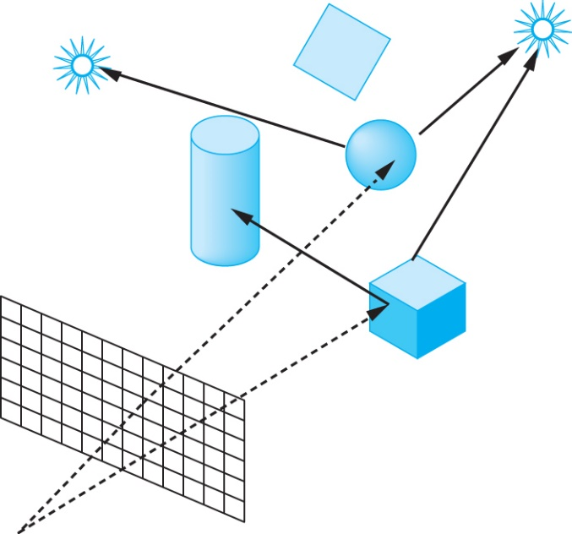
Shadow Rays
Even if a point is visible, it will not be lit unless we can see a light source from that point
Cast shadow or feeler rays

Slide 9
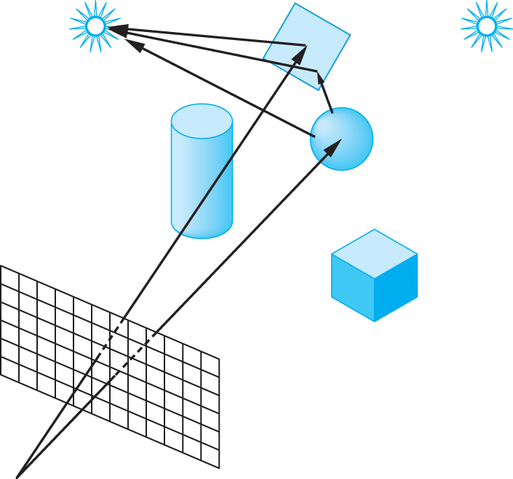
Reflection
Must follow shadow rays off reflecting or transmitting surfaces
Process is recursive

Slide 10
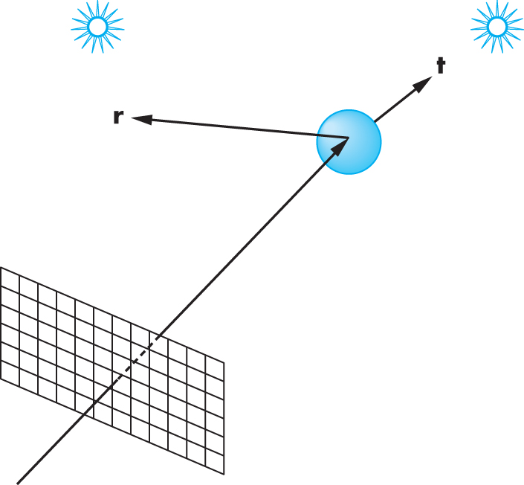
Reflection and Transmission

Slide 11
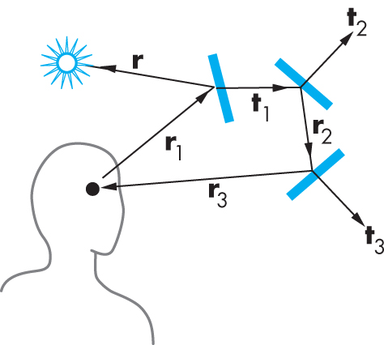
Ray Trees

Slide 12
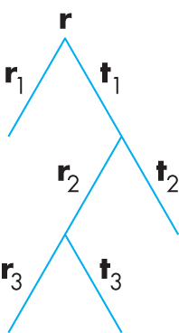
Ray Tree

Slide 13
Diffuse Surfaces
Theoretically the scattering at each point of intersection generates an infinite number of new rays that should be traced
In practice, we only trace the transmitted and reflected rays but use the modified Phong model to compute shade at point of intersection
Radiosity works best for perfectly diffuse (Lambertian) surfaces

Slide 14
Building a Ray Tracer
Best expressed recursively
Can remove recursion later
Image based approach
For each ray …….
Find intersection with closest surface
Need whole object database available
Complexity of calculation limits object types
Compute lighting at surface
Trace reflected and transmitted rays

Slide 15
When to stop
Some light will be absorbed at each intersection
Track amount left
Ignore rays that go off to infinity
Put large sphere around problem
Count steps

Slide 16
Recursive Ray Tracer
color c = trace(point p, vector d, int step)
{
color local, reflected,
transmitted;
point q;
normal n;
if(step > max)
return(background_color);

Slide 17
Recursive Ray Tracer
q = intersect(p, d, status);
if(status==light_source) return(light_source_color);
if(status==no_intersection) return(background_color);
n = normal(q);
r = reflect(q, n);
t = transmit(q,n);

Slide 18
Recursive Ray Tracer
local = phong(q, n, r);
reflected = trace(q, r, step+1);
transmitted = trace(q,t, step+1);
return(local+reflected+
transmitted);

Slide 19
Computing Intersections
Implicit Objects
Quadrics
Planes
Polyhedra
Parametric Surfaces

Slide 20
Implicit Surfaces
Ray from p₀ in direction d
p(t) = p₀ +t d
General implicit surface
f(p) = 0
Solve scalar equation
f(p(t)) = 0
General case requires numerical methods

Slide 21
Quadrics
General quadric can be written as
p^{T}Ap + b^{T}p +c = 0
Substitute equation of ray
p(t) = p₀ +t d
to get quadratic equation

Slide 22
Sphere
(p – p_{c}) • (p – p_{c}) – r² = 0
p(t) = p₀ +t d
p₀ • p₀ t²+ 2 p₀ • (d – p₀) t + (d – p₀) • (d – p₀)
– r² = 0

Slide 23
Planes
p • n + c = 0
p(t) = p₀ +t d
t = -(p₀ • n + c)/ d • n

Slide 24
Polyhedra
Generally we want to intersect with closed convex objects such as polygons and polyhedra rather than planes
Hence we have to worry about inside/outside testing
For convex objects such as polyhedra there are some fast tests

Slide 25
Ray Tracing Polyhedra
If ray enters an object, it must enter a front facing polygon and leave a back facing polygon
Polyhedron is formed by intersection of planes
Ray enters at furthest intersection with front facing planes
Ray leaves at closest intersection with back facing planes
If entry is further away than exit, ray must miss the polyhedron

