Slide 1
What is a 3D User Interface /
History and Roadmap of 3D UI’s
Kurt Andersen

Slide 2
Important Terms
Human-Computer Interaction (HCI) – Field of study that examines all aspects of the interplay between people and interactive technologies
User Interface (UI) –The medium in through which we interact with computers
Input Device – Hardware device allowing communication from user to computer
Output Device – Hardware device allowing communication from computer to user
Degrees of Freedom (DOF) – Number of independent dimensions of the motion of a body

Slide 3
More Important Terms
Interaction Technique – Method allowing a user to accomplish a task via the UI
Usability – Characteristics of an artifact that affect the user’s use of the artifact. i.e. ease of use, user task performance, or user comfort
User Experience (UX) – broad concept encompassing a user’s entire relationship with an artifact, including usability and emotional factors
UX Evaluation – Assessment or measurement of aspects of the UX
3D Interaction – User tasks performed in a real or virtual 3D spatial context.

Slide 4
Even More Terms (I Promise This is it)
3D UI – A UI in 3 dimensions (wow!)
Virtual Environment (VE) – A synthetic 3D world seen from a first person point of view
Virtual Reality (VR) – Interchangeable with VE.
Augmented Reality (AR) – Real world environment with synthetic objects
Mixed Reality (MR) – Combination of VR and AR
Ubiquitous Computing (UbiComp) – Notion that computing devices and infrastructure is mobile or scattered throughout the real world.
Telerobotics – Ability to control a robot that is geographically separated from the user

Slide 5
Components of a User Interface
Input Devices such as but not limited to mouse or touchscreen
Output devices such as a monitor or some sort of display screen
Interaction techniques such as drag and drop or pinch to zoom
Interface Widgets like pull-down menus, or UI metaphors like Windows, Icons, Menus, Pointer (WIMP)

Slide 6
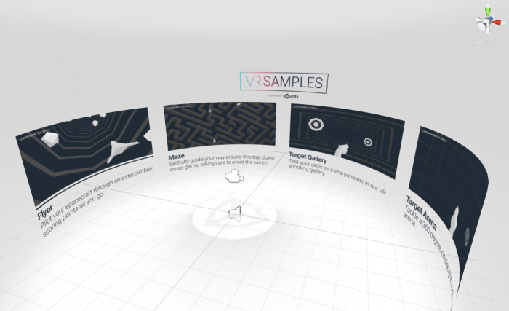
3D UI Applications
(more in depth on these later)
Design and prototyping
Heritage and tourism
Gaming and Entertainment
Simulation and training
Education
Art
Visual data analysis
Architecture and construction
Medicine and psychiatry
Robotics

Slide 7
3D interaction is relevant to real-world tasks
It gives us a sense of actually being there
Use natural skills to perform interactions
More direct and immediate than a 2D UI
  Shorter cognitive distance between action and response

Slide 8
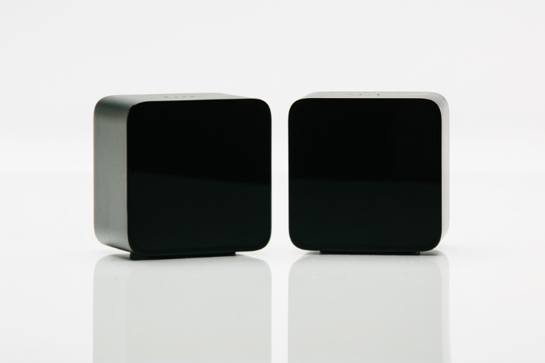
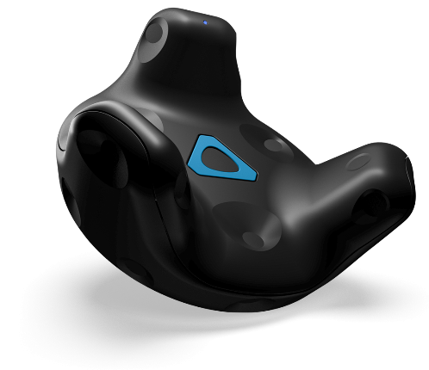
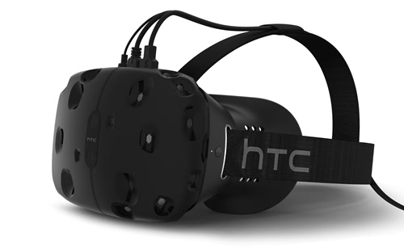
Technology in 3D UI’s
Input
  Spatial input devices
  3D pointing devices
  Whole hand devices allowing gestural input
Output
  Stereoscopic projection displays
  High-resolution head mounted display
  Spatial audio systems
  Haptic Devices

Slide 9
Why 3D UI’s are Difficult
Should be simple because we live in a 3D world
Our world gives us a lot more feedback for every action
Constructing similar cues in a virtual environment to mimic the real world
Restricted to less senses when in a virtual environment

Slide 10
3D UI’s are Straightforward or Lack Usability
For entertainment applications it is easy to evaluate its use
  Head turning is the only interaction (for VR films)
For other applications i.e. simulations, scientific visualization, modeling, or training
  Difficult to design and evaluate
  Leads to a lack of usability or poor user experience

Slide 11
Brief History of GUI’s
Pre 1980 – All interaction was done through the command line
Early 1980’s – inexpensive graphics rasterizer displays
  Utilities to interact with graphical display such as mouse
  Xerox Star one of the first computers with GUI
Birth of GUI was the start of research into HCI
  Draws on knowledge of perception, cognition, linguistics, human factors, ethnography, sociology, graphic design, industrial design, and other areas.

Slide 12
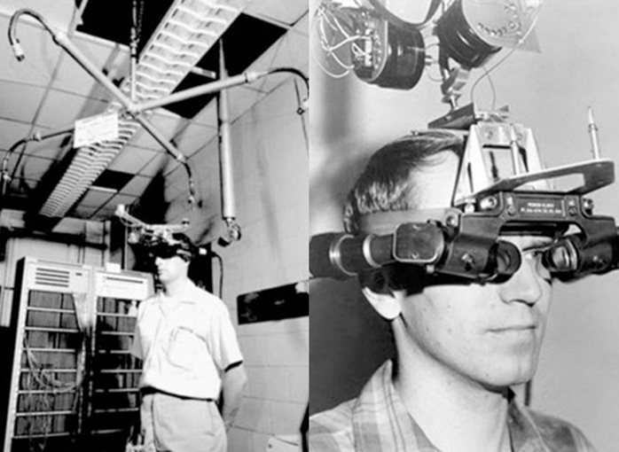
Brief History of VR
1960’s – Ivan Sutherland develops a head mounted display for simulated reality. Capable of both VR and AR.
  Tracked head position
  Precise but cumbersome mechanical head tracker
1980’s-1990’s – VR systems became more practical
  3D stereoscopic graphics on mini CRT displays
  Interaction devices such as the VPL DataGlove
  Early thoughts on how to enable users to interact with the world through tracked hands and tools.

Slide 13
Combination of 3D and 2D GUIs
Due to early research in GUI’s for personal computers, the field was already reasonably matured as research geared towards 3D GUIs became more relevant
The application of existing HCI knowledge to 3D interfaces helped improve their usability

Slide 14
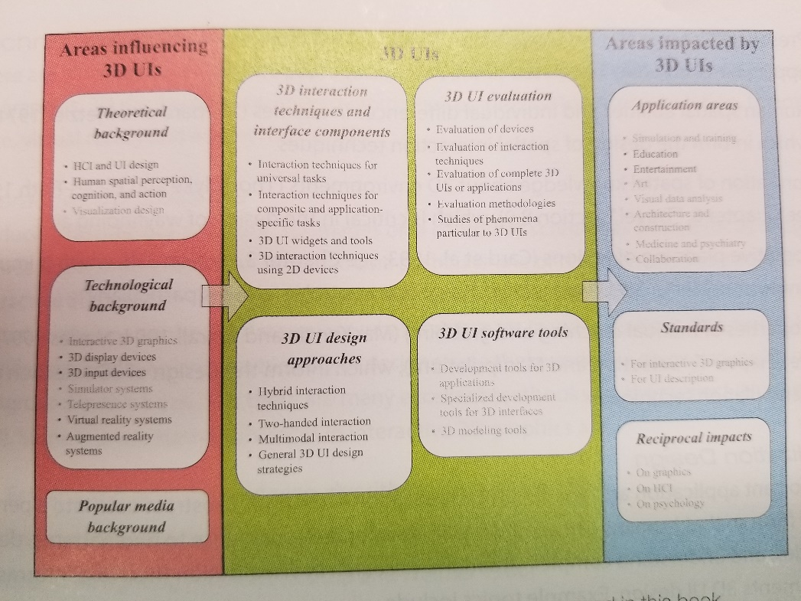
Roadmap to 3D UI’s
(page 15 for a better look)

Slide 15
Theoretical Background
Comes from work done in: human spatial perception, cognition, action, visualization design, HCI and UI design.
Users are acting in a real and/or virtual 3D space; therefore, psychology and human factors knowledge about spatial perception, cognition, human navigation, movement, and manipulation in a 3D space contain critical information for the design of 3D UI’s

Slide 16
Technological Background
Interactive 3D Graphics – images rendered in real time so users can interact with them directly
  Fast line polygon rendering algorithms, texture mapping, real-time lighting methods, dedicated graphics processor, algorithms for drawing stereoscopic images, shader algorithms, high level graphics software toolkits(Unity)
3D Display Devices – stereoscopic displays for desktop computers, walkaround 3D displays, head worn displays for VR/AR, 3D spatial sound, projection based spatially immersive displays
3D input devices – Position and orientation tracking sensors, posture and gesture sensing devices (mostly for hands), multiple DOF joysticks

Slide 17
Technological Background Continued
Simulator systems – precursor to VR. Large systems with an immersive display of 3D graphics. Used for many applications such as flight, space, or driving simulators.
Telepresence Systems – allows users to feel as if they are in a real-world location. Uses a combination of sensors on a remote with a display and interactive controls. Similar to VR but uses real world data rather than synthetic data.
VR/AR systems – Immersive synthetic environment/projecting synthetic objects into the real world.
  VPL’s HMD and DataGlove, Cave Automatic Virtual Environment, Spatial AR, handheld mobile AR on smartphones

Slide 18
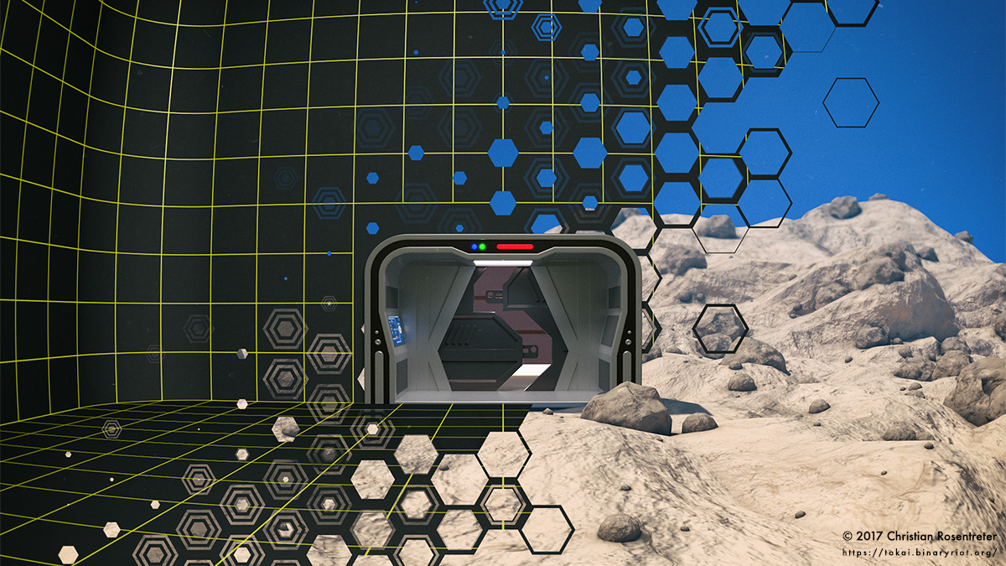
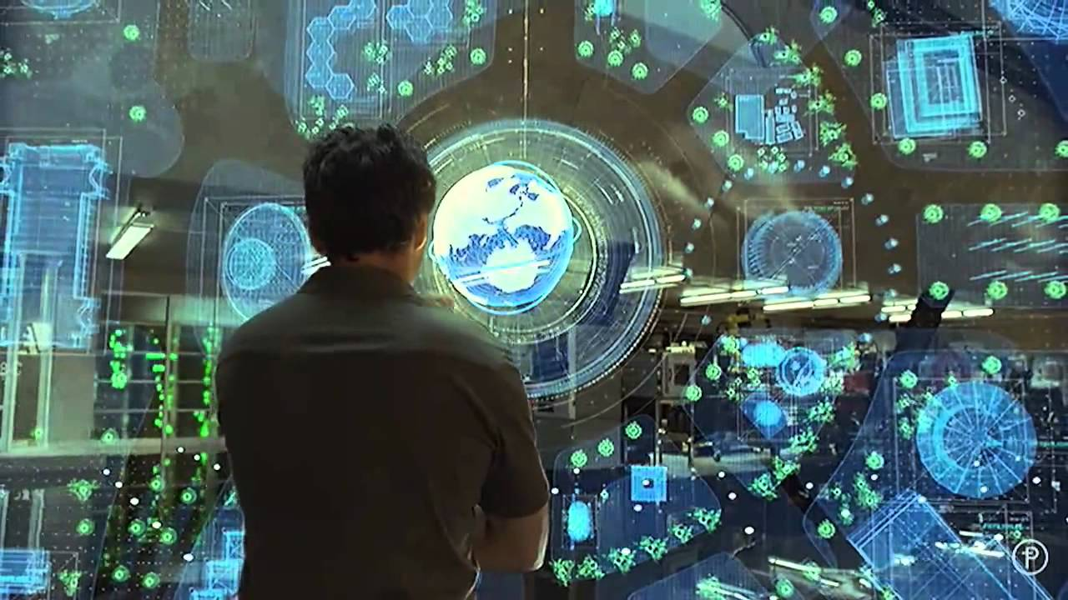
Popular Media
There has been a lot of influence from media sources such as sci-fi movies, fiction books, and other forms of media
These examples can be seen in: Star Trek: The Next Generation(Holodeck), Iron Man 2(3D interaction with data based on in air gestures), Disclosure (VR system with natural physical movement and language interaction)

Slide 19
3D UI Subareas
Each of the following will be gone over more in depth later in the book. These are bread and butter of what 3D UI’s are comprised of.
Interaction Techniques for Universal Tasks - Interaction Techniques for Composite and Application-Specific Tasks, 3D UI Widgets and Tools, 3D Interaction Techniques using 2D Devices
3D UI Design Approaches - Hybrid Interaction Techniques, Two-Handed Interaction, Multimodal Interaction
3D UI Software Tools -Specialized and Development Tools for 3D Applications, 3D Modeling Tools
3D UI Evaluation - Evaluation of Devices, Interaction Techniques, Complete 3D UIs or Applications, Methodologies, Study of Phenoomena Particuilar to 3D UIs

Slide 20
Areas Impacted by 3D UIs
List mentioned back on slide 6
Education – Newton’s Laws can be experimented with in a highly interactive virtual world
Visual Data Analysis – Rather than just observing numbers, we are able to visually see data and pick out points to analyze better.
Medicine and Psychiatry – 3D applications are used for telemedecine(remote diagnosis and treatment), or 3D visualizations of MRI’s.

Slide 21
Standards of 3D UIs
As of now there are no documented standards. However, there are some areas that have some standardization of a 3D UI
On Interactive 3D Graphics - World Wide Web Consortium has international standards for many aspects of the internet for interactive 3D graphics.
On HCI – What metrics should be used to study the user experience? Generally we measure speed, accuracy. Satisfaction, and perceived ease of use. In 3D we also need to consider physical comfort and presence.

Slide 22
What Else Will Be Discussed in This Book?
Will focus on the content that is specific to 3D UIs.
Basically more in depth of the aforementioned sub areas
Will cover presence/cybersickness, design or workings of various devices, graphics algorithms and techniques for rendering 3D environments and 3D toolkits/APIs.
Numerous case studies will be covered throughout the book as well.

Slide 23
Conclusion
Covered what a 3D UI is
Covered a brief history of 3D UIs
Briefly touched on all the subareas with the design of 3D UIs
Talked about what we can expect from this book

