Slide 1
Losing the Lake:
Development and Deployment of an Educational Game
Joseph M. Vesco, Katie Gilgen, Anne Paine, Marissa Owens, E. Michael Nussbaum, Gale M. Sinatra, Sajjad Ahmad, Kent J. Crippen, Sergiu M. Dascalu, Frederick C Harris, Jr.

Slide 2
Acknowledgements
This work was partially supported by the National Science Foundation
  under grant EPS-0814372

Slide 3
A Little Context
In 2007 the Nevada System of Higher Education (NSHE) applied for (and was awarded) an NSF EPSCoR research and infrastructure improvement grant
  $15,000,000 from NSF
  $7,500,000 match from the state
  5 years.
  The goal is to stimulate research, education, and outreach on the effects of regional climate change

Slide 4
A Little Context (cont)
There are 6 major components of this grant
  Climate Modeling
  Ecological Change
  Water
  Policy, Decision Making, and Outreach
  Cyberinfrastructure
  Education

Slide 5
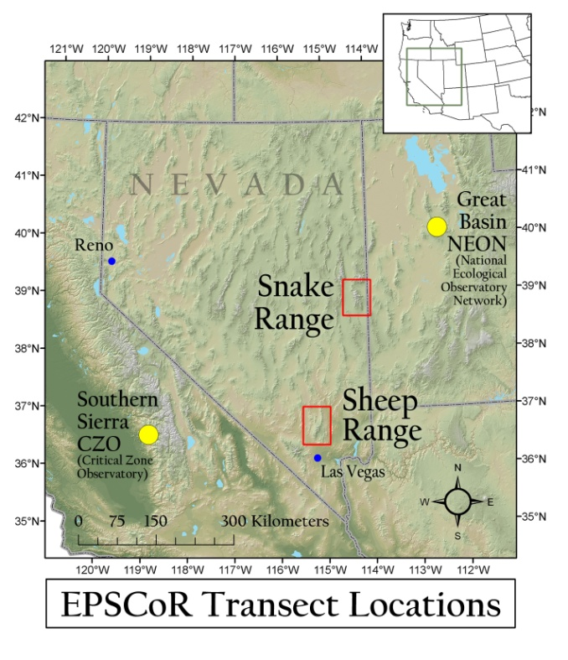
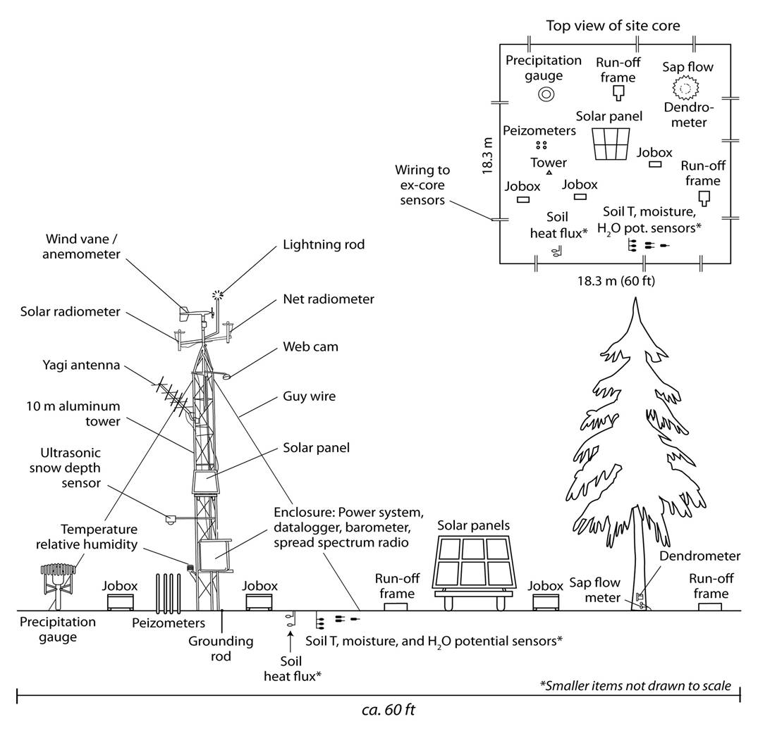
Sensor Networks
Two transects
  Across mountain ranges
  Collecting climate data

Slide 6
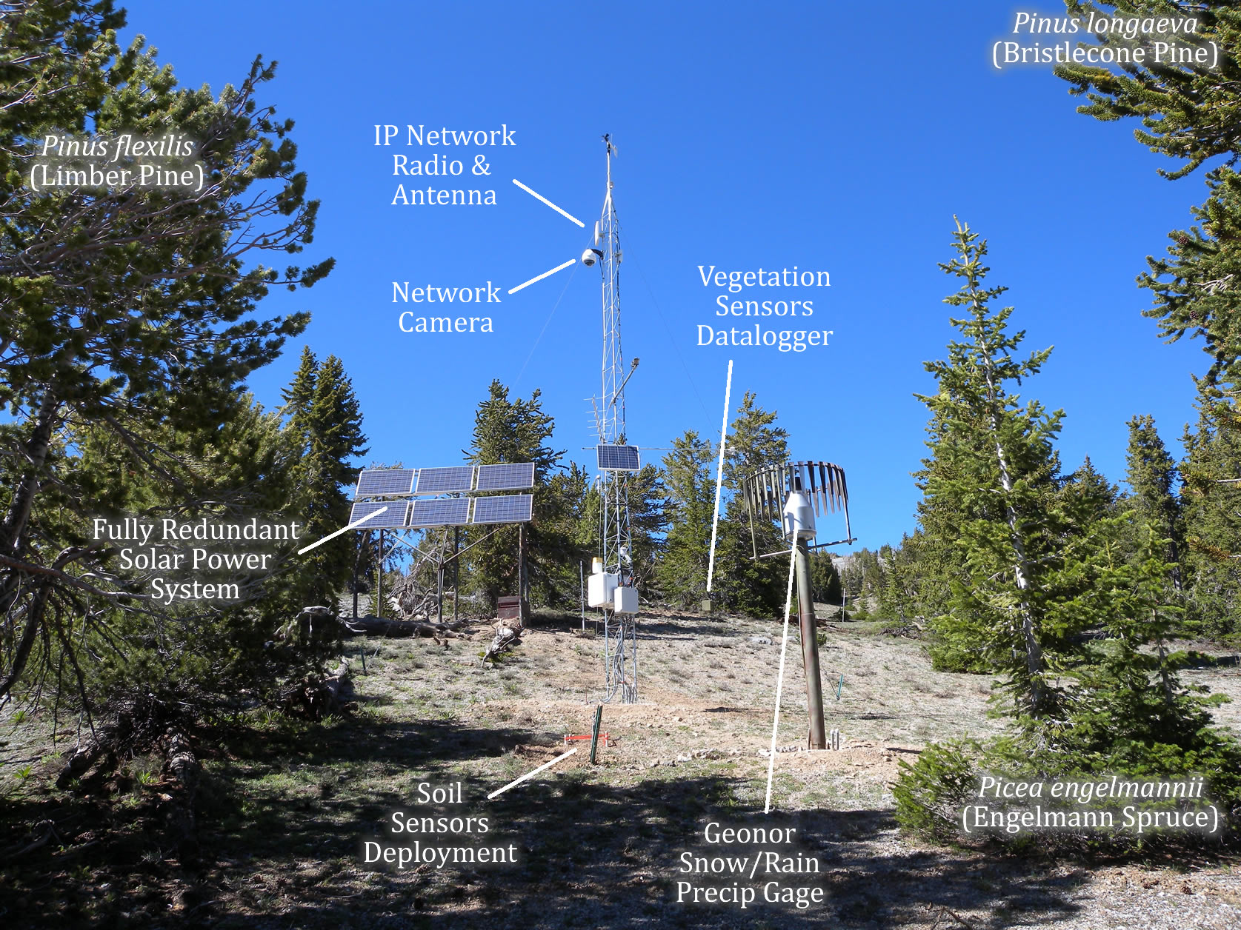

Slide 7
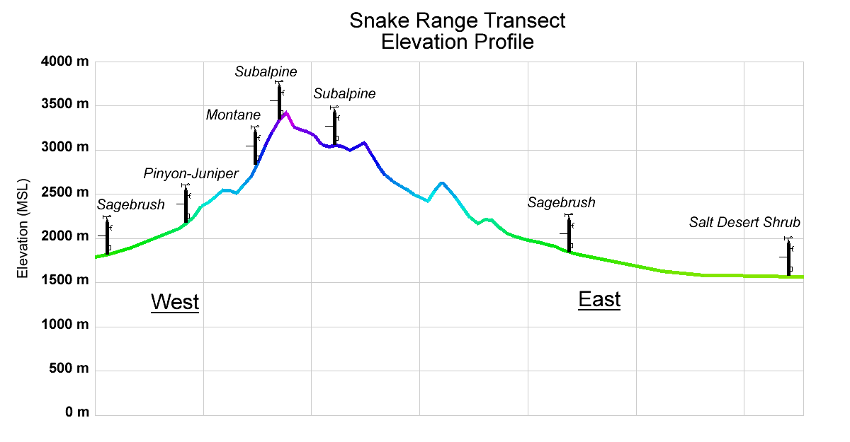

Slide 8
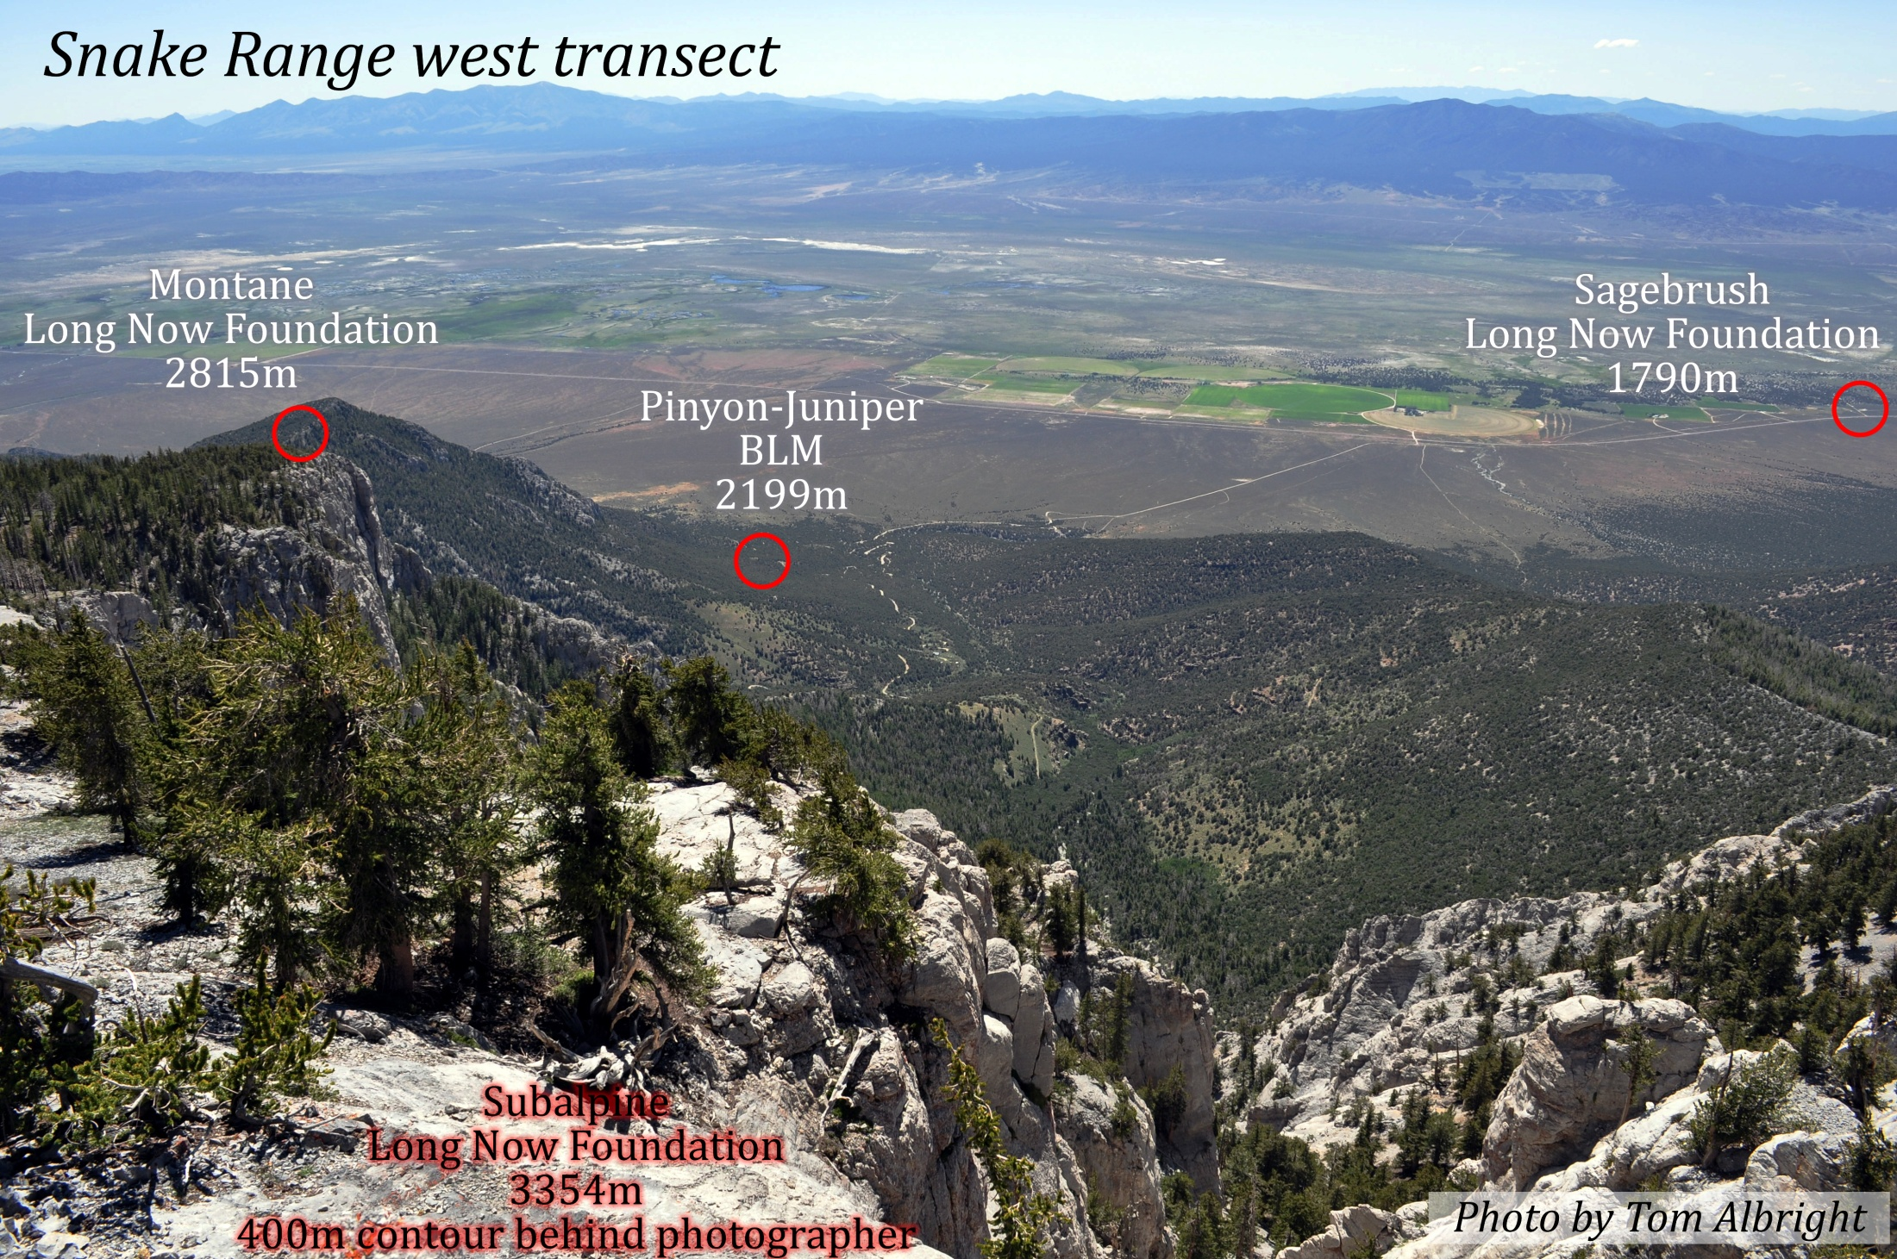

Slide 9
Seed Grants
In order to integrate the program components, the grant had structured into it seed grants for interdisciplinary and inter-institutional science teams.
There were many Science Team proposals submitted, and today I want to talk with you about one of them
  Losing the Lake

Slide 10
Losing the Lake Project Goals
Build an educationally informative simulation game
Teach users about water conservation, climate change, and Lake Mead system
Develop appreciation of climate change, conservation, and Lake Mead water level connection

Slide 11
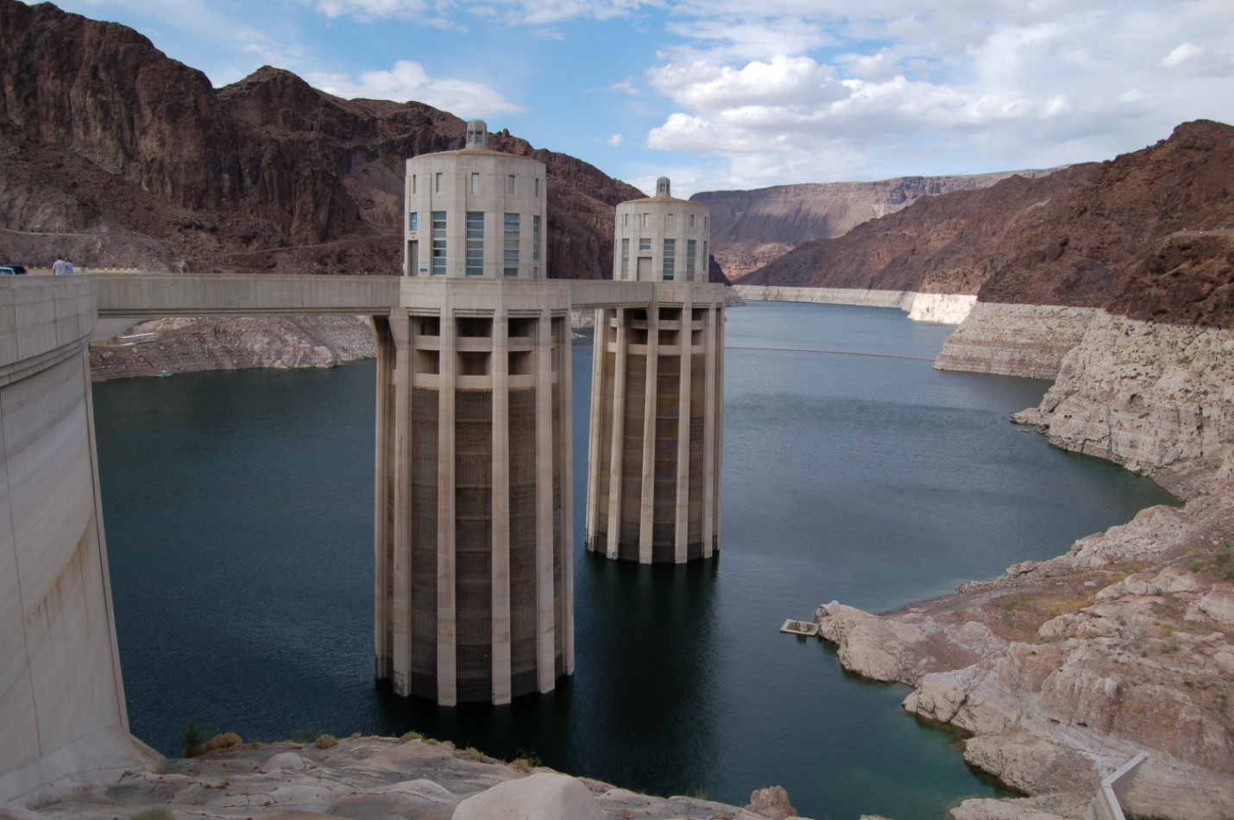
Lake Mead water level 2009. “Bathtub ring” shows decline of 142 ft since 1983.

Slide 12
Losing the Lake – Game Design
Five Activities
Activity 1 – A multiple choice assessment that builds background knowledge
Activity 2 – User is challenged to conserve water in home
Activity 3 – User is challenged to conserve water in the community
Activity 4 – Illustrate impacts of climate change
Activity 5 – Modeling climate change impact on Lake Mead

Slide 13
Demo

Slide 14
Project Next Steps
Focus groups with end users, middle-schoolers, teachers, and UGs
Research on learning outcomes from game interaction with middle-schoolers and UGs
Installation at informal learning environment

Slide 15
Conclusions
We have discussed the design and implementation of an educational game – Losing the Lake
  A Web deployed game targeted towards educating young Nevadans who will be our future policy and decision makers.

Slide 16
Losing the Lake:
Development and Deployment of an Educational Game
Joseph M. Vesco, Katie Gilgen, Anne Paine, Marissa Owens, E. Michael Nussbaum, Gale M. Sinatra, Sajjad Ahmad, Kent J. Crippen, Sergiu M. Dascalu, Frederick C Harris, Jr.

Slide 18
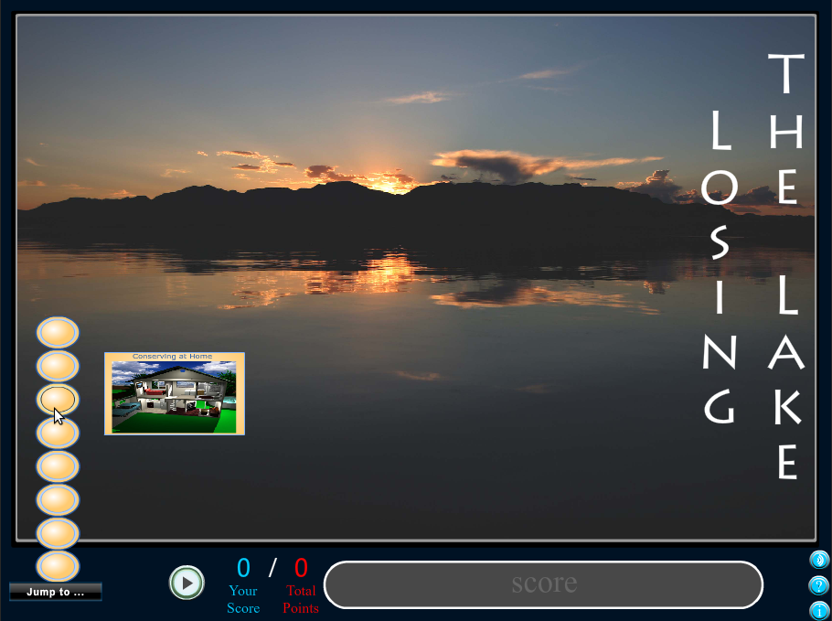

Slide 19
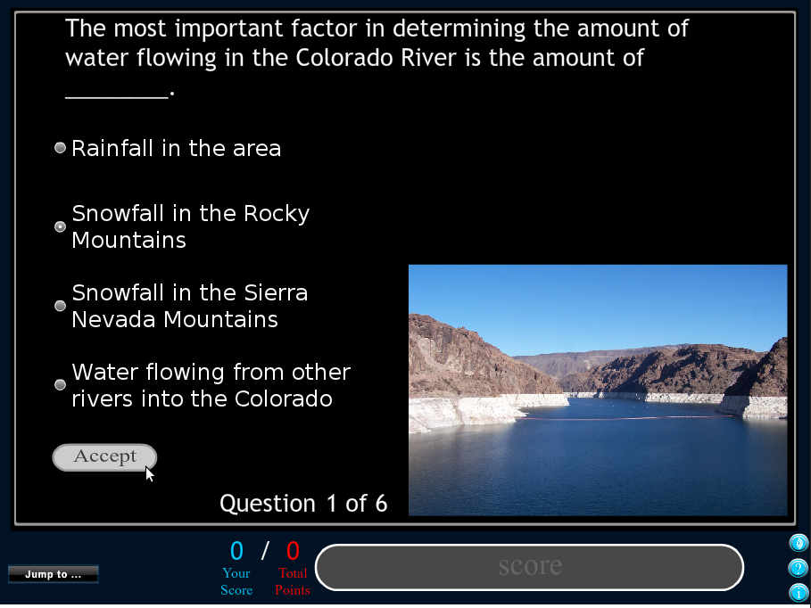
a

Slide 20
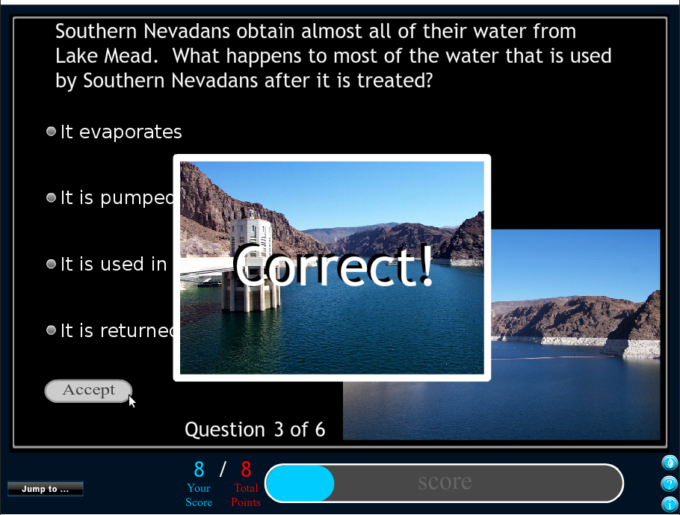

Slide 21
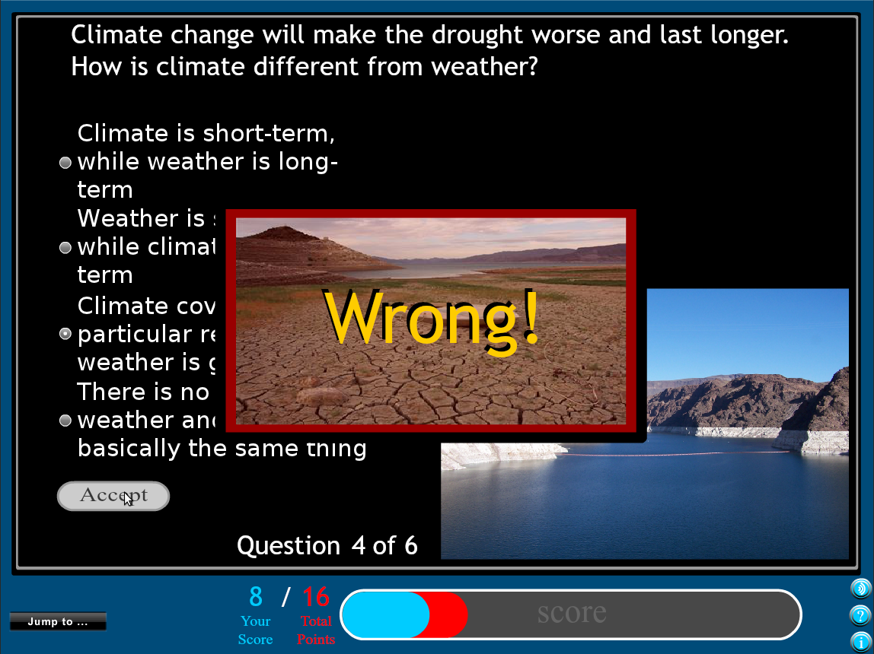

Slide 22
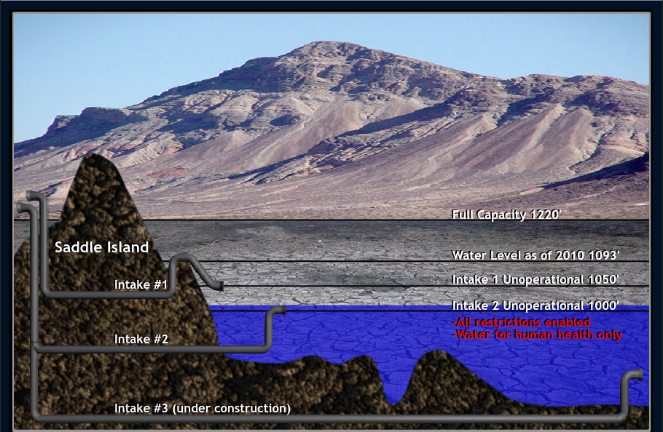

Slide 23
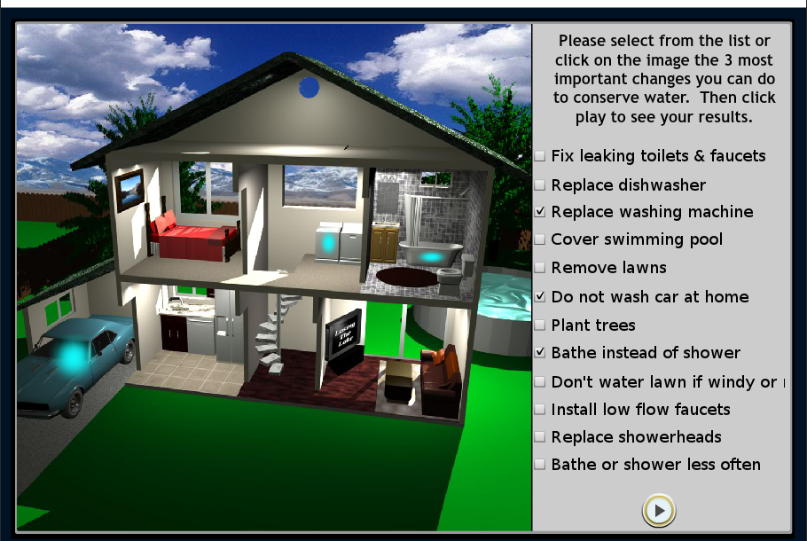

Slide 24
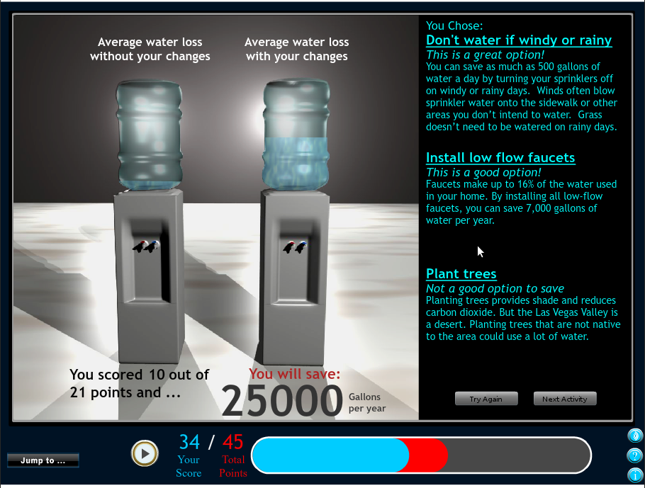

Slide 25
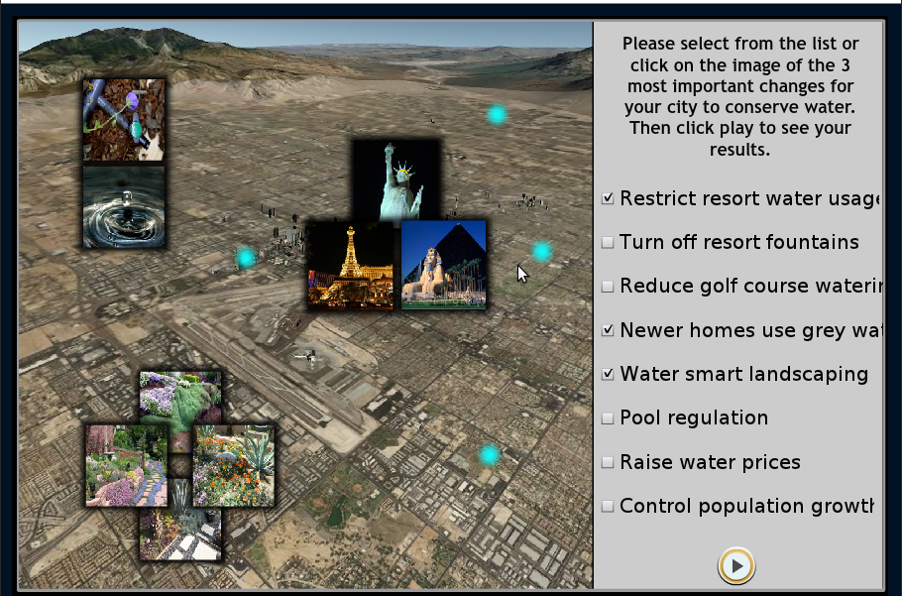

Slide 26
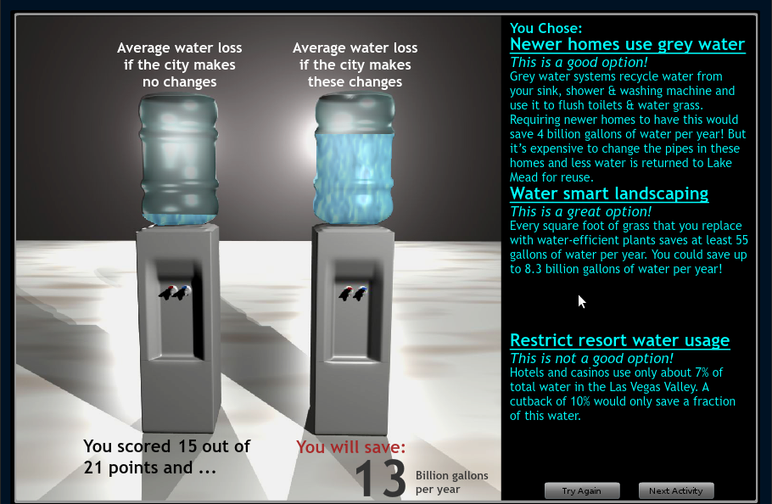

Slide 27
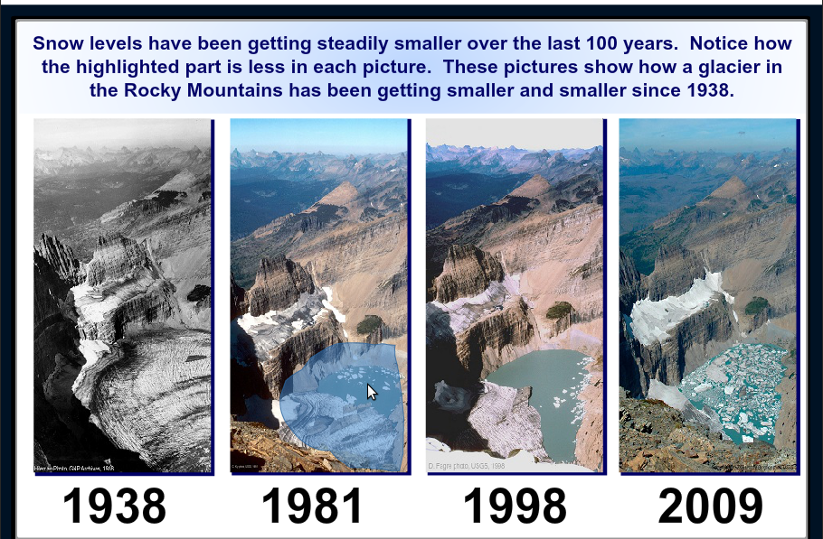

Slide 28
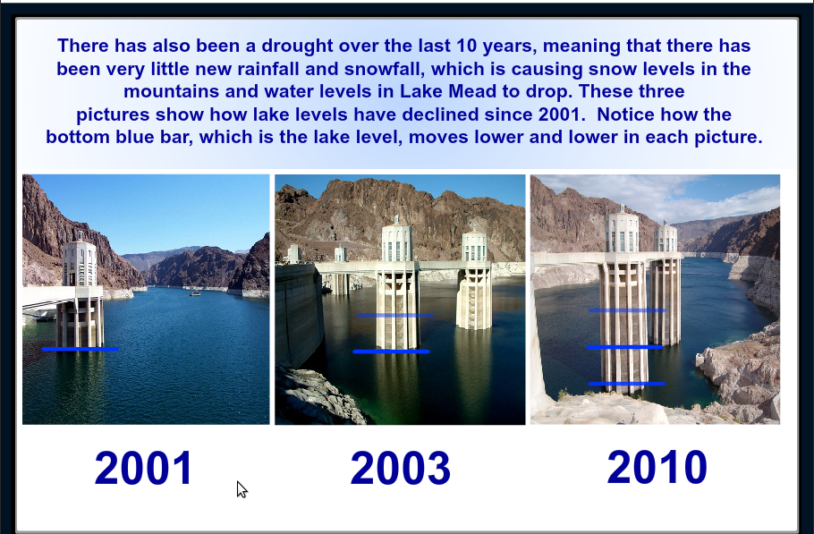

Slide 29
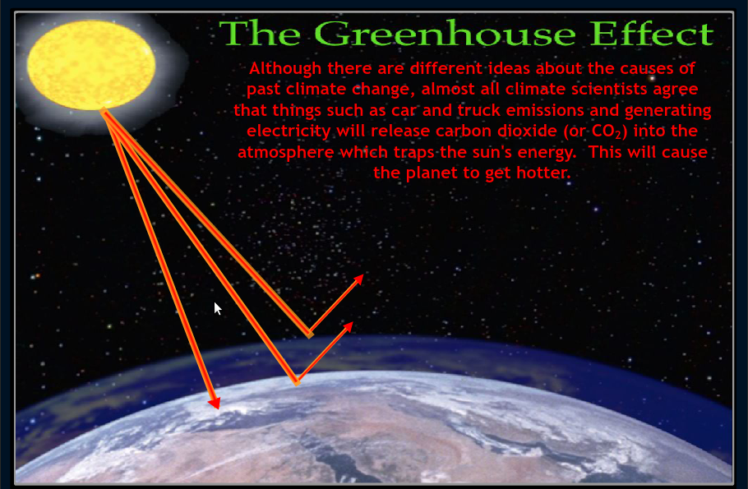

Slide 30
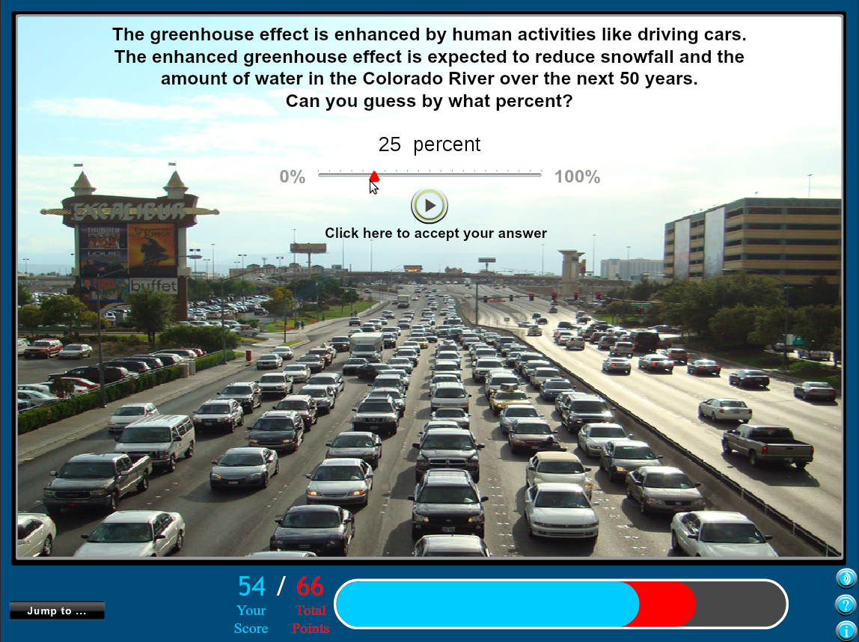

Slide 31
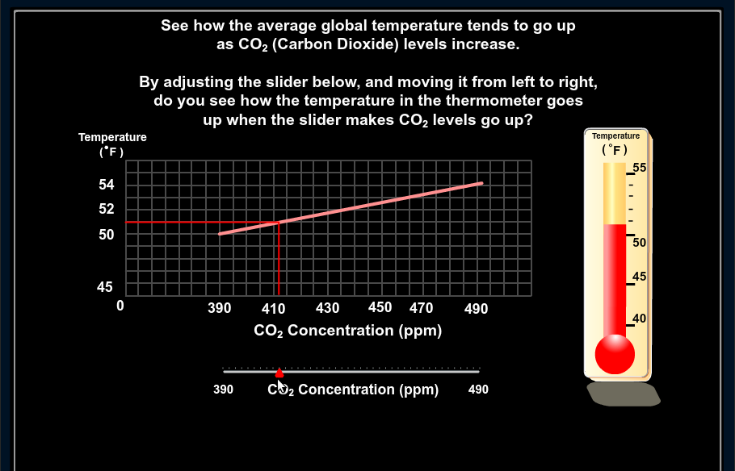

Slide 32
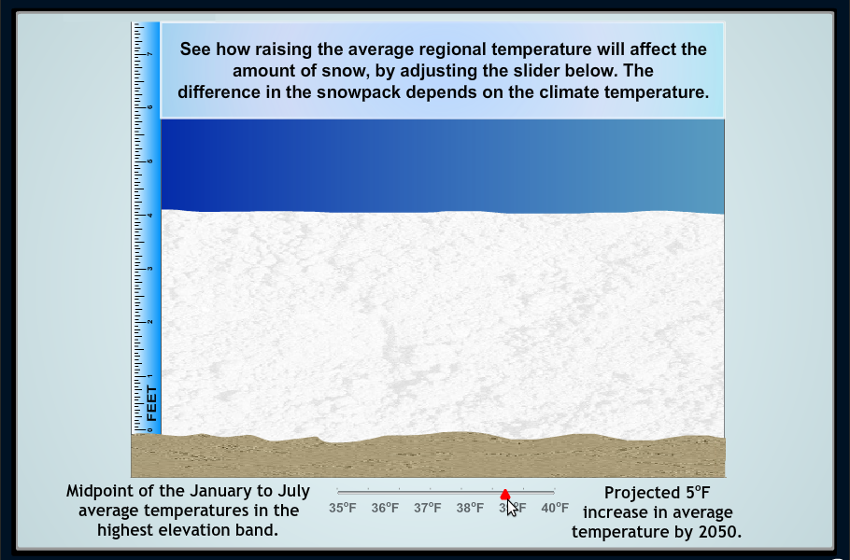

Slide 33
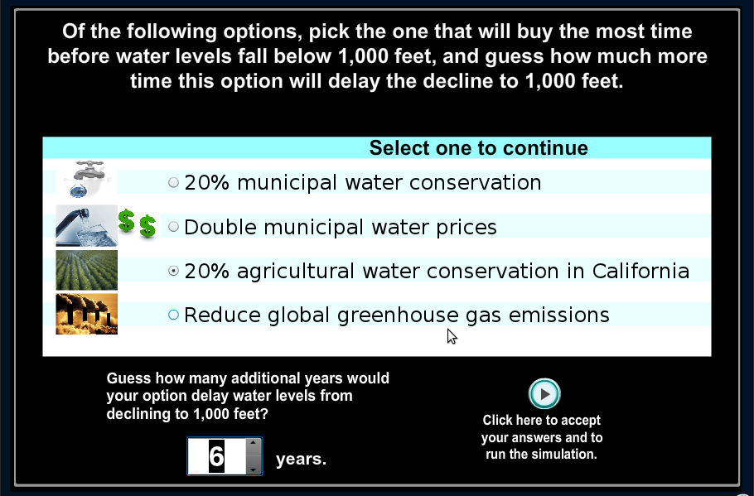

Slide 34
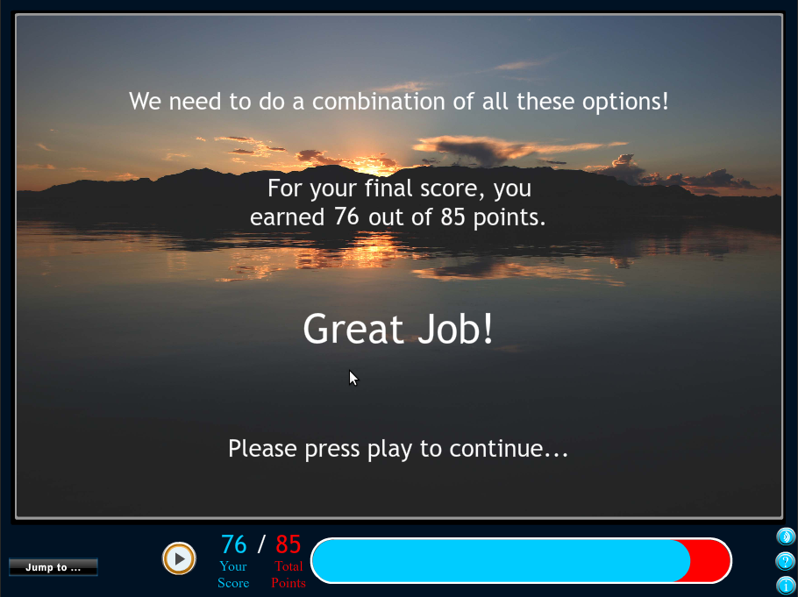

Slide 35
