Slide 1
A Web-enabled Approach for generating data processors
Jigar Patel
Sergiu M. Dascalu
Frederick C. Harris, Jr
University of Nevada Reno
CTS 2013
MAY 2013
University of Nevada Reno
Department of Computer Science & Engineering

Slide 2
Outline
Introduction
Problem Background
Proposed Approach
Conclusions & Future Work

Slide 3
Introduction
1

Slide 4
About the Larger NSF Project
NSF EPSCoR funded project
  Nevada, Idaho, and New Mexico
  Effects of climate change on their regional environment and ecosystem resources
Cyber-infrastructure (CI)
  Facilitate and support interdisciplinary climate change research, education, policy, decision-making, and outreach
  Design, develop and make available integrated data repositories and intelligent, user-friendly software solutions

Slide 5
Problem Background
2

Slide 6
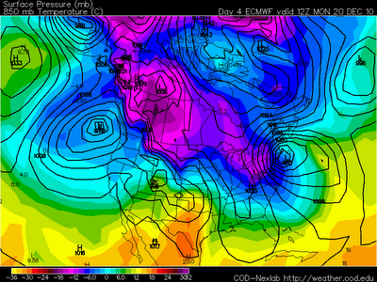
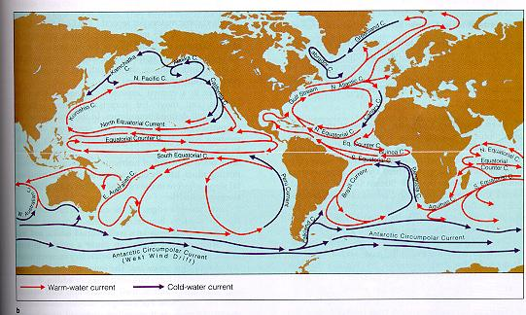
What is a model?
It could have different meaning in different context and research areas
  Climate change research
  Software Engineering
http://goo.gl/5ZCIP
http://goo.gl/wjeo8
Notes:
Definition of Model
SE: Description of the software that will be built. E.g ER diagram, class diagram, or activity diagram
Science: A model is a mathematical description of a problem/phenomenon.

Slide 7
What is model coupling?
Any single model cannot explain every system
  Surface water level
  Ground water level
  Precipitation
  Moisture
  Temperature
  Relative humidity
Model coupling involves a process to exchange data between models
  Two way vs. linking

Slide 8
Significance of model coupling
Combines knowledge of multiple domains
Eliminates some level of uncertainty from the model in process
  Water level depends on rain, temperature, moisture, relative humidity of given time and location
  This can be achieved by coupling an atmospheric model with hydrological model
Helps to understand and predict natural phenomenon at a larger scale

Slide 9
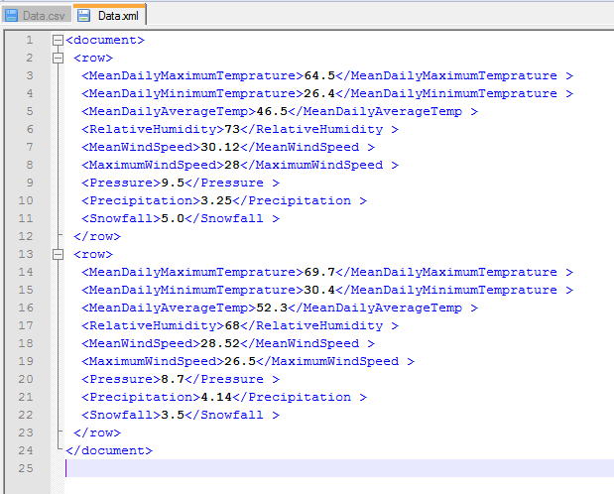

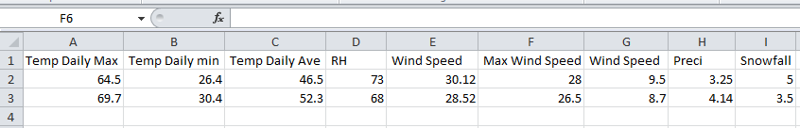
Data related issues in model coupling
File formats

Slide 10
Data related issues in model coupling
File Formats
  Orange circle represents a record line in a data set
  Green container represents file format container

Slide 11
Data related issues in model coupling
Data subsetting and merging
  Extract only partial data and merge with other data set

Slide 12
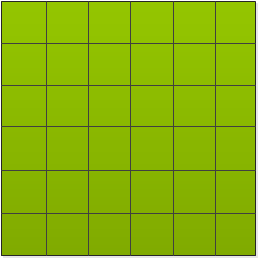
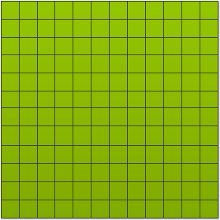
Data related issues in model coupling
Data sampling issues
  Some models run at different scale so data sampling becomes a major challenge
    Terrain also becomes a big challenge
  Time scale becomes an important issue as well

Slide 13
Data related issues in model coupling
Data subsetting in complex data sets and file formats

Slide 14
Proposed Solution
3

Slide 15
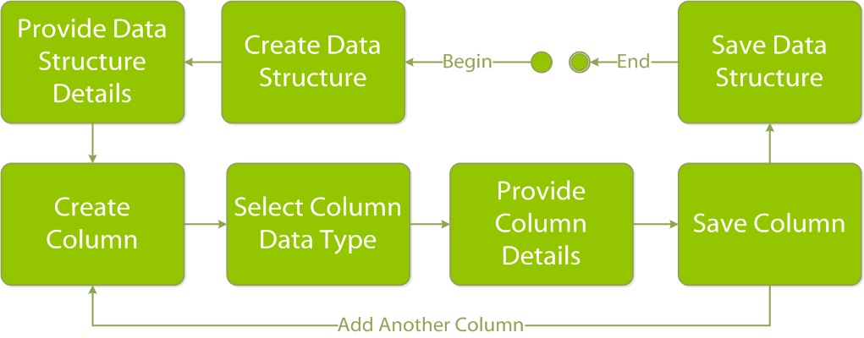
Data Structures
Data structures

Slide 16
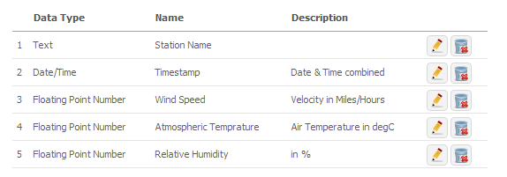
Data Structures

Slide 17
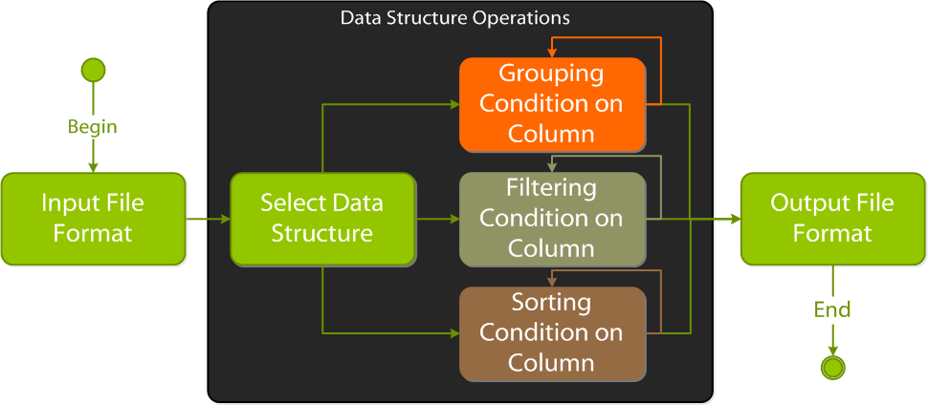
Data Structure Operations

Slide 18
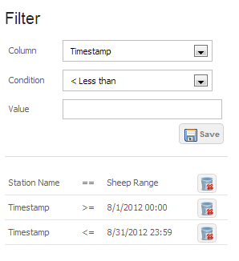
Data Structure Operation

Slide 19
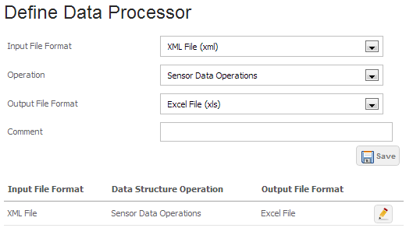
Data Processor

Slide 20
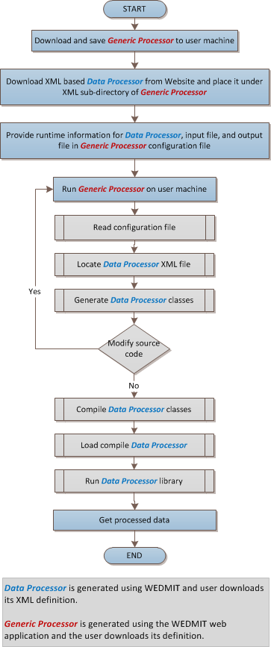
Generic Data Processor

Slide 21
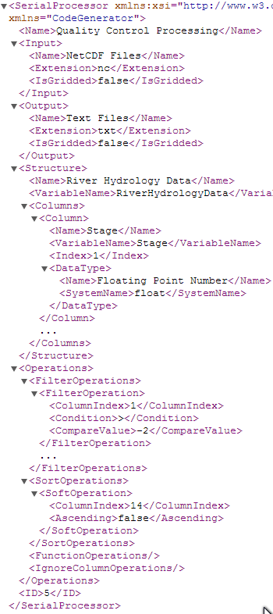
Data Processor Definition File

Slide 22
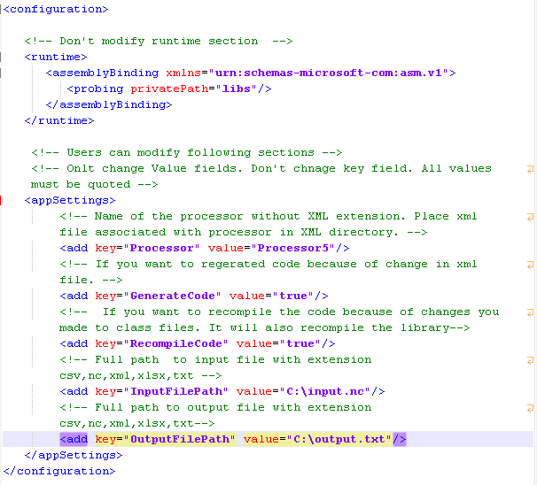
Generic Data Processor Configuration File

Slide 23
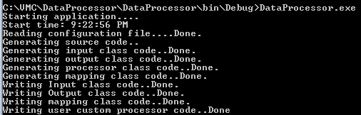
Generic Processor in Action

Slide 24
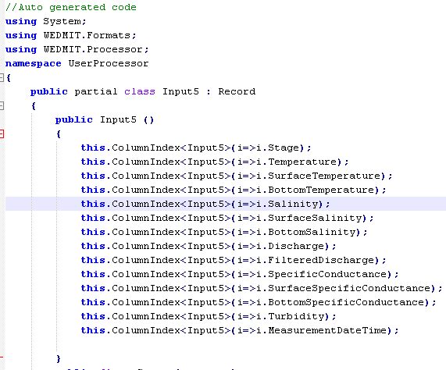
Auto Generated Class

Slide 25
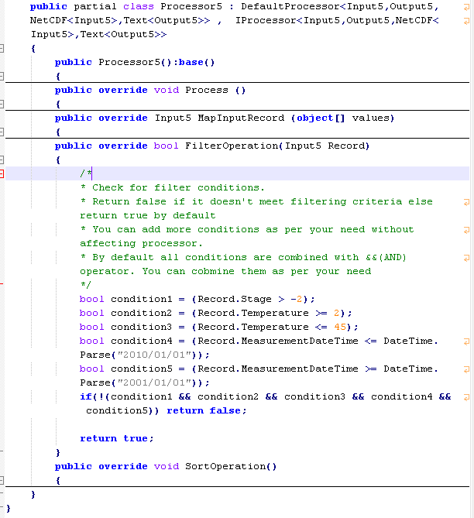
Auto Generated Processor

Slide 26
Conclusions & Future Work
5

Slide 27
Conclusions
There are many challenges related to data processing
Results of the proposed work can also be used to generate data filtering and transformation tools for day to day data processing in other areas of scientific research
Collaboration and reusability of generated data processors via web
Dynamically generated source code be used as a starting point to further address complex issues

Slide 28
Future Work
Support for additional file formats
Ability to create extended workflows
  Including models and other processes
Model coupling with pre-defined set of models
Integrate the solution with Nevada Climate Portal
Expose the API via RESTful services

Slide 29
Questions & Comments

