Slide 1
Design and Implementation of a Graphical Visualization Tool for NCS
Justin E. Cardoza, Alexander K. Jones, Denver J. Liu,
Roger V. Hoang, Devyani Tanna, Laurence C. Jayet Bray,
Sergiu M. Dascalu, Frederick C. Harris, Jr.
Brain Computation Lab
www.cse.unr.edu/brain

Slide 2

Neocortical View
A 3D visualization package for NCS

Slide 3
Overview
Background
Neocortical Simulator
Neocortical View
Questions

Slide 4

Neuroscience
The study of the nervous system
Highly interdisciplinary
Advancing rapidly

Slide 5
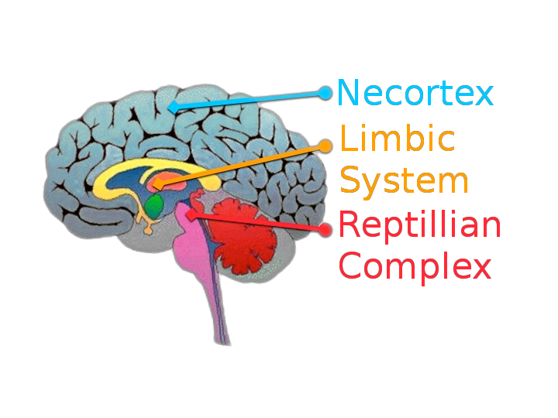
Neocortex
Involved with the more advanced functions and complex behaviors in mammals.

Slide 6
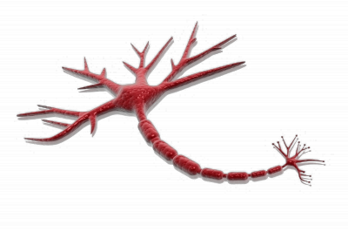
Neuron
The fundamental building block in the brain
Dendrites
Cell Body
Axon
Axon Terminals

Slide 7
Computational Neuroscience
Emulate brain behavior in software
Easier to work with on a cellular level than a real brain.
Can require large computational resources
Application in robotics & medical fields

Slide 8
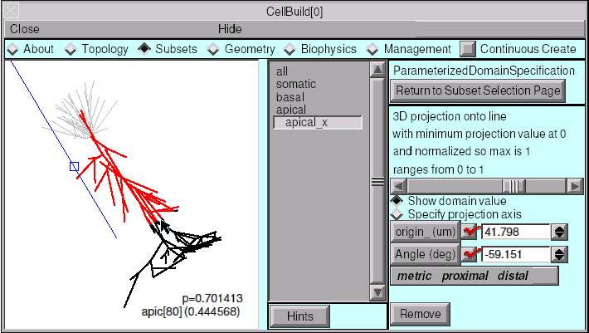
NEURON
Small scale simulationa
Focuses on biological accuracy

Slide 9
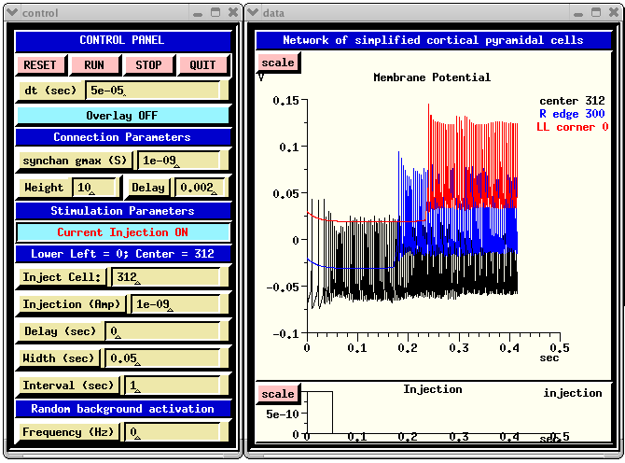
GENESIS
GEneral NEural SImulation System
Sacrificies some biological accuracy for ability to handle slightly larger simulations

Slide 10

Brain Computation Lab

Slide 11

The Neocortical Simulator
Emphasis is on speed and simulation size
Distributed across a cluster or a group of workstations
Utilizes CPUs & NVIDIA GPUs
Extensible through neuron model plugins

Slide 12
The Neocortical Simulator
Multi-stage command line process
Results gathered via text reports or network pipes of data
No capacity for run-time analysis
So, how do we improve this?

Slide 13
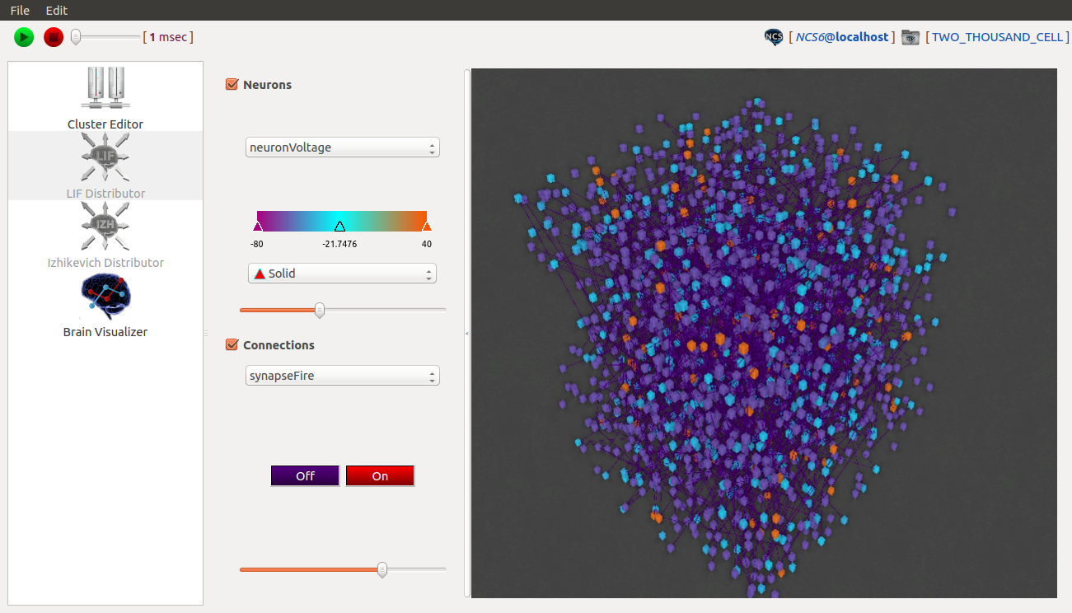
Neocortical View
Setup, launch, and visualize running NCS sims through a graphical user interface.

Slide 14
Neocortical View - Features
Fully abstracts NCS feature set
Saves work to projects for easy access
Build & save custom hardware profiles
Run simulations locally or remotely
Optimized for performance & usability

Slide 15



Neocortical View - Implementation
Implemented in C++ for performance
Utilizes the Qt framework for cross-platform distribution (Linux, Windows)
Uses OpenGL 3.3 for visualization

Slide 16
Neocortical View - Architecture
Plugins abstract functionality of NCS components
Plugins communicate asynchronously via signals / slots
Plugins satisfy globally declared interfaces to be recognized by main application
Plugins loaded at run-time

Slide 17
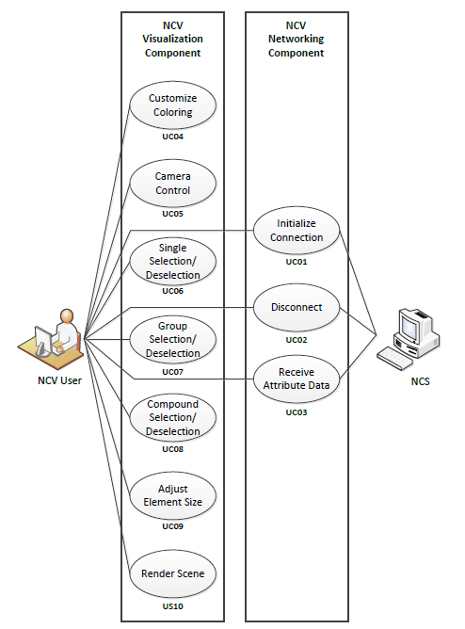
Neocortical
View –
Use Cases

Slide 18
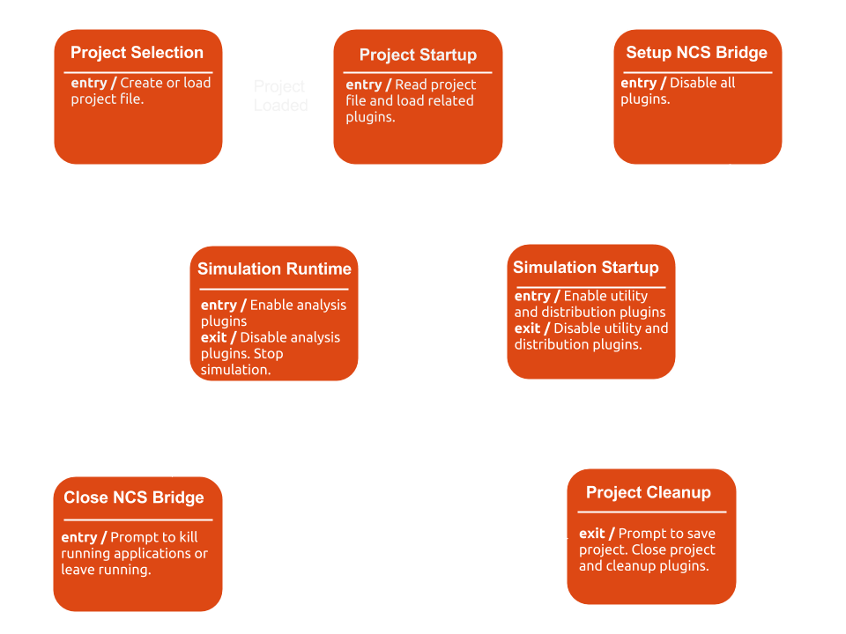
Neocortical View - State Diagram

Slide 19
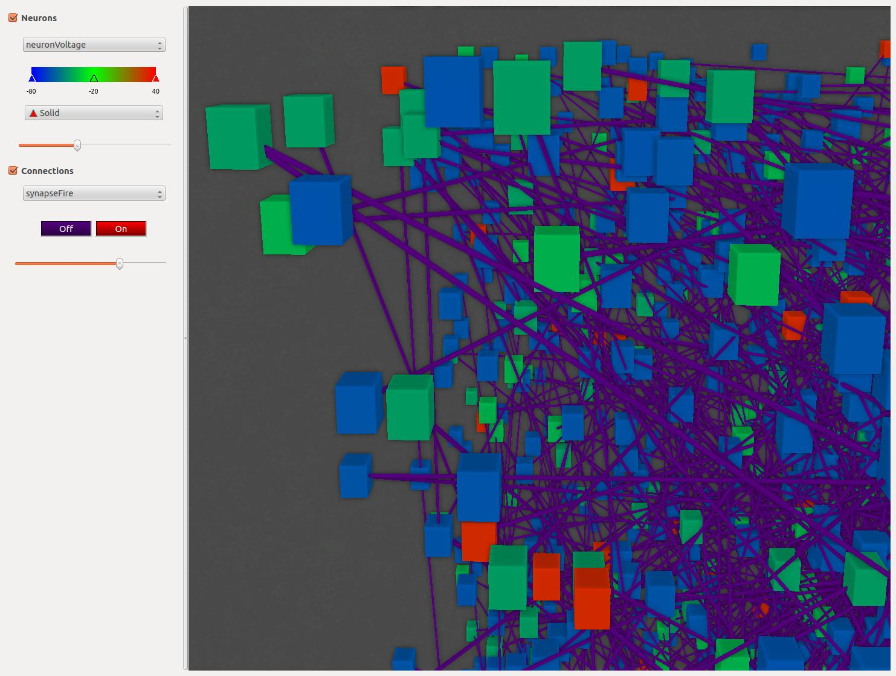
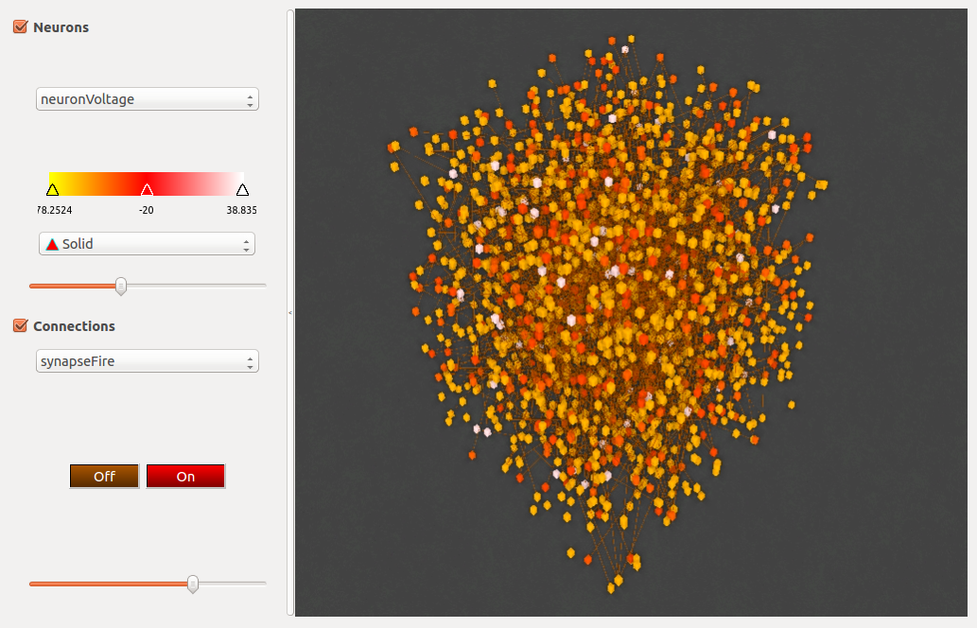
Visualization
Neurons represented as cubes
Synapses represented as rectangular pipes
The domains of tracked attributes are represented by color spectrums

Slide 20
Visualization - Displaying Data
Discrete attributes, such as whether a neuron is firing or not, are displayed using a different color for each state.
Continuous attributes, such as voltage of neurons, are displayed with a smooth gradient of color.
Neurons and synapses can each display separate attributes

Slide 21
Visualization - Implementation
Graphics pipeline optimized for performance
Instancing allows us to draw many copies of a shape very quickly
Vertex Buffer Objects store data on the graphics card for fast retrieval.
Simulation data accessed as textures to ensure effecient GDRAM memory fetching

Slide 22
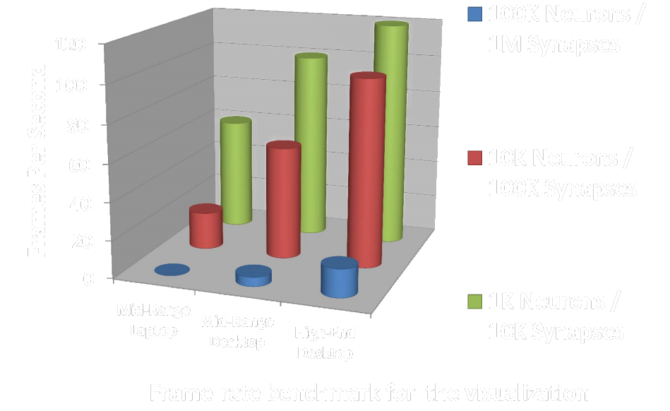
Visualization - Statistics

Slide 23
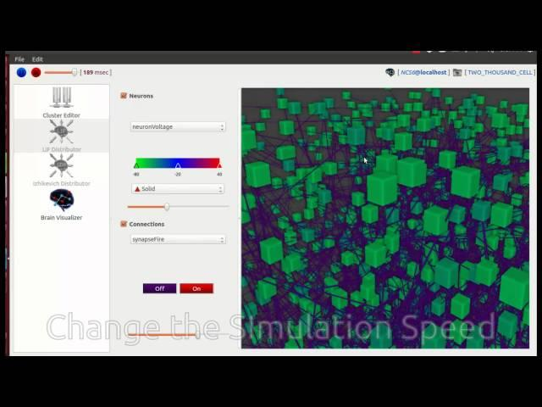
Neocortical View - Walkthrough

Slide 24
Future Work
Have finished developing a python interface for NCS
Currently designing a Web-App front end for NCS
  Model Builder
  Simulation Builder
  Report Viewer
  Hopefully NCV will be integrated into this

Slide 25
Design and Implementation of a Graphical Visualization Tool for NCS
Justin E. Cardoza, Alexander K. Jones, Denver J. Liu,
Roger V. Hoang, Devyani Tanna, Laurence C. Jayet Bray,
Sergiu M. Dascalu, Frederick C. Harris, Jr.
Brain Computation Lab
www.cse.unr.edu/brain

