Slide 1
ModFossa:
A Python Library for Ion Channel Modeling
Gareth Ferneyhough, Corey Thibeault,
Sergiu M. Dascalu Frederick C. Harris Jr.,
Computer Science and Engineering
University of Nevada, Reno

Slide 2
Overview
The creation and simulation of ion channel models using continuous-time Markov processes is a powerful and well-used tool in the field of electrophysiology and ion channel research.
While several software packages exist for the purpose of ion channel modeling, none are available as a Python library.
In an attempt to provide an easy-to-use, yet powerful Markov model-based ion channel simulator, we have developed ModFossa, a Python library supporting easy model creation and stimulus definition, complete with a fast numerical solver, and attractive vector graphics plotting.

Slide 3
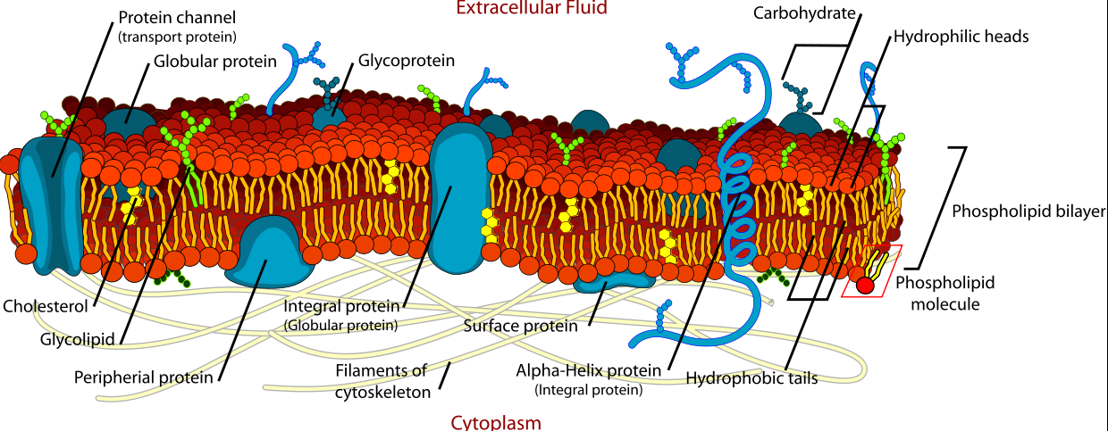
Introduction: Cell membrane

Slide 4
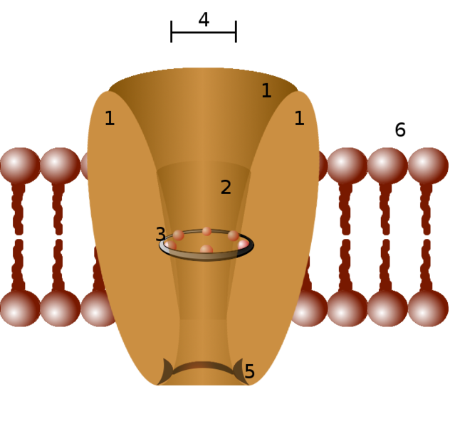
Introduction
What are ion channels?
  Family of proteins embedded in cell membrane
  Passive transport
  Selectively permeable
  Diverse
Used for:
  shaping cell voltage
  Sensing
  Communication
  regulation of volume

Slide 5
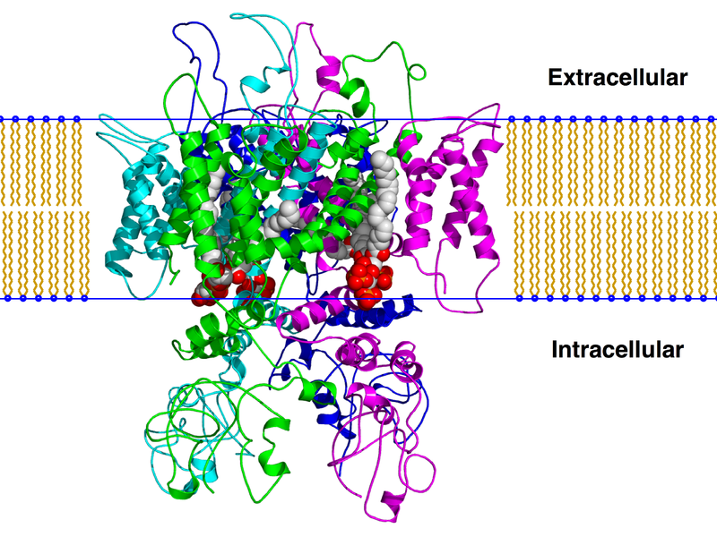
Introduction
Trpv1 (capsaicin receptor) ion channel [2].

Slide 6
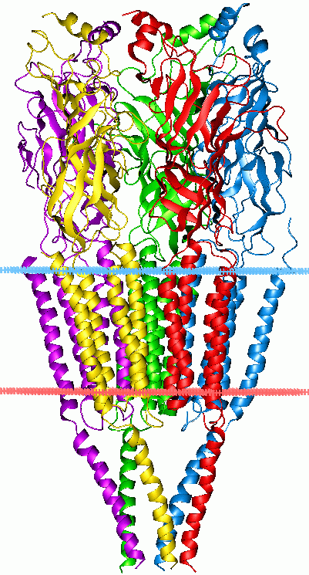
Introduction
Types of ion channels
  Voltage-gated
    Na+ channel
  Ligand-gated
    Calcium-activated chloride channel
  Stretch-gated
    Blood pressure regulation
Nicotinic acetylcholine receptor [3].

Slide 7
Introduction
Why study ion channels?
  Diseases:
    Familial hemiplegic migraine
    Cystic fibrosis
    Others
  Poisons / toxins
    Snakes, scorpions, spiders, bees
  Understanding function can lead to new treatments / drugs

Slide 8
Background: Electrochemical gradient
What provides the work to drive ions through their channels?
  The electrochemical gradient
What is that?
  Combination of diffusion and electrical forces

Slide 9
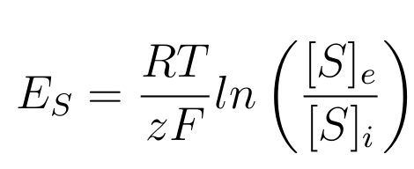
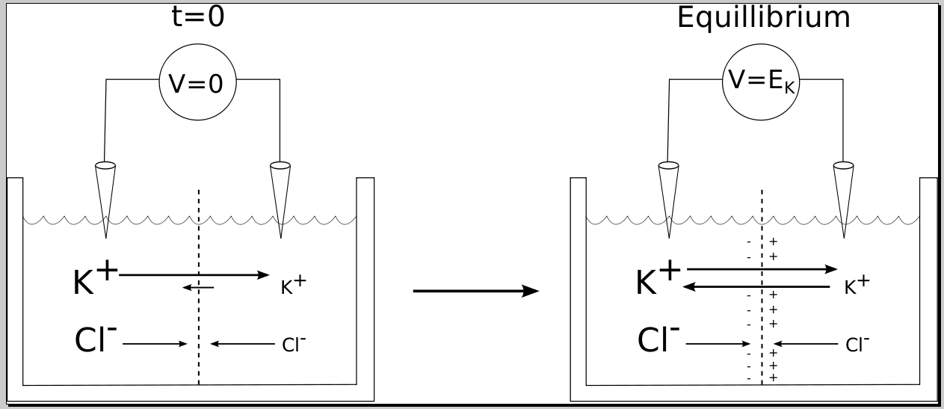
Background: Electrochemical gradient
Nernst equation:

Slide 10
Background:
Membrane potential
How do ion channels contribute to the cell's membrane potential?
  channel state affects membrane permeability to ions
  permeability ≈ conductivity
Ohm's law:
  V=IR
  V=I/G
  I=GV

Slide 11
Background:
Membrane potential
Formally,
  I_{s} = G_{s} * (DrivingForce_{s} ),
  where DrivingForce_{s} = (V_{m} - E_{s}).
  Substituting:
  I_{s} = G_{s} * (V_{m} - E_{s}).
How do we calculate G_{s}?
  Proportion of open channels

Slide 12

Background:
Channel modeling
How do we model the kinetics, or gating of ion channels?
  Represent channel as a continuous time Markov process
    States ≈ channel's functional shape
      i.e. open, closed, deactivated, inactivated
    States are connected using various rates

Slide 13
Background:
Channel modeling
Continuous time Markov process:
  used to simulate stochasticity
  maintain "memoryless" Markov property
  transitions between states can occur at any time
    with exponentially distributed probability
  can give us the model's probability distribution
    i.e. what is the probability that our ion channel is in the open state?
    or - out of many ion channels, how many are open?

Slide 14


Background:
Channel modeling
Continuous time Markov process:
  evolution of probability distribution:
  where P is the vector of state probabilities, and A is the transition matrix

Slide 15
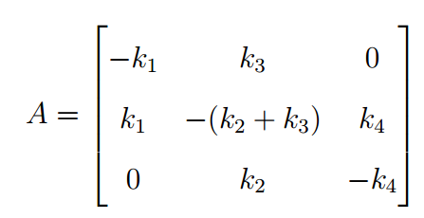
Background:
Channel modeling

Slide 16
Background:
Channel modeling
In summary:
  Ion channels change state in response to environmental factors
  The state of ion channels affects the cell membrane's permeability (conductance)
  We can model the conductance over time of an ion channel using continuous time Markov processes
    states - channel's physical state
    rates - transitions between states
      dependent on voltage, binding of ligands, etc.

Slide 17
Existing simulators
Several ion channel simulators exist that use CTMM
  many rely on a GUI
    IonChannelLab
    QUB
Some authors use MATLAB
  slow

Slide 18
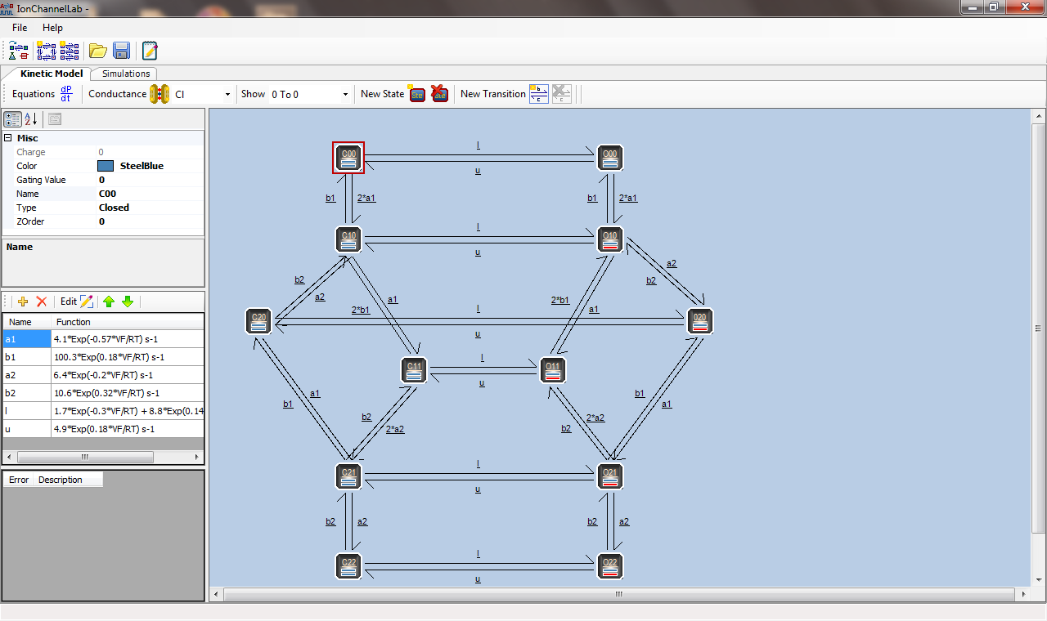
Existing simulators: IonChannelLab

Slide 19
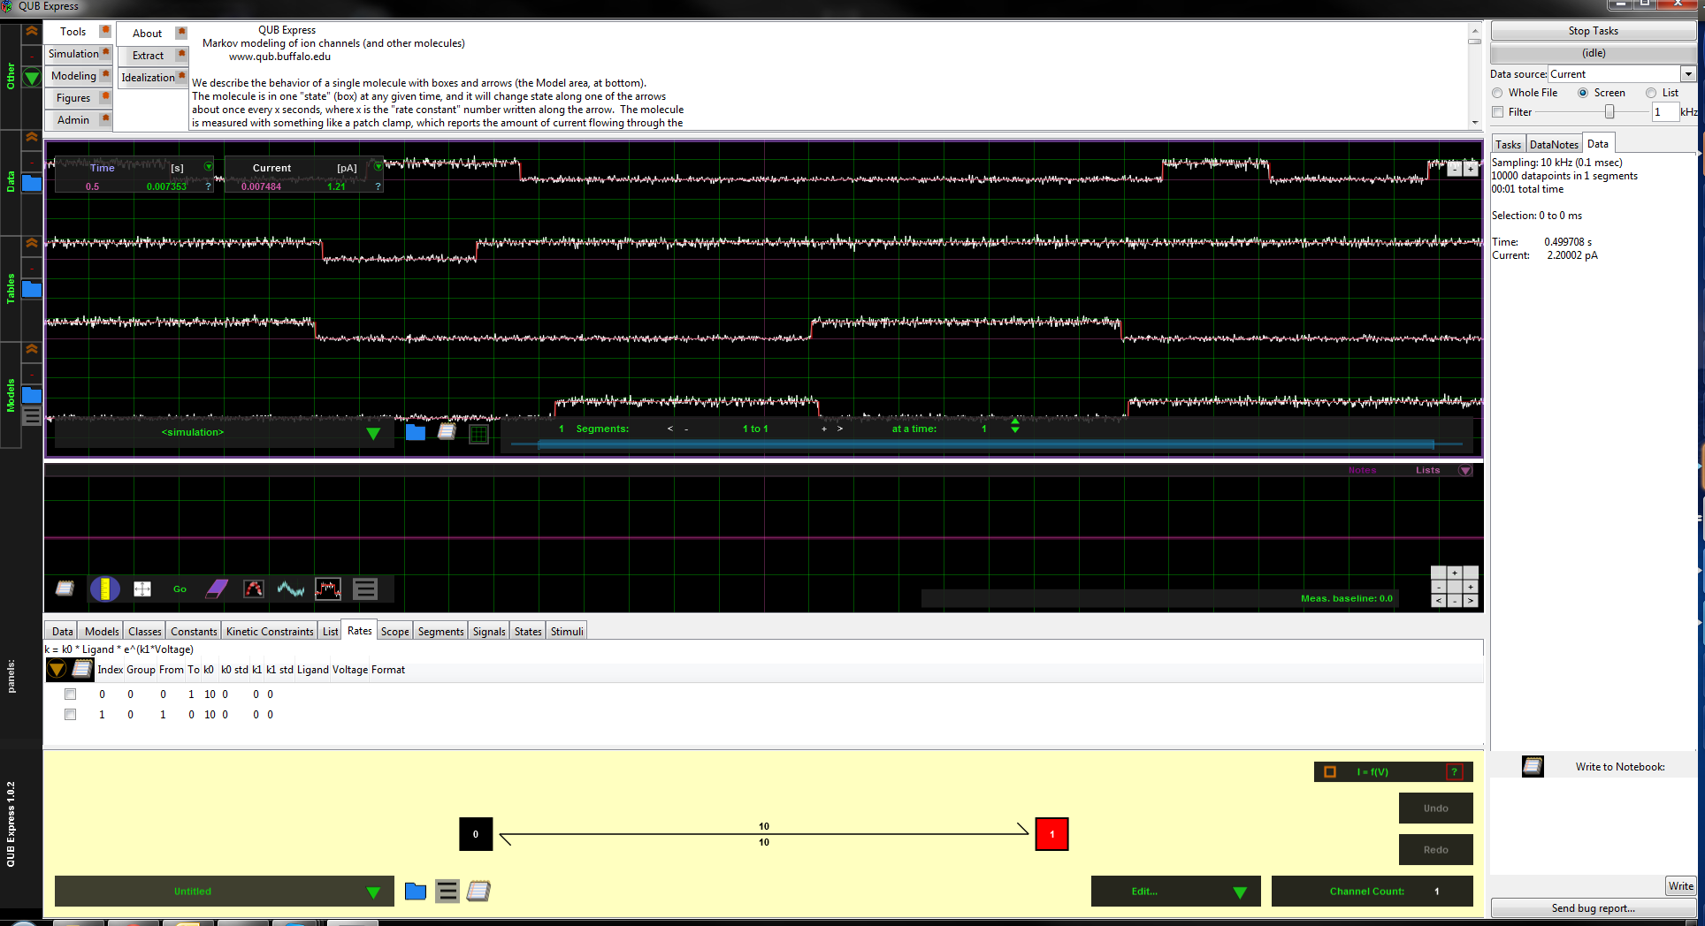
Existing simulators:
QUB

Slide 20
Our Software: ModFossa
ModFossa:
  CTMM ion channel simulator written in C++
    fast ODE solving
      17 times faster than the corresponding MATLAB implementation
  Available as Python library
    easy model creation
    attractive plotting
    scriptable

Slide 21
Our software: ModFossa
Rate constant types:
  Constant
  exponential voltage-gated
  sigmoidal voltage-gated
  ligand-gated
Experiment definition:
  voltage protocol
  concentration protocol

Slide 22
Our software: ModFossa
Plots:
  all plots are vector graphics
  Currents
  conductance vs. voltage
  conductance vs. concentration
  IV curves at specified time

Slide 23
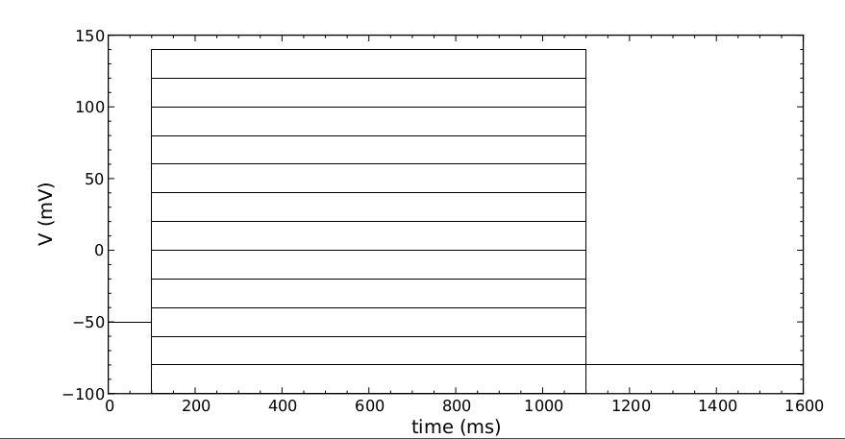
ModFossa plot: voltage protocol

Slide 24
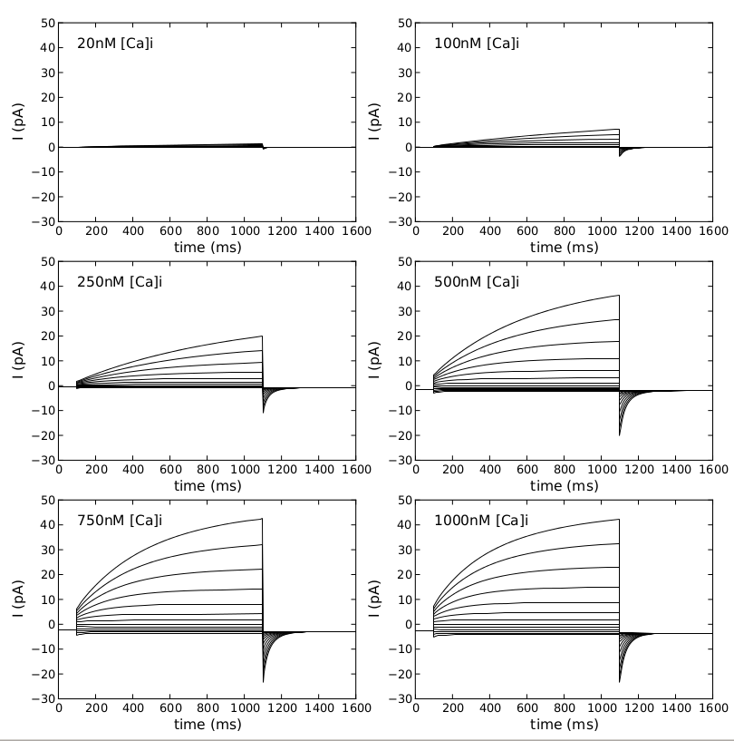
ModFossa plot: currents

Slide 25
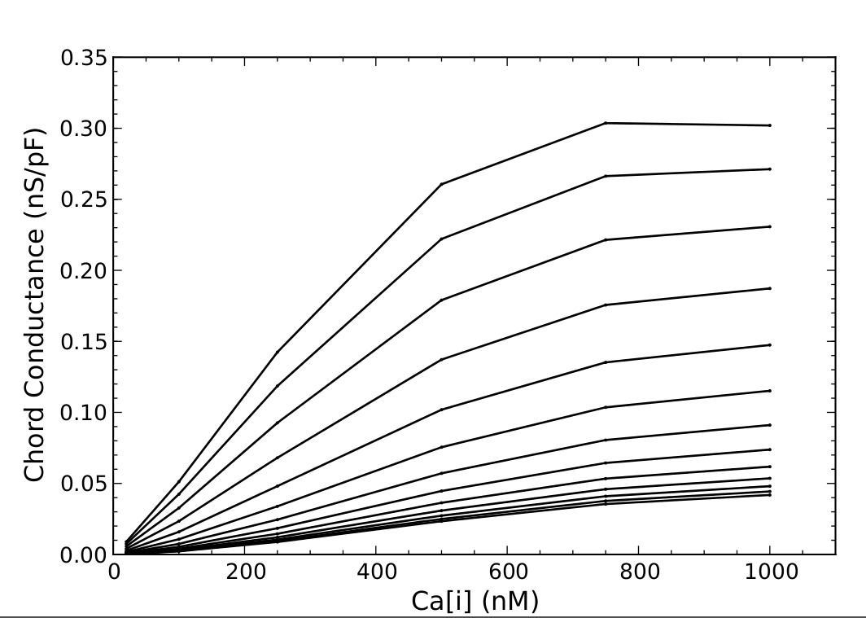
ModFossa plot:
G vs Concentration

Slide 26
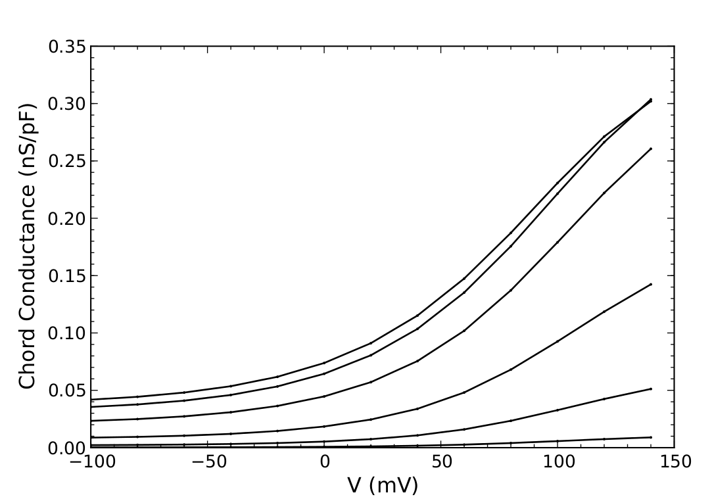
ModFossa plot:
G vs Voltage

Slide 27
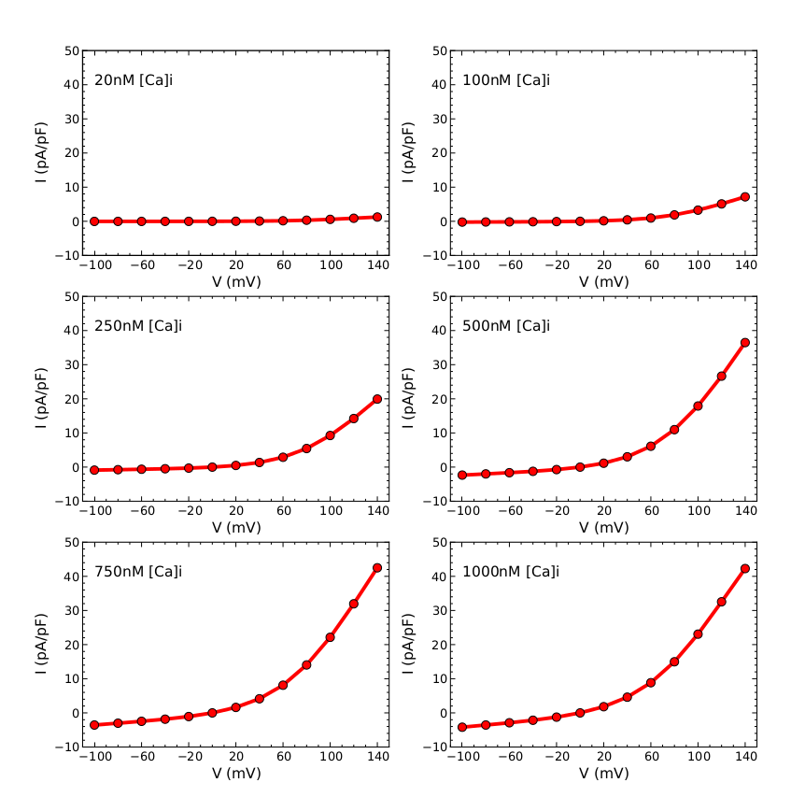
ModFossa plot:
IV curves

Slide 28
Our software: ModFossa
Software development:
  Ubuntu Linux with Eclipse CDT
  C++ 11
  SUNDIALS ODE solver
  Boost.Python
  Python 2.7
Building, testing, documentation:
  CMake
  Doxygen, Sphinx
  GTest

Slide 29
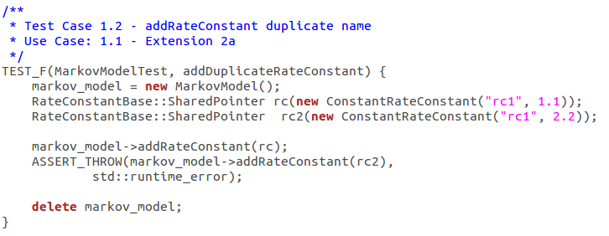
GTest example

Slide 30
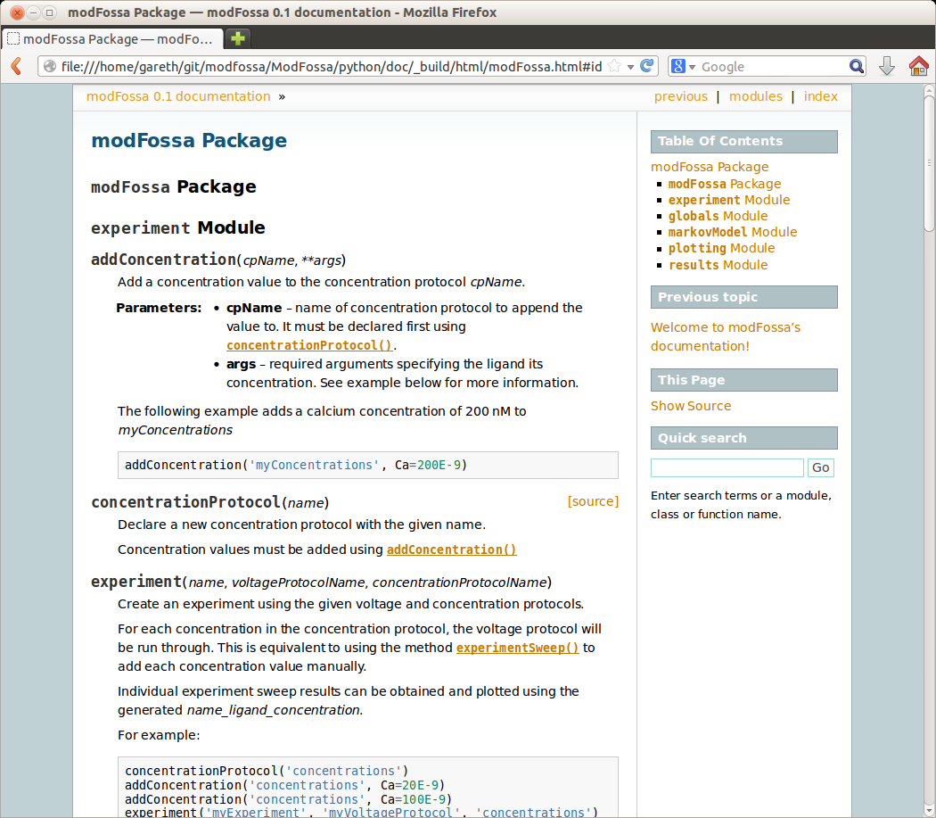
Sphinx example

Slide 31
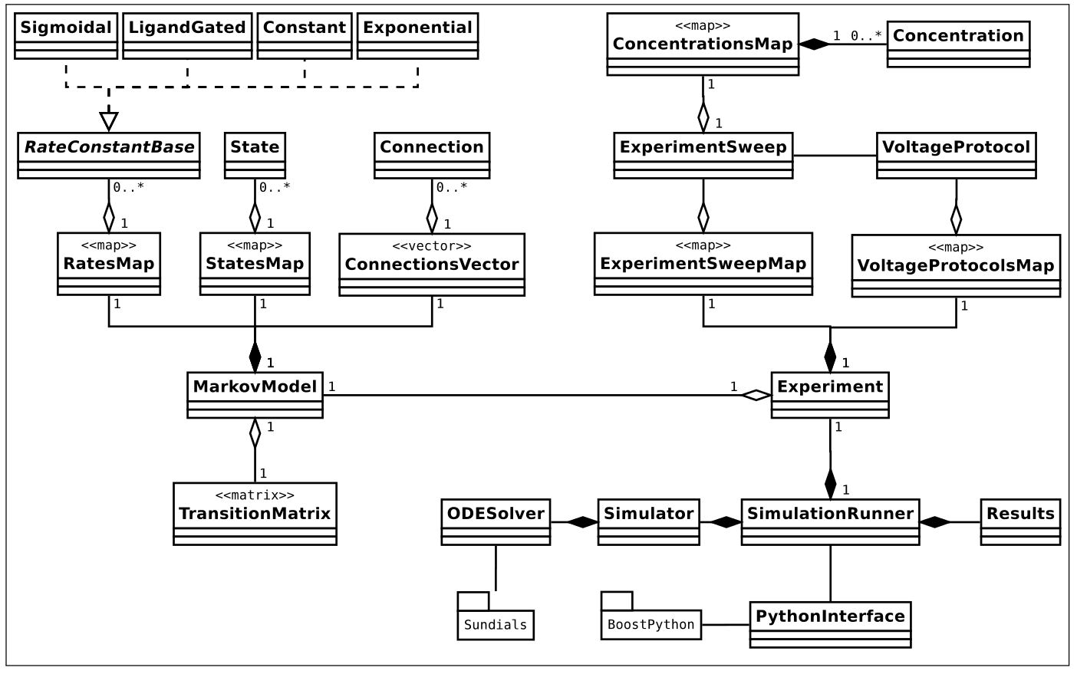
Our software: ModFossa

Slide 32
Conclusion
ModFossa:
  fast, easy-to-use
  Python library
  nice plotting
Applications:
  rapid model development
  parameter searching
Future work:
  user-defined rates
  curve fitting, parameter searching
  model visualization

Slide 33
ModFossa:
A Python Library for Ion Channel Modeling
Gareth Ferneyhough, Corey Thibeault,
Sergiu M. Dascalu Frederick C. Harris Jr.,
Computer Science and Engineering
University of Nevada, Reno

