Slide 2
GPU Based Sound Simulation and Visualization
Torbjorn Loken,
Sergiu M. Dascalu, and
Frederick C Harris, Jr.
Department of Computer Science and Engineering
University of Nevada, Reno

Slide 3
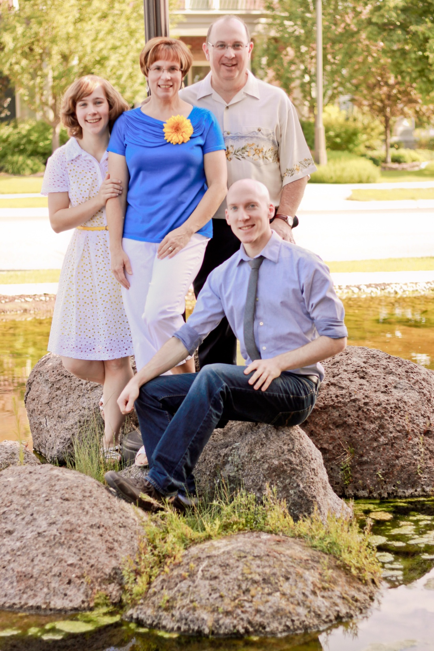

Slide 4
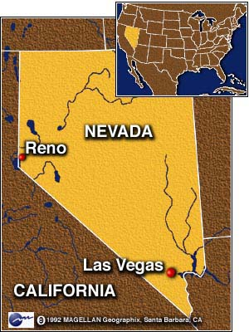
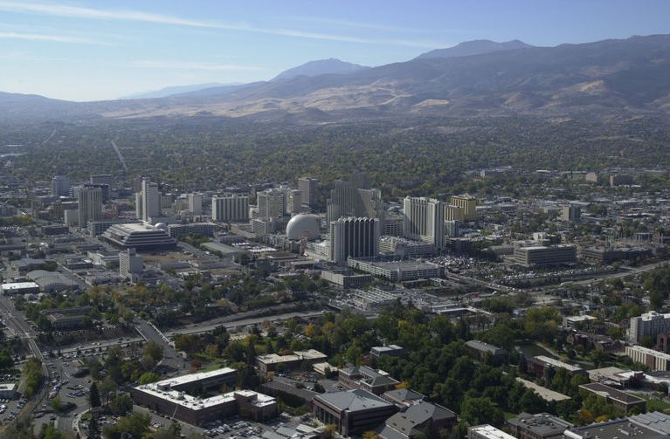
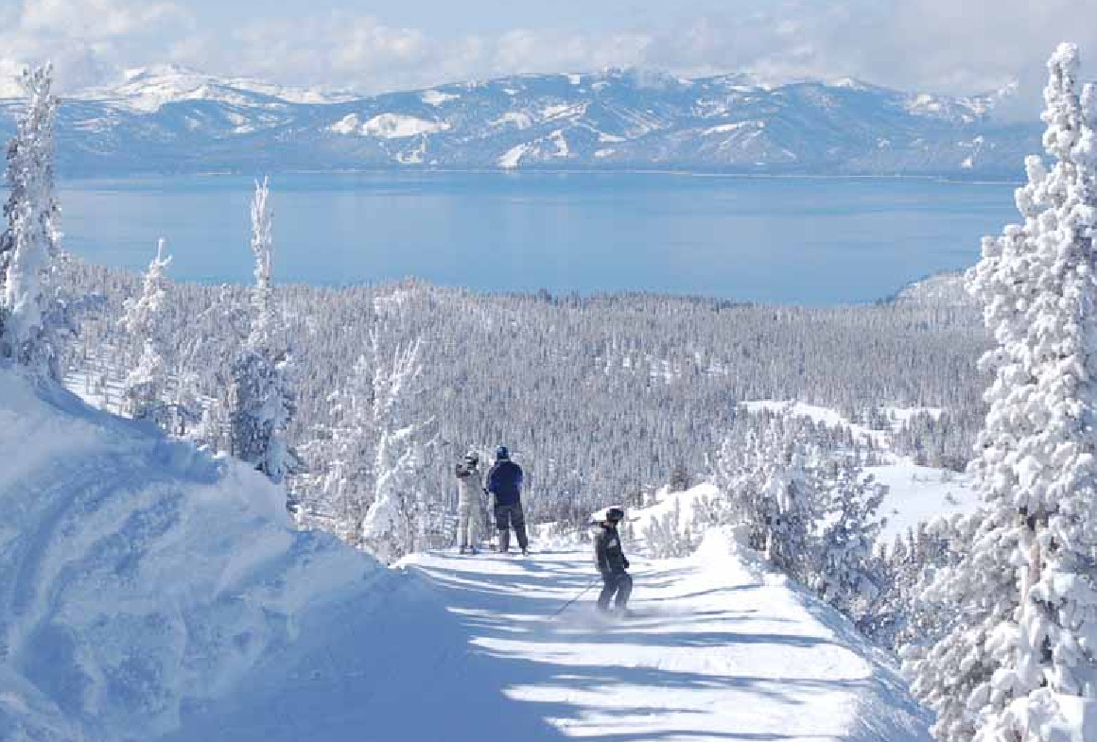
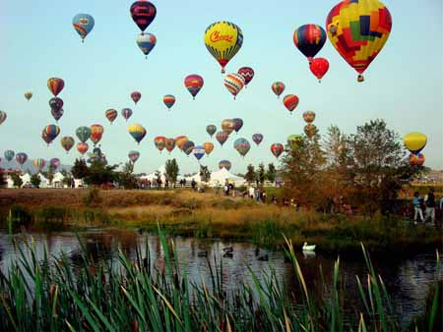
Reno, Nevada

Slide 5
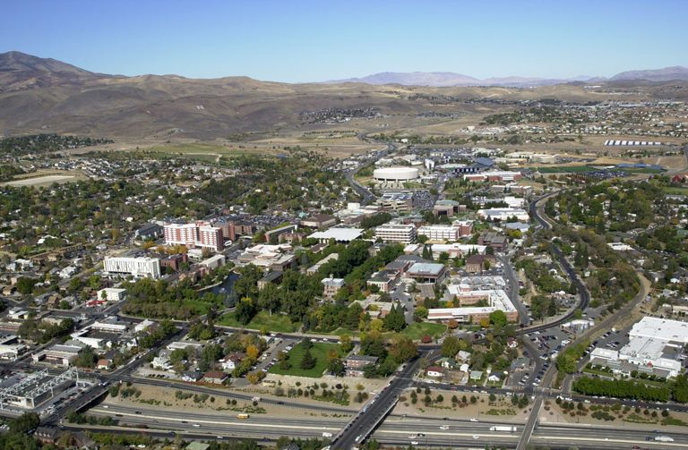
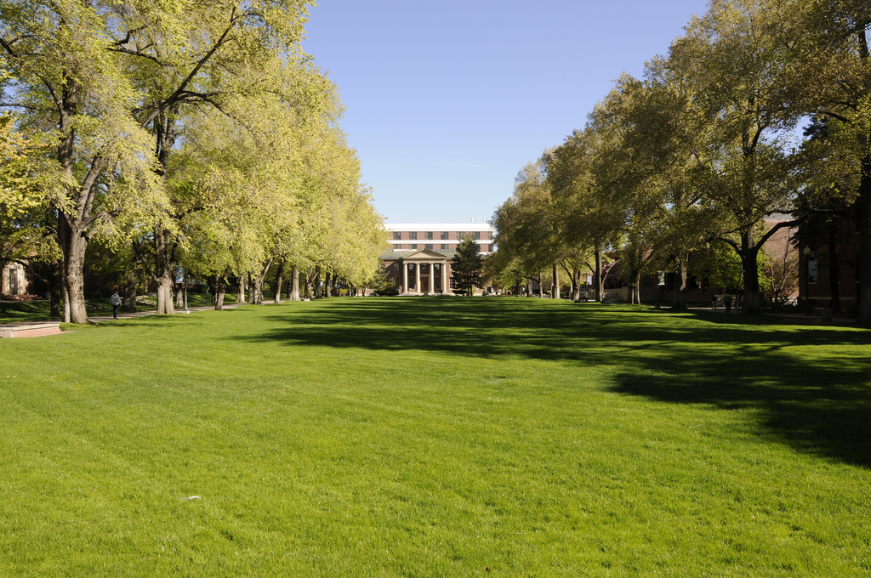
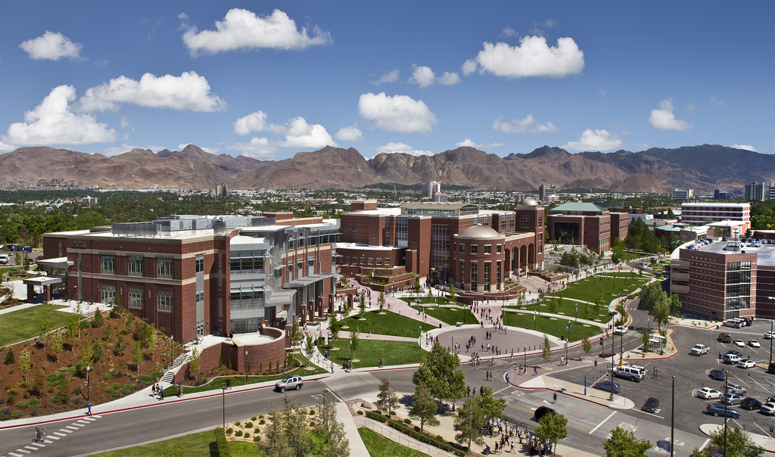
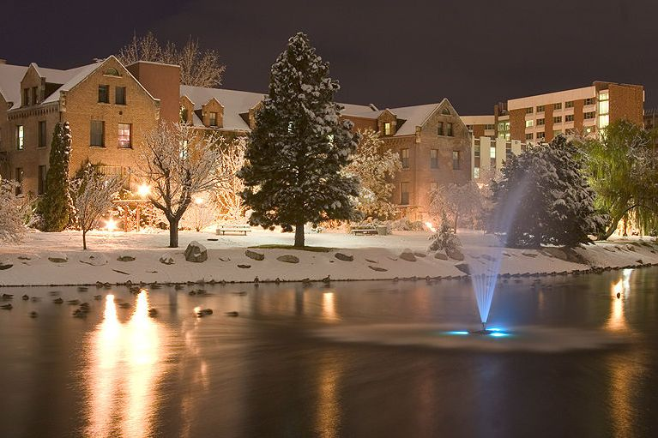
University of Nevada, Reno

Slide 6
GPU Based Sound Simulation and Visualization
Torbjorn Loken,
Sergiu M. Dascalu, and
Frederick C Harris, Jr.
Department of Computer Science and Engineering
University of Nevada, Reno

Slide 7
Coprocessors
Step back in time
  Channel I/O

Slide 8
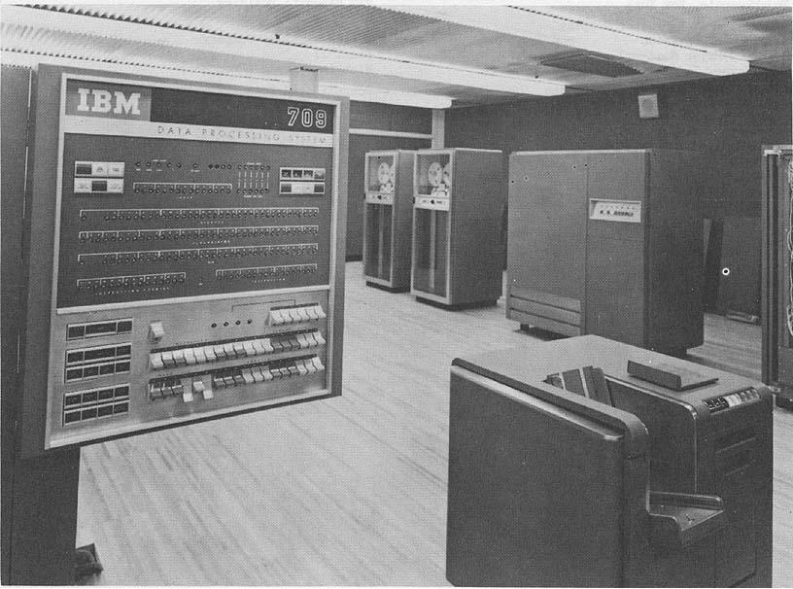
Notes:
http://www.columbia.edu/cu/computinghistory/ibm709.html
Thank you Columbia for the picture
IBM introduced the first coprocessor to offload processor intensive tasks

Slide 9
Channel I/O
I/O processing was taking a significant amount for processor time
  Just renting an IBM 709 could cost upwards of $55,000 a month

Slide 10
Channel IO
I/O channels hooked into data synchronizer units
  Central Processor free to continue
Similar to the modern Southbridge chip found on motherboards

Slide 11
Coprocessors
Step back in time
  Channel I/O
  Floating Point Units
Notes:
Floating Point Units were probably the most well known coprocessors until recently
They were often the difference between a scientific computer and a computer

Slide 12
Floating Point Math
Before 1985 and the IEEE 754 standard the implementation of floating point math varied greatly
  Word sizes varied, accuracy varied
Notes:
No common interface for dealing with floating point numbers
Some machine had many different floating point types
Most serious machines had some form of coprocessor or hardware acceleration if they supported floating point types
Dark times for portability and programmer sanity

Slide 13
Floating Point Math
IEEE Standard 754 and a consensus about word sizes (32-bits) helped greatly
Hardware implementations almost required
  Complex
  Slow
  Valuable
Notes:
Floating point math is a real bear.
Lead into the next slide with that

Slide 14
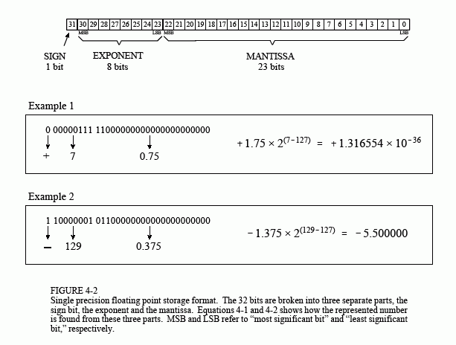
Floating Point Numbers
Notes:
As you can see the format of the float can be complicated
Addition and subtraction can be done if the numbers share a exponent
Multiplacation - multiply significant and add the exponents
Image Credit:
http://www.dspguide.com/ch4/3.htm

Slide 15
Floating Point units
Initially off chip
  One of the most popular coprocessors
Moore’s Law made room for them on chip

Slide 16
SSE and AVX
New instruction sets
Compute using 128-512 bit wide registers
  Multiple floating point numbers per register
Non-blocking, CPU free to continue while computations run.
Modern, widely available.

Slide 17
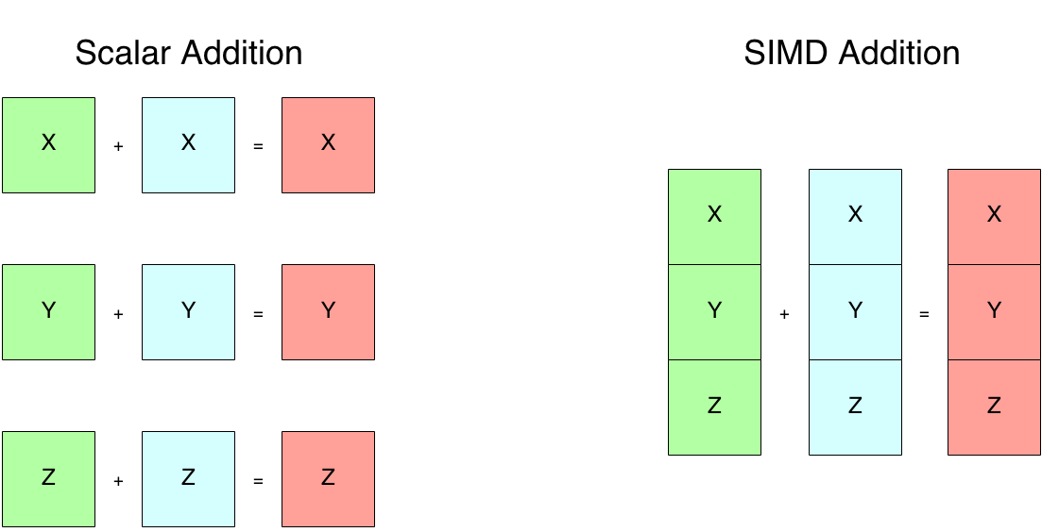

Slide 18
Coprocessors
Step back in time
  Channel I/O
  Floating Point Units
Graphics Processing units

Slide 19
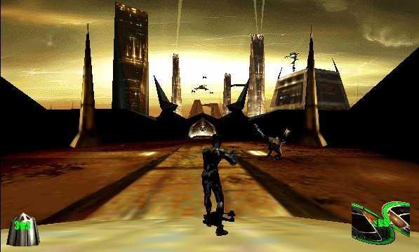
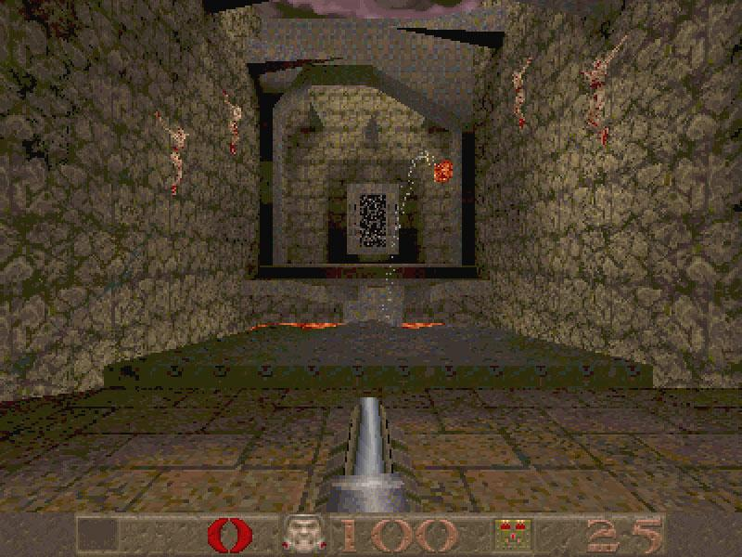
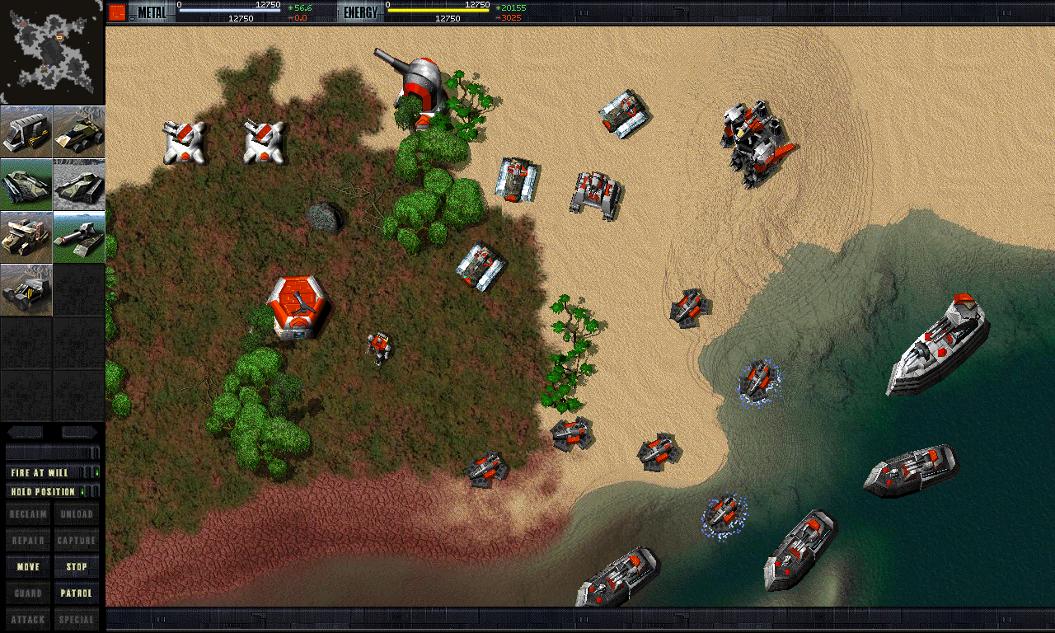
Games: FPU Powered
Notes:
Some graphical programs begin to show up which require more power than the FPU can throw out, in particular games
right 2 images are from 1997
Image credits:
http://mrserincmartin.com/quake-is-the-best-ms-dos-game-ever/
http://www.desura.com/games/mdk/images/mdk1-screenshot
http://www.impulsedriven.com/

Slide 20
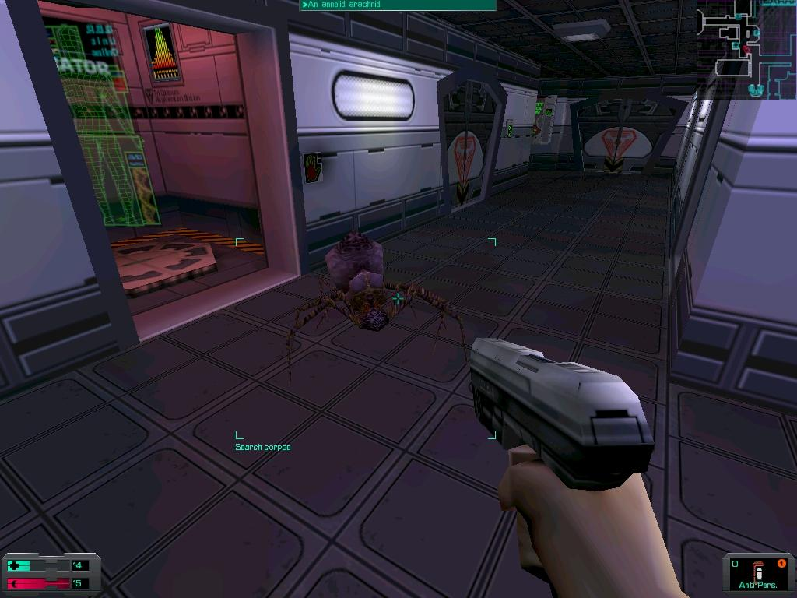
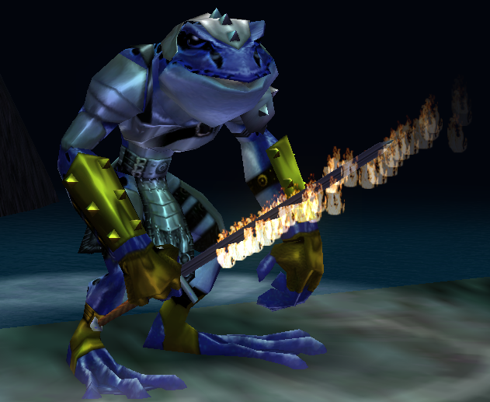
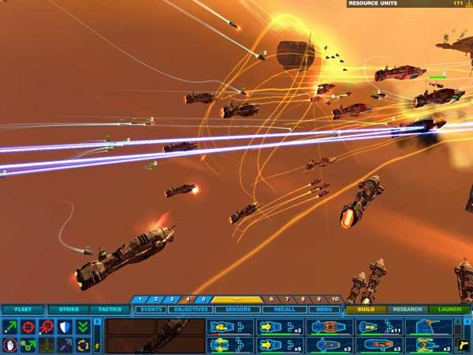
Games: GPU Powered
Notes:
Fully pipelined transformation and lighting allowed for higher polygon counts
All these games came out in 1999 the same year that SSE instructions first started seeing some use
Image Credits:
http://everquest.allakhazam.com/Im/image/203661
http://www.pcgamer.com/2011/03/13/reinstall-system-shock-2/
http://springfiles.com/games/strategy/real-time-strategy/homeworld

Slide 21
GPU Design
Goal: Floating Point Throughput
SIMD to the core
Hardware Accelerate common operations
  Initially Transformation and Lighting calculations
  Later Transcendentals, Texture sampling, etc...

Slide 22
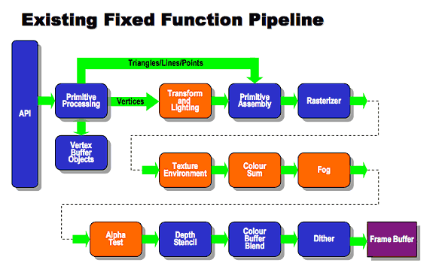
The Original Pipeline
Notes:
Graphics pipeline:
The basic steps things that a graphics card does, ignoring lighting
Image credits:
http://www.khronos.org/opengles/2_X/

Slide 23
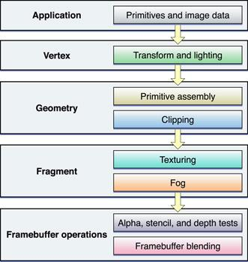
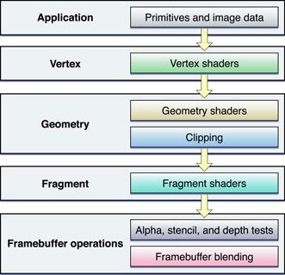
The evolution of the pipeline
Notes:
The evolution of the pipeline
A move towards generality and programmability
Image Credits:
https://developer.apple.com/library/mac/documentation/graphicsimaging/conceptual/opengl-macprogguide/opengl_shaders/opengl_shaders.html

Slide 24
Increasing Programmability
Shaders
  Intended for graphical use
  They were als used also to accelerate applications with a large amount of floating point math
    Image processing, simulations, etc
    VFire

Slide 25
Enter CUDA

Slide 26
Changes
Unified Processor Architecture
  No more vertex or fragment processors
Threading emphasized
  Many cores running many many threads

Slide 27
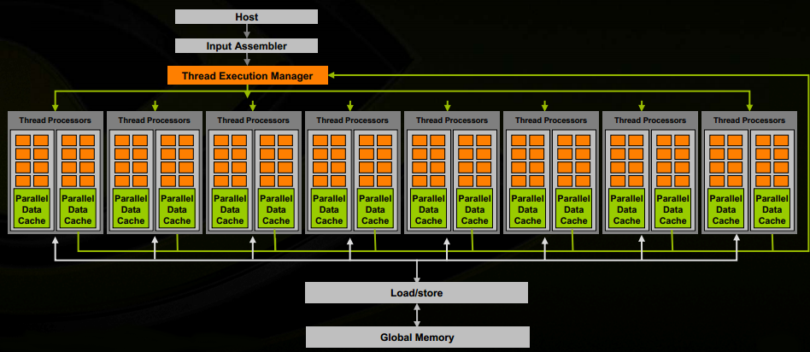

Slide 28
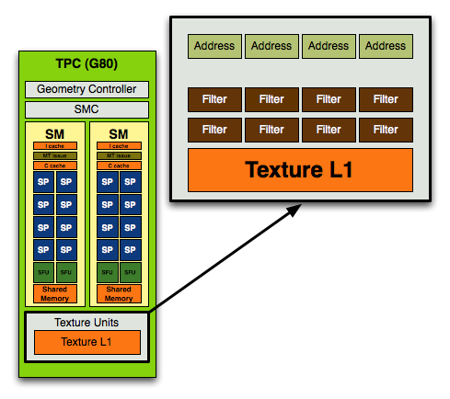
Notes:
Image Credit:
http://www.anandtech.com/show/2549/3

Slide 29
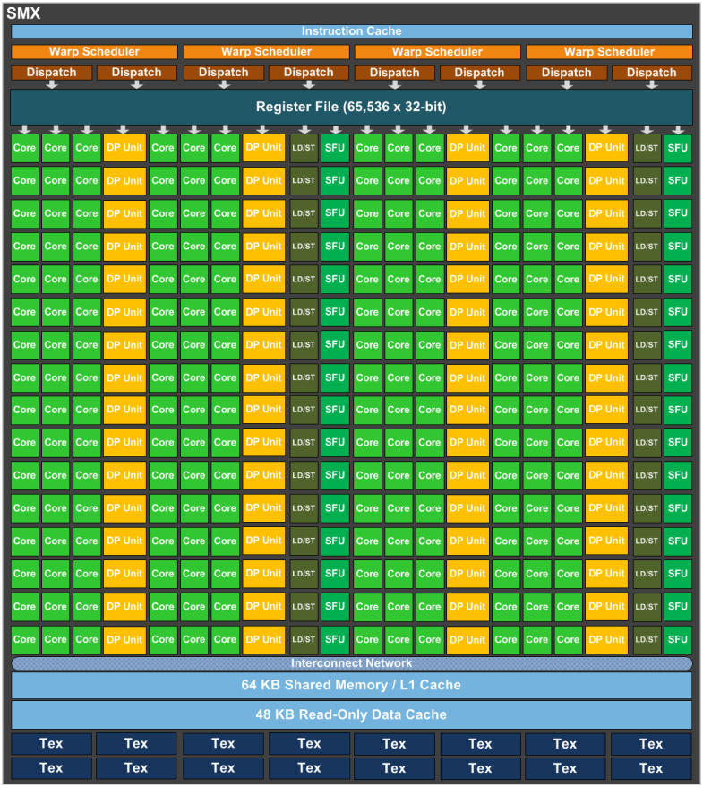

Slide 30
CUDA
A subset of C with some extensions
  Thread identifiers
  Launching kernels
  Some data types
    Mainly used for organizing thread numbering

Slide 31
Example Kernel
__global__ void kernel(float* a, int N) {
int idx = threadIdx.x;
if(idx < N) {
a[idx] = a[idx] * a[idx];
}
}
Notes:
Simply squares the array a

Slide 32
Now back to
Sound Simulation

Slide 33
Sound Simulation
What are the acoustic properties of a room?
What acoustic phenomena will be produced in a room?

Slide 34
Wave Simulation Techniques
Geometric
  Ray tracing
Numeric
  Finite Element Methods(FEM)
    Breaks domain into many smaller domains
  Finite Difference Time Domain(FDTD)
    Grid based
Notes:
FEM is like imagining a room as a series of Smaller rooms with boundries
FEM is more complicated and requires some precomputation
FDTD is like a specialized FEM where the domains are axis aligned on a grid
We choose FDTD because its simplicity
Numeric methods solve the entire space and frequency range

Slide 35
FDTD
Decomposes the space in a rectilinear grid
Visualization easy.
Naturally very data parallel
  Easy to fit to SIMD
Computationally expensive
  Increased frequency range -> Increased resolution of grid and decreased timestep size
Notes:
Used commonly to simulate EM waves to help design antennas
As the frequency of sampling increases the resolution of the grid must also increase, a doubling of the sampling frequency leads to a doubling of the resolution of the grid and number of time steps

Slide 36
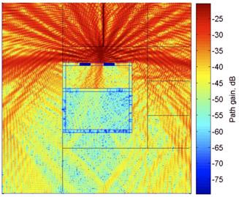
Radio Wave Propagation
Simulating a cellular telephone in an elevator
Notes:
Blue is very weak signal to Red being very strong.
Simulating cellular telephone in an elevator

Slide 37
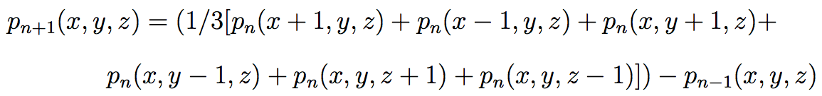
FDTD Sound Simulation
Solve for the acoustic pressure across the each point in the grid every time step
4 Different cases based on the boundaries at a grid point
Notes:
The equation is the solution for an air node

Slide 38
Implementation
1 array which encodes the boundaries for each point on the grid (the boundary is constant for the entire simulation)
A series of arrays for holding the current simulation state
Notes:
The boundary array is constant for the entire simulation
The resolution for these arrays

Slide 39
0110
0111
0101
1110
1111
1101
1010
1011
1001

Slide 40
System architecture
3 Components
  Simulation Manager
  Memory Manager
  Renderer
Notes:
Simulation manager handles all the simulation state
Memory manager handles getting simulation data off of the card and preparing it for visualization
The Visualizer handles all visualization tasks

Slide 41
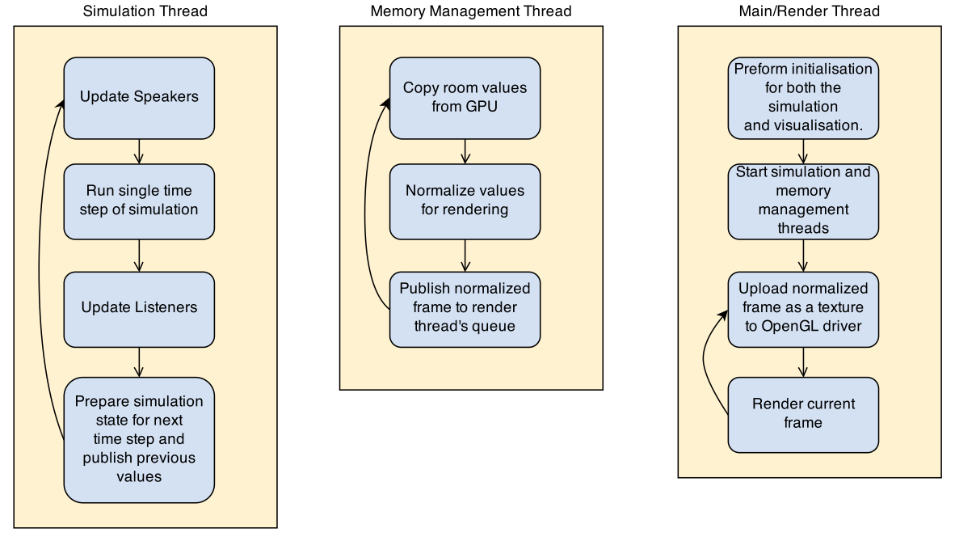

Slide 42
System Architecture
Each component runs on its own thread
Inter-thread communication done with thread-safe queues

Slide 43
GPU
Simulation Manager
Renderer
OpenGL Data
Simulation Data
Memory Manager
CPU
Frame Data

Slide 44
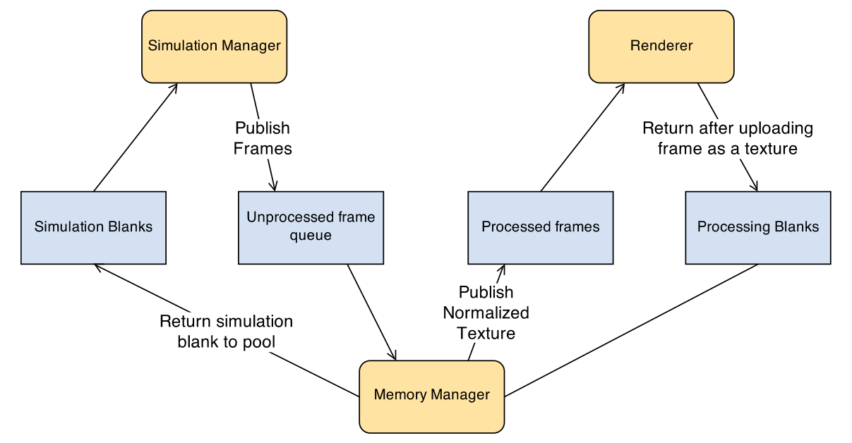

Slide 45
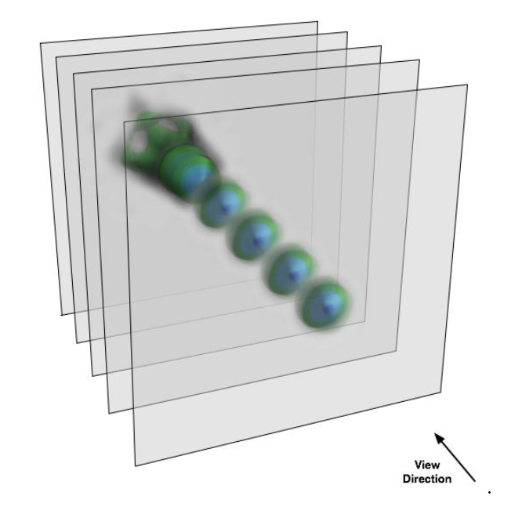
Texture Mapped Volume Rendering
Uses alpha blending to quickly render volumetric data.

Slide 46
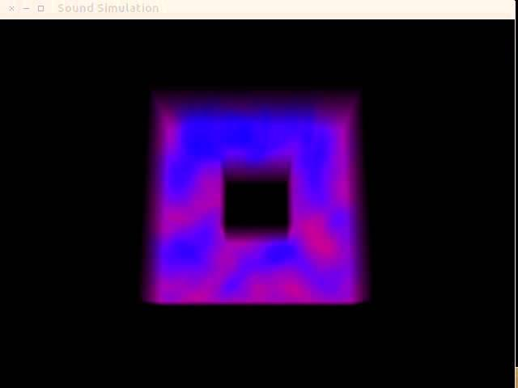

Slide 47
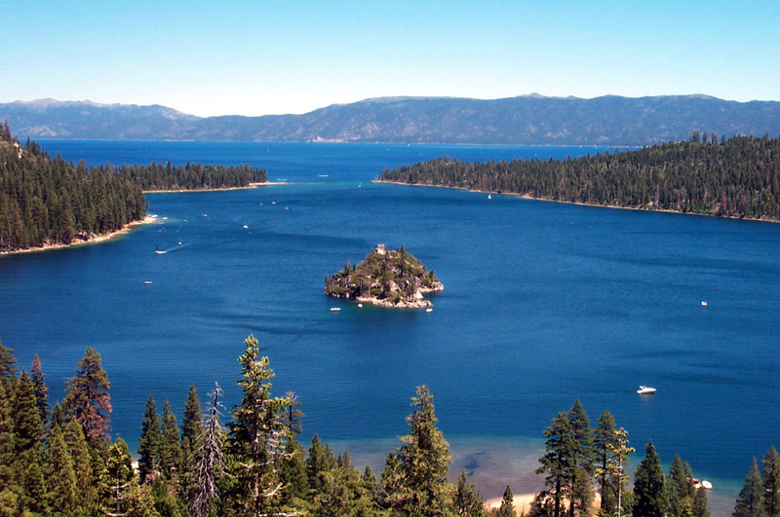
Thank you!

Slide 48
GPU Based Sound Simulation and Visualization
Torbjorn Loken,
Sergiu M. Dascalu, and
Frederick C Harris, Jr.
Department of Computer Science and Engineering
University of Nevada, Reno

