Slide 1

Neocortical Virtual Robot
Thomas Kelly, Thomas Rushton, Yantao Shen, Sergiu Dascalu, Frederick C Harris, Jr.
Frederick C. Harris, Jr.
Brain Computation Lab
Computer Science and Engineering
University of Nevada, Reno

Slide 2



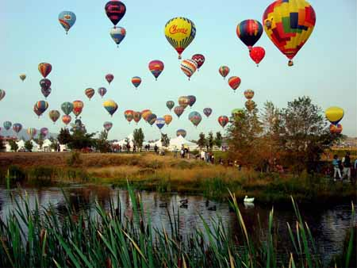
Reno, Nevada

Slide 3
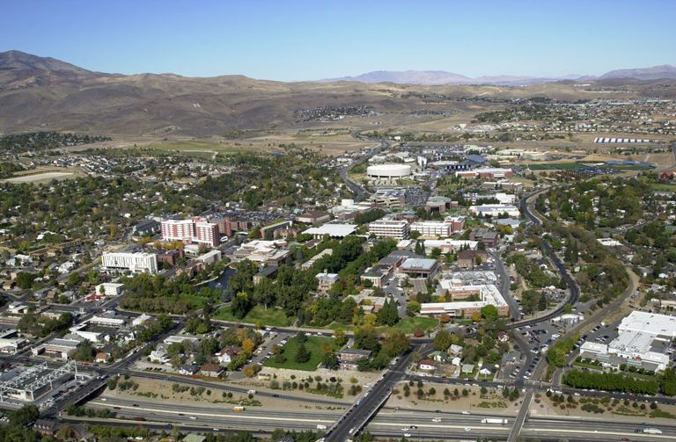
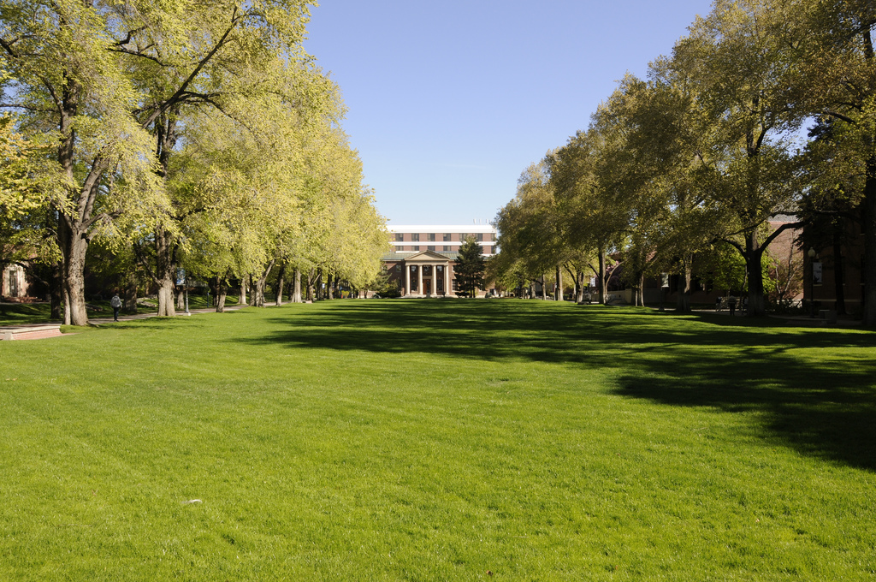


University of Nevada, Reno

Slide 4
Acknowledgements
This material is based in part upon work supported by: The National Science Foundation under grant number(s) IIA-1329469. Any opinions, findings, and conclusions or recommendations expressed in this material are those of the author(s) and do not necessarily reflect the views of the National Science Foundation.

Slide 5
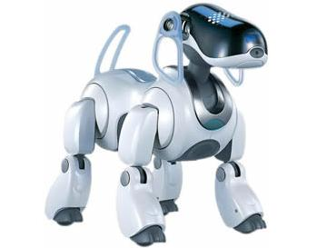
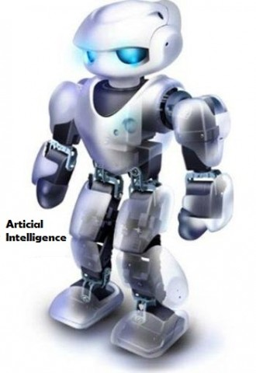
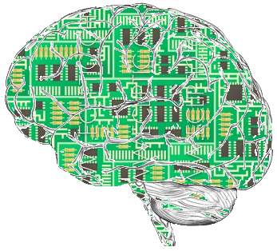
Our Goal: Intelligent Systems

Slide 6
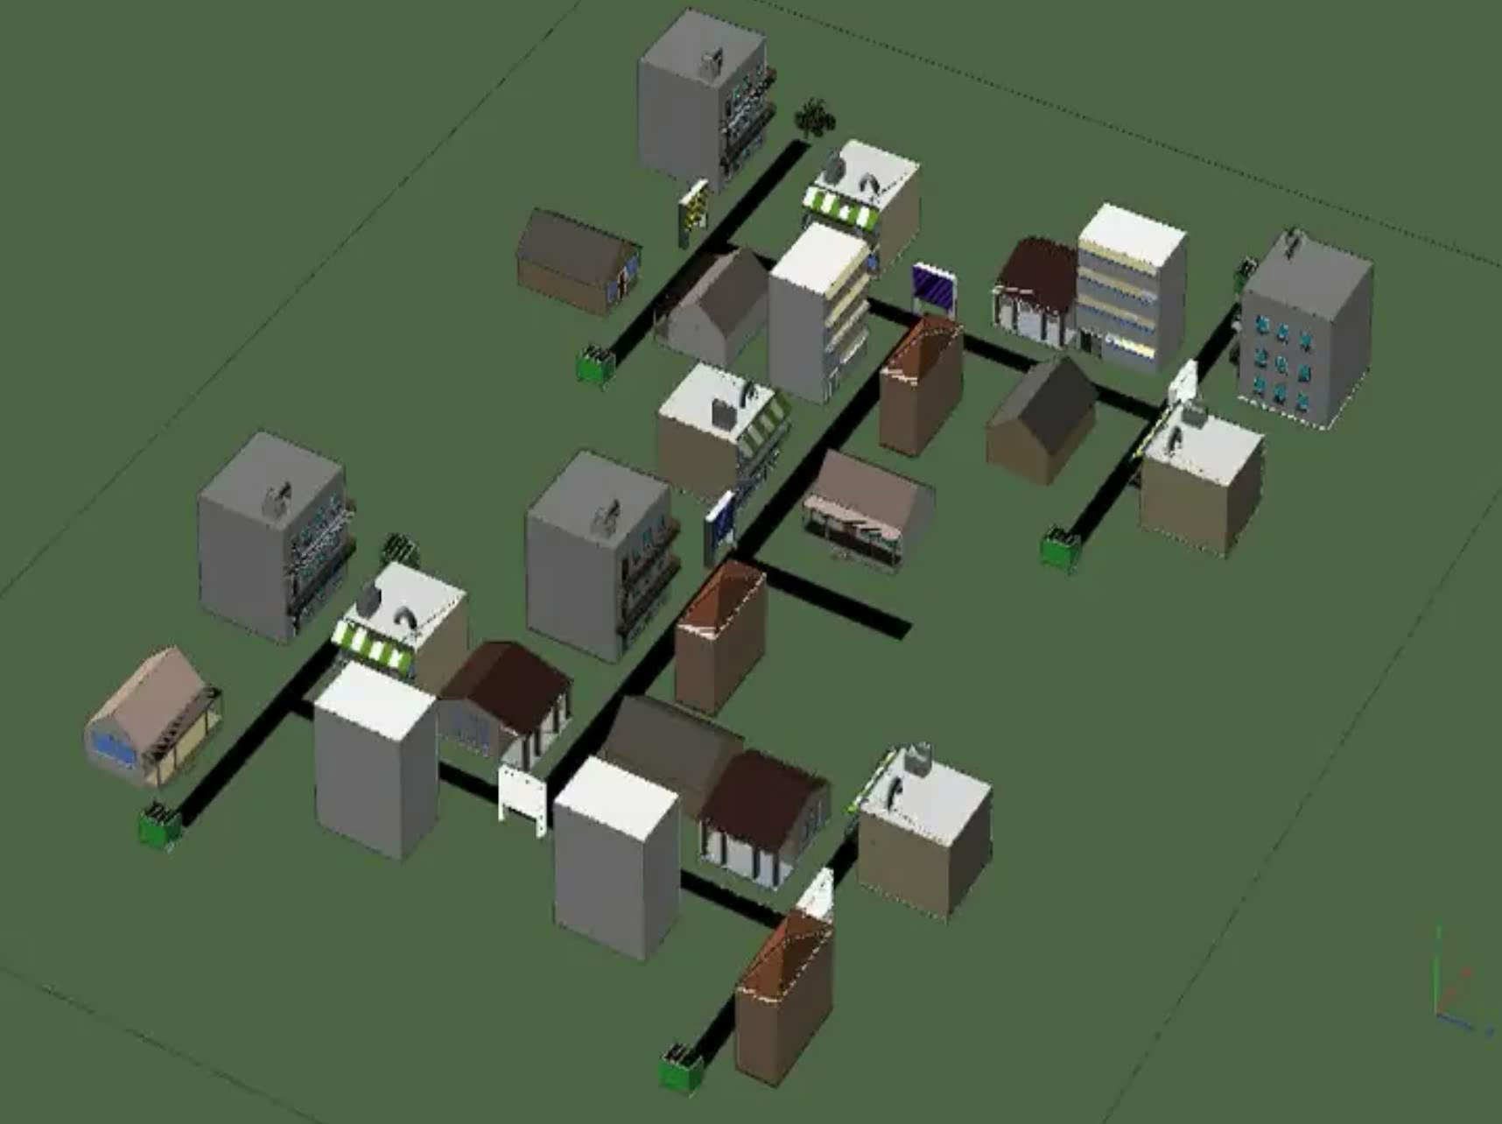
A Robot in a Maze

Slide 7

How can we build true intelligent systems?

Slide 8
Reverse Engineering
“The process of discovering the technological principles of a device, object, or system through analysis of its structure, function, and operation.”
How can reverse engineering be applied to machine intelligence?

Slide 9
Our Process
Understand:
  Brain dynamics behind cognition
  Animal and human intelligence
Replicate:
  Attention, memory, learning, decision making
  Emotion, reasoning, problem solving
Apply:
  Assistive Technologies
  Neurological Disorders

Slide 10
Today’s Presentation
Introduction
Virtual Neurorobotics
NCS Web Interface
Virtual Robot Implementation
Future Work

Slide 11
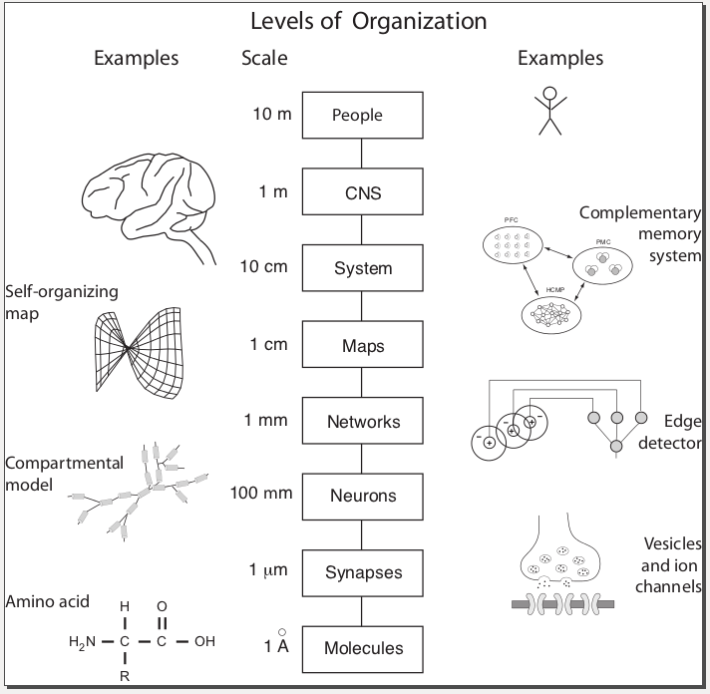
Computational Neuroscience
Multi-scale research
  Networks of functional and biologically realistic neurons
  Connectivity maps
  Systems
High-level behaviors
  Navigation
  Decision making
  Trust the intent recognition
  Reward-based learning
Introduction

Slide 12
Neuroscience Parameters

Slide 13
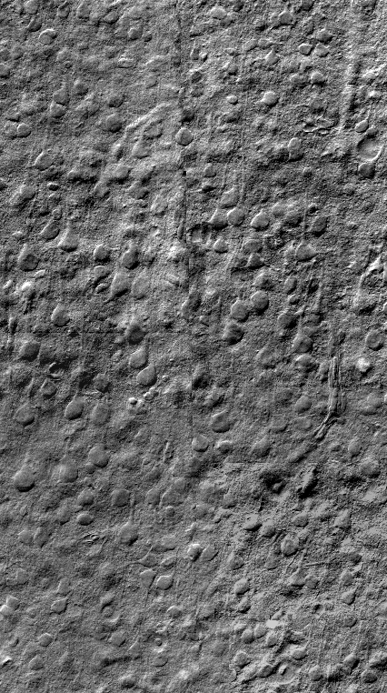
Neuroscience Parameters

Slide 14
Neuroscience Parameters

Slide 15
Does Size Matter?
“Intelligence” seems to be correlated to the number of neurons and synapses
It also seems to be correlated to the ratio between neurons and synapses
How can we study a large networks of neurons and synapses at one time?
Introduction

Slide 16
Two Major Problems
Simulation time
Biophysical realism
Trade-off between biological details and amount of computing time
Simulation

Slide 17
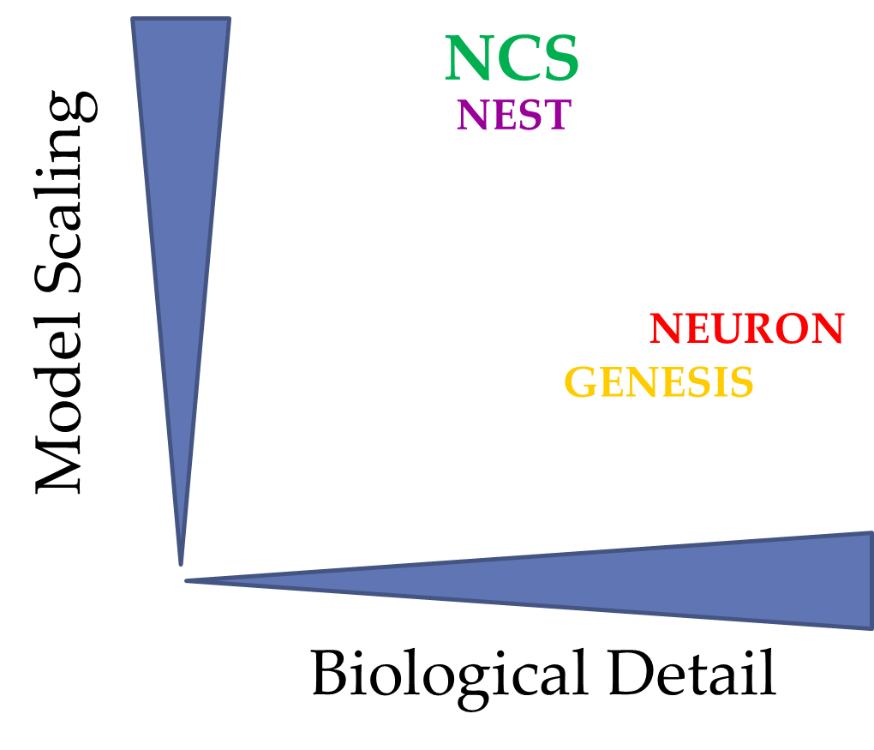
Neural Simulators
Simulation

Slide 18
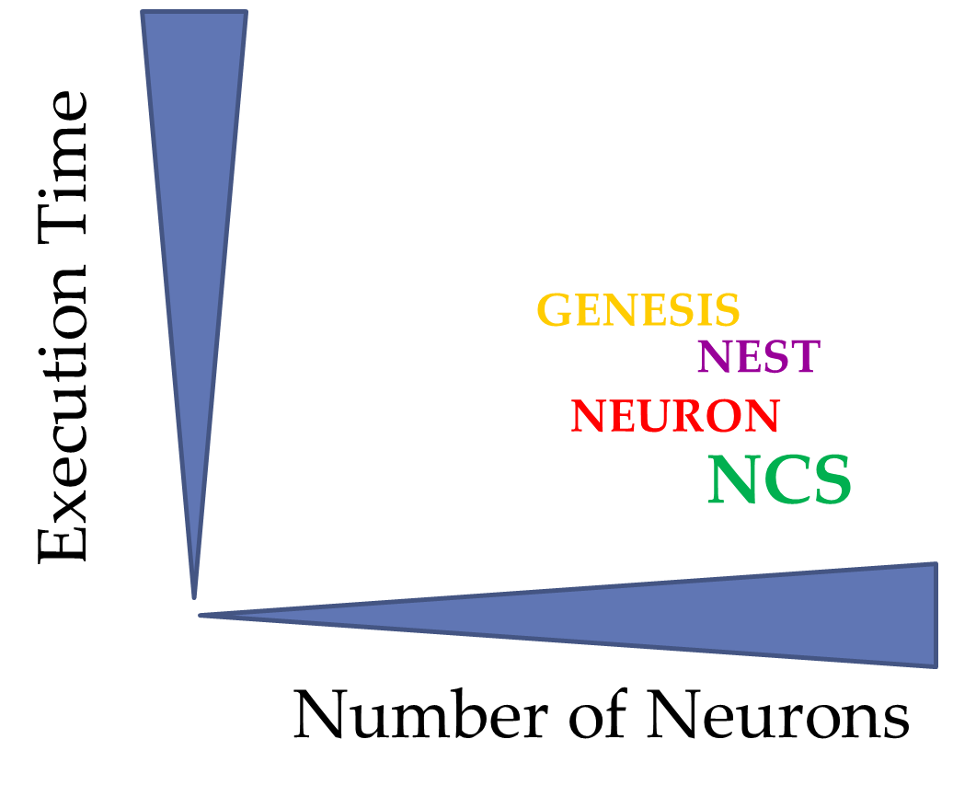
Neural Simulators
Simulation

Slide 19

NeoCortical Simulator (NCS)
Highly Optimized Neural Simulator
  Emphasizes speed and simulation size.
  Parallel computation
    across clusters of computers
  Utilizes CPUs and NVIDIA GPUs
Simulation

Slide 20
NeoCortical Simulator (NCS)
Designed to run large-scale biologically realistic neural models in real-time.
  Different types of neurons
    Leaky integrate-and-fire / Hodgkin-Huxley
    Izhikevich
  Flexible and Fast
Simulation

Slide 21
Back to Reverse Engineering:
Where do we start?
Define a mental process of interest:
  Navigation, learning, decision making
Determine levels of abstraction:
  Synapses/neurons → networks/systems
Bottom up vs. top down
Plan of work:
  Biological neural networks
  Real-time simulation
  Virtual neurorobotics

Slide 22
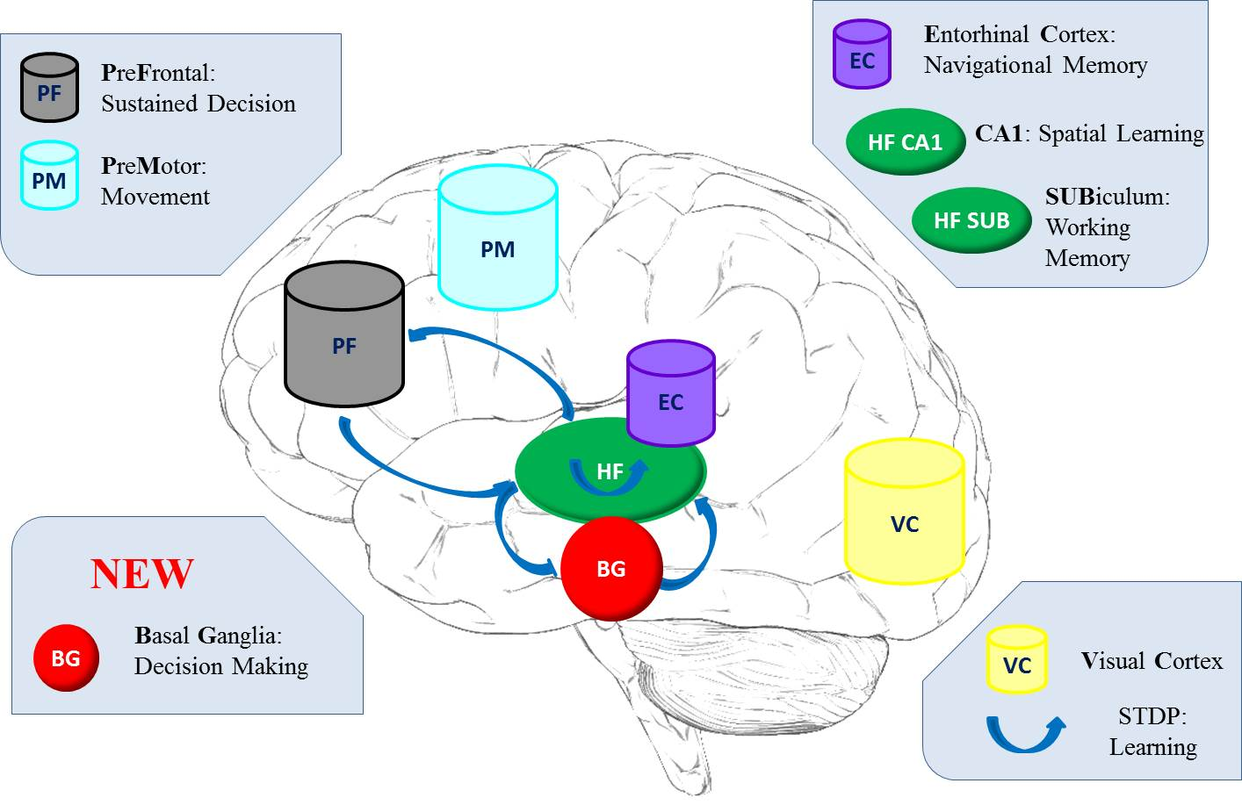
Navigation Model

Slide 23
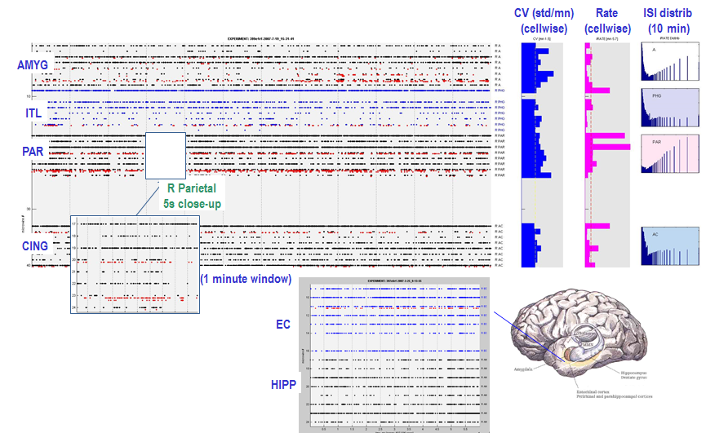
Human Recordings

Slide 24
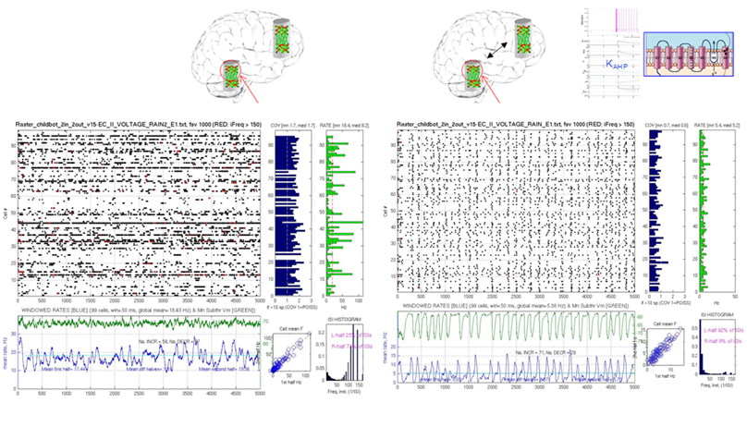
Recurrent Asynchronous Irregular Non-Linear (RAIN)

Slide 25
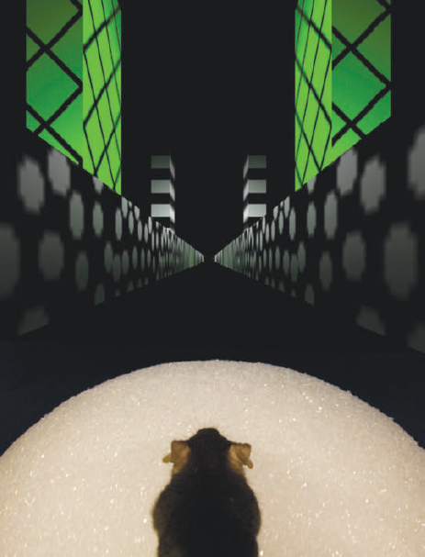
Relevant Biological Studies
Harvey, C. D., Collman, F., Dombeck, D. A., and Tank, D. W., "Intracellular dynamics of hippocampal place cells during virtual navigation," Nature, vol. 461, pp. 941-946, 2009.
Gasparini, S. and Magee, J. C., "State-dependent dendritic computation in hippocampal ca1 pyramidal neurons," Journal of Neuroscience, vol. 26, pp. 2088-2100, 2006.
Van Cauter, T., Poucet, B., and Save, E., "Unstable ca1 place cell representation in rats with entorhinal cortex lesions," European Journal of Neuroscience, vol. 27, pp. 1933-1946, 2008.

Slide 26
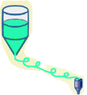
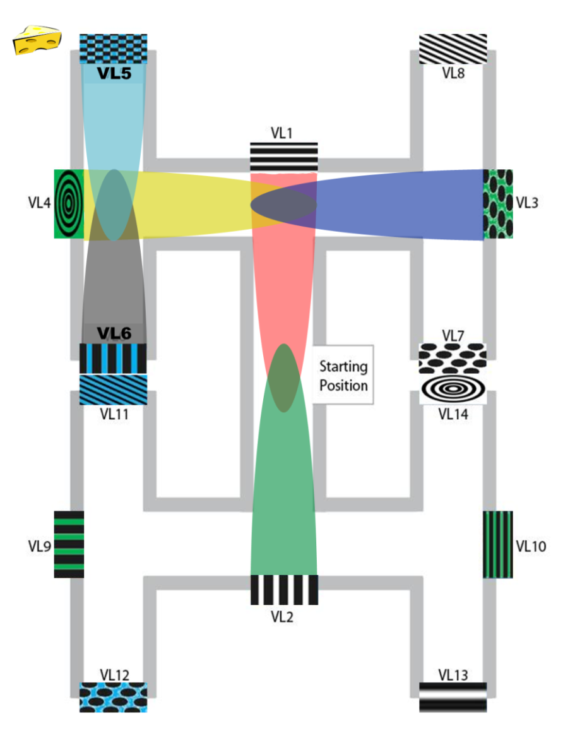
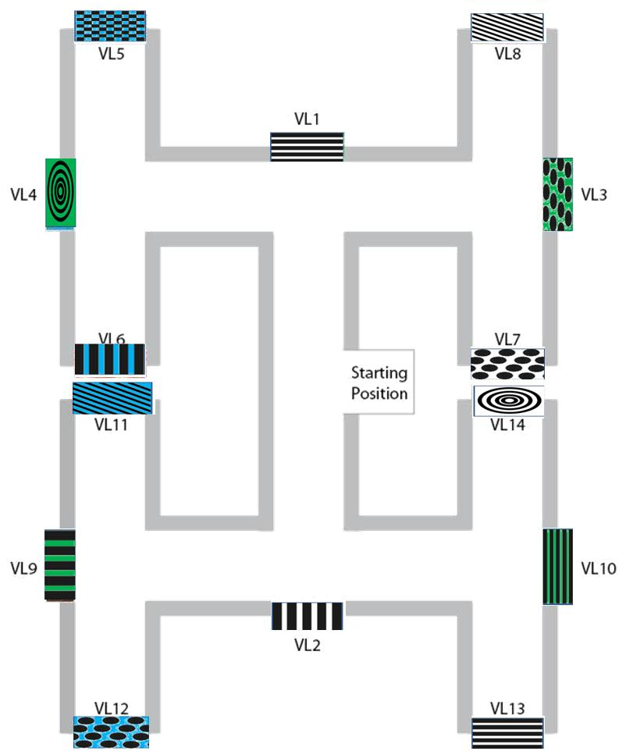

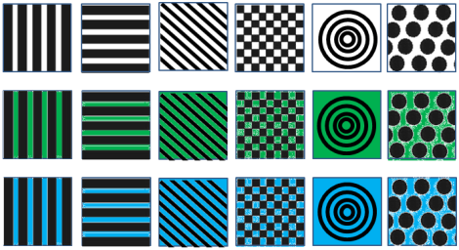
Multi T-Maze

Slide 27
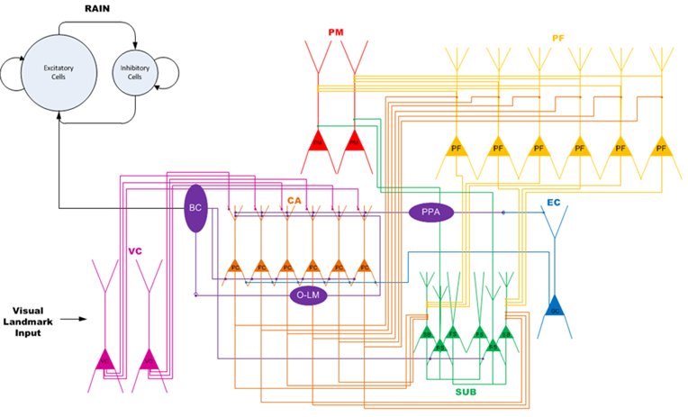
HP-EC-PF Model
Notes:
Preliminary results and current model

Slide 28
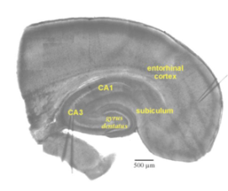

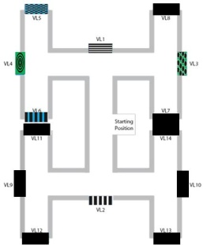
FIELD POTENTIAL
PM
PF
HP
SUB
S
E
R
γ
S
E
R
γ
S
E
R
γ
KEY
S=START POSITION
E=END POSITION
R=REWARD (green if earned)
γ =enhanced inhibitory oscillation
(resets prefrontal activity
if not enhanced by prior reward)
S
S
S
Trial 1: no reward
Trial 2: reward
Trial 3:no reward
Notes:
Preliminary results and current model

Slide 29
FIELD POTENTIAL
PM
PF
HP
SUB
S
E
R
γ
S
E
R
γ
S
E
R
γ
KEY
S=START POSITION
E=END POSITION
R=REWARD (green if earned)
γ =enhanced inhibitory oscillation
(resets prefrontal activity
if not enhanced by prior reward)
S
S
S
Trial 4: reward
Trial 5: reward
Trial 6: reward
Notes:
Preliminary results and current model

Slide 30
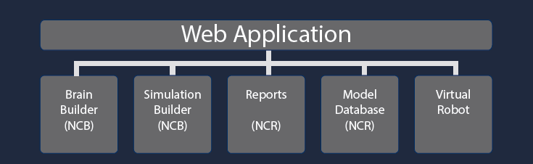
NCS Web Interface

Slide 31
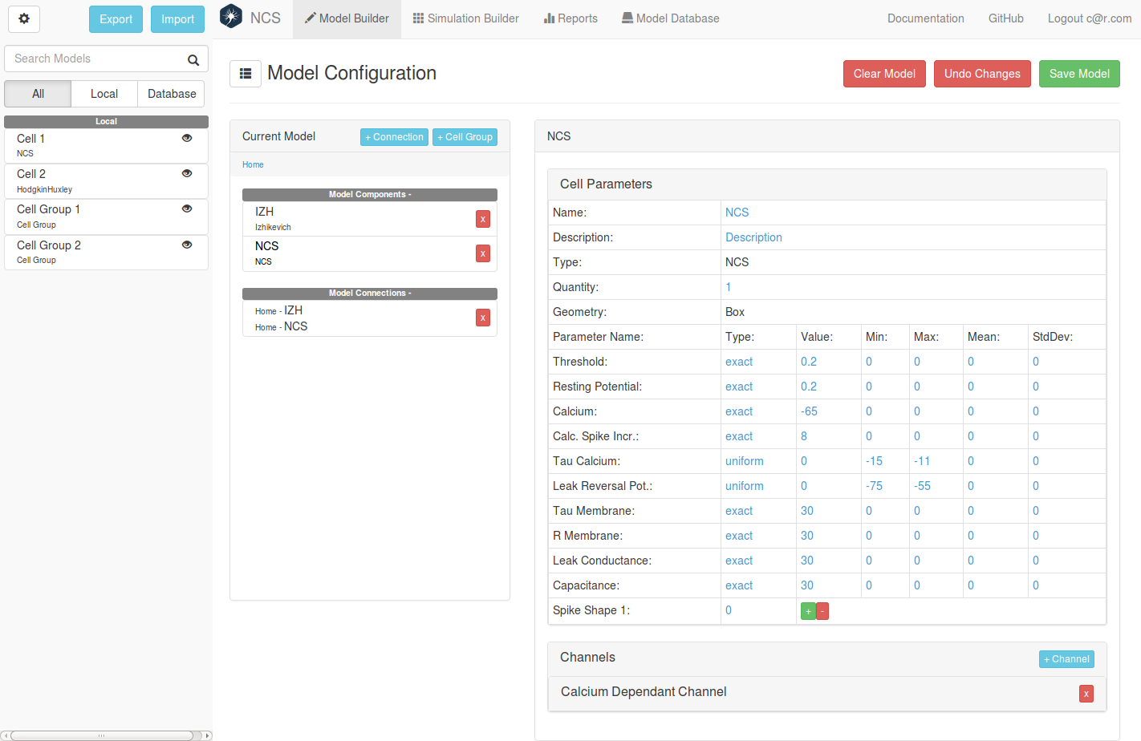
NCS Web Interface:
Brain Builder

Slide 32
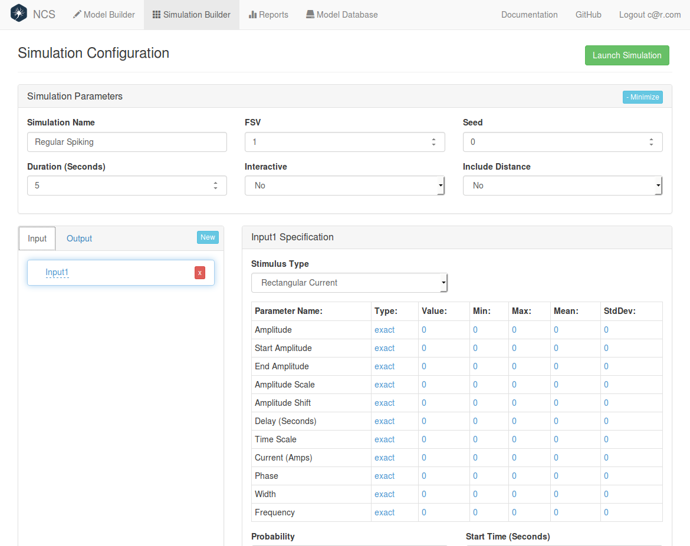
NCS Web Interface:
Simulation Builder

Slide 33
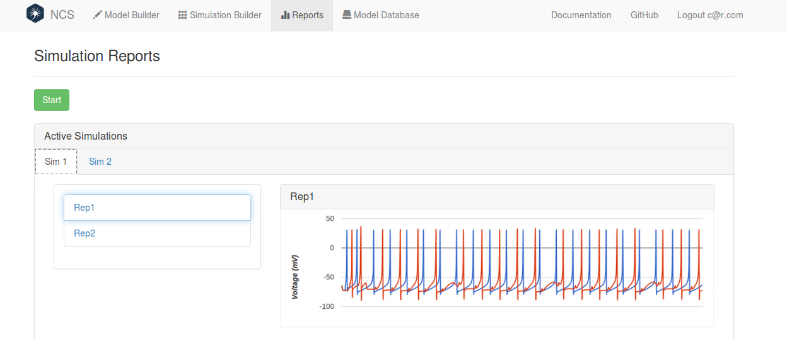
NCS Web Interface:
Reports

Slide 34
NCS Web Interface:
Virtual Robot
Several libraries were used:
  Three.js – a 3D engine
  Underscode.js – many useful utility functions
  Numeric.js – linear algebra used in physics and motion planning
  JSZip – used to extract data from KMZ files

Slide 35
Software Overview
main – sets up the initial configuration UI and connects with the rest of the Web interface.
  Now we can start the sim, load a level, and a script
The level, scrpit and simulation URL are sent to the app module which starts the rest of the modules
  It sends the level data to the loader and the loader sends parsed level data back

Slide 36
Software Overview (2)
  The level data is formatted into a scene which renders it with Three.js
  Level data is also sent to the physics engine
  Finally the robot is placed into the scene.
  Then the script and simulation are sent to the controller.
  The controller executes the script in an isolated worker module.
For Debugging all data is sent to the HUD.

Slide 37

Our Robot

Slide 38
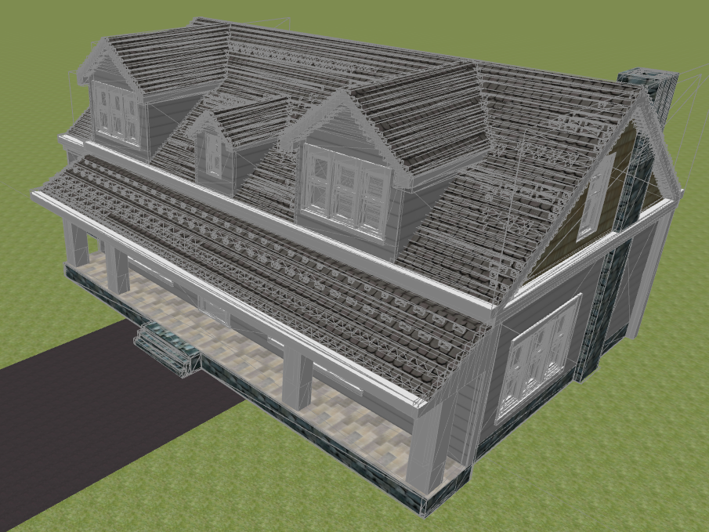
Things provided.
Collision Detection
  Done with Bounding Volumes
  "Point-tessellated Voxelization" by Fei, et al.
  and it works on complex models – like this house.
Motion Planning
  Using "Randomized path planning for redundant manipulators without inverse kinematics" by Weghe, et al.

Slide 39
Scripting: a simple scripting environment
  reachForAndGrabWithRightHand(“portable_thing”);
  function startWalking(){
  setSpeed(1.7);
  next(walkToWall);
  }
  function walkToWall(){
  if(sensors.collision.front){
  setSpeed(0);
  goBackward(1.0)
  .at(1.7)
  .then(waitForAction);
  }
  }

Slide 40
Scripting(2)
  function PickItUp(){
  reachForAndGrabWithRightHand(“portable_thing”)
  .then(turnaround);
  next(doNothing);
  }
  function turnaround(){
  turnRight(180);
  next(doNothing);
  }

Slide 41
Scripting(3)
  function waitForAction(){
  if(sensors.brainOutputs[0] > 0){
  turnLeft(90)
  .then(startWalking);
  next(doNothing);
  } else if (sensonrs.brainOutputs[1] > 0){
  turnRight(90)
  .then(startWalking);
  next(doNothing);
  } else if (sensors.brainOutputs[2] > 0){
  goForward(1.0)
  .then(pickItUp);
  next(doNothing);
  }
  }

Slide 42
Heads-up display
Allows the user to see what the current settings are.
It is placed on the left side of the simulation window, and it can be toggled on and off.

Slide 43
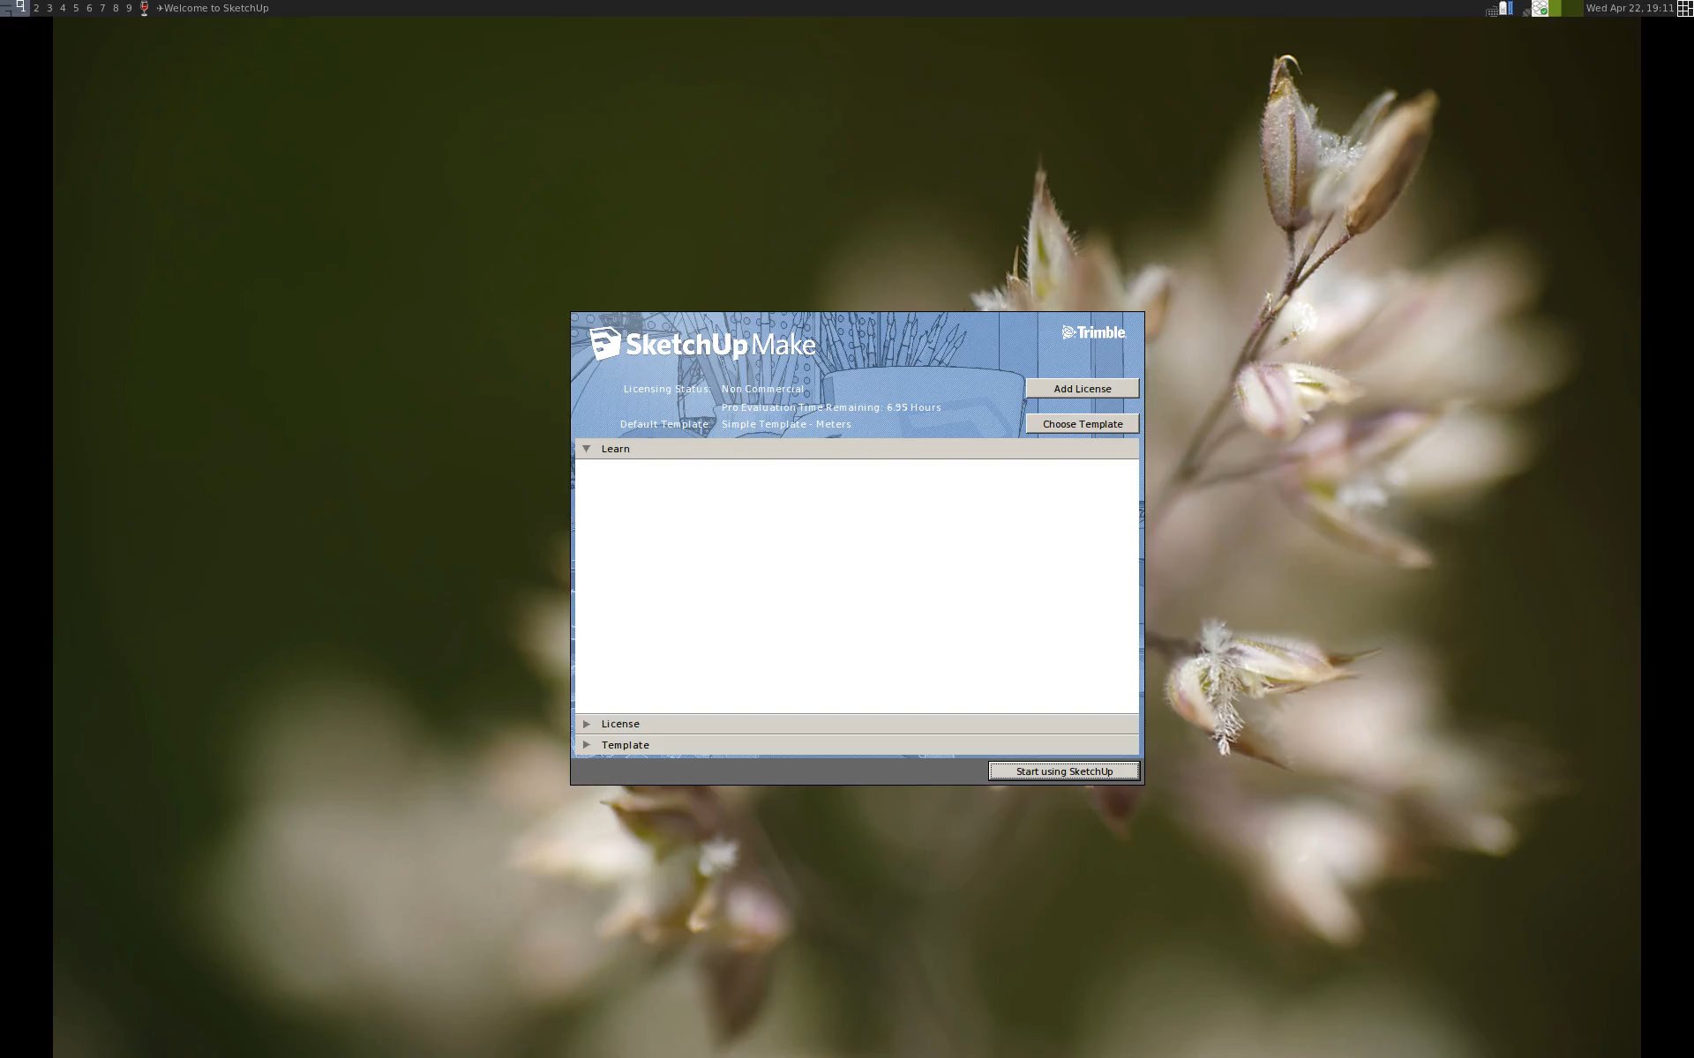
Making an environment:
With Sketchup

Slide 44

Sample Run

Slide 45
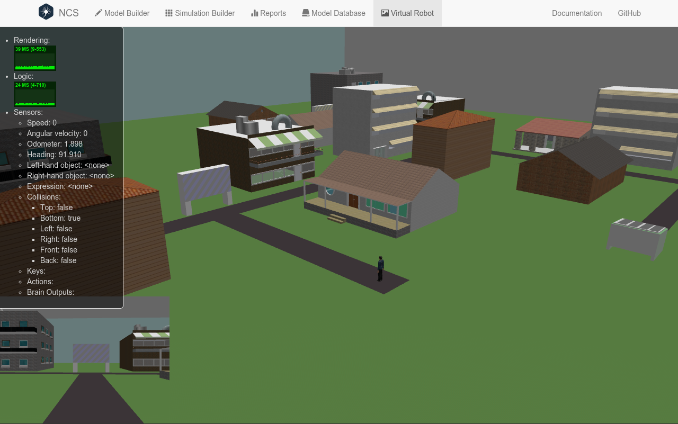
Future Work
Multiple Robots
WebCam input

Slide 46
Summary
Computational approaches to study high-level behavior
Virtual Robot
  Architecture
  Scripting
  Demo
Future Work

Slide 47

Questions
For more information go to the Brain Computation Lab @ www.cse.unr.edu/brain

Slide 49
Journal Publications:
Corey M. Thibeault, Frederick C. Harris, Jr., and Narayan Srinivasa, “Using Games to Embody Spiking Neural Networks for Neuromorphic Hardware” International Journal of Computers and Their Applications Vol 21, No 1, pg 40-53, March 2014.
Roger V. Hoang, Devyani Tanna, Laurence C. Jayet Bray, Sergiu M. Dascalu, and Frederick C. Harris, Jr., “A Novel CPU/GPU Simulation Environment for Large-Scale Biologically Realistic Neural Modeling” Frontiers in Neuroinformatics Vol 7, Article 19.
Alexander Jones, Justin Cardoza, Denver J. Liu, Laurence C. Jayet Bray, Sergiu M. Dascalu, Sushil J. Louis, and Frederick C. Harris, Jr., “A novel 3D visualization tool for large-scale neural networks” BMC Neuroscience, 14(Suppl 1):158
Corey Michael Thibeault, Kirill Minkovich, Michael John O'Brien, Frederick C Harris, Jr., and Narayan Srinivasa, “Efficiently passing messages in distributed spiking neural network simulation” Frontiers in Computational Neuroscience Vol 7, Article 77, June 2013.
Laurence C Jayet Bray, Gareth B Ferneyhough, Corey M Thibeault, Devyani Tanna, Emily R Barker, and Frederick C Harris, Jr., “Reward-Based Learning for Virtual Neurorobotics Through Emotional Speech Processing” Frontiers in Neurorobotics Vol 7, Article 8, April 2013.
Frederick C. Harris, Jr., Jeffrey L. Krichmar, Hava T. Siegelmann, Hiroaki Wagatsuma, “Guest Editorial: Biologically Inspired Human-Robot Interactions-Developing More Natural Ways to Communicate with our Machines” IEEE Transactions on Autonomous Mental Development,
Vol 4, No 3, pp 190-191, September 2012.
Laurence C Jayet Bray, Emily R Barker, Gareth B Ferneyhough, Roger V Hoang, Bobby D Bryant, Sergiu M Dascalu, and Frederick C Harris Jr., “Goal-related navigation of a neuromorphic virtual robot” BMC Neuroscience, 2012, 13(Suppl 2):O3
Laurence C. Jayet Bray, Sridhar R. Anumandla, Corey M. Thibeault, Roger V. Hoang, Philip H. Goodman, Sergiu M. Dascalu, Bobby D. Bryant, and Frederick C. Harris, Jr., “Real-time human-robot interaction underlying neurorobotic trust and intent recognition.” Neural Networks, 32:130-137, 2012.
Laurence C Bray Jayet, Mathias Quoy, Philip H Goodman, Frederick C Harris, Jr., “A Circuit-Level Model of Hippocampal Place Field Dynamics Modulated by Entorhinal Grid and Suppression-Generating Cells” Frontiers in Neural Circuits Vol 4, Article 122, Nov, 2010.
Corey M. Thibeault, Frederick C Harris, Jr., Philip H Goodman, “Breaking the virtual barrier: real-time interactions with spiking neural models” BMC Neuroscience Vol 11, Supp 1, pp 73-74.
Romain Brette, Michelle Rudolph, Ted Carnevale, Michael Hines, David Beeman, James M. Bower, Markus Diesmann, Abigail Morrison, Philip H. Goodman, Frederick C. Harris, Jr., Milind Zirpe, Thomas Natschlager, Dejan Pecevski, Bard Ermentrout, Mikael Djurfeldt, Anders Lansner, Olivier Rochel, Thierry Vieville, Eilif Muller, Andrew P. Davison, Sami El Boustani and Alain Destexhe, “Simulation of networks of spiking neurons: A review of tools and strategies” Journal of Computational Neuroscience Vol. 23, December, 2007, pgs 349-398.
Ripplinger MC, Wilson CJ, King JG, Frye J, Drewes R, Harris FC, and Goodman PH, “Computational Model of Interacting Brain Networks” Journal of Investigative Medicine, Vol. 52, No. 1, Jan 2004, pp. S155.
Juan C. Macera, Philip H Goodman, Frederick C. Harris, Jr., Rich Drews, and James B. Maciokas. “Remote-Neocortex Control of Robotic Search and Threat Identification” Robotics and Autonomous Systems, Vol. 46, No. 2, February 2004, pp 97-110.

Slide 50
Full Paper Refereed Conference Publications:
Corey M. Thibeault, Frederick C. Harris, Jr., Narayan Srinivasa, “A Virtual Environment Framework for Embedding Neural Models” Proceedings of The 2014 International Conference on Computer and Their Applications (CATA 2014), March 24-26, 2014, Las Vegas, NV.
Corey M. Thibeault, Frederick C. Harris, Jr., Narayan Srinivasa, “Embodied modeling with spiking neural networks for neuromorphic hardware: a simulation study” Proceedings of The 2013 International Conference on Computer Applications in Industry and Engineering (CAINE 2013), pp 3-10, Best Paper Nominee September 25-27, 2013, Los Angeles, CA.
Justin E. Cardoza, Alexander K. Jones, Denver J. Liu, Roger V. Hoang, Devyani Tanna, Laurence C. Jayet Bray, Sergiu M. Dascalu, and Frederick C. Harris, Jr., “Design and Implementation of a Graphical Visualization Tool for NCS” Proceedings of The 2013 International Conference on Software Engineering and Data Engieering (SEDE 2013), pp 37-43, September 25-27, 2013, Los Angeles, CA.
Nathan M. Jordan, Kimberly B. Perry, Nitish Narala, Laurence C. Jayet Bray, Sergiu M. Dascalu and Frederick C Harris, Jr., “Design and Implementation of an NCS-NeuroML Translator” in Proceedings of the 2012 ISCA International Conference on Software Engineering and Data Engineering pp. 13-19, June 27-29, 2012 Los Angeles, CA.
Corey M. Thibeault, Joshua Hegie, Laurence Jayet Bray, and Frederick C Harris, Jr., “Simplifying Neurorobotic Development with NCSTools” in Proceedings of the 2012 Conference on Computers and Their Applications March 12-14, 2012, Las Vegas, NV.
Sridhar R. Anumadla, Laurence C. Jayet Bray, Corey M. Thibeault, Roger V. Hoang, Sergiu M. Dascalu, Frederick C Harris, Jr., and Philip H. Goodman, “Modeling Oxytocin Induced Neurorobotic Trust and Intent Recognition in Human Robot Interaction” in Proceedings of the International Joint Conference on Neural Networks (IJCNN 2011) July 31-Aug 5, 2011, San Jose, CA.
C. M. Thibeault, O. Sessions, P. H. Goodman, and F. C. Harris Jr., “Real-Time Emotional Speech Processing for Neurorobotics Applications”, in Proceedings of ISCA's 23rd International Conference on Computer Applications in Industry and Engineering, (CAINE '10) pp 239-244, November 12-14, 2010, Imperial Palace, Las Vegas, NV.
Frederick C. Harris, Jr., Mark C. Ballew, Jason Baurick, James Frye, Lance Hutchinson, James G. King, Philip H. Goodman, Rich Drewes, "A Novel Parallel Hardware and Software Solution for A Large-Scale Biologically Realistic Cortical Simulation" Proceedings of the 19th International Conference on Computer Applications in Industry and Engineering (CAINE 2006), November 13-15, 2006
Kishor K. Waikul, Lianjun Jiang, E. Courtenay Wilson, Frederick C. Harris, Jr., and Philip H. Goodman, “Design and Implementation of a Web Portal for a NeoCortical Simulator ” in Proceedings of the 17th International Conference on Computers and Their Applications (CATA 2002) pp. 349-353, Editors: R. Gantenbein and S. Shin. April 4-6, 2002, San Francisco, CA
E. Courtenay Wilson, Frederick C. Harris, Jr., and Phillip H. Goodman, ”A Large-Scale Biologically Realistic Cortical Simulator” in Proceedings of SC2001 November 12-16, 2001, Denver, Colorado
E. Courtenay Wilson, Phillip H. Goodman, and Frederick C. Harris, Jr., ”Implementation of a Biologically Realistic Parallel Neocortical-Neural Network Simulator” in Proceedings of the Tenth SIAM Conf. on Parallel Process. for Sci. Comp. March 12-14, 2001, Portsmouth, Virginia

