Slide 1

Accelerating BFS Shortest Paths Calculations Using CUDA for Internet Topology Measurements
Eric Klukovich¹, Mehmet Hadi Gunes¹,
Lee Barford^{1,2}, and Frederick C. Harris, Jr.¹
¹Department of Computer Science and Engineering
University of Nevada, Reno
²Keysight Laboratories, Keysight Technologies
HPCS 2016

Slide 2


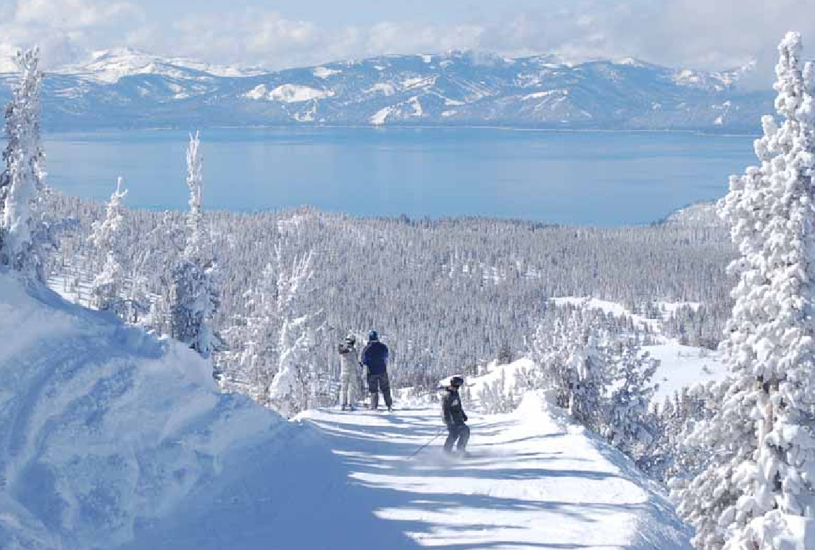
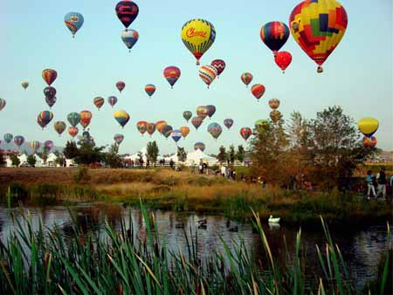
Reno, Nevada

Slide 3
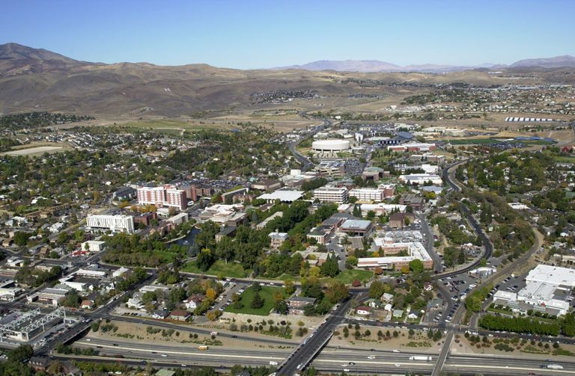



University of Nevada, Reno

Slide 4

Overview
Background
Related Work
Algorithms and Implementation
Performance Results
Conclusion and Future Work

Slide 5
The Internet
An interconnection of Autonomous Systems (AS)
  A collection of networks that are managed by a single entity or organization
  Telefonica, Sky, Orange
Each AS is assigned a group of IP addresses
  Manages one or multiple networks comprised of many different routers
Organized into a two-level hierarchy:
  First tier defines the routing within the AS
  Second tier defines the routing to systems outside of the AS
    Handled through a Border Gateway Protocol router, also called an Ingress Node

Slide 6



Autonomous Systems
AS B
AS C
AS A
Target
Server
PC 1
PC 2
PC 3
AS E
AS D

Slide 7
Internet Topology
Studying the large structure and complexity of the Internet has become a research focus
  Identify vulnerabilities and threat analysis
  Develop new protocols and simulations
  Monitor network evolution
  Analyze the economic benefits of connecting to other ASes
The data for each AS is collected and put through a topology generator in order to create the topology for the entire Internet

Slide 8
Data Collection
Need data about ASes and subnetworks to generate an accurate topology
  Use computing systems (vantage points)
  Each machine uses traceroute to send an packet towards the destination address
The packet has a time to live (TTL) value that starts with an initial value and is decremented as it goes from router to router
  Once the TTL value is 0, then a response is sent to the sender
IP_{A}
IP_{B}
IP_{C}
IP_{D}
Vantage Point
Destination
TTL=1
TTL=2
TTL=3
TTL=4
A
B
C
D

Slide 9
Internet Topology Generation
The traceroute method only provides one path from the vantage point to the destination
  May skip alternative paths within the subnetwork
Can use multiple vantage points at different locations to get a more accurate map of the topology

Slide 10

AS Subnetwork
Destination 1
Destination 2
Destination 3
Ingress
Node 1
Ingress
Node 2
Monitor 1
Monitor 2

Slide 11
Topology Generators
BRITE is a parameterized topology generation tool
  Flexible to control various parameters - connectivity and growth models
  Can be used to study various properties
    Power laws
    Path length
    Clustering coefficient
Uses Router Barabasi-Albert
  Creates realistic scale-free graphs (heavy tailed distribution)
  Uses a preferential attachment mechanism

Slide 12
Overview
Background
Related Work
Algorithms and Implementation
Performance Results
Conclusion and Future Work

Slide 13
Related Work
[2007] Harish and Narayanan provide one of the first studies to implement BFS and other shortest path algorithms using CUDA
  Processed vertices instead of edges
  Focused on large scale random graphs (>1 million nodes)
    Showed 20x to 60x speed up using an NVIDIA 8800 GTX GPU
  They also provided results using real world data
    Did not achieve significant speed up due to the nature of the data

Slide 14
Related Work
[2010] Luo et al. improved the work by Harish and Narayanan
  Added a hierarchical queue management technique and a three-layer kernel arrangement strategy for BFS
  Achieved a 2x to 6x speed up on the real world data used in by Harish and Narayanan
[2013] Singla et al. parallelized BFS by processing the edges instead of vertices for graphs with large amounts of edges
  Obtained a 5x to 11x speed up
  Found that the BFS is more efficient for graphs with a large number of edges

Slide 15
Related Work
[2014] Fu et al. implement BFS on a distributed GPU clusters
  Had a total of 64 GPUs
  Partitioned the graph's adjacency matrix in two dimensions based on the number of GPUs available
  Used the Graph 500 generator to create large scale graphs
    The largest graph had 134 million vertices and 4.3 billion directed edges
    They were able to achieve full edge-to-edge traversal in ~0.148 seconds

Slide 16
Related Work
[2012] Ahmad and Guha also implement APSP on the GPU
  Used CAIDA as their topology generator
  They had a 2x to 35x speed up over their sequential algorithm on graphs less than 12,000 nodes
[2013] Swenson et al. implemented a CUDA all-pairs shortest path (APSP) algorithm to analyze the routing paths for Internet topology graphs
  Used the BRITE topology generator
  Achieved a significant performance increase for graphs with less than 10,000 nodes

Slide 17
Overview
Background
Related Work
Algorithms and Implementation
Performance Results
Conclusion and Future Work

Slide 18
Breadth First Search
Commonly used algorithm in graph theory
  Can be applied to many different applications to process data
Processes tree-like structures
  Starts at the root of the tree (the source) and explores the neighboring nodes first
  Once all neighbors are processed, then the next level of nodes are processed
  Repeated until all of the levels have been visited
Finds the shortest paths from a source node to all the nodes in an unweighted graph G(V,E)

Slide 19
Sequential Implementation
Need to keep track of which nodes need to be processed
  Can use a queue (FIFO) data structure, where the ingress node is used as the source
Process nodes until the queue is empty
  When a node needs to be processed, all of the node's edges are checked if they have been visited
  If not visited, then the cost is incremented and the node is put in the queue
  If the node has been visited, then it is ignored
Has a time complexity of O(|V|+|E|)
  large graphs to take a long time to process

Slide 20
Graph Representation
Typically done in two ways
  Adjacency matrix – used for dense graphs
  Adjacency list – used for spare graphs
Adjacency lists are commonly used for GPUs due to the lower memory available
  Store the lists into a packed array
  Requires two arrays one for all the vertices and one for all the edges
  Removes the pointer memory requirements in the linked adjacency list

Slide 21
Graph Representation

Slide 22
CUDA Implementation
BFS on the GPU is highly parallelizable due to the ability to perform level synchronization
  Each level can be processed in parallel because there are no data dependencies
  The previous levels are not processed again
BFS uses a frontier which separates out the visited and not visited vertices
  Only holds the recently visited nodes
  Helps find the nodes that need to be processed in the next level
Does not use a queue because implementing a queue on the GPU is not efficient

Slide 23
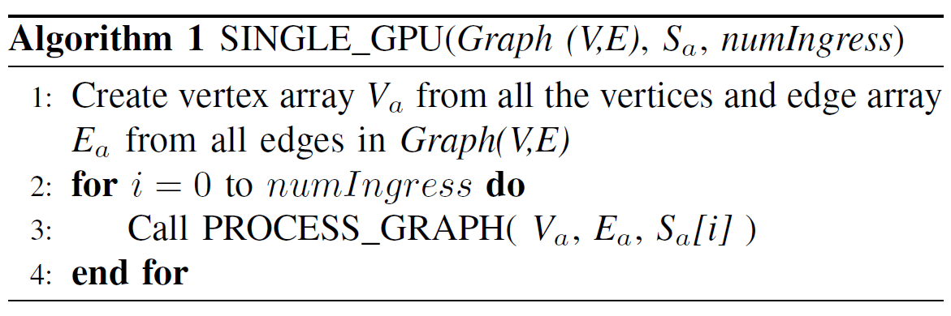
Single GPU

Slide 24
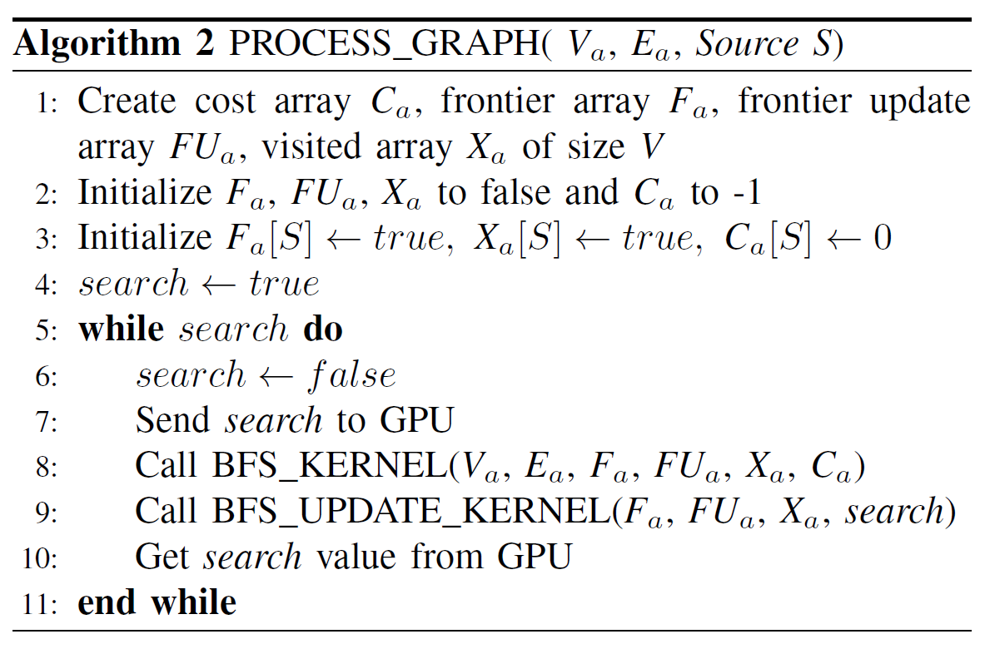
Process Graph

Slide 25
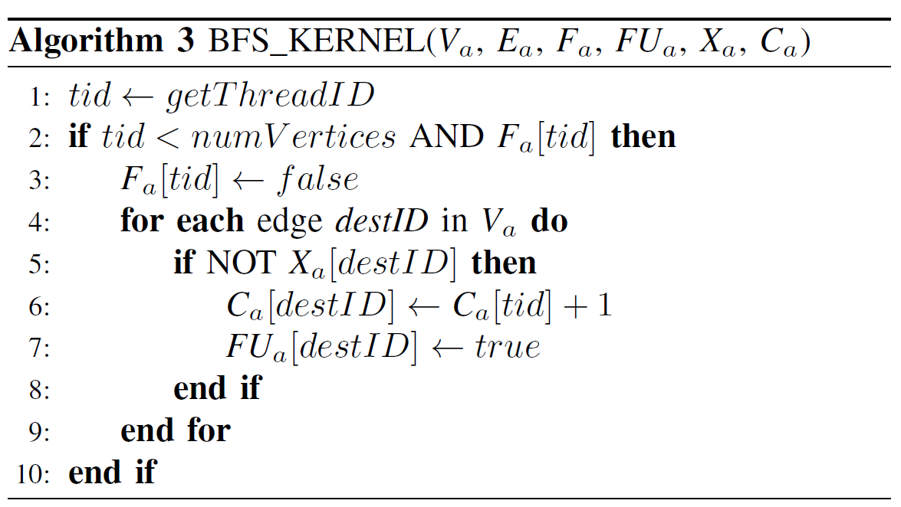
BFS CUDA Kernel

Slide 26
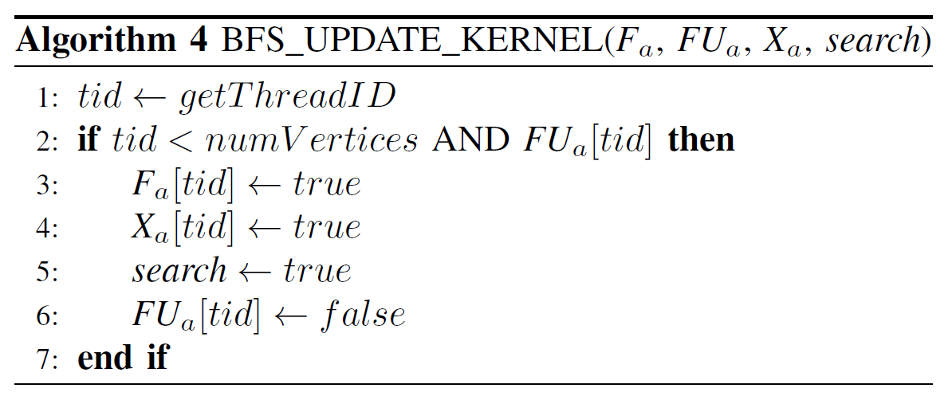
BFS Update CUDA Kernel

Slide 27
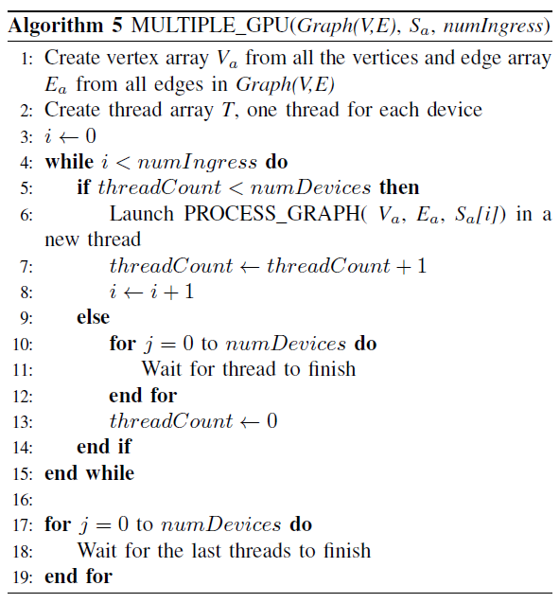
Multiple GPU

Slide 28
Overview
Background
Related Work
Algorithms and Implementation
Performance Results
Conclusion and Future Work

Slide 29
Measurement Platform
Performance measurements were carried out using a PC with:
  2 Intel Xeon E5-2620 CPU at 2.0 GHz
  64 GB RAM
  8 NVIDIA GeForce GTX 780 GPUs
    each with 3 GB RAM and 2304 CUDA cores
The algorithms were written using
  C++11
  CUDA 7.0
  C++ standard template library

Slide 30
Data Set
Data was collected using traceroute method
  Contains data for 47,000 out of the 51,171 ASes available today
  AS subnetwork ranged from 1,100 to 6.8 million routers
Measured the BFS performance of 230 Ases
  Used unique AS sizes and to provide a fair sampling of the data range
  The number of ingress nodes was averaged to be directly compared
    Used 50 and 100 ingress nodes in the measurements
The number of GPU blocks used were calculated based on the graph size
  Each vertex was given a thread

Slide 31
Sequential Results (100 Ingress Nodes)

Slide 32
Parallel Results (100 Ingress Nodes)

Slide 33
Parallel Results (100 Ingress Nodes)

Slide 34
Parallel Results (100 Ingress Nodes)
Execution Time (sec)
Graph Size | Sequential | 1 GPU | 2 GPUs | 3 GPUs | 4 GPUs | 5 GPUs | 6 GPUs | 7 GPUs | 8 GPUs
4.6 M | 624.21 | 15.98 | 11.19 | 7.92 | 6.93 | 6.36 | 5.96 | 5.95 | 5.55
4.8 M | 668.23 | 16.57 | 10.25 | 8.36 | 7.00 | 6.67 | 6.27 | 6.10 | 5.86
6.8 M | 1080.73 | 24.36 | 14.69 | 12.99 | 10.38 | 9.82 | 9.06 | 8.78 | 8.56
Speed Up
Graph Size | 1 GPU | 2 GPUs | 3 GPUs | 4 GPUs | 5 GPUs | 6 GPUs | 7 GPUs | 8 GPUs
4.6 M | 38.91 | 55.56 | 78.47 | 89.65 | 97.72 | 104.38 | 104.47 | 111.96
4.8 M | 40.14 | 64.90 | 79.54 | 95.06 | 99.78 | 106.07 | 109.12 | 113.53
6.8 M | 44.18 | 73.28 | 82.82 | 103.70 | 109.60 | 118.77 | 122.59 | 125.69

Slide 35
Optimization
The multiple GPU algorithm can be optimized
  Must wait for all GPUs to finish processing before a new batch of nodes is given
  Processing time is dependent on the graph structure
Can use a striding scheme to overcome this issue
  Each GPU is given a set of nodes ahead of time to process
Speed Up for 6.8M Graph
 | 1 GPU | 2 GPUs | 3 GPUs | 4 GPUs | 5 GPUs | 6 GPUs | 7 GPUs | 8 GPUs
Not Optimized | 44.18 | 73.28 | 82.82 | 103.70 | 109.60 | 118.77 | 122.59 | 125.69
Optimized | 55.25 | 82.21 | 108.57 | 121.14 | 126.41 | 130.05 | 132.06 | 132.69
Delta | 11.07 | 8.93 | 25.75 | 17.44 | 16.81 | 11.28 | 9.47 | 7.00

Slide 36
Conclusion
The Internet has become a popular research area to study the structure and how it has evolved over time
  Requires very large graphs that need to be processed
Successfully implemented single and multiple GPU BFS algorithms to perform analysis on different topology graphs
  Generated graphs based on real-world topology data
Measured the algorithm performance with 50 and 100 ingress nodes
  Max speed up of 124x for a 6.8 million node graph with 100 ingress nodes using 8 GPUs
  The performance was found to be easily increased with additional GPUs

Slide 37
Future Work
Implement code for a distributed system to see how well these algorithms scale
  Each machine can provide one or more GPUs
  Determine the threshold where additional GPUs will no longer be beneficial
Optimize multiple GPU algorithm to have better load balancing
Measure the algorithm performance on a dataset with a larger number of edges
  The number of edges impacts the memory usage and processing time

Slide 38

Questions?

