Slide 1
vFireLib: A Forest Fire Simulation Library Implemented on the GPU
A Thesis Defense
By
Jessica Smith

Slide 2
Dedication
To Madeline, Melody, and Lily
  My future coding army

Slide 3
Acknowledgements
Thank you to Dr. Harris, Dr. Dascalu, and Dr. Wang for being on my committee
Thank you to my labmates for assisting me during the process of this project
  Special thanks to Chase Carthan and Thomas Rushton for putting up with my debugging
This material is based in part upon work supported by:
  The National Science Foundation under grant number(s) IIA-1329469, and
  Cubix Corporation through use of their PCIe slot expansion hardware solutions and HostEngine.
  Any opinions, findings, and conclusions or recommendations expressed in this material are those of the author(s) and do not necessarily reflect the views of the National Science Foundation or Cubix Corporation.

Slide 4
Outline
Introduction
Background and Related Work
Real-Time GPU-Based Wildfire Simulation
Analysis and Conception
Modeling and Implementation
Results
Conclusions and Future Work

Slide 5
Outline
Introduction
Background and Related Work
Real-Time GPU-Based Wildfire Simulation
Analysis and Conception
Modeling and Implementation
Results
Conclusions and Future Work

Slide 6
Introduction
Every year, fighting forest fires costs taxpayers in the United States millions of dollars
  From 2002 to 2012 the average amount per year spent on fire suppression amounted to $962 million
  This cost only covers 32% of wildfire protection funds [13]
This cost does not include other important cost factors:
  Loss of habitat
  Loss of property
  Loss of life
A better ability to model and simulate real-world forest fires would allow for more effective, safe wildfire suppression efforts

Slide 7
Introduction
In order to simulate wildfires, scientists have developed several methods for modeling fire propagation [4,30,29]
  Components to calculating fire spread: Fuel load, Fuel type, Wind, Live moisture, Dead moisture, Crown height
Four parts of a forest fire [24]
    Base fire
    Crown fire
    Fire Acceleration
    Spotting

Slide 8
Introduction
The Graphics Processing Unit (GPU) is ideally suited to large-scale computations when each element must undergo the same processing
The GPU may process millions of inputs simultaneously [31]
Conversely, the CPU may process only a few
The key difference: CPU threads are much more powerful than GPU threads
  In a one-to-one comparison, the CPU thread will beat the GPU thread every time

Slide 9
Outline
Introduction
Background and Related Work
Real-Time GPU-Based Wildfire Simulation
Analysis and Conception
Modeling and Implementation
Results
Conclusions and Future Work

Slide 10
Background and Related Work
The most widely-used propagation model in wildfire simulators was developed by Richard C. Rothermel [30]
Rothermel’s spread equations use properties of fuel models to predict the spread in a given direction of the fire [29]
  Rothermel developed the first eleven fuel models
A wildfire simulation is broken up into cells, each having its own set of properties including:
  Fuel properties
  Moisture properties
  Terrain properties

Slide 11
Background and Related Work
Three types of fire models [24,26]:
  Empirical: use statistical descriptions of wildfires to predict where they may go based on empirical tests in controlled environments.
    Limitation: These have had limited success in their usefulness as the environments are too controlled in a laboratory to simulate real-world forests.
  Theoretical: Rely solely on physical principles, so they are based on known properties of the forest.
    Limitation: Input data is hard to come by.
  Semi-Empirical: A combination of theoretical and empirical data, which incorporates the ‘best of both words’ mentality.
    Limitation: a smaller combination of both of the above

Slide 12
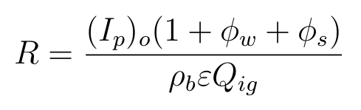
Background and Related Work
The majority of simulators use Rothermel’s equations which are as follows[30]:
Where R is the rate of spread. (I_{p})_{o} is the no-wind propagating flux, Ф_{w} and Ф_{s} are the additional propagating flux introduced by wind and slope respectively. The product of ρ_{b} and ε is referred to as the effective bulk density. Q_{ig} is the heat of preignition.
These values are derived from or contained in the fuel model for each cell
The desired output of a wildfire simulator is a time of arrival map depicting when a cell ignites and begins contributing to the spread of the fire

Slide 13
Background and Related Work
The method for propagation of a fire determines the method by which time iterates in a simulation
Three methods implemented in this work:
  Minimal Time (MT)
  Iterative Minimal Time (IMT)
  Burn Distances (BD)
MT and IMT are based on work done by Sousa, dos Reis, and Pereira [34]
  Implemented methods on the GPU
BD is based on work on by Hoang [15,16, 17]
  Used OpenGL and GLSL to use the GPU for computation and visualization

Slide 14
Background and Related Work: Crowning
Crowning is the phenomena of a fire spreading from the forest floor to the crowns of the trees [35, 36]
  Passive Crowning: The crowning does not impact the spread of the fire
  Active Crowning: The crowning increases the maximum rate of spread of the fire in that cell
This work implemented the same method for crowning as used in vFire [15,16, 17] who based their implementation on FARSITE [11].

Slide 15
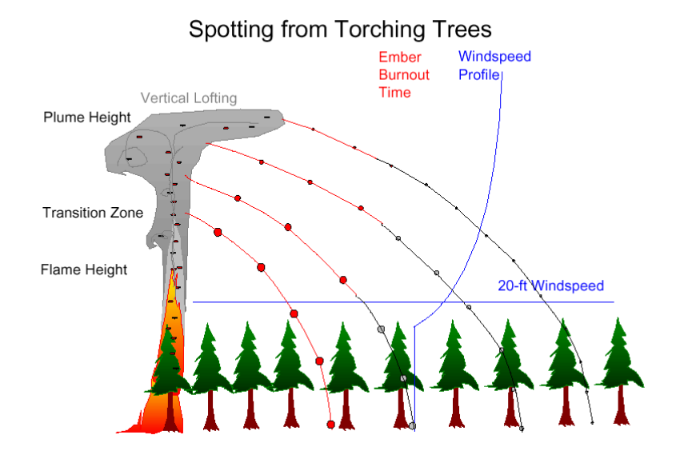
Background and Related Work: Spotting
Spotting occurs when firebrands from the wildfire are lofted into the air and fall ahead of the advancing flame wall, igniting a new fire
Three main components:
  Generation [18,19,21,32]
  Transport [11, 19]
  Ignition [18,28]
Figure taken from [2]

Slide 16
Background and Related Work: Spotting
Spotting occurs when firebrands from the wildfire are lofted into the air and fall ahead of the advancing flame wall, igniting a new fire
Three main components:
  Generation [18,19,21,32]
  Transport [11, 19]
  Ignition [18,28]
Figure taken from [2]

Slide 17
Background and Related Work: Fire Simulators
BEHAVE [4]
  Developed in 1986
  Two main functions:
    Run a point-in-time simulation
    Test new fuel model data
  Used by researchers to develop new fuel models and test them outside a laboratory environment
  Also used as a training tool for firefighters

Slide 18
Background and Related Work: Fire Simulators
fireLib [6]
  Developed in 1996
  Updated BEHAVE’s models and implementations to modern platform using C
  Runs much faster than BEHAVE, and output is generated over time as a time-of-arrival map.
  Each (x,y) in the output corresponds to a cell in the fire.

Slide 19
Background and Related Work: Fire Simulators
FARSITE [11]
  Continually developed since 2004
  FARSITE runs entirely sequentially, which makes it extremely slow
  It has very comprehensive inclusion of forest properties and models with the ability to incorporate advanced geospatial data

Slide 20
Background and Related Work: Fire Simulators
vFire [15,16,17]
  Developed in the High Performance Computing and Visualization lab by Dr. Roger Hoang
  vFire was the first forest fire simulator to utilize the parallel parameters of the GPU to decrease computation time needed to run a simulation by using OpenGL’s GLSL [33]
  The visualization and data processing of this simulator are tied together

Slide 21
Background and Related Work: Fire Simulators
FIRETEC [20]
  The only simulation package that does not use Rothermel’s spread equations to determine spread patterns
  Uses theoretical models of chemical reactions and heat transfers to determine where the fire will propagate
  Very computationally expensive
  Mainly used for research purposes

Slide 22
Background and Related Work: GPU Computation
GPU’s were originally designed for accelerating graphics with very specific fixed-function pipelines
  vFire was developed under the fixed-function pipeline constraint
In 2006, NVIDIA released CUDA which was the world’s first solution to general-purpose computing on the GPU [23]
The architecture of the GPU allows for thousands of low-powered threads to run in parallel
Notes:
CPU vs GPU thread vs thread, CPU wins every time
Pitfalls exist when data dependencies exist

Slide 23
Background and Related Work: CUDA
CUDA allows programmable kernels to be written that take advantage of the thousands of cores available [23]
  A kernel is a small bit of code that is run by a thread on the GPU
  Host: Machine which runs the parent code that calls the CUDA kernels
  Device: The GPU and its associated resources
Data must be transferred between the host and device
A thread is allocated in a block, and a block belongs to a grid
  There are 2-3 grids per GPU
  Up to 65535 blocks per grid, or in later compute capabilities it increases to 2³¹ - 1
  There are between 512 and 1024 threads per block

Slide 24
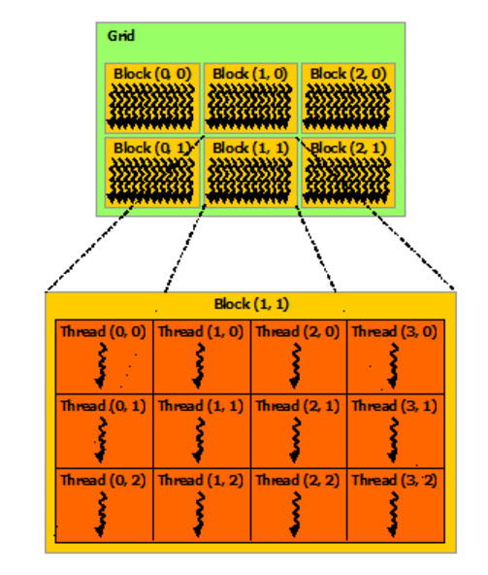
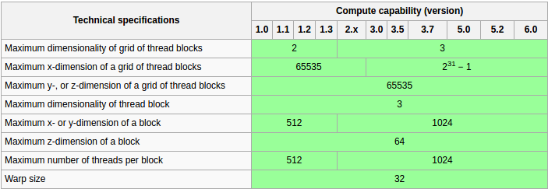
Background and Related Work: CUDA
This figure shows the changes in block/thread/grid sizes based on the CUDA Compute Level.
Figure from [37]
This figure presents a visualization on the differences between grids, blocks, and threads. Figure from [32]

Slide 25
Outline
Introduction
Background and Related Work
Real-Time GPU-Based Wildfire Simulation
Analysis and Conception
Modeling and Implementation
Results
Conclusions and Future Work

Slide 26
Real-Time GPU-Based Wildfire Simulation
vFireLib is a wildfire simulation library that takes advantage of the highly-parallel nature of the GPU
The propagation, crowning, and spotting are all implemented as CUDA kernels
The existing fire simulators (excluding vFire) all run sequentially, which limits their real-time usefulness.
The GPU allows each time tick in the simulation to be processed simultaneously across the entire simulation
  Unless the size of simulation exceeds the possible number of threads

Slide 27
Real-Time GPU-Based Wildfire Simulation
The focus of this work:
  Improve runtime to achieve faster-than-real-time simulations on real-world complex data.
The models used in this paper are first found in vFire and FARSITE
vFire provided the basis code for the data processing portion of this project, but had to be re-implemented without using GLSL
This work will be available as a library which will allow users to run a custom fire simulation on one of three propagation methods with crowning and fire acceleration methods available
Spotting has been implemented as a prototype for future work in this work

Slide 28
Outline
Introduction
Background and Related Work
Real-Time GPU-Based Wildfire Simulation
Analysis and Conception
Modeling and Implementation
Results
Conclusions and Future Work

Slide 29
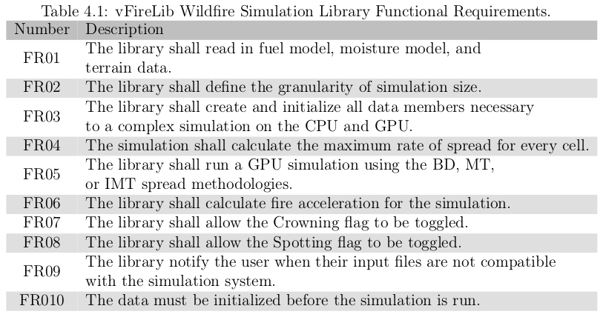
Analysis and Conception
Functional requirements were created from the behavioral requirements of the library’s functionality as used by an outside source

Slide 30
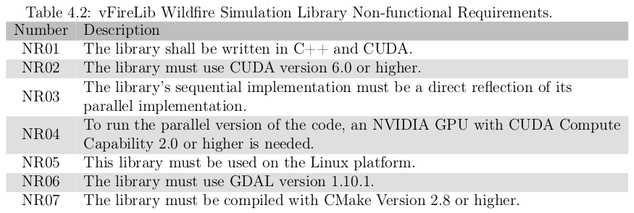
Analysis and Conception
Non-Functional Requirements were based on the internal interactions of the library functions

Slide 31
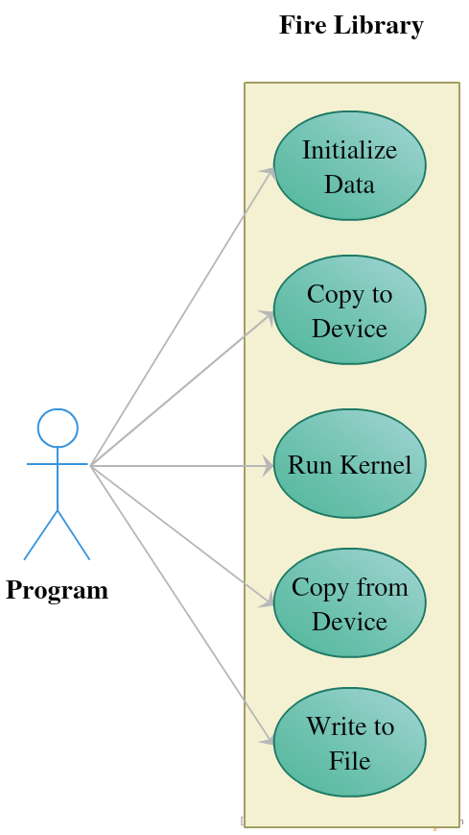
Analysis and Conception
Use Case Diagram:
  Depicts the interactions of a user (parent program) with the library’s functionality

Slide 32
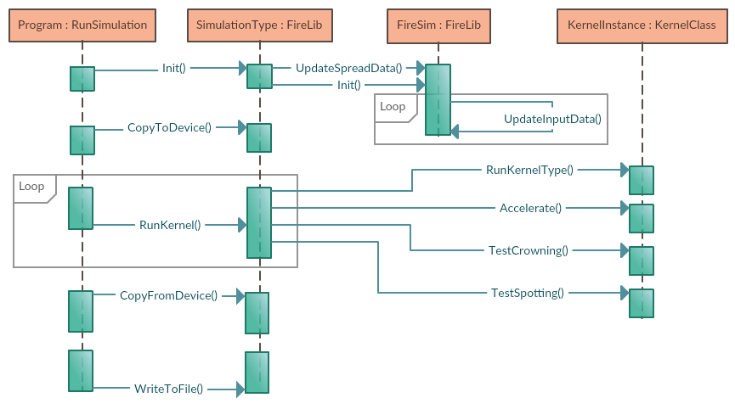
Analysis and Conception

Slide 33
Analysis and Conception: Detailed Use Cases
Initialize Simulation Data:
  Read from terrain, fuel, moisture, canopy height, crown base height and crown bulk density files and interpolate them to match simulation size.
Initialize CPU Data:
  Perform pre-processing on the data which will be fed into simulation. This includes pre-calculated values that will not change during the life of the simulation. Whenever there is a change (i.e. a tree bulldoze), this functionality must be performed.
Copy to Device:
  Transfer data from the host to the device to be used by kernels.
Propagate:
  The BD, MT, or IMT kernel is called in a loop to propagate the fire.
Accelerate:
  Once the fire propagation has been processed, the acceleration is performed.

Slide 34
Analysis and Conception: Detailed Use Cases
Crowning
  Once the fire has been accelerated, a kernel tests for the crowning phenomena. This includes a check to determine if the fire has moved from passive to active, where the maximum spread rate is increased.
Spotting
  Spotting occurs when the initial event of crowning occurs. The firebrand’s fall is calculated at each time step.
Copy From Device:
  On full or partial completion of the simulation, to receive the time of arrival map, the data must be copied from the device back to host.
Write to File
  This functionality writes the time of arrival map generated by the kernel to a .csv output file

Slide 35
Outline
Introduction
Background and Related Work
Real-Time GPU-Based Wildfire Simulation
Analysis and Conception
Modeling and Implementation
Results
Conclusions and Future Work

Slide 36
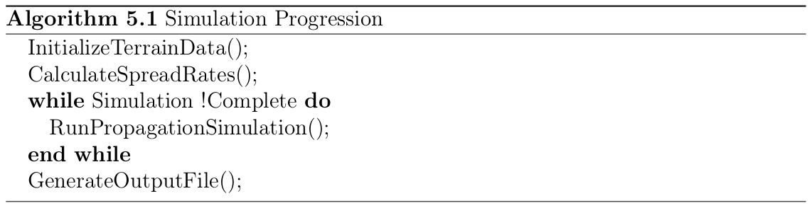
Modeling and Implementation
Once the preprocessing is complete, one of three simulation methods can be applied: Burn Distances, Minimal Time, or Iterative Minimal Time

Slide 37
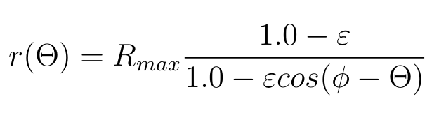
Modeling and Implementation
The three propagation methods were found in vFire[16] or the work done by Sousa, dos Reis, and Pereira [34]
All three methods use Rothermel’s fire spread equation. After preprocessing, the rate of spread is calculated as follows:
R_{max} is the maximum spread rate. દ is the eccentricity of the fire, which is based on wind and slope data. Φ is the orientation and θ is the direction in which the fire is spreading.
R_{max}, Φ, and દ are all based on data found in the input files
Equation 5.1

Slide 38
Modeling and Implementation
Preprocessing phase:
  Read in from input files
  Use Geospatial Data Abstraction Library (GDAL) to interpolate all files to be correct sizes [12]
  Wind is incorporated as a 2D vector at each cell and is set by a manual input parameter
Secondary Kernel
  There are some slight data dependencies in this project, so a secondary kernel for copying data or updating time was implemented for each method to compensate

Slide 39
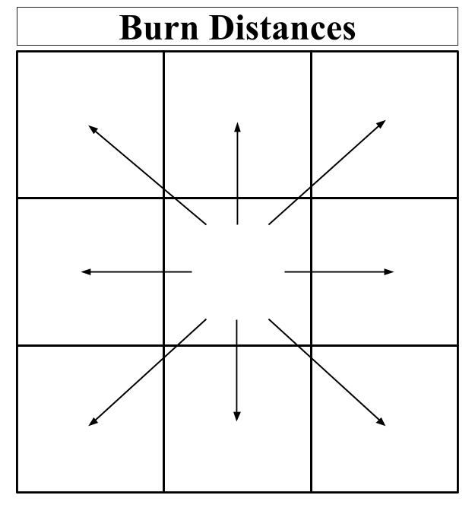
Modeling and Implementation: Burn Distances
The BD kernel simulates the time it takes to physically burn the distance between two cells at a fixed time step
  Each cell looks to its neighbors to see if it has burned the complete distance for ignition
  When a cell ignites, it inherits the properties of the fire which ignited it
    In the case where that fire spreads at a higher rate, it caps it to the max rate of the current cell
  This is the only floating-point precision kernel out of the three

Slide 40
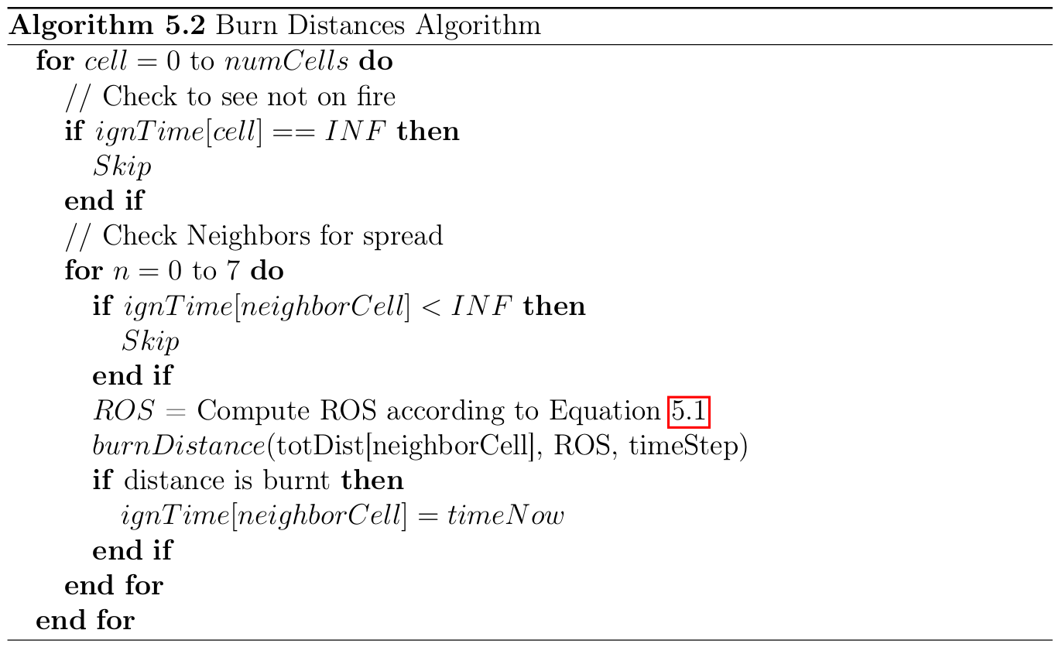
Modeling and Implementation: Burn Distances

Slide 41
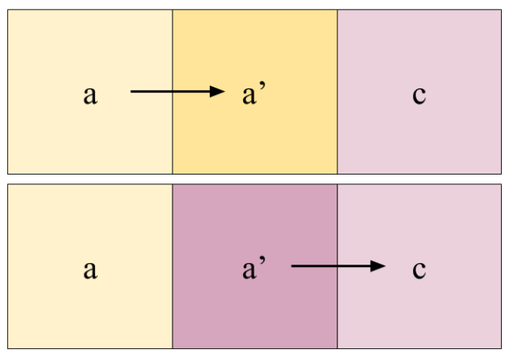
Modeling and Implementation: Burn Distances
There is an issue with data synchronization that arises when reading to and writing from the same time of arrival map
Thread 1 processes a, and writes the results out to a’. Thread 2 needs to read the data from the cell at a’ for calculations for c, and receives data relevant to the next time step.

Slide 42
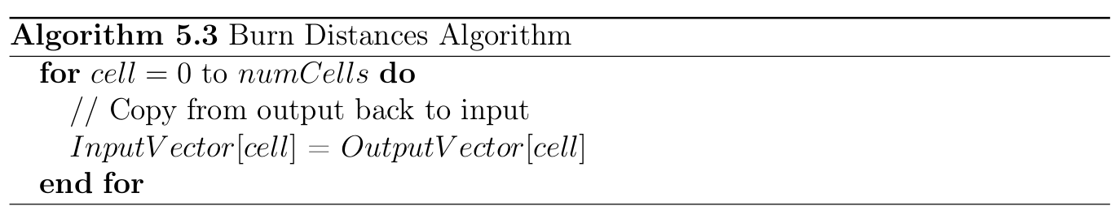
Modeling and Implementation: Burn Distances
Solution: two time of arrival maps, one for reading and one for writing.
New need: the output file needs to transfer data to input file for next iteration
  This is accomplished in a secondary kernel
Note: atomic functions are still used to ensure that during the writeout phase to the output vector, the lowest time of arrival is achieved.

Slide 43
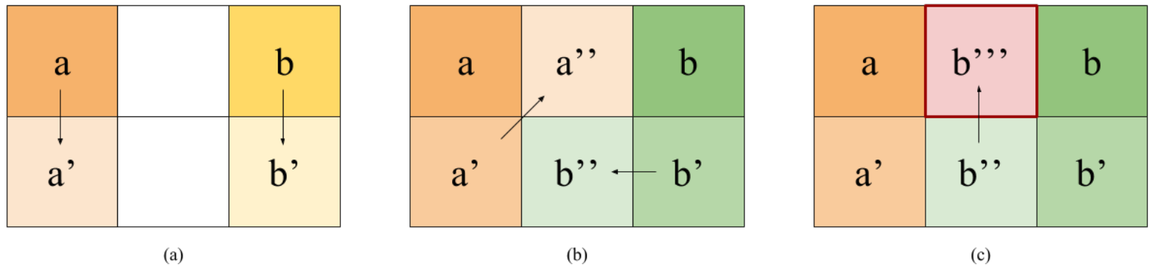
Modeling and Implementation: Burn Distances
Another issue arose from the fixed-time-step in this method
(a), (b), and (c) are all steps in time. The time step is too large and shows a propagating faster than b, when b’’’ should be the correct value at the cell in question
Fix: make time step smallest time to propagate across a cell, which can be precomputed

Slide 44

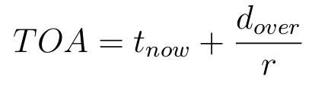
Modeling and Implementation: Burn Distances
The change in distance each time step is calculated as follows:
To compensate for ‘overburn’, when a cell is found to be ignited, it calculates the time of arrival as:
Where d_{over} is the extra distance that was burnt

Slide 45
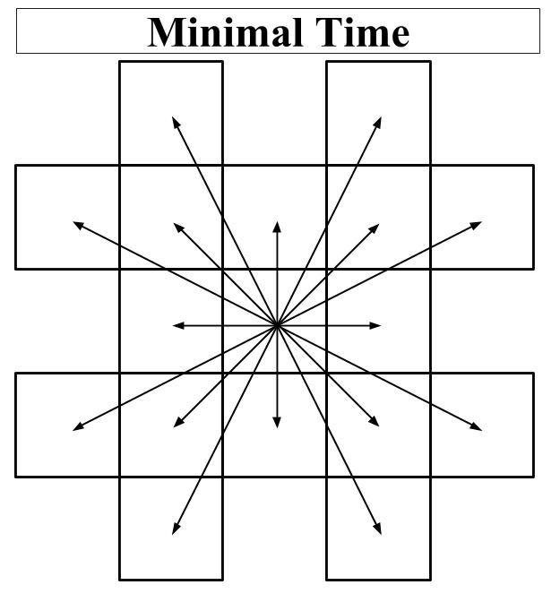
Modeling and Implementation: Minimal Time
The MT kernel steps through time by calculating the next-soonest time of arrival and stepping to that point in time
  When a cell ignites, it inherits the properties of the fire which ignited it
  In the case where a neighbor cell is already on fire, it is ignored

Slide 46
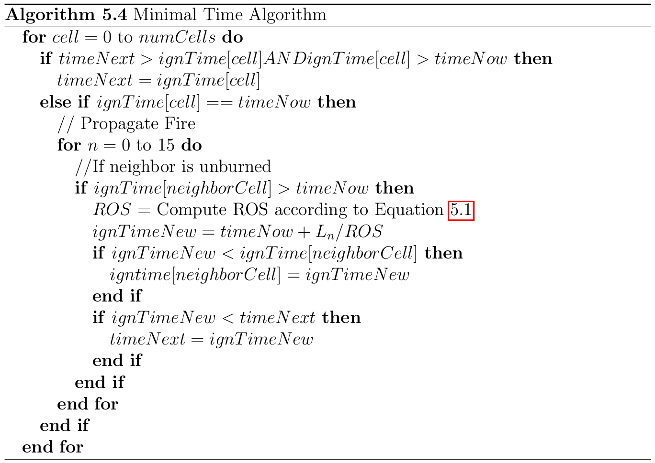
Modeling and Implementation: Minimal Time

Slide 47
Modeling and Implementation: Minimal Time
The same data synchronization issues occur in this kernel as in the BD kernel
The solution here is to use the CUDA atomic function AtomicMin()
  Atomic functions put a lock on a data location so that only one thread may access it at a time
  This AtomicMin() function ensures that the soonest time of arrival is written to a memory cell
Downside:
  Atomic functions are slow
Secondary Kernel:
  There is no way with CUDA to enforce block-wise synchronization without the termination of a kernel
  Time is updated on the device with a kernel that is called after the propagation kernel is complete
  Note: Calling this rather trivial kernel is faster than transferring the data back to the host and updating it before transferring it back

Slide 48
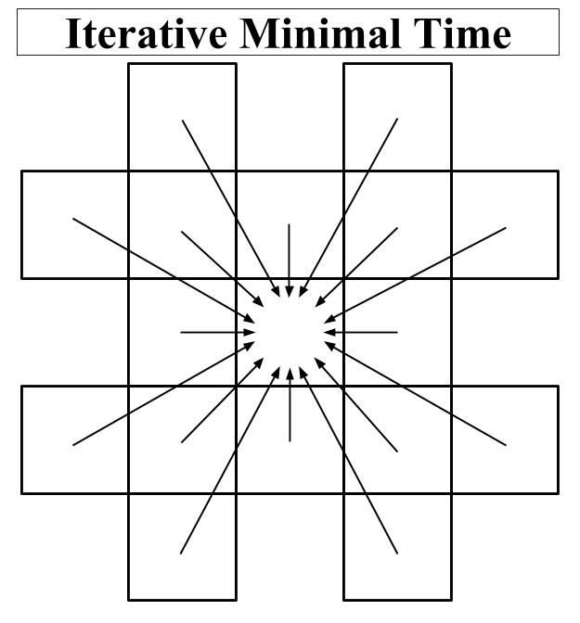
Modeling and Implementation: Iterative Minimal Time
The IMT kernel calculates each cell’s toa and stops computing when its value converges
  This is the only method which does not require atomic functions
  When a cell ignites, it inherits the properties of the fire which ignited it

Slide 49
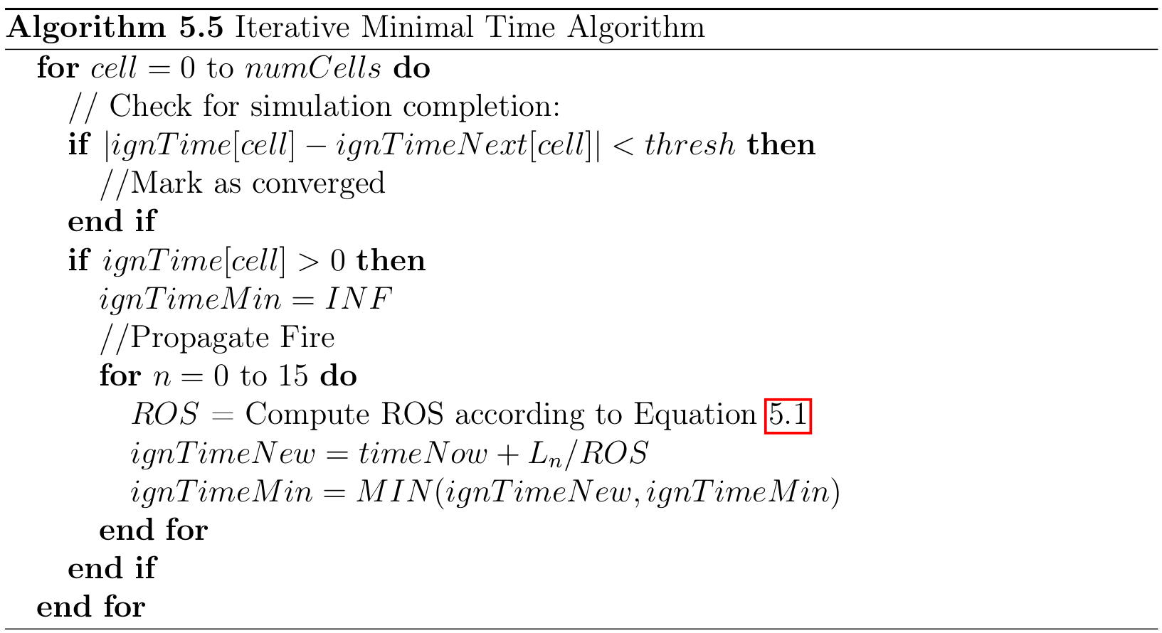
Modeling and Implementation: Iterative Minimal Time

Slide 50
Modeling and Implementation: Iterative Minimal Time
This kernel avoids atomic functions and using an if statement through the use of the mathematical equation as follows:
  ignTimeMin = ignTimeNew*(ignTimeNew < ignTimeMin) +
ignTimeMin*(ignTimeNew >= ignTimeMin);

Slide 51

Modeling and Implementation: Acceleration
In a real wildfire, the fire does not begin to propagate at its maximum rate. It begins small and increases towards its maximum rate over time.
The fire acceleration implemented in this work was based on vFire and FARSITE [11,16].
Given R_{max,} the maximum spread rate at some time t is given by:
Where a_{a} is the acceleration constant (given by fuel model).

Slide 52
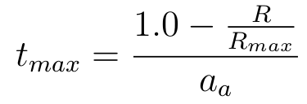
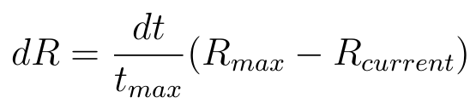
Modeling and Implementation: Acceleration
The time t_{max} required to achieve maximum spread rate R is given by:
To calculate how much the rate should change per given time step, the rate of spread dR is calculated as:
Notes:
If max_accel > max_rate then clamp
Acceleration starts from zero and moves up from there

Slide 53
Modeling and Implementation: Crown Fire
Crowning occurs when the base fire spreads to the treetops
This method was based on vFire and FARSITE [11,16], who got their methods from work done by Van Wagner [35,36].
Torching is important for spotting, which occurs at the time when the fire moves from the base of the trees to the peaks

Slide 54

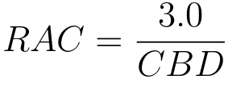
Modeling and Implementation: Crown Fire
Maximum Passive crown rate is given by:
The threshold which determines the promotion from passive to active:
Where CBD is the crown bulk density, and is given by the input files of the simulator
Notes:
R10 is base max spread

Slide 55


Modeling and Implementation: Crown Fire
The reaction intensity (I_{b}) can be obtained as:
The threshold intensity for the crown fire to occur (I_{o}) is:
Where CBH is the Crown Base Height and M is the foliar moisture content.
  CBH data is input through a file in the preprocessing phase
  Foliar moisture is just assumed to be 1.0 as it was in vFire
  I_{o} values only need to be calculated once and are calculated as a part of the preprocessing phase

Slide 56
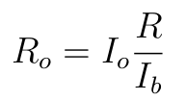


Modeling and Implementation: Crown Fire
Surface Fuel Consumption R_{o} can be found as:
The Crown Coefficient a_{c} can be found as:
The Crown Fraction Burned is calculated using the above values
Using CFB, the actual spread rate is found as:
Notes:
We need these to calculate the actual rate of spread

Slide 57
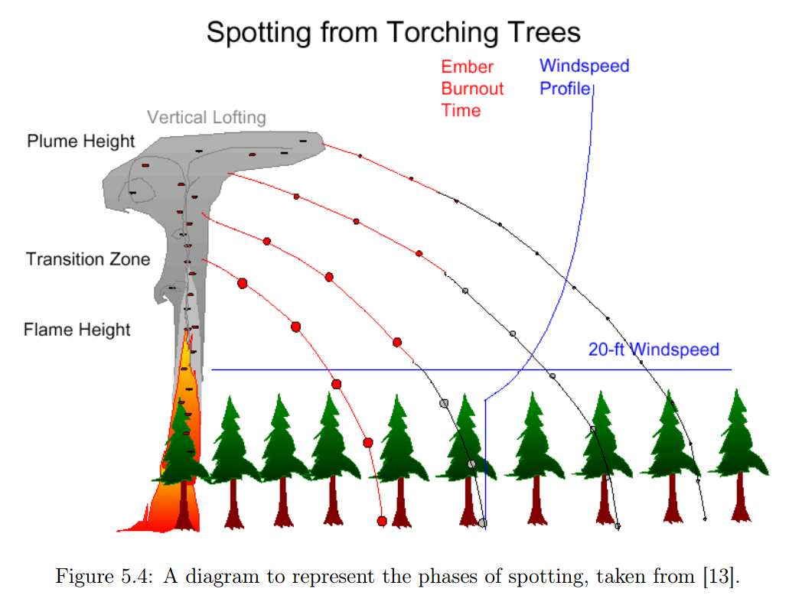
Modeling and Implementation: Spotting
Three Parts to Spotting:
  Generation
  Transport
  Ignition
Assumptions Made:
  Fire brands are cylinders
  Fire brands originate at the top of the canopy
  Spotting occurs every time torching occurs
All equations are derived by work found in FARSITE [11]

Slide 58
Modeling and Implementation: Spotting
Three Parts to Spotting:
  Generation
  Transport
  Ignition
Assumptions Made:
  Fire brands are cylinders
  Fire brands originate at the top of the canopy
  Spotting occurs every time torching occurs
All equations are derived by work found in FARSITE [11]

Slide 59
Modeling and Implementation: Spotting
Three Parts to Spotting:
  Generation
  Transport
  Ignition
Assumptions Made:
  Fire brands are cylinders
  Fire brands originate at the top of the canopy
  Spotting occurs every time torching occurs
All equations are derived by work found in FARSITE [11]

Slide 60
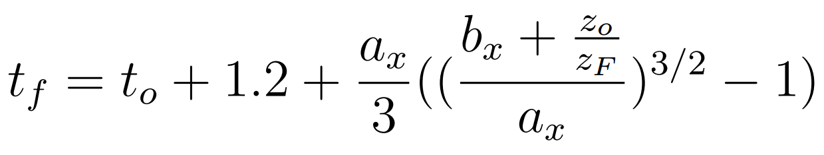

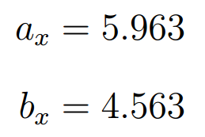
Modeling and Implementation: Spotting
The time at which the particle is at its maximum height is when t_{f} = t_{t}
  Where t_{f} is:
  Where t_{t} is:
Where:

Slide 61
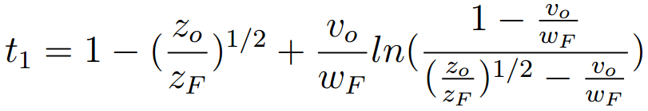

Modeling and Implementation: Spotting
t₀ is the time of steady burning tree crowns
t₁ is the time it takes to travel from its origin point to the flame tip
&
Where z_{o} is the height of the particle, z_{F} is the flame height, B is a constant set to 40 and D_{p} is particle diameter.

Slide 62
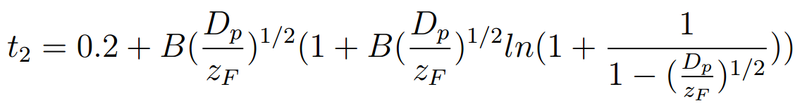
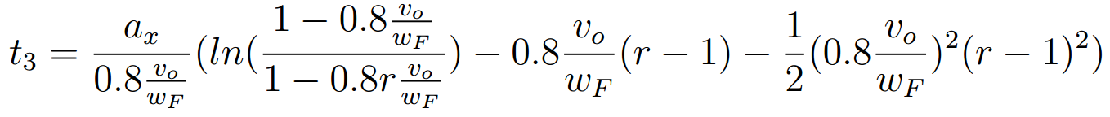
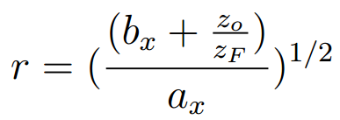
Modeling and Implementation: Spotting
t₂ is the time it takes to travel from the flame tip to the buoyant plume
t₃ is the time it takes to travel through the buoyant plume
Where

Slide 63
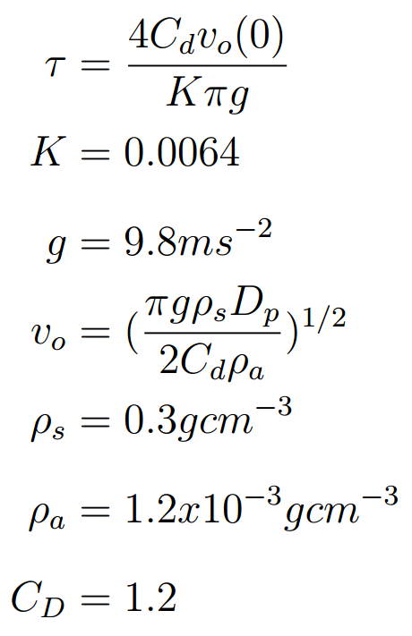
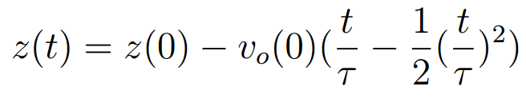
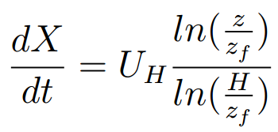
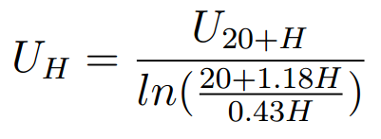
Modeling and Implementation: Spotting
Once the particle is lofted to its maximum height, it descends at a rate determined by:
The change in X direction is dependent on the wind whose influence decreases logarithmically as it approaches the canopy
Where:

Slide 64
Outline
Introduction
Background and Related Work
Real-Time GPU-Based Wildfire Simulation
Analysis and Conception
Modeling and Implementation
Results
Conclusions and Future Work

Slide 65
Results
While initial tests were done using a CUBIX box for this project, technical difficulties at the time of running result tests meant it was unavailable for these results
These results were run on a machine using:
CPU: Intel(R) Core(TM) i7-3770K CPU @ 3.50GHz.
GPU: GTX-970 with 4GB of RAM and 1664 cuda cores

Slide 66
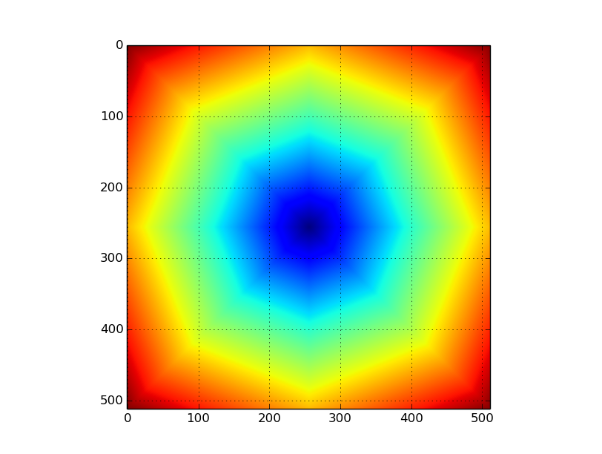
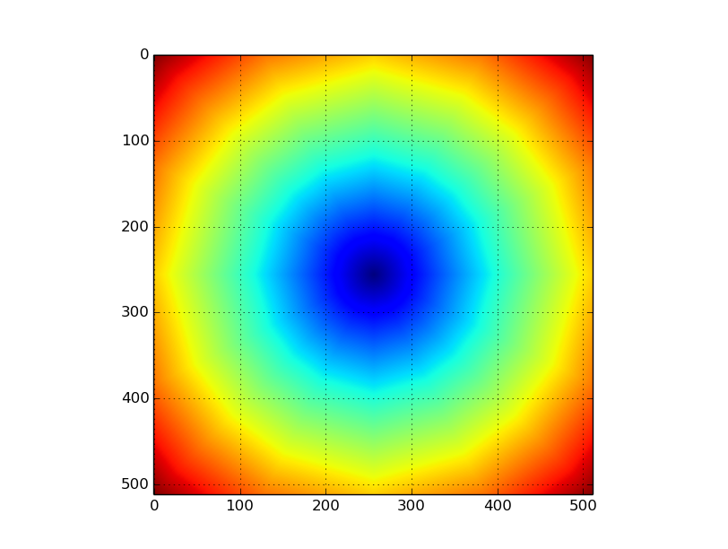
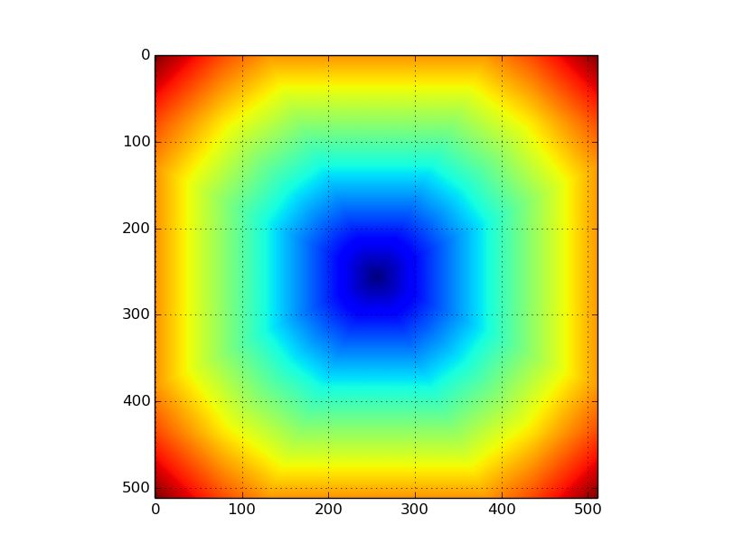
Results: Base Spread
The base spread for BD, MT, and IMT are as follows:
Burn Distances
Minimal Time
Iterative Minimal Time

Slide 67
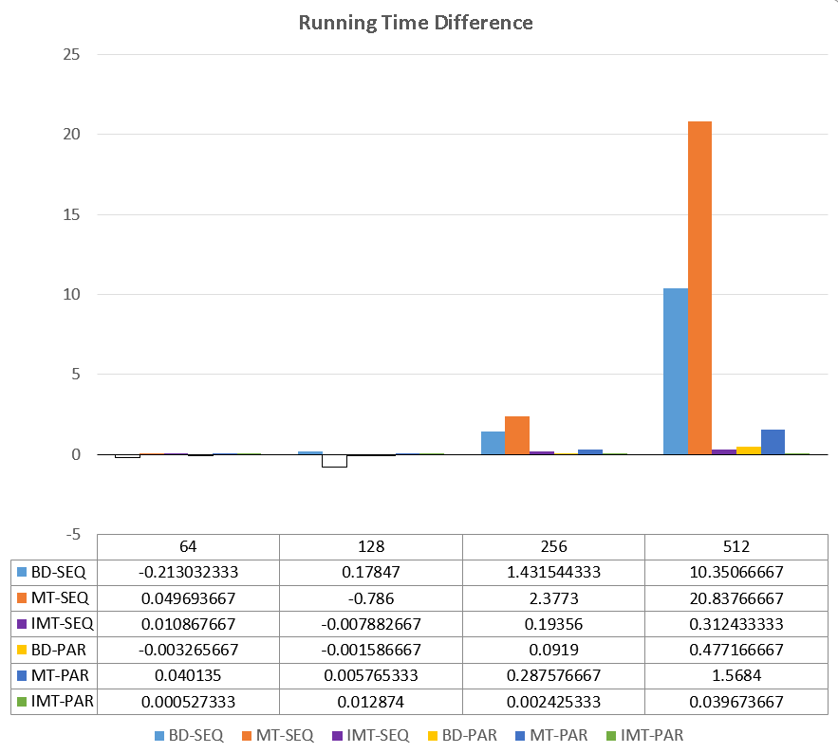
Results: Timings
Acceleration is built directly into the base propagation, but crowning is a toggleable feature
The timing differences between crowning and no-crowning were not significantly different so the results are only shown on crowning data

Slide 68
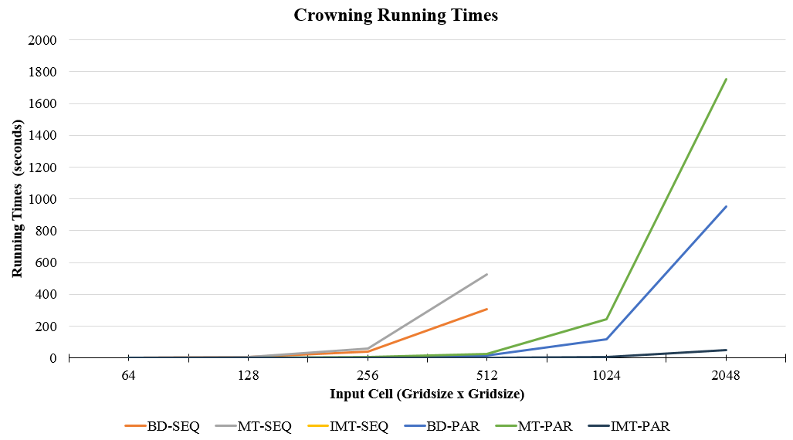
Results: Timings
Figure: Crowning Running Times in for all test runs on sizes reaching up to 2048x2048 for the GPU methods

Slide 69
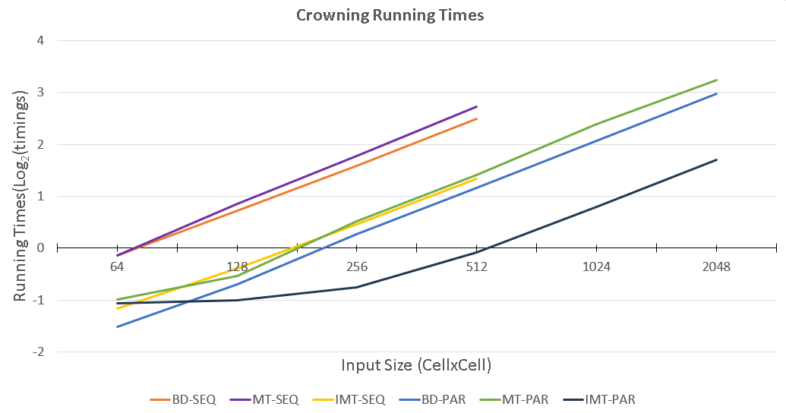
Results: Timings
Figure: Crowning Running Times in log₂ scale for all test runs on sizes reaching up to 2048x2048 for the GPU methods

Slide 70
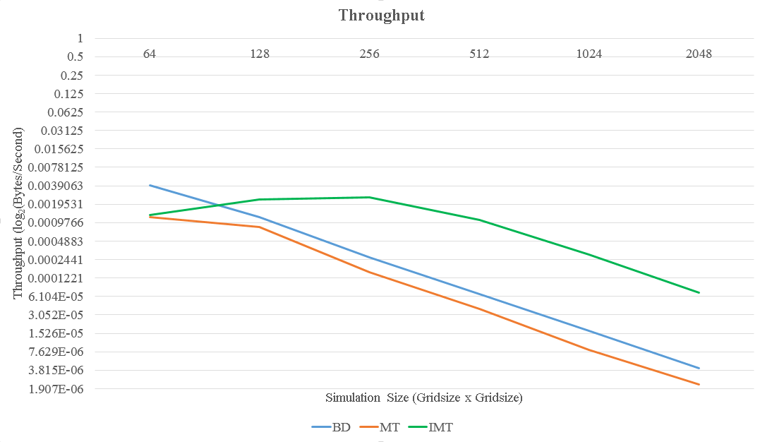
Results: Throughput
Figure: This graph presents the log₂ scale of the throughput results, which were calculated by dividing the GigaBytes processed / second.

Slide 71
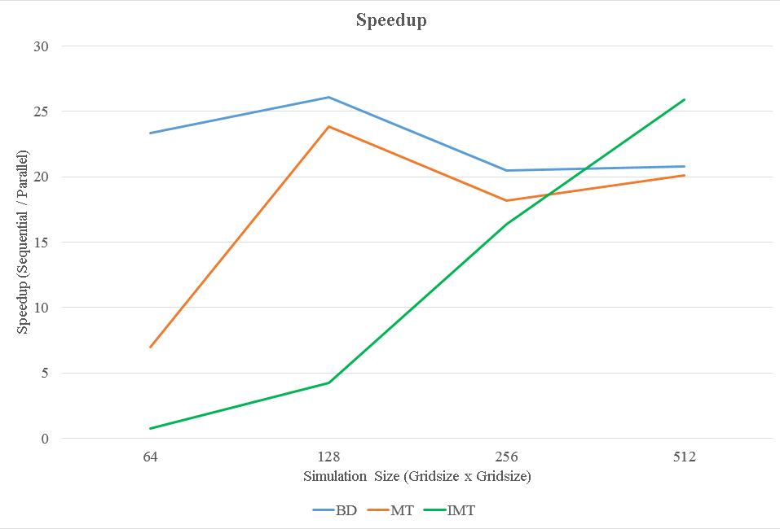
Results: Speedup
Figure: This graph presents the speedup between the parallel and sequential implementations. The average speedup was around 20X faster for all the versions.

Slide 72
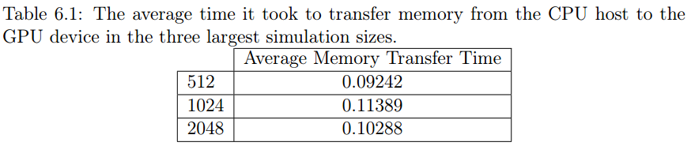
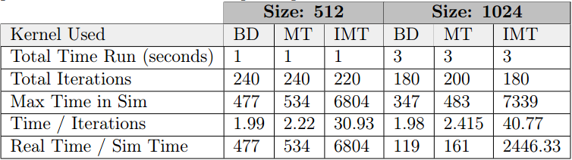
Results: Single Run Analysis
Recall the kernel will be called in a loop, so individual timings for memory transfer and individual kernel calls may be relevant to the users
The following are the average memory transfer time per input size and sim time vs real time comparison:

Slide 73
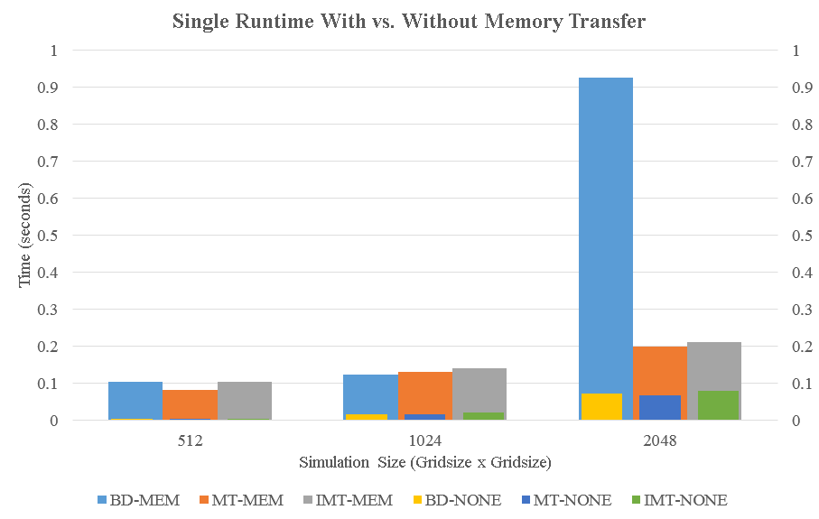
Results: Single Run Analysis
Figure: This figure displays the runtimes found for a single iteration of the kernel call with and without memory transfer time

Slide 74
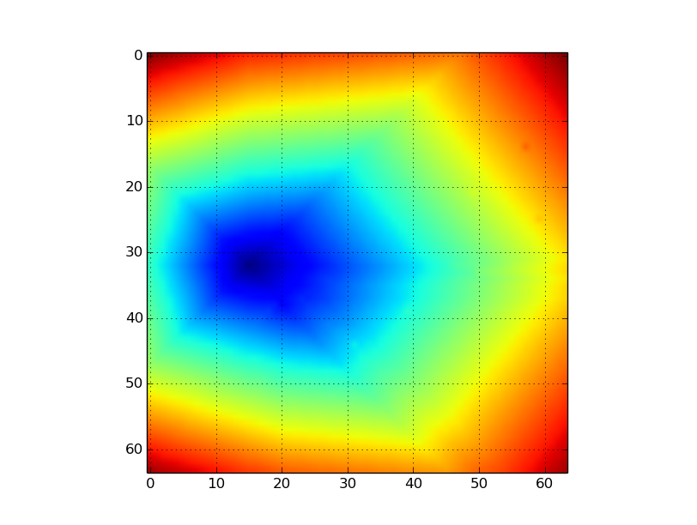
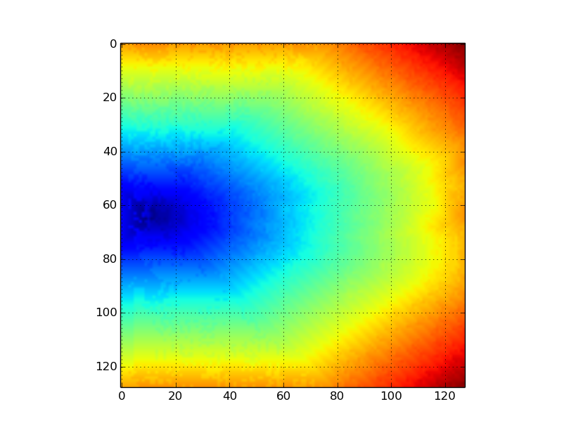
Results: Wind and Spotting
Figure: No Spotting, Wind in +X direction at magnitude 40
Figure: Spotting, Wind in +X direction at magnitude 40

Slide 75
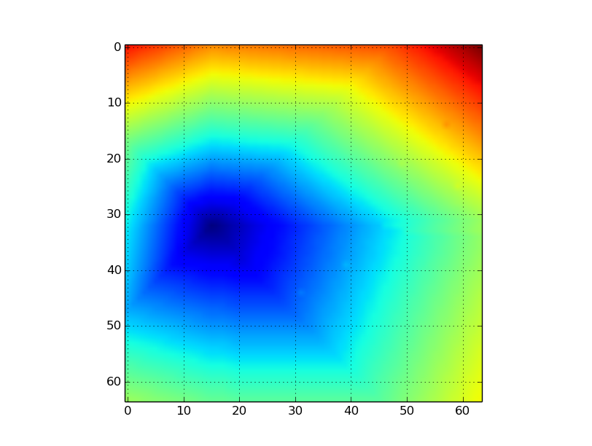
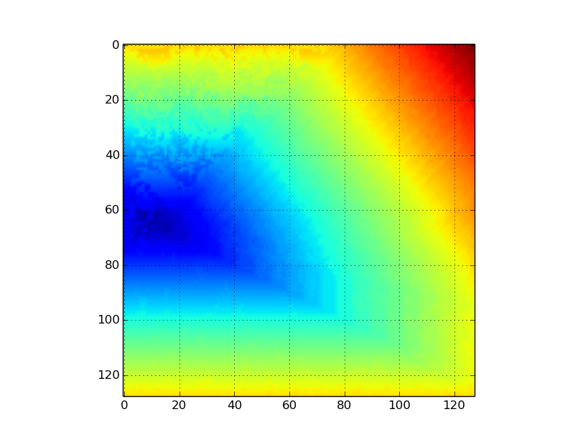
Results: Wind and Spotting
Figure: No Spotting, Wind in +X and +Y directions at magnitude 40
Figure: Spotting, Wind in +X and +Y directions at magnitude 40

Slide 76
Results: Real Data
Location
  Kyle Canyon Nevada
  Located outside Las Vegas
Input Size
  906x612
Propagation Method:
  Burn Distances

Slide 77

0
Notes:
5000 iterations (20.5 seconds to run)

Slide 78

3,000
Notes:
7000 iterations (28.8 seconds)

Slide 79

4,000
Notes:
10,000 iterations (41.1 seconds).

Slide 80

5,000

Slide 81

6,000

Slide 82

7,000

Slide 83

8,000

Slide 84

9,000

Slide 85

10,000

Slide 86

10,000

Slide 87
Outline
Introduction
Background and Related Work
Real-Time GPU-Based Wildfire Simulation
Analysis and Conception
Modeling and Implementation
Results
Conclusions and Future Work

Slide 88
Conclusions and Future Work
Each kernel achieved an approximate 20X speedup over the sequential implementation and ran in faster-than-real-time
While this library has all the functionality it needs to run forest fire simulations on real-world data, there are areas which may be improved

Slide 89
Comparisons and Future Work
Improved Spotting
  What is implemented is a framework for the future work, but had to make several approximations
Atmospheric Incorporation
  A more detailed model of wind influences could be built based on real-time streaming data from weather sites
Multi-GPU Implementation
  On the large-scale simulations, using multiple GPUs could increase runtimes for the simulation.
Visualization
  Recall vFire incorporated the processing and visualization into the same application. This library does not include any visualization components

Slide 90
Questions?

Slide 92
References
[1] Cubix corporation, xpander rackmount 8 gen3 16-channel (128gbps) pcie slot expansion system and hostengine. http://www.cubix.com/. [Online; accessed 23-September-2015].
[2] Frank A Albini and Robert G Baughman. Estimating windspeeds for predicting wildland fire behavior. USDA Forest Service Research Paper INT (USA), 1979.
[3] Patricia L Andrews. Behave: fire behavior prediction and fuel modeling systemburn subsystem, part 1. 1986.
[4] Jim Arlow and Ila Neustadt. UML 2 and the unified process: practical objectoriented analysis and design. Pearson Education, 2005.
[5] Collin D Bevins. Firelib user manual and technical reference. Systems for Environmental Management, 1996.
[6] Winfred H Blackmarr. Moisture content influences ignitability of slash pine litter. 1972.
[7] Larry S Bradshaw, John E Deeming, Robert E Burgan, and D Jack. The 1978 national fire-danger rating system: technical documentation. 1984.
[8] Stephen C Bunting and Henry A Wright. Ignition capabilities of non-flaming firebrands. Journal of Forestry, 72(10):646–649, 1974.
[9] creately. Creately Online. http://creately.com/diagram-products. [Online; accessed 26-February-2016].
[10] Mark Arnold Finney. Farsite: Fire area simulator: model development and evaluation. Intermountain Forest and Range Experiment Station, General Technical Report, 2004.
[11] GDAL Development Team. GDAL - Geospatial Data Abstraction Library, Version x.x.x. Open Source Geospatial Foundation, 2016.
[12] Ross W Gorte and Kelsi Bracmort. Forest fire/wildfire protection. Congressional Research Service, Library of Congress, 2006.
[13] National Wildfire Coordinating Group. Fire Behavior Field Reference Guide, volume PMS. 437 edition.
[14] Kelvin G Hirsch et al. Canadian forest fire behavior prediction (FBP) system: user’s guide, volume 7. 1996.
[15] Roger V Hoang, Joseph D Mahsman, David T Brown, Michael A Penick, Frederick C Harris Jr, and Timothy J Brown. Vfire: virtual fire in realistic environments. In Virtual Reality Conference, 2008. VR’08. IEEE, pages 261–262. IEEE, 2008.
[16] Roger V. Hoang, Matthew R. Sgambati, Timothy J. Brown, Daniel S. Coming, and Frederick C. Harris Jr. Vfire: Immersive wildfire simulation and visualization. Computers & Graphics, 34(6):655 – 664, 2010.
[17] Roger Viet Hoang. Wildfire Simulation on the GPU. ProQuest, 2008.

Slide 93
References
[18] Eunmo Koo, Rodman R Linn, Patrick J Pagni, and Carleton B Edminster. Modelling firebrand transport in wildfires using higrad/firetec. International journal of wildland fire, 21(4):396–417, 2012.
[19] Eunmo Koo, Patrick J Pagni, David R Weise, and John P Woycheese. Firebrands and spotting ignition in large-scale fires. International Journal of Wildland Fire, 19(7):818–843, 2010.
[20] RR Linn and FH Harlow. Firetec: a transport description of wildfire behavior. Technical report, Los Alamos National Lab., NM (United States), 1997.
[21] Samuel L Manzello, Alexander Maranghides, and William E Mell. Firebrand generation from burning vegetation. International Journal of Wildland Fire, 16(4):458–462, 2007.
[22] RS McAlpine and RH Wakimoto. The acceleration of fire from point source to equilibrium spread. Forest Science, 37(5):1314–1337, 1991.
[23] CUDA Nvidia. Programming guide, 2008.
[24] E Pastor, L Zarate, E Planas, and J Arnaldos. Mathematical models and calculation systems for the study of wildland fire behaviour. Progress in Energy and Combustion Science, 29(2):139–153, 2003.
[25] Michael A Penick, Roger V Hoang, Frederick C Harris Jr, Sergiu M Dascalu, Timothy J Brown, William R Sherman, and Philip A McDonald. Managing data and computational complexity for immersive wildfire visualization. Proceedings of high performance computing systems (HPCS’07), Prague, Czech, 2007.
[26] GLW Perry. Current approaches to modelling the spread of wildland fire: a review. Progress in Physical Geography, 22(2):222–245, 1998.
[27] Seth H Peterson, Marco E Morais, Jean M Carlson, Philip E Dennison, Dar A Roberts, Max A Moritz, David R Weise, et al. Using hfire for spatial modeling of fire in shrublands. 2009.
[28] Matt P Plucinski and Wendy R Anderson. Laboratory determination of factors influencing successful point ignition in the litter layer of shrubland vegetation. International Journal of Wildland Fire, 17(5):628–637, 2008.
[29] Richard C Rothermel. How to predict the spread and intensity of forest and range fires. The Bark Beetles, Fuels, and Fire Bibliography, page 70, 1983. 63
[30] Richard C Rothermel and Intermountain Forest. A mathematical model for predicting fire spread in wildland fuels. AUSFS, 1972.

Slide 94
References
[31] Jason Sanders and Edward Kandrot. CUDA by Example: An Introduction to General-Purpose GPU Programming, Portable Documents. Addison-Wesley Professional, 2010.
[32] Nicolas Sardoy, Jean-Louis Consalvi, Bernard Porterie, and A Carlos FernandezPello. Modeling transport and combustion of firebrands from burning trees. Combustion and Flame, 150(3):151–169, 2007.
[33] Dave Shreiner. OpenGL Reference Manual: The Official Reference Document to OpenGL, Version 1.2. Addison-Wesley Longman Publishing Co., Inc., Boston, MA, USA, 3rd edition, 1999.
[34] Ian Sommerville. Software engineering-9th ed. p. cm. McGraw-Hill Companies Inc., New York, 2011.
[35] FA Sousa, RJN Dos Reis, and JCF Pereira. Simulation of surface fire fronts using firelib and gpus. Environmental Modelling & Software, 38:167–177, 2012.
[36] CE Van Wagner. Conditions for the start and spread of crown fire. Canadian Journal of Forest Research, 7(1):23–34, 1977. [37] CE Van Wagner. Prediction of crown fire behavior in two stands of jack pine. Canadian Journal of Forest Research, 23(3):442–449, 1993.
[37]Wikimedia Foundation, CUDA. https://en.wikipedia.org/wiki/cuda. [Online; accessed 25-April-2016].

