Slide 1
Budget and User Feedback Control Strategy-based
PRMS Scenario Web Application
Rui Wu, Jose Painumkal, Sergiu M. Dascalu,
Frederick C. Harris, Jr
Department of Computer Science and Engineering University of Nevada, Reno
15th International Conference on Information Technology : New Generations

Slide 2

Acknowledgement
This material is based upon work supported by the National Science Foundation under grant numbers IIA-1329469 and IIA-1301726.
Any opinions, findings, and conclusions or recommendations expressed in this material are those of the authors and do not necessarily reflect the views of the National Science Foundation.

Slide 3
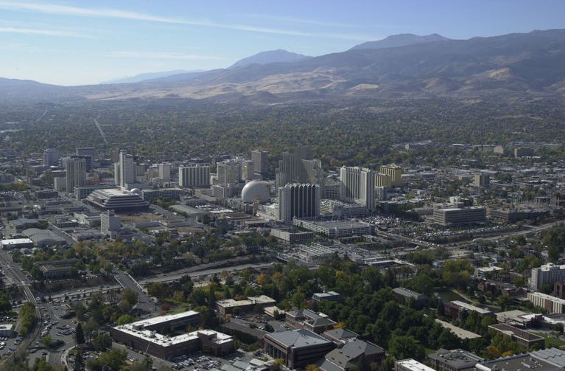
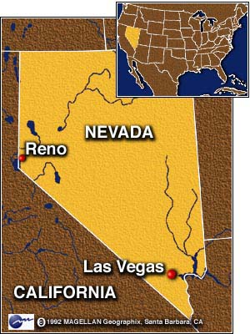
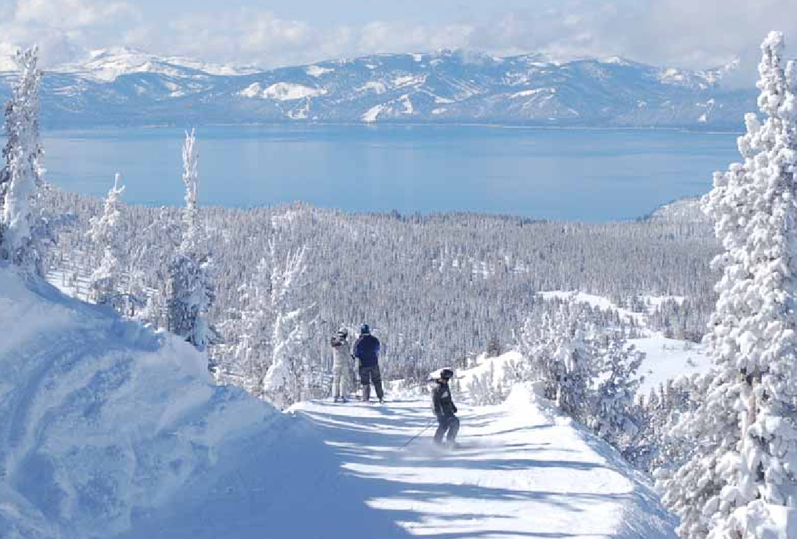
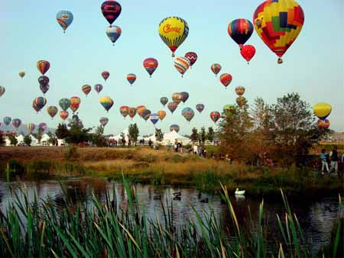
Reno, Nevada

Slide 4
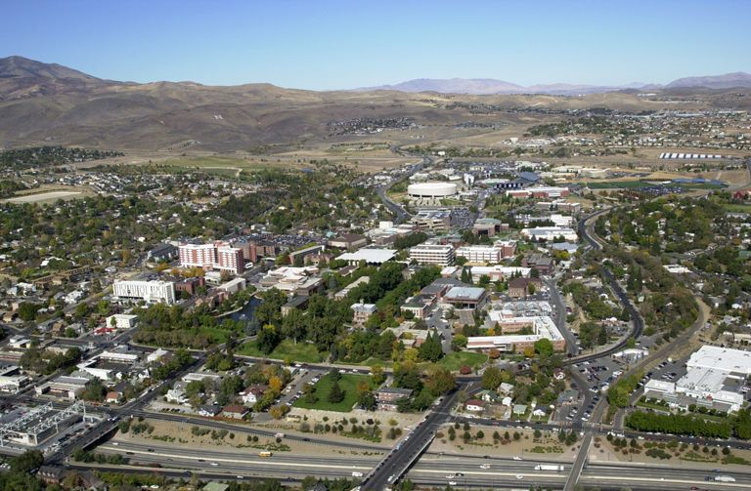




University of Nevada, Reno

Slide 5
Outline
Background
Proposed Solution
  Design
  Control Strategy
  One Example Application Using the Solutions
Conclusion and Future Work

Slide 6
Background
Precipitation-Runoff Modeling System (PRMS)
  Study and simulate hydrological environment systems
  Widely used in hydrological research
  Available from United States Geological Survey (USGS)
Need to execute multiple PRMS model runs to simulate different scenarios
Need a server cluster to process multiple model execution requests from multiple users

Slide 7

Background
How to set up this server cluster:
  Idea 1: Rent nodes from a third-party company? E.g. Netflix sets up their servers in Amazon Web Services: Too expensive
  Idea 2: Buy physical servers? A10-node server cluster can easily cost $100k.
Challenge: on one hand, we want our server as powerful as possible, on the other hand, we (academia) do not have a lot of money when compared with industry
Solution: combine idea 1 and 2

Slide 8
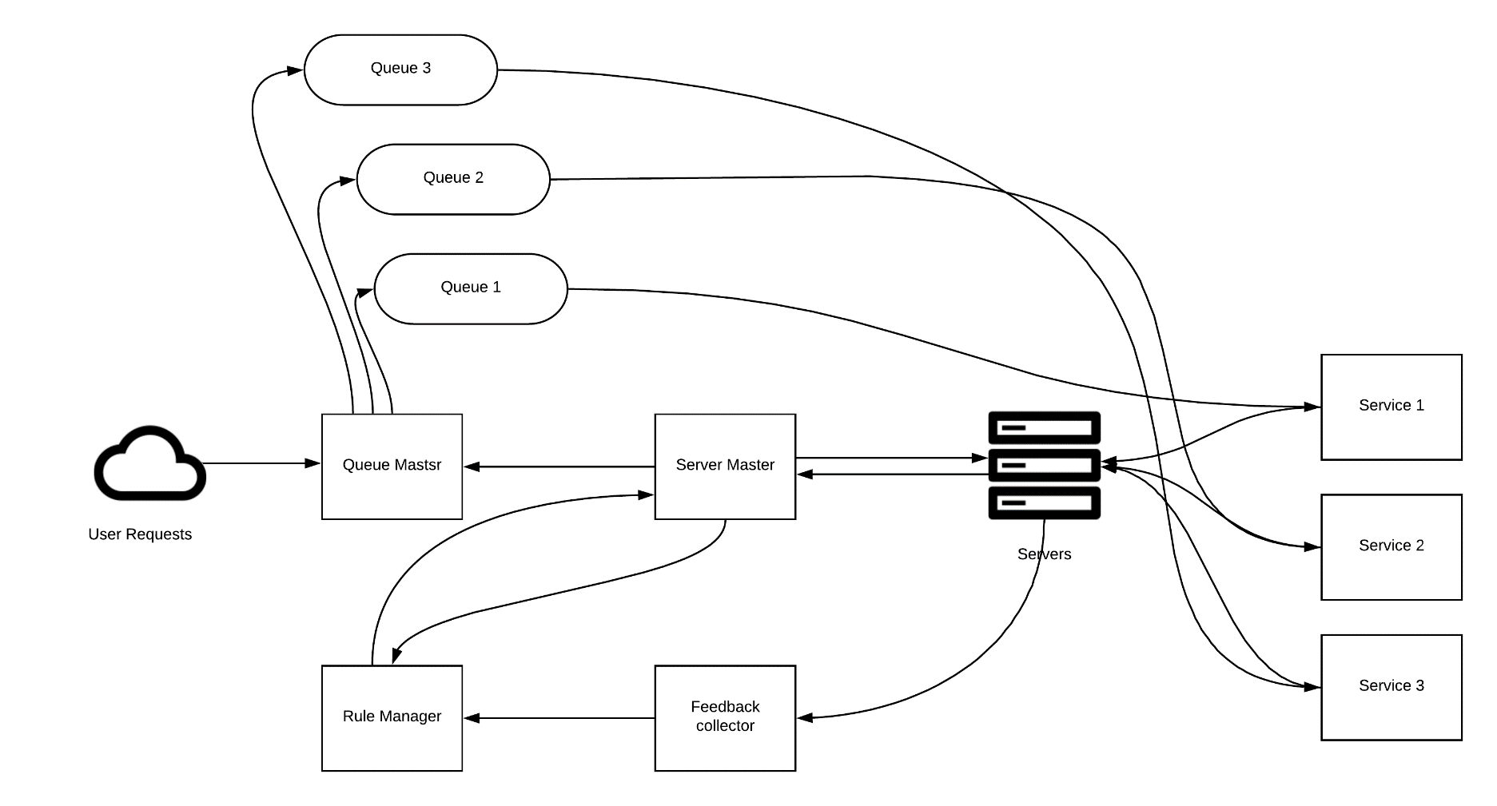
Proposed Solution: Design

Slide 9
Proposed Solution: Server Master
Server master: inspect all the host machines health information, such as server failures and budget information.
Host machine: physical machines, contain many worker containers (Docker instances)
Worker containers: separate into different groups based on their jobs (services)

Slide 10
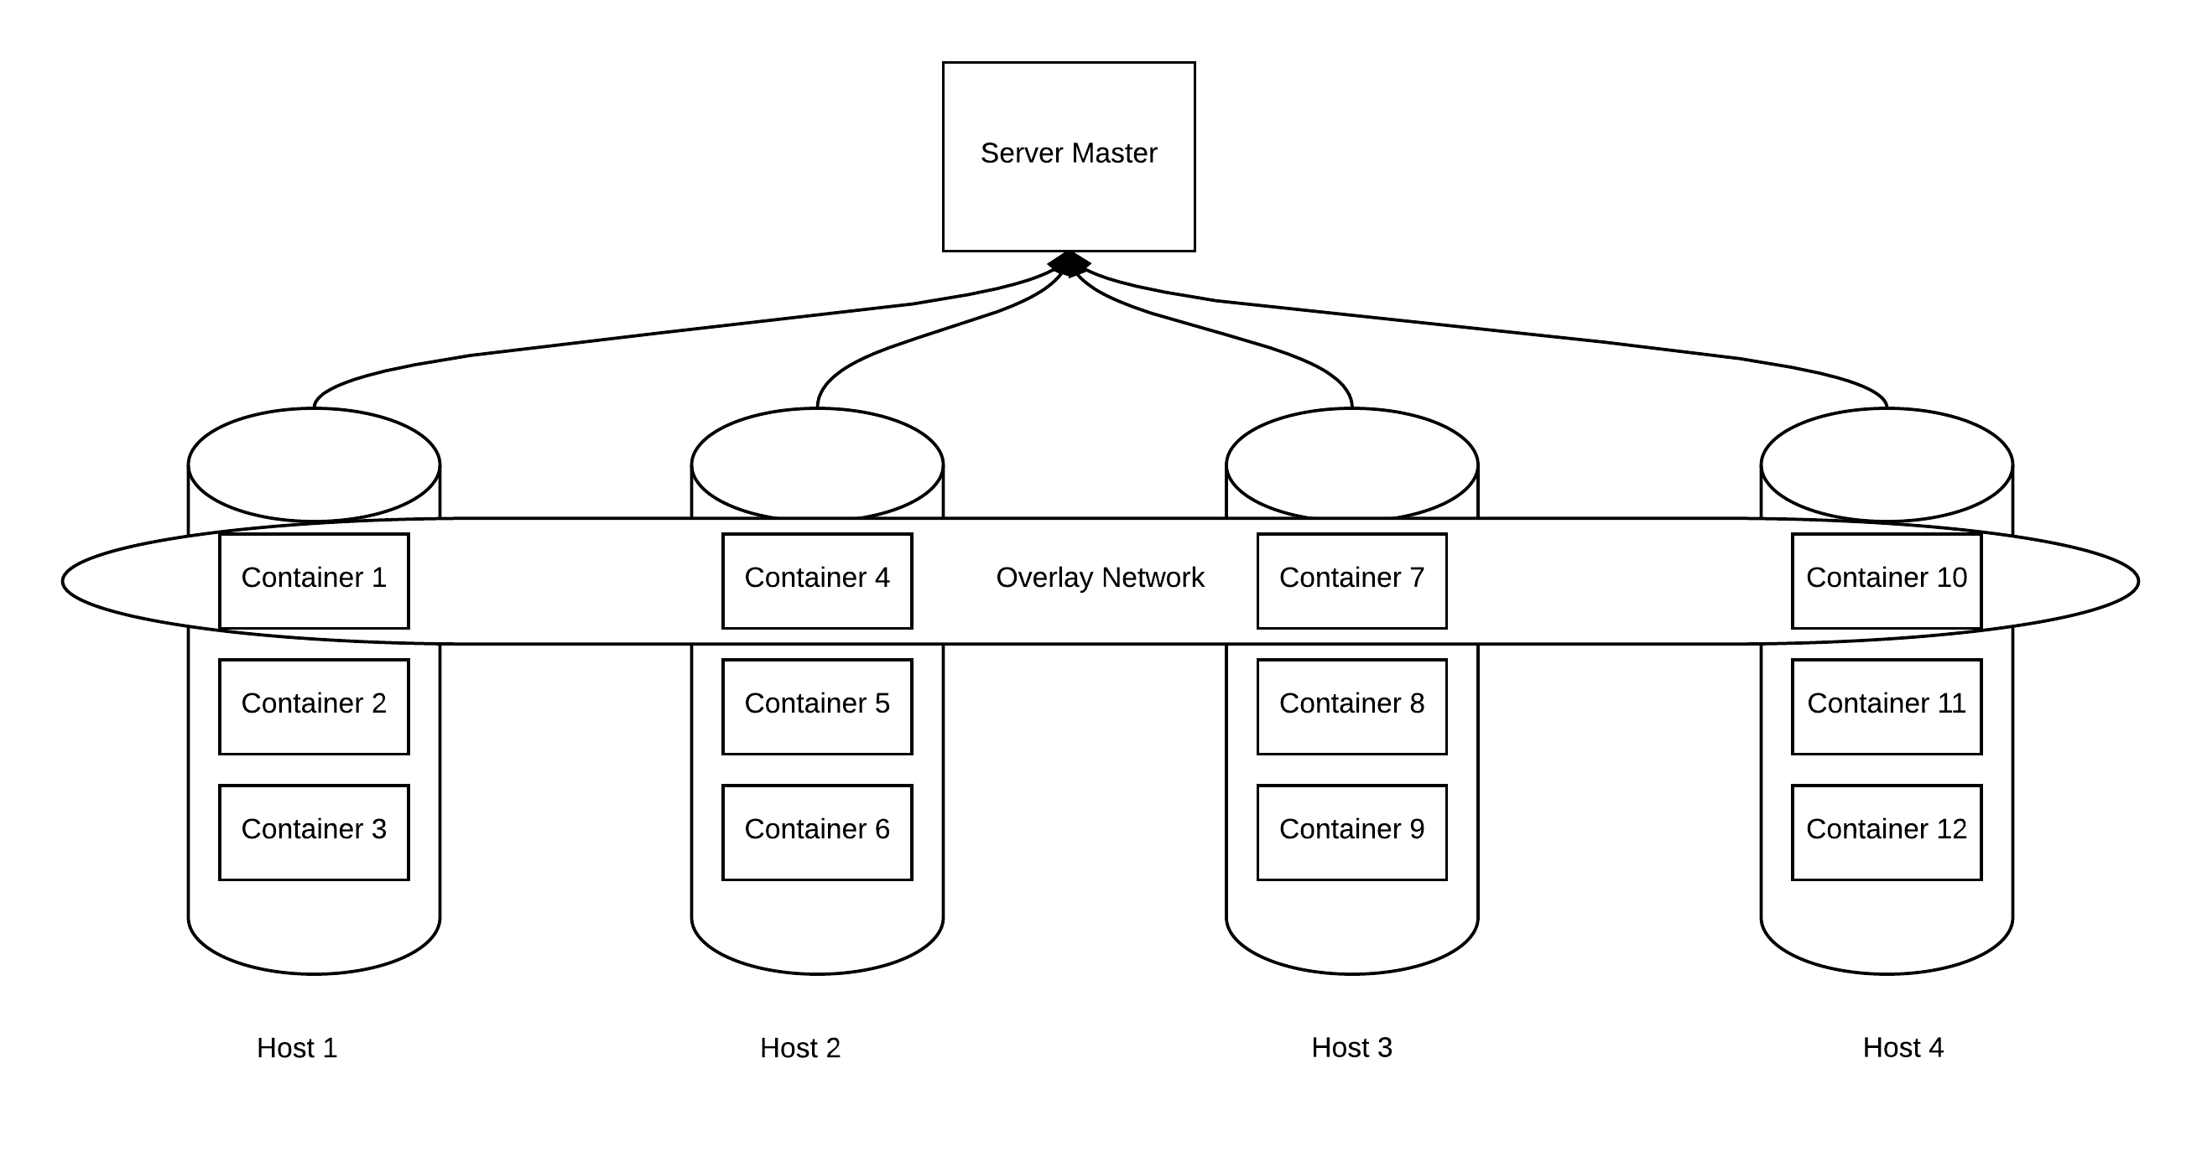
Proposed Solution: Design

Slide 11
Proposed Solution: Design
Task manager: create worker containers on different host machines and delete the worker container after the job is finished.
Feedback collector: turn user feedback into score. If the score is lower than the feedback threshold, rent more nodes.
Rule manager: store control strategy and feedback threshold
Notes:
Figure credit: http://adamczyklawfirm.com/when-will-the-residents-get-control-of-master-amenities-budget/

Slide 12
Proposed Solution: Control Strategy
Key idea:
  place usage requests (e.g. model run request) in queues and execute requests with owned servers and rented nodes
  The maximum number rented nodes are decided by budget period (how long the budget will last), rented server price, rented server performance, and budget
Notes:
Tint: the shortest time interval to rent a new server node
Tb: budget period
Trent: job execution time in the a rented server
P: price to rent a new server node

Slide 13
Proposed Solution: Control Strategy
By using modified M/M/1/1/∞/∞ queuing model, the average waiting time of each job (TH) and queue length (LH) can be expressed as:
maximum of number of jobs that can be processed with owned servers per time unit
total number of jobs that can be processed with rented servers per time unit
Average job arrival rate
Notes:
Experiment results can be found from our previous paper: https://www.cse.unr.edu/~fredh/papers/conf/176-smeshsubiauf/paper.pdf

Slide 14
One Example Application
Challenges: originally model tool hard for users to use
  A model execution time can be very long
  Learning curve consumes a lot of time
    Change input by manually change numbers in text files
    Execute models in terminal, no GUIs
Solutions:
  Use proposed framework to execute models in parallel
  User friendly GUIs

Slide 15
One Example Application
Easy to modify input parameters

Slide 16
One Example Application
Drag to select and input values

Slide 17
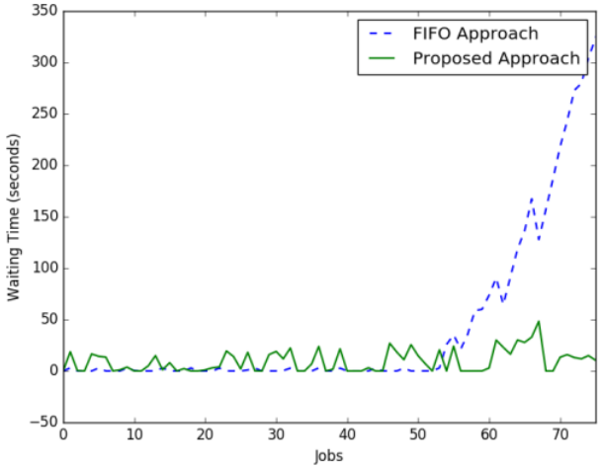
One Example Application
Stable service by using proposed framework

Slide 18
Conclusion and Future Work
What we have done:
  Proposed a framework to change server size based on the budget and user feedback.
  An model execution application has been implemented and introduced to prove the concept.
What we will do:
  Improve the control strategy by adding “rented server starting time”
    This can be 30 seconds to 5 minutes for Amazon Web Service

Slide 19
Thank you
Questions?

