Slide 1



A model-driven development platform for developing
cloud-based information systems
Jalal Kiswani, Sergiu M. Dascalu
Muhanna Muhanna, Frederick C Harris, Jr.

Slide 2

Acknowledgement
This material is based upon work supported by the National Science Foundation under grant numbers IIA-1329469 and IIA-1301726.
Any opinions, findings, and conclusions or recommendations expressed in this material are those of the authors and do not necessarily reflect the views of the National Science Foundation.

Slide 3
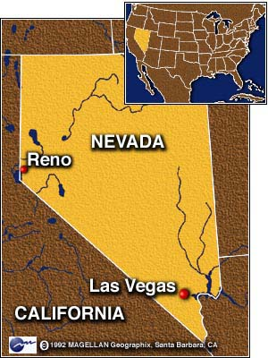



Reno, Nevada, USA

Slide 4



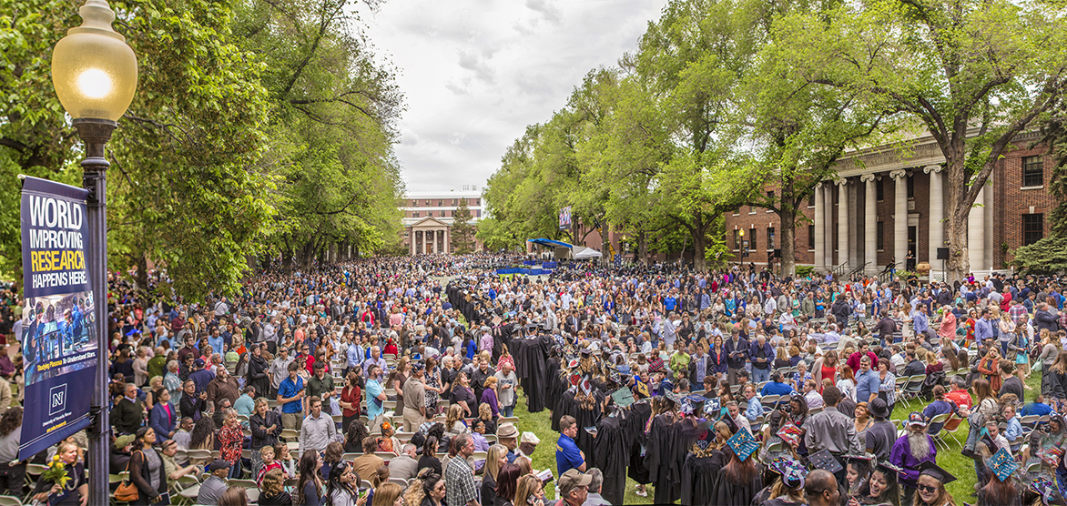
University of Nevada, Reno

Slide 5

Agenda
Problem
Requirements
Design
Prototype

Slide 6


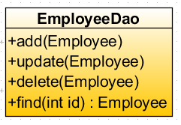

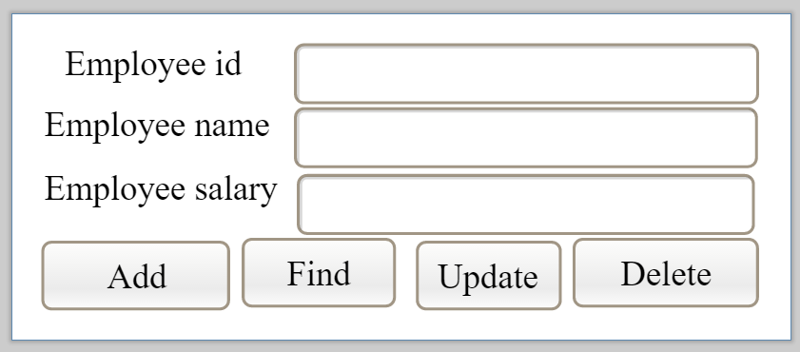
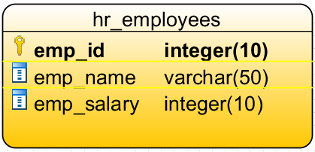
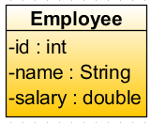
Problem : Traditional web based software development
Web Server
Database
Web based application
Presentation
Business
Data Access
EmployeeMVC
Commons(e.g. API’s and Entities)

Slide 7
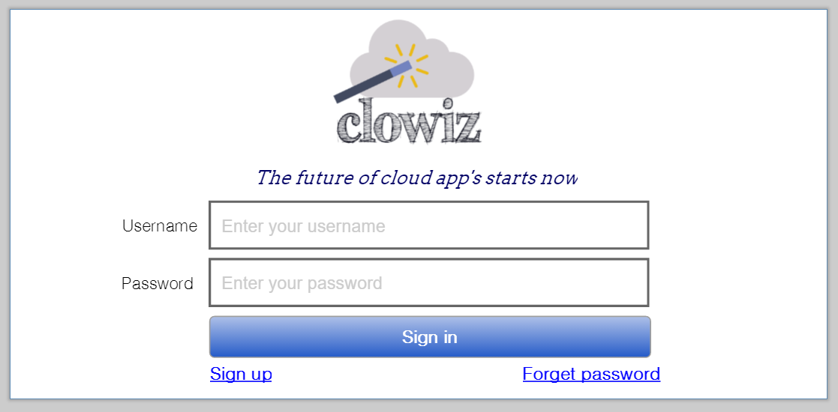
Clowiz Prototype 1/3

Slide 8
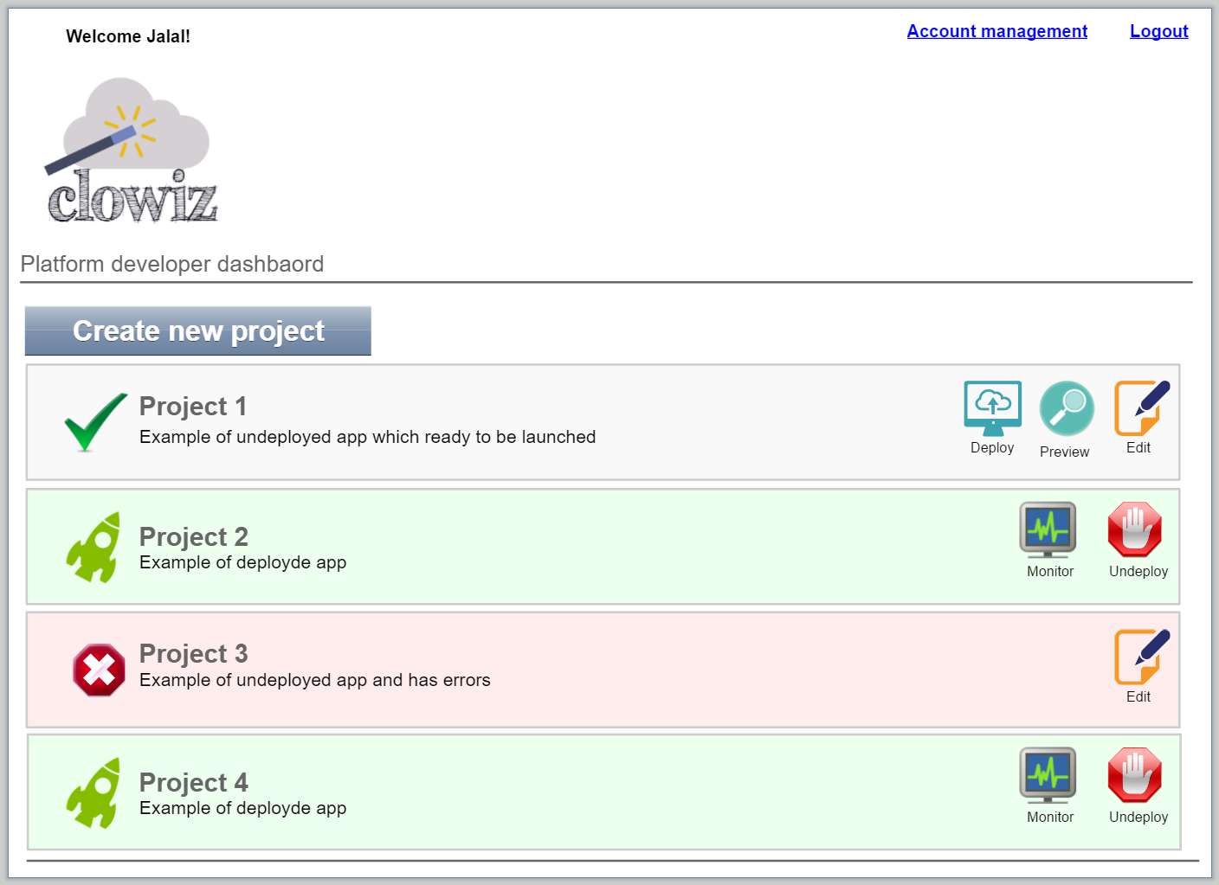
Clowiz Prototype 2/3

Slide 9
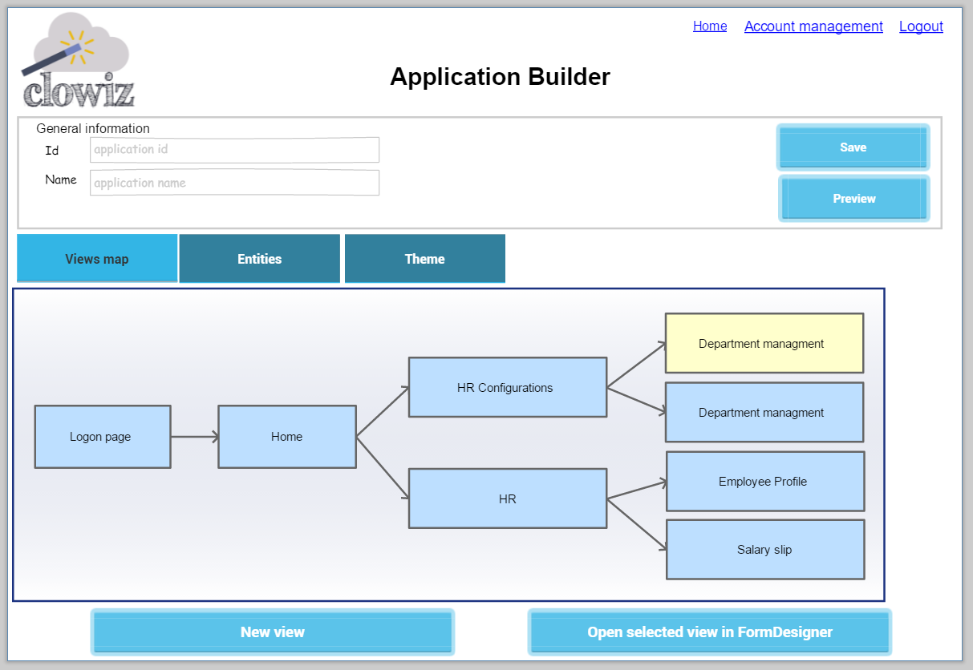
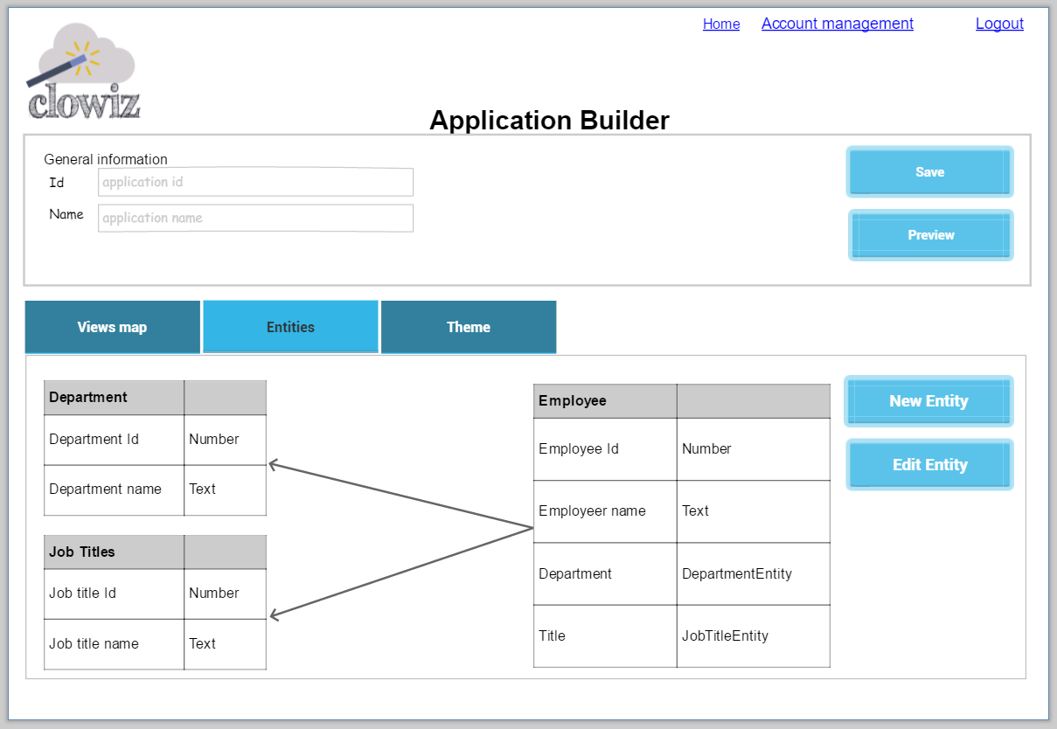
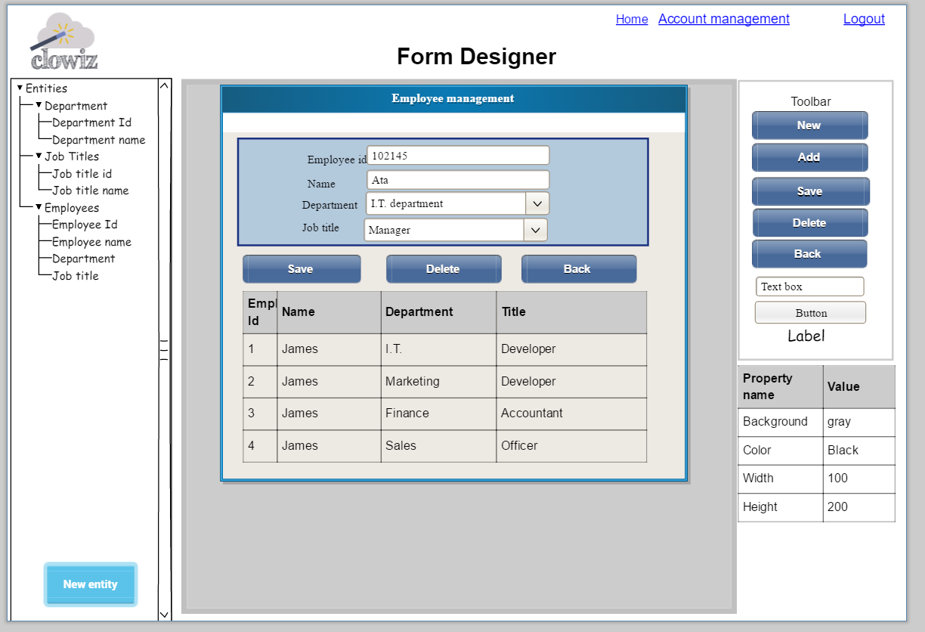
Clowiz Prototype 3/3

Slide 10
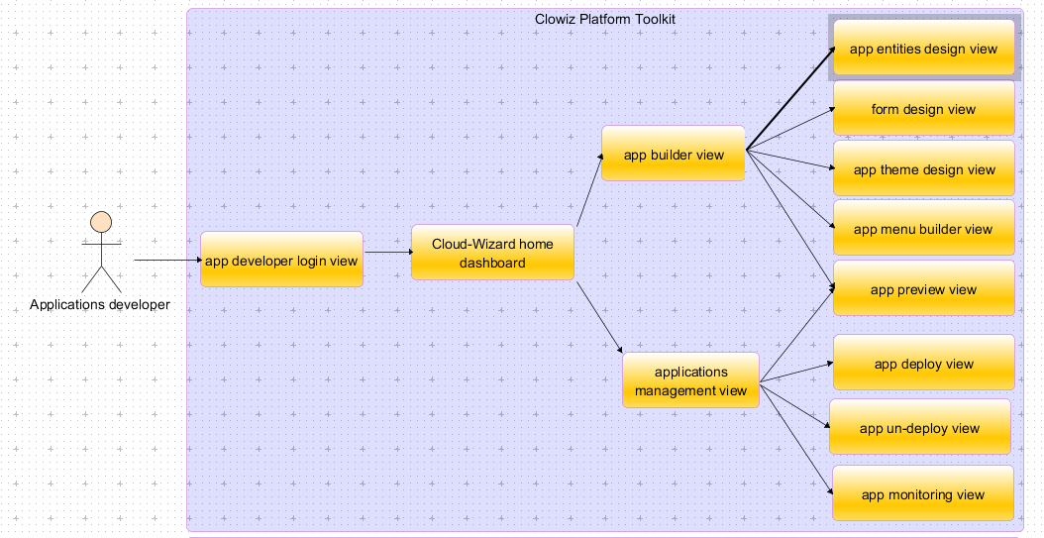
Clowiz (The Cloud-Wizard): 1/3

Slide 11
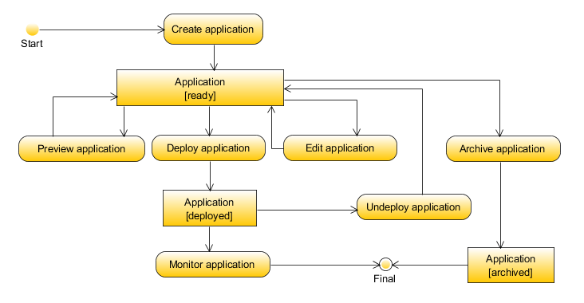
Clowiz Design (The Cloud-Wizard) 2:3

Slide 12
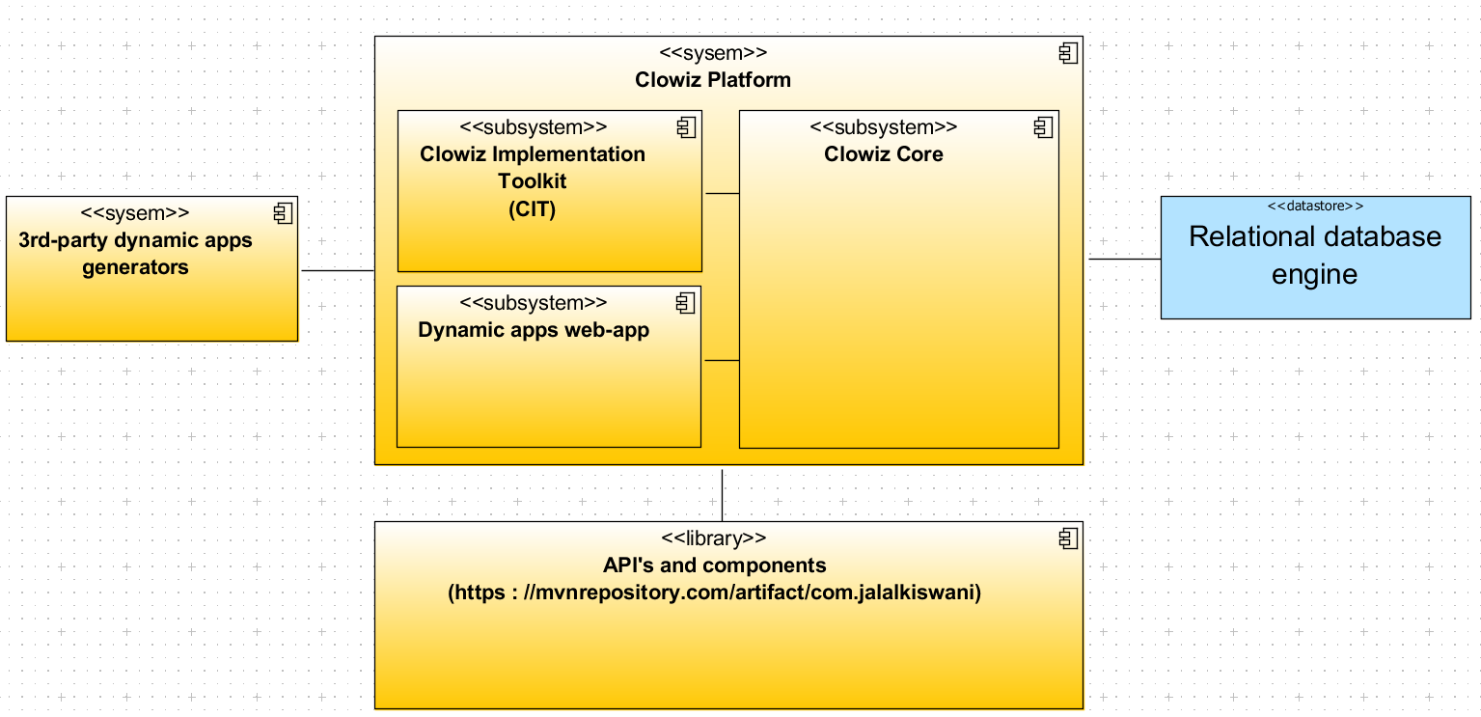
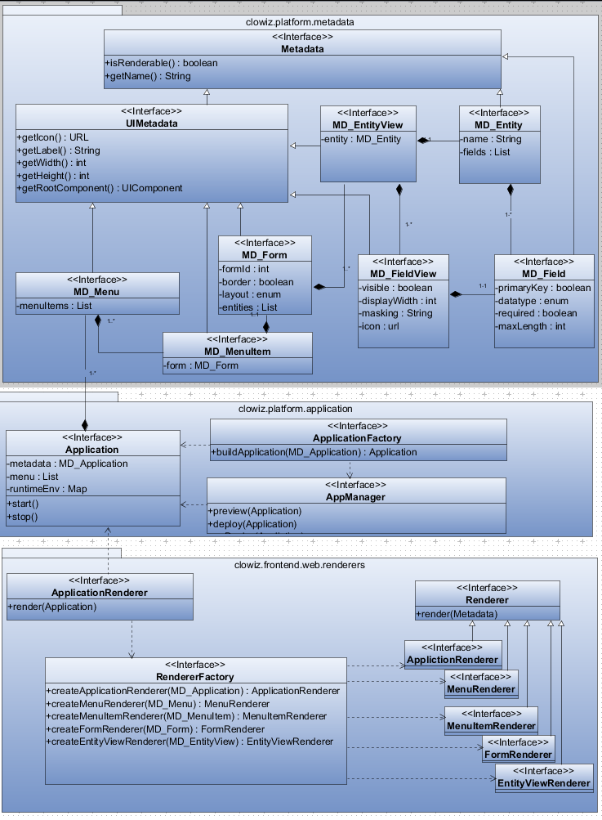
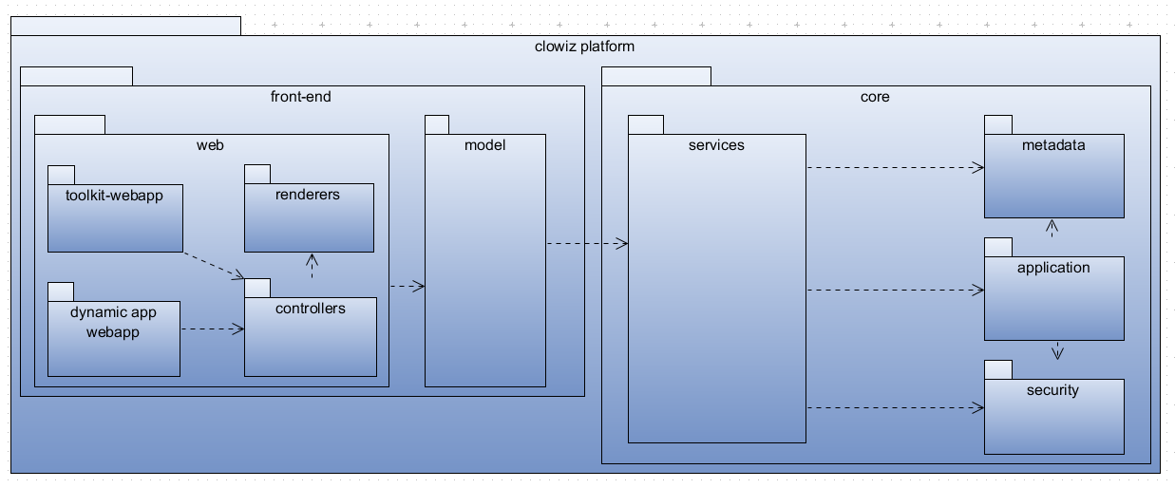
Clowiz Design (The Cloud-Wizard) 3:3

Slide 13

Lets enable the illusion of simplicity
Takeaway

Slide 14
Thank You

