Slide 1

RealPi - A Real Time Operating System on the Raspberry Pi
Samuel Delaney, Dwight Egbert, and Frederick C. Harris, Jr.
Department of Computer Science and Engineering
University of Nevada, Reno

Slide 2




Reno, Nevada

Slide 3
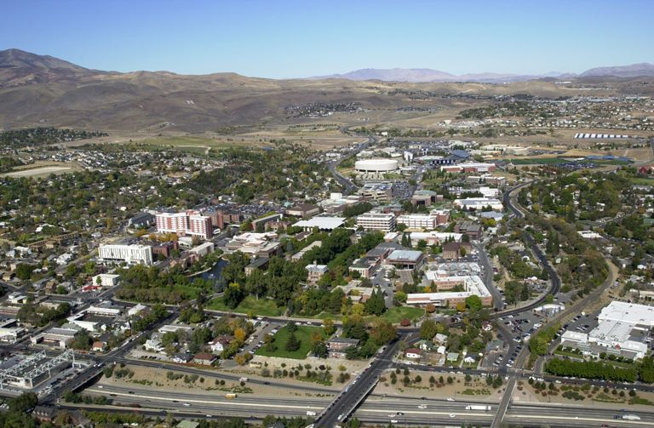
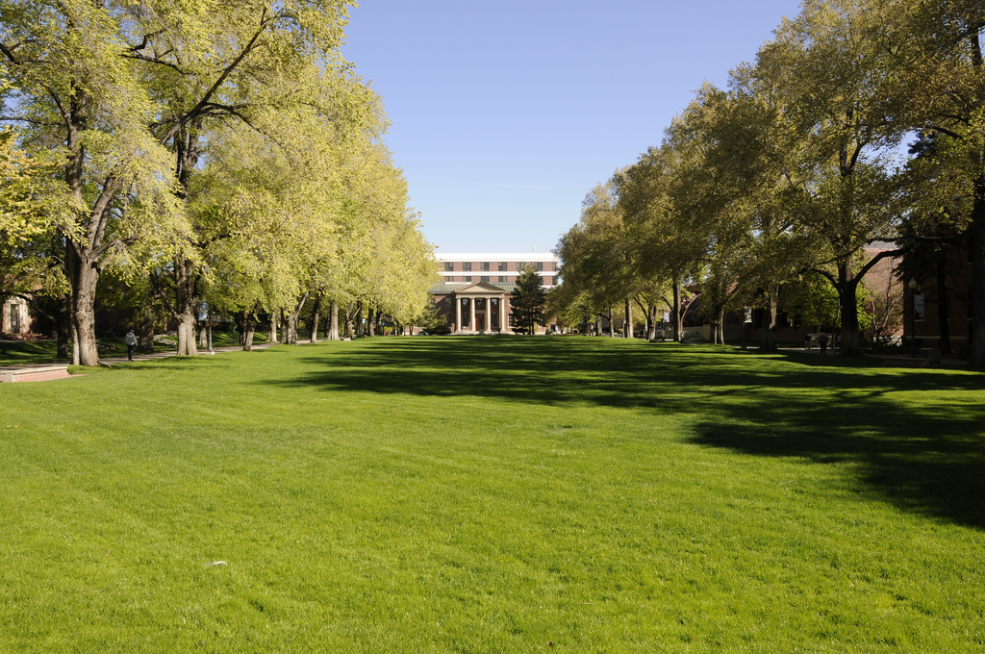
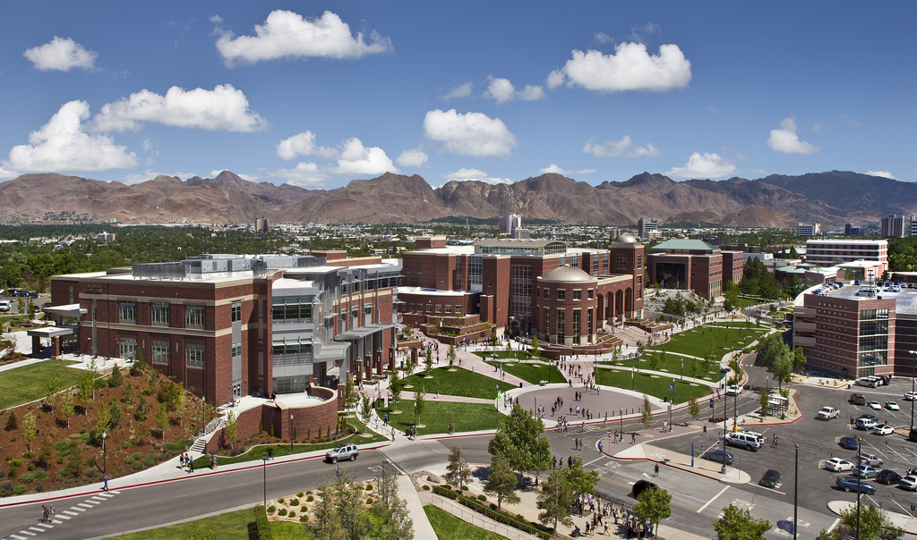

University of Nevada, Reno

Slide 4
Acknowledgement
This material is based in part upon work supported by the National Science Foundation under grant number IIA- 1301726.
  Any opinions, findings, and conclusions or recommendations expressed in this material are those of the authors and do not necessarily reflect the views of the National Science Foundation.

Slide 5
AGENDA
Situation
Purpose
Real Time Systems
Hardware
  Life of Pi
Implementation
  Rage
Conclusion
QA

Slide 6
Situation - 2015
Real Time Operating Systems(RTOS) course is a highly valuable course to Computer Science students
  The uCOS-II RTOS is a beginner friendly, highly flexible and cost effective option for students
  Unfortunately
    examples used by Jean Labrosse for the RTOS course require outdated boards and software architecture
    The 8051 board while king of its day has seen less practical use as time moves on

Slide 7
Situation - 2015
Builder boards saturate the market
  Option for academics/hobbyists/industry to add computing power to Lines of Efforts (LOE) normally too cost prohibitive for practical use.
  Multiple repositories of information available (Official and Unofficial)
  Great resource for education – utilized world wide to teach programming

Slide 8

Purpose
Can we update the uCOS-II projects to utilize todays architecture?
  Retain entry level accessibility
  Retain functionality
  Emphasize real time systems (No faking it till you make it)
  Add relatability
  Add reusability
  Minimalize cost

Slide 9
Real Time
How do we tell if a system is real time?
  One simple rule: All tasks must be complete and correct before it’s deadline is hit.
  But… maybe not so simple in application
    Is your laptop currently running in real time?
    How about your phone?
    The answer is unfortunately no. But don’t worry, it wasn’t built to be

Slide 10
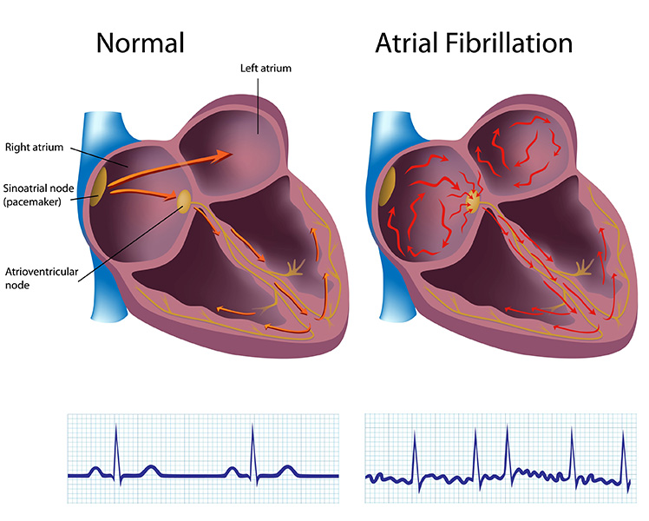
A perfect example
Let’s look a pacemaker
  Has one task for our purpose
    When the left ventricle compresses send a pulse to the right ventricle
  Has a deadline
    Pulse must be sent within a millisecond of receiving input
  Why is it real time?
    Because it will always send the pulse in the allotted time, guaranteed

Slide 11
Let’s clarify the difference
Real Time
High Performance
May or may not run jobs fast
May or may not be able perform significant amounts of work (process count)
Can guarantee to complete jobs correctly on time every time
Runs jobs as fast as possible
Can perform vast amounts of work
Cannot guarantee to complete jobs correctly or on time every time
  Waiting on resources
  Too many processes running at once
  Tasks priority issues

Slide 12
Bringing it back into the OS
So we need our OS to guarantee job completion in a set time.
  Sounds like a job for the scheduler!!
Real Time Operating Systems
  Prioritize scheduler as part of the OS
  Designs of scheduling algorithms vary
    Most prevalent
      Preemptive
      Earliest Deadline First

Slide 13
Standards… No Compromise
Guarantees are great, but must everything in life be absolute?
  Not everyone graduates with a 4.0
Also, from a cost standpoint, when is the monetary savings > performance?
Software engineers and the Finance Departments around the world agree that maybe would should have some gray area.

Slide 14
Hard and Soft
Hard Real Time
Soft Real Time
Deadlines are absolute
  The failure of a single task to complete in time constitutes a failure of the entire system
  Very hard to implement, therefore more rare to encounter
  Must be a deterministic system (every input has an output)
  Examples:
    Pacemaker
    Anti-lock brakes
Deadlines are flexible
  As long as tasks are completed reasonably quickly, it’s OK to miss a deadline
    But the longer we wait the less useful the output is
  Can handle more tasks in general than Hard Real Time
  Most common form of real time
  Examples
    Weather stations
    Video feeds

Slide 15
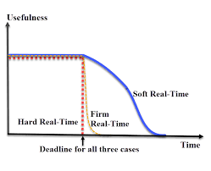
Firm?
A blend of Hard and Soft
  Allowed to miss deadlines, albeit very infrequently
  If a task fails to complete before it’s deadline, all value associated with its output is lost

Slide 16

But what are we using and why?
uCOS-II
  Disclaimer: Not the latest and greatest (see: uCOS-III)
  Free!
  LOTS of documentation
  Scalability
    Free your executable from bloat
  Preemptive scheduler
    Make the OS work for you
  Deterministic

Slide 17
Into The Unknown
Many discussions of using the Pi as a RTOS platform
  No wide spread or complete native solutions
    Starting points
Virtualization
    FreeRTOS
    Mostly complete port
    Good enough for government work

Slide 18
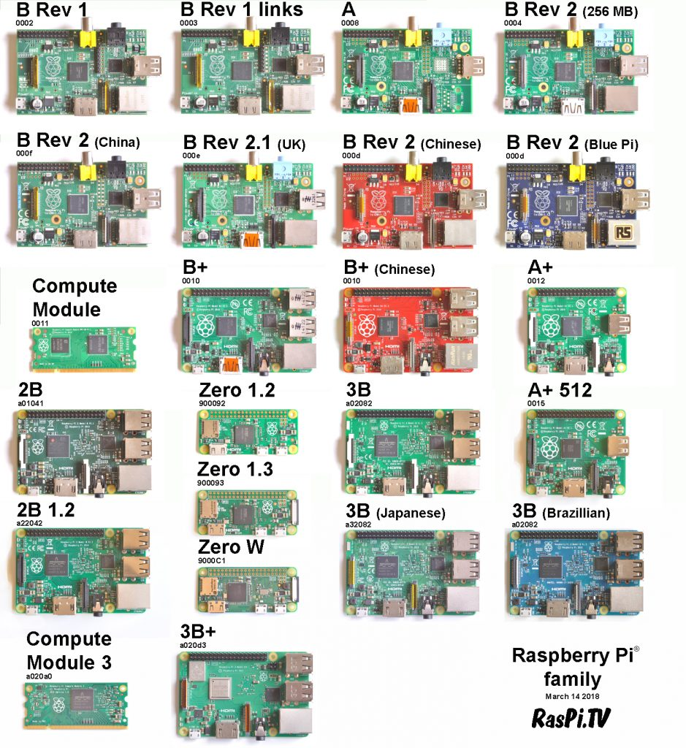
Hardware:
Target Acquired
Raspberry Pi
  Many forms: Zero, Zero W, 1, 1 A+, 1 B+, 2, 2 B, 2 B+, 3, 3 B+
    All ARM based (More on this later)
  Arose from the need for a low cost, all in one, entry computer to teach people how to code
  No ROM (Unbrickable)

Slide 19
ARM Processor
Licensed by ARM Holdings
  Stands for Advanced RISC Machine
Pi’s utilize the ARM organization
  BCM2835 – ARM 11 (Pi Zero and Ones)
  BCM2836 – ARM Cortex A7 (Pi 2)
  BCM2837/B0 – ARM Cortex A53 (some Pi2s, Pi 3) *64bit

Slide 20
Organization and Instruction Sets
Computer Organization
  How the CPU handles instruction sets
    Or how we allow all the parts of the CPU to talk to each other
  Organizations are usually established by it’s manufacturer
    Hence why all ARM chips will be called ARM“marketingNameHere_version”
Instruction Sets
  Two types of sets
    RISC – Reduced Instruction Set
    CISC – Complex Instruction Set
      Also known as “Not-RISC”

Slide 21
CISC vs RISC
CISC
RISC
Complex – One instruction may perform more than one task
  Example: Add two numbers
    ADD: addr1 addr2
      This instruction tells the CPU to add the value in addr2 to addr1.
      No need to load the registers ourselves.
  Smaller program footprints
  Hardware handles the load
Reduced – Each instruction performs a finite and specific task
  Example: Add two numbers
    LOAD A, addr1
    LOAD B, addr2
    ADD A, B
    STORE addr1, A
      Four times as many instructions!
      Memory management!
    Emphasis on software

Slide 22
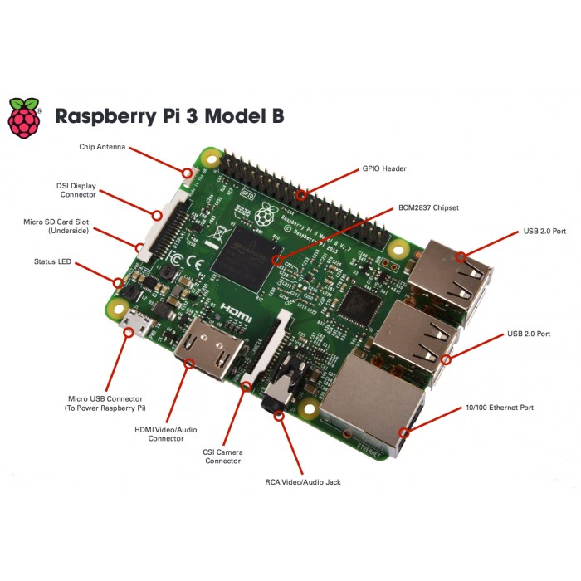
Back to the Pi
The Base Board
  All the things!
    WiFi
    HDMI
    USB
    GPIO
    Ethernet
  On second though let’s just treat everything as a generic device
    Pass-through objects
    Bare Metal approach (We don’t need no stinking drivers)

Slide 23
Implementation: We need tools!
Toolchain
  Group of tools chained together like a chain to create an executable
  Term has lost relevance in the rise of Integrated Developer Environments (IDEs)
    Visual Studio
    Allows users to edit, compile, link and package
    On the fly debugging through built in hooks

Slide 24
Toolchains
IDE – pay for play
  Not preinstalled on machines
    Need to purchase separately
  Cost prohibitive for the better IDEs
    Visual Studio (Every version but student, and even then…)
  Can add bloat to executables
    Really need to look in your compiler options

Slide 25
Toolchains
Buck the trend
  Freeware
    Cost does not equal quality
Scour the INTERNET
  Just google compiler and see what happens
  We do need to make sure all our tools work together too!

Slide 26
Yagarto
Saves us time
  ARM Toolchain developed in 2006
  Contains the GNU embedded Tools
    GCC compiler
  One of the first inexpensive, user friendly ARM toolchains available
    Despite new IDEs and Toolchains, Yagartos simplicity keep it relevant
  Resembles an IDE in theory but…

Slide 27
Makefiles and Text Editors
Makefiles tell Yagarto how to make our product
  Tools and wood don’t make a table without instructions!
Text editors allow us to make changes
  Dealer’s choice
    Just know what you’re dealing with
      \n

Slide 28
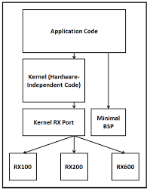
Let’s make a kernel
Needed Components
  ARM shell
    Yagarto
  OS
    uCOS-II
  Board Support Package
    ??
  CPU Port
    ??

Slide 29
Early Goals
Hello Word or its equivalent
  Bare metal programming by Dave Welch
    Creating an “OS” that is essentially a simple while loop
    Write to devices directly (Pass through)
      BSP?
  Key Memory address and modes
    Start.s

Slide 30
Next Steps
Basic Port by Weng Kai
  90% solution for creating a CPU Port of uCOS-II to the original Raspberry Pi
    Great build structure!
  Runs basic functions of the uCOS-II OS to alternate between two tasks forever
  Served as a great “check” for when I broke my code adding more functionality

Slide 31
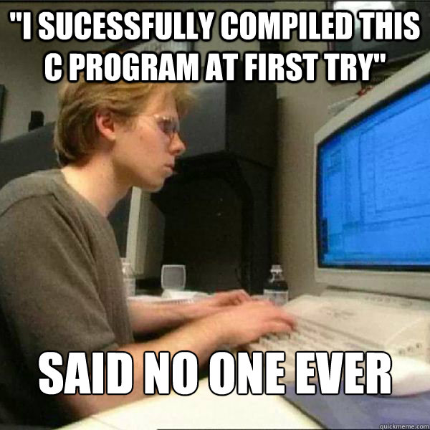
The board works!
BSP + CPU Port + Yagarto
  Working kernel file!
  Base uCOS-II functionality
  uART and Timer devices

Slide 32
Porting Jean Lebrasse’s examples
As provided
For the Pi
Takes over for DOS
Uses Borland specific functions to write to the “Video Buffer”
  Display to video output (DOS window)
Boots directly from SD card
  Start.s
No need to date myself by mentioning I used Borland and all calls can be ported to C++
Outputs to PuTTY terminal through serial device

Slide 33
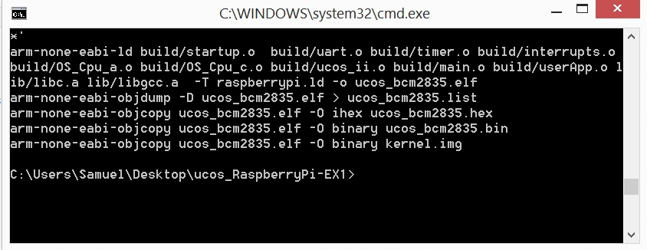
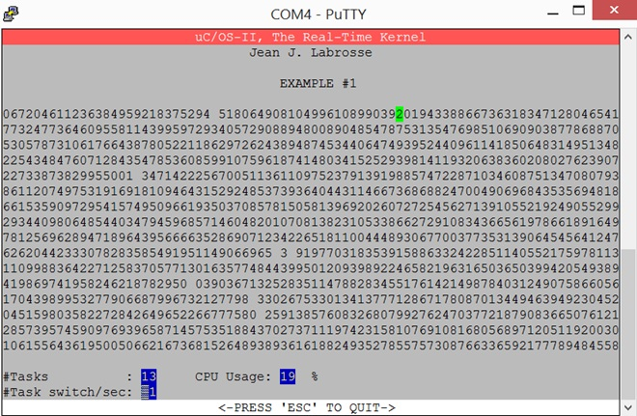
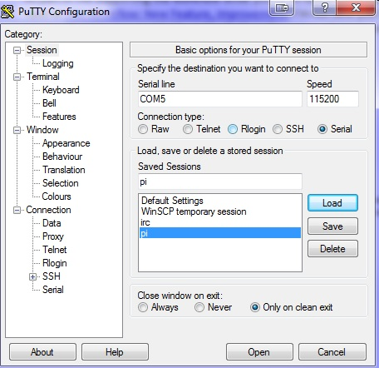
Porting Jean Lebrasse’s examples

Slide 34
Future Work
Utilize 64 bit
Graphics DLL
Real World Application

Slide 35
RealPi - A Real Time Operating System on the Raspberry Pi
Samuel Delaney, Dwight Egbert, and Frederick C. Harris, Jr.
Department of Computer Science and Engineering
University of Nevada, Reno

Slide 36
References
Remzi Arpaci-Dusseau and Andrea Arpaci-Dusseau. Operating Systems: Three Easy Pieces. Arpaci-Dusseau Books, 2014.
Joe Bartel. Non-preemptive multitasking. The Computer Journal, (30):37{39, 2011.
M. Ben-Ari. Principles of Concurrent and Distributed Programming. Prentice Hall, rst edition, 1990.
Margarita Esponda and Rojas Ra'ul. The risc concept - a survey of implementations. Institut fuer Informatik, Technical Report B-91-12, 1991.
Raspberry Pi Foundation. Raspberry pi, Last accessed Mar 2017. https://www.raspberrypi.org/.
FreeRTOS. Freertos, Last accessed Mar 2017. https://www.freertos.org/.
Weng Kai. Github, 2013. https://github.com/fmlab/ucos_RaspberryPi.
Linfo. Context switch denition, September 2013. http://www.linfo.org/context_switch.html.
Micrium. Micrium embedded software, Last accessed Mar 2017. https://www.micrium.com/rtos/kernels/.
riscos.info. Preemptive multitasking, November 2009. http://www.riscos.info/index.php/Preemptive_multitasking.
K.G Shin. Real-time computing: a new discipline of computer science and engineering. Proceedings of the IEEE, 82(1):6{24, 1994.
William Stalling. Operating Systems Internals and Design Principles. PrenticeHall, forth edition, 2004.
Jon Stokes. Risc vs cisc: the post-risc era. Arstechnica, 2004.
David Welch. Github, 2016. https://github.com/dwelch67/raspberrypi.
RichardWexelblat. History of Programming Languages. ACM Monograph Series. Academic Press, First edition, 1981.
W. Wulf, E. Cohen, W. Corwin, A. Jones, R. Levin, C. Pierson, and J. Pollack. Hydra: the kernel of a multiprocessor operating system. Communications of the ACM, 17(6):337{345, 1974.
Yagarto. Yagarto, Last accessed Mar 2017. http://www.yagarto.org/.

Slide 37
Questions?
Thank You

