Slide 1
Robust Fuzzy Cluster Ensemble on
Cancer Gene Expression Data
Yan Yan, Tin Nguyen, Bobby Bryant,
and Frederick C. Harris, Jr.
Department of Computer Science and Engineering
University of Nevada, Reno
Notes:
Good afternoon?.
Thank you for coming to my talk today.
The topic of our paper is Robust Fuzzy Cluster Ensemble on Cancer Gene Expression Data.

Slide 2
Acknowledgement
This material is based in part upon work supported by the National Science Foundation under grant number IIA- 1301726.
  Any opinions, findings, and conclusions or recommendations expressed in this material are those of the authors and do not necessarily reflect the views of the National Science Foundation.

Slide 3



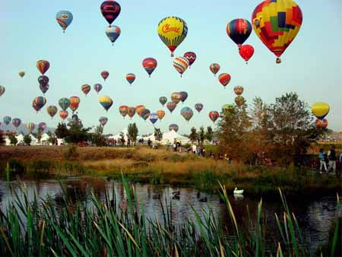
Reno, Nevada

Slide 4
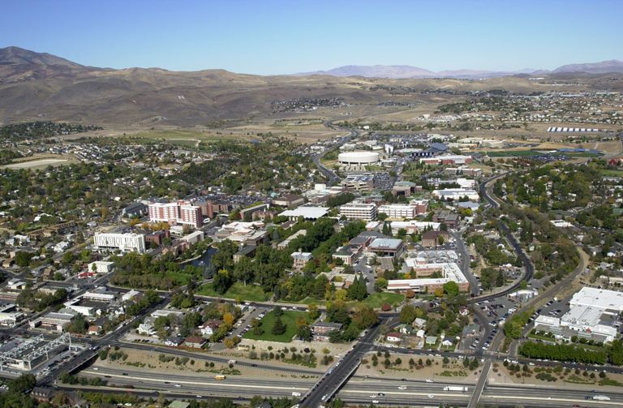



University of Nevada, Reno

Slide 5
Outline
Introduction
Related Work
Methodology
Experimental Results
Conclusion
Notes:
This is the outline of our paper.
There are 5 sections.
Section 1 is Introduction
Section 2 is Background and Literature.
Section 3 is Methodology.
Section 4 is Experimental Results.
Section 5 is Conclusion.

Slide 6
Intro: Goal and Challenges
Clustering on cancer gene expression data is important
  It is used in cancer subtype diagnosis and accurate cancer subtype diagnosis is crucial to treatment success.
Clustering on cancer gene expression data remains challenging
  Challenges: noise, curse of dimensionality, accuracy and reliability, complexities in cancers and cancer subtypes, others (efficiency, time complexity, number of clusters, ill-posed problem, etc.)
Notes:
This is the motivation, or why we choose to apply clustering on cancer gene expression data.
-
The 1st motivation is its importance. It is used in cancer type and subtype diagnosis, which is crucial to treatment success and patient survival.
-
The 2nd motivation is that it remains challenging.
For example,
the data noise problem:
and the high-dimensionality data problem:
and the well-known complexities in cancer types and subtypes

Slide 7
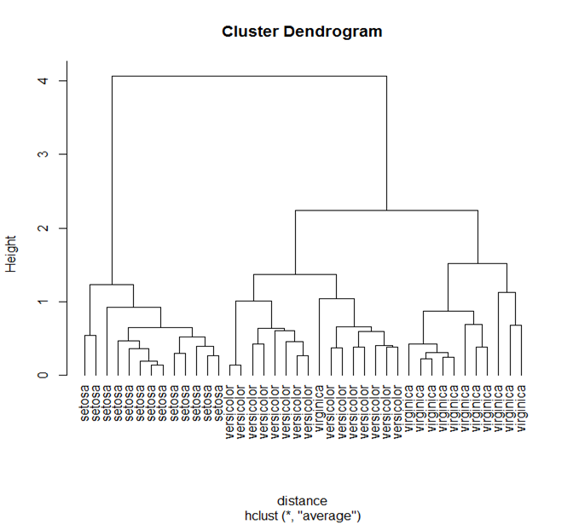
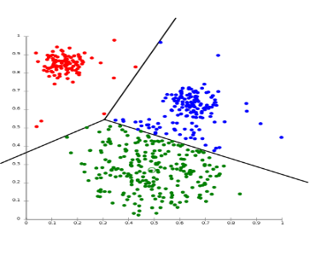
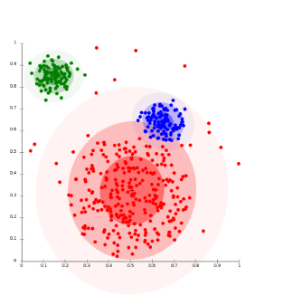
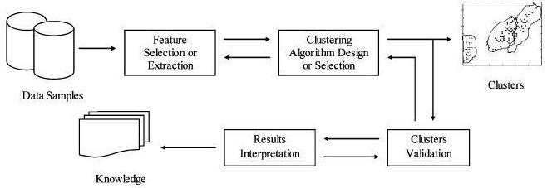
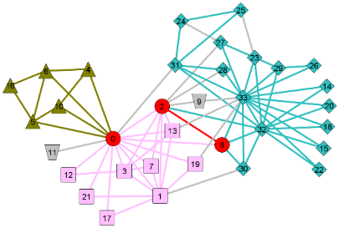
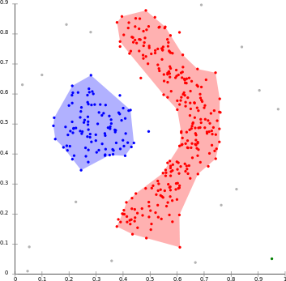
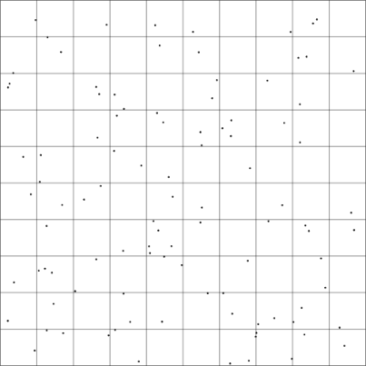
Intro: Clustering
Partitioning Clustering [Chire 2011c]
Hierarchical Clustering [Ho 2012]
Distribution-based Clustering [Evans 2014]
Clustering Design and Evaluation [https://grid.cs.gsu.edu]
Graph-based Clustering [Chire 2011b]
Density-based Clustering [Chire 2011a]
Grid-based Clustering [Yolkowski 2014]
Notes:
These are examples of several types of clustering:
The 1st one is hierarchical clustering
2nd is partitioning clustering
3rd is distribution-based clustering
4th is graph-based clustering
5th is density-based clustering
The last one is grid-based clustering
This is a diagram of clustering design and evaluation steps:
First, we have data samples
From data samples, we perform step one: feature selection or extraction
step two: clustering algorithm design or selection
step three: cluster validation
step four: results interpretation,
Which then becomes knowledge.

Slide 8
Intro: Clustering Methods
– cluster ensemble
Definition
  Cluster ensemble methods use multiple cluster methods to obtain better performance.
Generation methods
  Same algorithms different initializations; different algorithms; subset of features; data sampling etc.
Consensus methods
  Relabeling and voting; Mutual Information (MI); Co-association based functions; Finite mixture models; graph/hypergraph partitioning approach etc.
Notes:
Now Let’s see cluster ensemble
--
A cluster ensemble use multiple clustering methods to obtain better performance. Other names includes consensus clustering, aggregation of clusterings (or partitions), ensemble clustering.
--
There are different cluster ensemble methods.
For generation methods: we can use Same algorithms different initializations; different algorithms; subset of features; data sampling etc.
For consensus methods: we can use
Relabeling and voting
Mutual Information (MI)
Co-association based functions
Finite mixture models
And, graph/hypergraph partitioning approach.

Slide 9
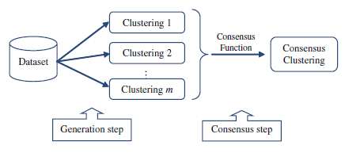

Intro: Clustering Methods
– cluster ensemble (Cont’d)
Cluster ensemble [https://www.computer.org]
Jury trial [https://en.wikipedia.org/wiki/Jury_trial]
Notes:
This is a diagram to show cluster ensemble
--
First we have a dataset
And then, we run different clustering methods also called base clustering methods on this dataset to obtain multiple clustering results
And then, we use consensus function to decide a final clustering
--
We can see this is the generation step
And this is the consensus step
This is a picture to show the concept of ensemble in a jury trial.
The decision is not made by one person, but by the consensus or ensemble of a team of jury members

Slide 10
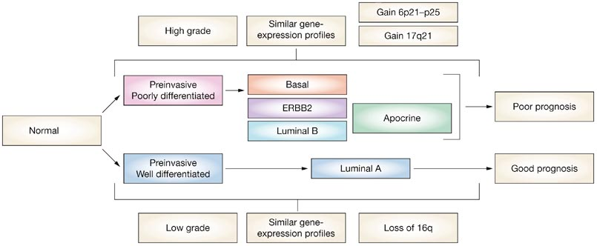
Intro: Applications – clustering cancer gene expression data for subtyping
Molecular-data-based cancer subtyping
  Based on certain characteristics of the cancer cells
Limitations with clinical-data-based cancer subtyping
  Similar cancer types respond differently to anticancer agents.
Breast cancer subtyping
[http://www.nature.com]
Notes:
Now I will explain what molecular-data-based cancer subtypes are:
They are based on certain characteristics of the cancer cells.
There are limitations with clinical-data-based diagnosis and treatment:
Patients with similar cancer types respond differently to anticancer agents, a huge obstacle for effective treatments.
This is a picture of breast cancer molecular subtype diagnosis and prognosis.
We can see several breast cancer subtypes: such Bassal, ERBB2, Luminal B, Apocrine, Luminal A

Slide 11
Related Work
Traditional clustering methods
  Hierarchical clustering, K-means, SOM, etc.
Novel clustering methods designed for gene expression data
  Non-negative Matrix Factorization (NMF) method , etc.
Cluster ensemble methods
  Ensemble generation methods
  Ensemble consensus methods
Notes:
(Note: maybe too long … but these are all good information from the paper …)
Clinical researchers usually use simple traditional clustering methods such as hierarchical, K-Means, and SOM for cancer gene expression data cluster analysis.
(Such traditional methods have much better availability in standard software packages and are easy to implement. )
Novel clustering methods have been proposed by bioinformaticians to improve the clustering results on gene expression data to address its intrinsic characteristics including noisy and high dimensional, such as Non-negative Matrix Factorization (NMF) method.
(Such new methods are not getting enough attention from clinical researchers as they may require particular programming environments or more user-speciﬁed parameters, which is diﬃcult for non-expert users. )
Cluster ensembles have emerged as simple and eﬀective methods for improving the robustness and accuracy of clustering results.
(Cluster ensembles combine multiple clustering decisions from base clusterings. )
There are two main steps in a clustering ensemble: generation step and consensus step.
In the generation step, cluster ensemble methods use a variety of approaches to obtain diversity in base clusterings. Four ensemble generation methods have been commonly used, such as
using a single clustering algorithm with diﬀerent initializations,
(
b) using multiple clustering algorithms,
c) using diﬀerent subsets of genes, and
d) using data sampling techniques.
)
In the consensus step, cluster ensemble methods use a variety of consensus functions to combine base clusterings. Four ensemble consensus methods have been commonly used, such as
using a pairwise similarity-based consensus function,
(
b) using a graph-based consensus function,
c) using a mutual information-based consensus function, and
d) using voting based consensus function.
)

Slide 12
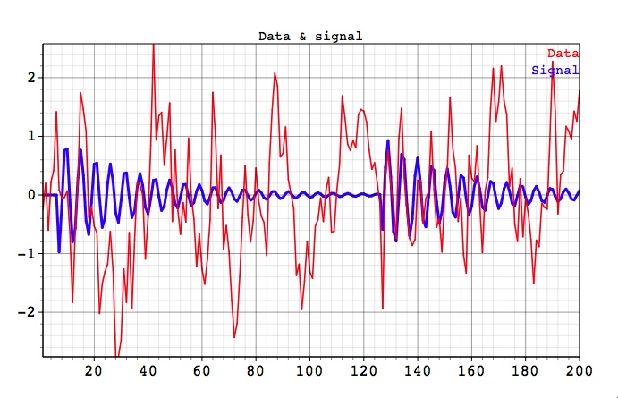
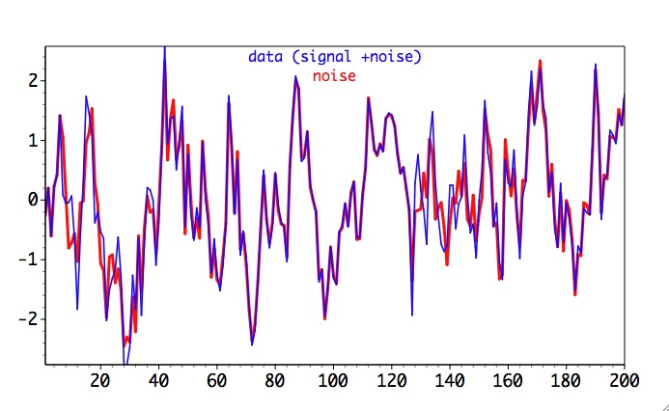
Methodology: Improvements
Noise robustness problem
  Real world data including gene expression data contain noise or imprecise information.
  Existing clustering methods that use hard or crisp methods are not immune to the noise causing misclassification.
[http://www.spectraworks.com]
Notes:
First, let’s see improvements
The main improvement is to address the data noise problem.
Real world data including gene expression data contain noise or imprecise information.
Existing clustering methods that use a distance (e.g. Euclidean distance) as similarity measure, are not immune to the noise and can cause misclassification.
Here are two graphs that show Data, Signal, and Noise. Data is signal with noise added to it.
From the graph on the left, we can see Signal in blue color and Data in red color.
From the graph on the right, we can see Data in blue color and Noise in red color.
They have high noise-to-signal ratio

Slide 13
Methodology: Improvements (Cont’d)
Fuzzy clustering
  Uses fuzzy set theory which takes imprecision into consideration.
  A cluster is viewed as a fuzzy set.
  Each feature vector has a membership value with each cluster.
  A membership function is a function that maps each feature vector to a fuzzy membership value between 0 and 1 representing degree of membership.
Notes:
Now, lets see fuzzy clustering
Fuzzy clustering uses fuzzy set theory which takes imprecision into consideration:
A cluster is viewed as a fuzzy set.
Each feature vector has a membership value with each cluster.
A membership function is a function that maps each feature vector to a fuzzy membership value between 0 and 1 representing degree of membership.

Slide 14
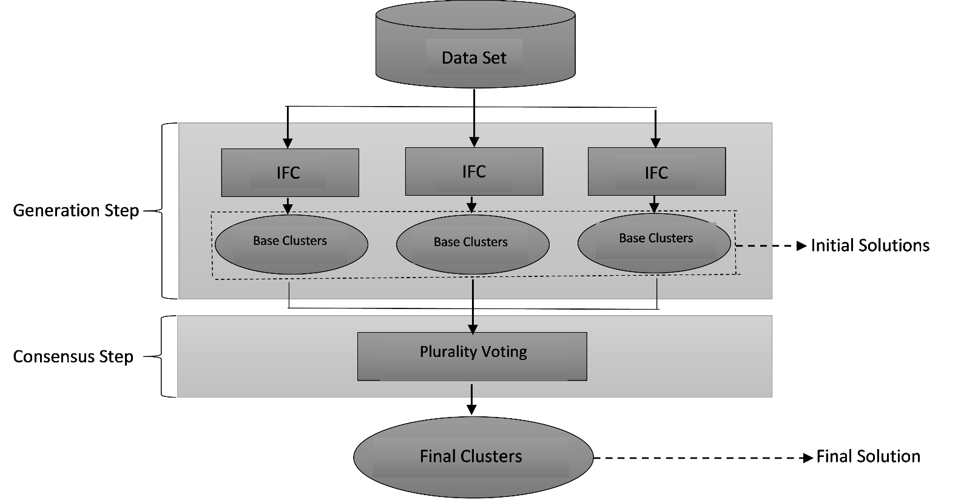
Methodology: IFCE
Adapted from [262]
Notes:
This is a diagram to show more details about our IFCE.
We can see that
at generation step: each base clustering algorithm IFC generates base clusters forming the initial solutions.
at consensus step: plurality voting is used to obtain final clusters forming the final solution.
note
----------
Teng2016

Slide 15
Methodology: IFCE (Cont’d) ensemble generation and consensus
Base clusterings
  IFCs with different initializations
Consensus function: plurality voting
  It allows each feature vector to vote for only one cluster, and the cluster who polls more votes (plurality) than any other cluster is the winner.
  Different than majority voting, with which the winner polls more than half of the votes.
Notes:
Again, our proposed IFCE uses multiple IFCs each with different initializations as its base clusterings.
--
After diverse clustering results have been produced by the multiple base clustering algorithms, they need to be integrated into a single result. Voting method is commonly used as the consensus function in integrating clustering results for ensemble.
IFCE uses plurality voting as its integration function to obtain the final clustering. With plurality voting, each data object is assigned to one cluster in each base clustering, and the cluster who has more votes (plurality) than any other cluster is the winner.
-
It is different than majority voting, with which the winner has more than half of the votes.

Slide 16
Results: Experiment Design
Validity measure (CA) comparison
  Four simple clustering algorithms
  Six cluster ensemble algorithms
Parameter analysis
  N: number of clustering runs
  IMT: initial merging threshold
  M: ensemble size, or number of base clusterings
Complexity analysis
  Time complexity
  Space complexity
Noise robustness analysis
  Adding 10%, 20%, 30%, 40%, 50% artificial noise to the real cancer gene expression data sets: Chowdary2006 and Chen2002.

Slide 17
Results: Experiment Design (Cont’d)
- real cancer gene expression data sets
Notes:
These are the data sets we use in our experiments
They are real cancer gene expression data sets
We can see the cancer types include liver cancer, breast cancer, blood cancer, brain cancer etc.
We can see the number of genes can be very large exceeding 1000
At the same time, the number of samples are mostly much smaller and below 100.

Slide 18
Results: Experiment Design (Cont’d)
- comparable algorithms
Notes:
These are more details of the four simple clustering algorithms.
The first one K-means is partitioning clustering. It is efficient with time complexity of ‘O-(N)’
The last three are hierarchical clustering algorithms. They are less efficient than K-means with time complexity ranging from O-N-square to ‘O-N-square’ multiplied by ‘Log-N’
All these four algorithms are popular and commonly available.
These are more details of the six cluster ensemble algorithms.
The first three are pairwise similarity based cluster ensembles, and they have been developed for gene expression data analysis; and
The last three are graph-based cluster ensembles, and they have been considered as benchmarks in the literature.
These are their time complexities.

Slide 19
Results: Experiment Design (Cont’d)
- validity measure, K, others
Validity measure comparison: Classiﬁcation Accuracy (CA) is chosen
Number of clusters (K)
  IFCE: automatic calculated
  Other clustering methods: fixed
Data space
  full-space
Program runs
  50 per clustering method (except for parameter M)
Notes:
As for validity measure, we choose Classiﬁcation Accuracy (CA) - because of the importance of domain meaningfulness.
We use CA to measure the validity of the ﬁnal consensus clustering.
CA calculates the percentage of accurately clustered data objects among all data objects clustered.
Here is its equation.
These are our other experiment design and settings
For the number of clusters K, we use automatically calculated K for IFCE, and for the rest of the algorithms we use fixed K,
For data space, we use full-space data. This way, we consider all features and avoid information loss.
As for the number of program runs per clustering method, we choose 50 runs. And then we take an average over these runs (to reduce random errors).

Slide 20
Results: CA Comparisons
Notes:
This is the table for CA results comparison.
These are IFCE and ten comparison clusterings
These are the eight real cancer gene expression data sets
These are the CA values for IFCE
These are the CA values for other comparison clustering algorithms. CA values for other comparison algorithms are adopted from a published research paper.

Slide 21
Results: CA Comparisons (Cont’d)
Notes:
This is the figure for CA results comparison.
These are IFCE and ten comparison clustering algorithms
These are the eight real cancer gene expression data sets - represented by different colors
These are the CA values for IFCE
These are the CA values for comparison clustering algorithms. (Again, CA values for other comparison algorithms are adopted from a published research paper)

Slide 22
Results: CA Comparisons (Cont’d) - IFCE
Notes:
Let’s take a closer look at the CA values for IFCE on the eight real cancer gene expression data sets.
From this figure, we can see that
- the CA value on Chowdary data set is the highest and exceeds 90%, which means over 90% classification accuracy. This may mean that IFCE works very well on data sets similar to Chowdary.
the CA value on Pomeroy data set is the lowest and is just about 40%, which means about 40% classification accuracy. This may mean that IFCE doesn’t work well on data sets similar to Pomeroy.
We can also see that
the CA values on Golub1 and Chen are about 75% and 80% respectively. These are also good results.
Additiona notes
----------
(
the CA values on Golub2 and Armstrong are over 60%
the CA values on Nutt and Khan are over 50%
)

Slide 23
Results: CA Comparisons (Cont’d)
- Chowdary, Golubv1, Khan
Notes:
Let’s take a closer look at the CA values of all the algorithms on data set Chowdary.
From this figure we can see that
IFCE is the top 1 performer. (Its CA value is 0.923)
This is a closer look at the CA values on data set Golubv1.
From this figure we can see that
IFCE is also the top 1 performer. (Its CA value is 0.743)
This is a closer look at the CA values on data set Khan.
From this figure we can see that
IFCE is also the top 1 performer. (Its CA value is 0.543.)

Slide 24
Results: CA Comparisons (Cont’d)
- Golubv2, Armstrong, Nutt, Pomeroy, Chen
Notes:
This is a closer look at the CA values on data set Golub2.
From this figure we can see that
IFCE is the 6th performer (with CA value of 0.625). The top 1 performer is HGPA (with CA value of 0.710.)
This is a closer look at the CA values on data set Armstrong.
From this figure we can see that
IFCE is the 7th performer (with CA value of 0.627). The top 1 performer is MCLA (with CA value of 0.821).
This is a closer look at the CA results (of all the algorithms) on data set Nutt.
From this figure we can see that
IFCE is the 8th performer (with CA value of 0.557). The top 1 performer is MCLA (with CA value of 0.644).
This is a closer look at the CA results (of all the algorithms) on data set Pomeroy.
From this figure we can see that
IFCE is the 9th performer (with CA value of 0.403).
The top 1 performers are CCHC and GCC (both with CA values of 0.640).
This is a closer look at the CA results (of all the algorithms) on data set Chen.
From this figure we can see that
IFCE is the 4th performer (with CA value of 0.799)
The top 1 performer is CSPA (with CA value of 0.836).

Slide 25
Results: CA Comparisons (Cont’d)
IFCE is the top performer on three of the eight data sets, more than any other methods examined.
IFCE performs well on most of the other data sets.
Notes:
In summary
IFCE is the top performer on three of the eight data sets, more than any other methods examined.
Also, it performs well on most of the other data sets.

Slide 26
Results: Parameters Analysis – N
Notes:
This is the figure for CA analysis on parameter N.
These are various N values: (1, 5, 50, 100, and 200)
These are two data sets, represented by different colors: blue is Chowdary; red is Chen
These are the CA values.
From this figure we can see that
CA values of IFCE are relatively stable with varying N values. It also shows that higher N values usually produce small increase in classification accuracy.

Slide 27
Results: Parameters Analysis – IMT
Notes:
This is the figure for CA analysis on parameter IMT.
These are various IMT values: (1.0, 2.0, 3.0, 4.0)
These are the two data sets, represented by different colors: blue is Chowdary; red is Chen
These are the CA values.
From this figure we can see that
CA values of IFCE are relatively stable with varying IMT values.

Slide 28
Results: Complexity Analysis
Time complexity
  Stage 1 initialization with I iterations of improved K-Means O(IKQN).
  Stage 2 three base clusterings: O(MKQN).
  Stage 3 relabeling and plurality voting: O(K³).
  Total: O(IKQN)+O(MKQN)+O(K³), and converges to O(N).
Space complexity
  Matrix of QxN: O(QN); and for M base clusterings: O(MQN).
  Relabeling matrix: O(K²).
  Total: O(MQN)+O(K²), and converges to O(N).
Notes:
Now, lets see the complexity analysis.
First, time complexity
IFCE involves three stages.
- Stage 1: initialization with I iterations of Improved K-Means. (One vector distance costs O(N), and complexity for KQ distances is O(KQN). Complexity for I iterations is O(IKQN).
- Stage 2: involve three base clusterings. (One vector distance costs O(N), and complexity for KQ distances is O(KQN). Cost for computing the weights for K cluster centers is O(KQ). The complexity for M base clusterings is O(MKQN).
- Stage 3: relabeling and plurality voting ensemble. (Relabeling and voting approach is proved to be O(K^3).
The total time complexity of IFCE (is O(IKQN)+O(MKQN)+O(K^3), and)
converges to O(N).
Then, space complexity
for each base clustering, this is the cost of storing a matrix of QxN in memory [ is O(QN) ].
For M base clusterings, the cost is [ O(MQN).]
The cost of storing relabeling matrix is [ O(K^2).]
The total space complexity of IFCE [ is O(MQN)+O(K^2), and ]
converges to O(N).

Slide 29
Results: Noise Robustness Analysis
Notes:
This is the figure for CA analysis on noise robustness.
From this figure we can see that
IFCE demonstrates robustness to highly noisy data sets. It maintains classification accuracy above 0.870 for Chowdary and above 0.770 for Chen even when signals are reduced by 50%.

Slide 30
Conclusion
IFCE is the top performer on three of the eight data sets, more than any other methods examined; it performs well on most of the other data sets
IFCE is relatively stable with varying parameter values
IFCE is computationally efficient
  Time complexity converges to O(N)
  Space complexity converges to O(N)
IFCE is robust against highly noisy synthetic data sets
Notes:
From the results we can conclude that
IFCE is the top performer on three of the eight data sets, more than any other methods examined; it performs well on most of the other data sets
IFCE is relatively stable with varying parameter values
IFCE is computationally efficient:
both its Time complexity and space complexity converges to O(N)
IFCE is robust against highly noisy synthetic data sets

Slide 31

[https://etiquettejulie.com]
Notes:
Thank you for coming to my talk!

