Slide 1

Design and Development of the CTAR All-Star
Terri Heglar, Andrew Penrose, Austin Yount,
Kristine Galek, Yantao Shen,
Sergiu M. Dascalu, and Frederick C. Harris, Jr.
University of Nevada, Reno

Slide 2




Reno, Nevada

Slide 3




University of Nevada, Reno

Slide 4
ACKNOWLEDGEMENTS
This material is based upon work supported by the National Science Foundation under grant number IIA1301726. Any opinions, findings, and conclusions or recommendations expressed in this material are those of the authors and do not necessarily reflect the views of the National Science Foundation.

Slide 5
Dysphagia:
Dysphagia is a medical condition primarily seen in stroke victims and the elderly.
Dysphagia is a swallowing difficulty that can cause serious health issues such as malnutrition, dehydration, aspiration pneumonia and death.
Dysphagia is a symptom of a primary medical condition caused by neurological, subcortical, and/or neuromuscular impairments.
It can be estimated that 3.3 million people undergo medical treatment for dysphasia every year.
This project is targeted at Dysphagia caused by Upper Esophageal Sphincter (UES) dysfunction.

Slide 6
Chin Tuck Against Resistance:
Chin Tuck Against Resistance (CTAR) is a common exercise to strengthen the suprahyroid muscles which increase the size of the UES opening.

Slide 7
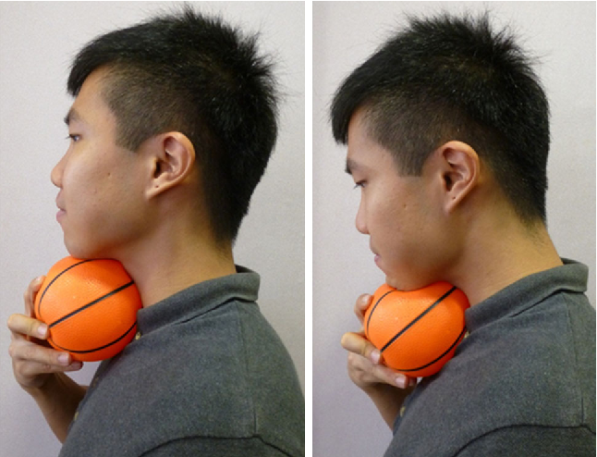
Chin Tuck Against Resistance
Monotonous
No Quantifiable Data
Does it even help?

Slide 8
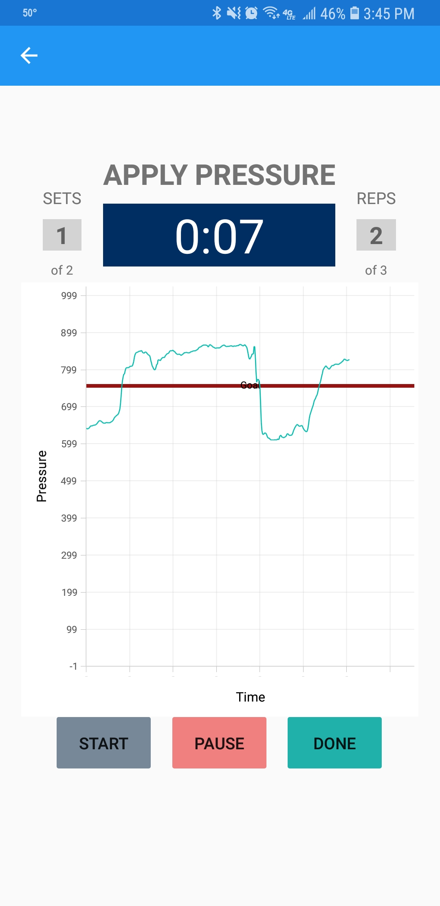
SOLUTION:
The CTAR All-Star.

Slide 9
Goals:
Visual Feedback
Bluetooth Communication
Quantifiable Data
Interactive

Slide 10
Functional Requirements
1. The CTAR All-Star stores a user profile.
2. The CTAR All-Star identifies users only by EMR numbers.
3. The CTAR All-Star forces the user to log in for the first time.
4. The CTAR All-Star connects via Bluetooth 4.0 using an HM-10
5. The CTAR All-Star measures the gauge pressure between the ambient air and the inside of the ball.
6. The CTAR All-Star broadcasts pressure readings at least once every 100ms.
7. The CTAR All-Star allows the user to drop/change the current bluetooth connection.

Slide 11
Functional Requirements
8. The CTAR All-Star allows the user to start a new session.
9. The CTAR All-Star allows the user to stop the current session.
10. The CTAR All-Star offers Isometric and Isotonic exercise routines.
11. The CTAR All-Star provides a visual representation of the pressure during an exercise.
12. The CTAR All-Star stores the 1-Rep Max value used for calculating a threshold.
13. The CTAR All-Star stores a repetition count value.

Slide 12
Functional Requirements
14. The CTAR All-Star allows the user to view data from previous sessions.
15. The CTAR All-Star provides a countdown timer.
16. The CTAR All-Star timer pauses and restarts if the pressure falls below the threshold.
17. The CTAR All-Star allows the user to view aggregate data.

Slide 13
Non-Functional Requirements
1. The CTAR All-Star runs on Android and iOS platforms.
2. The CTAR All-Star communicates between the device and ball via Bluetooth 4.0.
3. The CTAR All-Star is implemented using the Xamarin framework.
4. The CTAR All-Star is written in C, C#, XAML
5. The CTAR All-Star provides Visual feedback in real time.
6. The CTAR All-Star has a user friendly interface.
7. The CTAR All-Star protects the security of each user.
8. The CTAR All-Star visualization is neutral to appeals to multiple demographics.

Slide 14
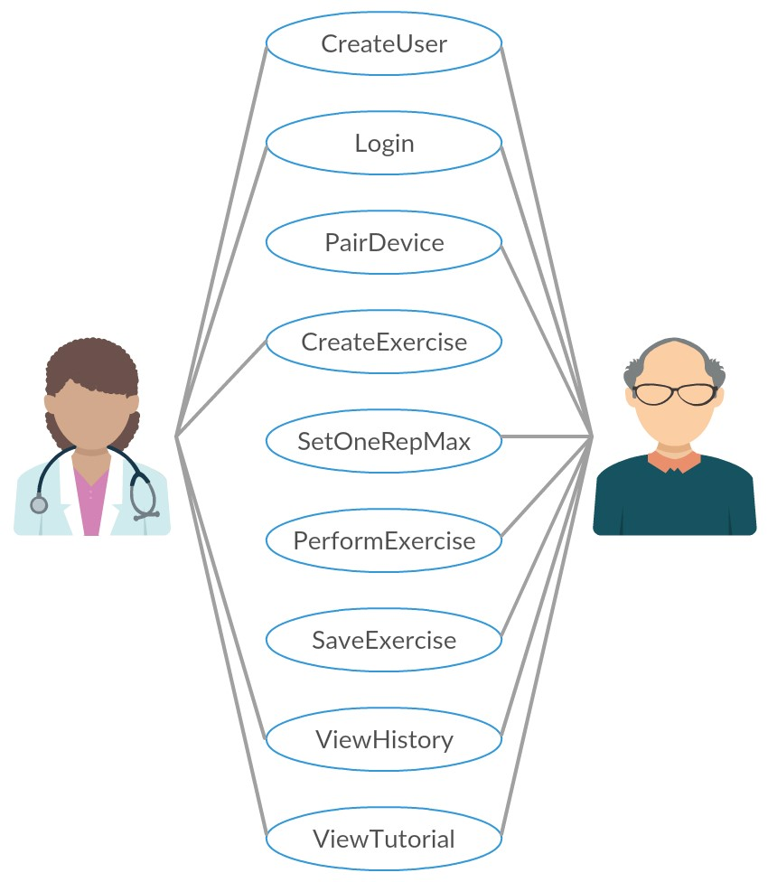
Use Cases:
Doctor:
  Create User Account
  Login
  Create Exercises
  View Patient Exercise History
  View User Tutorials
Patient:
  Create User Account
  Login
  Pair to Bluetooth Device
  Set a One-Rep-Max
  View Their History
  View User Tutorials

Slide 15
USE Cases
1. CreateUser: Patients and medical professionals should be able to make a patient user account from a mobile device using the patient’s EMR number. Medical professionals should be able to make an account which allows them to view their patient’s information.
2. LogIn: Patients should be able to log in to the mobile app the first time the app opens. The home screen is displayed after successful login.
3. PairDevice: Users should be able to connect their mobile device to the exercise ball by selecting from a list of available Bluetooth devices. The app will prompt this when a device is not connected or allow the user to change the connection through settings.

Slide 16
USE Cases
4. CreateExercise: Medical professionals should be able to make a patient exercise plan that the patient can work on between appointments. Plans would include specifying the exercise module and the number of times or frequency that the module should be completed during a specified time period.
5. Set1 RepMax: The app guides the patient through setting a 1-rep max at the beginning of each exercise session. The app prompts the user to squeeze the ball as hard as they can and stores the maximum pressure inside the ball.

Slide 17
USE Cases
6. PerformExercise: Patients should be able to follow an exercise routine. The program sets various pressure thresholds based on the patients 1 rep max. The program then guides the patient through the exercise routine where the patient squeezes and releases the ball while a counter counts the repetitions for a certain threshold.
7. SaveExercise: The patient’s exercise should be saved at the end of a session so that the results can be viewed at a later date.

Slide 18
USE Cases
8. ViewHistory: Patients and medical professionals should be able to view historical exercise data.
9. ViewTutorial: The patient or medical professional should be able to view various tutorials with screenshots instructing them on how to use the various features of the app.

Slide 19
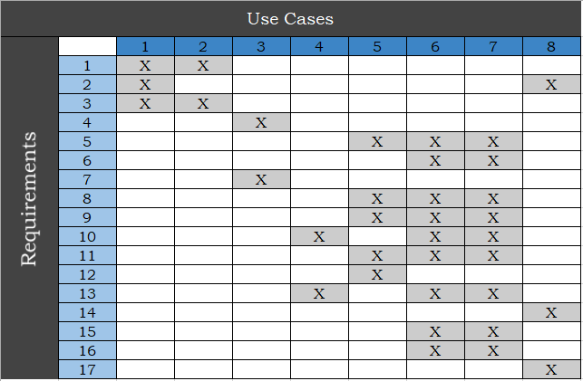
Traceability Matrix

Slide 20
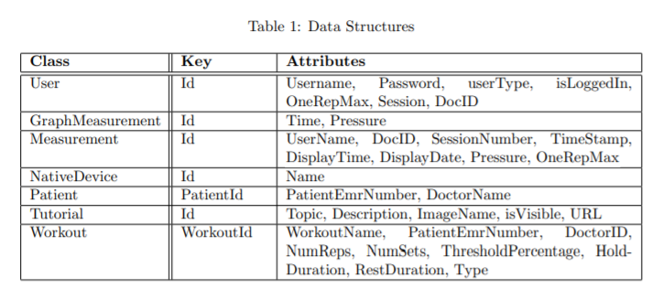
Data Structures

Slide 21
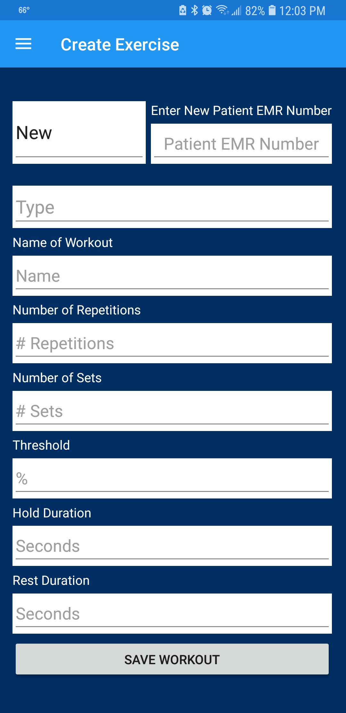
Creating an Exercise:
The Doctor can create an exercise and assign it to a patient.
Most information populates with default values when the Workout Type is selected (isometric/isotonic)
The Doctor can configure the rest of the parameters as they see fit.

Slide 22
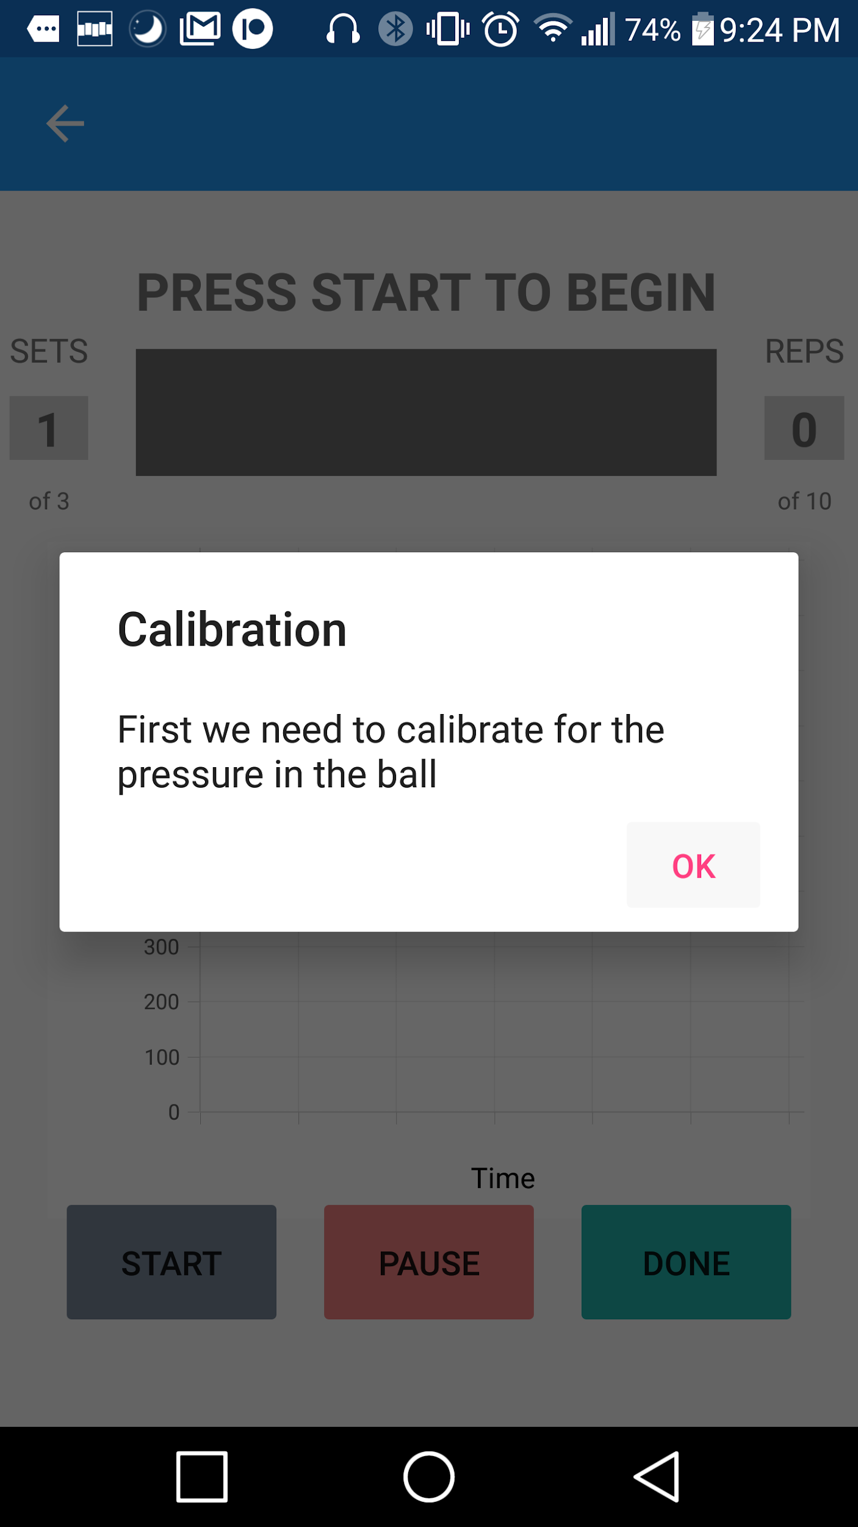
Calibration:
Guides patient through a routine which gathers the ball’s base pressure and the max pressure they are able to exert.

Slide 23
Exercise In progress:
Set counter
Repetition counter
Repetition timer
Graph of ball pressure
Controls for Start, Pause and Finishing an exercise
The timer shows the amount of time to complete a repetition. It counts down the number of seconds the patient must keep the pressure above the goal line until the repetition is complete.
The timer pauses when pressure falls below the line and resumes when above.

Slide 24
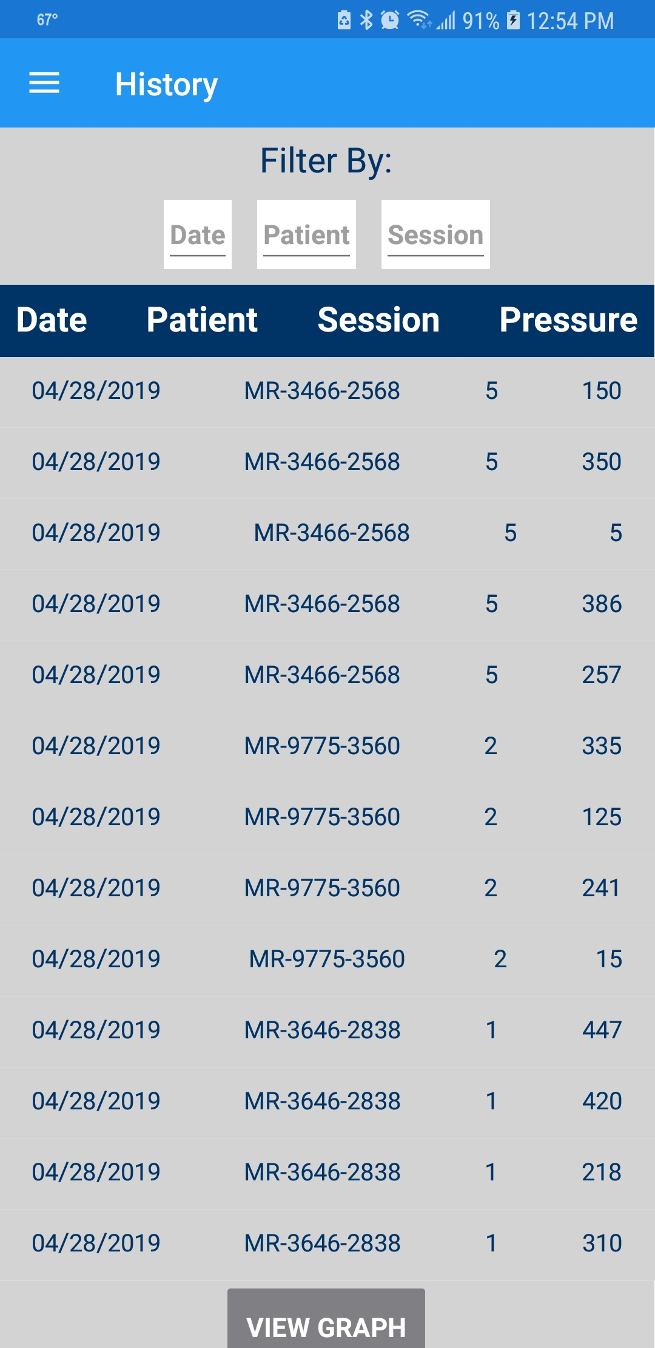
Exercise History:
Shows the session History.
Allows filtering by:
Date
Patient
Session Number.

Slide 25
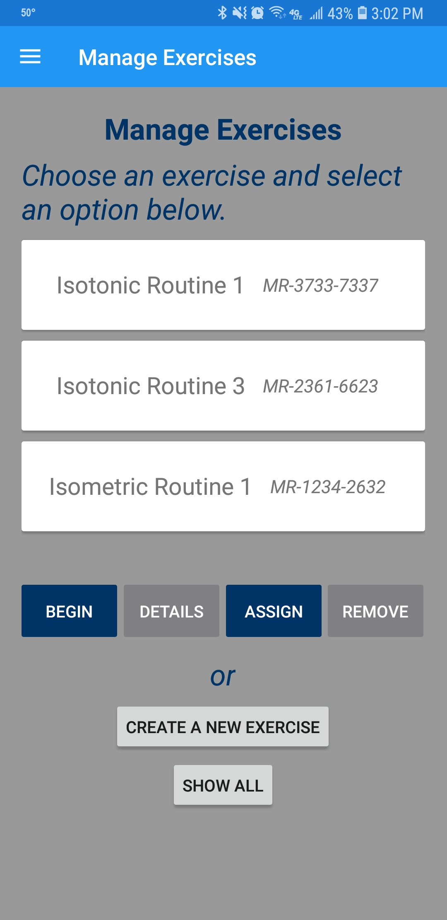
Exercise Management:
This screen shows how the user can:
  Begin following an exercise.
  View the details of the exercise.
  Assign it to a new patient
  Delete
  Create a new exercise

Slide 26
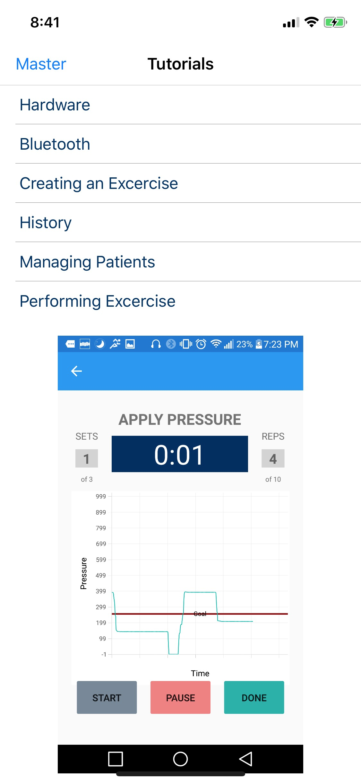
Tutorials:
Tabs For Many Instruction Guides
Link to Project Website

Slide 27
Hardware Prototype:
Arduino Uno
HM-10
Pressure Transducer
Some plumbing
Inflatable rubber ball
The pressure transducer takes an analog reading from the ball, the Arduino samples the pressure every 50ms and broadcasts the reading over Bluetooth 4.0 to the mobile app.

Slide 28
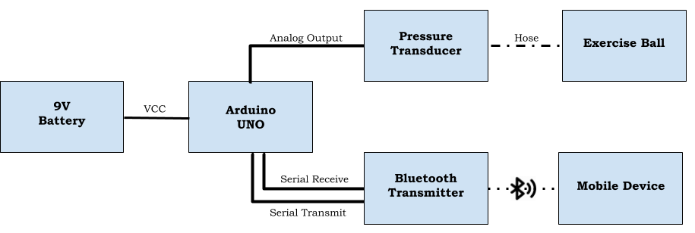
Hardware Prototype:

Slide 29
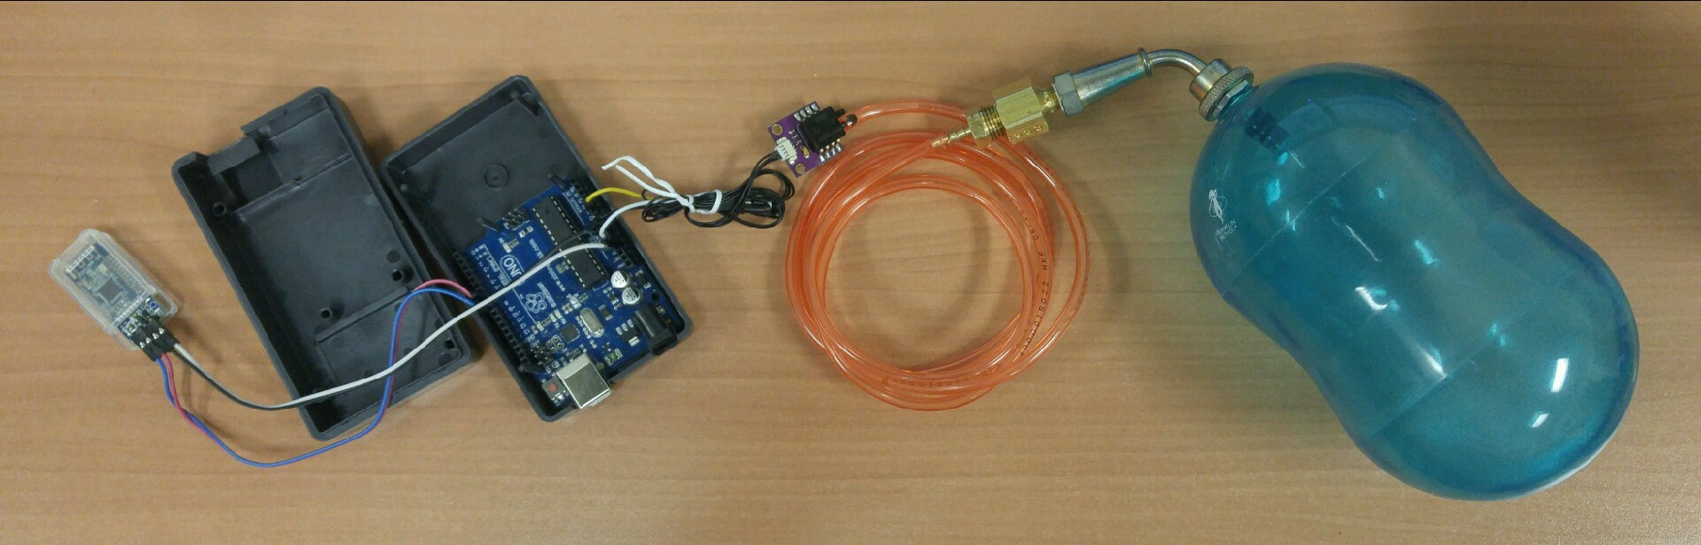
Hardware Prototype:

Slide 30
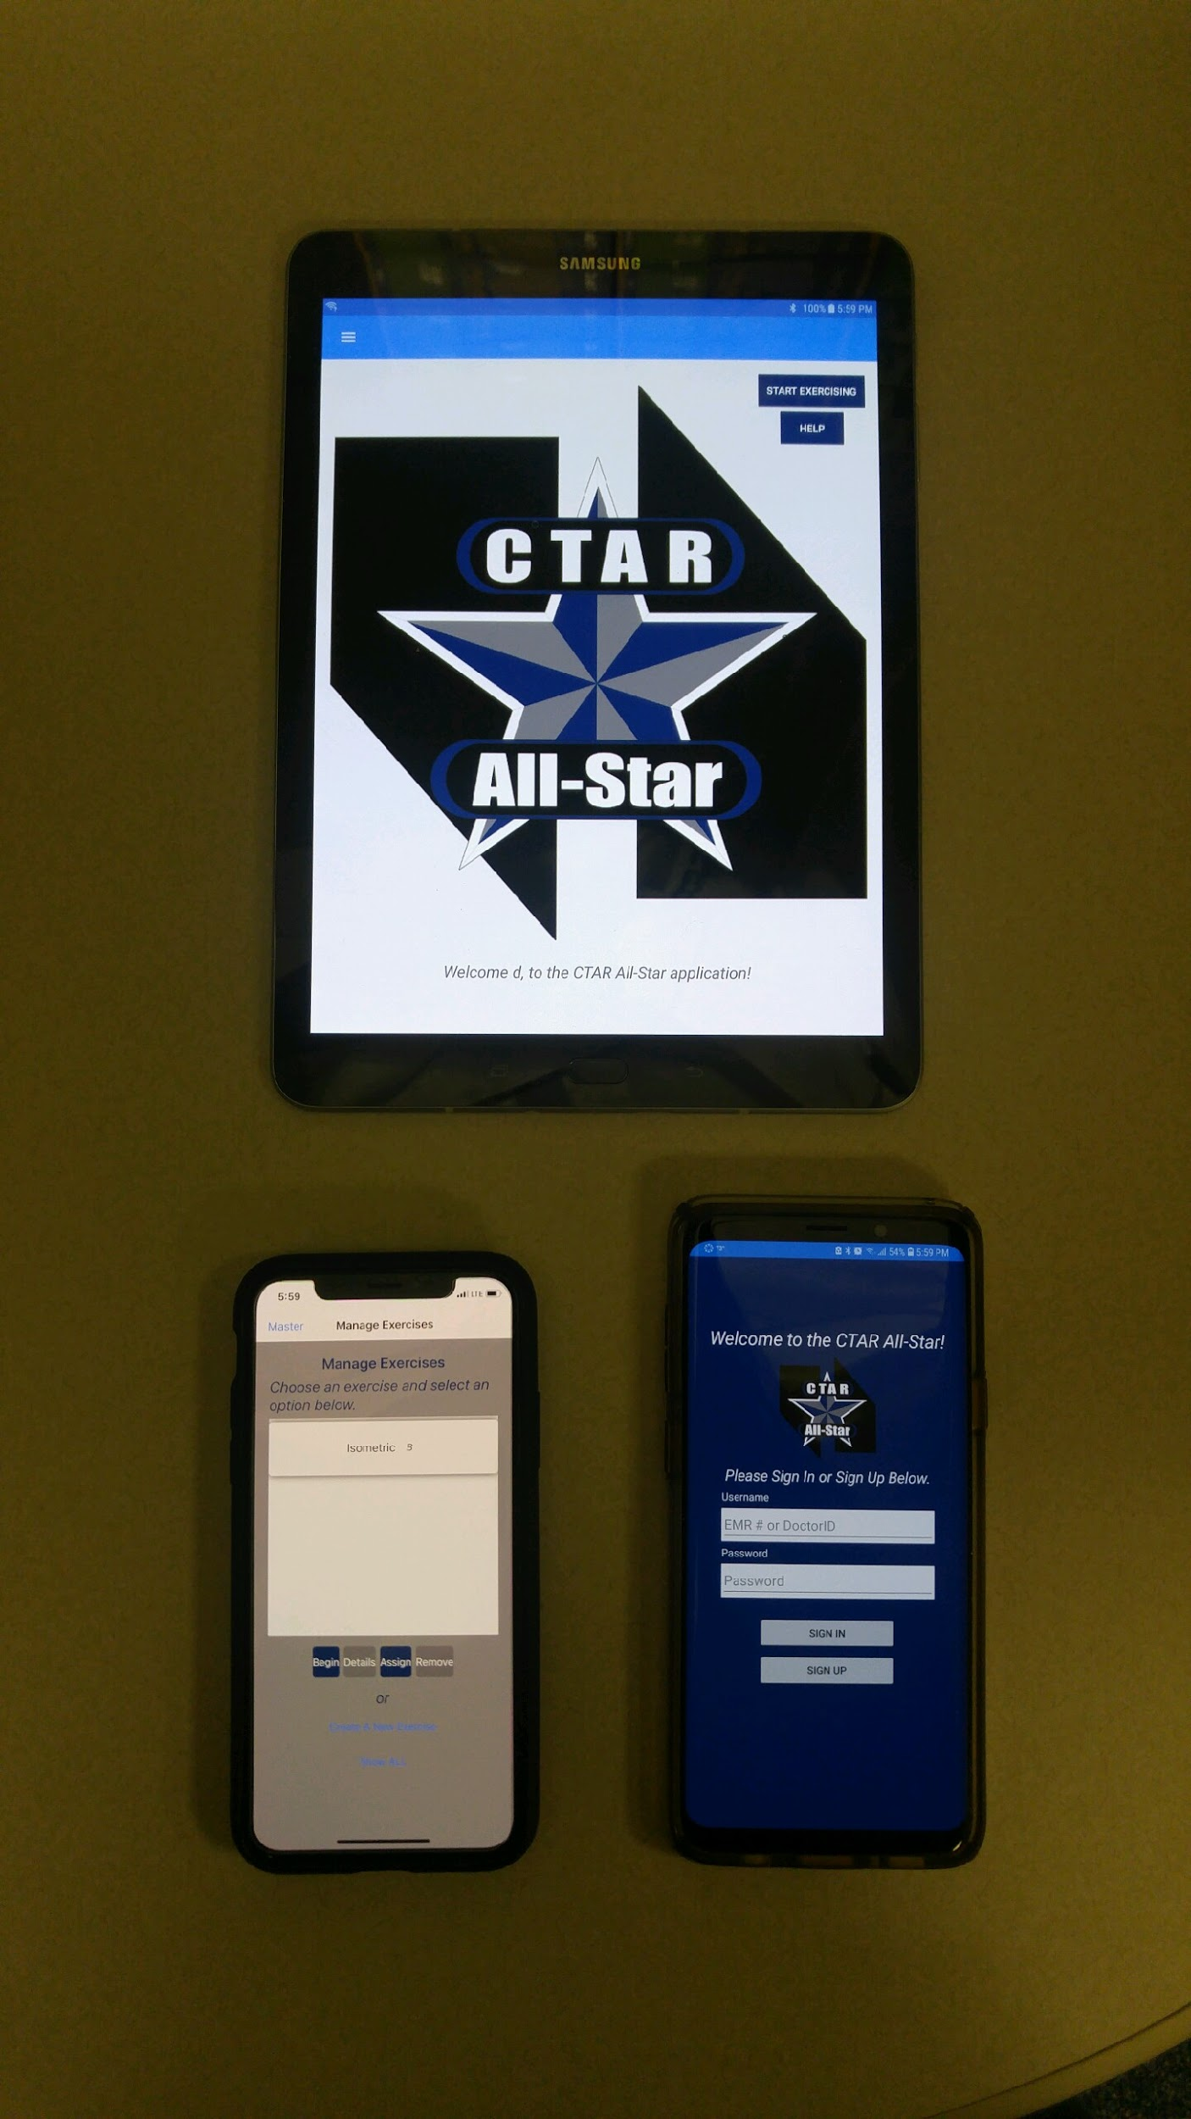
Cross Platform Compatible:
The app will work on:
  Android
  iOS
  Mobile Phones
  Tablets

Slide 31
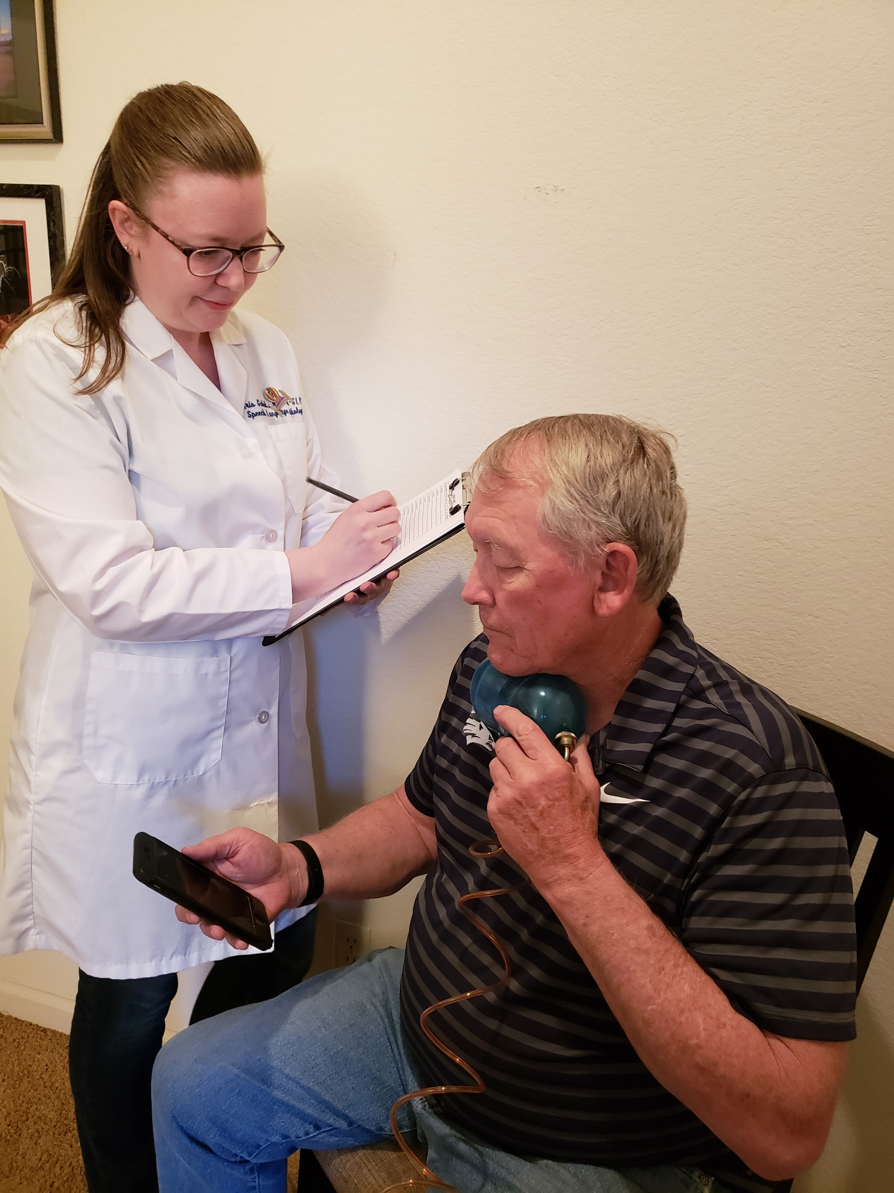
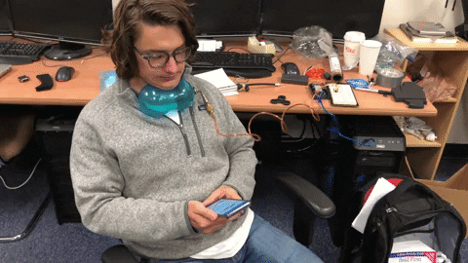
Testing:
Test Cases
“Patient” Trials

Slide 32
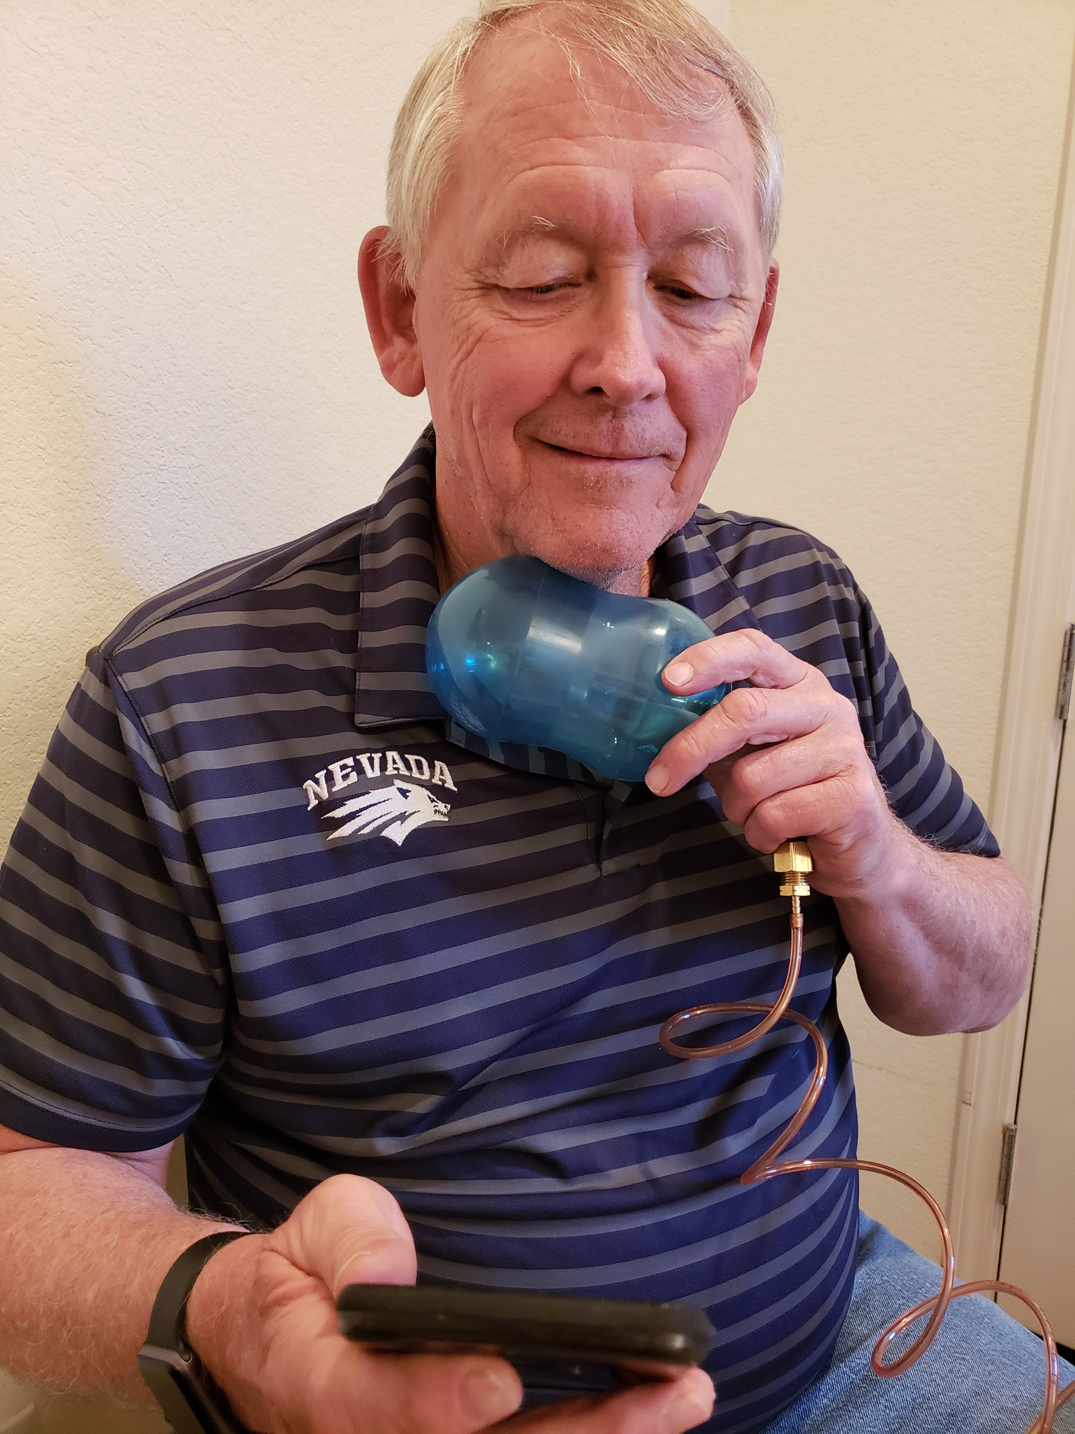
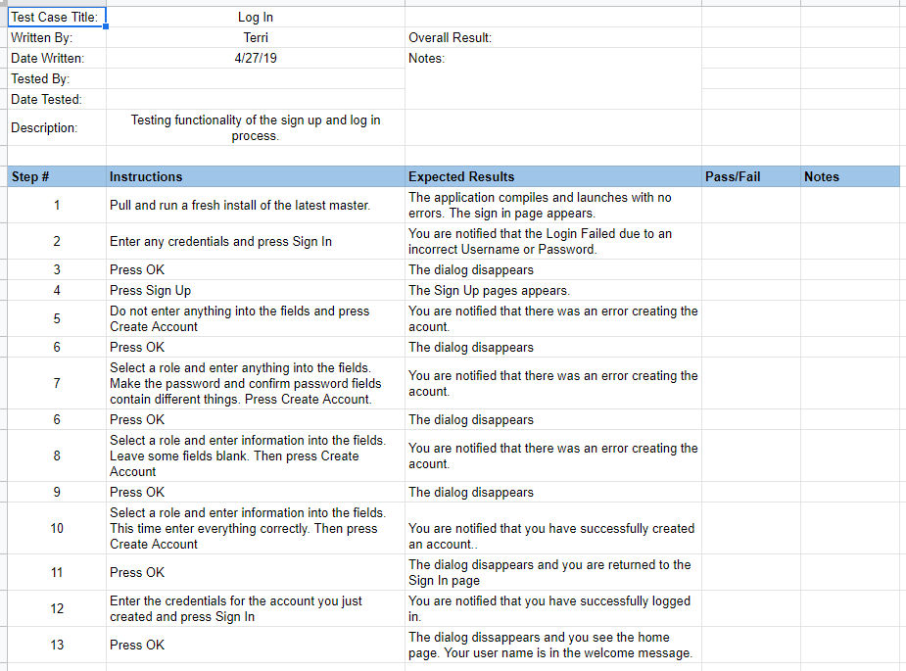
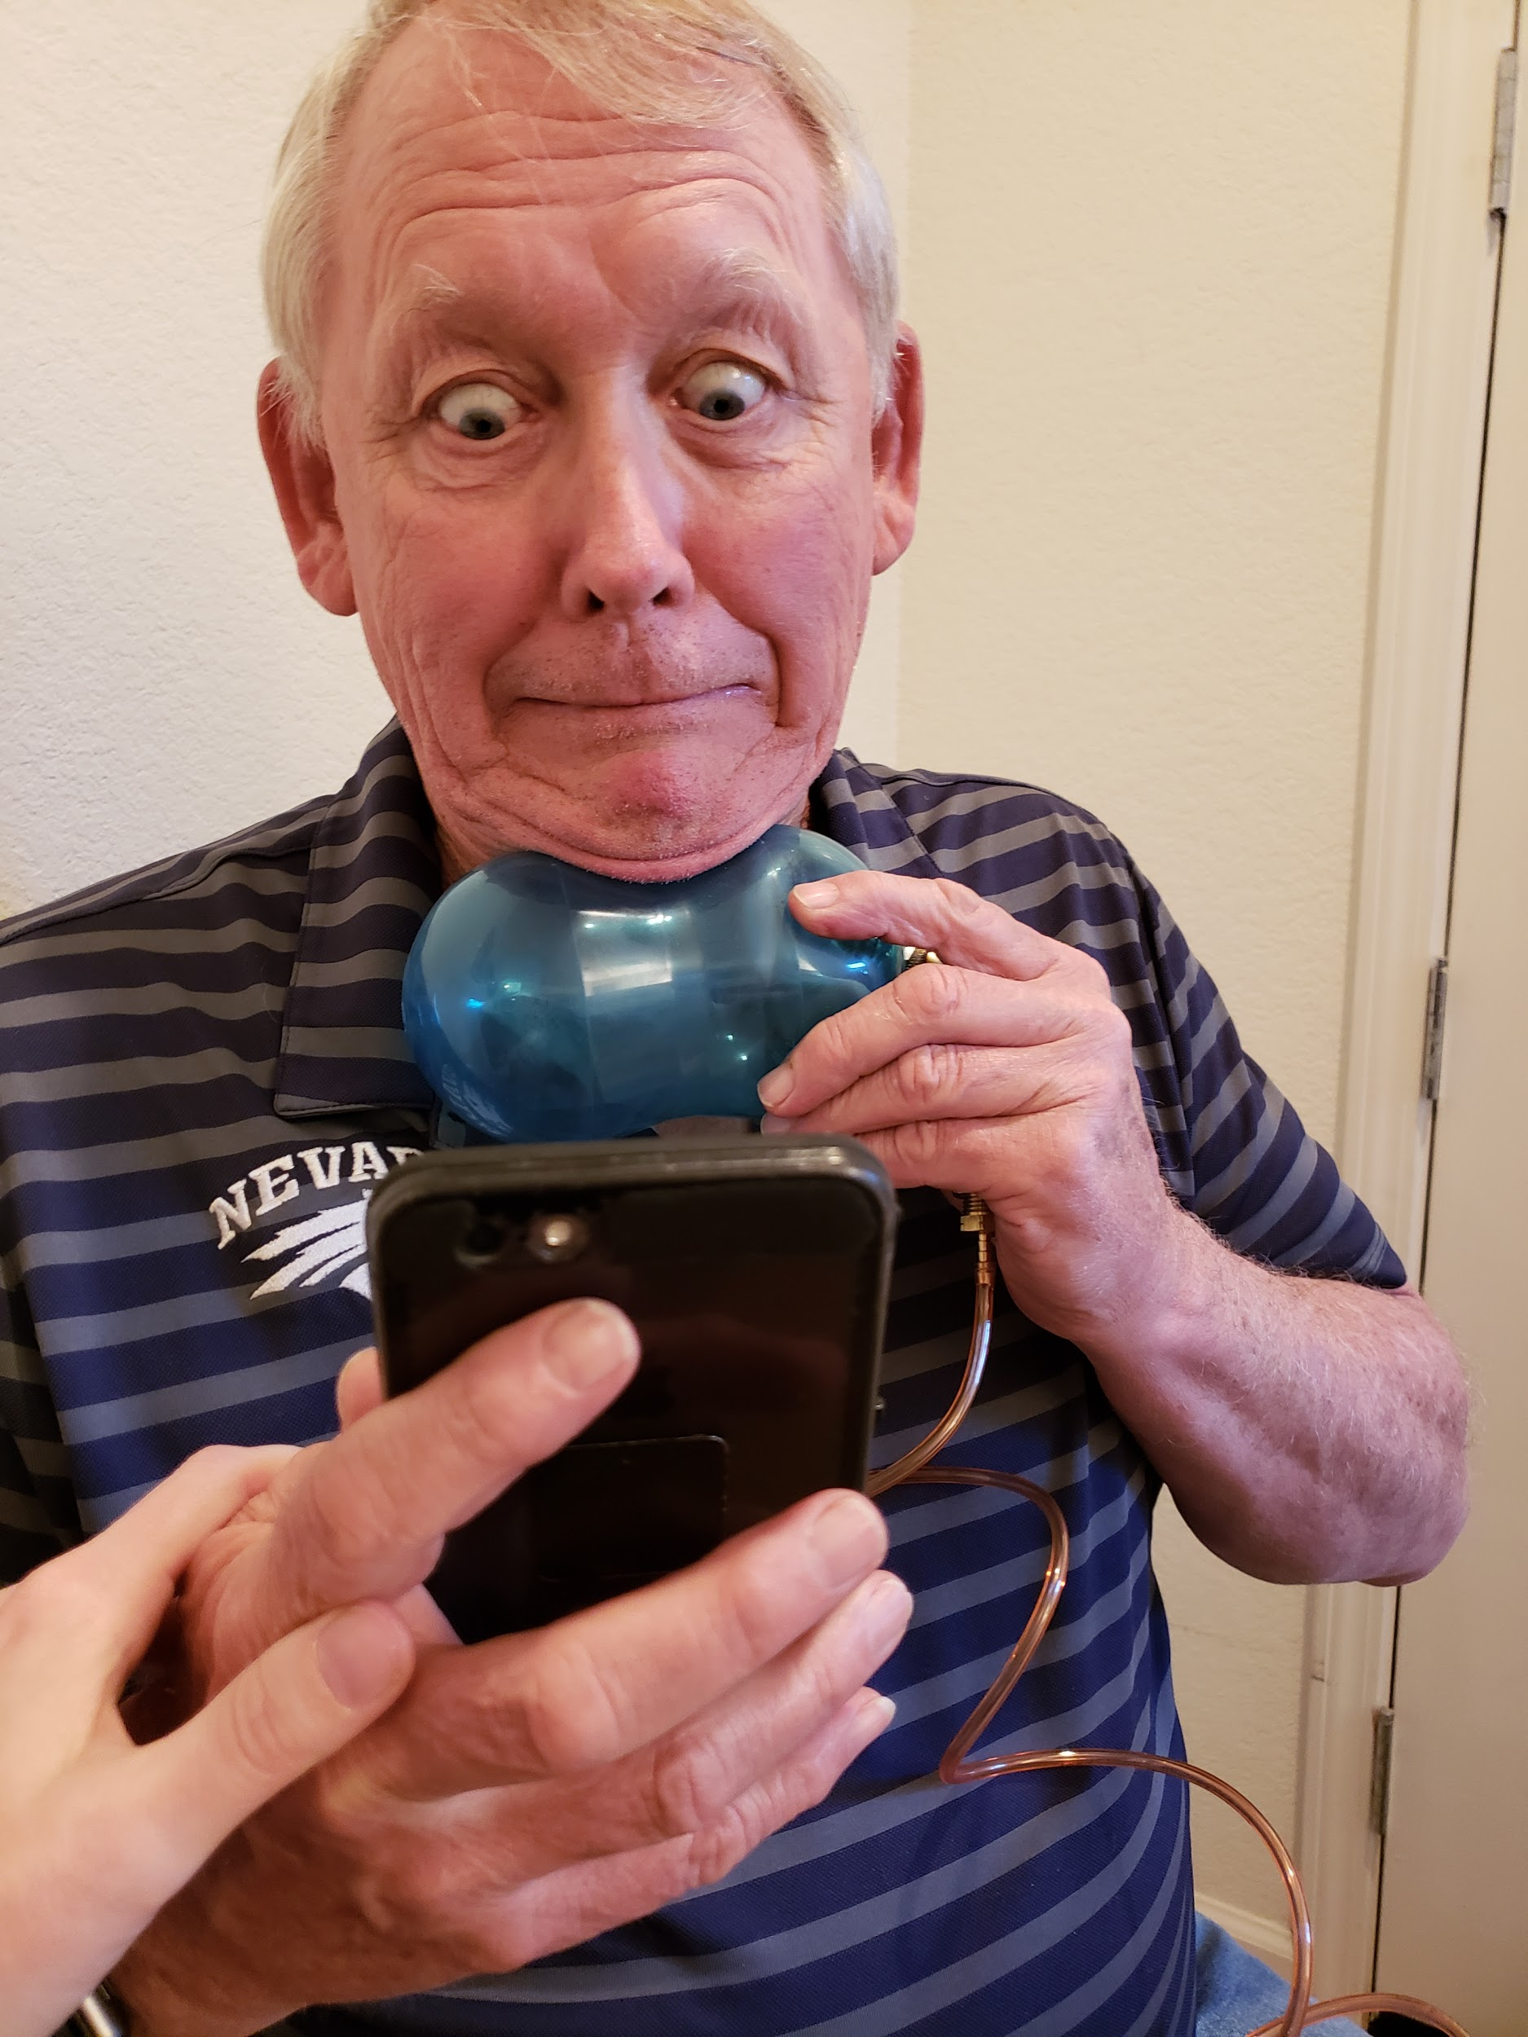
Testing:

Slide 33
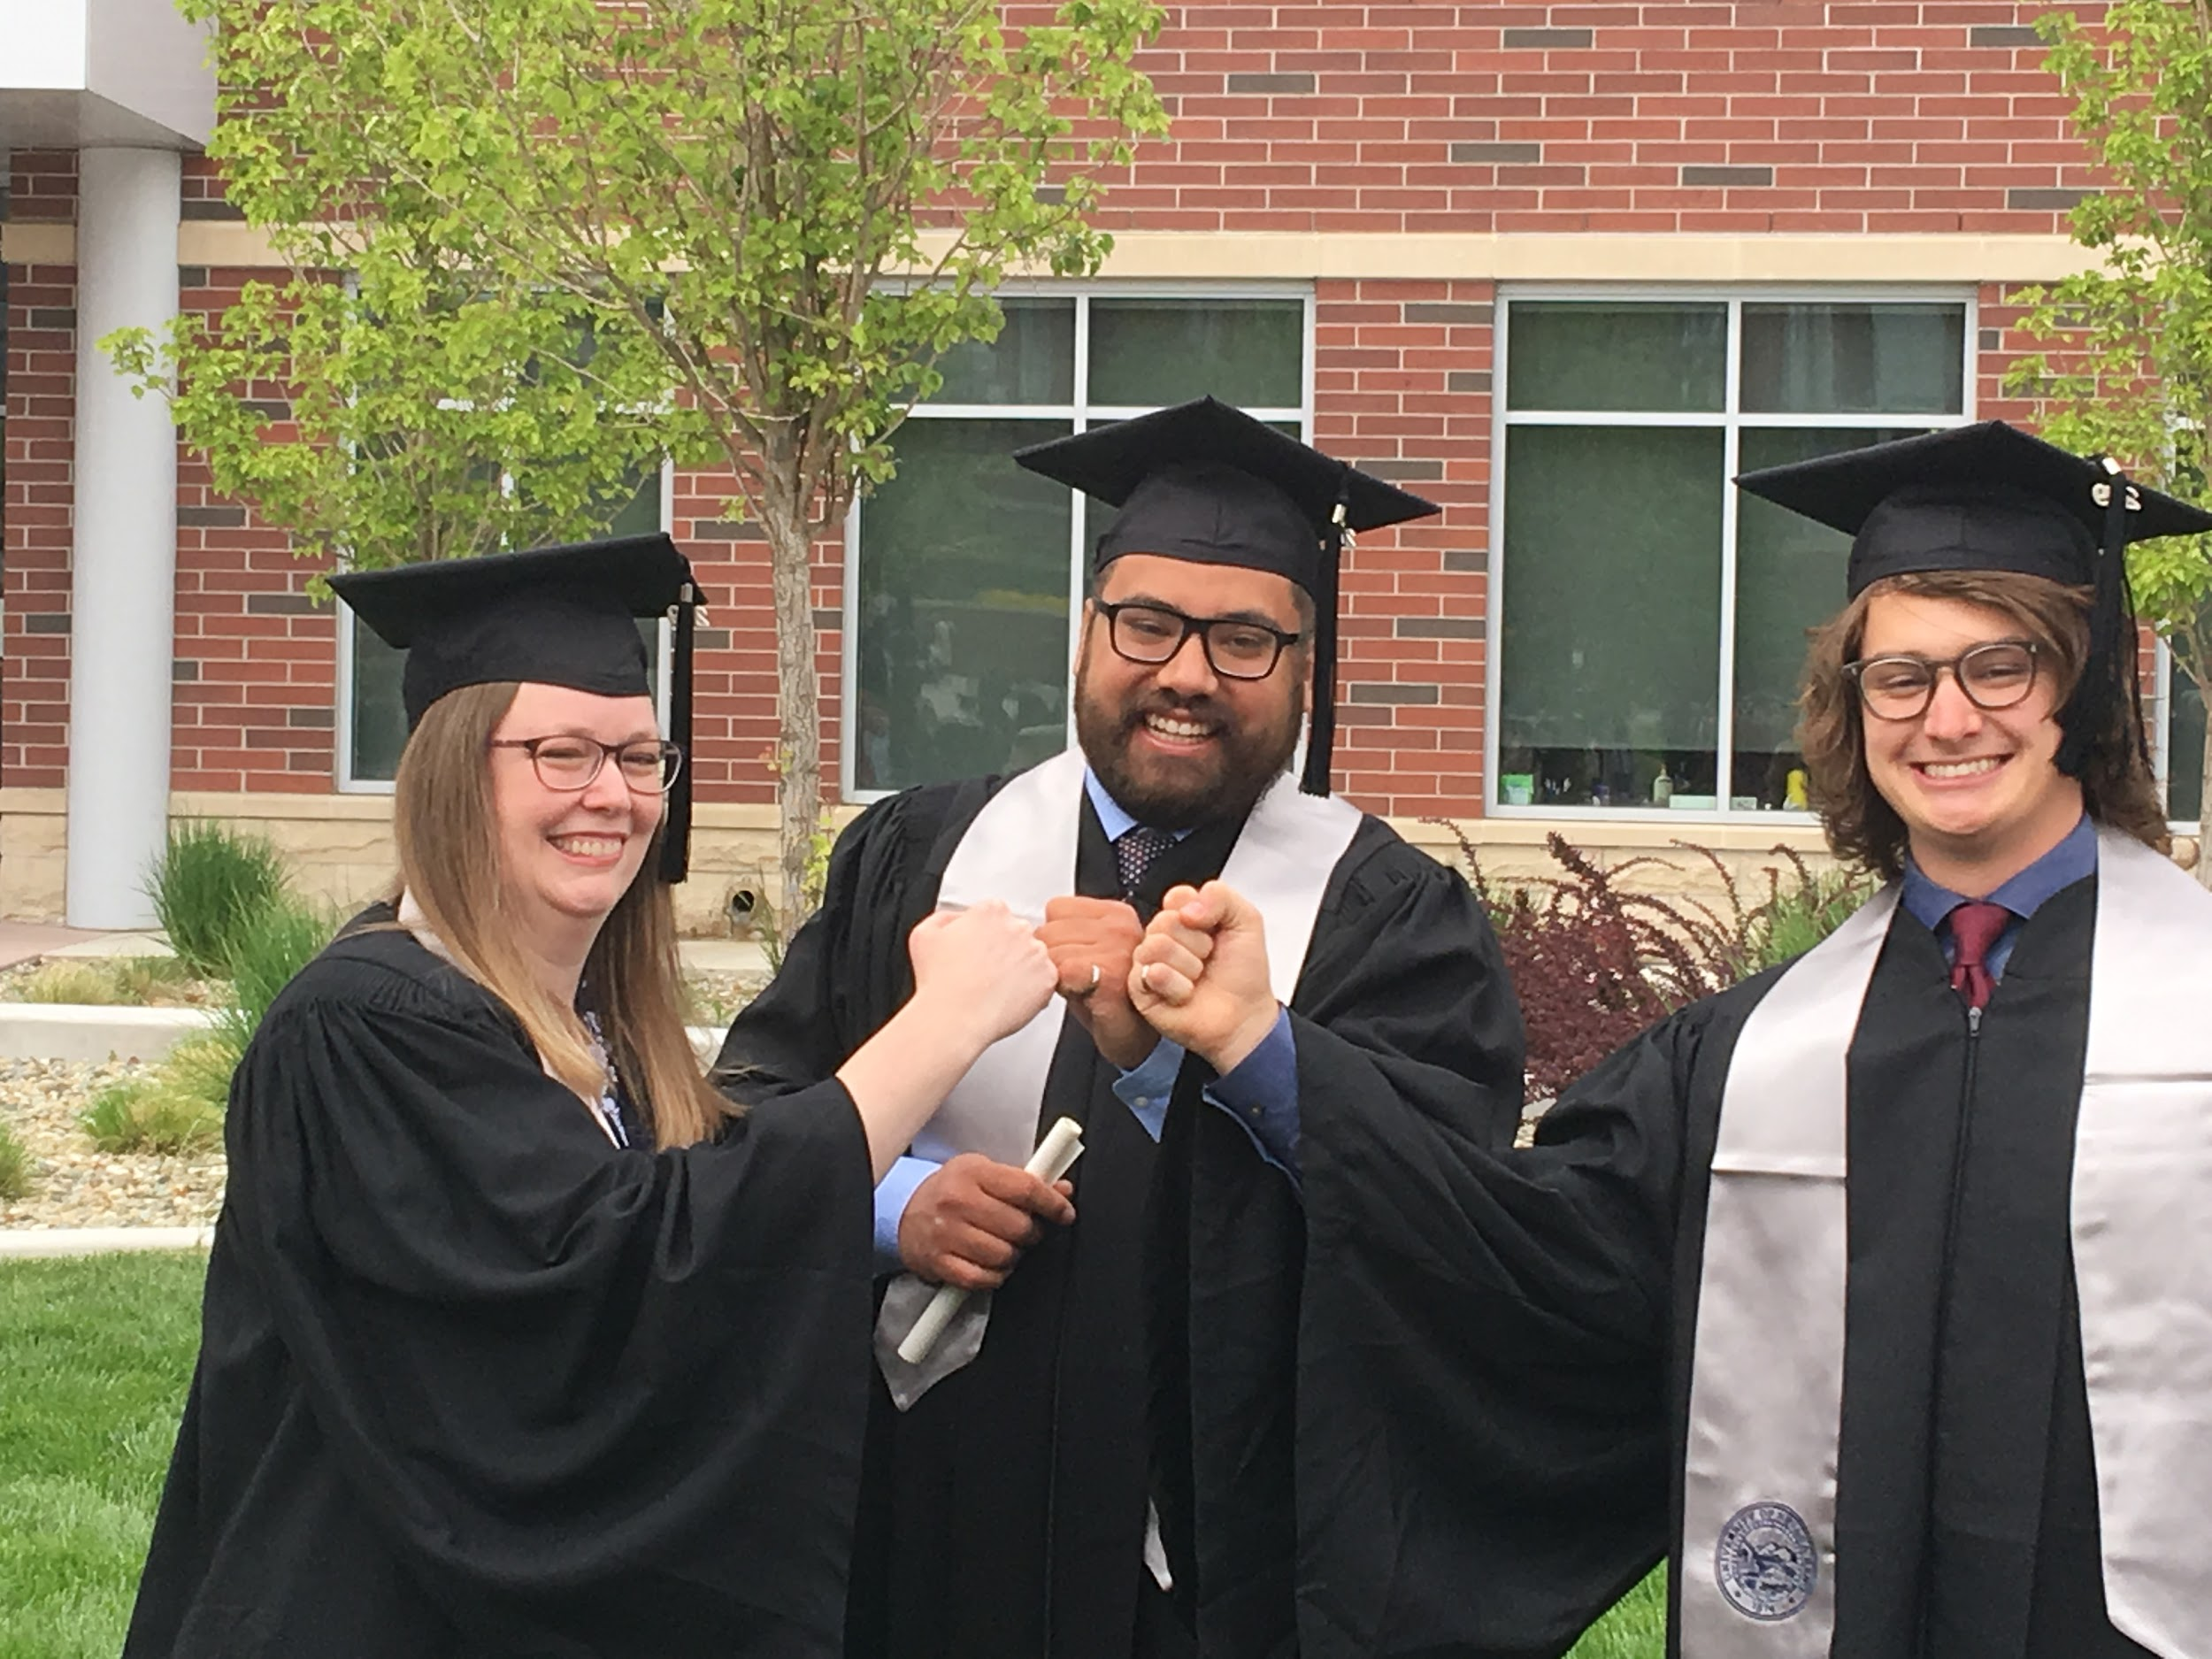

Slide 34
Future Improvements
Embedded Bluetooth Device
Multiple Kinds of Hardware
Game Integration
Web/Server with API

Slide 35


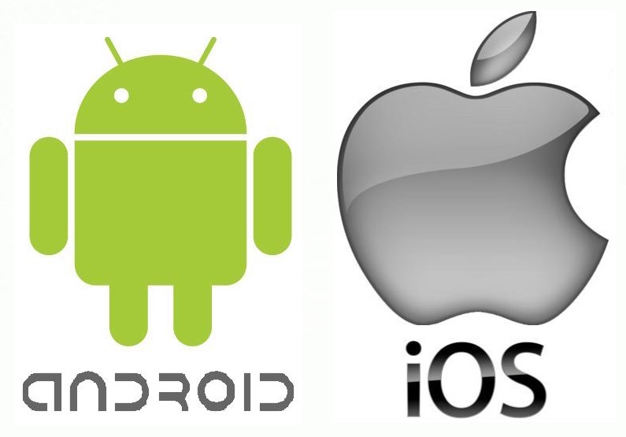




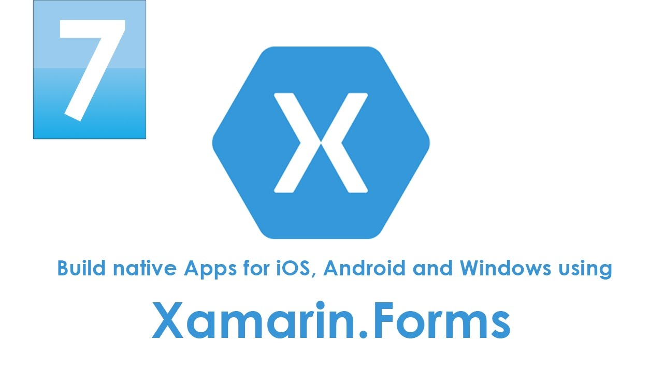
Tools

Slide 36
Website
https://theglar.wixsite.com/ctar

Slide 37
Video Demo

Slide 38

Thank YOu
Any Questions

Slide 39
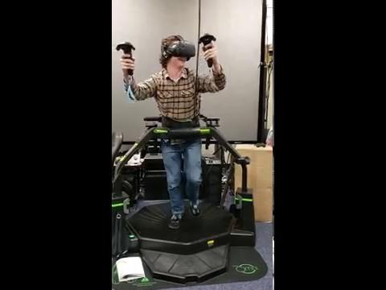
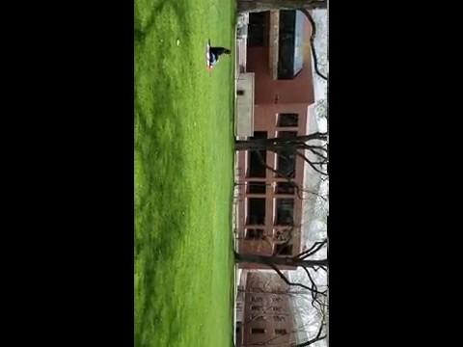
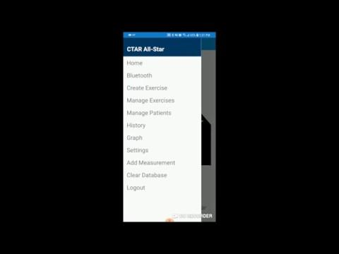
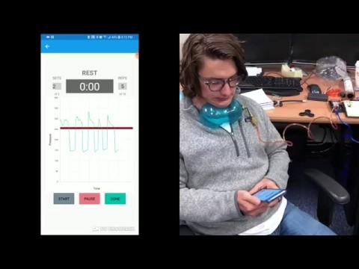
Videos

