Slide 1


ARIA 3.0: A Modern Approach to Web-based Music Festival Registration Systems
Nikkolas J. Irwin, Anthony Bennett, Kevin Carlos,
Jalal Kiswani, Cynthia R. Harris,
Sergiu M. Dascalu, Frederick C. Harris, Jr.
Department of Computer Science and Enginering University of Nevada, Reno

Slide 2
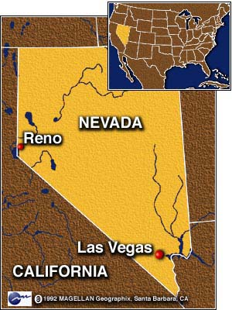
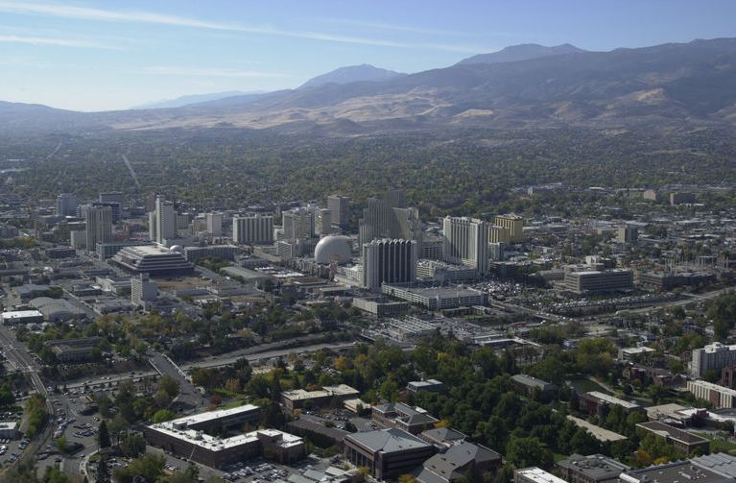

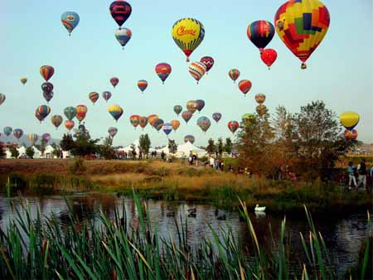
Reno, Nevada

Slide 3
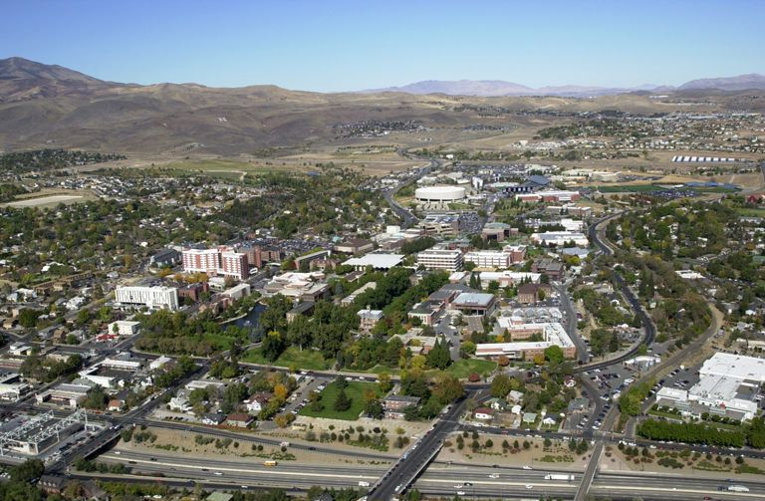
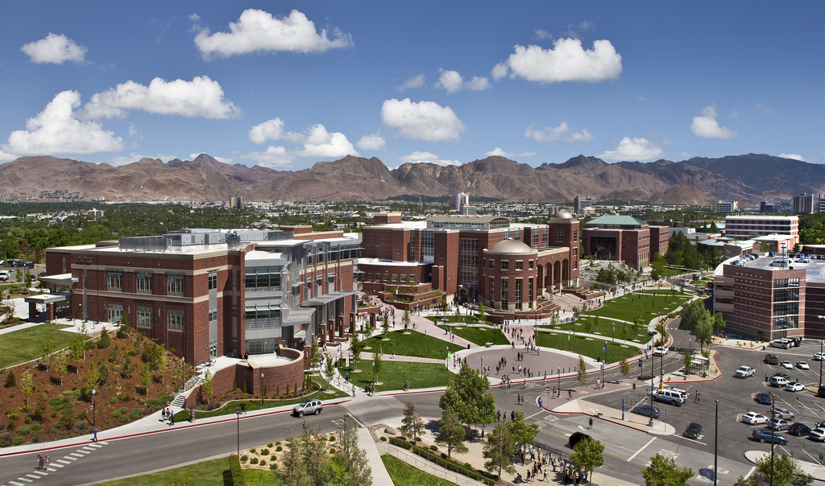
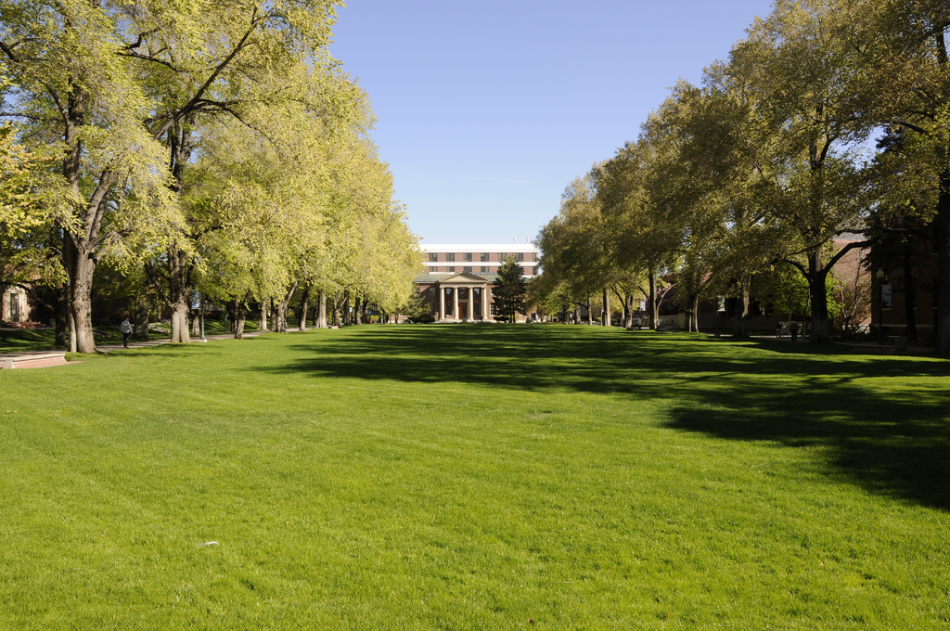

University of Nevada, Reno

Slide 4
University of Nevada, Reno

Slide 5
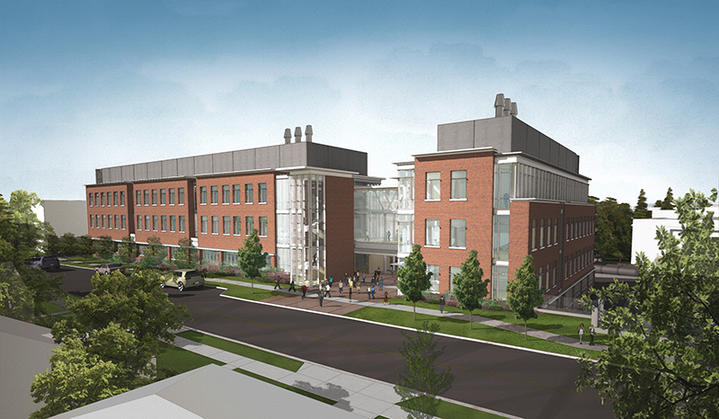
University of Nevada, Reno
William N Pennington
Engineering Building

Slide 6
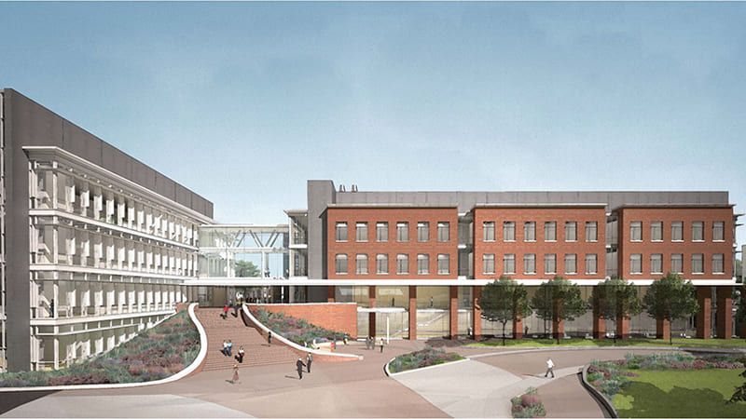
University of Nevada, Reno
William N Pennington
Engineering Building

Slide 7
ACKNOWLEDGEMENTS
This material is based upon work supported by the National Science Foundation under grant number IIA1301726. Any opinions, findings, and conclusions or recommendations expressed in this material are those of the authors and do not necessarily reflect the views of the National Science Foundation.

Slide 8
Overview
Introduction
Motivation and Design
Functional/Non-Functional Requirements
Detailed Use-Cases
Results
Conclusion
Acknowledgements
References

Slide 9
Introduction
Administration, Registration, and Information Assistant (ARIA) is an event management system for the Northern Nevada Music Teacher Association (NNMTA).
First developed in 2018, ARIA addresses the needs of the NNMTA by facilitating services digitally for event management.

Slide 10
Motivation
Previous versions of ARIA were based on the WordPress platform and had multiple restrictions using the platform such as limited flexibility in adding features and limited control of WordPress plugins.
ARIA 3.0 attempts to resolve these concerns by providing NNMTA with a microservice application equipped to maintain the majority of existing features from ARIA 2.0 while also providing an ideal platform for future development

Slide 11
Design
ARIA 3.0 was completely redone in a microservice architecture supported by multiple backend services and a singular frontend.
It was designed with the intention of having three accessible portals for different types of users: administrators, teacher, and customers.
Each portal has workflows implemented that facilitate the registration and management of each event as well as the organization of data needed by NNMTA.
Design was primarily focused on user experience (UX) and detailed attention to the user interface (UI).

Slide 12
Functional Requirements
Functional Requirements were based on the services that the system needed to provide through the three portals that are assigned to users based on their role.
Workflows were designed to completely remove work done by paper and have them moved to a digital platform.

Slide 13
General Application Functional Requirements
Users will be able to create and manage an account.
The system should provide a database for music selection.
Service will be provided for uploading and generation of documents needed by the organization.
Scheduling of students based on age, level, and preferences.
JSON Web Token implementation for authentication.
Concurrent competitions
Access to variety of payment services for events

Slide 14
Administrator
Functional Requirements
Administrators will be able to submit a form for event creation, schedule the event, and form a command performance.
Modification of events during scheduling to resolve external conflicts/concerns.
Input of student scores after they are judged.
Generation of documents after scores are received.

Slide 15
Teacher
Functional Requirements
Ability to add students and modify information about students.
Register and schedule students for events.

Slide 16
CLIENT/Parent-Student Functional Requirements
The system will provide the ability to add, remove, and modify data for students.
Customer will be able to assign a teacher to a student.
Customers will be able to register their students for an event
Customer will be able to pay for the event and confirm registration

Slide 17
Non-Functional
Requirements
Non-Functional Requirements were based on the design and the focus on UX and UI.
The system shall be highly available, functional and viewable for modern browsers, use the HTTPS protocol.
Application pages should be responsive and work on mobile devices.
Modern security techniques will be used to facilitate secure authentication and data integrity.

Slide 18
Detailed Use-Cases
Workflows were developed facilitate management and registration of events through the three different user portals.
Administrators have the ability to create, modify, and schedule events along with other functionalities that can manage accounts.
Teachers have the ability to register and view students as well as functions to register them for the event.
Customers have the ability to add students and pay for event registration.

Slide 19
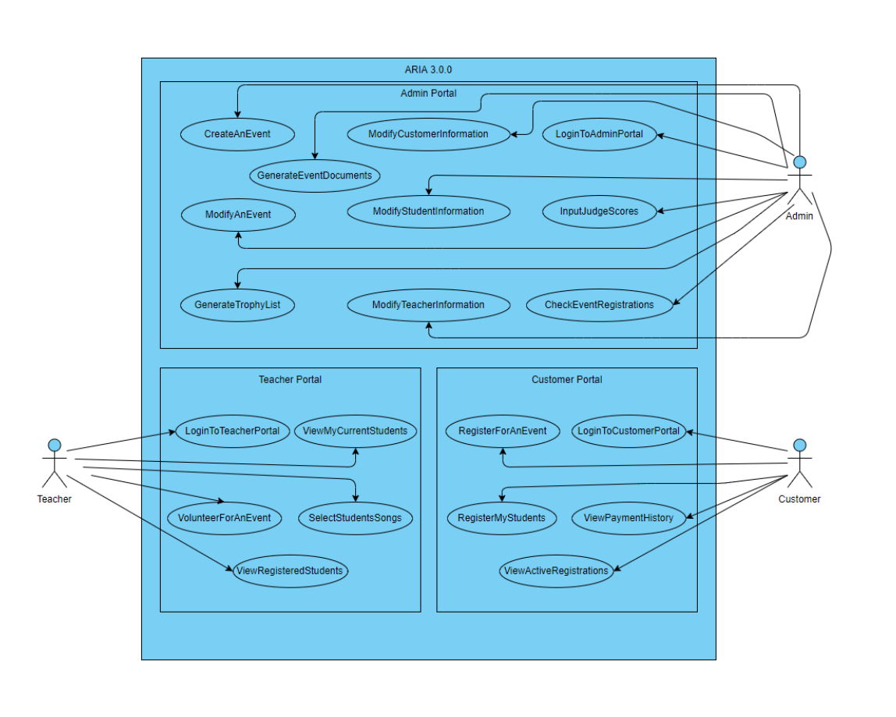
Notes:
Figure 1: A use case diagram displaying the users of the system and the system functionalities related to each user along with their respective portals in the web-application service.

Slide 20
Administrator Use-Cases
CreateAnEvent - Creation of event including forms to event information that are saved in the database.
ModifyAnEvent - Modify existing events by retrieving information from database and present a mutable form to save information.
GenerateEventDocuments - Generation of event documents to advertise an event and facilitate directions for customers, students, and teacher.
GenerateTrophyList - Generate trophy list for participants of an event.
ModifyStudentInformation, ModifyCustomerInformation, ModifyTeacherInformation - Ability to edit any user account’s information.

Slide 21
Administrator Use-Cases
(Cont.)
LoginToAdminPortal - Admin Portal Login
InputJudgeScores - Ability to input scores to be calculated after performance has concluded.
CheckEventRegistrations - Ability to check all registrations for an event. Students will register and pay for registration, then teachers will register the student with selection of songs, before the administrator confirms registration.

Slide 22
Teacher Use-Cases
LoginToTeacherPortal - Teacher Portal Login
ViewMyCurrentStudents - Ability to view current students with relevant informaiton such as contact, music-level, and recently participated event.
ViewRegisteredStudents - Ability to view students who are currently registered for an active event.
SelectStudentSongs - Apart of the registration process, the ability to select songs for a student that is registered for an event.
VolunteerForAnEvent - Ability to sign up for volunteering. Teachers are able to select their duty for an event (e.g. Door Monitor).

Slide 23
Customer Use-Cases
LoginToCustomerPortal - Customer Portal Login
RegisterMyStudents - Ability to register students into the system which is needed for register students for events.
RegisterForAnEvent - Ability to register students for an event. Registration will include relevant information such as preferences and payment of registration.
ViewActiveRegistrations - Ability to view customer’s students who are currently registered for an active event.
ViewPaymentHistory - Ability to view history of payments for previous event registrations.

Slide 24
Results
Major features were implemented such as a portal for each primary user (administrator, teacher, and customer).
Payment processing was implemented using PayPal’s Braintree API.
Document generation was implemented as a separate service that generates multiple documents for the administrator.
Event creation was implemented, allowing administrators to create an event and input information for the upcoming event.

Slide 25
Results: Infrastructure and Technologies
ARIA 3.0 was built using a set of modern web frameworks, libraries, tools, and technologies. For our web application service, we primarily used the following technologies: React.js, Redux , Node.js, Express , and PostgreSQL. For our document generator, a separate service, we utilized Python, and Flask to process and generate requested documents.
The application is containerized by docker and deployed through a CI/CD platform, CircleCI, which is then deployed to Kubernetes for container orchestration through Google Cloud Engine. This allows for rolling updates, very high availability, and a fast development workflow.

Slide 26
Results: Portals
Each primary type of user (customer, teacher, and administrator) has a portal which provides that user with information regarding their account and the set of functionalities that user is allowed to perform.
For example, the customer portal displayed next contains functionalities for adding event participants (students), registering for events, viewing active registrations, etc.

Slide 27
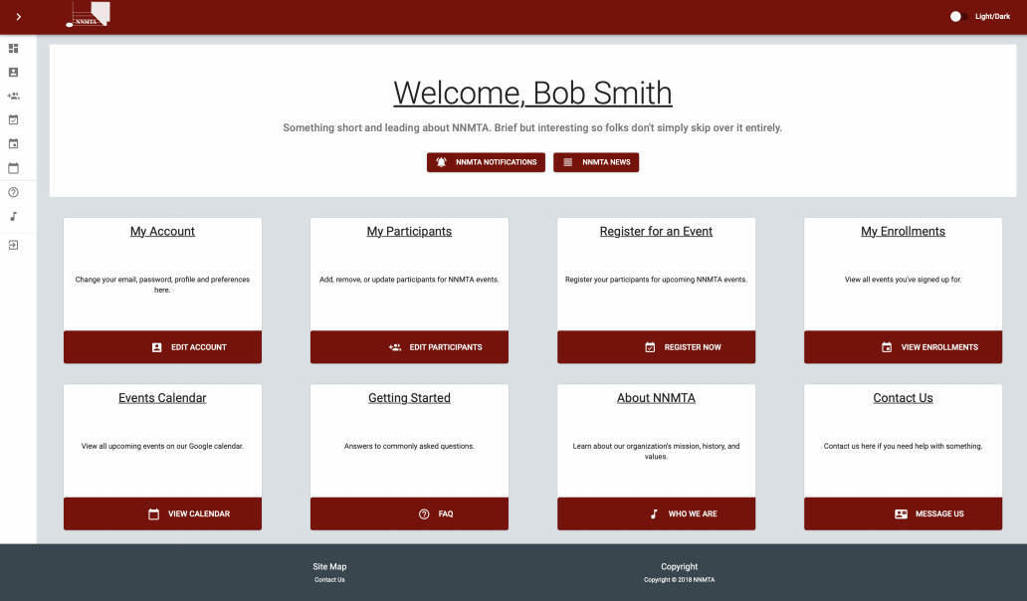
Client Portal
Notes:
Figure 3: The customer portal dashboard (light-theme) which contains a set of cards. Each card describes a function of the customer portal to the user.

Slide 28
Results: Payment Processing
Payment processing for event registrations are performed using PayPal’s Braintree API. The Braintree API was used because it supports major credit cards and PayPal, a drop-in UI (illustrated next), a testing suite for verifying functionality, and the API conforms with modern financial regulations.
Using PayPal should aid in the adoption of ARIA 3.0 by customers when paying for services provided by NNMTA.

Slide 29
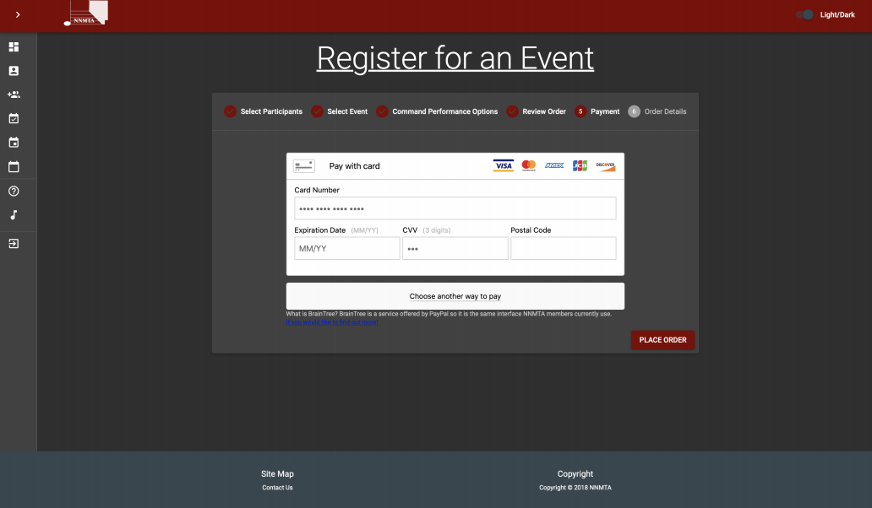
Notes:
Figure 4: PayPal’s Braintree drop-in UI is shown (dark-theme). It is the fifth step of event registration and it is a feature of the customer portal.

Slide 30
Results: Document Generation
Document generation was built as a separate service to ARIA 3.0 using a Python-Flask web server.
The document generator listens for incoming processing requests and accepts a JSON object from ARIA 3.0’s web-application service containing the document types to be generated and customer, teacher, and event-data to fill in the document fields. This data is gathered from ARIA 3.0’s PostgreSQL database.
One of the documents that ARIA 3.0 generates, announcing sheets, are shown next.

Slide 31
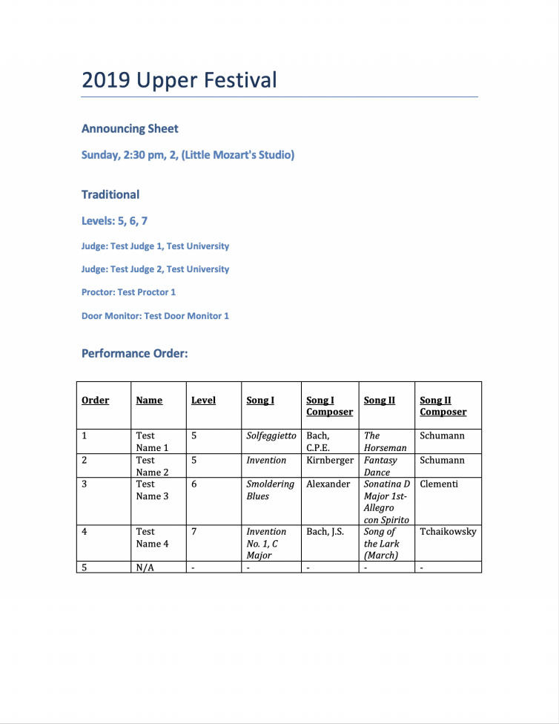
Notes:
Figure 5: An announcing sheet created by the document generator with entries in the documents fields from information gathered from ARIA 3.0’s database and passed to the document generator as a JSON object.

Slide 32
Results: Event Creation
Event creation is a primary function of administrators. A form, shown on the next slide, is presented to administrators which helps to set up the event criteria.
Once created, the event goes to the scheduling phase where it can either be scheduled and propagated to customers and teachers or the criteria can be modified.

Slide 33
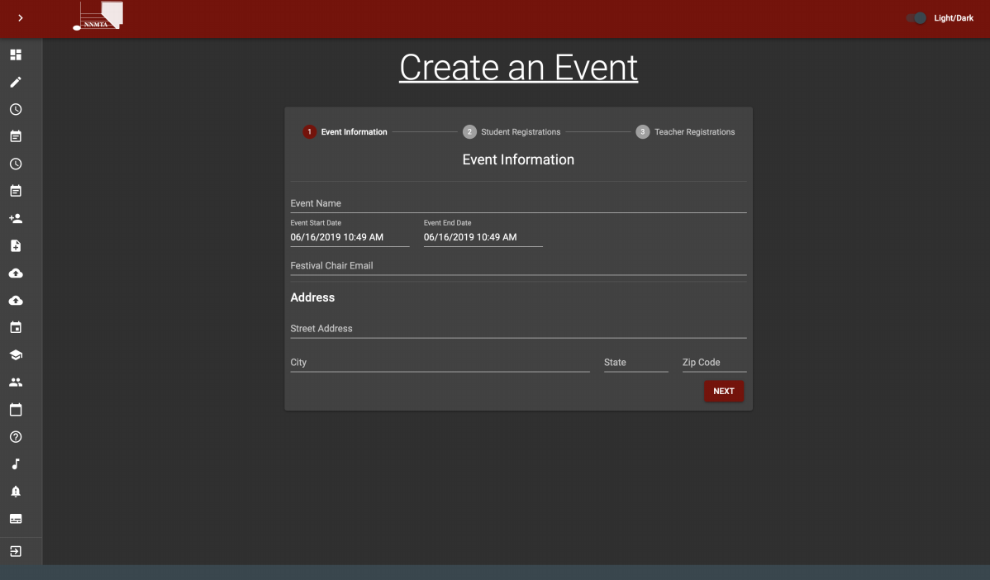
Notes:
Figure 5: The first step of the event creation form is shown (dark-theme). This form helps administrators create new events once logged into ARIA 3.0’s administrator portal.

Slide 34
Conclusions
ARIA 3.0 is a full-stack single-page web-application which demonstrates that software currently hosted on a platform such as WordPress can be developed as a proprietary stand-alone microservice application.
Migrating features from previous versions of ARIA (1.0/2.0) to ARIA 3.0 was accomplished by decomposing the previous applications features into loosely-coupled services.
Frequent meetings with stakeholders were an integral part of determining which business capabilities should be fulfilled by ARIA and implemented as services.

Slide 35
Future Work
Despite progression on the project, further work needs to be done before ARIA 3.0 is fully functional and able to replace previous versions.
Some work includes: Event scheduler, song-list processing, online judge scoring, SMS notifications, and email notifications.

Slide 36
Video Demo

Slide 37
Thank YOu
Any Questions

Slide 38
References
[1] Dan Abramov and the Redux documentation authors. Redux, A predictable state container for JavaScript apps. https://redux.js.org/, 2015. Last Accessed June 27, 2019.
[2] Circle Internet Services, Inc. CircleCI: The shortest distance from idea to execution. https: //circleci.com/, 2019. Last Accessed June 27, 2019.
[3] Cloud Native Computing Foundation (CNCF). Kubernetes, Production-Grade Container Orchestration: Automated container deployment, scaling, and management. https://kubernetes.io/, 2019. Last Accessed June 27, 2019.
[4] Node.js Foundation. Node.js, a JavaScript runtime built on Chrome’s V8 JavaScript engine. https://nodejs.org/en/, 2009. Last Accessed June 27, 2019.

Slide 39
References (Cont.)
[5] Node.js Foundation. Express: Fast, unopinionated, minimalist web framework for Node.js . http: //expressjs.com/, 2017. Last Accessed June 27, 2019.
[6] Docker Inc. Docker: Enterprise Container Platform for High-Velocity Innovation. https://www. docker.com/, 2019. Last Accessed June 27, 2019.
[7] Facebook Inc. React: A JavaScript library for building user interfaces. https://reactjs.org/, 2019. Last Accessed June 27, 2019.

