Slide 1
SyNAPSE Phase I Candidate Model
Hippocampal-Entorhinal-Prefrontal Decision Making
HRL0011-09-C-001
Computational Neuroscience, Vision and Acoustic Systems
HRL Labs, Malibu, June 17-18, 2010
Phil Goodman^{1,2} & Mathias Quoy³
¹Brain Computation Laboratory, School of Medicine, UNR
²Dept. of Computer Science & Engineering, UNR
³Dept. of Epileptology, University of Bonn, Germany
⁴Brain Mind Institute, EPFL, Lausanne, Switzerland

Slide 2



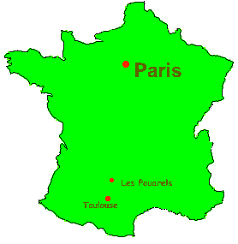




Contributors
Graduate Students
  Brain models
  Laurence Jayet
  Sridhar Reddy
  Investigators
  Phil Goodman
  Mathias Quoy
  U de Cergy-Pontoise
  Paris

Slide 3
Outline
Biology
  Wakeful activity dynamics
  Hippocamptal-Prefrontal Short-Term Memory
Model Assumptions
Equations
DARPA Aspects
Status/Results

Slide 4
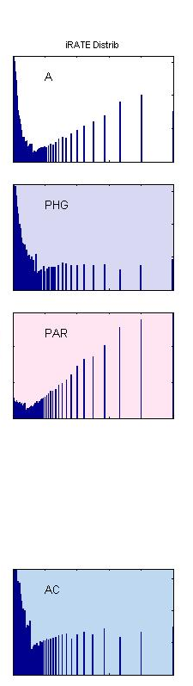
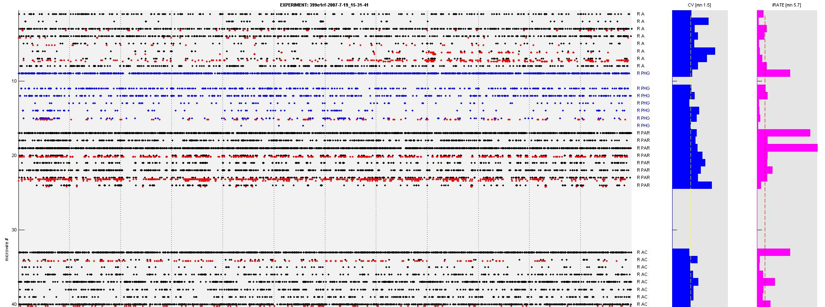
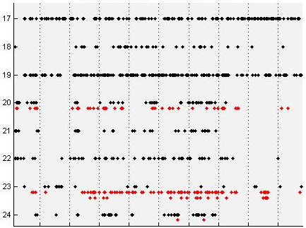
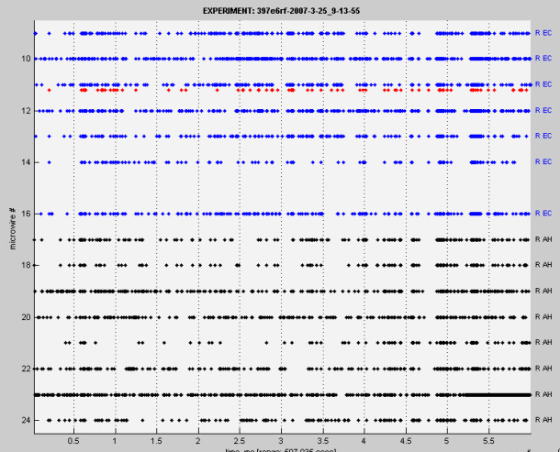
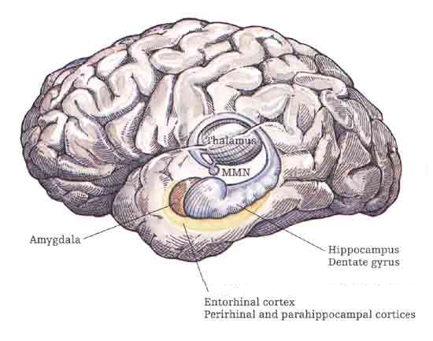
1a. Biology: Ongoing Activity
CV (std/mn)
(cellwise)
Rate
(cellwise)
ISI distrib
(10 min)
AMYG
ITL
PAR
R Parietal
5s close-up
CING
(1 minute window)
EC
HIPP
(data from I Fried lab, UCLA)

Slide 5
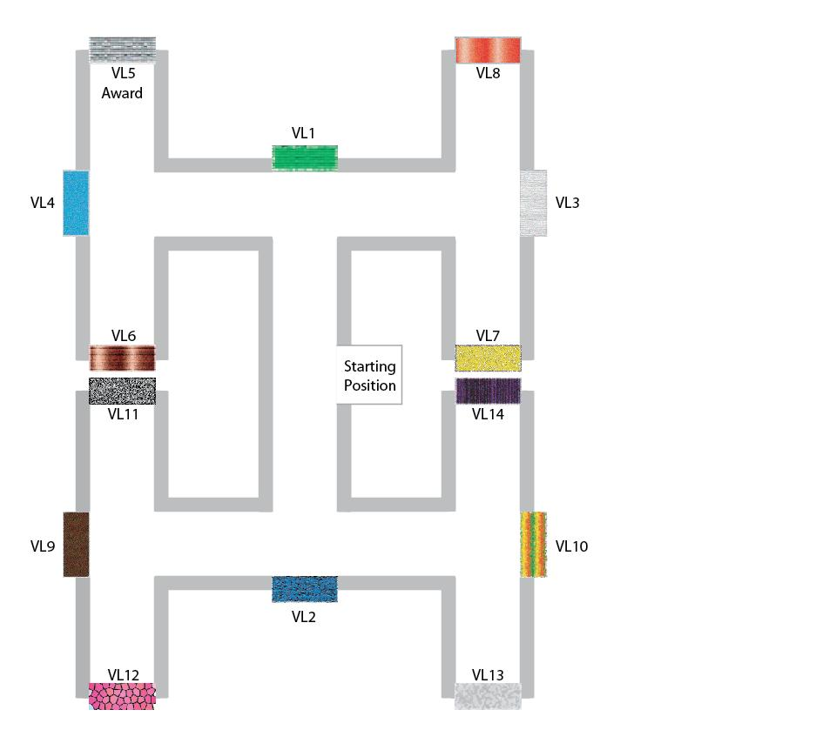
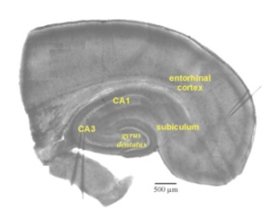
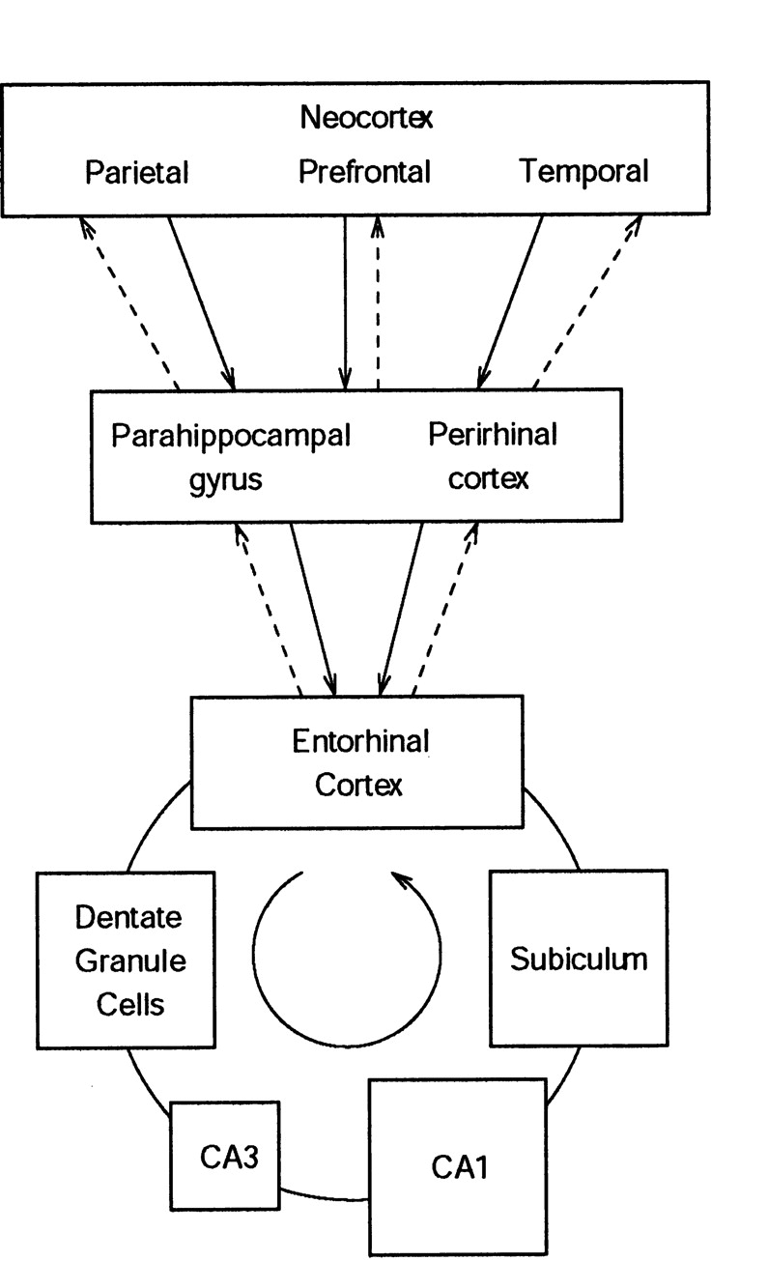

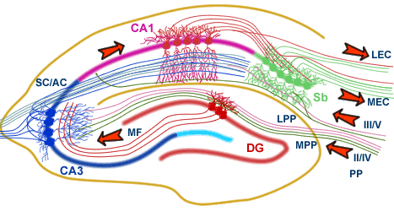
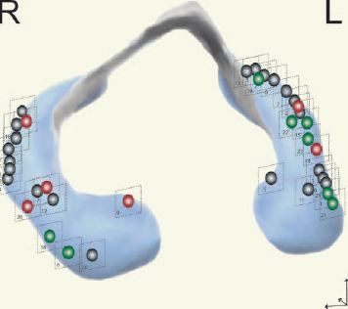
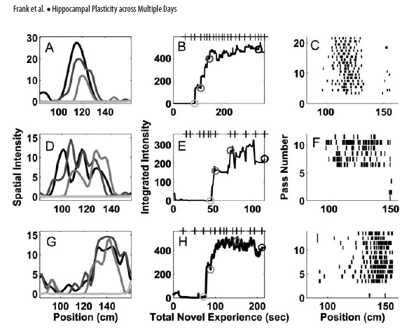
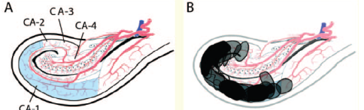
1b. Biology: Neocortical-Hippocampal STM
Rolls E T Learn. Mem. 2007
Frank et al. J NS 2004
Batsch et al. 2006, 2010

Slide 6
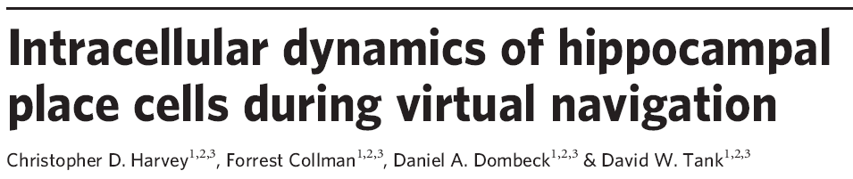


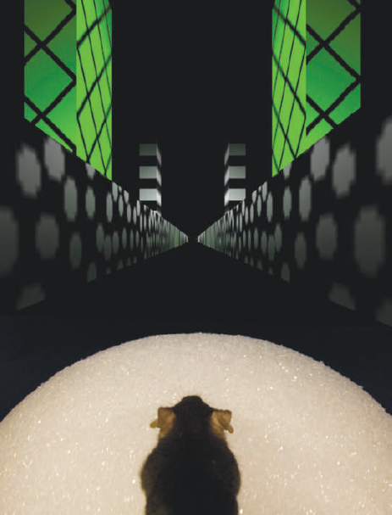
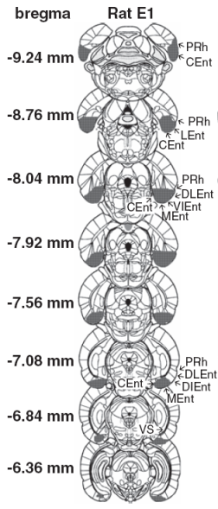
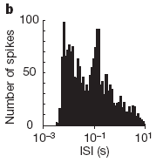
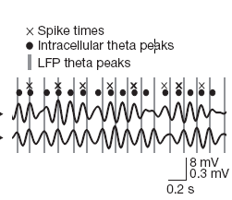
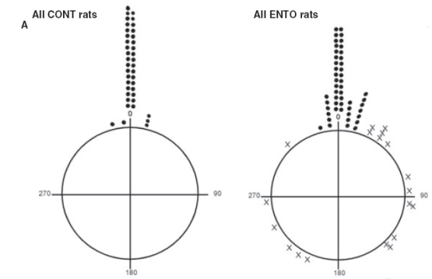
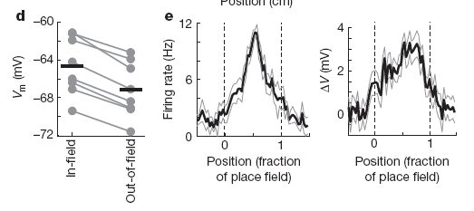
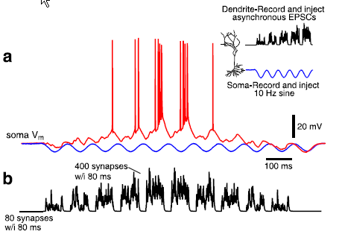
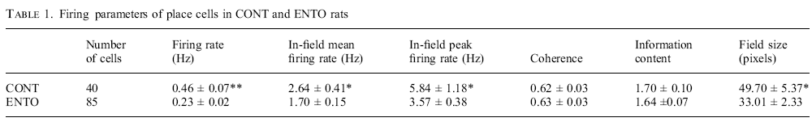
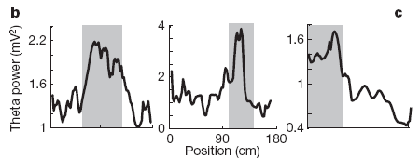
3c. Biology: EC and HP in vivo
EC grid cells ignite PF
EC suppressor cells stabilize
NO intracellular theta precession
Asymm ramp-like depolarization
Theta power & frequ increase in PF

Slide 7
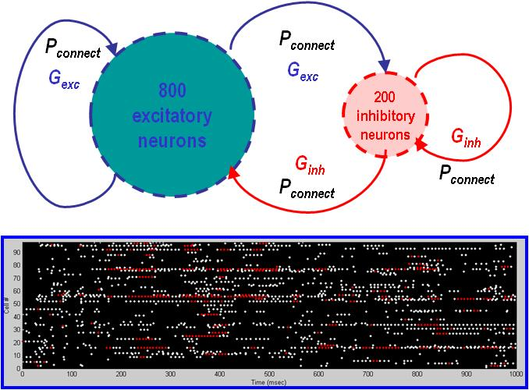
2. Assumptions
Parietal
Premotor
Prefrontal
Visual
input
Olfactory
input
EC
DG
SUB
CA

Slide 8
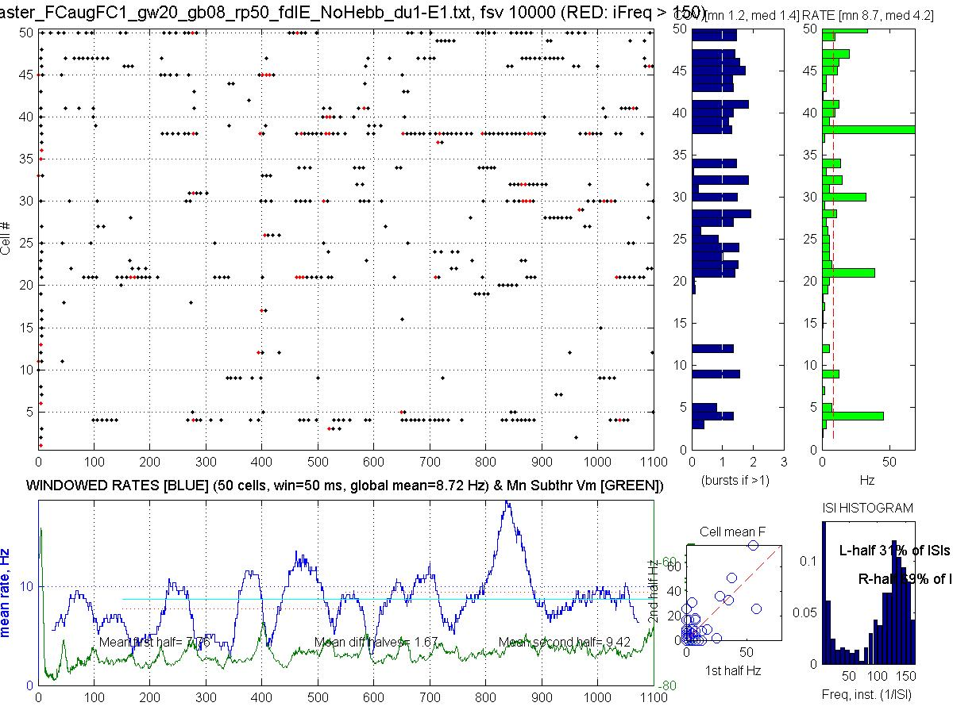

RAIN Activity

Slide 9
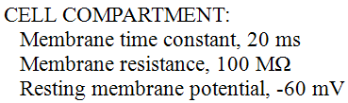
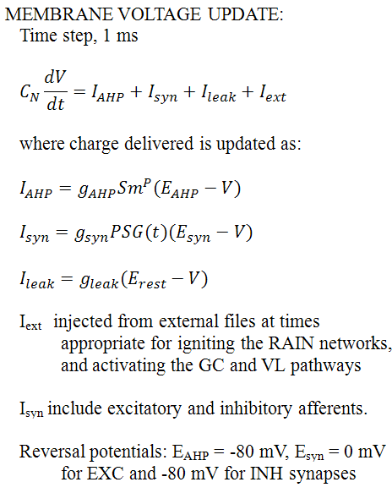
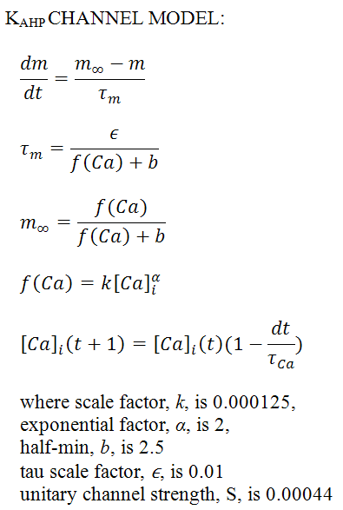
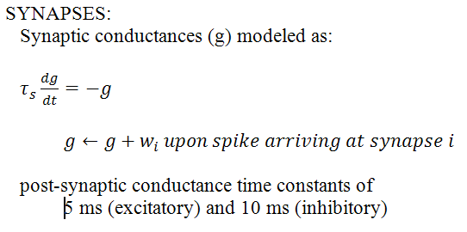

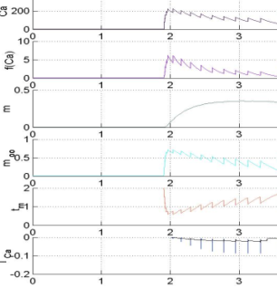
3. Cell Model Equations

Slide 10
4. Aspects of DARPA Large-Scale Simulation
Phase 1 DARPA Goal
“To simulate a system of up to 10⁶ neurons and demonstrate core functions and properties including:
(a) dynamic neural activity, (b) network stability, (c) synaptic plasticity and (d) self-organization
in response to (e) sensory stimulation and (f) system-level modulation/reinforcement”
The proposed Hippocampal-Frontal Cortex Model includes aspects of all 6 target components above:
  dynamic neural activity: RAIN, Place Fields, Short Term Memory, Sequential Decision Making
  network stability : affects of lesions and perturbations
  synaptic plasticity: role of STP and STDP (exc & inhib)
  self-organization: during PF formation, but not development
  sensory stimulation: visual
  modulation/reinforcement : reinforcement learning of correct sequence of decisions

Slide 11
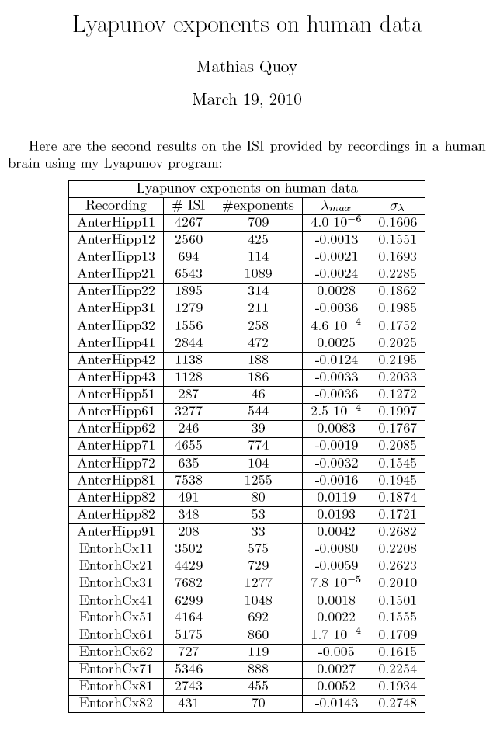
Mesocircuit RAIN: “Edge of Chaos”
Lyapunov exponents on human unit simultaneous recordings
from Hippocampus and Entorhinal Cortex
Edge of Chaos Concept
Originally coined wrt cellular automata: rules for complex processing most likely to be found at “phase transitions” (PTs) between order & chaotic regimes (Packard 1988; Langton 1990; but questioned by Mitchell et al. (1993)
Hypothesis here wrt Cognition, where SNN have components of SWN, SFN, and exponentially truncated power laws
PTs cause rerouting of ongoing activity (OA), resulting in measured rhythmic synchronization and coherence
The direct mechanism is not embedded synfire chains, braids, avalanches, rate-coded paths, etc.
Modulated by plastic synaptic structures
Modulated by neurohormones (incl OT)
Dynamic systems & directed graph theory > theory of computation
Unpublished data, 3/2010: Quoy, Goodman

Slide 12
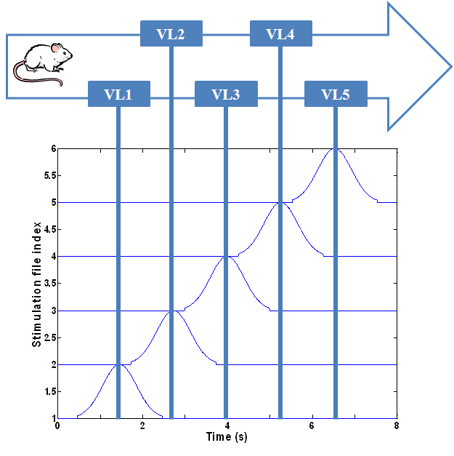

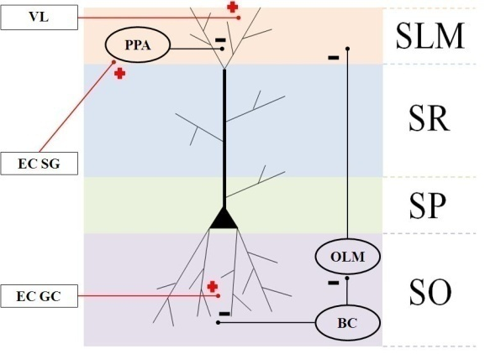
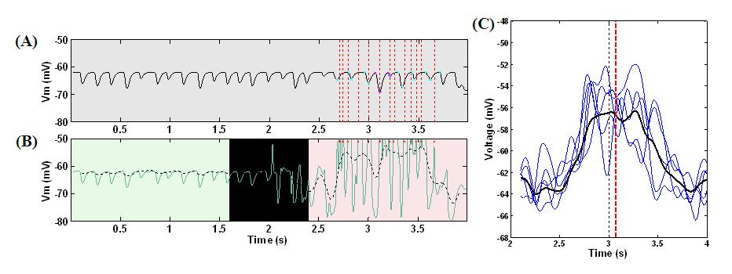
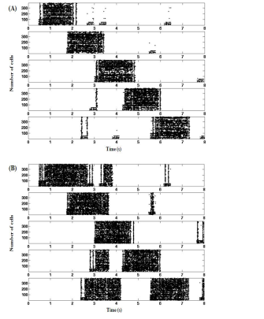
Early Results
A Circuit-Level Model of Hippocampal Place Field Dynamics
Modulated by Entorhinal Grid and Suppression-Generating Cells
Laurence C. Jayet^{1*}, and Mathias Quoy², Philip H. Goodman¹
¹ University of Nevada, Reno
² Université de Cergy-Pontoise, Paris
Explained findings of Harvey et al.
(2009) Nature 461:941
Harvey et al.
(2009) Nature 461:941
NO intracellular theta precession
Asymm ramp-like depolarization
Theta power & frequ increase in PF
Explained findings of Van Cauter et al.
(2008) EJNeurosci 17:1933
EC grid cells ignite PF
EC suppressor cells stabilize
w/o K_{ahp} channels
EC lesion

Slide 13
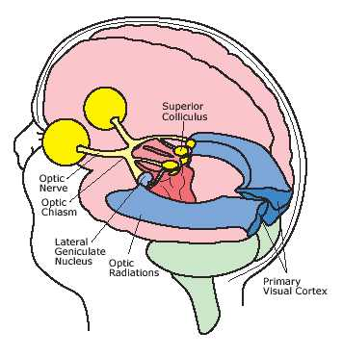
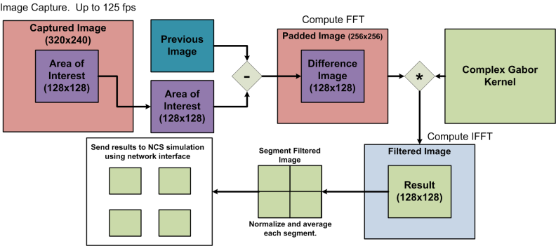
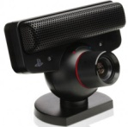







Phase I: Trust the Intent (TTI)
Gabor V1-3 emulation
LEARNING
CHALLENGE (at any time)
Robot Initiates Action
Human Responds
Human Acts
Robot Reacts
Robot brain initiates arbitrary sequence of motions
human moves object in either a similar (“match”), or different (“mismatch”) pattern
human slowly reaches for an object on the table
Robot either “trusts”, (assists/offers the object), or “distrusts”, (retract the object).
Match: robot learns to trust
Mismatch: don’t trust
trusted
distrusted

Slide 14
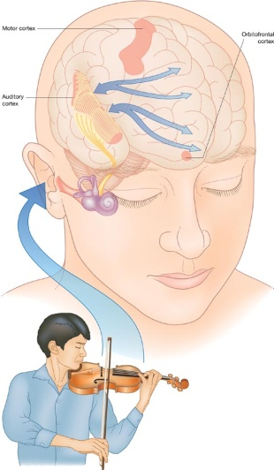
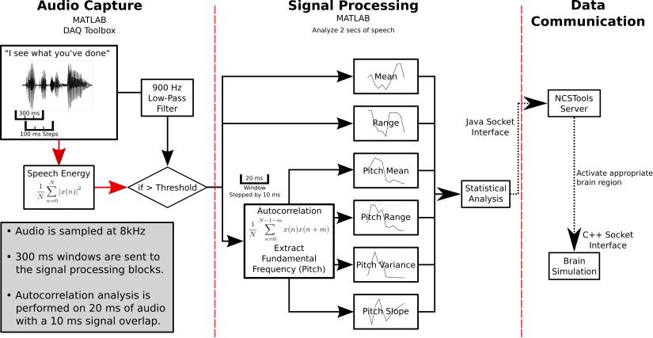
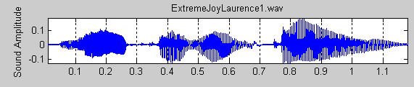

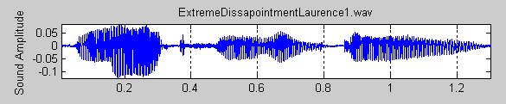
Phase II: Emotional Reward Learning (ERL)
LEARNING
GOAL (after several + rewards)
Human Initiates Action
Robot Responds
human initiates arbitrary sequence of object motions
robot moves object in either a similar (“match”), or different (“mismatch”) pattern
Match:
voiced +reward
Mismatch: voiced –reward
Matches consistently

Slide 15

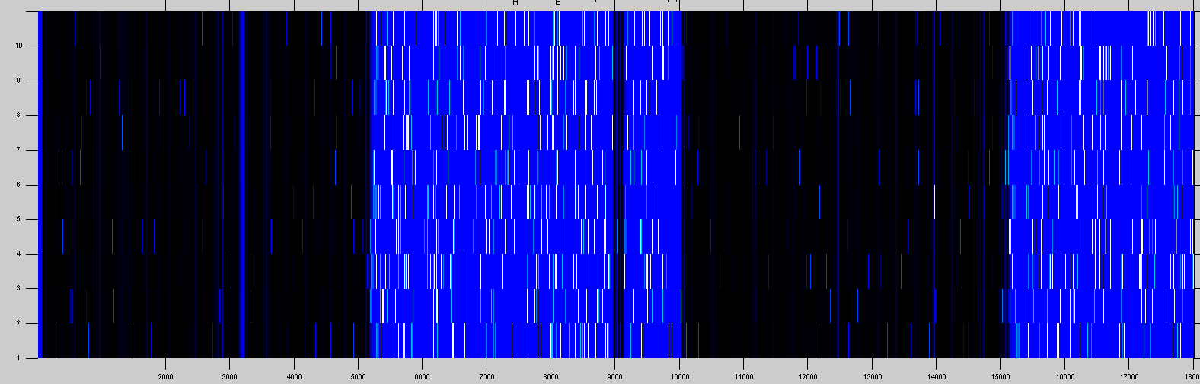
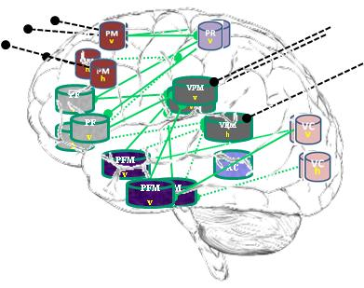
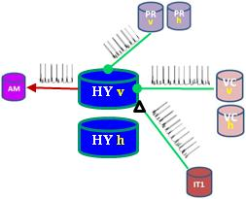

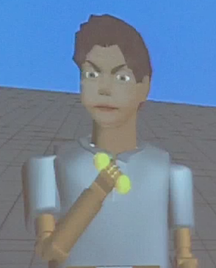
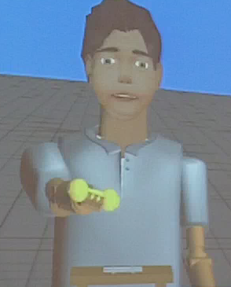
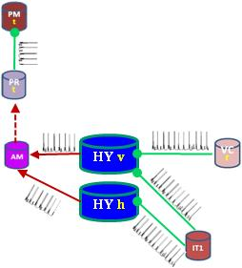
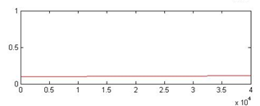
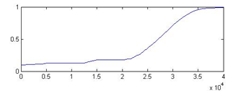
Early ITI Results
Discordant > Distrust
Concordant > Trust
mean synaptic strength

Slide 16

The Quad at UNR

Slide 17

5b. Status of Simulation & Results
Figure 3 – Place Cell RAIN Activity. (A) A RAIN (recurrent asynchronous irregular non-linear) network using 4:1 ratio of excitatory and inhibitory cells with 3% connectivity, and synaptic conductances G_{exc} and G_{inh}. (B) Sample of RAIN activity. Membrane potential (green), and mean rate (blue). (C) Mean membrane potential and firing rates showing biological-like theta activity obtained when two RAIN networks interact. (D) Supra-Poissonian coefficient of variation (typically 30-50% greater than a Poisson spiking process. (E) Wide range of RAIN firing rates of 2-60 Hz with mean rate of 14.8 Hz. (F) Bimodal distribution of firing. (n=50 cells).

Slide 18


5c. Status of Simulation & Results
Figure 5 – Frequency of Intracellular Theta. (A) 6-10 Hz filtered mean theta within a typical place field. (B) Corresponding moving window-average of the theta oscillation period. (n=18). (C) Comparison of the mean frequency during the first, second, and last thirds of all fields (P<0.001 by ANOVA, middle versus combined first and last thirds, n=498). Error bars are ± 1 s.e.m.
Figure 4 – Place Field Activity During Multiple Runs Through the Track. Typical place field firing during the first traversal, mean rate of 3.8 Hz (A), second traversal, 3.6 Hz (B), and third traversal, 2.7 Hz (C) through the maze. (D-F) Corresponding evolution of RAIN place cell excitatory synaptic strength (sample of 100 cells).
Figure 6 – Spectral Analysis of Intracellular Membrane Potential Recordings. (A) Power spectral analysis as a function of the mouse’s position on the linear track (n=21). (B) Ratio of power during epochs inside the place field to power during epochs outside the place field for bands from 6 to 10 Hz (control and lesioned groups, n=498). Error bars are ± 1 s.e.m.

Slide 19

5d. Status of Simulation & Results
Figure 8 – Spike Precession with respect to LFP during Place Fields. (A) Magnification of first spike timing of all 19 cells from a single run superimposed on extracellular theta within the third place field (B) For each spike in (A), phase with respect to LFP, with outer hull fit. (C) Location of spikes with respect to theta waveform. (See text, n=21). (D) Representative sample for clarity (25%) of outer hull fit of precession during third place fields; statistics were performed on all 24 runs (472 unlesioned cells). Black dashed line, true center of place field; red dashed line, mean timing of the troughs (maximal precession).
Figure 7 – Asymmetric Ramp-Like Membrane Potential Depolarization Inside Place Fields. (A) LFP as measured from within the soma of a CA pyramidal cell, outside (0-2 sec) and within a place field (2-4 sec); spike unit timing is indicated by dotted red lines. Cyan and magenta markers indicate auto-detection of 0 and 180 degree theta limits. (B) Corresponding intracellular Vm (green line), and superimposed 1-2 Hz filtering (dashed black line). Red dots indicate spike timing (truncated, n=1). (C) Representative sample of mean 1-2 Hz filtered ramps from third place field; statistics were performed on all 24 unlesioned runs (n=472). Black line, mean of all curves. Black vertical dashed line, true center of place field; red vertical dashed line, mean timing of the peak of individual ramps (see text for details).

Slide 20


5d. Status of Simulation & Results
Figure 9 – Number of Active Cells and their Firing Rates within Place Fields. (A) Average number of active cells within five Place Fields. (B) Average firing rates within five place fields. (n=498, control vs. lesioned groups).
Figure 10 – Place Fields Stabilization. (A) Control: entorhinal cortex grid cells tonic suppression on five place fields during one run (8 sec). (B) Lesioned: no entorhinal cortex grid cells tonic suppression on five place fields during one run (8 sec). (n=380).

Slide 21
6. Challenges & Issues

Slide 22





Task: one million neuron hippocampal formation
Microcircuit:
Axial distribution of Hippocampal CA1 Place Field Networks controlled by Temporal Lobe Entorhinal Cortex Grid Cell (EC-GC) Populations
Task: Can recent discoveries about EC-GC control^{1,2} control of CA1 Place Fields³,including in vitro recordings⁴ during awake behavior, be modeled in large-scale compartmental neuronal networks compatible with the HRL SyNAPSE phase I hardware?
Visual Navigation Task
Prefrontal Cortex: planning, decision making
Temporal Cortex:
  Visual scene processing
  Entorhinal cortex modulates Hippocampus
Hippocampal Formation:
  Short-term memory for navigation
  Short-term episodic memory in primates
  Transfer to neocortex for long-term memory
Methods: Results (as of February, 2010):
1. RAIN networks server as Place Cell clusters 1. Successful RAIN theta phase precession
  A. 3,000 cells/place field x 5 fields in current model
  B. Interneurons: Basket cells & O-LM cells (300/field)
  C. Two-compartments: apical tuft and soma, 180º theta phase offset
  (for SyNAPSE, modeled as cell-types connected synaptically)
2. EC-GC serve to “ignite” and stabilize place fields 2. Successful ignition, elimination of spontaneous firing
    A. Ignite place fields at boundaries between them reduction of place cell population, and increase in rate
    B. Tonically suppress place fields from spontaneous firing
    C. Reduces number of place cells by about half
    D. Increase mean firing rate of remaining cells by 30%
Firing vs Phase:
Precession:
GC intact:
GC lesion:
    Work plan: expand to 500,000 cell-equivalent (allow other 500k cells for visual processing and motor control networks)
    a. expand Hippocampus & Grid Cell regions
    (300,000 cell-equivalents)
    b. add prefrontal interaction circuit (200,000 cell-equivalents)
O’Keefe J, Dostrovsky J. Brain Res 1971; 34:171.
Hafting T et al. Nature 2005; 436:801.
Van Cauter T et al. Eur J Neurosc 2008; 27:1933.
Harvey CD et al. Nature 2009; 461:941.

Slide 23


Behavioral VNR System
Notes:
Definition of Virtual Neurorobotics. We define virtual neurorobotics as follows: a computer-facilitated behavioral loop wherein a human interacts with a projected robot that meets 5 criteria: (1) the robot is sufficiently embodied for the human to tentatively accept the robot as a social partner, (2) the loop operates in real time, with no pre-specified parcellation into receptive and responsive time windows, (3) the cognitive control is a neuromorphic brain emulation incorporating realistic neuronal dynamics whose time constants that reflect synaptic activation and learning, established membrane and circuitry properties, and (4) the neuromorphic architecture is expandable to progressive larger scale and complexity to model brain development, (5) the neuromorphic architecture can potentially provide circuitry underlying intrinsic motivation and intentionality, which physiologically is best described as “emotional” rather than rule-based drive. A summary of the requirements for a VNR system is shown in Table 1.
High-level social robotic systems reported to-date are generally controlled by artificial intelligence and machine learning algorithms that incorporate explicit task lists and criteria for task satisfaction, segmenting time into periods of action and of awaiting response. Our interest is not to characterize the rules of social engagement per se, but rather to uncover the basis of biological brain sensorimotor control, information processing and learning. The corresponding neuromorphic brains must therefore be driven intrinsically by a motivational influence such that the dynamics that subserve information processing are themselves affected by a drive to accomplish the tasks (with neural learning that reinforces successful behavioral adaptation) (Samejima and Doya, 2007; Schweighofer et al, 2007). The motivational system must therefore demonstrate intentionality, which means that the intelligent system takes into account the “aboutness” of its own relationship to other behaving entities (and vice versa) in its environment. With sufficiently complex neuromorphic architectures, intentionality would be expected to be reflected by frontal and parietal mirror neuron responsiveness characteristic of many mammalian intentional behaviors (Iacoboni and Dapretto, 2006). This combined physiological responsiveness of intrinsic motivation and intentionality in animals, including humans, most generally can be described as emotion:
Emotion, as the name suggests, sets in motion the moment-to-moment behaviors of an intelligent system (Breazeal, 2003; Frijda, 2006). From this perspective, “intelligence” has evolved as a way to better serve emotional drive. That is, intelligence may be a derivative of emotion, rather than vice versa. We therefore make the following hypothesis: the development of truly intelligent systems cannot occur outside the real-time, emotional interaction of humans with a neuromorphic system. This does not mean that intelligent systems, once refined, cannot ultimately be cloned (at a point in development where they are ready to learn advanced tasks). Rather, to grow the early intelligent systems we must start with minimalist brain architectures that demonstrate intrinsic motivation and intentionality in scenarios requiring intelligent behavior in a real-world context. This recapitulates the way in which humans develop cognitive function over the first several years of social experience. With the VNR approach, we seek not only to “grow” such intelligent systems but also to comprehend, at each step, the differential changes in architecture giving rise to novel and intelligent cognition.

