Slide 1
SyNAPSE Phase I Large-Scale Model Candidate
The Entorhinal-Hippocampal-Subicular-Prefrontal Loop
Multiple-Decision Navigation based on Short-Term Memory
HRL Labs, Malibu, August 27, 2010
HRL0011-09-C-001
Phil Goodman¹ & Mathias Quoy²
¹Brain Computation Laboratory, School of Medicine, UNR
  ²U de Cergy-Pontoise, PARIS
Laurence Jayet Bray, PhD-candidate, BME
Jeff Dorrity, MD-candidate
Mia Koci, BA-candidate

Slide 2
Phase I DARPA Simulation Components
To simulate a system of up to 10⁶ neurons
and demonstrate core functions and properties including:
(a) dynamic neural activity,
(b) network stability,
(c) synaptic plasticity and
(d) self-organization in response to
(e) sensory stimulation and
(f) system-level modulation/reinforcement

Slide 3
Outline
Relevance of HP-PF Loop
Biology of Short-Term Memory for Navigation
Model Assumptions & Equations
Results, Virtual Environment, Scalability
DARPA Targets

Slide 4
Relevance
TECHNOLOGY
  Mobile robotic navigation & search
  Neuromorphic STM for on-line AI in dynamic environments
  Human-computer interface for improved STM in the field
PATHOPHYSIOLOGY
  Alzheimer’s, Parkison’s, Mad Cow, other degenerative dementia
  Stroke & Traumatic brain injury
  Schizophrenia
  Drug addiction
  Epilepsy

Slide 5
MEMORY
Rehearsal
Encoding
Decision
Retrieval
Consolidation
&
Re-consolidation
Sensory
Visual
Short-term Memory
Episodic
Long-term Memory
Reward
Learning
Environmental
Input:
Landmarks
Motor
Movement Response:
Left or Right Turn

Slide 6
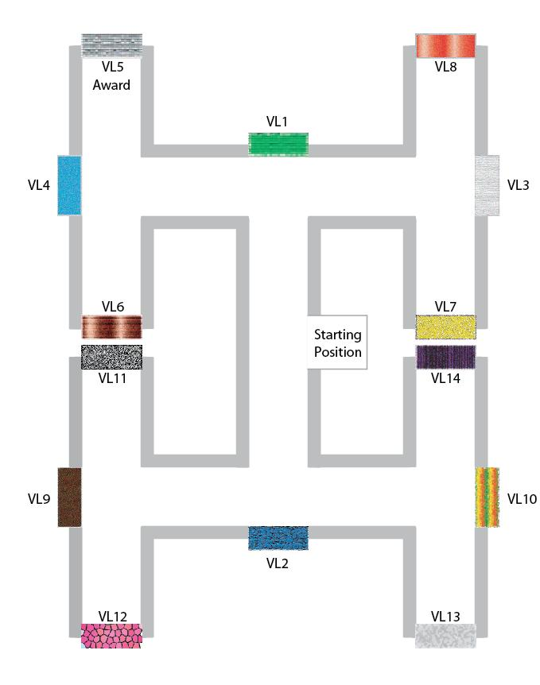
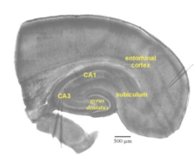
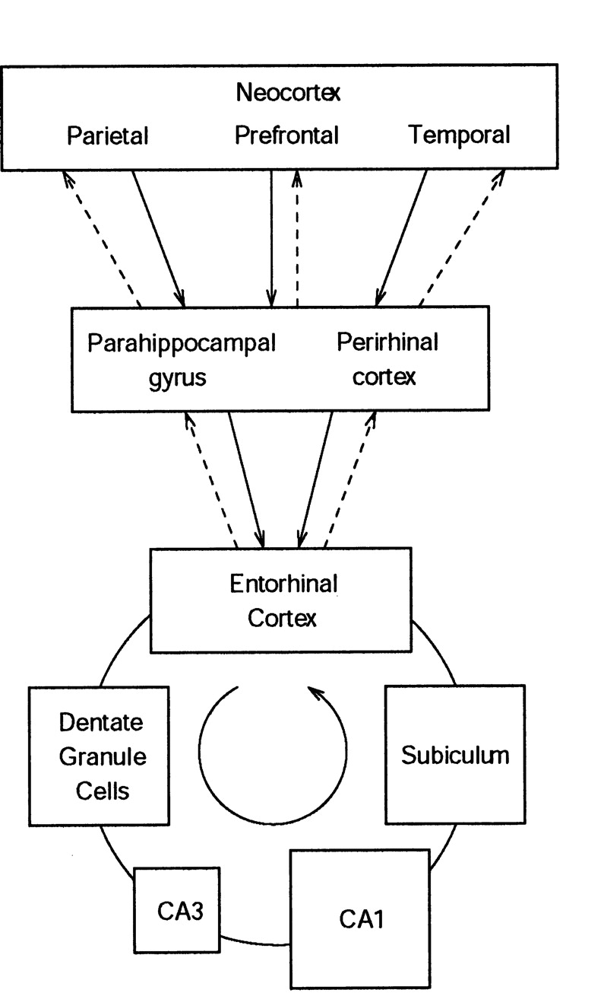

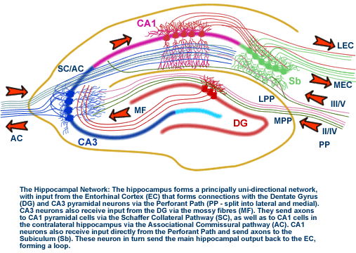
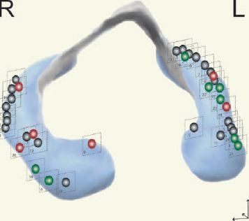
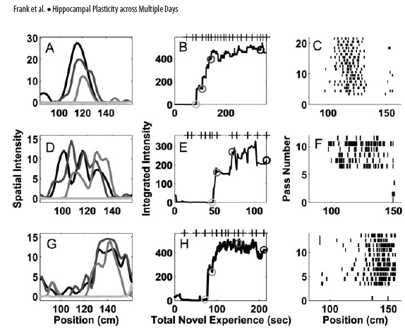
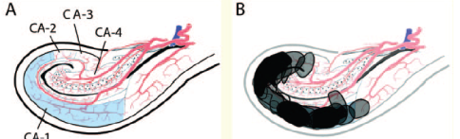
Biology: Neocortical-Hippocampal STM
Rolls E T Learn. Mem. 2007
Frank et al. J NS 2004
Bartsch et al. 2006, 2010

Slide 7
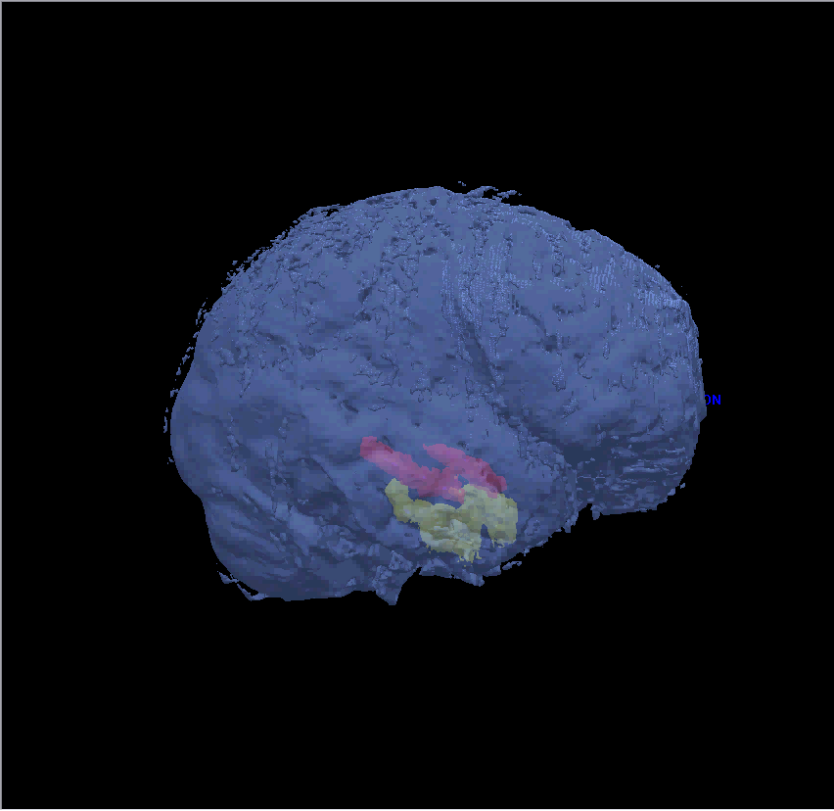
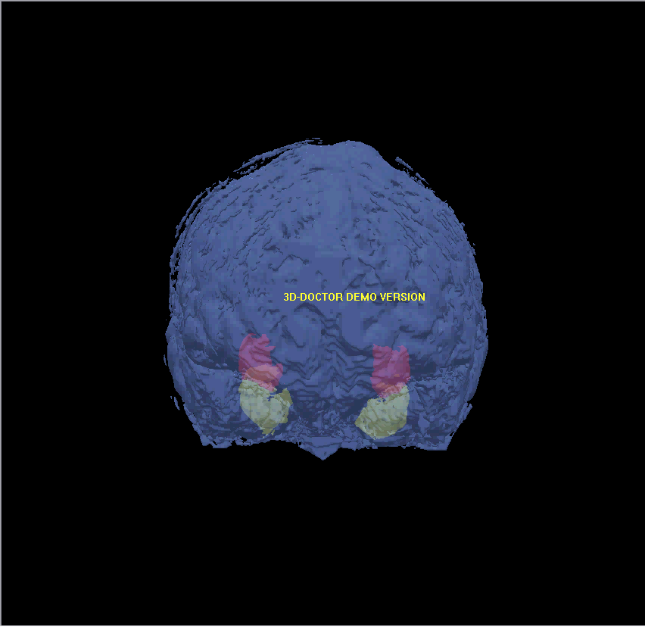
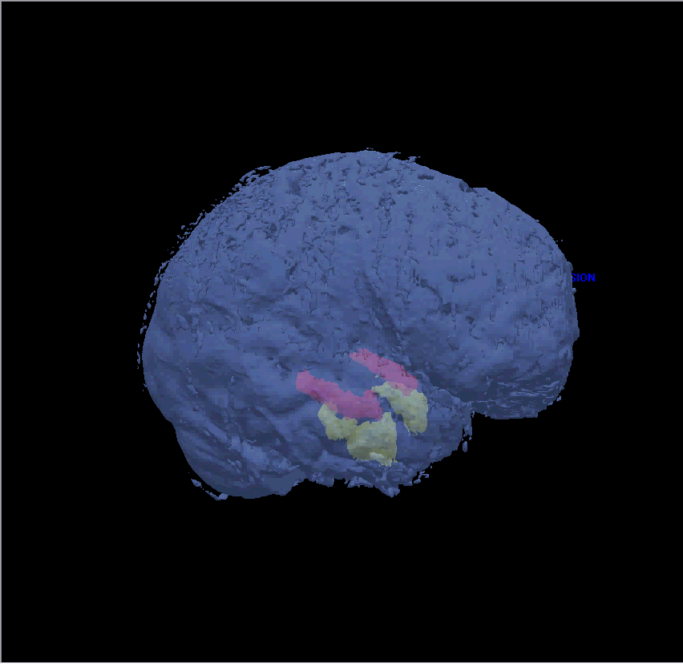
(possible 3 D rendering animation here)

Slide 8
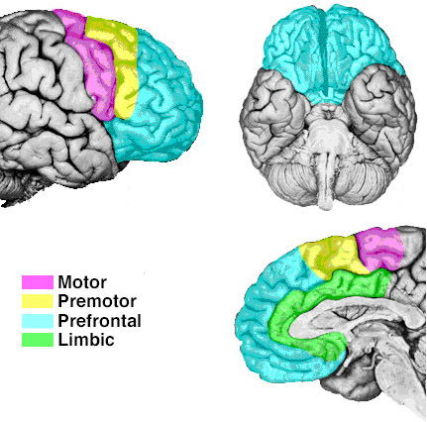
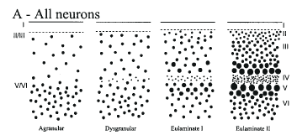
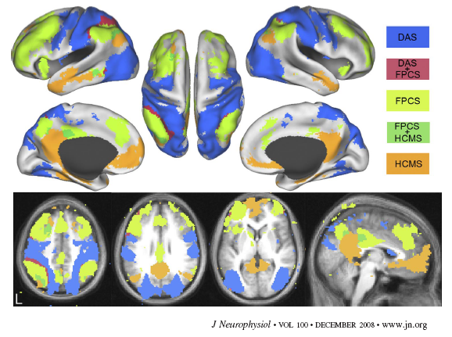
Biology: Prefrontal Cortex
Anterior to, and distinguished from other frontal areas by having a recognizable granular layer (IV)
Heavier staining for PV+ inhibitory neurons (vs. limbic cortex enriched in CB+ interneurons)
Densely connected : primary sensory, association & premotor cortex, hippocampus (monosynaptic), basal ganglia, brainstem (RAS)
Functional roles: working memory, planning & decision making, personality expression, control of socially correct behavior
Executive function/attentional:
  1. “search/detect” FEF-MT, WM (search & detection) [DAS]
  2. “frontoparietal control”, WM [FPCS]
  3. “bottom-up” HF-cortical [HCMS]
  4. “salience network”
  Selection rather than storage
  Relevance of input within an emotional context
  Incr. persistent activity (up states)
Notes:
Top-down attention: This brain system includes regions in the frontal eye fields, ventral premotor cortex, superior parietal lobule, intraparietal sulcus, and motion-sensitive middle temporal area (MT). Activity in the dorsal attention system is increased at the onset of search displays, maintains activity while awaiting a target, and further increases activity when targets are detected. Also known as oculomotor system. The dorsal attention system (also known as the oculomotor system) has been implicated in eye movements, overt and covert spatial attention, and the generation of motor plans via transformations of sensory inputs from multiple modalities.
Frontoparietal control system: includes the anterior prefrontal, dorsolateral prefrontal, dorsomedial superior frontal/anterior cingulate, anterior inferior parietal lobule, and anterior insular cortex. The frontoparietal control system has been
implicated in monitoring of conflict, the updating and implementation of goal-directed behavior, and the integration of sensory information with internal representations of intentions to coordinate behavior (both in WM).
Hippoc-cortical: active during passive mental states linked to internally directed cognition including recollection of the past and thinking about the future (often labeled the default network, which also includes medial prefrontal and some aIPL). These properties are consistent with the system
supporting externally directed cognition. This brain system includes regions in ventral medial prefrontal cortex, posterior inferior parietal lobule, retrosplenial cortex, posterior cingulate, and the lateral temporal lobe. Overlap regions active during episodic memory retrieval.
The close interposition of the aIPL (FPCS) among pIPL (HCMS) and SPL (DAS) regions may function to facilitate the transfer of information between either the dorsal attention or hippocampal-cortical memory systems and the frontoparietal control system during task performance. The aIPL (FPCS) component of the control system may be recruited during tasks that demand a temporary buffer. For example, during articulatory suppression, the aIPL may hold information on-line in working memory (Gruber 2001), and during long-term memory retrieval, the aIPL may represent retrieved information in a form accessible to decision-making processes (Wagner et al. 2005). Alternatively, increases in activity within aIPL may reflect processes recruited to maintain an attentional set during demanding tasks.
Two of the regions that showed the greatest expansion included anterior lateral prefrontal cortex and anterior inferior parietal lobule—two of the prominent components of the frontoparietal control system. Collectively, these studies suggest that the human frontoparietal control system may be especially important in the evolution of the human brain.
Salience network: salience network (SN), which includes the ventrolateral prefrontal cortex (VLPFC) and anterior insula (jointly referred to as the fronto-insular cortex; FIC) and the anterior cingulate cortex (ACC) (1, 2, 4, 5). Sridharan. PNAS 08
Vincent. J Neurophysiol • VOL 100 • DECEMBER 2008:
FIG. 7. Intrinsically defined dorsal attention (DAS), frontoparietal control (FPCS), and hippocampal-cortical memory (HCMS) systems and the overlap between them from dataset 3. Voxels in the DAS include regions correlated with MT and SPL and are shown in blue. Voxels in the FPCS include regions correlated with aPFC and aIPL and are shown in light green. Voxels in the HCMS include regions correlated with HF and pIPL and are shown in orange. Voxels significantly correlated with the DAS and FPCS are shown in red. Voxels significantly correlated with the HCMS and FPCS are shown in dark green. Data are displayed on the lateral, medial, and dorsal surfaces of the left and right hemispheres as well as MNI atlas space axial and sagittal slices.

Slide 9
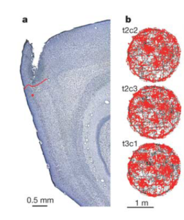
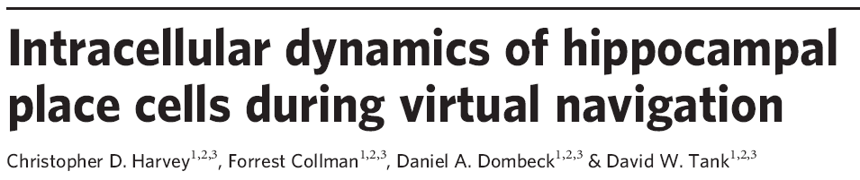

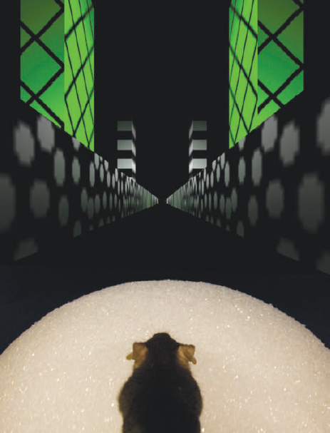

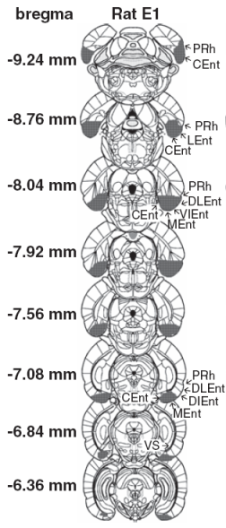
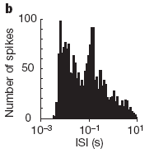
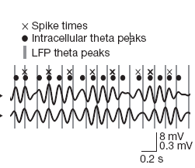
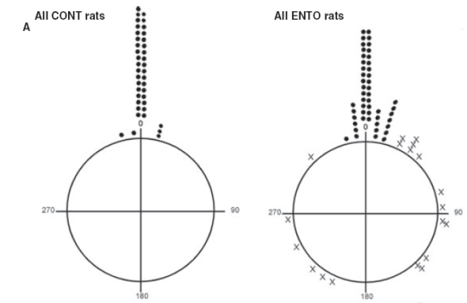
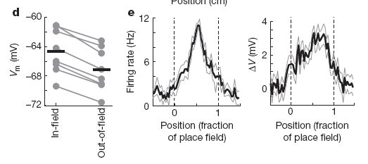
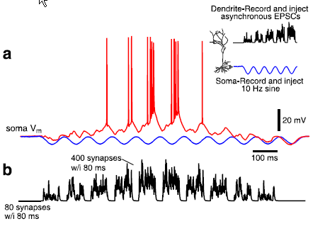
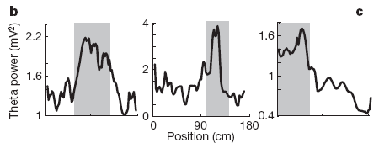
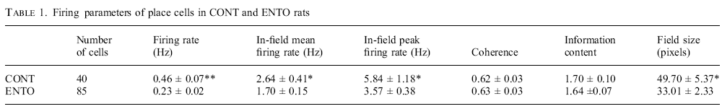
Biology: HP & EC in vivo
(Hafting 2005)
NO intracellular theta precession
Asymm ramp-like depolarization
Theta power & frequ increase in PF
EC cells stabilize PF ignition
EC suppresses # of PF cells firing while increasing firing rate

Slide 10
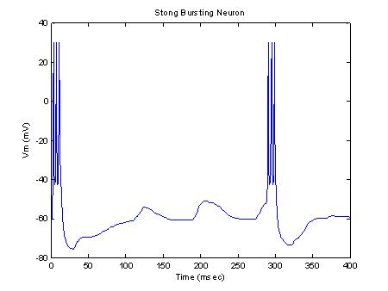
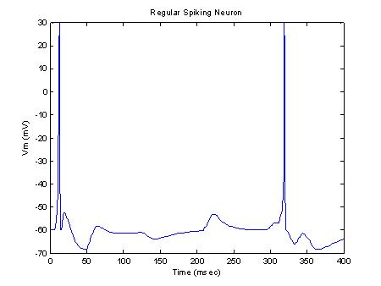
Biology: SUBICULUM in vivo
SB (Strong Bursting)
RS (Regular Spiking)
xxx
xxx

Slide 11
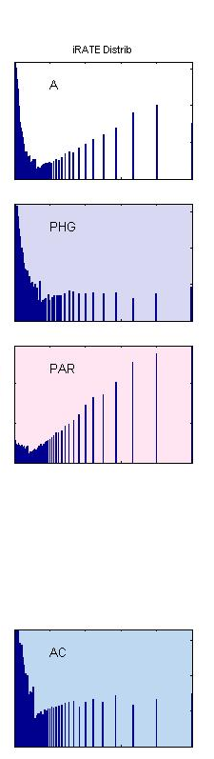
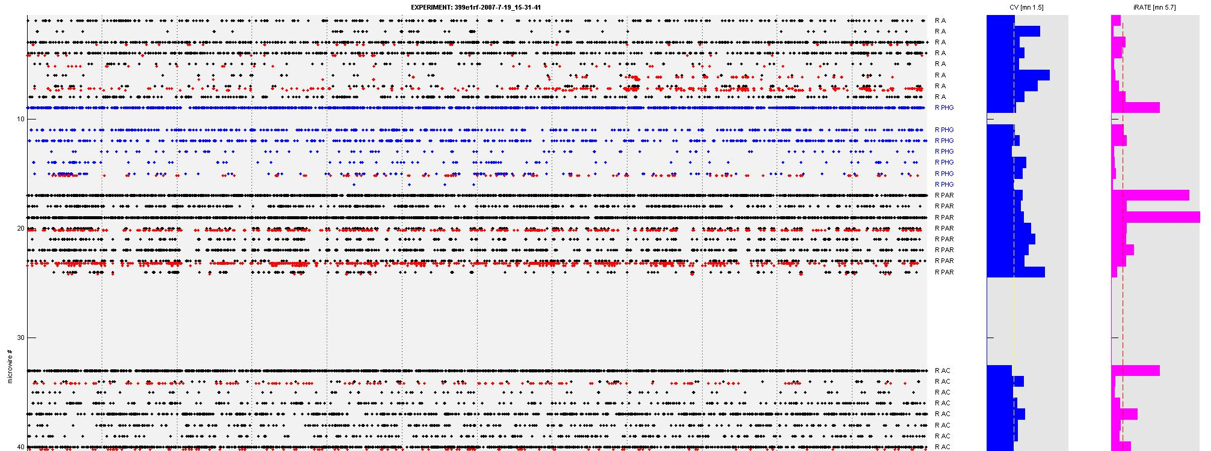
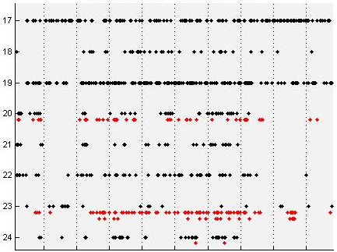
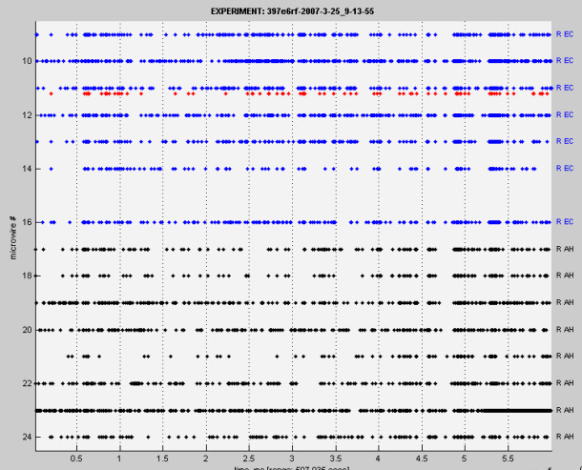
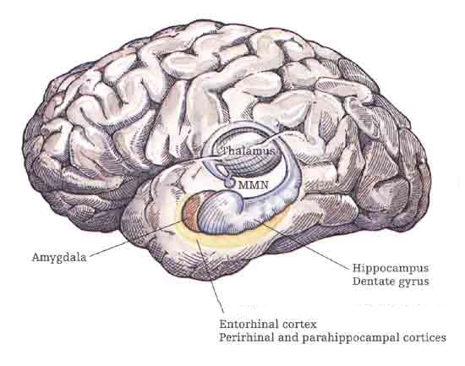
Biology: Ongoing Activity
CV (std/mn)
(cellwise)
Rate
(cellwise)
ISI distrib
(10 min)
AMYG
ITL
PAR
R Parietal
5s close-up
CING
(1 minute window)
EC
HIPP
(data from I Fried lab, UCLA)

Slide 12
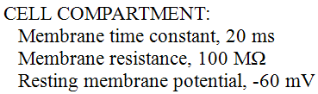
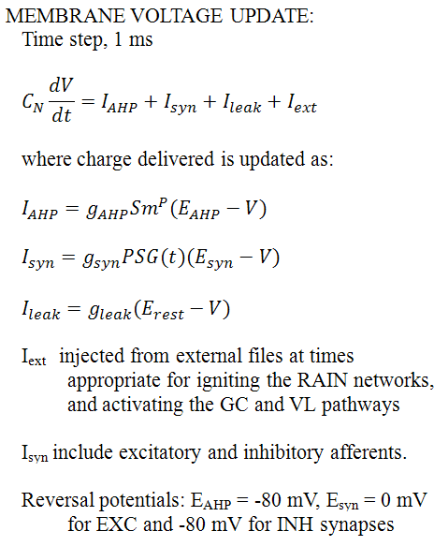
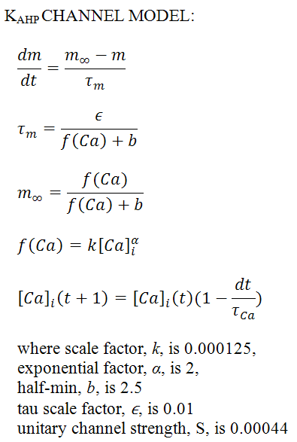
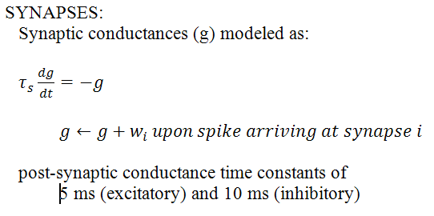

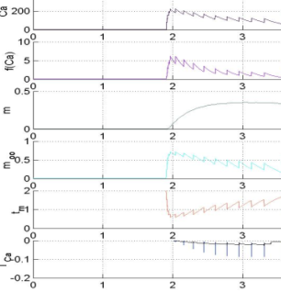
Cell Model Equations

Slide 13
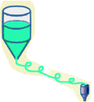
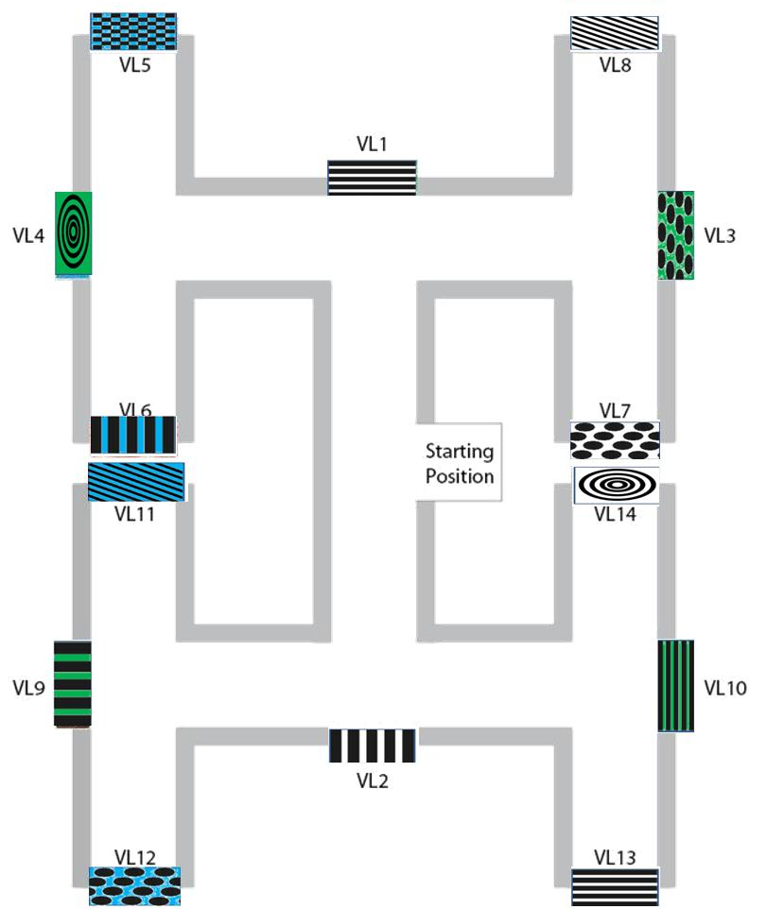

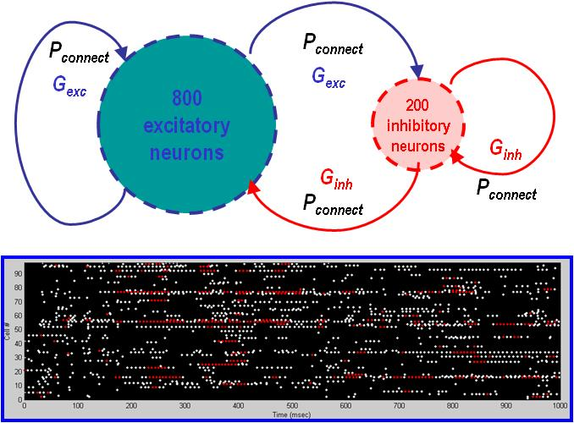
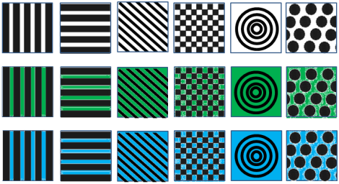
Paradigm & Model Assumptions
Visual-Parietal
Premotor
Prefrontal
Visual
input
Somato-sensory
input
EC
DG
SUB
CA

Slide 14
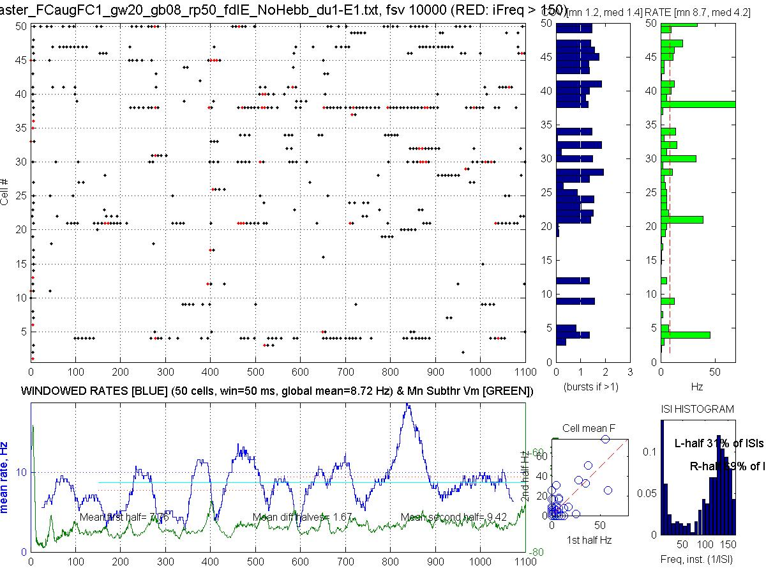

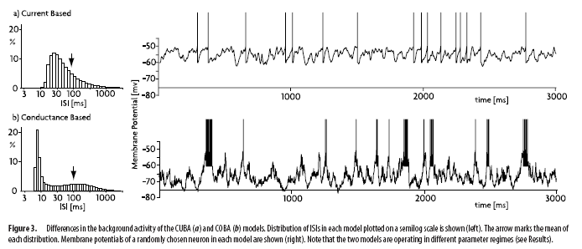
RAIN activity

Slide 15
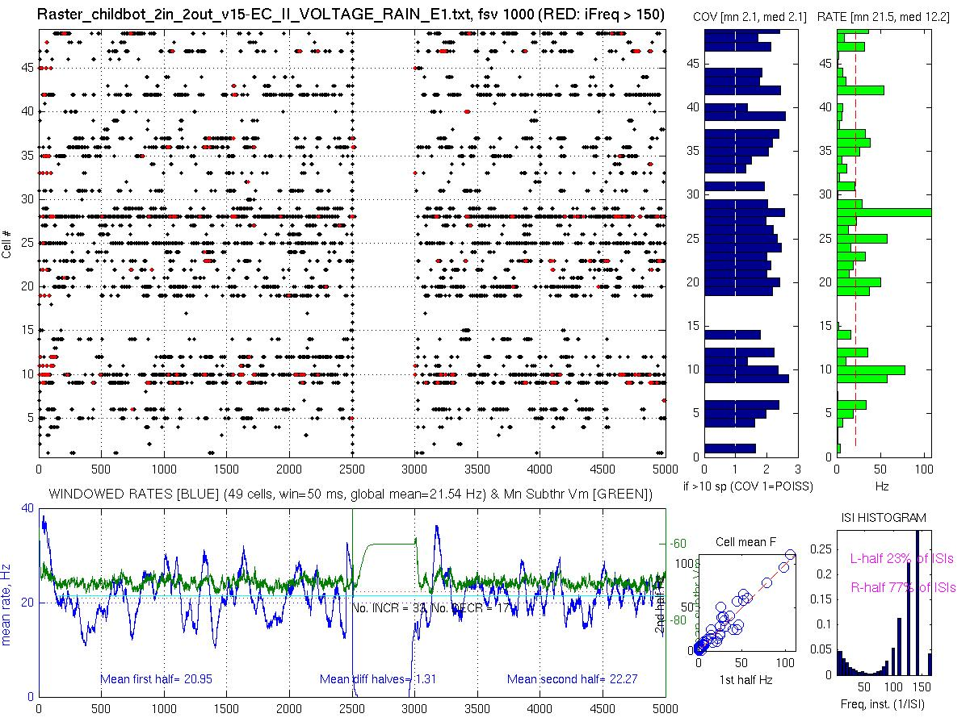
ON/OFF Properties of RAIN
A network of 2000 cells can be shut off
by 50% synchrony…
Yet 20 spikes spread over 6 ms
can reignite network…

Slide 16
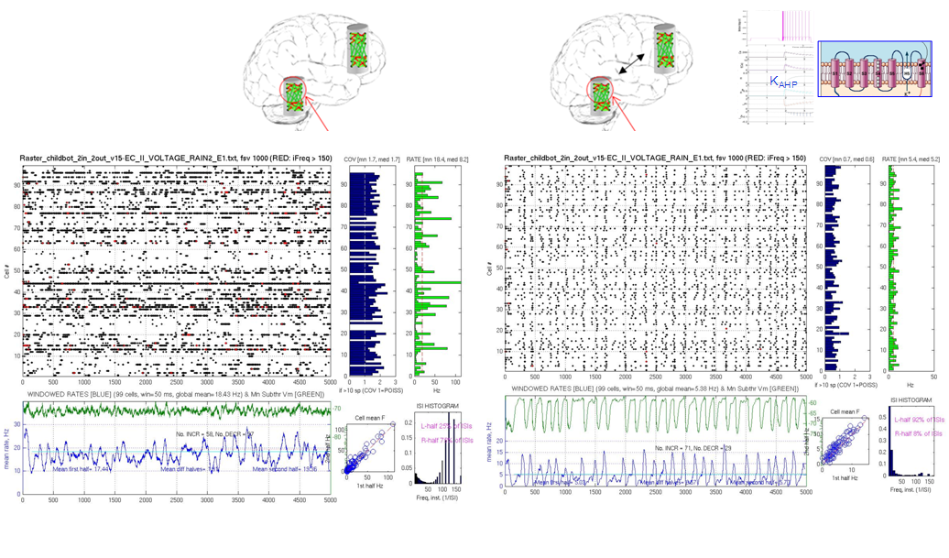
Weak Coupling Yields THETA Oscillation

Slide 17
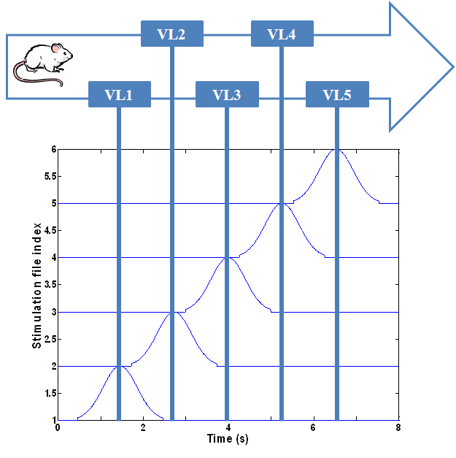

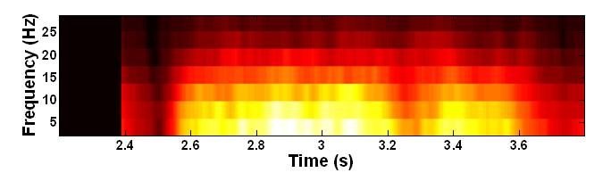
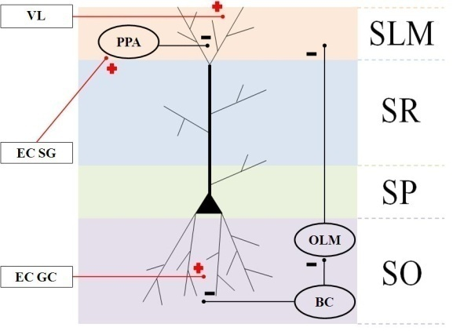
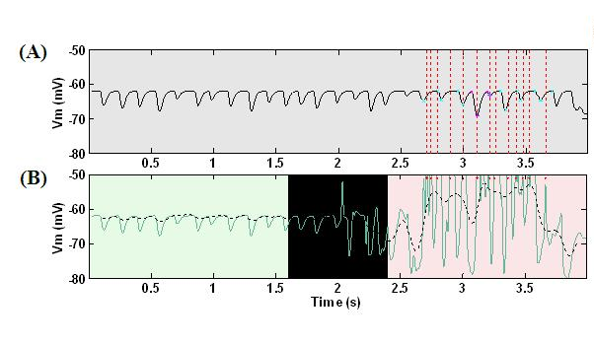
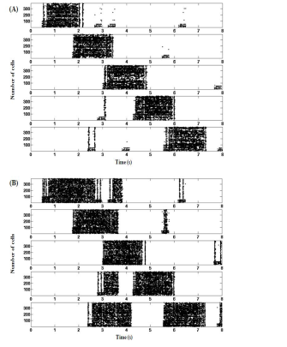
Early Summer Results: EC-HP Pathway Place Cell Dynamics
A Circuit-Level Model of Hippocampal Place Field Dynamics
Modulated by Entorhinal Grid and Suppression-Generating Cells
Laurence C. Jayet^{1*}, and Mathias Quoy², Philip H. Goodman¹
¹ University of Nevada, Reno
² Université de Cergy-Pontoise, Paris
Explained findings of Harvey et al.
(2009) Nature 461:941
NO intracellular theta precession
Asymm ramp-like depolarization
Theta power & frequ increase in PF
Harvey et al.
(2009) Nature 461:941
Explained findings of Van Cauter et al.
(2008) EJNeurosci 17:1933
EC grid cells ignite PF
EC suppressor cells stabilize
w/o K_{ahp} channels
EC lesion

Slide 18
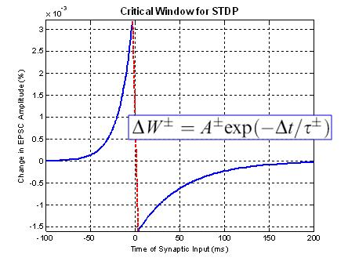
Role of STDP in Stabilizing Place Fields
xxx
xxx

Slide 19





New Brain Slice Experiments Motivated by the Model
HF
EC
Mouse brain removal
Orientation to get EC-HP loop
400 µ Slicing
HF
EC
DIC Video Microscope
10x
80x Patching
(slide from EPFL)

Slide 20




Late Summer Results: Sequence Learning using HP-PF Loop & STDP Reward
Field Potential
0
5
10
15
20
25
R
R
PFC
STM
R
R
HIP
PLACE
CELLS
R
R
SUBICULUM
R
R
β
R
β
R
β
S
S
S
Trial 1: no reward
Trial 2: reward
Trial 3

Slide 21





Virtual environment interface: NCS-CASTLE
Interface Command Specification
Example Maze Trials
successful sequence
unsuccessful sequence
NCS-CASTLE
DEMO

Slide 22
Scalability: 1 million neuron STM Navigational Loop
Pres:
1. RAIN networks server as Place Cell clusters
  A. 3,000 cells/place field x 5 fields in current model
  B. Interneurons: Basket cells & O-LM cells (300/field)
  C. Two-compartments: apical tuft and soma, 180º theta phase offset
  (for SyNAPSE, modeled as cell-types connected synaptically)
2. EC-GC serve to “ignite” and stabilize place fields
    A. Ignite place fields at boundaries between them
    B. Tonically suppress place fields from spontaneous firing
    C. Reduces number of place cells by about half
    D. Increase mean firing rate of remaining cells by 30%

Slide 23
Phase 2: 1 million neuron STM Navigational Loop
Region | Phase 1 (14 PFs, RAIN 2k cell) | Phase 2 (28 PFs, RAIN 10k cell)
Visual cortex pathway | 2,800 | 39,200
Entorhinal Cortex | 2,000 | 14,000
CA1 | 46,700 | 627,200
Subiculum | 360 | 2,520
Prefrontal Cortex | 22,400 | 254,800
Premotor Cortex | 200 | 2,800
Total # neurons: (including RAIN and interneurons) | 87,460 | 1,031,520

Slide 24
Phase I DARPA Simulation Components
“To simulate a system of up to 10⁶ neurons and demonstrate core functions and properties including:
(a) dynamic neural activity, (b) network stability, (c) synaptic plasticity and (d) self-organization
in response to (e) sensory stimulation and (f) system-level modulation/reinforcement”
The proposed Hippocampal-Frontal Cortex Model includes aspects of all 6 target components above:
  dynamic neural activity:
    √ RAIN, Place Fields, Short Term Memory, Sequential Decision Making
  network stability :
  √ effects of lesions and perturbations
  synaptic plasticity:
  √ STDP (excitatory only in this phase)
  self-organization:
  √ Place Field formation & stabilization
  sensory stimulation:
  √ visual landmark representation (no structural visual cortex per se)
  modulation/reinforcement :
  √ reinforcement learning of correct sequence of decisions

Slide 25

The Quad at UNR

