Slide 1
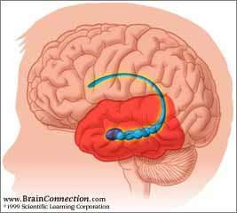

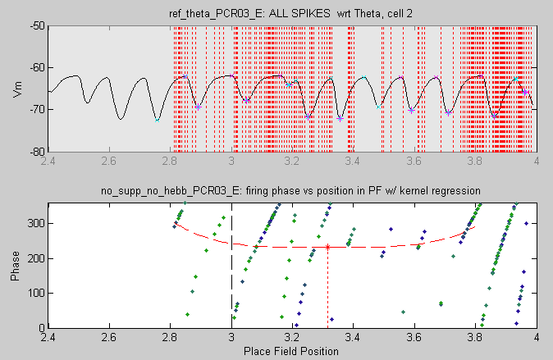
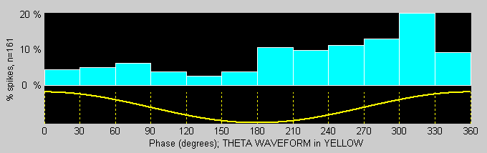
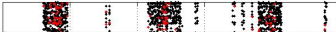
Task: one million neuron hippocampal formation
Microcircuit:
Axial distribution of Hippocampal CA1 Place Field Networks controlled by Temporal Lobe Entorhinal Cortex Grid Cell (EC-GC) Populations
Task: Can recent discoveries about EC-GC control^{1,2} control of CA1 Place Fields³,including in vitro recordings⁴ during awake behavior, be modeled in large-scale compartmental neuronal networks compatible with the HRL SyNAPSE phase I hardware?
Visual Navigation Task
Prefrontal Cortex: planning, decision making
Temporal Cortex:
  Visual scene processing
  Entorhinal cortex modulates Hippocampus
Hippocampal Formation:
  Short-term memory for navigation
  Short-term episodic memory in primates
  Transfer to neocortex for long-term memory
Methods: Results (as of February, 2010):
1. RAIN networks server as Place Cell clusters 1. Successful RAIN theta phase precession
  A. 3,000 cells/place field x 5 fields in current model
  B. Interneurons: Basket cells & O-LM cells (300/field)
  C. Two-compartments: apical tuft and soma, 180º theta phase offset
  (for SyNAPSE, modeled as cell-types connected synaptically)
2. EC-GC serve to “ignite” and stabilize place fields 2. Successful ignition, elimination of spontaneous firing
    A. Ignite place fields at boundaries between them reduction of place cell population, and increase in rate
    B. Tonically suppress place fields from spontaneous firing
    C. Reduces number of place cells by about half
    D. Increase mean firing rate of remaining cells by 30%
Firing vs Phase:
Precession:
GC intact:
GC lesion:
    Work plan: expand to 500,000 cell-equivalent (allow other 500k cells for visual processing and motor control networks)
    a. expand Hippocampus & Grid Cell regions
    (300,000 cell-equivalents)
    b. add prefrontal interaction circuit (200,000 cell-equivalents)
O’Keefe J, Dostrovsky J. Brain Res 1971; 34:171.
Hafting T et al. Nature 2005; 436:801.
Van Cauter T et al. Eur J Neurosc 2008; 27:1933.
Harvey CD et al. Nature 2009; 461:941.
Notes:
NOTES 2010-02-14
We are modeling visual navigation by a physiologically realistic hippocampal formation that demonstrates the latest neuroscience discoveries of place field firing, include theta phase precession, and EC grid cell biology. The hippocampal formation includes the hippocampus proper (CA1, CA3) + dentate gyrus + subiculum with the associate entorhinal cortex of the medial temporal lobe.
Later in Phase I we plan to include prefrontal cortical control, as time permits (due to budget reductions). The overall number of cell-equivalents will be about half a million (to allow the other half million for those working on visual procession and motor control).
Please note that the model can function with as little as 20,000 cells, and later be scaled up (with increasing number of place fields).
We have also overcome a potential obstacle: 2 compartments needed for pre-mixing of CA1 tuft dendritic excitation and inhibition and the soma; the “compartments” are 180 degrees out of phase wrt theta. We are successfully using simple synaptic connections from tuft to soma to achieve the effects, which should be compatible with HRL approaches in Phase I and II. Note that this uses 2 “cells” per actual CA1 cell.
PS Not reported here: we are also continuing to analyze the dynamics of RAIN networks: just this week we were able to prove that the RAIN networks indeed satisfy complexity theory requirements as chaotic attractors. This will enable us to run the same chaos analyses of spiking cells from the HRL hardware/emulation models. You might also mention that we found that RAIN dynamics were not affected by forcing synaptic strength values into 10 discrete levels.
-Phil Goodman

