Slide 1

Computational Science Applications and
The Research They Drive
Frederick C. Harris, Jr.
Computer Science and Engineering
University of Nevada, Reno

Slide 2
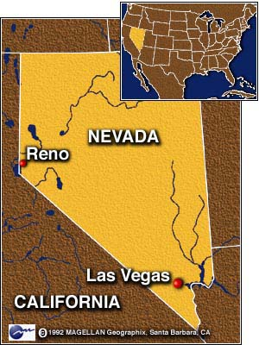
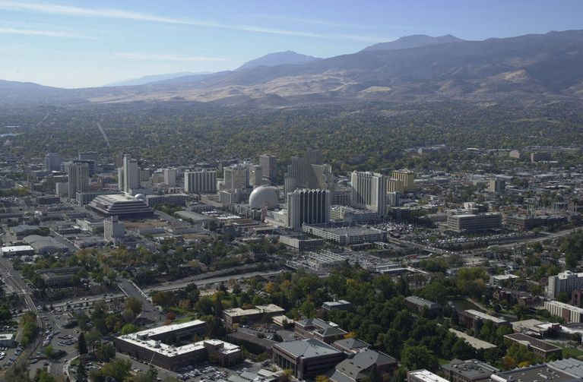
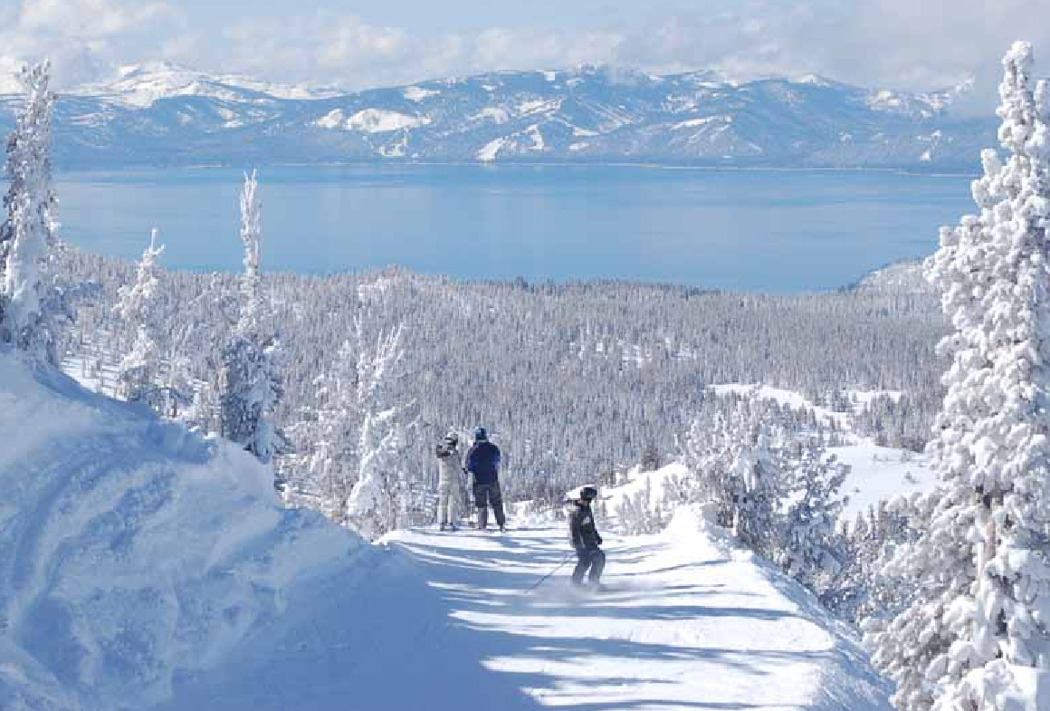
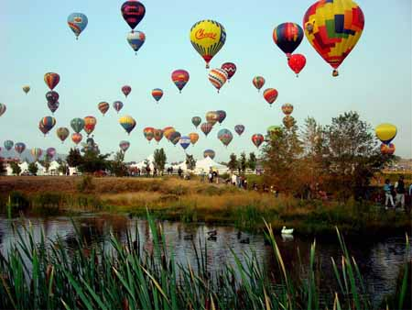
The Place: Nevada

Slide 3
The Science
Focus:
  What are the effects of regional climate change on ecosystem resources
Major interdisciplinary science questions:
  How will climate change affect water resources and linked ecosystem services and human systems?
  How will climate change affect disturbance regimes (e.g., wildland fires, insect outbreaks, droughts) and linked systems?

Slide 4

The Application: Data Portal
Goal:
  Build a Climate Change Data Portal for Nevada.
Purpose:
  Create a virtual climate change center

Slide 5
The Application: Data Portal
This is part of an NSF 5-year $21.7 million project:
  Infrastructure for Nevada Climate Change Research, Education, and Outreach
The Data Portal is the glue between
  (Climate Modeling Component) AIR
  (Ecological Change Component) LAND
  (Water Resources Component) WATER

Slide 6
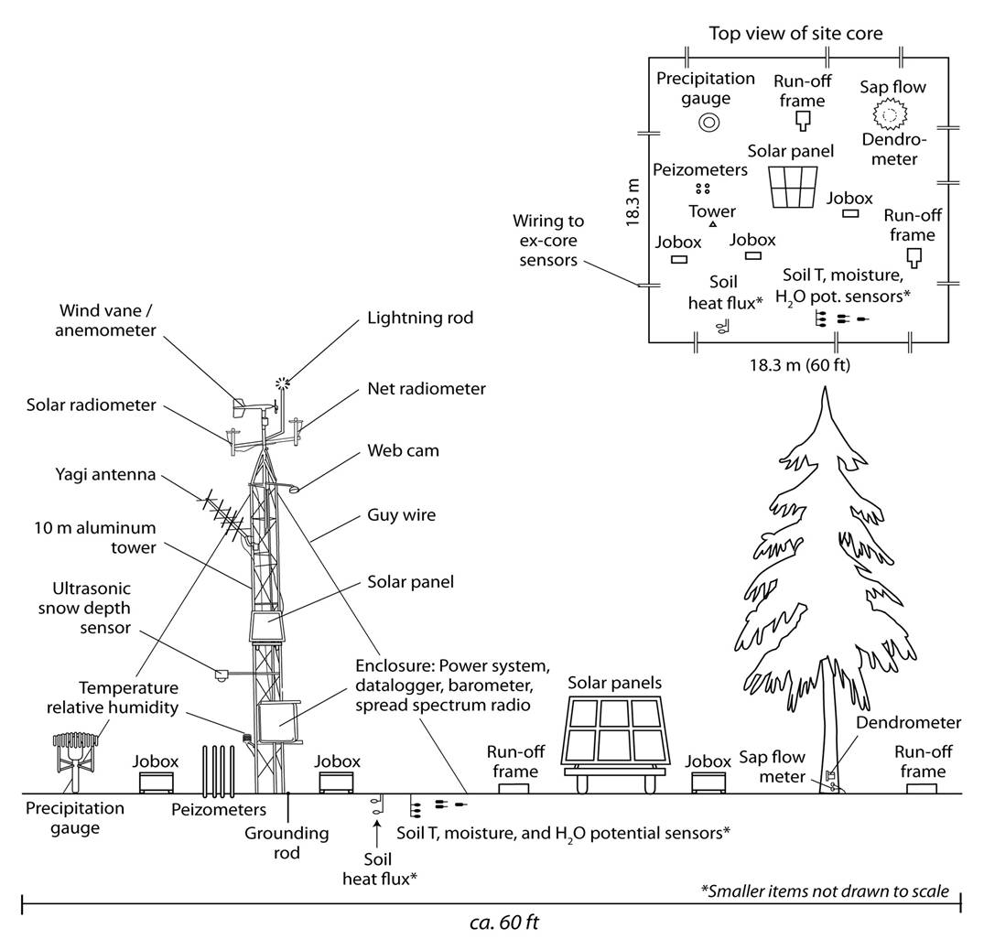
The Application: Data Portal
Allow public access to raw files via:
  FTP site
  HTTP browser
Video

Slide 7
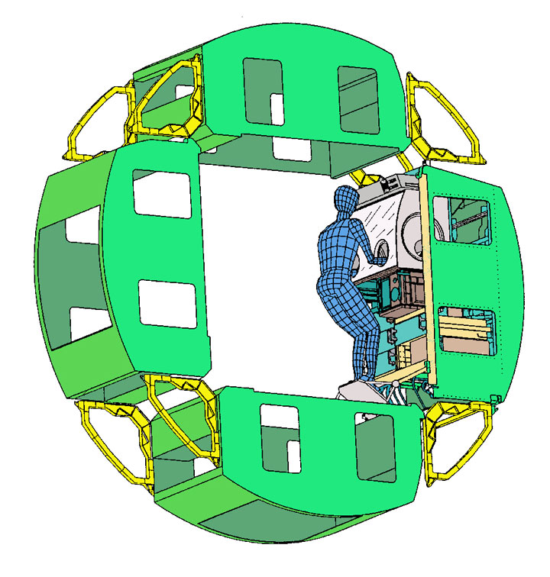
The Place: The International Space Station
Topic:
  Science Experiments aboard the International Space Station.

Slide 8
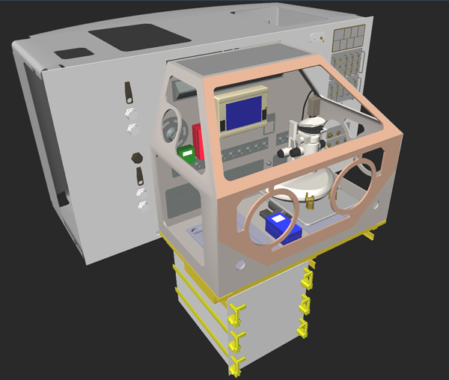
The Science
Studying the long-term effects of microgravity on living systems
Issue:
  You need to train and practice before you get there.

Slide 9
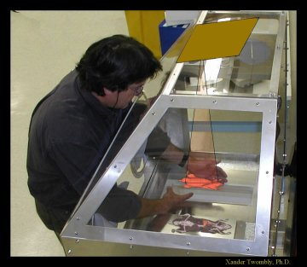
Solution (round 1)
Solution:
  Build the same setup here
What’s the problem?
  Gravity (or lack thereof) for the simulation

Slide 10
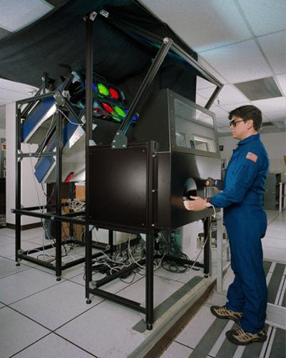
Solution (round 2)
NASA built a Virtual Glove Box (VGX)

Slide 11
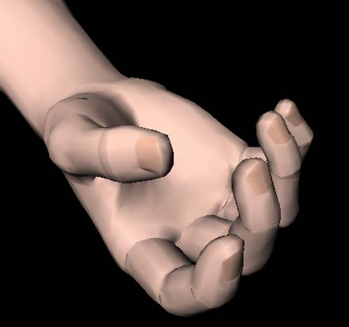
Solution (round 3)
To enhance the utility and effectiveness of the VGX, we are developing a non-contact, computer vision-based system for real-time tracking of the human arm, hand, and fingers in space.

Slide 12
Solution (round 3) (cont)
This encompasses:
  Computer Vision
  Virtual Reality
  Distributed computation
We have several modules completed
  Hand pose estimation
  Virtual Model (and API) of the hand.
  GUI interface to show the two together.
Video Clip

Slide 13
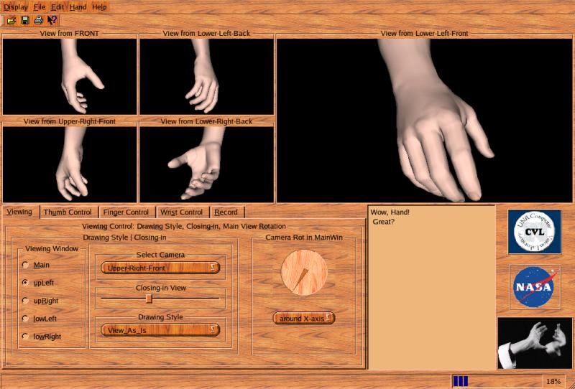

Slide 14
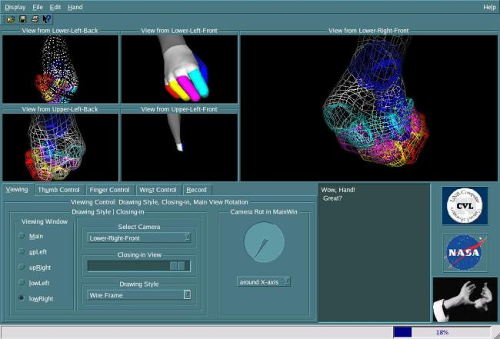
GUI Design (cont)

Slide 15
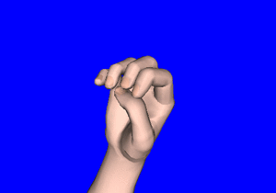
Preliminary Results:
Hand animation example: American Sign Language numbers 0-9

Slide 16
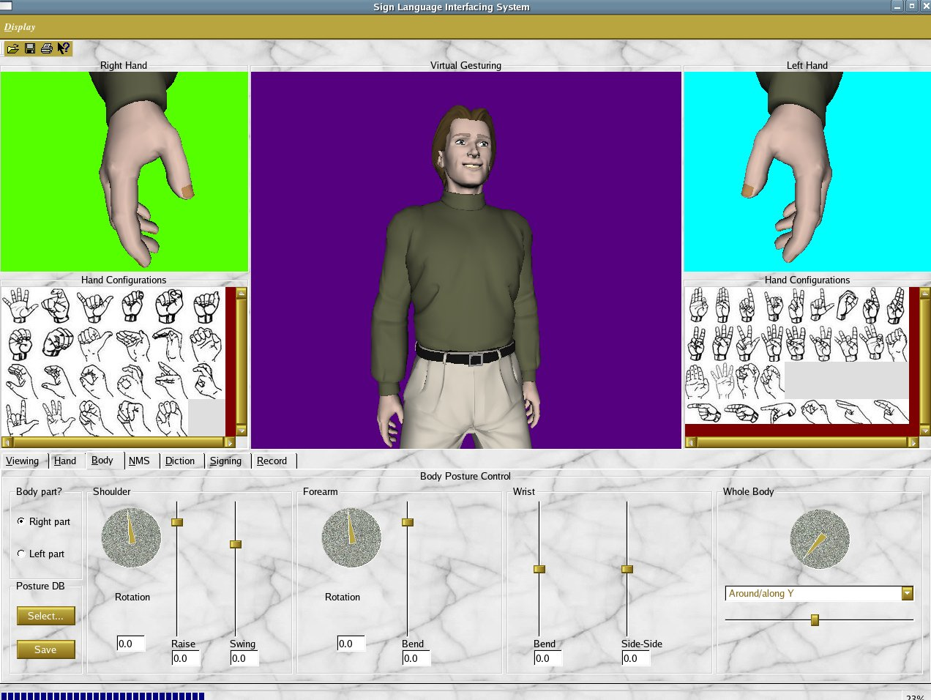
Future Applications:

Slide 17
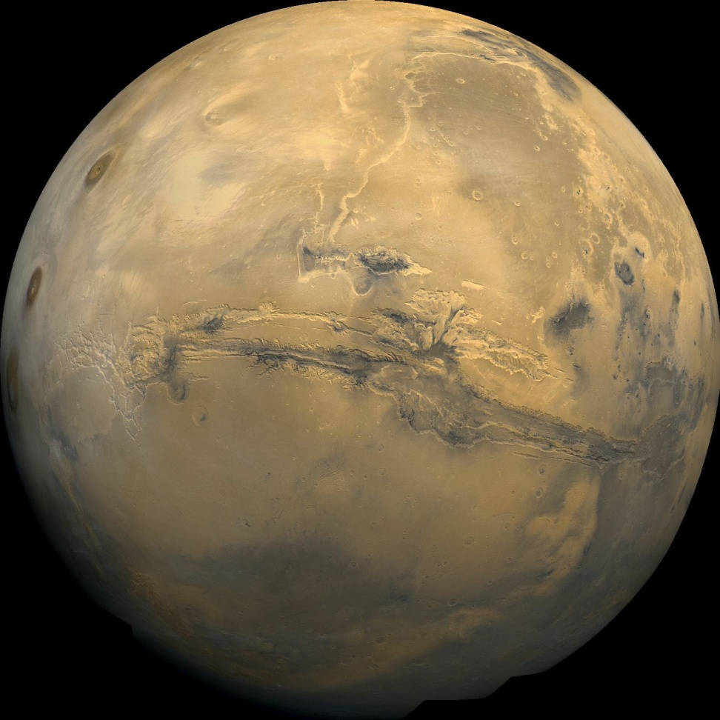
The Place: Mars
Topic
  Can we do remote studying of geomorphology on Mars?
  Mars in 1980 as seen by the Viking 1 Orbiter

Slide 18
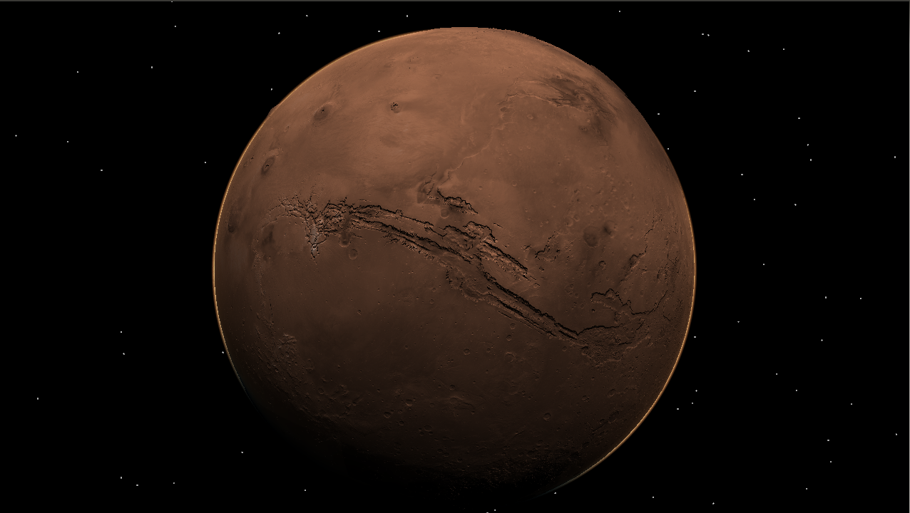
The Application
Full Planetary Rendering of Mars
  with multiple Data Sets
Video

Slide 19
The Place: The Human Brain
Goal:
  create the first large-scale, synaptically realistic cortical computational model.
Purpose:
  Simulation Experiments
    Drug Trials
    Alzheimer’s Research
    Robotics

Slide 20
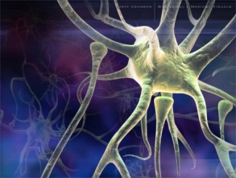
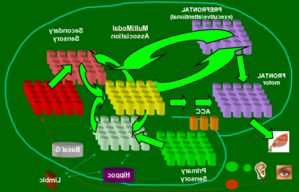
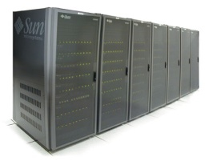

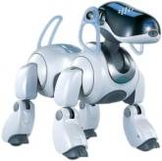
Present Scope of Work
Neuroscience
Modeling &
Neural Engineering
Robotic/Human Loops

Slide 21
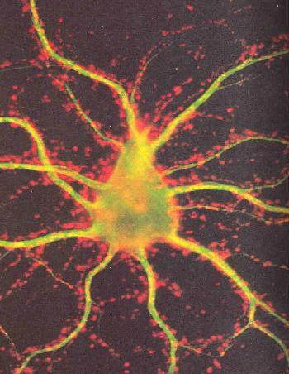
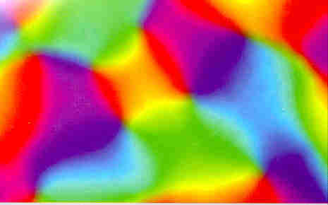
A Little Neuroscience
  Neurons
    Excitatory
    Interneurons (inhibitory)
  Neurons
    Excitatory
    Interneurons (inhibitory)
  Neurons
    Excitatory
    Interneurons (inhibitory)
  Columns
    High connectivity within columns.
    Less connectivity across columns

Slide 22
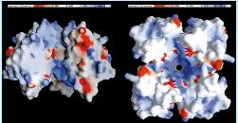
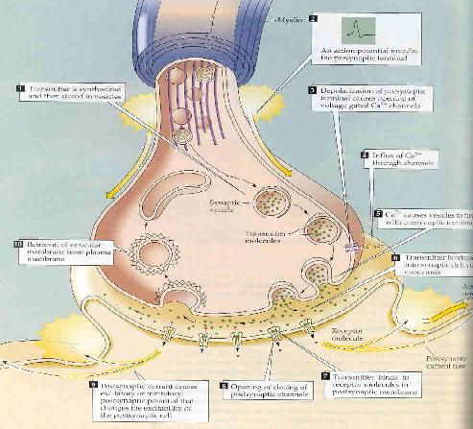
A Little Neuroscience
  Channels
    Potassium Family
      M, A, AHP Channels
      Suppressing behavior on parent cell
  Synapses
    Analog converter of binary spike event.
    Contextual filters.

Slide 23
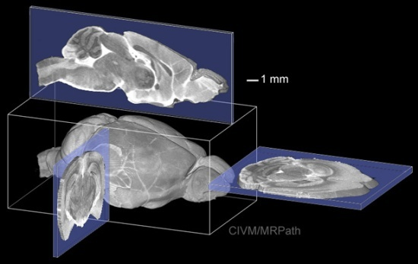
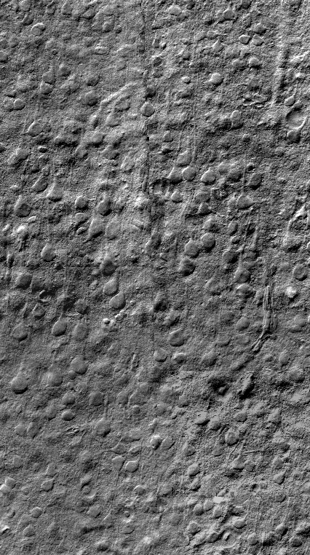
A Little Neuroscience
Brain Slice technology from EPFL

Slide 24
A Little Neuroscience
Voltage Injection & Measurements

Slide 25
A Little Neuroscience
But we need more than 1
  Currently a 12 clamp

Slide 26
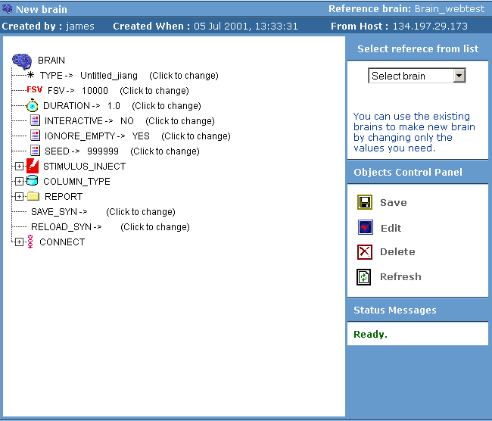
Web Interface
Goals:
  Allow rapid creation of brain models
  Allow remote collaboration
Kishor K. Waikul, Lianjun Jiang, E. Courtenay Wilson, Frederick C. Harris, Jr., and Philip H. Goodman, “Design and Implementation of a Web Portal for a NeoCortical Simulator,” in Proceedings of the 17th International Conference on Computers and Their Applications (CATA 2002) pp. 349-353, April 4-6, 2002, San Francisco, CA

Slide 27
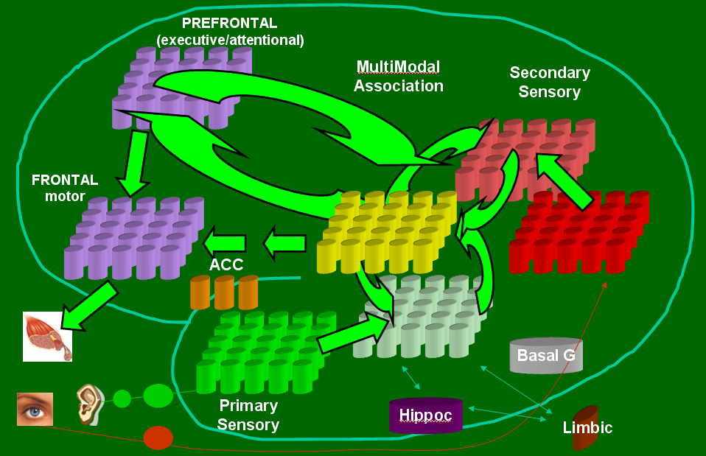
Modeling &
Neural Engineering
Ripplinger MC, Wilson CJ, King JG, Frye J, Drewes R, Harris FC, and Goodman PH, “Computational Model of Interacting Brain Networks,” Journal of Investigative Medicine, Vol. 52, No. 1, Jan 2004, pp. S155.

Slide 28
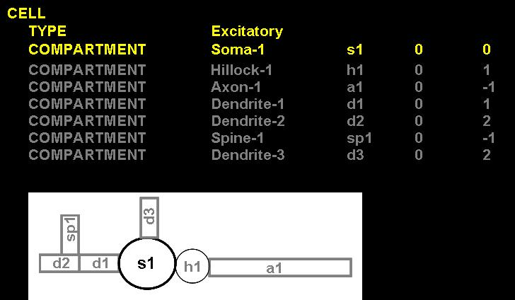
Modeling &
Neural Engineering
Romain Brette, Michelle Rudolph, Ted Carnevale, Michael Hines, David Beeman, James M. Bower, Markus Diesmann, Abigail Morrison, Philip H. Goodman, Frederick C. Harris, Jr., Milind Zirpe, Thomas Natschlager, Dejan Pecevski, Bard Ermentrout, Mikael Djurfeldt, Anders Lansner, Olivier Rochel, Thierry Vieville, Eilif Muller, Andrew P. Davison, Sami El Boustani and Alain Destexhe, “Simulation of networks of spiking neurons: A review of tools and strategies,” Journal of Computational Neuroscience Vol. 23, December, 2007, pgs 349-398.

Slide 29
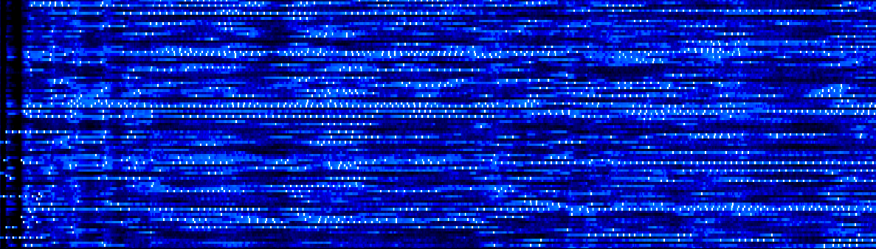

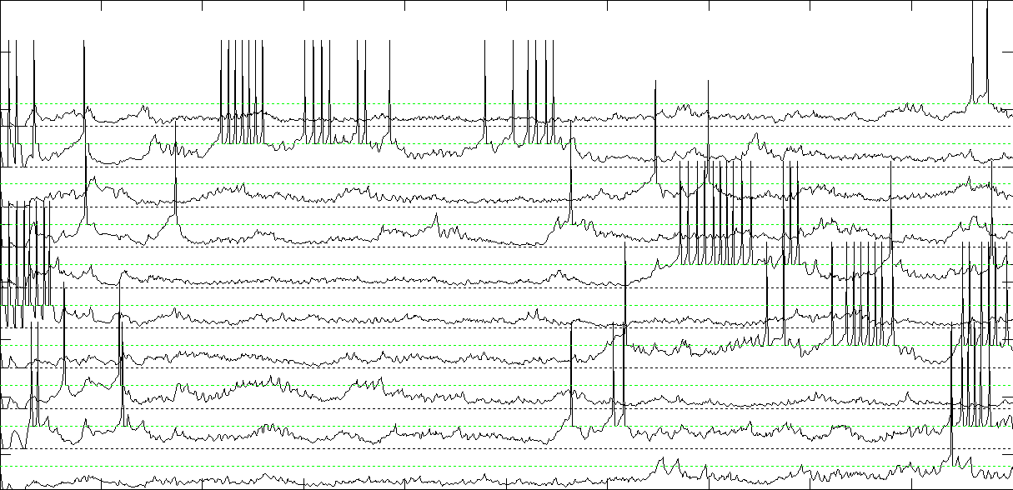
Modeling &
Neural Engineering
RAIN Firing Characteristics

Slide 30
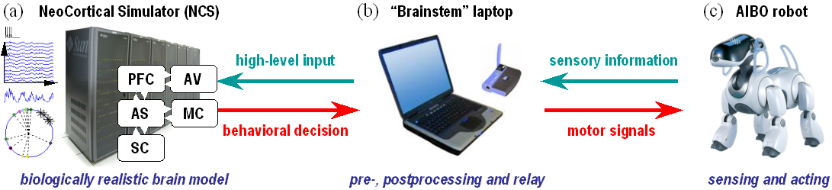
Robotic/Human Loops
Juan C. Macera, Philip H Goodman, Frederick C. Harris, Jr., Rich Drews, and James B. Maciokas
  “Remote-Neocortex Control of Robotic Search and Threat Identification,” Robotics and Autonomous Systems, Vol. 46, No. 2, February 2004, pp 97-110.`

Slide 31
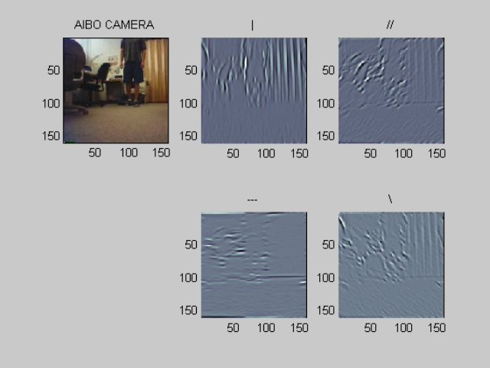
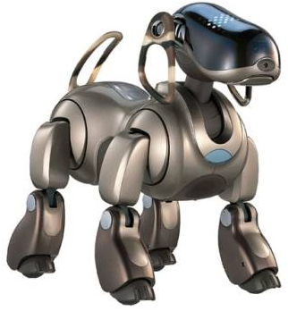
Robotic/Human Loops
Coarse Gabor Filters transduced into a raster of spikes
VC
31
Notes:
31

Slide 32
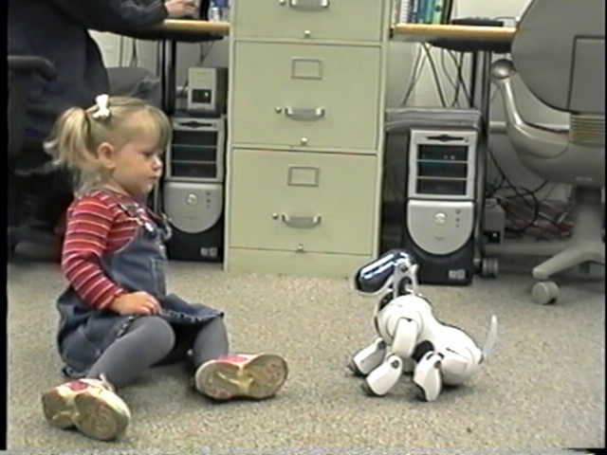
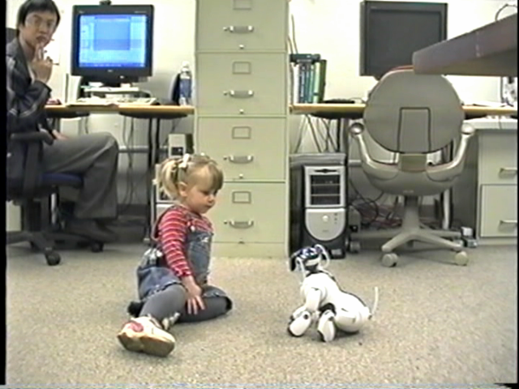
Robotic/Human Loops
Engaging & Rewarding
Evocative
32
Notes:
32

Slide 33
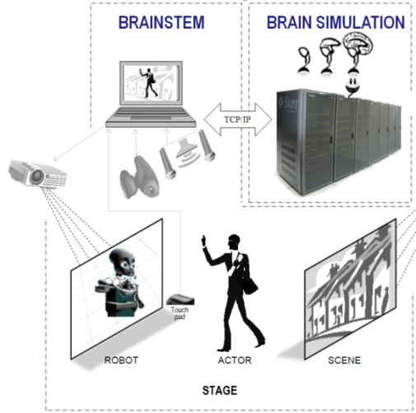
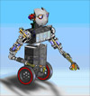
Robotic/Human Loops
Virtual Robots
Philip H. Goodman, Sermsak Buntha, Quan Zou, Sergiu M. Dascalu, :Virtual neurorobotics (VNR) to accelerate the development of plausible neuromorphic brain architectures” Frontiers in Neurorobotics 1(1) pp. 1-7 November 2007.

Slide 34
Objectives:
  Create neurally-based cognitively intelligent systems
  Develop neuromorphic robots which interact with humans
  Complement Neuroscience wet lab and cognitive research

Slide 35
Impacts:
  Multi-compartment and million-cell brain models
  New theory of “mesocircuit” to link biology and behavior
  Robotic prototype advanced from CANINE to HUMANOID robot

Slide 36
Computational Science Applications and
The Research They Drive
Frederick C. Harris, Jr.
Computer Science and Engineering
University of Nevada, Reno

