Slide 1


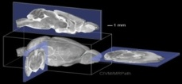
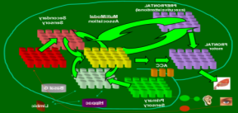
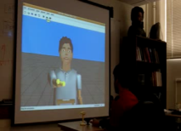

Large-Scale Biologically Realistic Models of Cortical
Microcircuit Dynamics for Human Robot Interaction
Frederick C. Harris, Jr./University of Nevada, Reno
10/1/09-9/30/12
Project Objectives:
Simulate a system up to 10⁵ and 10⁶ neurons real-time:
  Neocortical-Hippocampal Navigation
Create emotionally intelligent decision making agents, founded on biological episodic memory and neuromodulator-driven reward
Construct shared-memory cluster to support AI goals
Neuroscience
Mesocircuit Modeling
Robot/Human Loops
Software/Hardware Engineering
Technical Approach:
Interdisciplinary (neuroscience, computer science, biomedical engineering)
Incorporate latest bench neuroscience into large-scale supercomputer simulations to extract mesocircuit dynamics and neuromodulation
Robotic instantiation of real-time human interaction and episodic memory
Implement new hybrid 64-bit CPU cluster with shared memory + GPUs
Accomplishments/Impact/Transitions:
Neocortical-Hippocampal Navigational Learning
  100,000 cell model running real-time
Development of a GPU version of our Neural Simulator [NCS]
  Multi-Box/Multi-GPU
Hypothalamic Trust
  Robust and functional architecture
Emotional Speech Processing
  Reward Learning
Several peer-reviewed papers & presentations supported in part by this grant

