Slide 1


Large-Scale Biologically Realistic Models of Cortical
Microcircuit Dynamics for Human Robot Interaction
Dr. Frederick C. Harris, Jr.^{1,2}
Sergiu Dascalu^{1,2}, Florian Mormann³ & Henry Markram⁴
¹Brain Computation Laboratory, School of Medicine, UNR
²Dept. of Computer Science & Engineering, UNR
³Dept. of Epileptology, University of Bonn, Germany
⁴Brain Mind Institute, EPFL, Lausanne, Switzerland
ONR N00014-10-1-0014
October 2009 – September 2012
ONR Computation Neuroscience, Vision & Audition
June 27, 2011

Slide 2
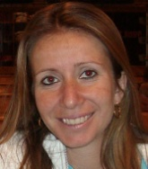

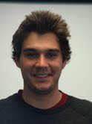
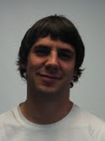


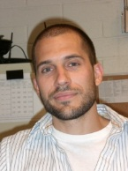
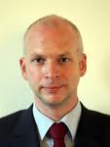




CONTRIBUTORS
  Postdoctoral and Graduate
  Students
  Neural Computation
  And Robotics
  Laurence Jayet Bray
  Nick Ceglia
  Gareth Ferneyhough
  Kevin Cassiday
  Computer Science
  Infrastructure
  Corey Thibeault
  Roger Hoang
  Josh Hegie
  Childbot
Investigators
  Fred Harris, Jr.
  University of Reno
  Nevada
  Sergiu Dascalu
  University of Reno Nevada
  Florian Mormann
  University of Bonn Germany
  Henry Markram
  EPFL
  Switzerland

Slide 3
OBJECTIVES
Simulate a system up to 10⁵ and 10⁶ neurons real-time and demonstrate its functionality and robustness
  Neocortical-Hippocampal Navigation
Use emotional reward learning during human-robot interaction
  Reward-Based Learning
  Trust the Intent Recognition
Notes:
Briefly describe the motivation and objective of the overall project.
What is the significance and potential scientific impact of the project?
What makes this effort original and exciting?

Slide 4
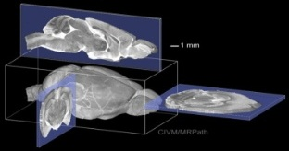
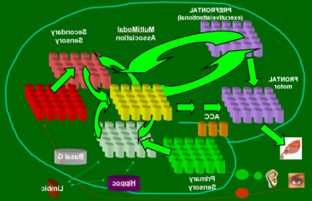
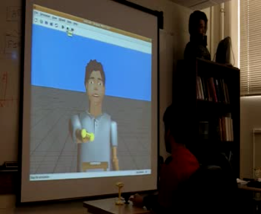
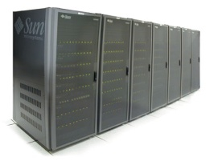
TECHNICAL APPROACH
Neuroscience
Mesocircuit Modeling
Robot/Human Loops
Software/Hardware Engineering

Slide 5
TECHNICAL APPROACH
Neuroscience
Mesocircuit Modeling
Robot/Human Loops
Software/Hardware Engineering

Slide 6
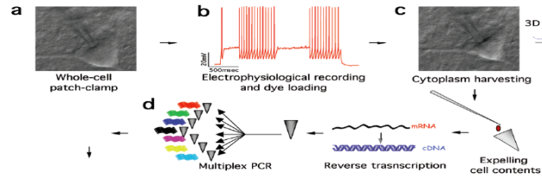

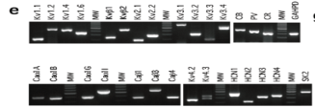

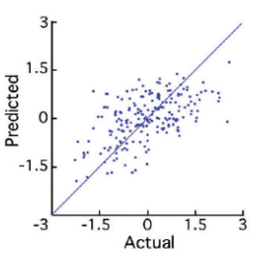

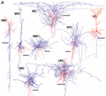
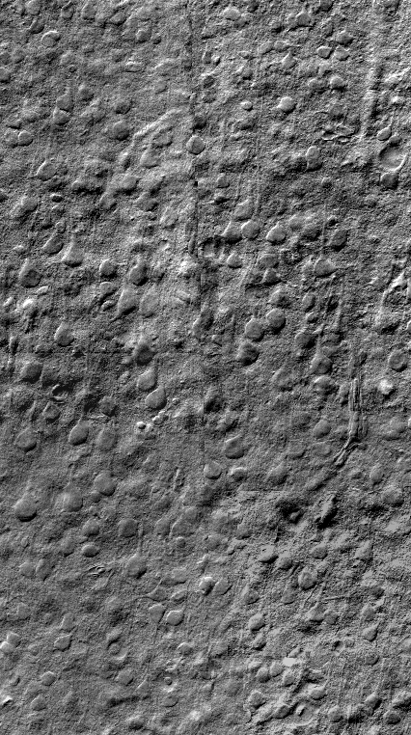
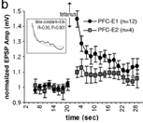
From Brain Slice to Physiology

Slide 7
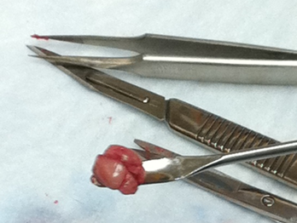
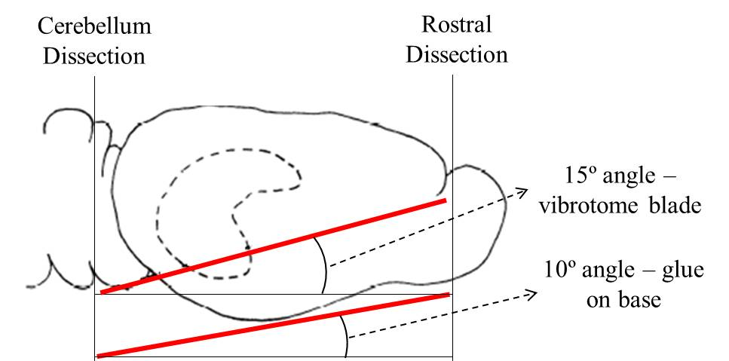
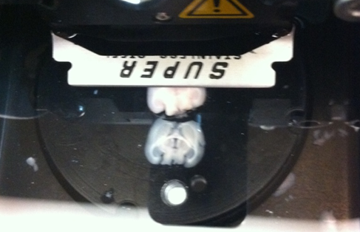
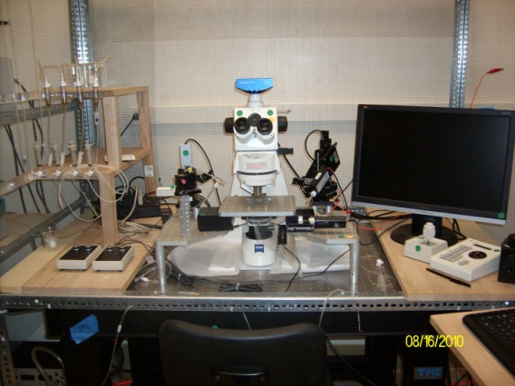

New Brain Slice Experiments
Mouse brain removal
Orientation to get EC-HP loop
400 µm slicing
HF
EC
DIC Video Microscope
10x magnification
80x Patching

Slide 8
TECHNICAL APPROACH
Neuroscience
Mesocircuit Modeling
Robot/Human Loops
Software/Hardware Engineering

Slide 9
Navigational Learning
A Circuit-Level Model of Hippocampal Place Field Dynamics Modulated by Entorhinal Grid and Suppression-Generating Cells
Laurence C Jayet Bray, Mathias Quoy, Frederick C Harris, Jr., and Philip H Goodman.
Frontiers in Neural Circuits. Vol 4, Article 122, November 2010.
A Circuit-Level Model of Hippocampal, Entorhinal and Prefrontal Dynamics
Laurence C Jayet Bray, Corey M. Thibeault, Frederick C Harris, Jr.
In Proceedings of the Computational and Systems Neuroscience (COSYNE 2011) Feb 24-27, 2011, Salt Lake City, UT.
Large-Scale Simulation of Hippocampal and Prefrontal Dynamics during Sequential Learning
Laurence C. Jayet Bray, Corey M. Thibeault, Jeffrey A. Dorrity, Frederick C. Harris, Jr., and
Philip H. Goodman
Journal of Computational Neuroscience. In Preparation, June 2011.

Slide 10
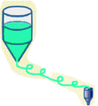
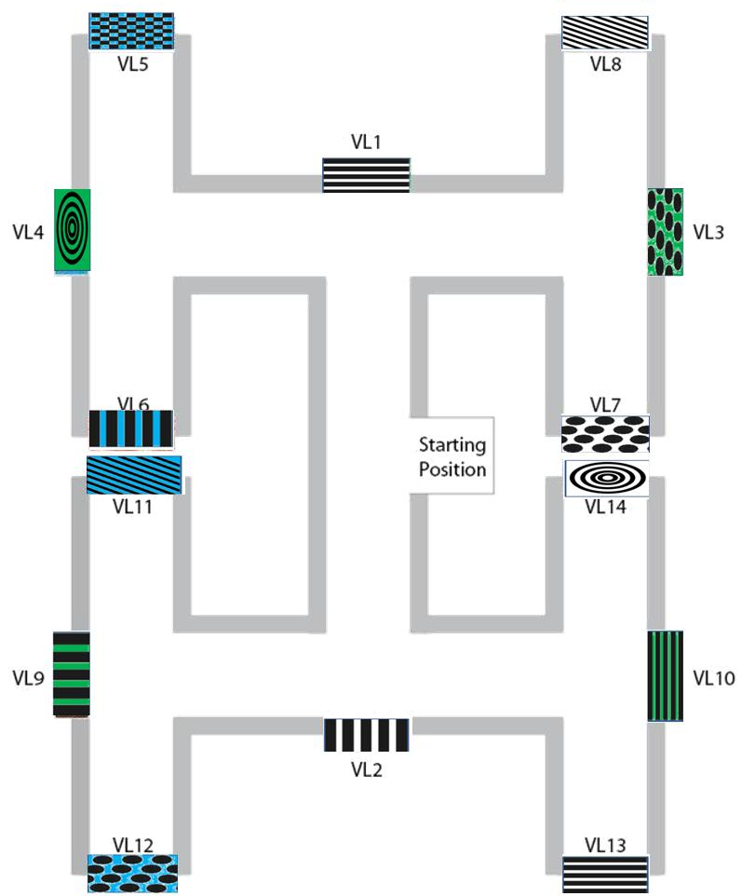

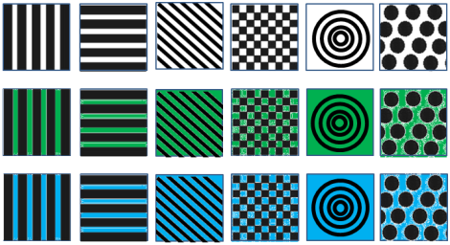
Sequential/Navigational Learning

Slide 11
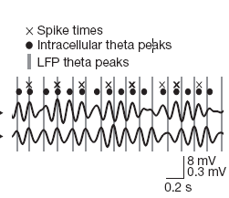
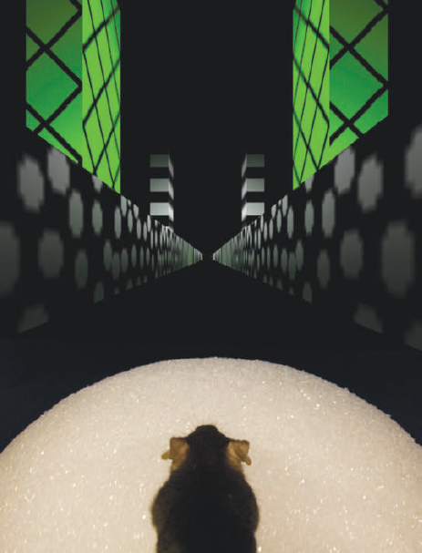
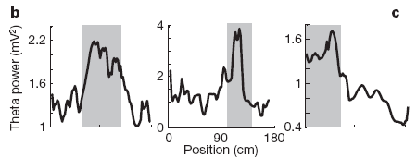
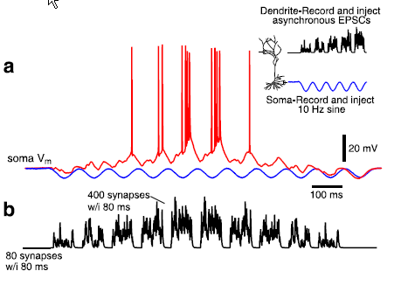
HP Biological Studies
Harvey, C. D., Collman, F., Dombeck, D. A., and Tank, D. W., "Intracellular dynamics of hippocampal place cells during virtual navigation," Nature, vol. 461, pp. 941-946, 2009.
Theta precession with respect to LFP
Theta power increase in place fields
Gasparini, S. and Magee, J. C., "State-dependent dendritic computation in hippocampal ca1 pyramidal neurons," Journal of Neuroscience, vol. 26, pp. 2088-2100, 2006.
Asymmetric ramp-like depolarization
Theta frequency increase in place fields

Slide 12
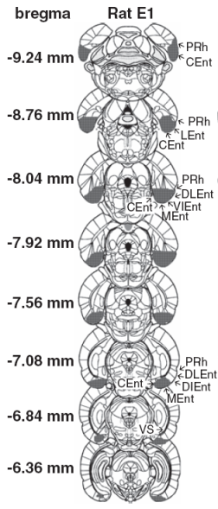
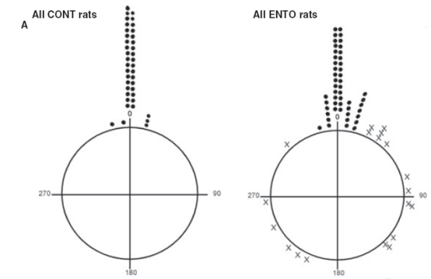
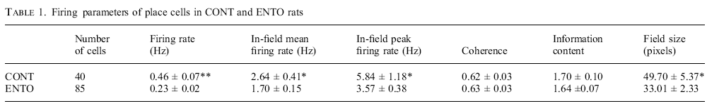
HP-EC Biological Studies
EC cells stabilize place field ignition
EC suppresses the number of place field cells firing while increasing their firing rate
Van Cauter, T., Poucet, B., and Save, E., "Unstable ca1 place cell representation in rats with entorhinal cortex lesions," European Journal of Neuroscience, vol. 27, pp. 1933-1946, 2008.

Slide 13
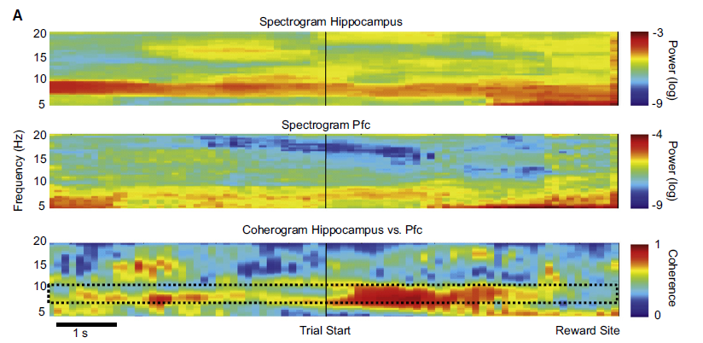
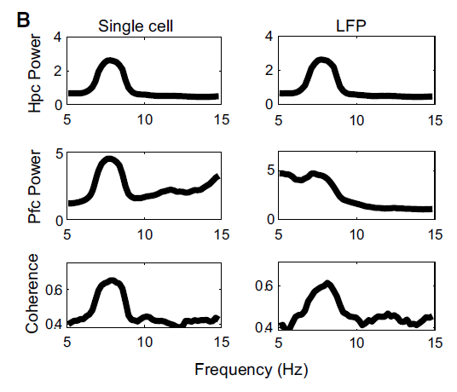
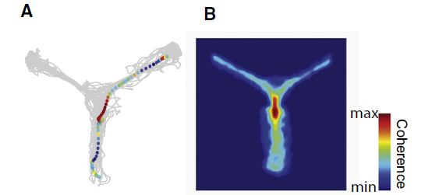
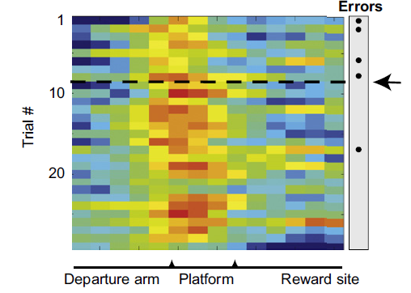
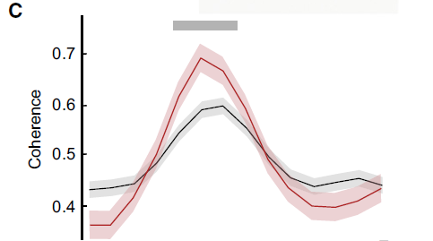
HP-PF Biological Studies
Coherence increase at decision point
Coherence increase
with learning
Benchenane, K., Peyrache, A., Khamassi, M., Tierney, P. L., Gioanni, Y., Battaglia, F. P., and Wiener, S. I., "Coherent theta oscillations and reorganization of spike timing in the hippocampal-prefrontal network upon learning," Neuron, vol. 66, pp. 921-936, 2010.

Slide 14
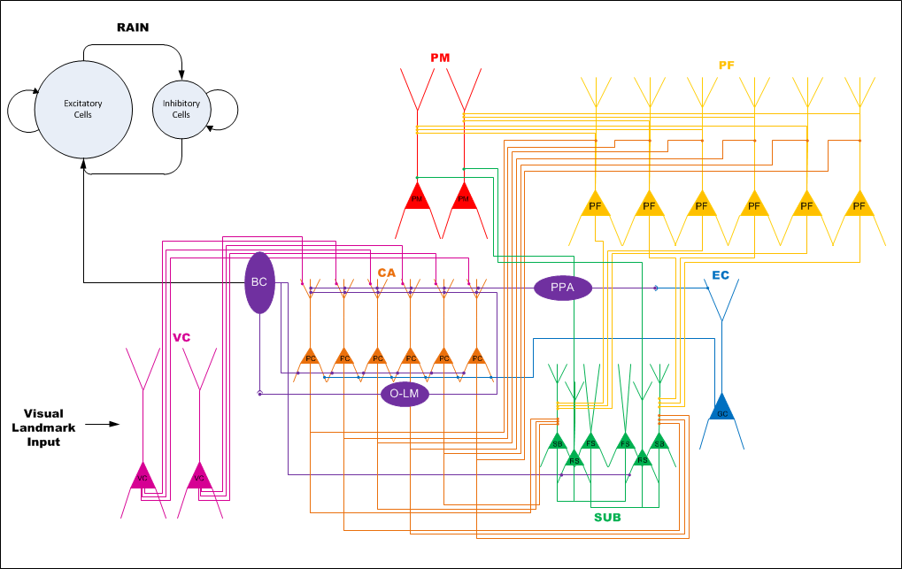
Neocortical-Hippocampal Microcircuitry

Slide 15
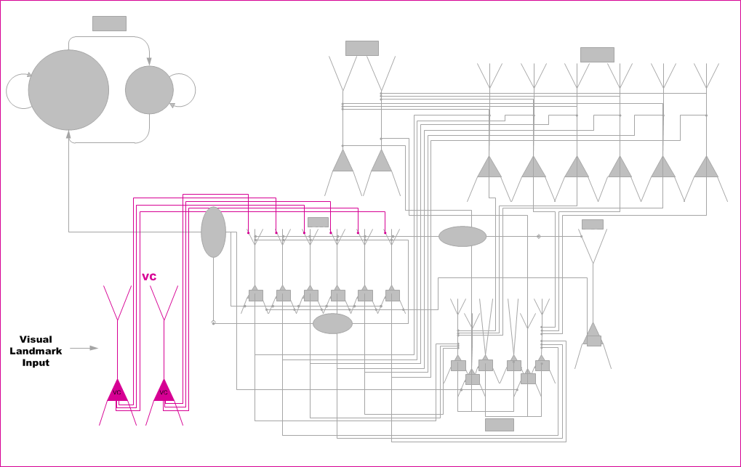
VC Microcircuitry

Slide 16
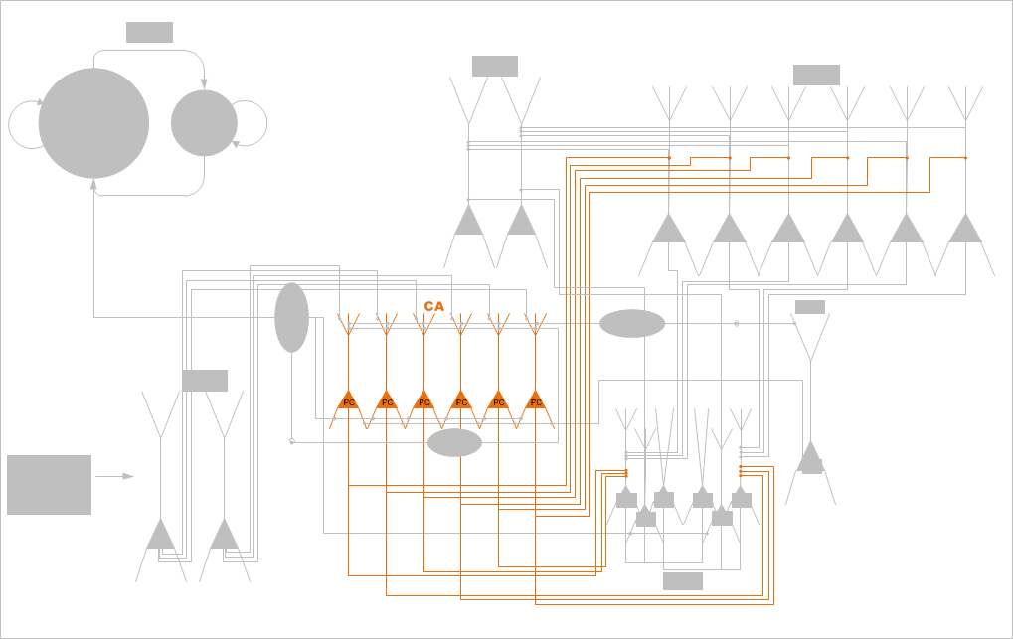
CA Microcircuitry

Slide 17
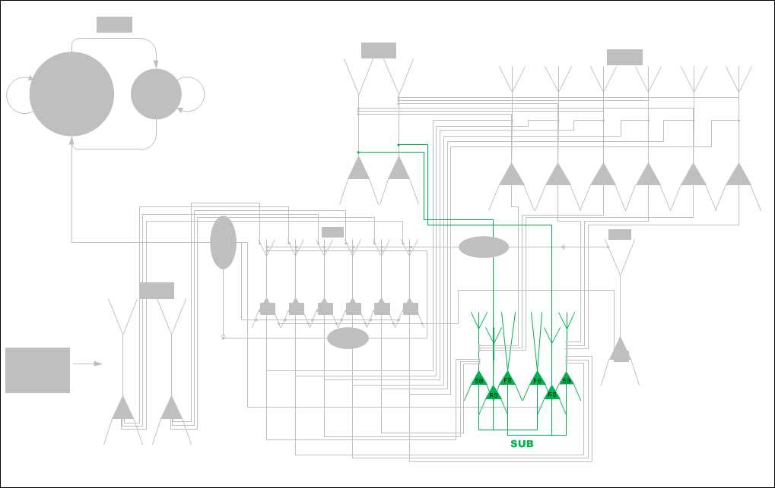
SUB Microcircuitry

Slide 18
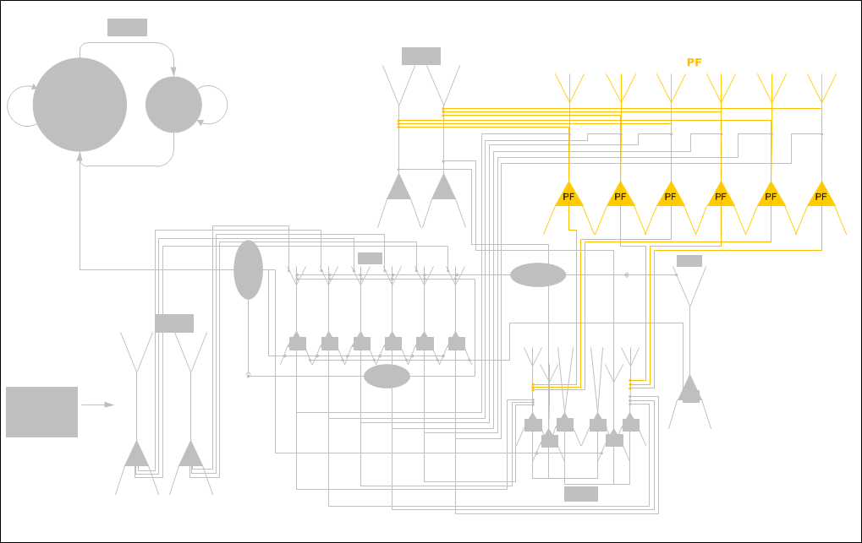
PF Microcircuitry

Slide 19
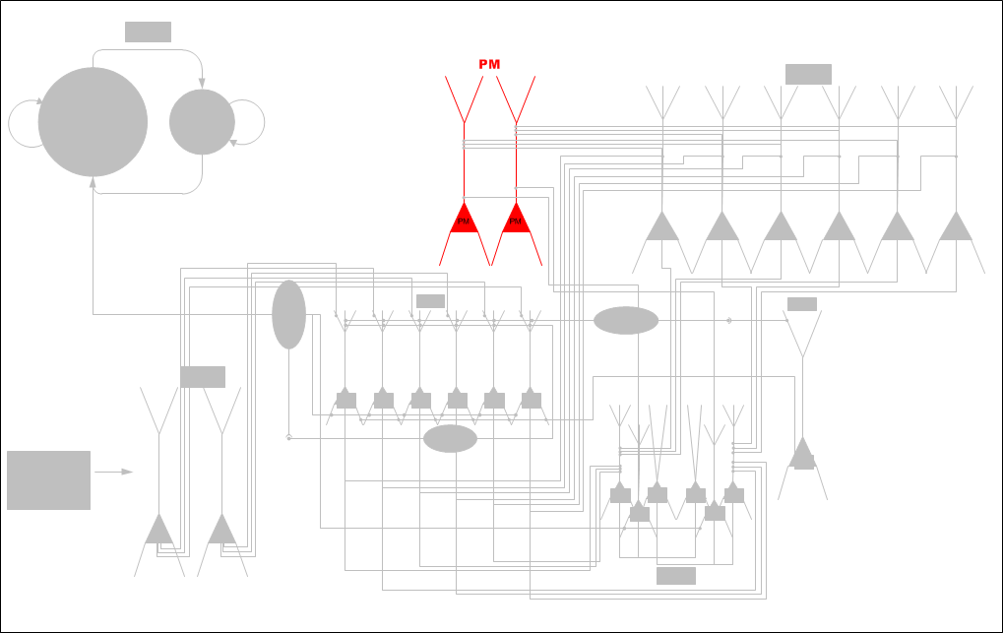
PM Microcircuitry

Slide 20
HP-PF Loop Microcircuitry

Slide 21
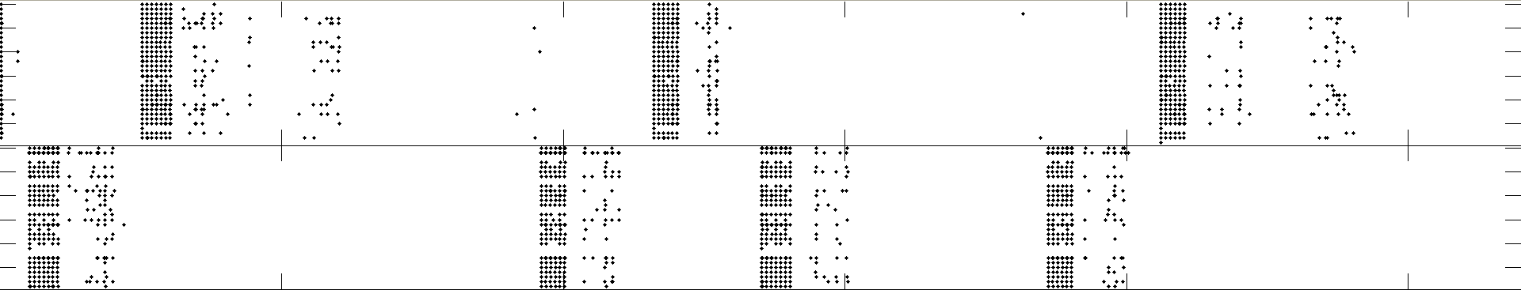
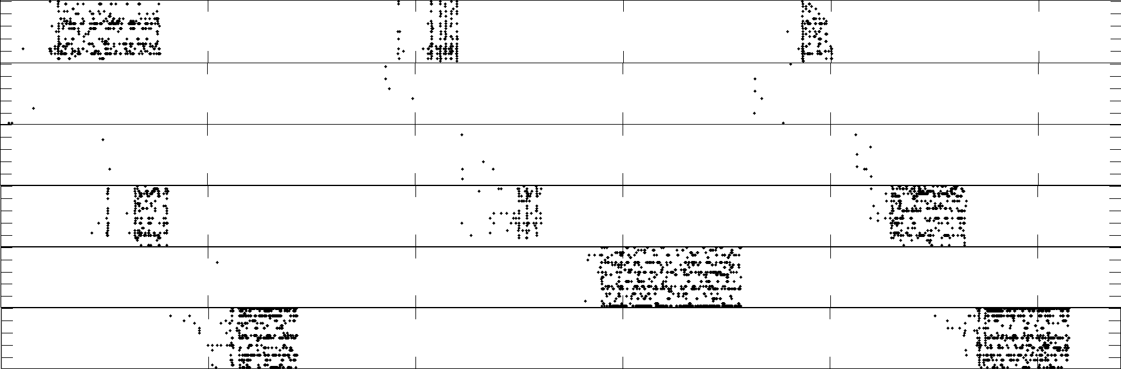
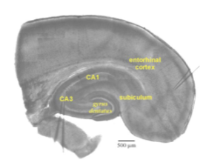
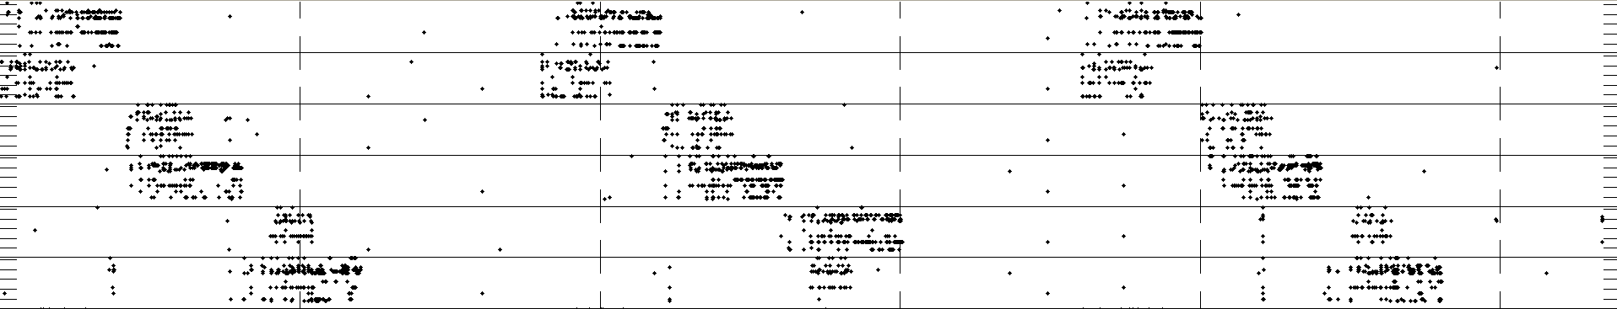
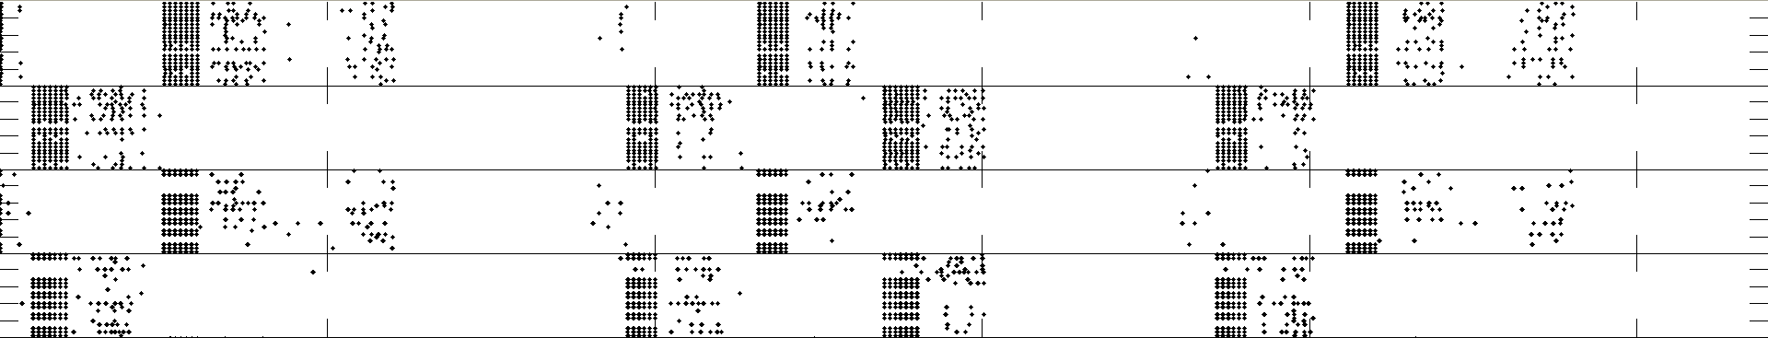

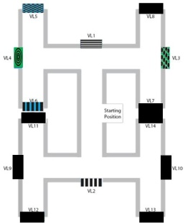
FIELD POTENTIAL
PM
PF
HP
SUB
S
E
R
γ
S
E
R
γ
S
E
R
γ
KEY
S=START POSITION
E=END POSITION
R=REWARD (green if earned)
γ =enhanced inhibitory oscillation
(resets prefrontal activity
if not enhanced by prior reward)
S
S
S
Trial 1: no reward
Trial 2: reward
Trial 3:no reward

Slide 22
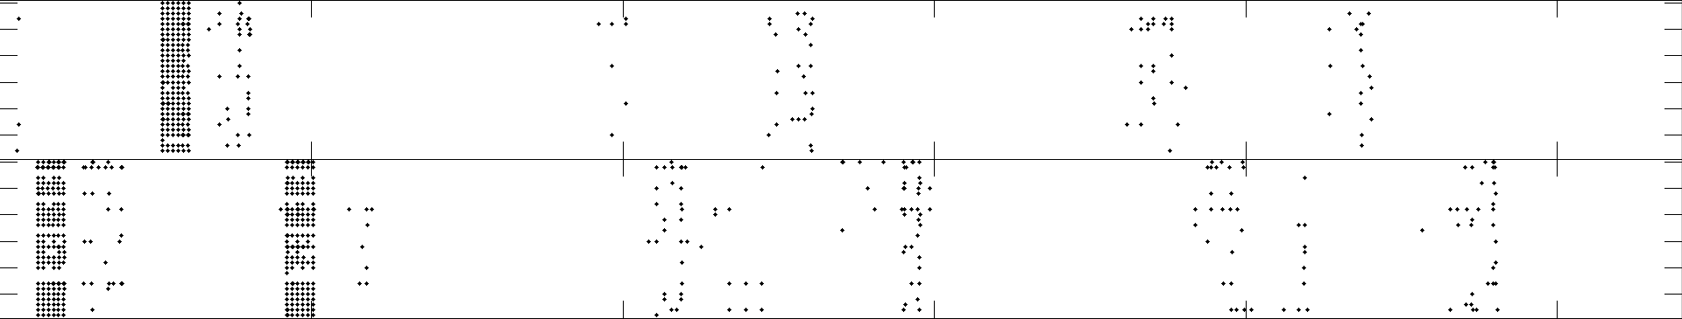
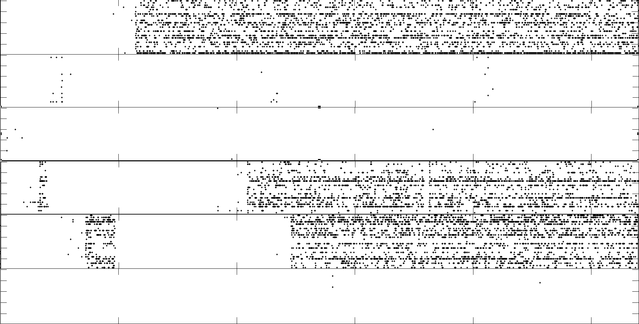
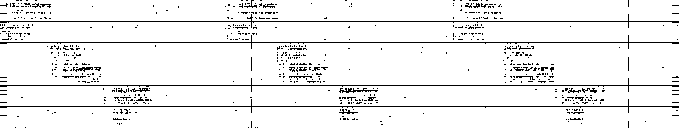
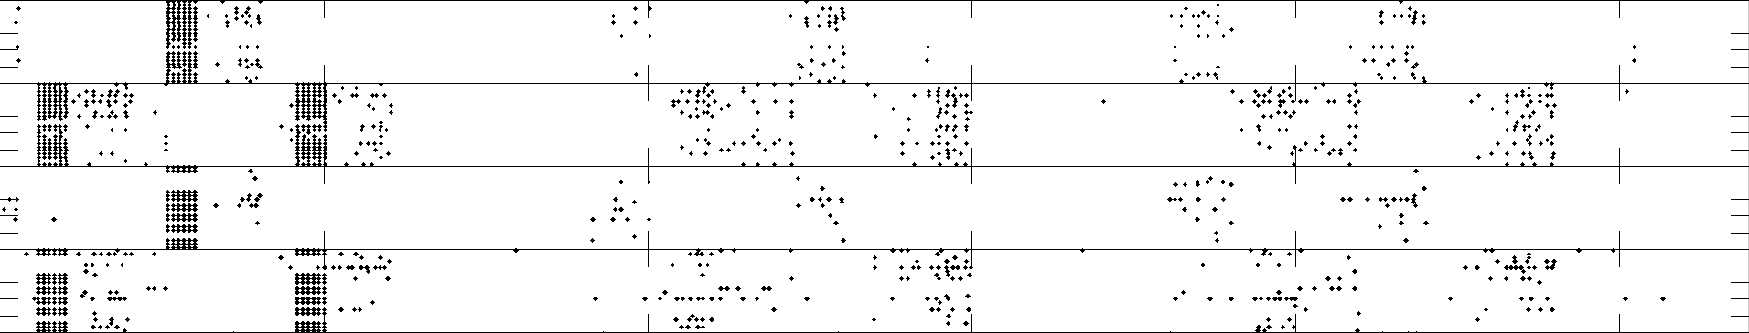
FIELD POTENTIAL
PM
PF
HP
SUB
S
E
R
γ
S
E
R
γ
S
E
R
γ
KEY
S=START POSITION
E=END POSITION
R=REWARD (green if earned)
γ =enhanced inhibitory oscillation
(resets prefrontal activity
if not enhanced by prior reward)
S
S
S
Trial 4: reward
Trial 5: reward
Trial 6: reward

Slide 23
HP-PF Memory Loop
Region | Phase 2 (14 PFs, RAIN 2k cell)
Visual cortex pathway | 2,800
Entorhinal Cortex | 2,000
Hippocampal CA | 46,700
Subiculum | 360
Prefrontal Cortex | 22,400
Premotor Cortex | 200
Total # neurons: (including RAIN and interneurons) | ~ 100,000

Slide 24

Virtual Navigational Environment - Correct

Slide 25

Virtual Navigational Environment - Incorrect

Slide 26
TECHNICAL APPROACH
Neuroscience
Mesocircuit Modeling
Robot/Human Loops
Software/Hardware Engineering

Slide 27


Virtual Neuro-Robotics (VNR)
Modeling Oxytocin Induced Neurorobotic Trust and Intent Recognition in Human Robot Interaction
Sridhar R. Anumandla, Laurence C. Jayet Bray, Corey M. Thibeault, Roger V. Hoang, Sergiu M. Dascalu, Frederick C Harris, Jr., and Philip H. Goodman
In Proceedings of the International Joint Conference on Neural Networks (IJCNN 2011) July 31-Aug 5, 2011, San Jose, CA.

Slide 28



Behavioral VNR System

Slide 29

Reward-Based Learning
Notes:
1- Gabor input (seeing red card)
2- “saw red” sent to NCSTools
3- Data sent into visual (red column) cortex
4- Red PMC column wins over blue PMC column
PMC data sent back to NCSTools
5- NCSTools “point left”
6- If correct, reward given

Slide 30

Reward-Based Learning
Notes:
1- Gabor input (seeing red card)
2- “saw red” sent to NCSTools
3- Data sent into visual (red column) cortex
4- Red PMC column wins over blue PMC column
PMC data sent back to NCSTools
5- NCSTools “point left”
6- If correct, reward given

Slide 31

Reward-Based Learning

Slide 32




“Trust and Affiliation” Paradigm
Time spent facing
Willingness to exchange token for food
Notes:
Briefly describe the motivation and objective of the overall project.
What is the significance and potential scientific impact of the project?
What makes this effort original and exciting?

Slide 33




Oxytocin Physiology
Neuroanatomy
“neurohypophyseal OT system”
OT is 9-amino acid cyclic peptide
first peptide to be sequenced & synthesized! (ca. 1950)
means “rapid birth”: promotes uterine contraction
promotes milk ejection for lactation
reflects release from pituitary into the blood stream
“direct CNS OT system” (OT & OTR KOs & pharmacology)
Inputs from neocortex, limbic system, and brainstem
Outputs: Local dendritic release of OT into CNS fluid Axonal inhib synapses in amygdala & NAcc
SON: magnocellular to pituitary
PVN: parvocellular to amygdala & brainstem
rodents: maternal & paternal bonding
voles: social recognition of cohabitating partner vs stranger
ungulates: selective olfactory bonding (memory) for own lamb
seems to modulate the saliency & encoding of sensory signals
Human trials using intranasal OT
Willingness to trust, accept social risk (Kosfeld 2005)
Trust despite prior betrayal (Baumgartner 2008)
Improved memory for familiar faces (Savaskan 2008)
Improved memory for faces, not other stimuli (Rummele 2009)
Notes:
Briefly describe the motivation and objective of the overall project.
What is the significance and potential scientific impact of the project?
What makes this effort original and exciting?

Slide 34







Instinctual Trust the Intent Recognition
LEARNING
CHALLENGE (at any time)
Robot Initiates Action
Human Responds
Human Acts
Robot Reacts
Robot brain initiates arbitrary sequence of motions
Human moves object in either a similar (“match”), or different (“mismatch”) pattern
Human slowly reaches for an object on the table
Robot either “trusts”, (assists/offers the object), or “distrusts”, (retract the object).
Match: robot learns to trust
Mismatch: don’t trust
trusted
distrusted
Notes:
Briefly describe the motivation and objective of the overall project.
What is the significance and potential scientific impact of the project?
What makes this effort original and exciting?

Slide 35



Video Input – Gabor Filtering
Images are processed and values are sent to the simulated visual pathways (V1, V2 and V4)
Input closely resembles how visual information is processed in a biologically realistic brain
Notes:
Briefly describe the motivation and objective of the overall project.
What is the significance and potential scientific impact of the project?
What makes this effort original and exciting?

Slide 36

Trust the Intent Microcircuitry
Notes:
Briefly describe the motivation and objective of the overall project.
What is the significance and potential scientific impact of the project?
What makes this effort original and exciting?

Slide 37

Trust the Intent Recognition
Discordant Motions
Notes:
Briefly describe the motivation and objective of the overall project.
What is the significance and potential scientific impact of the project?
What makes this effort original and exciting?

Slide 38

Trust the Intent Recognition
Discordant Motions – short version
Notes:
Briefly describe the motivation and objective of the overall project.
What is the significance and potential scientific impact of the project?
What makes this effort original and exciting?

Slide 39

Trust the Intent Recognition
Concordant Motions
Notes:
Briefly describe the motivation and objective of the overall project.
What is the significance and potential scientific impact of the project?
What makes this effort original and exciting?

Slide 40

Trust the Intent Recognition
Concordant Motions – short version
Notes:
Briefly describe the motivation and objective of the overall project.
What is the significance and potential scientific impact of the project?
What makes this effort original and exciting?

Slide 41









Early Results
Discordant > Distrust
Concordant > Trust
Notes:
Briefly describe the motivation and objective of the overall project.
What is the significance and potential scientific impact of the project?
What makes this effort original and exciting?

Slide 42






Current Results
Notes:
Briefly describe the motivation and objective of the overall project.
What is the significance and potential scientific impact of the project?
What makes this effort original and exciting?

Slide 43

Audio Processing
Real-Time Emotional Speech Processing for Neurorobotics Applications C. M. Thibeault, O. Sessions, P. H. Goodman, and F. C. Harris Jr.
In Proceedings of ISCA's 23rd International Conference on Computer Applications in Industry and Engineering, (CAINE '10) November 12-14, 2010, Imperial Palace, Las Vegas, NV.
Extraction of the emotional content has been completed
Notes:
The current version (Matlab) could potentially be integrated into the
reward learning scenario (red/blue ball) but it may make more sense to
rewrite it and integrate it with the new brainstem.
Collaborators: Page Lab at Dickinsonn College to develop an emotional speech database
Will expand the current Matlab model by re-writing the extraction and classification of audio features in C++
Will use support vector machines for classification
Rewards will be given via emotional speech queues instead of the keyboard.

Slide 44
TECHNICAL APPROACH
Neuroscience
Mesocircuit Modeling
Robot/Human Loops
Software/Hardware Engineering
Notes:
Briefly describe the motivation and objective of the overall project.
What is the significance and potential scientific impact of the project?
What makes this effort original and exciting?

Slide 45







Software Engineering - NCS
(bAC)
K_{AHP}

Slide 46
Software Engineering - Brainslug
A Novel Multi-GPU Neural Simulator
C.M. Thibeault, R. Hoang, and F.C. Harris, Jr.
In Proceedings of 3rd International Conference on Bioinformatics and Computational Biology (BICoB 2011) March 23-25, 2011, New Orleans, LA.
General neural simulator for large-scale modeling
Designed for both heterogeneous and homogeneous computing clusters
Inherently parallel between computing nodes and multithreaded within
Executes on CPUs and GPUs using NVidia’s CUDA interface
Interchangeable Neurons (allows mixed models)
  GPU Based: IAF (NCS) and Izhikevich so far
  CPU: IAF (NCS) and Izhikevich – Neuron being evlauated

Slide 47


Dr. Phil Goodman
Notes:
Describe any technical issue that you encountered during the past year.
Describe any specific non-technical or resource issues that are affecting the project.
NOTE:
Try to limit to 1 slide
Include information such as difficulty in recruiting staff, foreign student visa issues, experiments that didn’t go as planned, delays due to equipment issues, other factors that might affect the planned direction of the work.

Slide 48
Other Issues:
Our only obstacle this past year remained the need for more computational power to sustain real-time performance as the robotic brains increased in complexity
  We have Simulation software that can run more complex mixed models in real time, but do not have the hardware to run them on in real time.

Slide 49
CONCLUSIONS
Neocortical-Hippocampal Navigational Learning
100,000 cell model running real-time
Hypothalamic Trust
    Robust and functional architecture
Emotional Speech Processing
Reward Learning

Slide 50








COMING YEAR GOALS
“Trust and Learn” Robotic Project
PF
Prefrontal:
sustained decision
PR
Parietal Reach (LIP):
reach decision making
VPM
BG
Basal Ganglia:
decision making
Ventral PreMotor:
sustained activity
PR
DPM
HPF
Hippocampal
Formation
DPM
Dorsal PreMotor:
planning & deciding
PF
VPM
EC
Entorhinal
Cortex
AC
EC
AM
VC
HPF
IT
HYp
AC
Auditory Cortex
BG
oxytocin
AM
Amygdala [fear response]: inhibited by HYp oxytocin
VC
Visual Cortex
HYp
HYpothalamus paraventricular nucleus [trust]: oxytocin neurons
1,000,000 CELL MODEL
REAL-TIME
IT
InferoTemporal cortex:
responds to faces
HPF

Slide 51
FUTURE WORK
The “trust and learn” robotic project will further include the following aspects:
  Sensory stimulation:
  → Structural visual cortex
  Auditory cortex
    → Emotional speech for reward
  Structural entorhinal cortex
  → Grid cells, PPA interneurons
  Auto-stimulating neural activity
  → Self-activating RAIN
First Biological Realistic Mixed Neuron Model
Improved functionality, efficiency, and robustness

Slide 52

COOPERATIVE DEVELOPMENT
DARPA: HRL 0011-09-C-001
Phase 0: Sep 2008 – May 2009
Phase 1: May 2009 – Apr 2011

Slide 53
TRANSITION PLAN
Over this past year we have collaborated with HRL on the Synapse Project and are discussing future collaboration.
  One of our PhD Students is working with/for them on modeling of the Hippocampus.
We anticipate expanded collaboration with other groups in the next scope of work,
  with possible transfer of ONR R&D-funded neuromorphic architectures, and
  sharing of the NCS-software with ONR and non-ONR investigators – this will become more feasible with Workgroup GPU computation of models – HRL has already begun using a beta version of this implementation.
  We are looking at NSF funding for the software engineering lifecycle of NCS this year.

Slide 54

QUESTIONS

Slide 55
EXTRA SLIDES

Slide 56



“Recurrrent Asynch Irreg Nonlinear” (RAIN) networks
P_{connect}
800
excitatory
neurons
P_{connect}
G_{exc}
G_{exc}
200
inhibitory
neurons
G_{inh}
G_{inh}
P_{connect}
P_{connect}

Slide 57

RAIN Activity

Slide 58



HUMAN Wakeful RAIN Activity
CV (std/mn)
(cellwise)
Rate
(cellwise)
ISI distrib
(10 min)
R Parietal
5s close-up
(1 minute window)

Slide 59



Mesocircuit RAIN: “Edge of Chaos”
Lyapunov exponents on human unit simultaneous recordings
from Hippocampus and Entorhinal Cortex
Edge of Chaos Concept
Originally coined wrt cellular automata: rules for complex processing most likely to be found at “phase transitions” (PTs) between order & chaotic regimes (Packard 1988; Langton 1990; but questioned by Mitchell et al. (1993)
Hypothesis here wrt Cognition, where SNN have components of SWN, SFN, and exponentially truncated power laws
PTs cause rerouting of ongoing activity (OA), resulting in measured rhythmic synchronization and coherence
The direct mechanism is not embedded synfire chains, braids, avalanches, rate-coded paths, etc.
Modulated by plastic synaptic structures
Modulated by neurohormones (incl OT)
Dynamic systems & directed graph theory > theory of computation
Unpublished data, 3/2010: Quoy, Goodman

Slide 60
Short-Term Memory Loop
Region | Phase 2 (14 PFs, RAIN 2k cell) | Phase 3 (28 PFs, RAIN 10k cell)
Visual cortex pathway | 2,800 | 39,200
Entorhinal Cortex | 2,000 | 14,000
CA1 | 46,700 | 627,200
Subiculum | 360 | 2,520
Prefrontal Cortex | 22,400 | 254,800
Premotor Cortex | 200 | 2,800
Total # neurons: (including RAIN and interneurons) | ~ 100,000 | ~ 1,000,000
Notes:
Briefly describe the motivation and objective of the overall project.
What is the significance and potential scientific impact of the project?
What makes this effort original and exciting?

