Slide 1
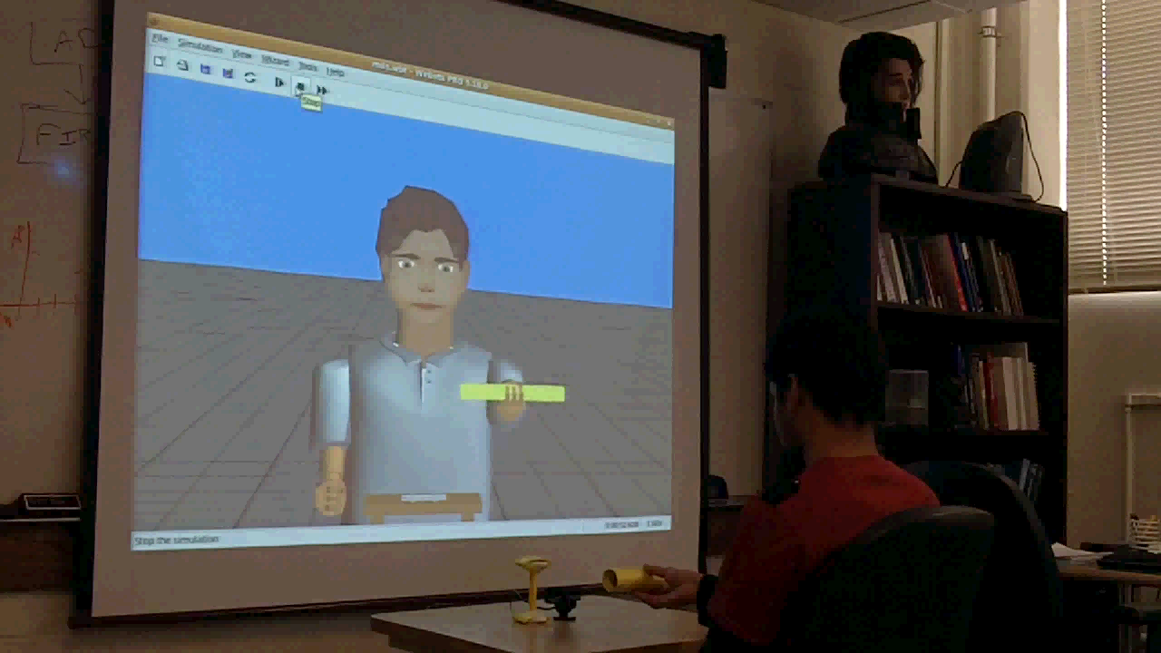
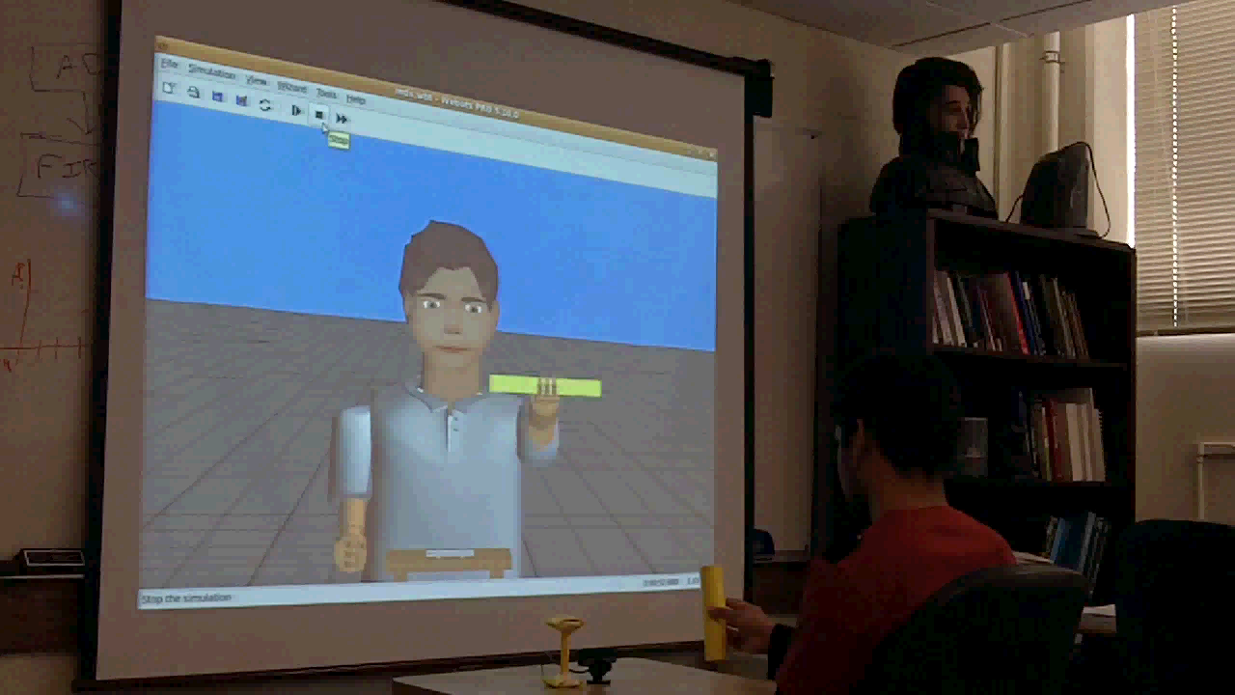


“Large-Scale Biologically Realistic Models of Brain Dynamics
Applied to Intelligent Robotic Decision Making”
ONR N00014-10-1-0014
Computational Neuroscience, Vision and Acoustic Systems
Arlington, VA, June 9, 2010
Phil Goodman^{1,2}, Fred Harris, Jr ^{1,2} , Sergiu Dascalu^{1,2}, Florian Mormann³ & Henry Markram⁴
¹Brain Computation Laboratory, School of Medicine, UNR
²Dept. of Computer Science & Engineering, UNR
³Dept. of Epileptology, University of Bonn, Germany
⁴Brain Mind Institute, EPFL, Lausanne, Switzerland

Slide 2

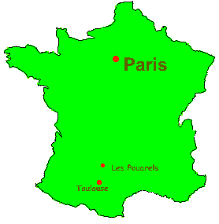














Contributors
Graduate Students
  Brain models & NCS
  Laurence Jayet
  Sridhar Reddy
  Robotics
  Sridhar Reddy
  Roger Hoang
  Cluster Communications
  Corey Thibeault
Investigators
  Fred Harris, Jr.
  Sergiu Dascalu
  Phil Goodman
  Mathias Quoy
  U de Cergy-Pontoise
  Florian Mormann
  U Bonn
  Henry Markram
  EPFL
ChildBot

Slide 3
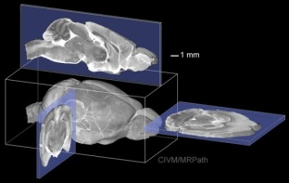
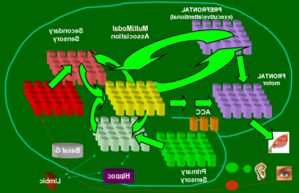
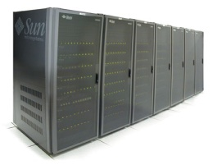

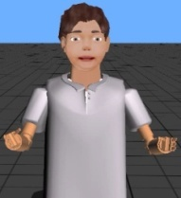
Present Scope of Work
Neuroscience
Mesocircuit Modeling
Software/Hardware Engineering
Robotic/Human Loops
(Virtual Neurorobotics)

Slide 4
Neuroscience
Mesocircuit Modeling
Software/Hardware Engineering
Robotic/Human Loops
(Virtual Neurorobotics)

Slide 5

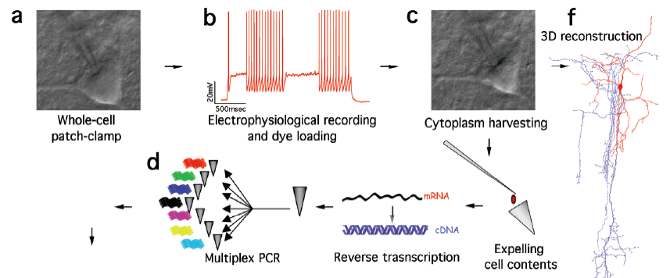
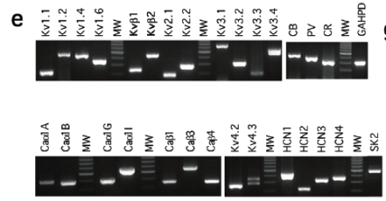
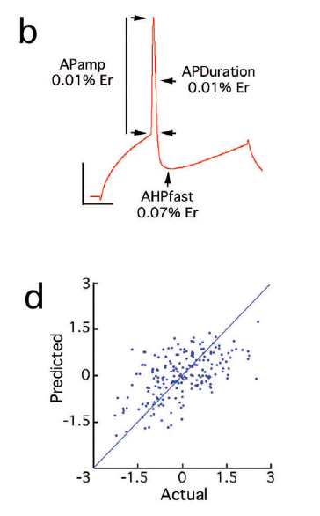
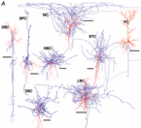

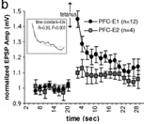
Brain slice technology to Physiology

Slide 6
Neuroscience
Mesocircuit Modeling
Software/Hardware Engineering
Robotic/Human Loops
(Virtual Neurorobotics)

Slide 7
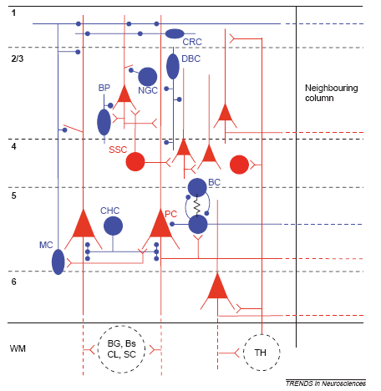
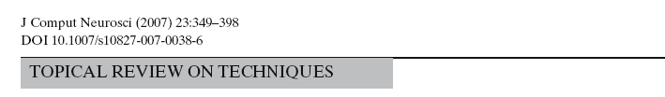
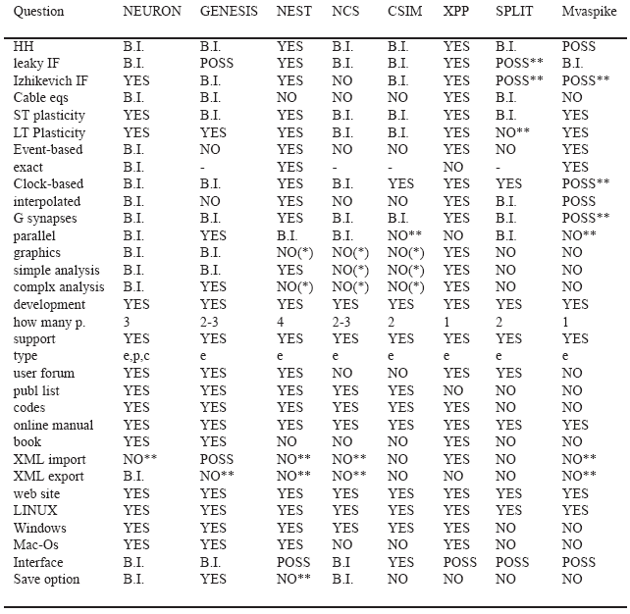
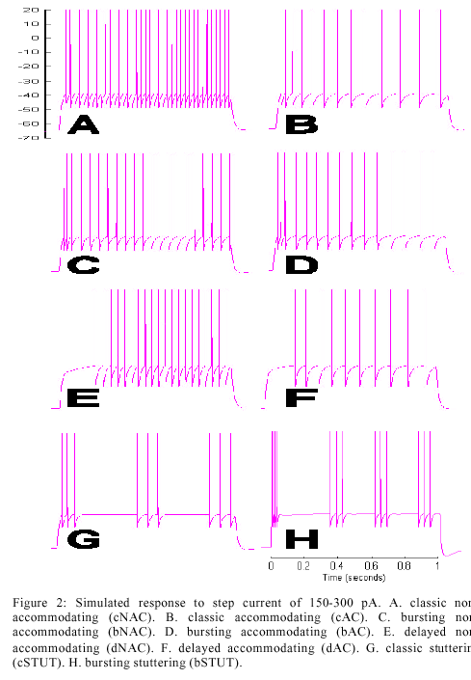
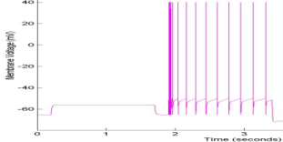
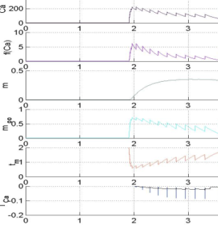
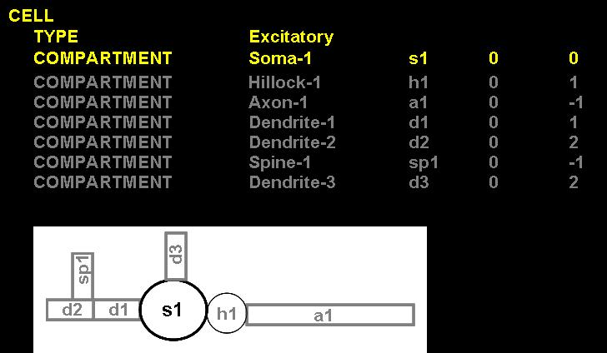
Neural Software Engineering
(bAC)
K_{AHP}
NCS is the only system with
a real-time robotic interface

Slide 8
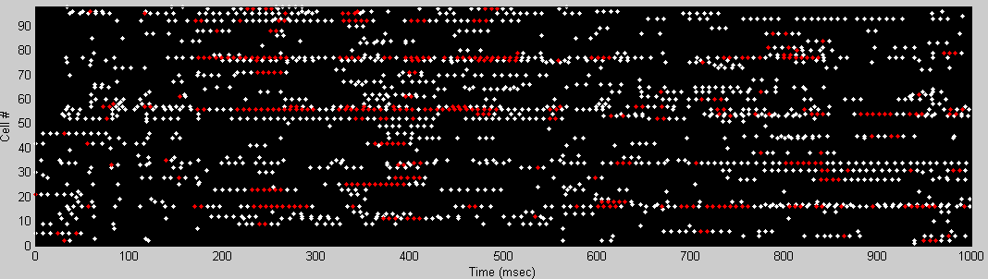
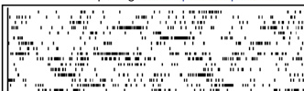
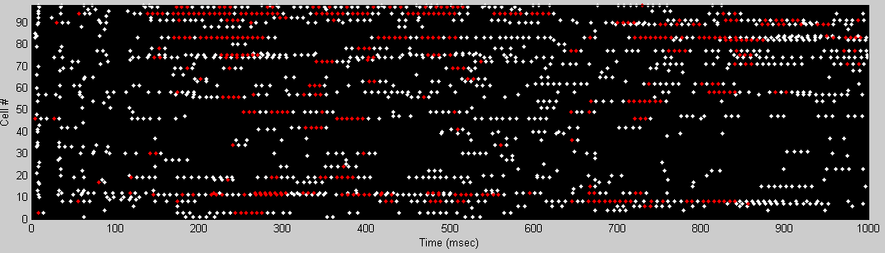
“Recurrrent Asynch Irreg Nonlinear” (RAIN) networks
P_{connect}
800
excitatory
neurons
P_{connect}
G_{exc}
G_{exc}
200
inhibitory
neurons
G_{inh}
G_{inh}
P_{connect}
P_{connect}

Slide 9
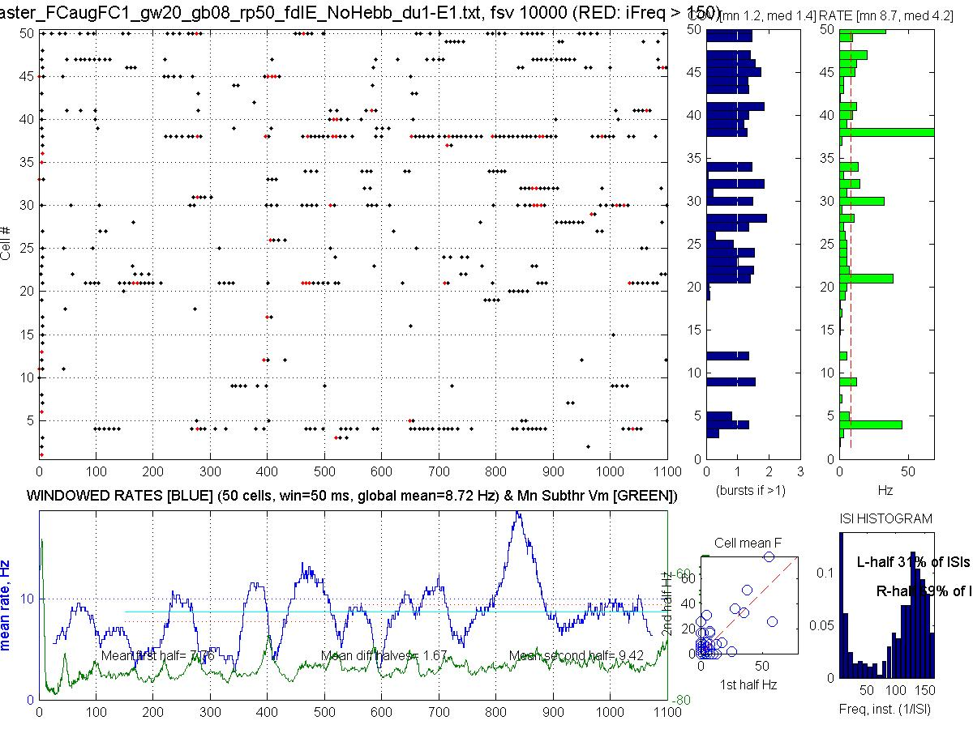

RAIN Activity

Slide 10
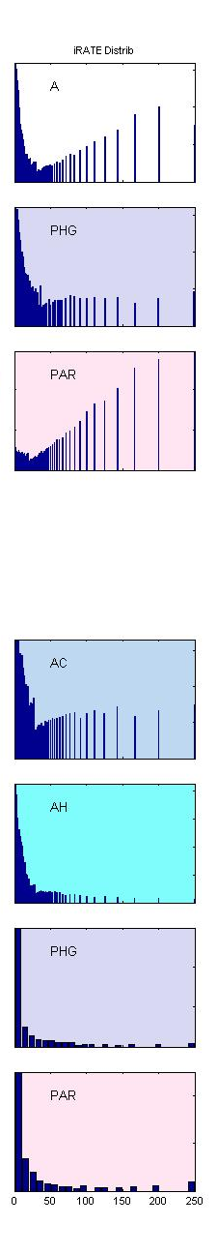
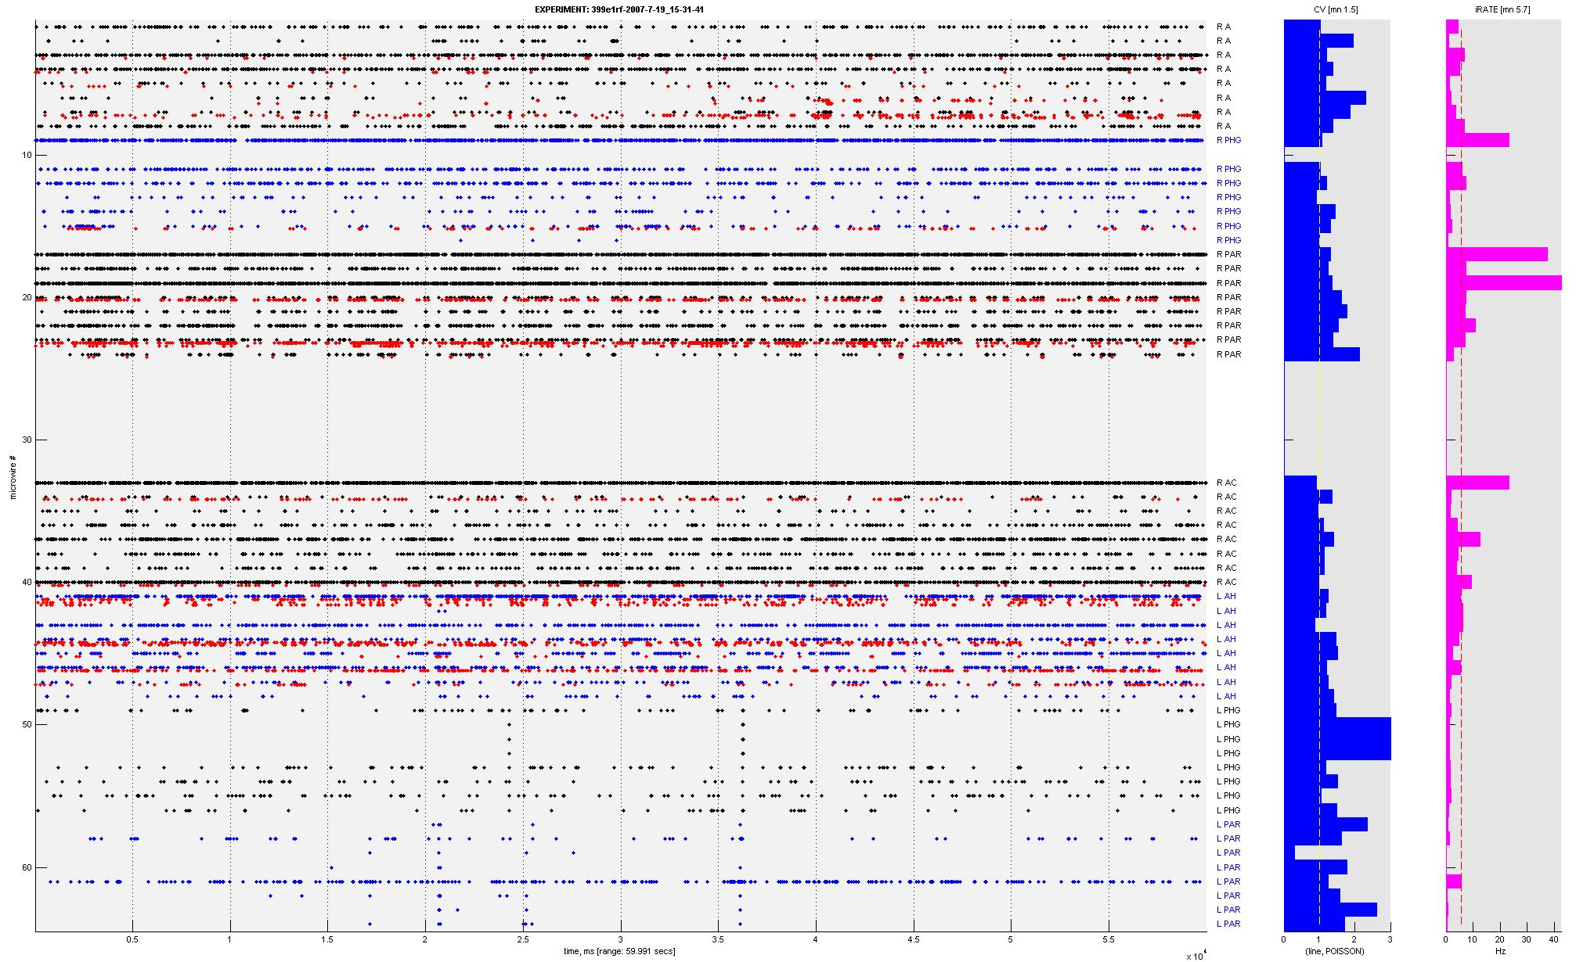
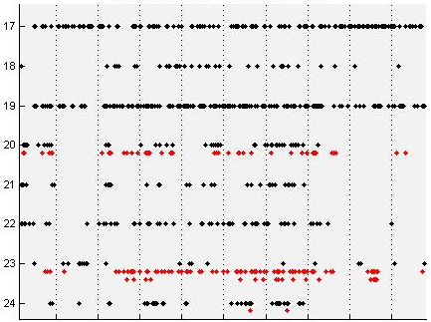
HUMAN Wakeful RAIN Activity
CV (std/mn)
(cellwise)
Rate
(cellwise)
ISI distrib
(10 min)
R Parietal
5s close-up
(1 minute window)

Slide 11
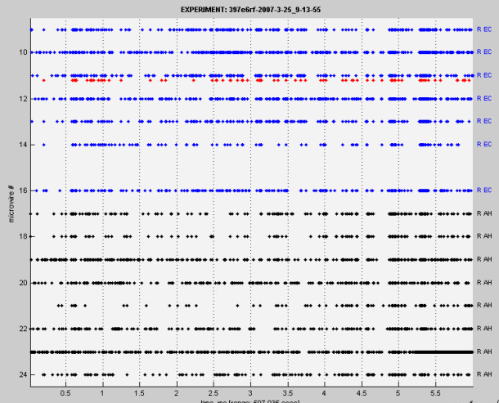
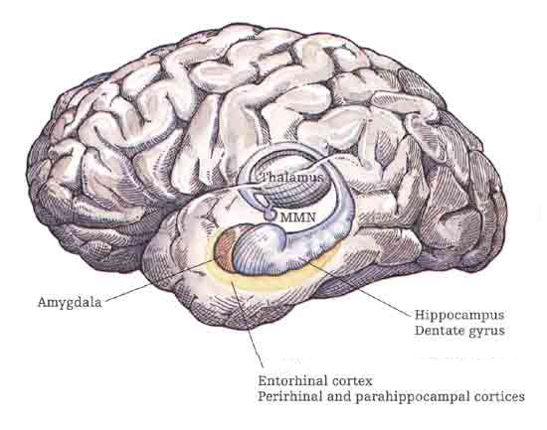
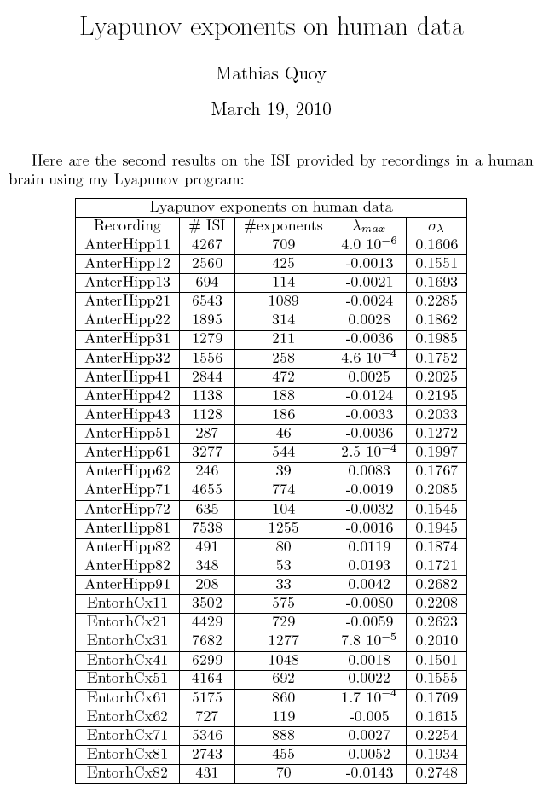
Mesocircuit RAIN: “Edge of Chaos”
Lyapunov exponents on human unit simultaneous recordings
from Hippocampus and Entorhinal Cortex
Edge of Chaos Concept
Originally coined wrt cellular automata: rules for complex processing most likely to be found at “phase transitions” (PTs) between order & chaotic regimes (Packard 1988; Langton 1990; but questioned by Mitchell et al. (1993)
Hypothesis here wrt Cognition, where SNN have components of SWN, SFN, and exponentially truncated power laws
PTs cause rerouting of ongoing activity (OA), resulting in measured rhythmic synchronization and coherence
The direct mechanism is not embedded synfire chains, braids, avalanches, rate-coded paths, etc.
Modulated by plastic synaptic structures
Modulated by neurohormones (incl OT)
Dynamic systems & directed graph theory > theory of computation
Unpublished data, 3/2010: Quoy, Goodman

Slide 12
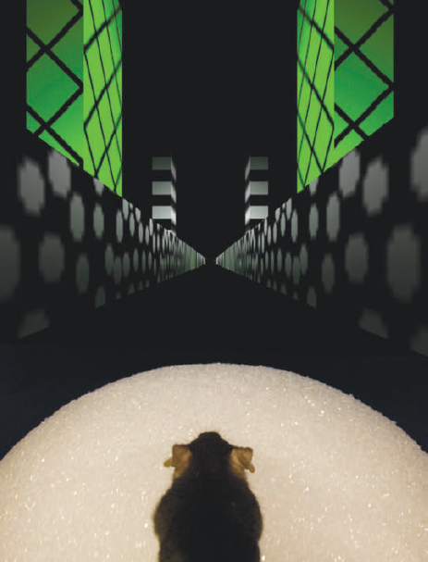
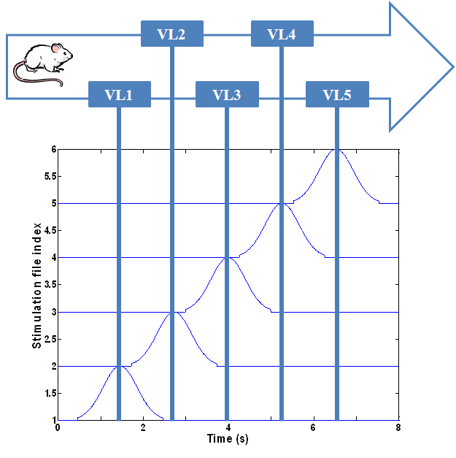
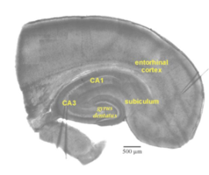
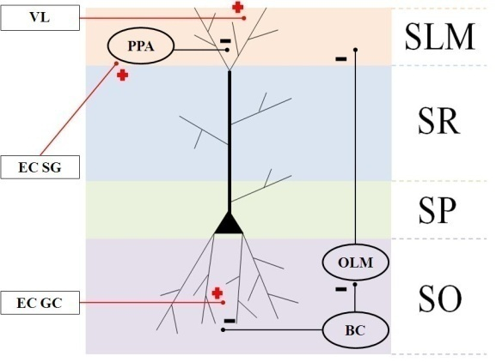
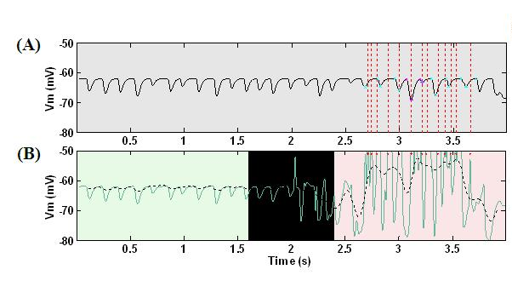
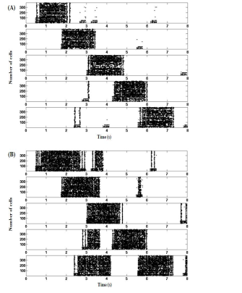
Neocortical-Hippocampal Navigation
A Circuit-Level Model of Hippocampal Place Field Dynamics
Modulated by Entorhinal Grid and Suppression-Generating Cells
Laurence C. Jayet^{1*}, and Mathias Quoy², Philip H. Goodman¹
¹ University of Nevada, Reno
² Université de Cergy-Pontoise, Paris
Explained findings of Harvey et al.
(2009) Nature 461:941
Harvey et al.
(2009) Nature 461:941
NO intracellular theta precession
Asymm ramp-like depolarization
Theta power & frequ increase in PF
Explained findings of Van Cauter et al.
(2008) EJNeurosci 17:1933
EC grid cells ignite PF
EC suppressor cells stabilize
w/o K_{ahp} channels
EC lesion

Slide 13

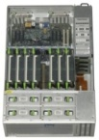
Neuroscience
Mesocircuit Modeling
GPU
Software/Hardware Engineering
Beowulf
200 cpu
Sunfire X4600
Robotic/Human Loops
(Virtual Neurorobotics)

Slide 14
Neuroscience
Mesocircuit Modeling
Software/Hardware Engineering
Robotic/Human Loops
(Virtual Neurorobotics)

Slide 15
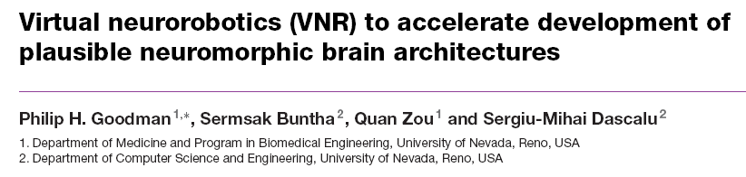
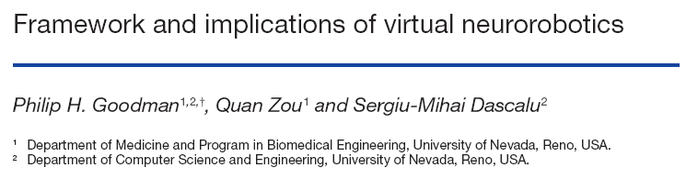
Virtual Neuro-Robotics
Notes:
Definition of Virtual Neurorobotics. We define virtual neurorobotics as follows: a computer-facilitated behavioral loop wherein a human interacts with a projected robot that meets 5 criteria: (1) the robot is sufficiently embodied for the human to tentatively accept the robot as a social partner, (2) the loop operates in real time, with no pre-specified parcellation into receptive and responsive time windows, (3) the cognitive control is a neuromorphic brain emulation incorporating realistic neuronal dynamics whose time constants that reflect synaptic activation and learning, established membrane and circuitry properties, and (4) the neuromorphic architecture is expandable to progressive larger scale and complexity to model brain development, (5) the neuromorphic architecture can potentially provide circuitry underlying intrinsic motivation and intentionality, which physiologically is best described as “emotional” rather than rule-based drive. A summary of the requirements for a VNR system is shown in Table 1.
High-level social robotic systems reported to-date are generally controlled by artificial intelligence and machine learning algorithms that incorporate explicit task lists and criteria for task satisfaction, segmenting time into periods of action and of awaiting response. Our interest is not to characterize the rules of social engagement per se, but rather to uncover the basis of biological brain sensorimotor control, information processing and learning. The corresponding neuromorphic brains must therefore be driven intrinsically by a motivational influence such that the dynamics that subserve information processing are themselves affected by a drive to accomplish the tasks (with neural learning that reinforces successful behavioral adaptation) (Samejima and Doya, 2007; Schweighofer et al, 2007). The motivational system must therefore demonstrate intentionality, which means that the intelligent system takes into account the “aboutness” of its own relationship to other behaving entities (and vice versa) in its environment. With sufficiently complex neuromorphic architectures, intentionality would be expected to be reflected by frontal and parietal mirror neuron responsiveness characteristic of many mammalian intentional behaviors (Iacoboni and Dapretto, 2006). This combined physiological responsiveness of intrinsic motivation and intentionality in animals, including humans, most generally can be described as emotion:
Emotion, as the name suggests, sets in motion the moment-to-moment behaviors of an intelligent system (Breazeal, 2003; Frijda, 2006). From this perspective, “intelligence” has evolved as a way to better serve emotional drive. That is, intelligence may be a derivative of emotion, rather than vice versa. We therefore make the following hypothesis: the development of truly intelligent systems cannot occur outside the real-time, emotional interaction of humans with a neuromorphic system. This does not mean that intelligent systems, once refined, cannot ultimately be cloned (at a point in development where they are ready to learn advanced tasks). Rather, to grow the early intelligent systems we must start with minimalist brain architectures that demonstrate intrinsic motivation and intentionality in scenarios requiring intelligent behavior in a real-world context. This recapitulates the way in which humans develop cognitive function over the first several years of social experience. With the VNR approach, we seek not only to “grow” such intelligent systems but also to comprehend, at each step, the differential changes in architecture giving rise to novel and intelligent cognition.

Slide 16
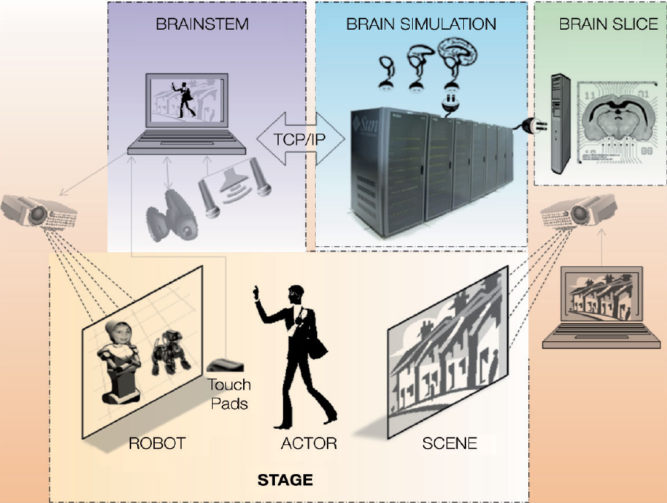
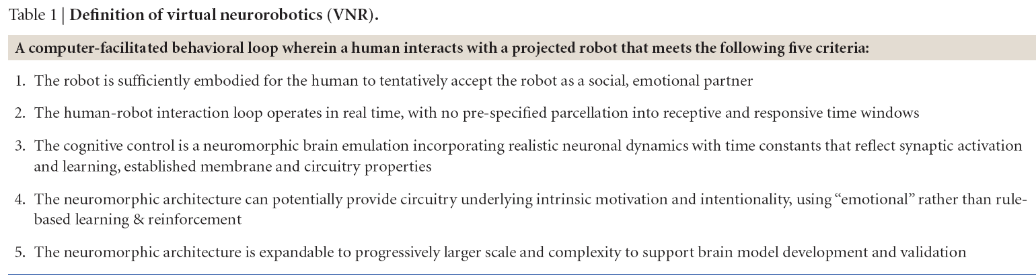
Behavioral VNR System
Notes:
Definition of Virtual Neurorobotics. We define virtual neurorobotics as follows: a computer-facilitated behavioral loop wherein a human interacts with a projected robot that meets 5 criteria: (1) the robot is sufficiently embodied for the human to tentatively accept the robot as a social partner, (2) the loop operates in real time, with no pre-specified parcellation into receptive and responsive time windows, (3) the cognitive control is a neuromorphic brain emulation incorporating realistic neuronal dynamics whose time constants that reflect synaptic activation and learning, established membrane and circuitry properties, and (4) the neuromorphic architecture is expandable to progressive larger scale and complexity to model brain development, (5) the neuromorphic architecture can potentially provide circuitry underlying intrinsic motivation and intentionality, which physiologically is best described as “emotional” rather than rule-based drive. A summary of the requirements for a VNR system is shown in Table 1.
High-level social robotic systems reported to-date are generally controlled by artificial intelligence and machine learning algorithms that incorporate explicit task lists and criteria for task satisfaction, segmenting time into periods of action and of awaiting response. Our interest is not to characterize the rules of social engagement per se, but rather to uncover the basis of biological brain sensorimotor control, information processing and learning. The corresponding neuromorphic brains must therefore be driven intrinsically by a motivational influence such that the dynamics that subserve information processing are themselves affected by a drive to accomplish the tasks (with neural learning that reinforces successful behavioral adaptation) (Samejima and Doya, 2007; Schweighofer et al, 2007). The motivational system must therefore demonstrate intentionality, which means that the intelligent system takes into account the “aboutness” of its own relationship to other behaving entities (and vice versa) in its environment. With sufficiently complex neuromorphic architectures, intentionality would be expected to be reflected by frontal and parietal mirror neuron responsiveness characteristic of many mammalian intentional behaviors (Iacoboni and Dapretto, 2006). This combined physiological responsiveness of intrinsic motivation and intentionality in animals, including humans, most generally can be described as emotion:
Emotion, as the name suggests, sets in motion the moment-to-moment behaviors of an intelligent system (Breazeal, 2003; Frijda, 2006). From this perspective, “intelligence” has evolved as a way to better serve emotional drive. That is, intelligence may be a derivative of emotion, rather than vice versa. We therefore make the following hypothesis: the development of truly intelligent systems cannot occur outside the real-time, emotional interaction of humans with a neuromorphic system. This does not mean that intelligent systems, once refined, cannot ultimately be cloned (at a point in development where they are ready to learn advanced tasks). Rather, to grow the early intelligent systems we must start with minimalist brain architectures that demonstrate intrinsic motivation and intentionality in scenarios requiring intelligent behavior in a real-world context. This recapitulates the way in which humans develop cognitive function over the first several years of social experience. With the VNR approach, we seek not only to “grow” such intelligent systems but also to comprehend, at each step, the differential changes in architecture giving rise to novel and intelligent cognition.

Slide 17
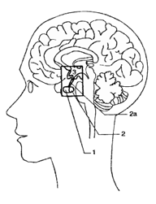
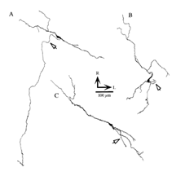
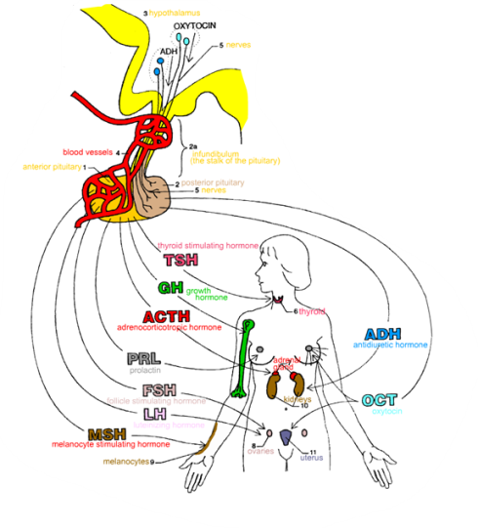

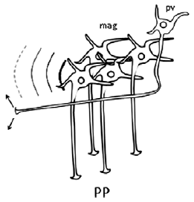
Oxytocin Physiology
Neuroanatomy
“neurohypophyseal OT system”
OT is 9-amino acid cyclic peptide
first peptide to be sequenced & synthesized! (ca. 1950)
means “rapid birth”: promotes uterine contraction
promotes milk ejection for lactation
reflects release from pituitary into the blood stream
“direct CNS OT system” (OT & OTR KOs & pharmacology)
Inputs from neocortex, limbic system, and brainstem
Outputs: Local dendritic release of OT into CNS fluid Axonal inhib synapses in amygdala & NAcc
SON: magnocellular to pituitary
PVN: parvocellular to amygdala & brainstem
rodents: maternal & paternal bonding
voles: social recognition of cohabitating partner vs stranger
ungulates: selective olfactory bonding (memory) for own lamb
seems to modulate the saliency & encoding of sensory signals
Human trials using intranasal OT
Willingness to trust, accept social risk (Kosfeld 2005)
Trust despite prior betrayal (Baumgartner 2008)
Improved ability to infer emotional state of others (Domes 2007)
Improved accuracy of classifying facial expressions (Di Simplicio 2009)
Improved accuracy of recognizing angry faces (Champaign 2007)
Improved memory for familiar faces (Savaskan 2008)
Improved memory for faces, not other stimuli (Rummele 2009)
Amygdala less active & less coupled to BS and neocortex w/ fear or pain stimuli (Kirsch 2005, Domes 2007, Singer 2008)
Parvo
Magno
fluid to CNS
axon to CNS
to PITUITARY

Slide 18
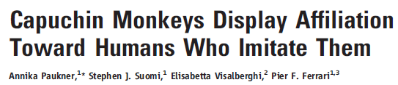
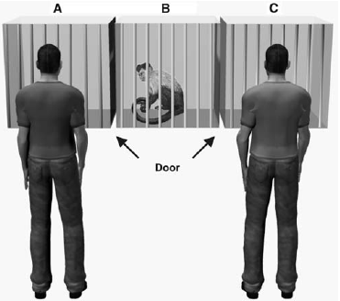
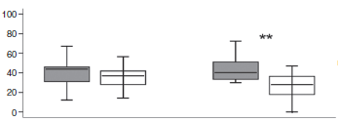
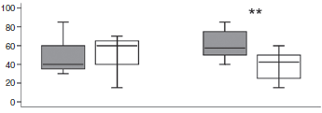
“Trust & Affiliation” paradigm
Time spent facing
Willingness to exchange token for food

Slide 19


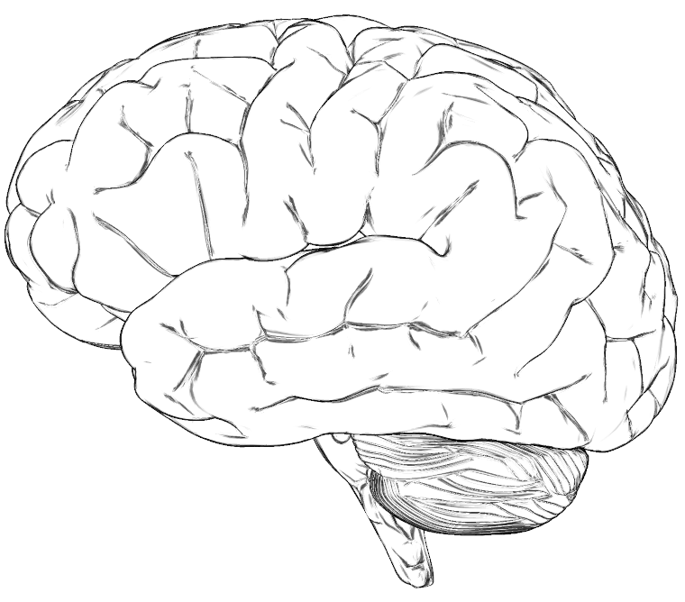


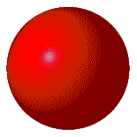











Phase I: Trust the Intent (TTI)
Phase II: Emotional Reward Learning (ERL)
“Trust & Learn” Robotic Brain Project
PFdl
Prefrontal, Dorsolateral:
sustained suppression
PR
Parietal Reach (LIP):
reach decision making
VPM
BG
Basal Ganglia:
decision making
Ventral PreMotor:
sustained activity
PR
HippoC
Formation
DPM
HPF
DPM
Dorsal PreMotor:
planning & deciding
EC
Entorhinal
Cortex
PFdl
VPM
AC
EC
AM
VC
HPF
IT
AC
Auditory Cortex
HYp
oxytocin
BG
AM
Amygdala [fear response]: inhibited by HYp oxytocin
VC
Visual Cortex
HYp
HYpothalamus paraventricular nucleus [trust]: oxytocin neurons
IT
InferoTemporal cortex:
responds to faces
HPF

Slide 20










Phase I: Trust the Intent (TTI)
Gabor V1-3 emulation
LEARNING
CHALLENGE (at any time)
Robot Initiates Action
Human Responds
Human Acts
Robot Reacts
Robot brain initiates arbitrary sequence of motions
human moves object in either a similar (“match”), or different (“mismatch”) pattern
human slowly reaches for an object on the table
Robot either “trusts”, (assists/offers the object), or “distrusts”, (retract the object).
Match: robot learns to trust
Mismatch: don’t trust
trusted
distrusted

Slide 21





Phase II: Emotional Reward Learning (ERL)
LEARNING
GOAL (after several + rewards)
Human Initiates Action
Robot Responds
human initiates arbitrary sequence of object motions
robot moves object in either a similar (“match”), or different (“mismatch”) pattern
Match:
voiced +reward
Mismatch: voiced –reward
Matches consistently

Slide 22










Early ITI Results
Discordant > Distrust
Concordant > Trust
mean synaptic strength

Slide 23



Scope of Work in the Coming Year
CA
EC
Neuroscience
Mesocircuit Modeling
Robotic/Human Loops
(Virtual Neurorobotics)
GPU
Software/Hardware Engineering
Sunfire X4600

Slide 24

The Quad at UNR

