Slide 1

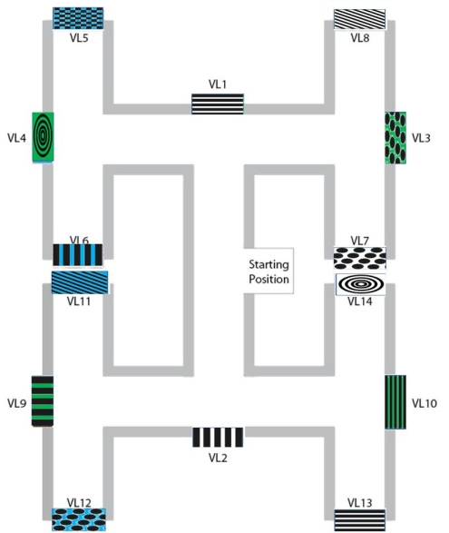
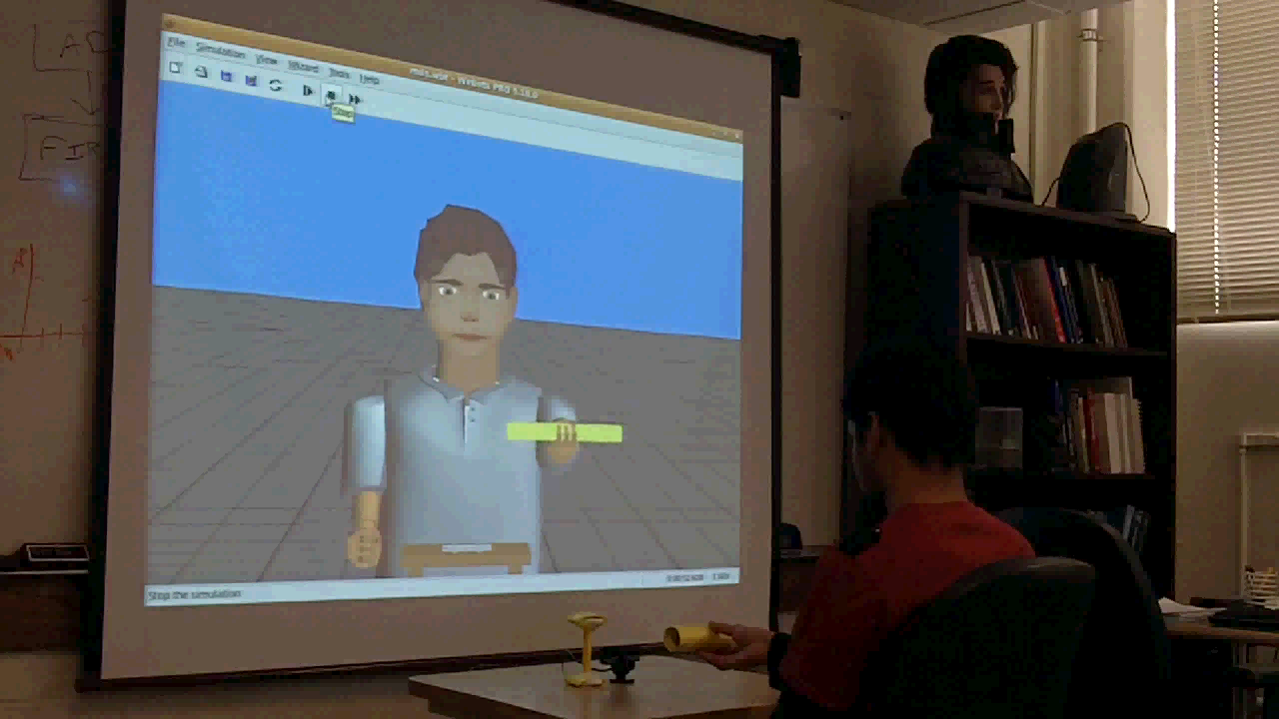



Large-Scale Biologically Realistic Models of Brain Dynamics
Applied to Intelligent Robotic Decision Making
ONR Cognitive Neuroscience & Human-Robot Interaction
Arlington, VA, June 9, 2010
N00014-10-1-0014
Phil Goodman^{1,2}, Fred Harris, Jr ^{1,2} , Sergiu Dascalu^{1,2}, Florian Mormann³ & Henry Markram⁴
¹Brain Computation Laboratory, School of Medicine, UNR
²Dept. of Computer Science & Engineering, UNR
³Dept. of Epileptology, University of Bonn, Germany
⁴Brain Mind Institute, EPFL, Lausanne, Switzerland

Slide 2
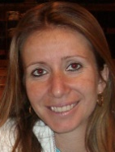
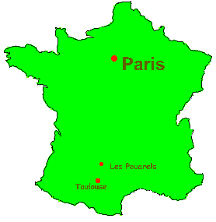



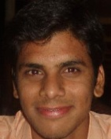

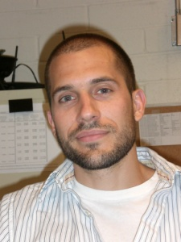
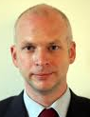







Contributors
Graduate Students
  Brain models & NCS
  Laurence Jayet
  Sridhar Reddy
  Robotics
  Sridhar Reddy
  Roger Hoang
  Cluster Communications
  Corey Thibeault
Investigators
  Fred Harris, Jr.
  Sergiu Dascalu
  Phil Goodman
  Mathias Quoy
  U de Cergy-Pontoise
  Florian Mormann
  U Bonn
  Henry Markram
  EPFL
ChildBot

Slide 3


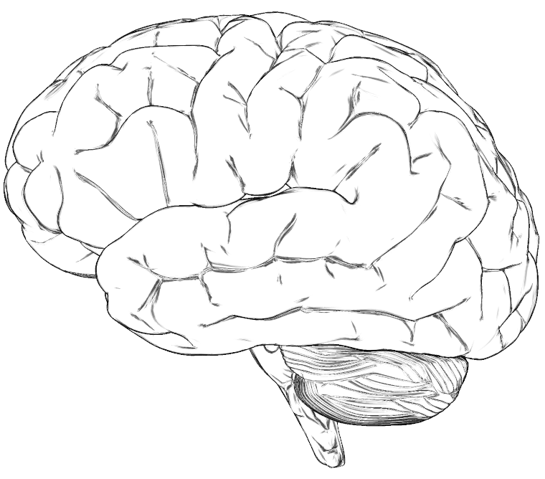


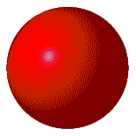








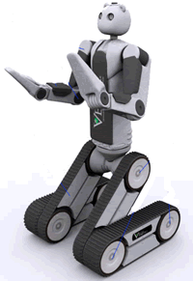


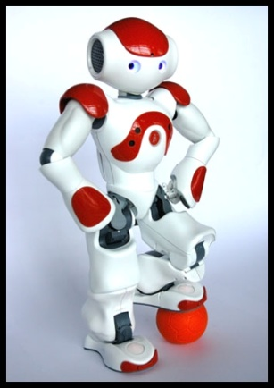
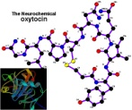
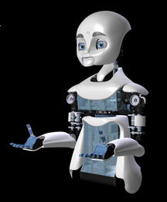
Million-Cell Brain Model
PF
Prefrontal, dorsolateral
and medial
PR
Parietal Reach (LIP):
reach decision making
VPM
BG
Basal Ganglia:
decision making
Ventral PreMotor:
sustained activity
PR
HippoC
Formation
DPM
HPF
DPM
Dorsal PreMotor:
planning & deciding
EC
Entorhinal
Cortex
PF
VPM
AC
EC
AM
VC
AC
Auditory Cortex
HPF
IT
HYp
oxytocin
BG
AM
Amygdala [fear response]: inhibited by HYp oxytocin
BS
dopamine
VC
Visual Cortex
HYp
HYpothalamus paraventricular nucleus [trust]: oxytocin neurons
HPF
IT
InferoTemporal cortex:
responds to faces
BS
BrainStem DA & NE centers

Slide 4
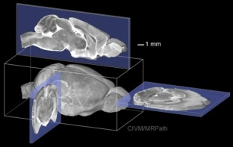
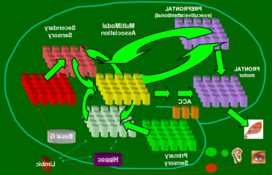

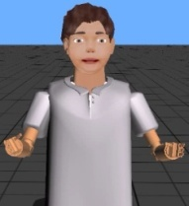
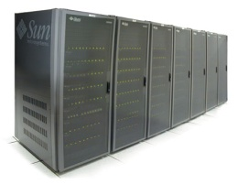
Present Scope of Work
Neuroscience
Mesocircuit Modeling
Robotic/Human Loops
(Virtual Neurorobotics)
Parallel Hardware Optimization

Slide 5

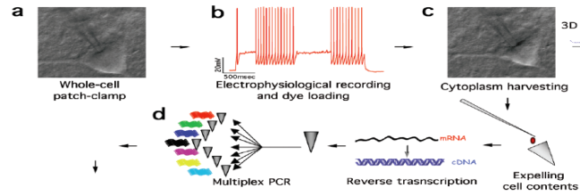
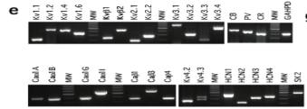
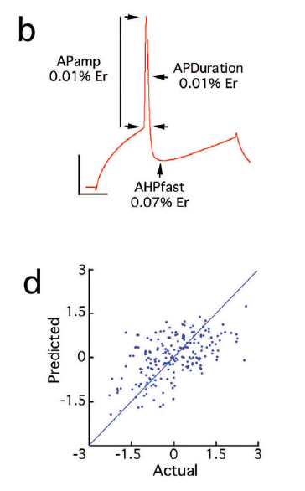
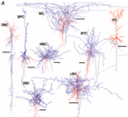
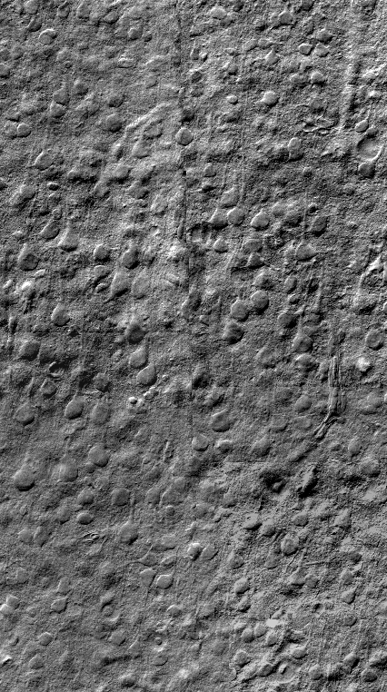
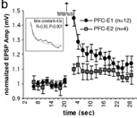
From Brain Slice to Physiological Parameters

Slide 6
Neuroscience
Mesocircuit Modeling
Robotic/Human Loops
(Virtual Neurorobotics)
Parallel Hardware Optimization

Slide 7
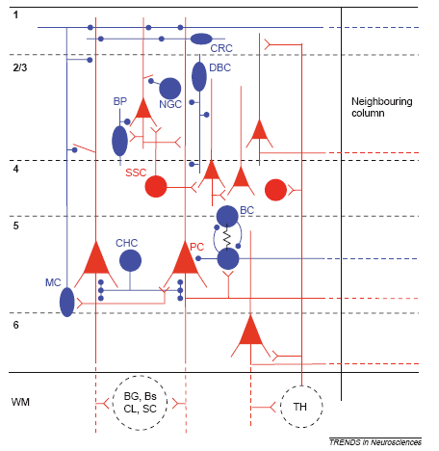
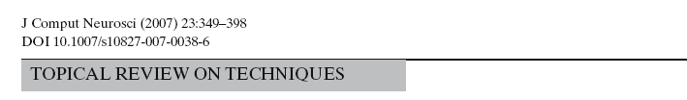
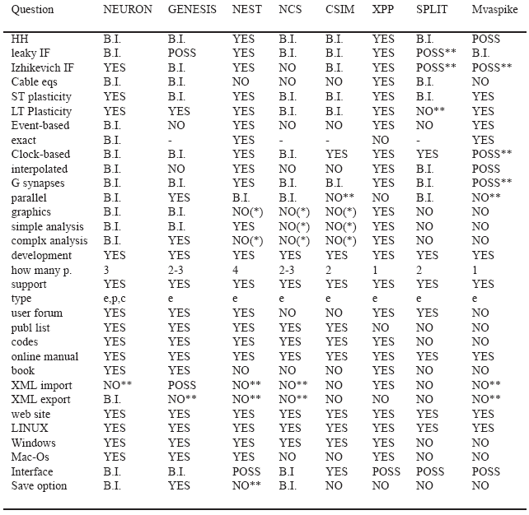
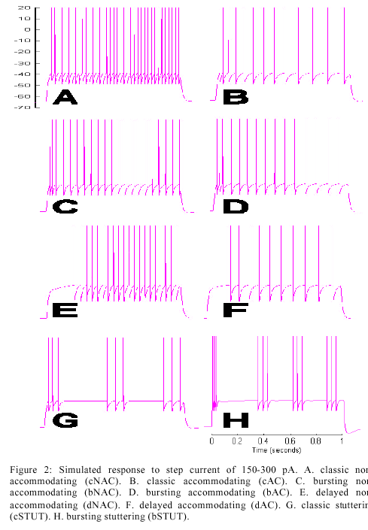
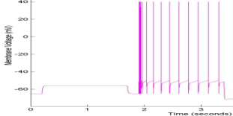
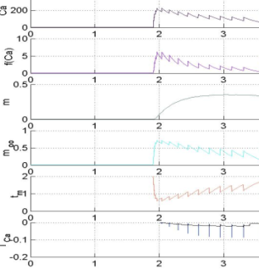
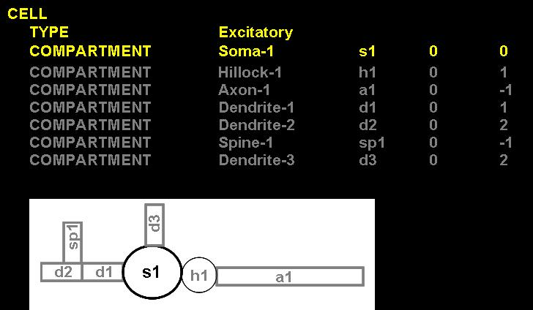
To Neural Models & Software Engineering
(bAC)
K_{AHP}
NCS is the only system with
a real-time robotic interface

Slide 8
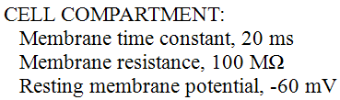
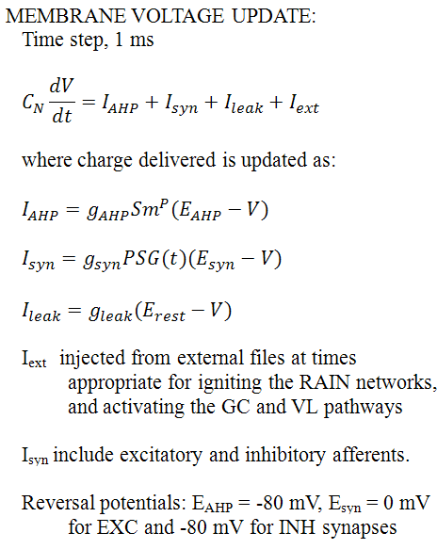
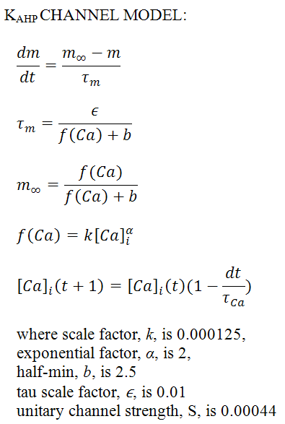
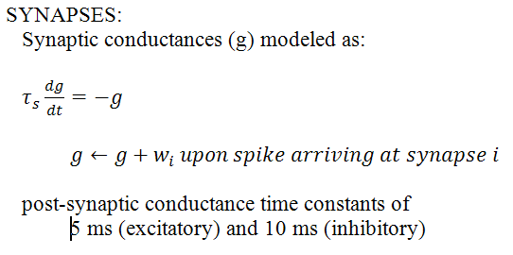

Leaky Integrate & Fire Equations

Slide 9
“Recurrent Asynch Irreg Nonlinear” (RAIN) networks
P_{connect}
800
excitatory
neurons
P_{connect}
G_{exc}
G_{exc}
200
inhibitory
neurons
G_{inh}
G_{inh}
P_{connect}
P_{connect}

Slide 10
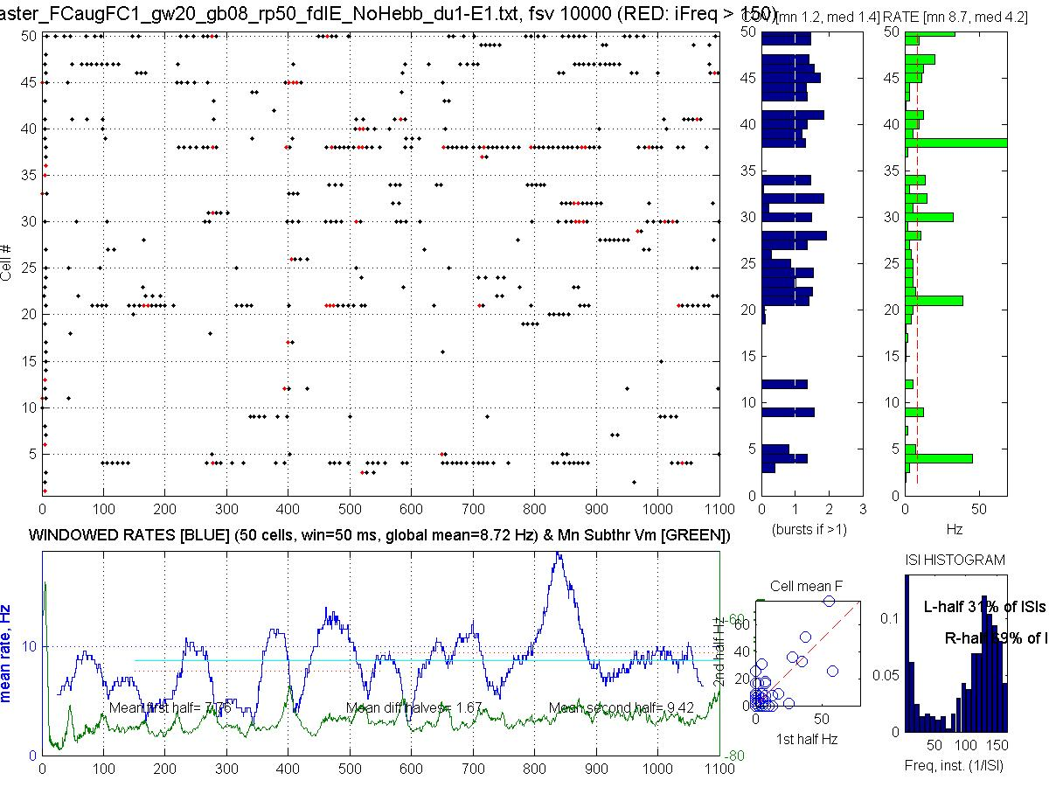

Simulated RAIN Activity (1600 cells, 4:1 E:I)

Slide 11
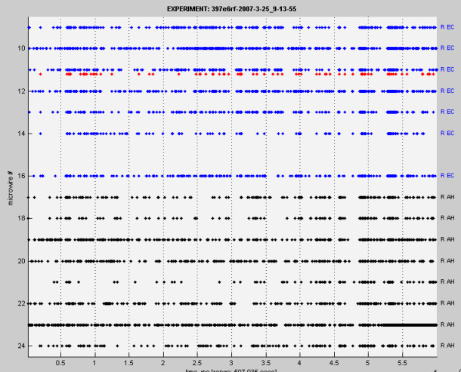
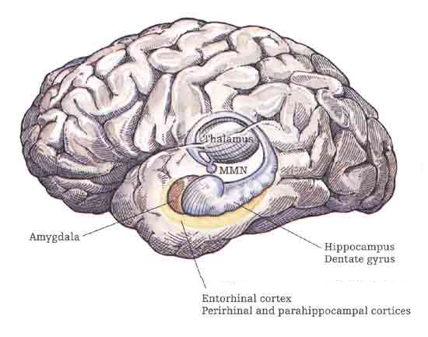
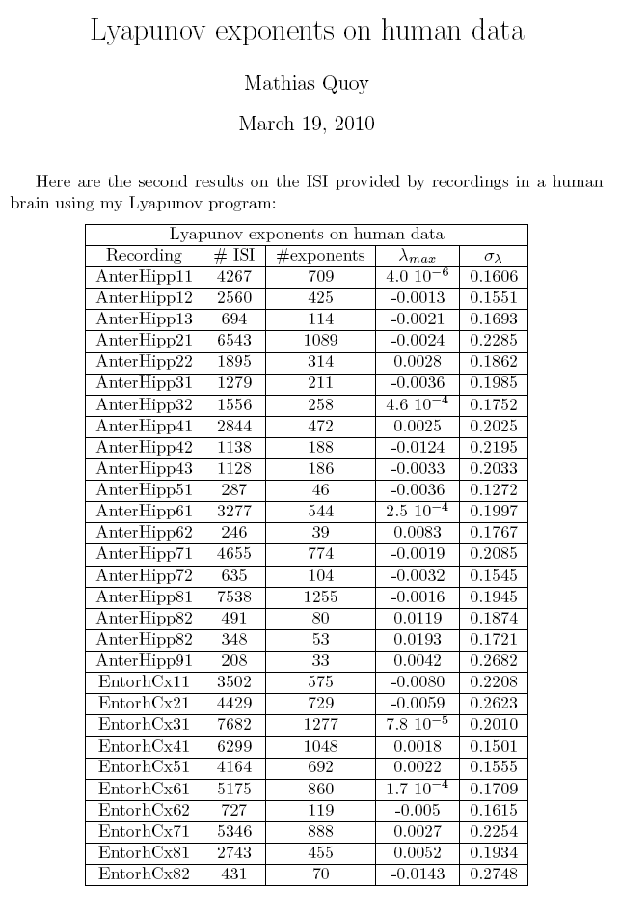
Mesocircuit RAIN: “Edge of Chaos”
Lyapunov exponents on human unit simultaneous recordings
from Hippocampus and Entorhinal Cortex
Edge of Chaos Concept
Originally coined wrt cellular automata: rules for complex processing most likely to be found at “phase transitions” (PTs) between order & chaotic regimes (Packard 1988; Langton 1990; but questioned by Mitchell et al. (1993)
Hypothesis here wrt Cognition, where SNN have components of SWN, SFN, and exponentially truncated power laws
PTs cause rerouting of ongoing activity (OA), resulting in measured rhythmic synchronization and coherence
The direct mechanism is not embedded synfire chains, braids, avalanches, rate-coded paths, etc.
Modulated by plastic synaptic structures
Modulated by neurohormones (incl OT)
Dynamic systems & directed graph theory > theory of computation
(data provided in collab withI Fried lab, UCLA)
EC
HIP
Unpublished data, 3/2010: Quoy, Goodman

Slide 12
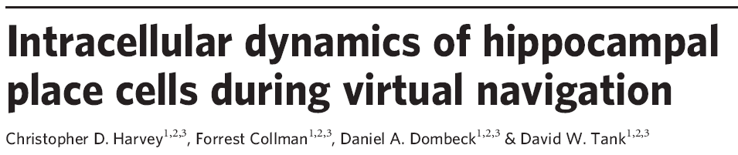
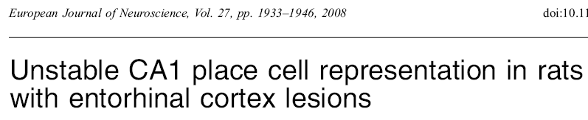

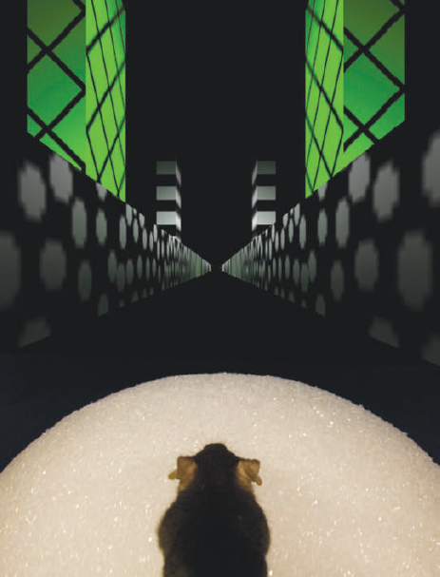
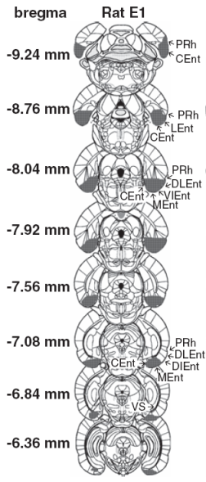
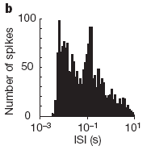
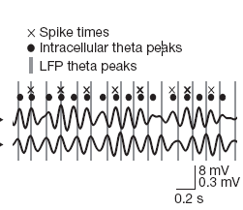
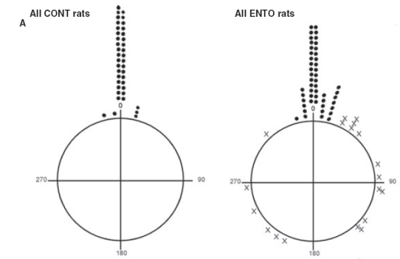
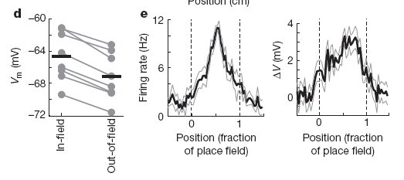
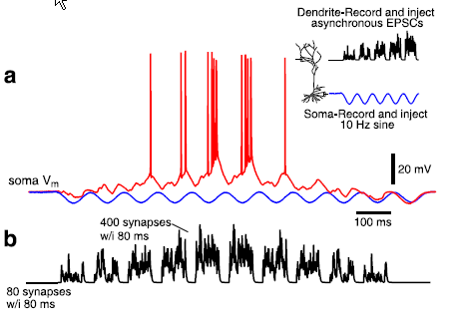
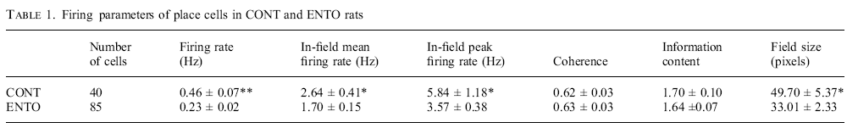
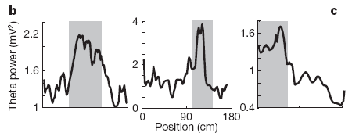
Biology: EC and HP in vivo
EC cells stabilize PF ignition
EC suppresses # of PF cells firing while increasing firing rate
NO intracellular theta precession
Asymm ramp-like depolarization
Theta power & frequ increase in PF

Slide 13
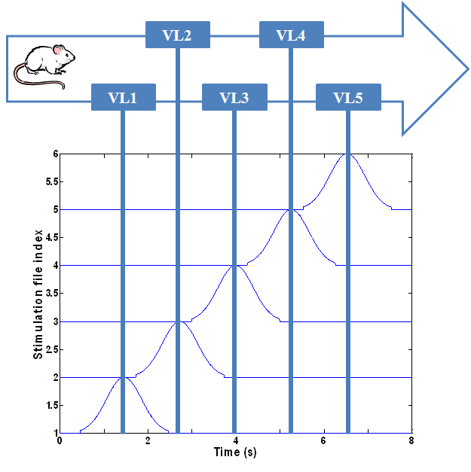





EC–HP Model: Linear Maze Place Fields
A Circuit-Level Model of Hippocampal Place Field Dynamics
Modulated by Entorhinal Grid and Suppression-Generating Cells
Laurence C. Jayet^{1*}, and Mathias Quoy², Philip H. Goodman¹
¹ University of Nevada, Reno
² Université de Cergy-Pontoise, Paris
Explained findings of Harvey et al.
(2009) Nature 461:941
NO intracellular theta precession
Asymm ramp-like depolarization
Theta power & frequ increase in PF
Harvey et al.
(2009) Nature 461:941
Explained findings of Van Cauter et al.
(2008) EJNeurosci 17:1933
EC grid cells ignite PF
EC suppressor cells stabilize
w/o K_{ahp} channels
EC lesion

Slide 14





Full Circuit Model: Short-Term Sequence Memory
Visual-Parietal
Premotor
Prefrontal
Visual
input
Somato-sensory
input
EC
DG
SUB
CA

Slide 15



Completing the loop: Neocortical-Hippocampal Sequence Learning
Field Potential
0
5
10
15
20
25
R
R
PFC
STM
R
R
HIP
PLACE
CELLS
R
R
SUBICULUM
R
S
E
R
γ
S
E
R
γ
S
E
R
γ
KEY
S=START POSITION
E=END POSITION
R=REWARD (green if earned)
γ =enhanced inhibitory oscillation
(resets prefrontal activity
if not enhanced by prior reward)
S
S
S
Trial 1: no reward
Trial 2: reward
Trial 3

Slide 16
Neuroscience
Mesocircuit Modeling
Robotic/Human Loops
(Virtual Neurorobotics)
Parallel Hardware Optimization

Slide 17





Oxytocin Physiology
Neuroanatomy
“neurohypophyseal OT system” (from pituitary to bloodstream)
OT is 9-amino acid cyclic peptide
first peptide to be sequenced & synthesized! (ca. 1950)
means “rapid birth”: OT bursts promote uterine contraction
OT bursts cause milk ejection during lactation
“direct CNS OT system” (OT & OTR KOs & pharmacology)
Inputs from neocortex, limbic system, and brainstem
Outputs: Local dendritic release of OT into CNS fluid Axonal inhib synapses in amygdala & NAcc
SON: magnocellular to pituitary to blood
PVN: parvocellular to amygdala, HIP, BG & brainstem
rodents: maternal & paternal bonding
voles: social recognition of cohabitating partner vs stranger
ungulates: selective olfactory bonding (memory) for own lamb
seems to modulate the saliency & encoding of sensory signals
Human trials using intranasal OT
Willingness to trust, accept social risk (Kosfeld 2005)
Trust despite prior betrayal (Baumgartner 2008)
Improved ability to infer emotional state of others (Domes 2007)
Improved accuracy of classifying facial expressions (Di Simplicio 2009)
Improved accuracy of recognizing angry faces (Champaign 2007)
Improved memory for familiar faces (Savaskan 2008)
Improved memory for faces, not other stimuli (Rummele 2009)
Amygdala less active & less coupled to BS and neocortex w/ fear or pain stimuli (Kirsch 2005, Domes 2007, Singer 2008)
Parvo
Magno
fluid to CNS
axon to CNS
to PITUITARY

Slide 18



“Trust & Affiliation” paradigm
Willingness to exchange token for food

Slide 19










Phase I: Trust the Intent (TTI)
Gabor V1,2,4 emulation
LEARNING
CHALLENGE (at any time)
Robot Initiates Action
Human Responds
Human Acts
Robot Reacts
Robot brain initiates arbitrary sequence of motions
human moves object in either a similar (“match”), or different (“mismatch”) pattern
human slowly reaches for an object on the table
Robot either “trusts”, (assists/offers the object), or “distrusts”, (retract the object).
Match: robot learns to trust
Mismatch: don’t trust
trusted
distrusted

Slide 20












Early ITI Results
Discordant > Distrust
Concordant > Trust
mean synaptic strength

Slide 21





Phase II: Emotional Reward Learning (ERL)
LEARNING
GOAL (after several + rewards)
Human Initiates Action
Robot Responds
human initiates arbitrary sequence of object motions
robot moves object in either a similar (“match”), or different (“mismatch”) pattern
Match:
voiced +reward
Mismatch: voiced –reward
Matches consistently

Slide 22
Million-Cell Brain Model
PF
Prefrontal, dorsolateral
and medial
PR
Parietal Reach (LIP):
reach decision making
VPM
BG
Basal Ganglia:
decision making
Ventral PreMotor:
sustained activity
DPM
Mirror N
PR
HippoC
Formation
HPF
DPM
Dorsal PreMotor:
planning & deciding
Multi
Modal
PF++S
EC
Entorhinal
Cortex
VPM
AC
EC
AM
VC
AC
Auditory Cortex
HPF
IT
HYp
oxytocin
BG
AM
Amygdala [fear response]: inhibited by HYp oxytocin
BS
dopamine
VC
Visual Cortex
HYp
HYpothalamus paraventricular nucleus [trust]: oxytocin neurons
HPF
IT
InferoTemporal cortex:
responds to faces
BS
BrainStem DA & NE centers

Slide 23

The Quad at UNR

